Slide 1
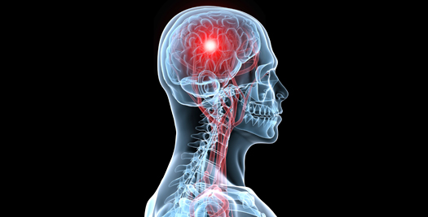
Cerebral Blood Circulation
Khaleel Alyahya, PhD, MEd
@khaleelya

Slide 2
OBJECTIVES
At the end of the lecture, students should be able to:
List the cerebral arteries.
Describe the cerebral arterial supply regarding the origin, distribution and branches.
Describe the arterial Circle of Willis .
Describe the cerebral venous drainage and its termination.
Describe arterial & venous vascular disorders and their clinical manifestations.

Slide 3
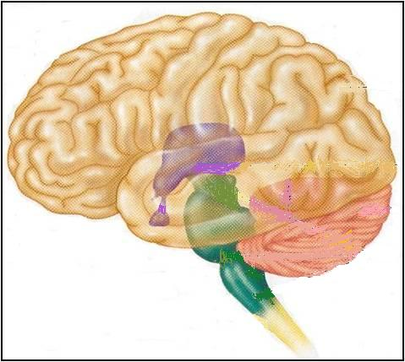
Review: THE BRAIN
Large mass of nervous tissue located in the cranial cavity.
Has four major regions.
Cerebrum
(Cerebral hemispheres)
Diencephalon: Thalamus, Hypothalamus, Subthalamus & Epithalamus
Cerebellum
Brainstem: Midbrain, Pons & Medulla oblongata

Slide 4
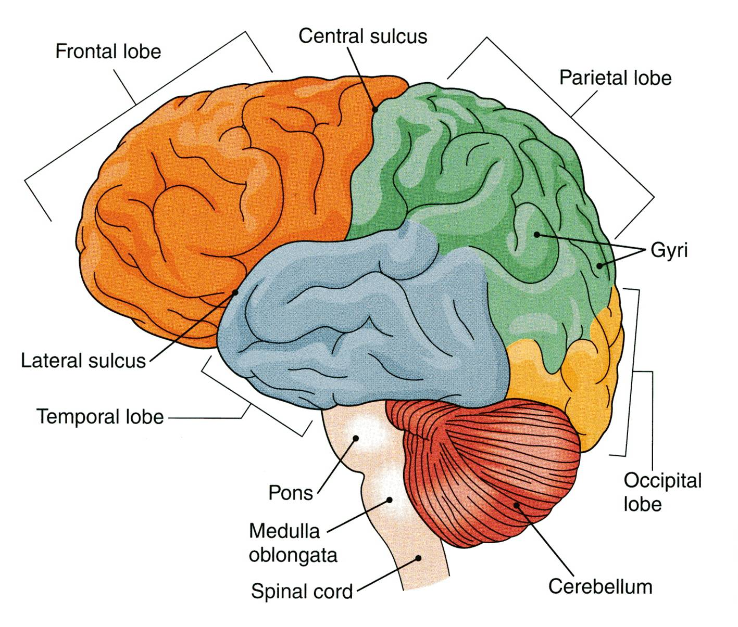
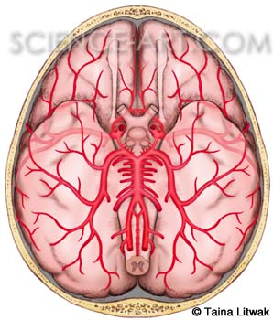
Review: CEREBRUM
The largest part of the brain, and has two hemispheres.
The surface shows elevations called gyri, separated by depressions called sulci.
Each hemispheres divided into four lobes by deeper grooves.
Lobs are separated by deep grooves called fissures.

Slide 5
CEREBRAL CIRCULATION
Cerebral circulation is the movement of blood through the network of blood vessels to supply the brain.
The arteries carry oxygenated blood and other nutrients to the brain.
The veins carry deoxygenated blood back to the heart removing carbon dioxide and other metabolic products.
The movement of blood in the cerebral circulation is called cerebral blood flow.

Slide 6
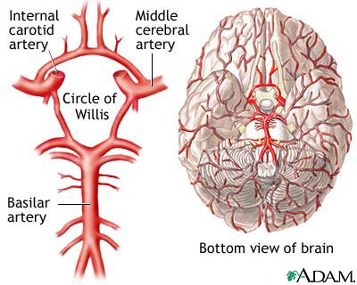
CEREBRAL ARTERIAL SUPPLY
The arterial cerebral circulation is divided into anterior and posterior cerebral circulations.
The anterior and posterior cerebral circulations are interconnected via bilateral posterior communicating arteries.
Posterior communicating arteries are part of Circle of Willis.
Located on the base of the brain.
It Encircles:
Optic chiasma
Hypothalamus
Midbrain
The cerebral Arterial Supply is Provided by Two Systems:
Carotid System
Supply anterior portion of the brain.
Vertebro-Basilar System
Supply posterior portion of the brain.

Slide 7
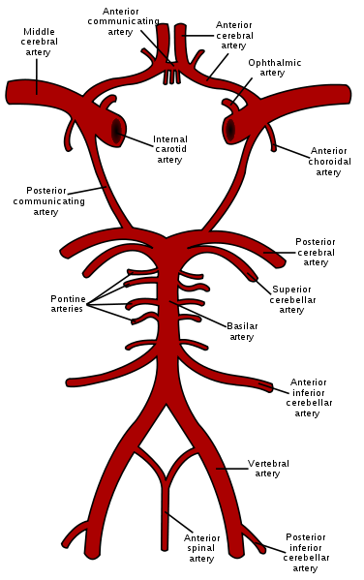
CIRCULUS ARTERIOSUS (OF WILLIS)
Named after Thomas Willis (1621–1675), an English physician
It is Formed by:
Two Anterior cerebral arteries
Two Internal carotid arteries
Two Posterior cerebral arteries
Two Posterior communicating arteries
One Anterior communicating artery
It Gives numerous small vessels that penetrate the surface of the brain
Perforating arteries
They are divided into:
Anterior perforating arteries
Posterior perforating arteries

Slide 8
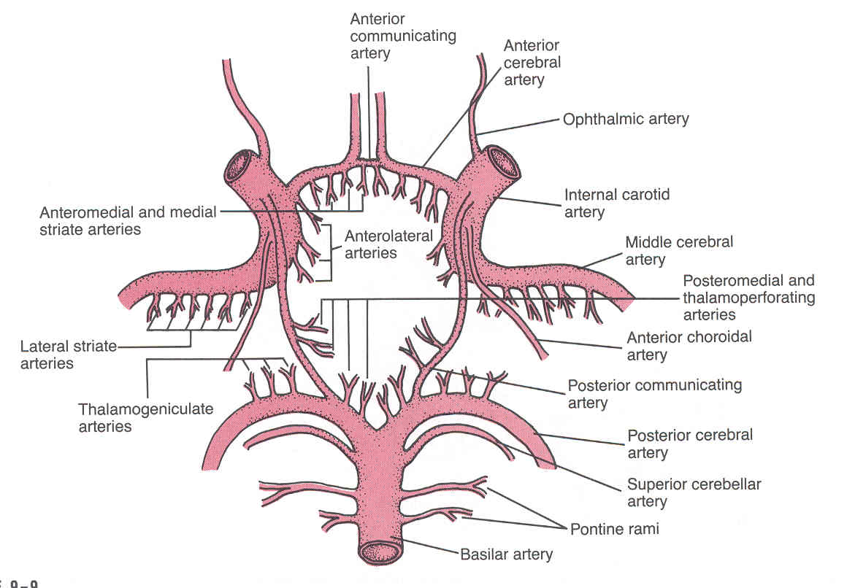
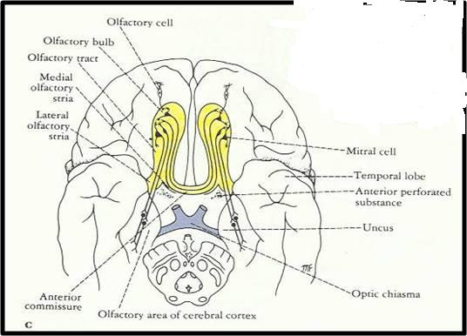
ANTERIOR PERFORATING ARTERIES
Arise from:
Anterior cerebral artery,
Anterior communicating artery
Middle cerebral artery
Enter brain through:
Anterior perforated substance
irregularly quadrilateral area in front of the optic tract and behind the olfactory trigone.
Supply:
Large part of basal ganglia
Optic chiasma
Internal capsule
Hypothalamus

Slide 9
POSTERIOR PERFORATING ARTERIES
Arise from:
Posterior cerebral artery
Posterior communicating artery
Enter brain through:
Posterior Perforated substance
Supply:
Ventral portion of Midbrain
Parts of Subthalamus and Hypothalamus

Slide 10
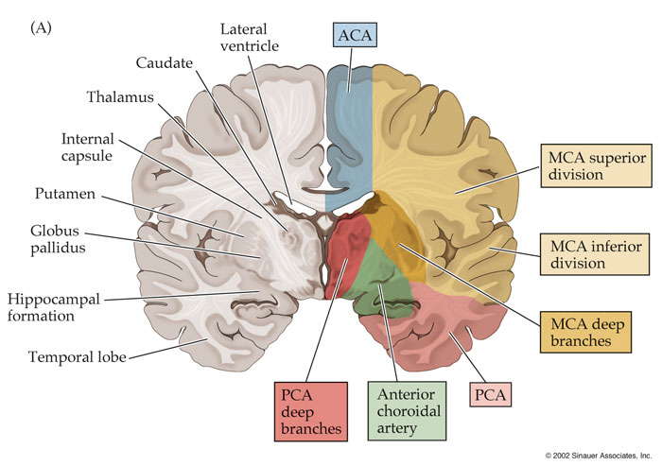
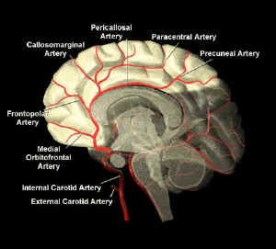
ANTERIOR CEREBRAL ARTERY
Supplies: Orbital and medial surfaces of frontal and parietal lobes

Slide 11
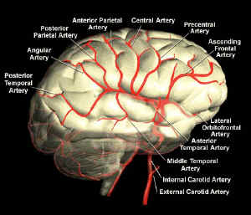
MIDDLE CEREBRAL ARTERY
Supplies: Entire Superolateral surface:
Somatosensory Cortex
Motor Cortex
Broca's Area
linked to speech production.
Heschl’s Gyrus
to process incoming auditory information
Wernicke’s Area
It is involved in the understanding of written and spoken language

Slide 12
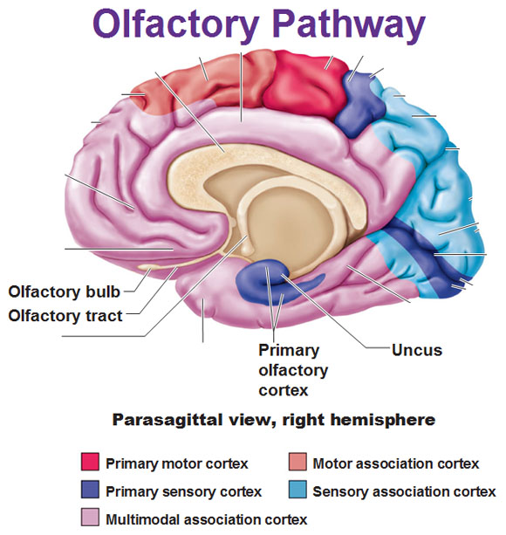
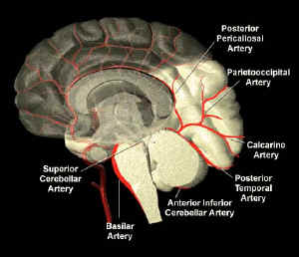
POSTERIOR CEREBRAL ARTERY
Supplies:
Anterior and inferior temporal lobes
Uncus
Located on the tip end of the medial surface of the parahippocampal gyrus.
Part of the olfactory cortex that processes information from the sense of smell.
Inferior temporal gyri
Inferior and Medial Occipital lobe

Slide 13
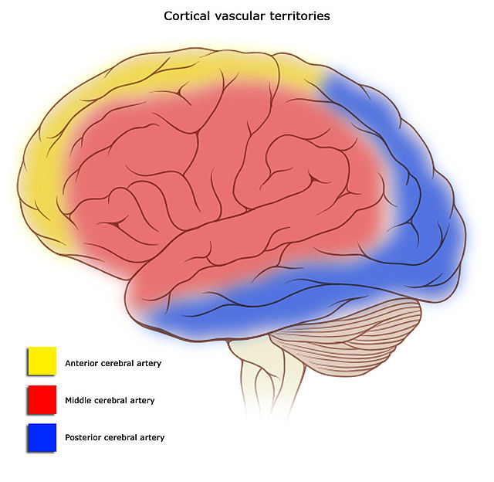
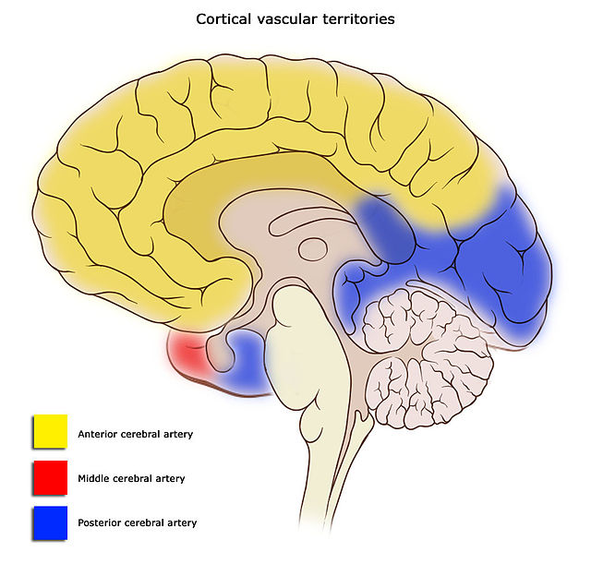
DISTRIBUTION OF CEREBRAL ARTERIES

Slide 14
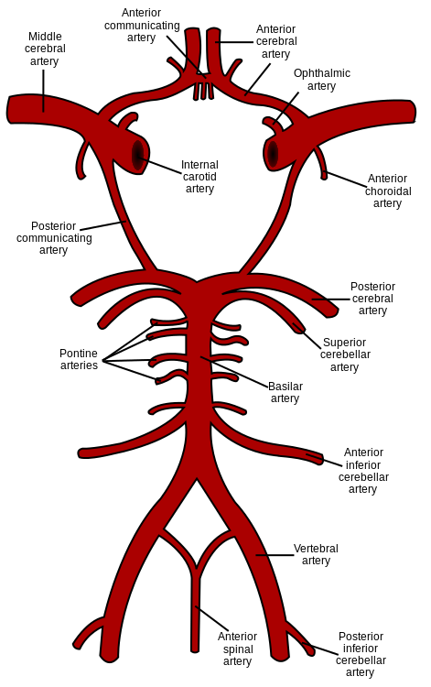
BASILAR ARTERY
Supplies: Midbrain and Cerebellum.
Branches:
Anterior inferior cerebellar artery
Pontine branches
Superior cerebellar artery

Slide 15
ARTERIAL DISORDER
Stroke
Sudden occlusion
Hemorrhage
Aneurysm
localized, blood-filled balloon-like bulge in the wall of a blood vessel.
Angioma
is benign tumors derived from cells of the vascular or lymphatic vessel walls (epithelium) or derived from cells of the tissues surrounding these vessels.

Slide 16
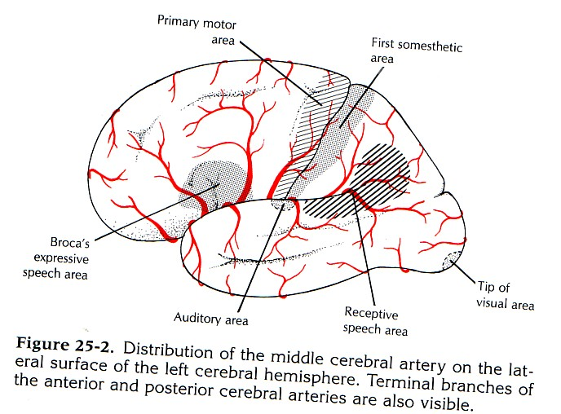
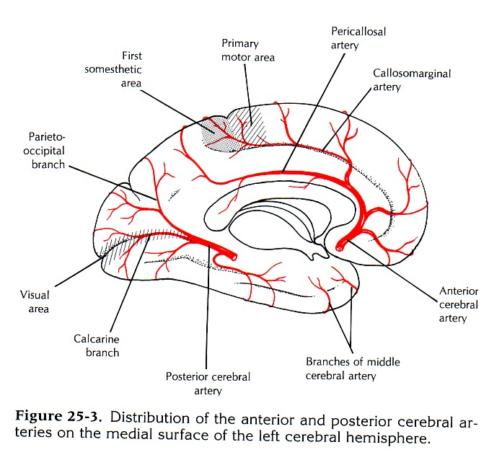
ACCLUSION OF ACA
Manifestations:
Motor disturbance in contralateral distal leg
Difficulty in Prefrontal lobe Functions:
Cognitive thinking
Judgment
Motor initiation
Self monitoring

Slide 17
ACCLUSION OF MCA
Manifestations:
Contralateral weakness of:
face, arm, and hand more than legs
Contralateral sensory loss of:
face, arm, and hand more than legs
visual field cut (damage to optic radiation)
Aphasia: language disturbances
Broca's: production
Wernicke's: comprehension

Slide 18
ACCLUSION OF PCA
Manifestations:
Visual disturbances
Contralateral homonymous hemianopsia
Bilateral lesions: cortical blindness
patients unaware they cannot see (Anton's syndrome)
Memory impairment
If temporal lobe is affected

Slide 19
HOW WE ARE DOING ..?
Which statement(s) of the following is NOT Wrong?
Anterior cerebral arteries supply Broca's and Wernicke’s Area..!!
Occlusion of MCA causes difficulty in Prefrontal lobe’s functions..!!
Middle cerebral arteries are part of Willis Circle..!!
Aneurysm is benign tumors derived from cells of the vascular or lymphatic vessel walls..!!
Posterior cerebral arteries supply anterior and inferior temporal lobes..!!

Slide 20
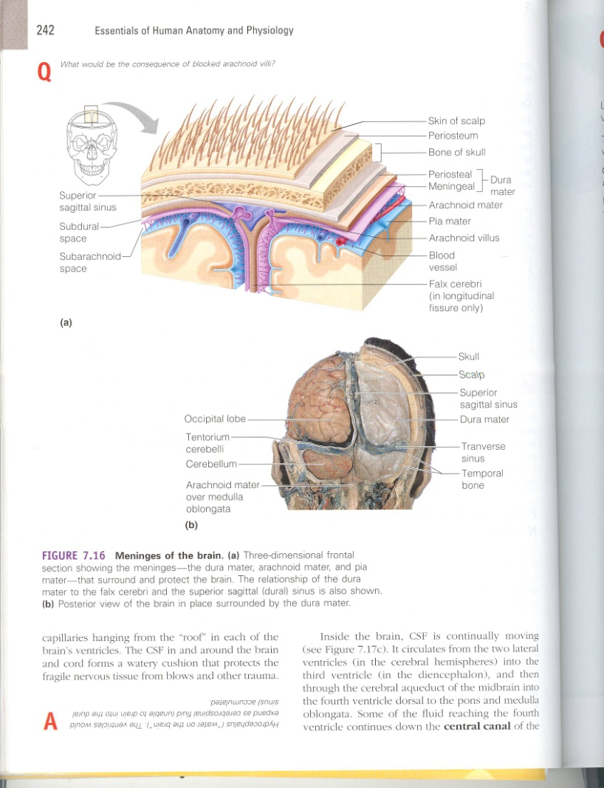
CEREBRAL VENOUS DRAINAGE
It involves:
Superficial (cortical) veins:
Drain the cortical surface
Deep veins:
Drain the deep structures
These veins ultimately drain into:
Dural Venous Sinuses
The Veins are thin walled and are devoid of valves.

Slide 21
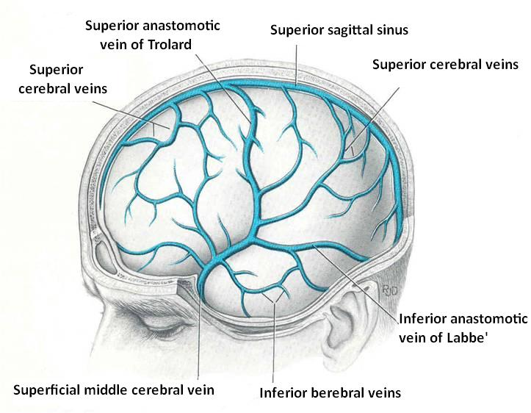
SUPERFICIAL CORTICAL VEINS
Lie on the brain surface, in the Subarchnoid space.
They are divided into:
Superior cerebral veins
Inferior cerebral veins
Superficial middle cerebral vein

Slide 22
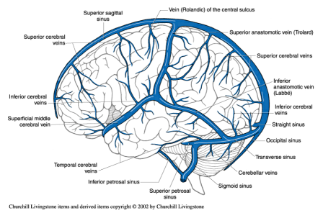
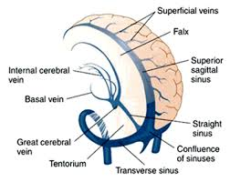
SUPERFICIAL CORTICAL VEINS
Superior Cerebral Veins
6 to 12 veins
Drain lateral surface of brain above the lateral sulcus
Terminate mainly into the Superior Sagittal sinus, and partly into superficial middle cerebral vein.

Slide 23
SUPERFICIAL CORTICAL VEINS
Inferior Cerebral Veins
Run below the lateral sulcus
Drain the lateral surface of the temporal lobe
Terminate partly into superficial middle cerebral vein & partly into Transverse sinus.

Slide 24
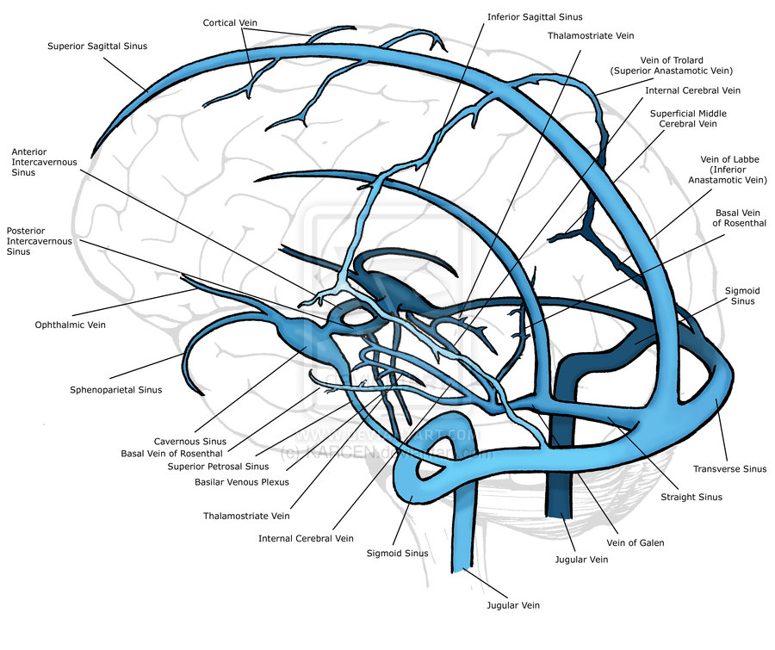
SUPERFICIAL CORTICAL VEINS
Superficial Middle Cerebral Vein
Runs along the lateral sulcus
Terminates into the Cavernous sinus
Connected posteriorly by Superior & Inferior anastomotic veins to Superior Sagittal & Transverse sinuses respectively.

Slide 25
DEEP CEREBRAL VEINS
They drain the internal structures;
Basal ganglia
Internal capsule
Thalamus
They merge to form the Internal Cerebral Veins.
The two veins unite in the midline to form the Great Cerebral vein.
This short vessel is continuous with the Straight Sinus.

Slide 26
DURAL VENOUS SINUSES
Paired
Single
Transverse
Sigmoid
Cavernous
Petrosal
Superior sagittal
Inferior sagittal
Straight
Occipital
Blood flows from transverse & sigmoid sinuses into IJV

Slide 27
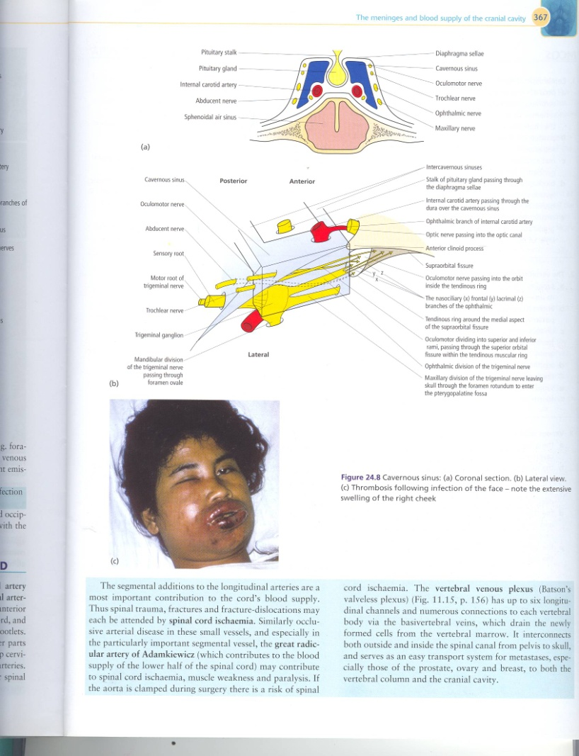
VENOUS DISORDER
Infarction
refers to tissue death (necrosis) that is caused by a local lack of oxygen due to obstruction of the tissue's blood supply
Sinus thrombosis:
SSS thrombosis
Superior Sagittal Sinus
Can complicates ear infection
Cavernous Sinus thrombosis
As a complication of infection in the dangerous area of the face
Obstruction of venous drainage of the brain leads to Cerebral swelling (edema) and raised Intracranial Pressure.

Slide 28
ALSO, HOW WE ARE DOING ..?
Which statement(s) of the following is Wrong?
Superior Cerebral Veins terminate mainly into the Superior Sagittal sinus, and partly into superficial middle cerebral vein..!!
Infarction refers to tissue death (necrosis)..!!
Superior Cerebral Veins drain lateral surface of brain above the lateral sulcus..!!
Inferior Cerebral Veins terminate partly into superficial middle cerebral vein & partly into Transverse sinus..!!
Superficial Middle Cerebral Vein drains the lateral surface of the temporal lobe..!!

Slide 29
QUESTION?

