Slide 1
Meninges ventricles & CSF
Dr.Sanaa Al-Shaarawy
Dr. Essam Eldin Salama

Slide 2
OBJECTIVES
By the end of the lecture the student should be able to:
Describe the cerebral meninges & list the main dural folds.
Describe the spinal meninges & locate the level of the termination of each of them.
Describe the importance of the subarachnoid space.
List the Ventricular system of the CNS and locate the site of each of them.
Describe the formation, circulation, drainage, and functions of the CSF.
Know some clinical point about the CSF

Slide 3
MENINGES
The brain and spinal cord are invested by three concentric membranes ;
The outermost layer is the dural matter.
The middle layer is the archnoid matter.
The innermost layer is the pia matter.

Slide 4
DURA MATER
The cranial dura is a two layered tough, fibrous membrane that surrounds the brain.
It is formed of two layers; periosteal and meningeal.
The periosteal layer is attached to the skull.
The meningeal layer is folded forming the dural folds; falx cerebri, and tentoriam cerebelli
Sensory innervation of the dura is mostly from the three branches of the trigeminal and vagus nerves & C1 to C3.

Slide 5
DURA MATER
Two large reflection of dura extend into the cranial cavity;
Falx cerebri;
It is a vertical sickle shaped sheet of dura, in the midline
Extends from the cranial roof into the great longitudinal fissure between the two cerebral hemispheres.
It has an attached border adherent to the skull.
And a free border lies above the corpus callosum.
falx cerebri

Slide 6
DURA MATER
Tentorium cerebelli;
A horizontal shelf of dura, lies between the posterior part of the cerebral hemispheres and the cerebellum.
It has a free border that encircles the midbrain.
Its superior surface in the middle line it is continuous with the falx cerebri, separated by the straight sinus

Slide 7
Arachnoid Mater & Pia Mater
Arachnoid mater; is a soft, translucent membrane loosely envelops the brain.
It is separated from the dura by a narrow subdural space.
Pia mater; is a thin, delicate & highly vascular membrane that is closely adherent to the gyri and fitted into the sulci.
Between the pia and arachnoid mater lies the subarachnoid space which contains; fibrous trabechulae, main blood vessels and CSF.

Slide 8
Subarachnoid Space
The subarachnoid space is varied in depth forming; subarachnoid cisterns.
The cisterna magna, or cerebllomedullary cistern which lies between the inferior surface of the cerebellum and the back of the medulla.
from this cistern CSF flows out of the fourth ventricle.

Slide 9
Subarachnoid Space
Interpeduncular cistern;
Is located at the base of the brain, where the arachnoid spans the space between the two cerebral peduncles.
It contains the optic chiasma & circulus arteriosus of Wills.

Slide 10
Spinal meninges
The spinal cord, is invested by three meningeal coverings: the pia mater, arachnoid mater and dura mater.
Dura mater; the outer covering, is a single, tough fibrous membrane.
It envelopes the cord loosely
It is separated from archnoid matter by the subdural space, and from the bony wall of the vertebral canal by the epidural space.
Archnoid matter; is a translucent membrane, lies between the pia and dura,
Between it and pia lies the subarachnoid space contains CSF.
Pia mater, is a delicate membrane closely envelops the cord and nerve roots.
It is attached through the arachnoid to the dura by the denticulate ligament.

Slide 11
Spinal meninges
Spinal cord terminates at level L1-L2, while
Arachnoid and dural and, subarachnoid space, continue caudally to S2.
Pia extends downwards forming the filum terminalis which pierces the arachnoid and dural sacs and passes through the sacral hiatus to be attached to the back of the coccyx.

Slide 12
VENTRICULAR SYSTEM
Interconnecting channels within the CNS.
In the spinal cord; represented by the central canal.
Within the brain; a system of ventricles is found.
The central canal of the spinal cord is continuous upwards to the forth ventricle.
On each side of the forth ventricle laterally, lateral recess extend to open into lateral aperture (foramen of Luscka),central defect in its roof (foramen of Magendie)

Slide 13
VENTRICULAR SYSTEM
The forth ventricle is continuous with the cerebral aqueduct, that opens in the third ventricle.
The third ventricle is continuous with the lateral ventricle through the interventricular foramen.
Lateral ventricle

Slide 14
CEREBROSPINAL FLUID
Present in the ventricular system, together with the cranial and spinal subarachnoid spaces.
It is colourless fluid containing little protein and few cells.
It is about 150 ml.
It serves to cushion the brain from sudden movements of the head

Slide 15
CEREBROSPINAL FLUID
It is produced by the choroid plexus, which is located in the lateral, third & fourth ventricles.
From there it flows: through the interventricular foramen to the third ventricle and, by way of the cerebral aqueduct, to the fourth ventricle.

Slide 16
CEREBROSPINAL FLUID
It leaves the ventricular system through the three apertures of the 4th ventricle ;
(median foramen of Magindi &
2 lateral foramina of Leushka), to enters the subarachnoid space.

Slide 17
CEREBROSPINAL FLUID
Reabsorbed into the venous system along;
arachnoid villi, and
arachnoid granulation
that project into the dural venous sinuses, mainly superior saggital sinus.
arachnoid villi
dural venous sinuses.

Slide 18
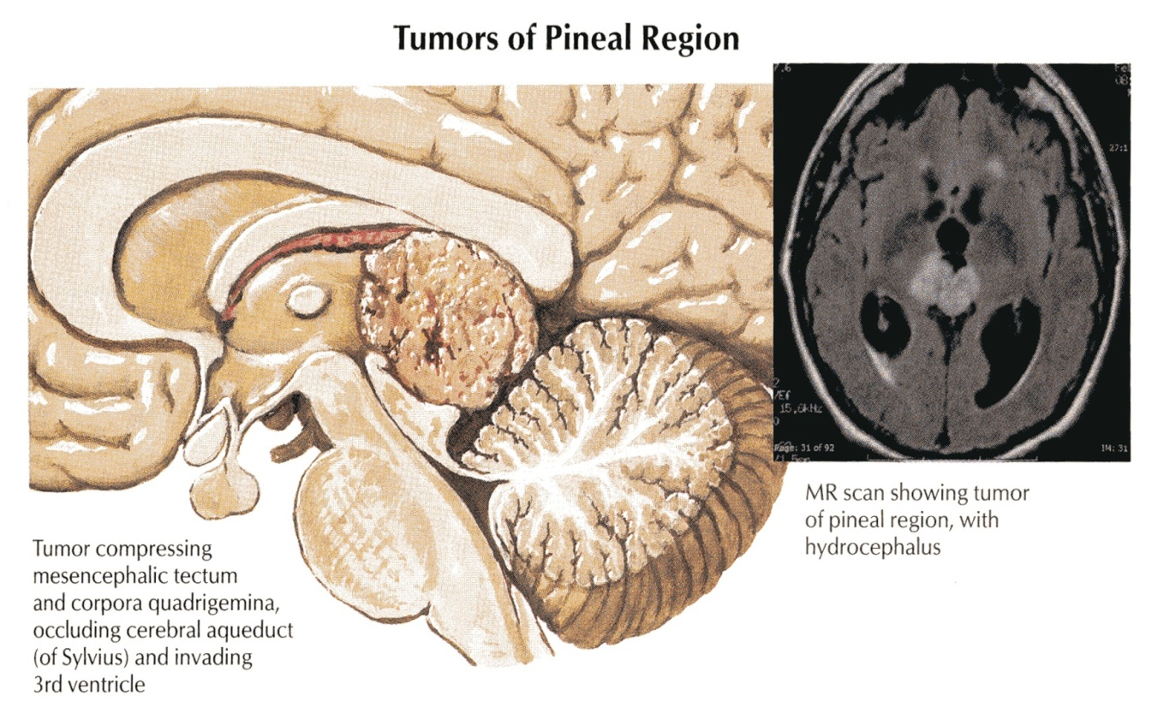
CEREBROSPINAL FLUID clinical point
Obstruction of the flow of CSF leads to a rise in fluid pressure causing swelling of the ventricles (hydrocephalus).

Slide 19
CEREBROSPINAL FLUID clinical point
Decompression of the dilated ventricles is achieved by inserting a shunt connecting the ventricles to the jugular vein or the abdominal peritoneum.

Slide 20
Summary
The brain & spinal cord are covered by 3 layers of meninges : dura, arachnoid & pia mater.
The important dural folds inside the brain are the falax cerebri & tentorium cerebelli.
CSF is produced by the choroid plexuses of the ventricles of the brain ;lateral ,3rd & 4th ventricles.
CSF circulates in the subarachnoid space.
CSF is drained into the dural venous sinuses principally superior saggital sinus.
The subarachnoid space in the spinal cord terminates at the 2nd sacral vertebra.
Obstruction of the flow of CSF as in tumors of the brain leads to hydrocephalus.

Slide 21
Thank yoU & Good Luck

