Slide 1
Cranial Nerves 1X-X (Glossopharyngeal & Vagus Nerves)
Dr. Jamela Elmedany Dr. Essam Eldin Salama

Slide 2
Objectives
By the end of the lecture, the student will be able to:
Define the deep origin of both Glossopharyngeal and Vagus Nerves.
Locate the exit of each nerve from the brain stem.
Describe the course and distribution of each nerve .
List the branches of both nerves.

Slide 3
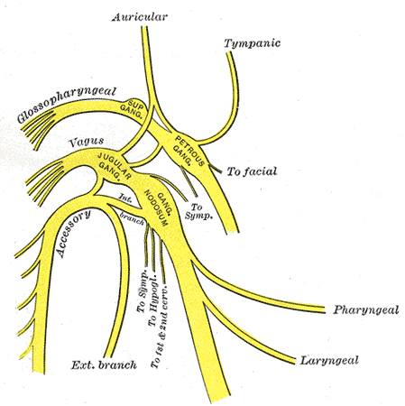
GLOSSOPHARYNGEAL (1X) CRANIAL NERVE
It is principally a Sensory nerve with preganglionic parasympathetic and few motor fibers.
It has no real nucleus to itself.
Instead it shares nuclei with VII and X.

Slide 4
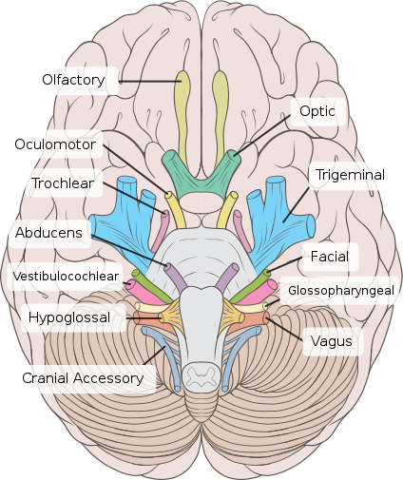
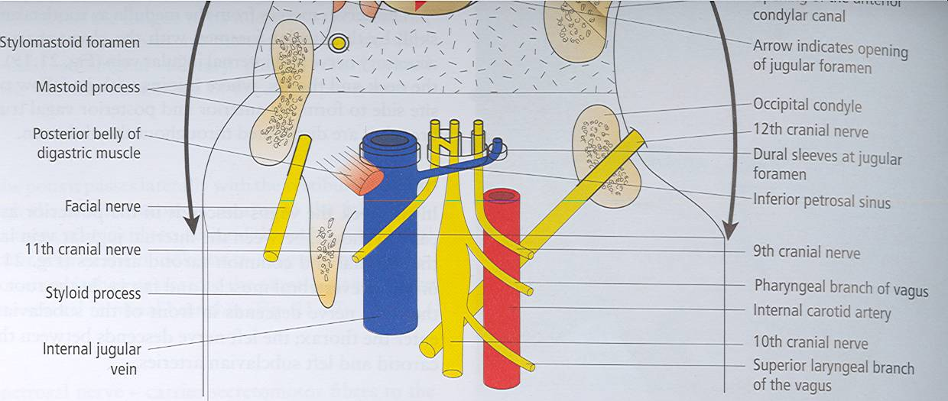
Superficial attachment
It arises from the ventral aspect of the medulla by a linear series of small rootlets, in groove between olive and inferior cerebellar peduncle.
It leaves the cranial cavity by passing through the jugular foramen in company with the Vagus , Acessory nerves and the Internal jugular vein.

Slide 5
COURSE
It Passes forwards between Internal jugular vein and External carotid artery.
Lies Deep to Styloid process.
Passes between external and internal carotid arteries
at the posterior border of Stylopharyngeus then lateral to it.
It reaches the pharynx by passing between middle and inferior constrictors, deep to Hyoglossus, where it breaks into terminal branches.

Slide 6
Component of fibers & Deep origin
Fibers originate from nucleus ambiguus (NA), supply stylopharyngeus muscle.
Fibers arise from inferior salivatory nucleus (ISN), relay in otic ganglion, the postganglionic fibers supply parotid gland.
Fibers arise from the cells of inferior ganglion, their central processes terminate in nucleus of solitary tract (NST), the peripheral processes supply the taste buds on posterior third of tongue.
Fibers receive visceral sensation from mucosa of posterior third of tongue, pharynx, auditory tube and tympanic cavity, carotid sinus, end in nucleus of solitary tract (NST).
NST
ISN
Otic G
NA

Slide 7
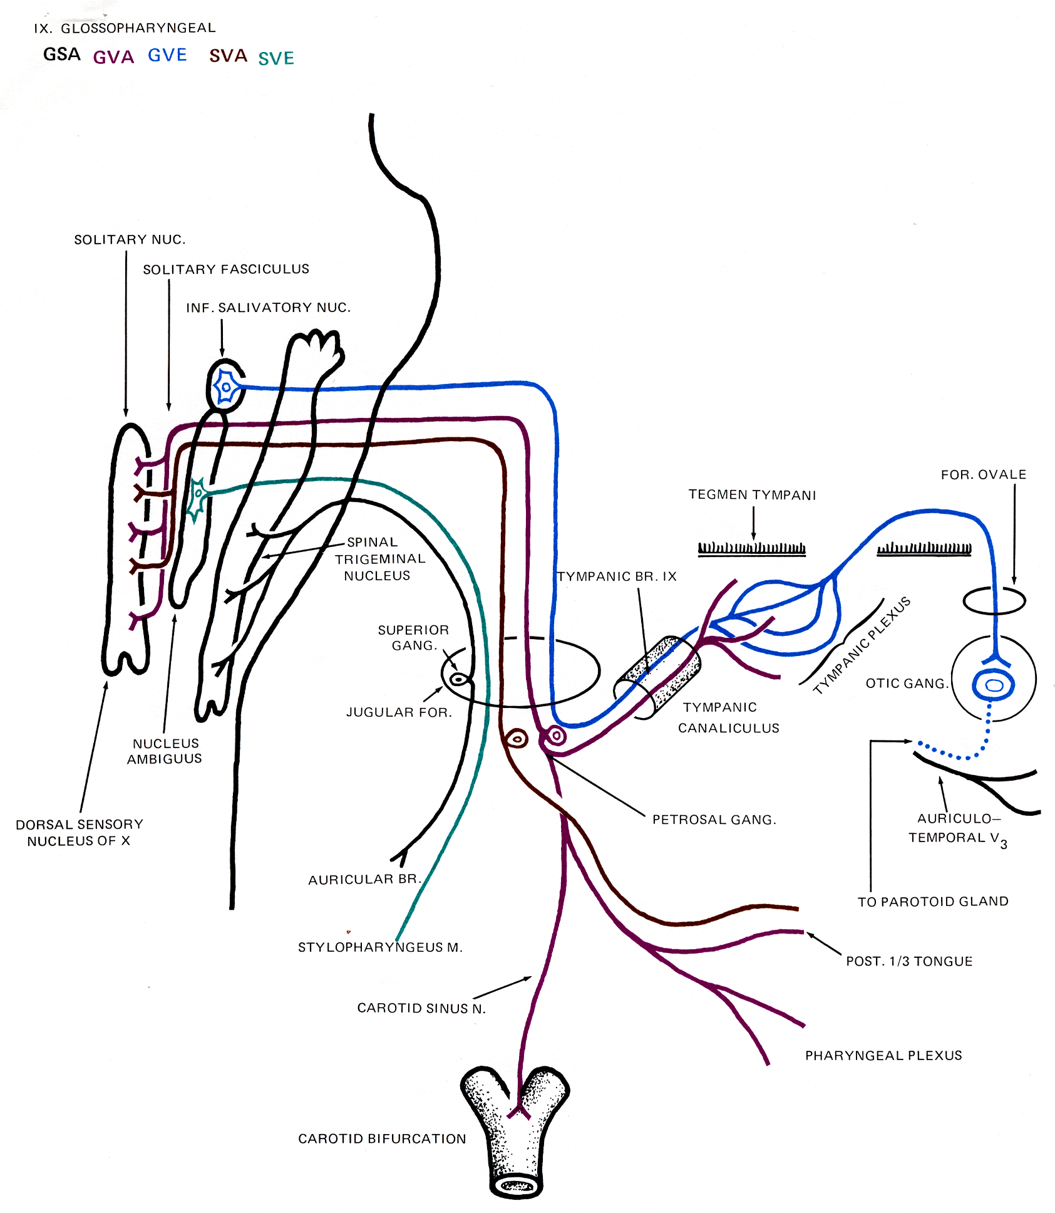

Slide 8
GANGLIA & COMMUNICATIONS
It has two ganglia:
Superior ganglion: Small, with no branches.
It is connected to the Superior Cervical sympathetic ganglion.
Inferior ganglion:
Large and carries general sensations from pharynx, soft palate and tonsil.
It is connected to Auricular Branch of Vagus.
The Trunk of the nerve is connected to the Facialn erve at the stylomastoid foramen.

Slide 9
Branches
Tympanic: relays in the otic ganglion and gives secretomotor to the parotid gland
Nerve to Stylopharyngeus muscle.
Pharyngeal: to the mucosa of pharynx .
Tonsillar.
Lingual : carries sensory branches, general and special ( taste) from the posterior third of the tongue.
Sensory branches from the carotid sinus and body ( pressoreceptors and chemoreceptors).

Slide 10
Glossopharyngeal nerve lesions
It produces:
Difficulty of swallowing;
Impairment of taste sensation over the posterior one-third of the tongue ,palate and pharynx.
Absent gag reflex.
Dysfunction of the parotid gland.

Slide 11
How to Test for 1x nerve Injury?
Have the patient open the mouth and inspect the palatal arch on each side for asymmetry.
Use a tongue blade to depress the base of the tongue gently if necessary.
Ask the patient to say "ahhh" as long as possible.
Observe the palatal arches as they contract and the soft palate as it swings up and back in order to close off the nasopharynx from the oropharynx.
Normal palatal arches will constrict and elevate, and the uvula will remain in the midline as it is elevated.
With paralysis there is no elevation or constriction of the affected side.
warn the patient that you are going to test the gag reflex. Gently touch first one and then the other palatal arch with a tongue blade, waiting each time for gagging.

Slide 12
SUMMARY

Slide 13
VAGUS (X) CRANIAL NERVE
It is a Mixed nerve.
Its name means wandering (it goes all the way to the abdomen)
So it is the longest and most widely distributed cranial nerve.
The principal role of the vagus is to provide parasympathetic supply to organs throughout the thorax and upper abdomen.
It also gives sensory and motor supply to the pharynx and larynx.

Slide 14
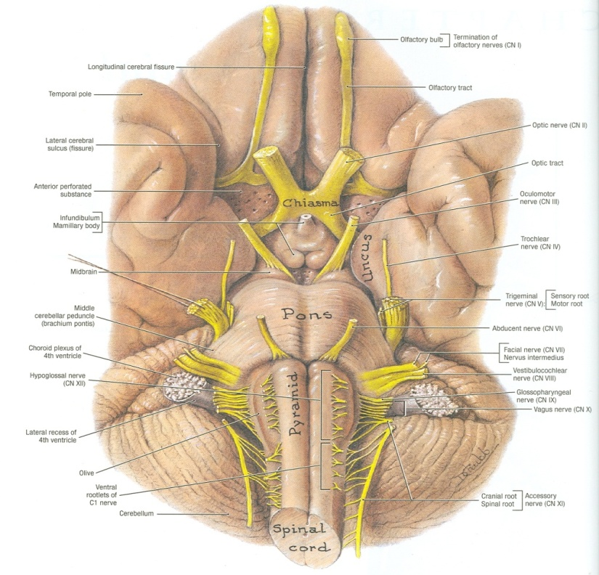
Superficial attachment & Course
Its rootlets exit from medulla between olive and inferior cerebellar peduncle.
Leaves the skull through jugular foramen.
It occupies the posterior aspect of the carotid sheath between the internal jugular vein laterally and the internal and common carotid arteries medially.
It has two ganglia:
Superior ganglion in the jugular foramen
Inferior ganglion, just below the jugular foramen

Slide 15
Communications
Superior ganglion with:
Inferior ganglion of glossopharyngeal nerve,
Superior cervical sympathetic ganglion&
Facial nerve.
Inferior ganglion with:
Cranial part of accessory nerve,
Hypoglossal nerve,
Superior cervical sympathetic ganglion.
1st cervical nerve.

Slide 16
Course
The vagus runs down the neck on the prevertebral muscles and fascia.
The internal jugular vein lies behind it, and
the internal and common carotid arteries are in front of it, all the way down to the superior thoracic aperture.

Slide 17
Course
It lies on the prevertebral muscles and fascia.
Enters thorax through its inlet:
Right Vagus descends in front of the subclavian artery.
Left Vagus descends between the left common carotid and subclavian arteries.

Slide 18
Components of fibers & Deep origin
Fibers originate from Dorsal Nucleus of Vagus synapses in parasympathetic ganglia, short postganglionic fibers innervate cardiac muscle, smooth muscles and glands of viscera.
Fibers originate from Nucleus Ambiguus, to muscles of pharynx and larynx.
Fibers carry impulse from viscera in neck, thoracic and abdominal cavities to Nucleus of Solitary Tract.
Fibers sensation from auricle, external acoustic meatus and cerebral dura mater, to Spinal Tract & Nucleus of Trigeminal.

Slide 19
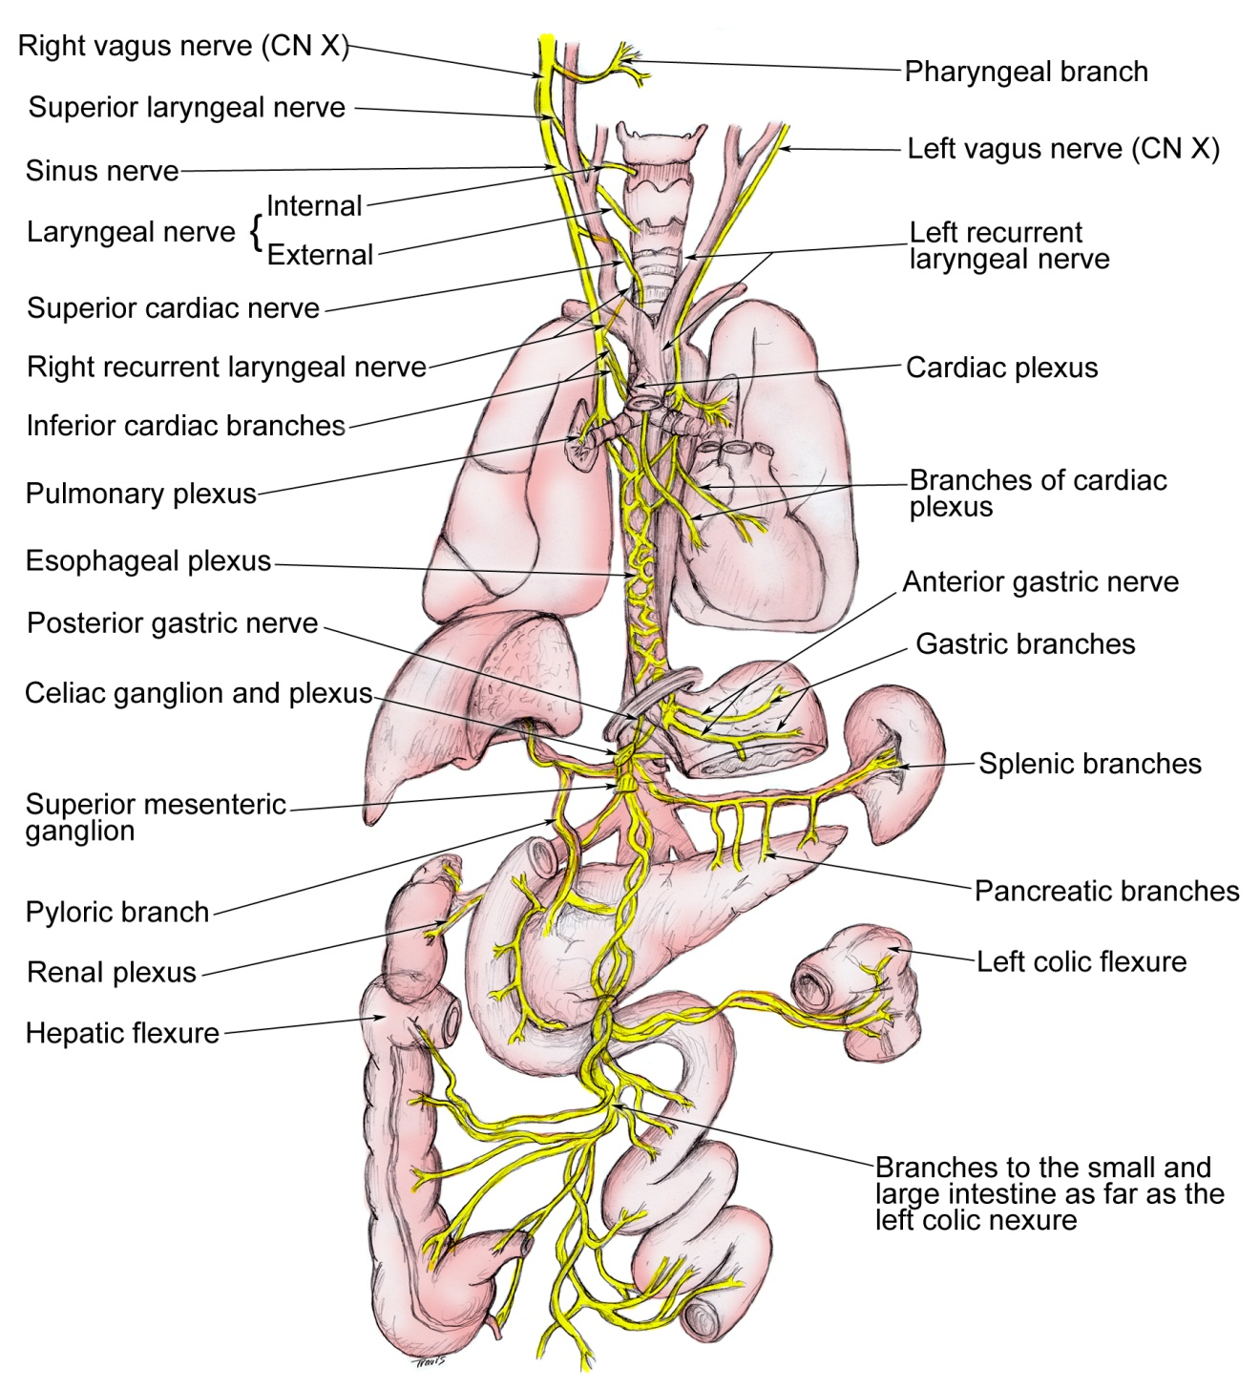
Branches
Meningeal : to the dura
Auricular nerve: to the external acoustic meatus and tympanic membrane.
Pharyngeal :it enters the wall of the pharynx. It supplies the mucous membrane of the pharynx, superior and middle constictor muscles, and all the muscles of the palate except the tensor palati.
To carotid body
Superior Laryngeal: It divides into:
(1) Internal Laryngeal :
It provides sensation to the hypopharynx, the epiglottis, and the part of the larynx that lies above the vocal folds.
(2) External Laryngeal :
supplies the cricothyroid muscle.
Recurrent Laryngeal :
the recurrent laryngeal nerve goes round the subclavian artery on the right, and round the arch of the aorta on the left

Slide 20
It runs upwards and medially alongside the trachea, and passes behind the lower pole of the thyroid gland.
The recurrent laryngeal nerve gives motor supply to all the muscles of the larynx, except the cricothyroid. It also provides sensation to the larynx below the vocal folds.

Slide 21
Summary
X is a mixed nerve.
It contains afferent, motor , and parasympathetic fibers.
The afferent fibers convey information from:
esophagus, tympanic membrane , external auditory meatus and part of chonca of the middle ear. End in trigeminal sensory nucleus .
Chemoreseptors in aortic bodies and baroreseptors in aortic arch.
Receptors from thoracic & abdominal viscera, end in nucleus solitarius.
The motor fibers arise from ( nucleus ambiguus of medulla to innervate muscles of soft palate, pharynx, larynx, and upper part of esophagus.
The parasympathetic fibers originate from dorsal motor nucleus of vagus in medulla distributed to cardiovascular, respiratory, and gastrointestinal systems.

Slide 22
Vagus nerve Lesions
Vagus nerve lesions produce palatal and pharyngeal and laryngeal paralysis;
Abnormalities of esophageal motility, gastric acid secretion, gallbladder emptying, and heart rate; and other autonomic dysfunction.

Slide 23
How to diagnose x nerve Injury?
Listen to the patient talk as you are taking the history.
Hoarseness, whispering, nasal speech, or the complaint of aspiration or regurgitation of liquids through the nose should make you especially mindful of abnormality.
Give the patient a glass of water to see if there is choking or any complaints as it is swallowed.
Laryngoscopy is necessary to evaluate the vocal cord.

Slide 24
Causes of 1X & X nerve lesions
1. Lateral medullary syndrome:
A degenerative disorder seen over age of 50 mostly due to
Thrombosis of the Inferior Cerebellar Artery.
2. Tumors compressing the cranial nerves in their exiting foramina from the cranium via the skull base
Manifested by:
Ipsilateral paralysis of the muscles of the Palate, Pharynx and Larynx.
Ipsilateral loss of Taste from the Posterior Third of tongue.

Slide 25
Thank you

