Slide 1
INTERNAL STRUCTURE
OF THE BRAIN STEM
By
Dr. Sanaa Alshaarawy
& Dr. Saeed Vohra

Slide 2
OBJECTIVES
By the end of the lecture, students will be able to :
Distinguish the internal structure of the components of the brain stem in different levels and the specific criteria of each level.
1. Medulla oblongata (closed, mid and open medulla)
2. Pons (caudal and rostral).
3. Mid brain ( superior and inferior colliculi).
Describe the Reticular formation (structure, function and pathway) being an important content of the brain stem.

Slide 3
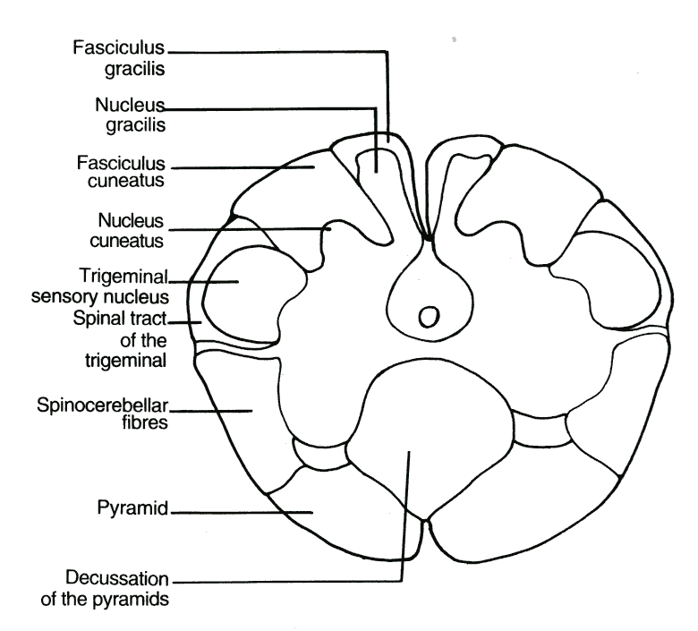
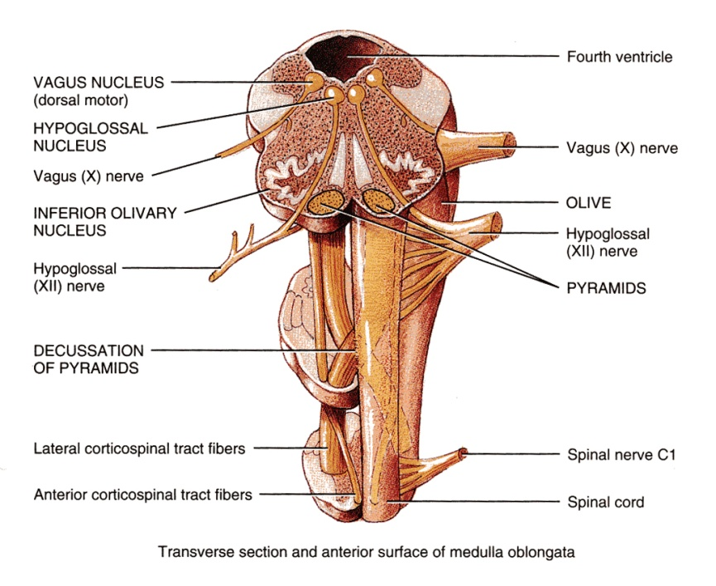
CAUDAL (closed) MEDULLA
Traversed by the Central Canal.
Motor Decussation.
Spinal Nucleus of Trigeminal. It is a larger sensory nucleus. It is the brain stem continuation of the Substantia Gelatinosa of spinal cord.
T.S of Caudal part of M.O.

Slide 4
PYRAMIDAL DECUSSATION
It is Motor Decussation.
Formed by pyramidal fibers, (75-90%) cross to the opposite side. They descend in the lateral white column of the spinal cord as the lateral corticospinal tract.
The uncrossed fibers form the anterior corticospinal tract
Decuss- = crossing

Slide 5
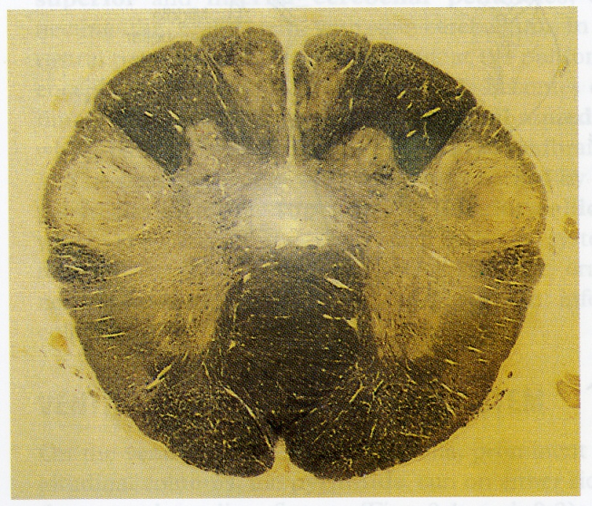
TRIGEMINAL SENSORY NUCLEUS & TRACT
The Nucleus Extends
Through the whole length of the brain stem and into upper segments of spinal cord.
It lies in all levels of M.O medial to the spinal tract of the trigeminal.
It receives pain and temperature from face, forehead.
Its tract present in all levels of M.O. is formed of descending fibers that terminate in the trigeminal nucleus

Slide 6
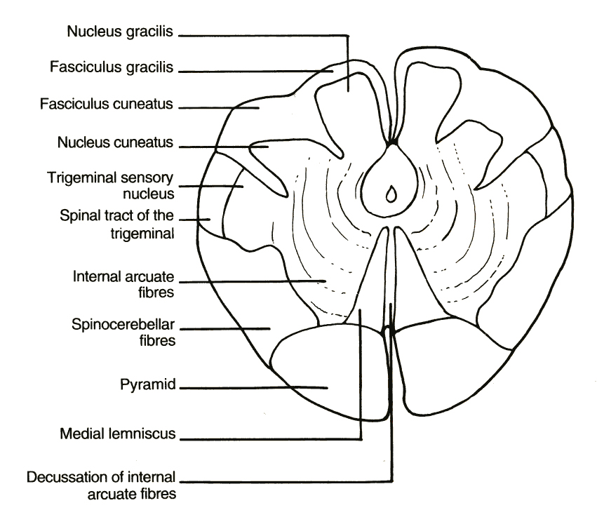
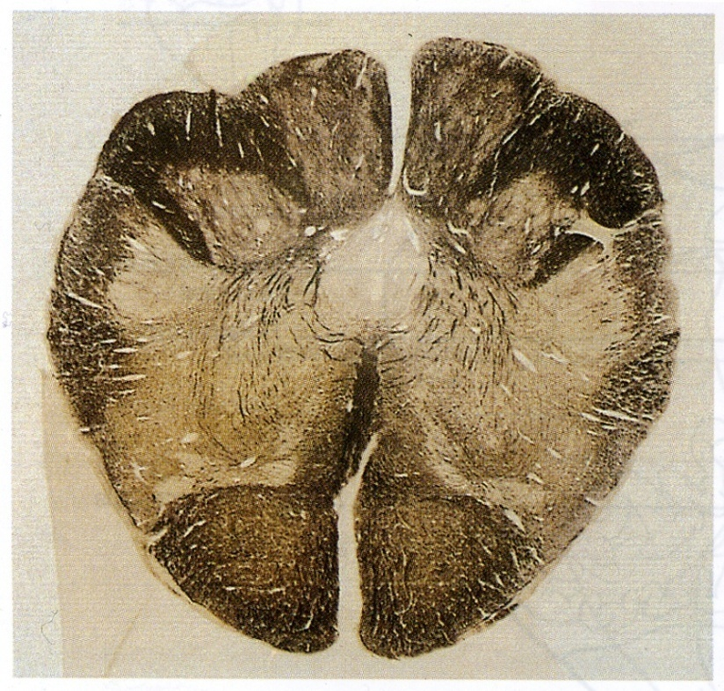
MID MEDULLA
Traversed by Central Canal.
Larger size Gracile & Cuneate nuclei, concerned with proprioceptive deep sensations of the body
Axons of Gracile & Cuneate nuclei form the internal arcuate fibers Sensory Decussation.
Pyramids are prominent ventrally.

Slide 7
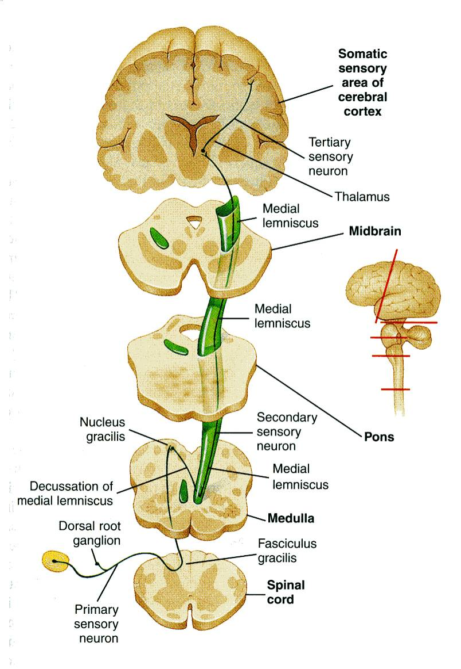
SENSORY DECUSSATION
Formed by the crossed internal arcuate fibers
Medial Leminiscus:
Composed of the ascending internal arcuate fibers after their crossing.
Lies adjacent to the middle line ventral to the central canal
Terminates in thalamus.
lemniscus = ribbon

Slide 8
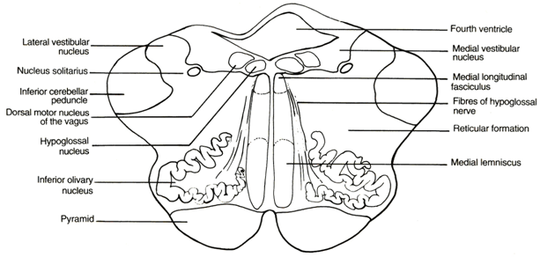
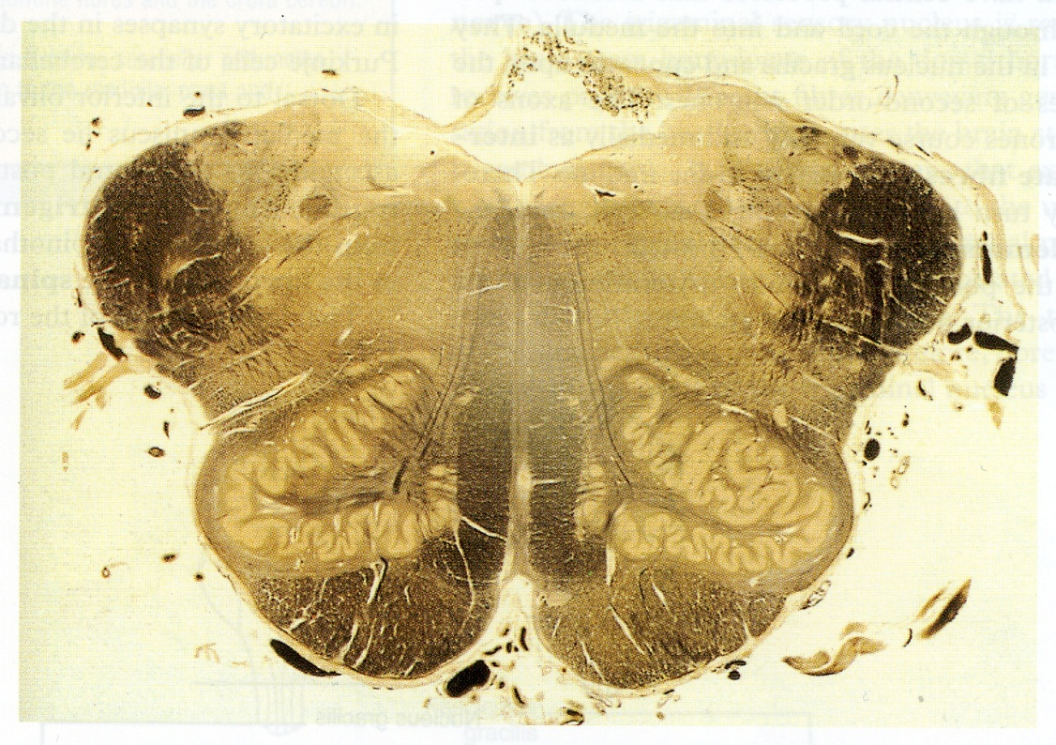
ROSTRAL (open) MEDULLA
On the ventral aspect
The pyramid is clear, with medial lemniscus on either sides of middle line dorsal to the pyramid
Inferior Olivary Nucleus
A convoluted mass of gray matter lies posterolateral to the pyramids & lateral to the medial leminiscus.
It is concerned with the control of movement.

Slide 9
ROSTRAL (open) MEDULLA
On the dorsal aspect
Lower part of the floor of the 4th ventricle.
The Inferior Cerebellar Peduncle is, connecting medulla oblangata with cerebellum.
dorsal and lateral to the inferior cerebellar peduncle lie the Cochlear nuclei (dorsal and ventral).

Slide 10
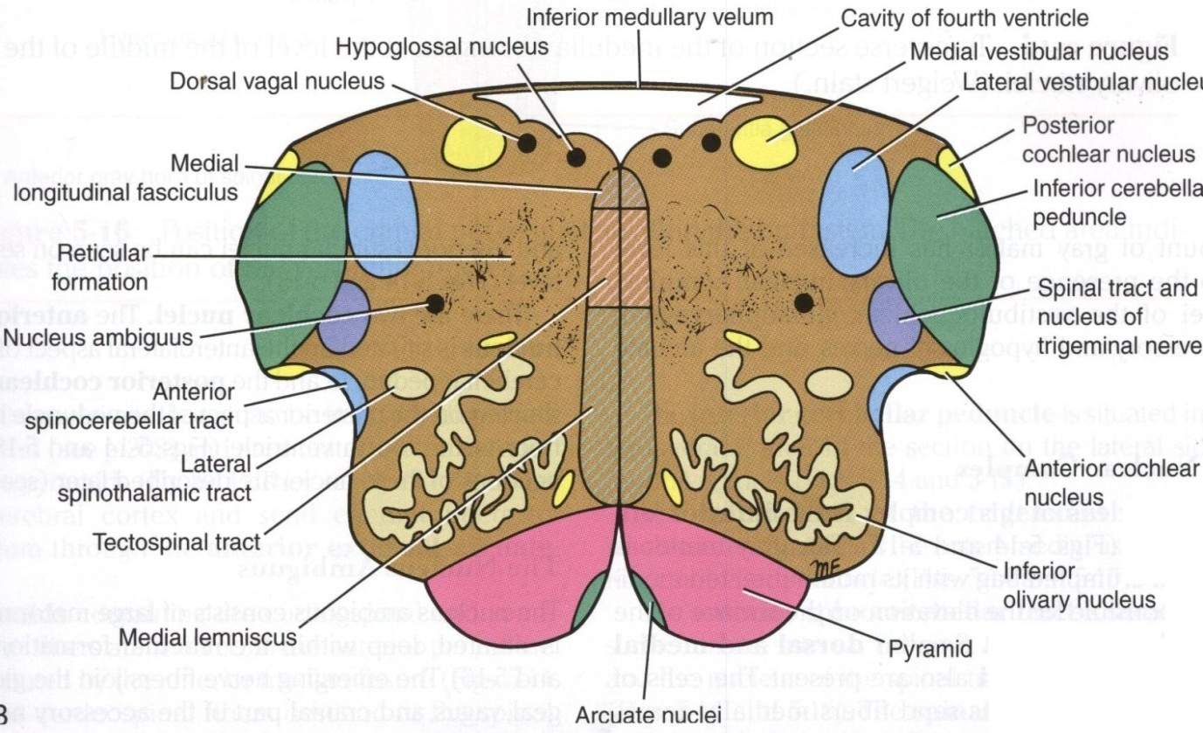
ROSTRAL (open) MEDULLA
Beneath the floor of 4th ventricle lie:
1. Hypoglossal Nucleus.
2. Dorsal Nucleus of Vagus lateral to the hypoglossal nucleus, contains preganglionic parasympathetic fibers.
3. Medial longitudinal fasciculus lies close to the midline, ventromedial to the hypoglossal nucleus, dorsal to the medial lemniscus. It links the vestibular nuclei with nuclei of extraocular ms. (3, 4 & 6) to help coordination of head & eye movements

Slide 11
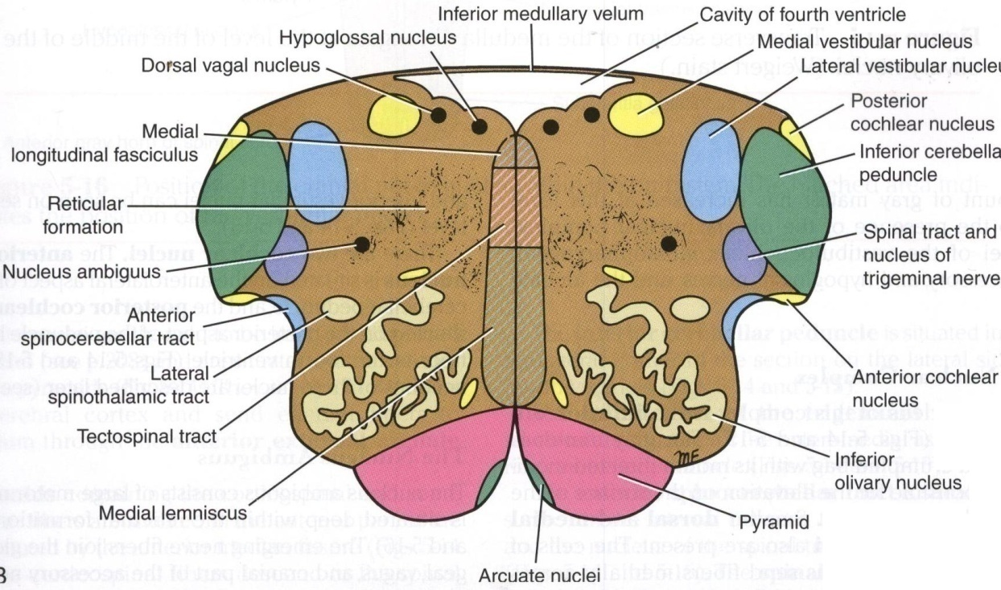
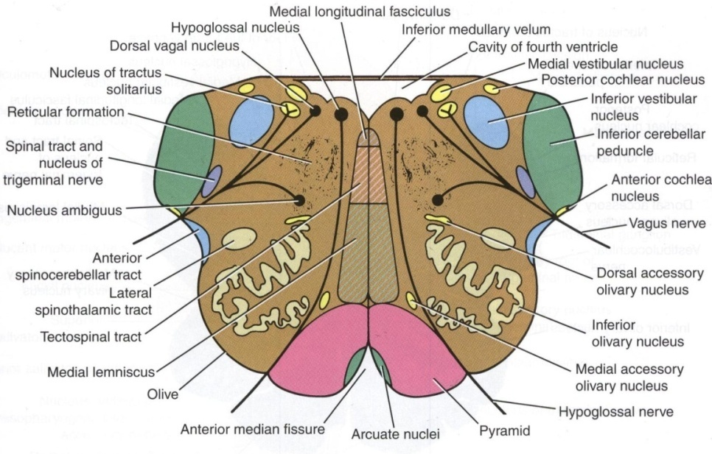
ROSTRAL (open) MEDULLA
Vestibular nuclei complex Concerned with equilibrium
Nucleus Ambiguus
lies dorsal to olivary nucleus gives motor fibers to constrictors of the pharynx & intrinsic muscles of the larynx
Solitary nucleus
lies ventrolateral to dorsal nucleus of vagus, receive taste sensation from the tongue along the facial (VII), glossopharyngeal (IX) and vagus (X) cranial nerves

Slide 12
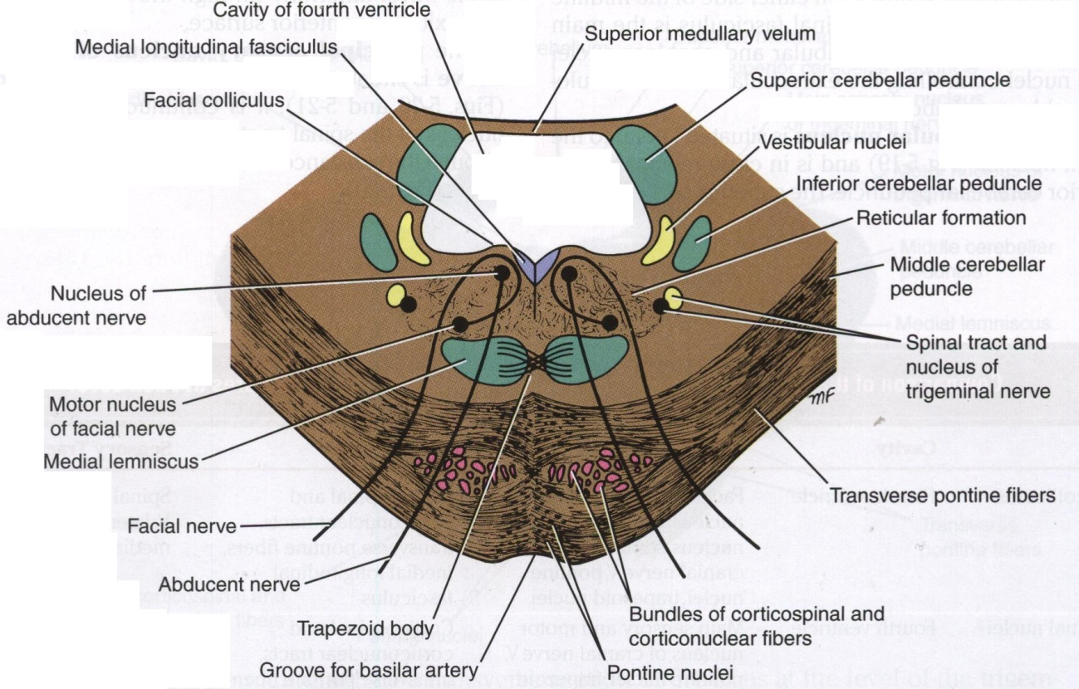
CAUDAL PART OF THE PONS
Divided into an anterior part (Basis Pontis) & a posterior part (Tegmentum) by the Trapezoid Body (consists of acoustic fibres from cochlear nuclei to ascend into midbrain as lateral lemniscus and terminate in inferior colliculus)
The ventral portion is marked by numerous transversely oriented fascicles of pontocerebellar fibres that originate from scattered cell groups, the pontine nuclei, and that pass to the contralateral side of the cerebellum through the massive middle cerebellar peduncle.

Slide 13
CAUDAL PART OF THE PONS
Pontine Nuclei
Are small masses of nerve cells, receive cortico pontine fibers (involved in motor activity)
Their axons form the transverse pontocerebellar fibers which pass to the contra lateral side of the cerebellum through middle cerebellar peduncles

Slide 14
CAUDAL PONS
The ascending fibres of the medial lemniscus become separated from the pyramid and displaced dorsally.
The Medial Lemniscus rotates 90 degrees and lies almost horizontally
It contains spinal nucleus & tract of Trigeminal.
Deep origin of cranial nerve nuclei:
Abducent nucleus
Facial motor nucleus

Slide 15
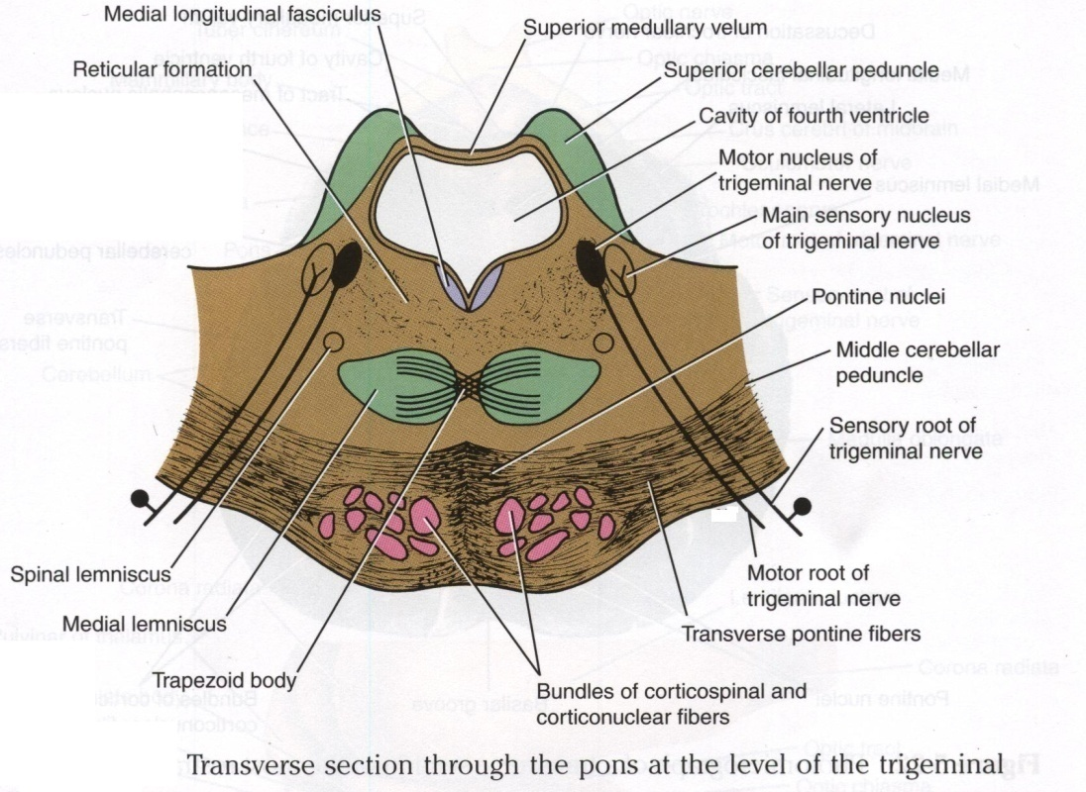
AT THE LEVEL OF THE TRIGEMINAL NERVE
Motor nucleus of the trigeminal nerve: Lies in the lateral part of the floor of the 4th ventricle.
Main sensory nucleus of the trigeminal nerve: Reaches its maximum extent in the pons and it lies lateral to the motor nucleus.
Superior cerebellar peduncles form the lateral boundary of the 4th ventricle

Slide 16
ROSTRAL PONS
Superior Medullary Velum
Passes between the two peduncles & forms the roof of the 4th ventricle.
Medial longitudinal fasciculus:
Lies close to the midline beneath the floor of the 4th ventricle.
It carries information about the direction that the eyes should move
It connects the cranial nerve nuclei Oculomotor nerve, Trochlear nerve and Abducent nerve together

Slide 17
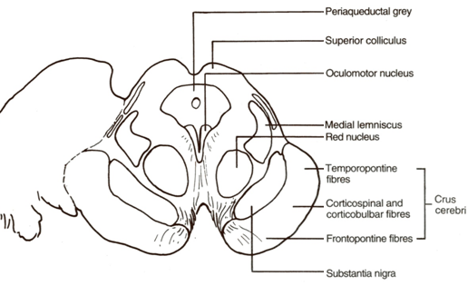
MIDBRAIN
It is divided into a dorsal part (Tectum) and a ventral part (Tegmentum) at the level of the cerebral aqueduct
The cerebral aqueduct is surrounded by a pear shaped periaqueductal (central) gray matter.
The most ventral part of the tegmentum is the massive fibrous mass (Crus Cerebri)

Slide 18
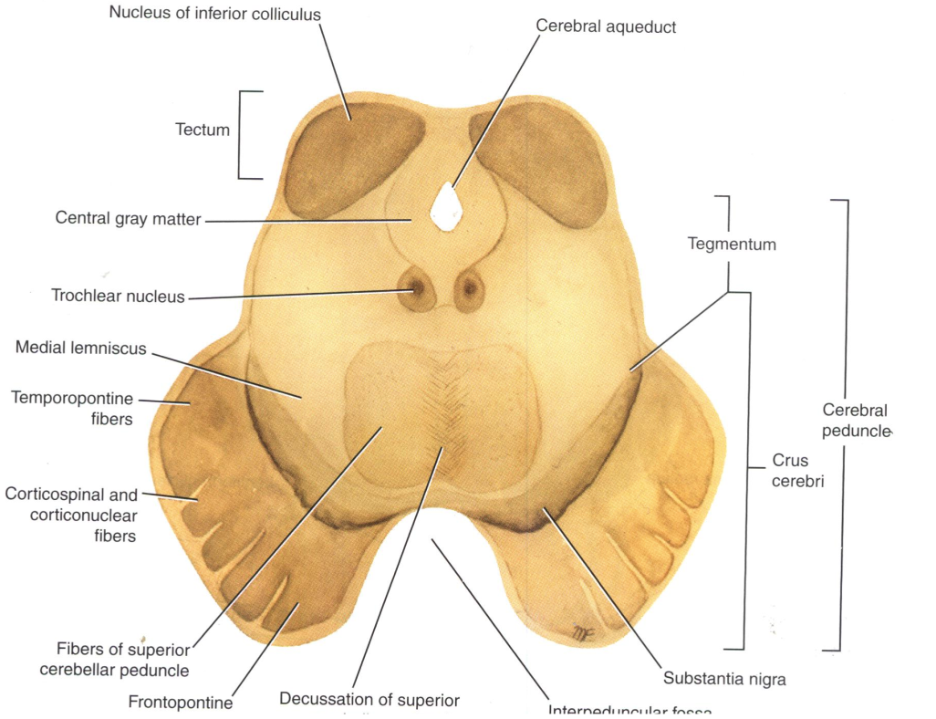
INFERIOR COLLICULUS LEVEL
Inferior colleculus is a large nucleus of gray matter that lies beneath a corresponding surface elevation.
It is part of the auditory pathway.
It receives fibers from the lateral lemniscus
Its efferent fibers pass to the thalamus

Slide 19
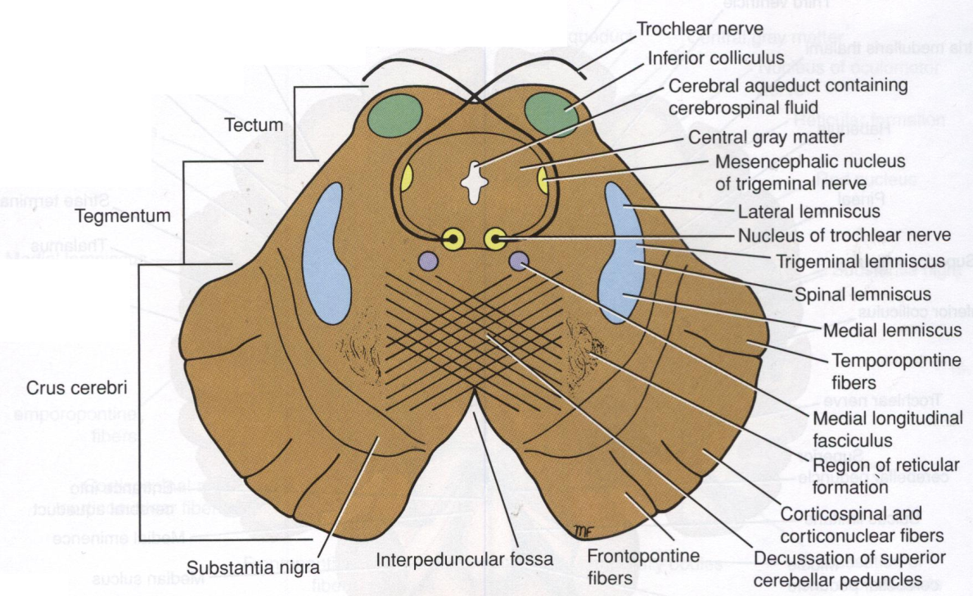
INFERIOR COLLICULUS LEVEL
1. Trochlear nucleus
lies in the central gray matter close to the median plane just posterior to the medial longitudinal bundle.
The fibers of the trochlear nerve decussate in the superior medullary velum.
2. Decussation of the superior
cerebellar peduncles in the
mid line.

Slide 20
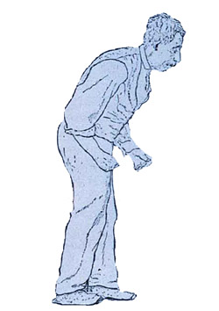
INFERIOR COLLICULUS LEVEL
3. Substantia nigra:
Occupies the most ventral part of the tegmentum.
It consists of pigmented, melanin containing neurones.
It projects to the basal ganglia. Its degeneration is associated with Parkinson’s disease
Mask Face
Flexion of the Trunk
Pill-Rolling Tremors
Slow Shuffling Feet movement

Slide 21
ASCENDING LEMINISCI
Composed of
Spinal (Lateral & anterior spinothalamic tracts)
Trigeminal (Lateral & medial).
Lateral lemniscus.
Medial lemniscus.

Slide 22
CRUS CEREBRI
It is a massive mass ventral to the substantia nigra.
It consists entirely of descending cortical efferent fibers (Frontopontine, Corticospinal & corticobulbar and Temporopontine Fibres) to the motor cranial nerve nuclei and to anterior horn cells.
Involved in the coordination of movement.

Slide 23
SUPERIOR COLLICULUS LEVEL
A large nucleus of gray matter that lies beneath corresponding elevation.
It forms part of the visual reflexes.
Its efferent fibers go to the anterior horn cells & to cranial nuclei 3, 4, 6, 7 & 11).
It is responsible for the reflex movements of the eyes, head and neck in response to visual stimuli, as in following a moving object or altering the direction of the gaze.

Slide 24
SUPERIOR COLLICULUS LEVEL
1. Oculomotor nucleus
Situated in the central gray matter close to the median plane.
The fibers of the oculmotor nerve passes anteriorly through the red nucleus to emerge on the medial side of the crus cerebri.

Slide 25
SUPERIOR COLLICULUS LEVEL
2. Red nucleus :
A rounded mass of gray matter that lies in the central portion of the tegmentum.
Its red coloration is due to its vascularity and the presence of an iron containing pigment in the cytoplasm of its neurons.
It is involved in motor control

Slide 26
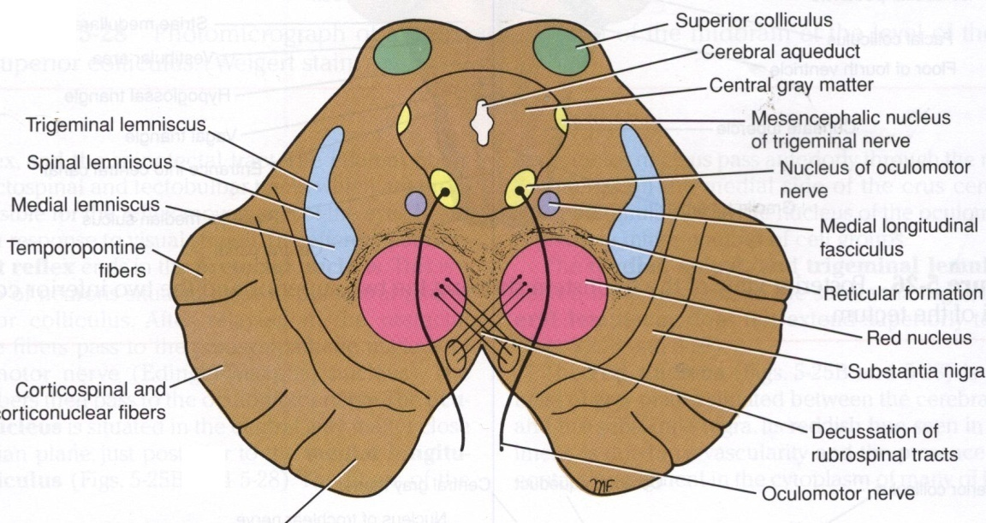
RETICULAR FORMATION
It is a complex matrix of nerve fibers & small groups of nerve cells that extends throughout the brain stem.
It has a number of important functions i.e. Respiratory and Cardio- vascular centers are located in the medullary and caudal pontine reticular formation.

Slide 27
RETICULAR TRACTS
Reticulo spinal tracts:
Influence a muscle tone & posture
Reticular Activating system:
Formed of some of the ascending fibers of the reticular formation.
They activate the cerebral cortex through the thalamus.

Slide 28
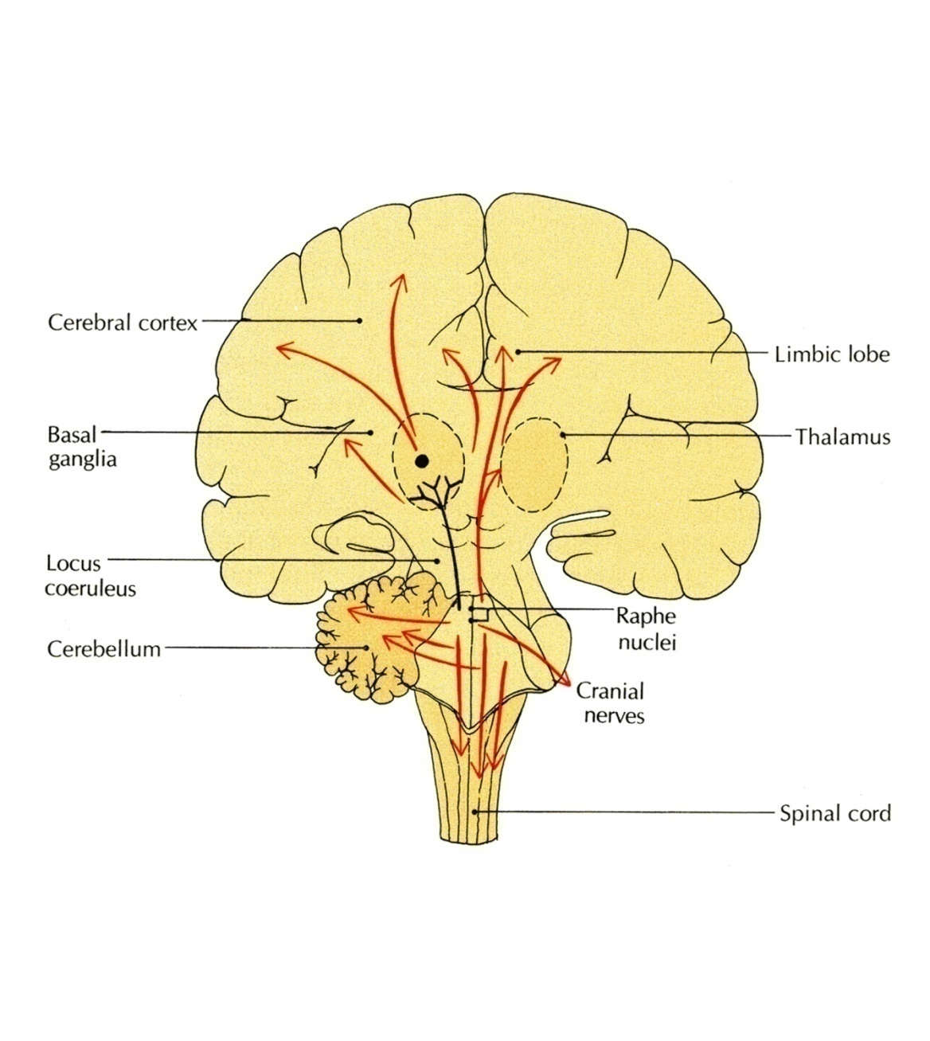
RETICULAR NEURONES
Raphe Nuclei
Midline reticular nuclei
Its ascending fibers to the cerebral cortex are involved in the mechanisms of sleep.
Its descending fibers to the spinal cord are involved in the modulation of Pain.
Locus Ceruleus
Pigmented neurons that lie in the tegmentum of the caudal mid brain & rostral pons
It is the main noradrenergic cell group of the brain.

Slide 29
THANK YOU

Slide 30
1. Most axons of cochlear nuclei cross the midline of pons forming:
a. The medial lemniscus.
b. The red nucleus.
c. The trapezoid body.
d. The medial longitudinal fasciculus.
2. The axons of the cochlear nuclei are represented in:
a. Trapezoid body.
b. Medial longitudinal bundle.
c. Tectospinal tract.
d. Spinal lemniscus.
3. Which one of these nuclei is lying in the tegmentum of the midbrain?
a. Oculomotor nucleus .
b. Trochlear nucleus.
c. Red nucleus.
e. Facial nucleus.
4.Parkinson's disease results from degeneration of:
a.Red nucleus.
b.Pyramid.
c.Substantia nigra.
d.Inferior olivary nucleus.

