Slide 1
Histology of the Eye

Slide 2
Objectives
By the end of this lecture, the student should be able to describe:
  The general structure of the eye.
  The microscopic structure of:
    Cornea.
    Retina.

Slide 3
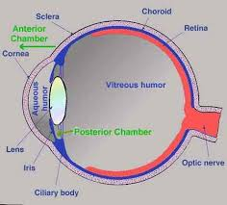
EYE BULB
Three coats
(3 Tunics):
1- Fibrous tunic:
Cornea.
Sclera.
2- Vascular tunic:
Choroid.
Ciliary body.
Iris.
3- Neural tunic:
Retina.

Slide 4
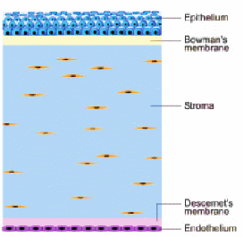
CORNEA
It is the transparent, avascular and highly innervated anterior portion of the fibrous coat.
It is composed of 5 distinct layers:
  1. Corneal epithelium.
  2. Bowman’s membrane.
  3. Stroma.
  4. Descemet’s membrane.
  5. Corneal endothelium.

Slide 5
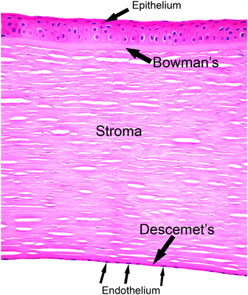
CORNEA (Cont.)
Corneal epithelium:
  Non-keratinized Stratified squamous epithelium.
  Contains numerous free nerve endings.
Bowman’s membrane:
  It is homogenous non-cellular layer containing type I collagen fibrils.

Slide 6
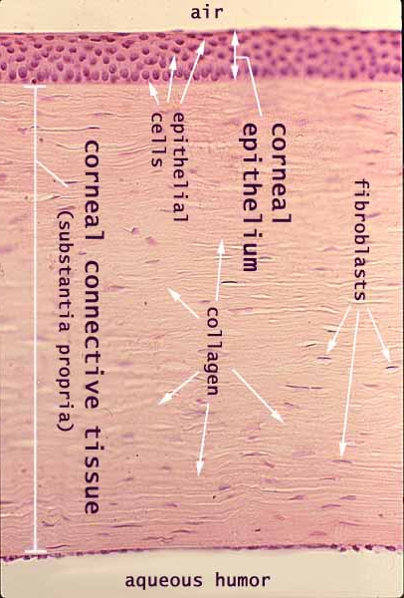
CORNEA (Cont.)
Stroma:
  It is the thickest layer (about 90%).
  It is composed of parallel lamellae of dense collagenous C.T.
  Each lamella is composed mainly of parallel type I collagen fibers with long fibroblasts.

Slide 7
CORNEA (Cont.)
Descemet’s membrane:
  It is a thick basement membrane.
Corneal endothelium:
  It is s simple squamous epithelium.
  Functions:
1- Formation of Descemet’s membrane.
2- Keeping the stroma relatively dehydrated
(sod. pump → water withdrawal from the stroma).

Slide 8
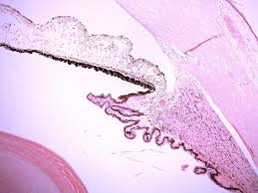
LIMBUS (CORNEO SCLERAL JUNCTION)
It is the transition region between the cornea and sclera.
It is about 1.5 mm width.
It is highly vascular.
It contains:
  Trabecular meshwork:
  Endothelium-lined spaces. It leads to canal of Schlemm.
  Canal of Schlemm:
  It drains the aqueous humor into the venous system.
Cornea
Canal of Schlemm
Iris
Sclera
Ciliary
body
Lens

Slide 9
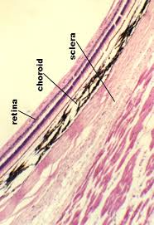
SCLERA
It covers the posterior 5/6 of the fibrous tunic.
Sclera Proper: consists of interlacing bundles of type I collagen
(dense collagenous C.T., irregular type).
Melanocytes are located in the deeper regions.

Slide 10
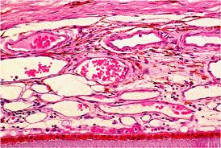
CHOROID
It is the vascular, pigmented posterior portion of the middle vascular tunic.
Structure:
It is composed mainly of loose C.T. with melanocytes.
It is separated from the retina by its Bruch’s membrane.

Slide 11
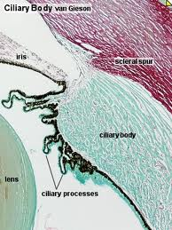
CILIARY BODY
It is the anterior continuation of the choroid. It surrounds the lens.
Structure:
  It is formed of loose vascular and pigmented C.T. that contains 3 bundles of smooth muscle cells (ciliary muscle).
  Its inner surface is lined by pars ciliaris retinae ( 2 rows of columnar cells; outer pigmented and inner non- pigmented layers) .
  Its inner surface is highly folded forming the ciliary processes.

Slide 12
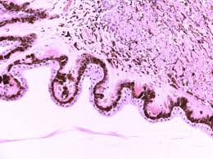
CILIARY PROCESSES
Processes project from the inner surface of the anterior 1/3 of the ciliary body towards the lens.
Are covered by pars ciliaris retinae (2 rows of columnar cells).
They give attachment to the lens suspensory ligaments (zonule fibers).

Slide 13
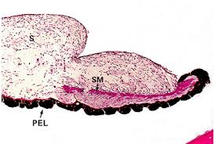
IRIS
It is formed of 5 layers:
1- Anterior border layer:
Incomplete layer of fibroblasts and melanocytes.
2- Stroma:
Poorly vascularized C.T. with fibroblasts and melanocytes.
3- Vessel layer:
Well-vascularized loose C.T.
Centrally, it contains circularly arranged smooth muscle fibers (sphincter pupillae muscle).
Stroma

Slide 14
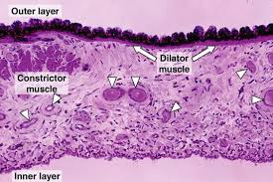
IRIS
4- Dilator pupillae muscle layer:
Contains radially arranged myoepithelial cells.
5- Posterior surface layer (pigmented epithelium layer):
It is composed of 2 rows of pigmented epithelial cells (pars iridis retinae).
They are the continuation of pars ciliaris retinae.
====

Slide 15
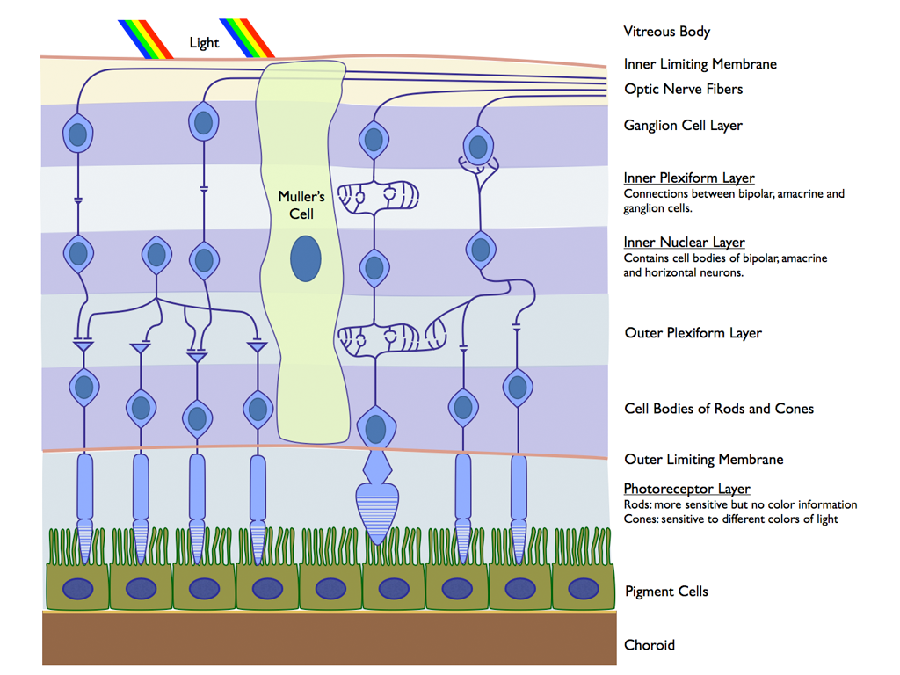
RETINA
It is composed of 10 distinct layers (from outside to inside):
1- Pigmented epithelium.
2- Rods and cones layer.
3- Outer limiting membrane.
4- Outer nuclear layer.
5- Outer plexiform layer.
6- Inner nuclear layer.
7- Inner plexiform layer.
8- Ganglion cell layer.
9- Optic nerve fiber layer.
10- Inner limiting layer.

Slide 16
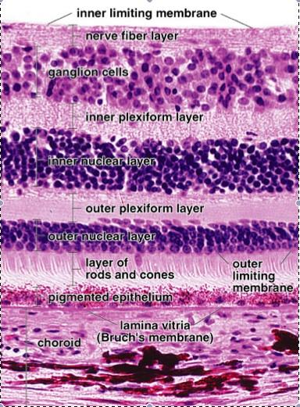
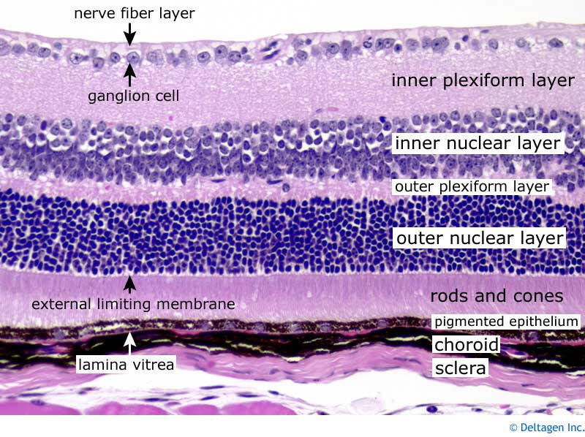
RETINA (Cont.)

Slide 17
RETINA (Cont.)
Pigmented Epithelium:
Cuboidal to columnar cells (single layer).
Apical microvilli.
Abundance of melanin granules.
Functions:
1- Absorb light.
2- Phagocytosis of membranous discs from tips of rods.
3- Esterification of Vitamin A (in SER).

Slide 18
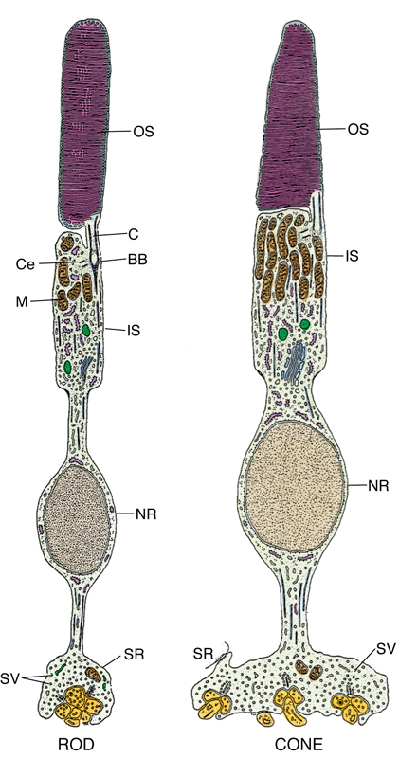
RODS AND CONES LAYER (Cont.)
Are photoreceptor cells.
Each has:
1. Dendrite formed of:
-Outer segment (OS): contains membranous discs containing rhodopsin (in rods) and iodopsin (in cones).
- Connecting Stalk: with modified cilium.
-Inner segment (IS).
2. Cell body.
3. Axon: synapses with dendrite of bipolar neuron of inner nuclear layer.
Functions:
Rods are receptors for dim light ( low intensity light).
Cones are receptors for bright light and color vision
(red, green & blue).

Slide 19
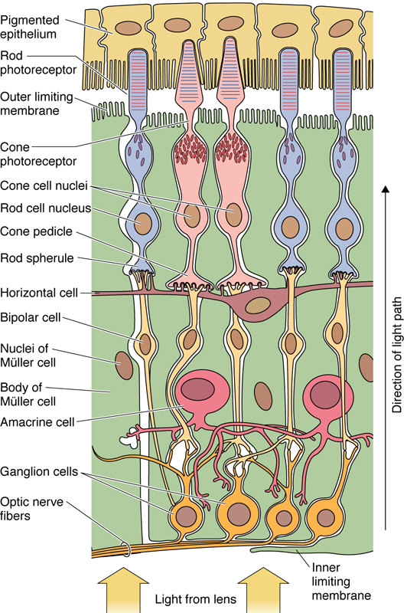
RETINA (Cont.)
Outer limiting membrane:
  A region of zonulae adherents junctions between Muller cells and the photoreceptors.
Outer nuclear layer:
  Contains nuclei of the rods & cones.
Outer plexiform layer:
  Contains axodendritic synapses between the
  photoreceptor cells and dendrites of bipolar and
  horizontal cells.
Inner nuclear layer:
  Contains the nuclei of:
1- Bipolar neurons.
2- Horizontal neurons.
3- Amacrine neurons (unipolar neurons):
4- Neuroglial cells (Muller cells) that extend
between the vitreous body and the inner segments of rods and cones.

Slide 20
RETINA (Cont.)
Inner plexiform layer:
Contains axodendritic synapses between axons of bipolar neurons and dendrites of ganglion cells and amacrine cells.
Ganglion cell layer:
Contains cell bodies of large multipolar neurons
of the ganglion cells.
Optic nerve fiber layer:
Contains unmyelinated axons of the ganglion cells.
N.B. These axons become myelinated as the nerve
pierces the sclera.
The inner limiting membrane:
It is formed by the basal laminae of the Muller cells.

Slide 21
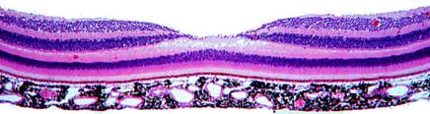
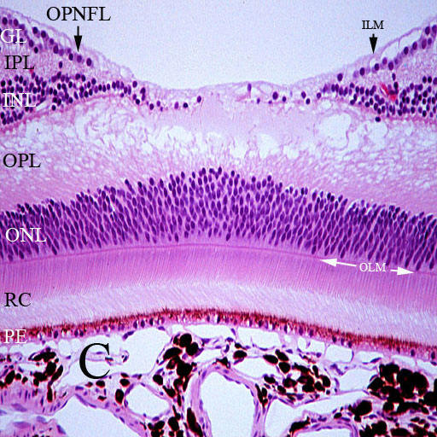
RETINA (Cont.)
Fovea centralis:
It lies in the center of macula lutea.
Cones are highly concentrated in the fovea.
It is responsible for visual acuity.

Slide 22
RETINA (Cont.)
Types of cells in the retina:
1- Pigmented epithelium.
2- Nerve cells:
- Photoreceptor cells (rods & cones)
- Bipolar neurons.
- Ganglion cells.
- Association neurons:
i. Horizontal cells.
ii. Amacrine cells.
3- Neuroglial cells:
- Muller’s cells.
- Astrocytes.

Slide 23
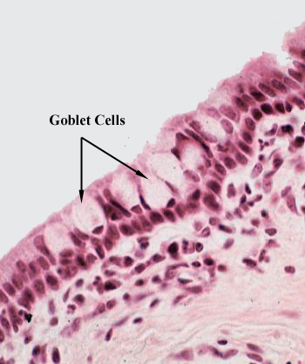
CONJUNCTIVA
It is the transparent mucous membrane lining the inner surfaces of the eyelids (palpebral conjunctiva) and reflecting onto the sclera of the anterior surface of the eye (bulbar conjunctiva).
L/M:
1- Epithelium:
Stratified columnar epithelium with
numerous goblet cells.
2- Lamina propria:
Loose C.T.

Slide 24
GOOD
LUCK

