Slide 1
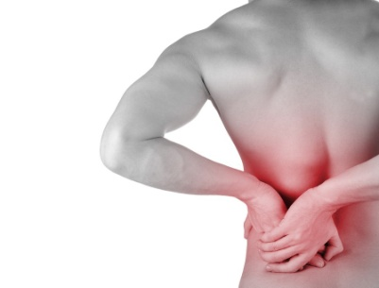
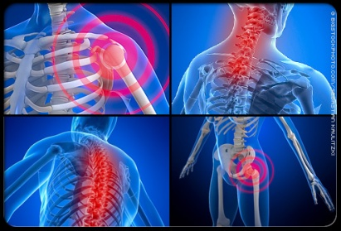
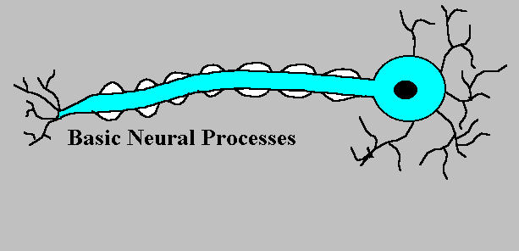
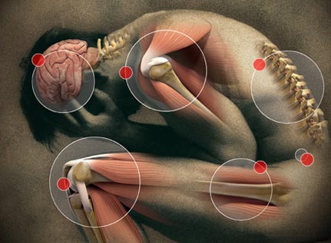

DRUGS IN MANAGEMENT OF PAIN
ILOs:
Revise how pain is perceived and modulated, emphasizing
on neurotransmitters, receptors, channels involved
Classify drugs used in management of pain
Expand on pharmacology of opiates, patterns of
classification, mechanism of action,indications, ADR,…etc.
detailing on morphine as an example.
Compare in brief actions and indications of other opiate
agonists and antagonists.
Prof. Dr. OMNIA NAYEL
Ass. Prof. Osama Yousif

Slide 2
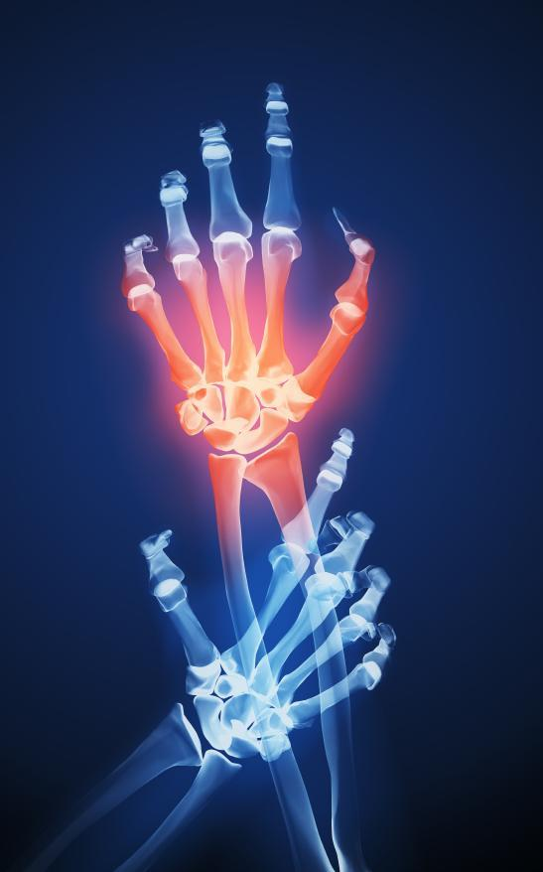
TREATMENT OF PAIN
Noniceptive Pain
Neuropathic as Cancer Pain
NSAIDs
NSAIDs
OPIOIDS
OPIOIDS
Adjunctive
Adjunctive
ANALGESICSUsed to induce ANALGESIA
A state in which a painful stimuli is modulated; though perceived but felt no more painful.
NSAIDs
OPIOIDS
For Mild To Moderate Dull Aching
For Moderate To Severe
> Visceral

Slide 3

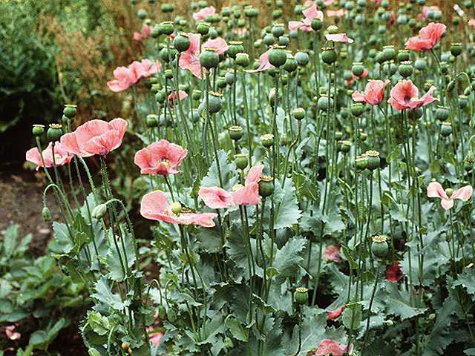
OPIOIDS
ANALGESICS  OPIOIDS
Derived from the dried milky juice  exuded by incised seed capsules of a species of poppy, Papaver somniferum,
It contains a mixture of alkaloids, the principal components being
morphine, codeine & papaverine.
Mimic action of endogenous opioids;
Endorphins, Dynorphins,Enkephalins
Act on endogenous opioid receptors
mu, delta, kappa, sigma

Slide 4
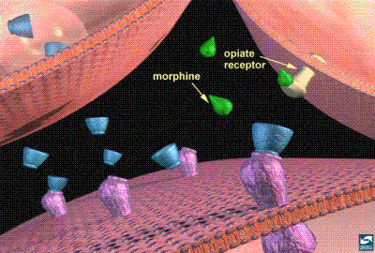
Functions mediated by endogenous OPIOIDS RECEPTORS
μ→ supraspinal analgesia, respiratory depression, euphoria,
physical dependence
δ→spinal analgesia, respiratory depression, GIT motility
Κ→ spinal analgesia, sedation, pupil constriction, dysphoria
All of them typical G-protein coupled receptors.
σ→ dysphoria, hallucination , pupil dilation, anxiety bad
dreams,…
It is not a true opioid receptor, as it binds psychotomimetic drugs.
Exceptionally of opioids only benzomorphans binds to it.

Slide 5
CLASSIFICATION OF OPOID ANALGESICS
According to their source
Natural ( Morphine)
Semisynthetic ( Codine )
Synthetic ( Mepiridine, Methadone, Fentanyl, Tramadol )
According to agonistic/antagonistic actions at receptors:
Agonists; Morphine, Codeine, Pethidine, Methadone
Fentanyl, Tramadol, Loperamide [no BBB  diarrhea]
Mixed agonists /antagonists; Pentazosine, Buprenorphine
Pure antagonist; Nalaxone, Naltraxone, Nalmefene
According to their specificity of action on receptors:

Slide 6
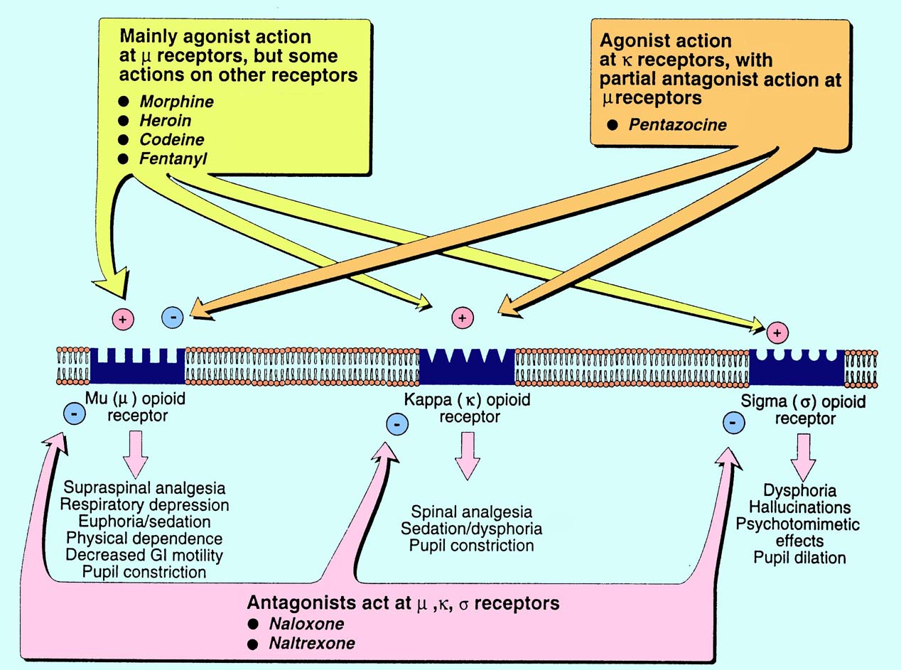

Slide 7
Binding to presynaptic opioid receptors coupled to Gi  AC & cAMP  voltage-gated Ca²⁺ channels  excitatory transmitter.
Binding to postsynaptic opening of K channels neuronal excitability
firing of nociceptive pathways converging at Periaqueductal GM
to allow for inhibitory firing along the descending pathway returning
to dorsal horn pain
Also inhibit pain transmission by acting directly on the dorsal horn, and by  excitation of peripheral nociceptive afferent neurones.
Morphine, Heroin, Pethadine,
Codeine, Fentanyl
CELLULAR MECHANISM OF ACTION OF AGONISTS & ANTAGONISTS

Slide 8
Pharmacodynamic Actions of Morphine
1- Analgesia [in acute & chronic pain]
2- Euphoria → powerful sense of contentment & well being
3- Respiratory depression→↑pCO₂
4- Depression of cough reflexes
5- Nausea & vomiting → ↑CRTZ
6- Pin point pupil:- due to stimulation
of occulomotor center by μ, κ
effects. Diagnostic
7- Effects on GIT:-↑in tone ↓motility
→severe constipation
↑pressure in the biliary tract +
constriction of biliary sphincter →
contraction of gall bladder
8- Releases histamine from mast cells
9- LH, FSH, ACTH , testosterone
Prolactin, GH, ADH → urine
retention

Slide 9
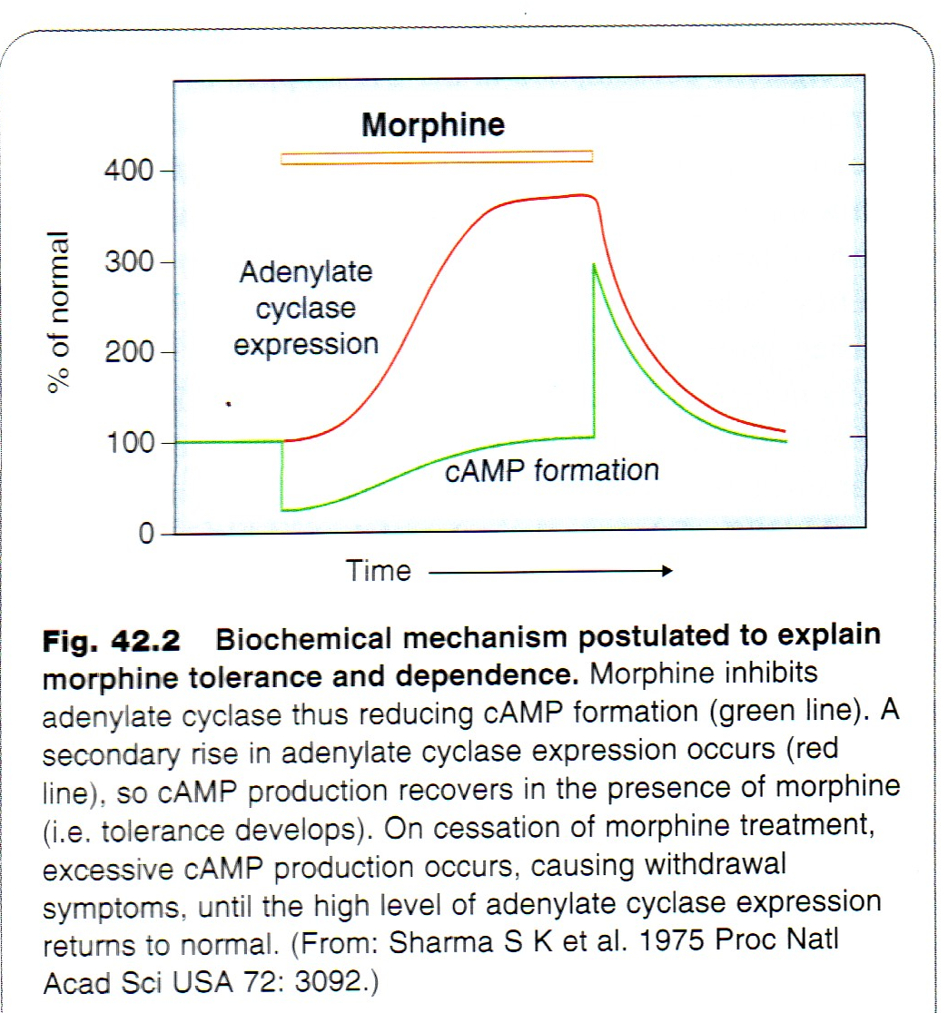
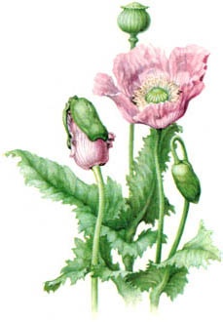
TOLERANCE & DEPENDENCE develop rapidly .
Withdrawal manifestations develops upon stoppage.
Dependence comprises both:
Physical dependence lasting for a few days in form of ↑ body ache, insomnia, diarrhea, goose flesh, lacrimation
Psychological dependence lasting for months / years → craving
Withdrawal→

Slide 10
Pharmacokinetics of Morphine
t ½ is 2-3h
It is slowly & erratically absorbed orally.
Medically given by IM or IV injection.
It should be repeated if sustained effect is needed.
Undergoes enterohepatic recycling,
crosses BBB
crosses placenta.

Slide 11
Clinical Indications of Morphine
CONTROL PAIN; cancer pain, severe burns, trauma
Severe visceral pain (not renal/biliary colics, acute pancreatitis )
DIARRHOEA
COUGH
ACUTE PULMONARY OEDEMA
MYOCARDIAL ISCHEMIA
NON PAINFUL CONDITIONS; HF to relieve distress
PREANAESTHETIC MEDICATION ??
ADR
Sedation
Respiratory depression.
Constipation.
Nausea & vomiting.
Itching → histamine release
Tolerance; not to meiosis, convulsion or constipation
Dependence.
Euphoria.

Slide 12
HEAD INJURY
PREGNANCY
BRONCHIAL ASTHMA or impaired pulmonary function
Liver & Kidney diseases (including renal& biliary colics )
Endocrine diseases ( myxedema & adrenal insufficiency)
Elderly are more sensitive;metabolism, lean body
mass & renal function
Not given infants, neonates or during child birth
conjugating capacity  accumulate   respiratory
With MAOIs
Contrindications of Morphine
Codeine
μ Agonist
Dependence < morphine
Used in mild& moderate pain, cough, diarrhea
HEROIN
μ agonist
Crosses BBB
Converted to morphine
No medical use
Strong addicting drug

Slide 13

Meperidine
Pethidine
Synthetic > effective κ agonism
Actions
analgesic,  constipating ,  depressant on faetal respiration than morphine
Has atropine –like action / Smooth muscle relaxant
No cough suppressant effect
Indications
As in morphine but not in cough & diarrhea
Used in severe visceral pain; renal & biliary colics sm. relaxant)
Used in obstetric analgesia (No  resp.)
Preanaesthetic medication ( better)
ADR
Tremors, Convulsions, Hyperthermia, Hypotension
Burred vision, Dry mouth, Urine retention
Tolerance & Addiction

Slide 14
TRAMADOL
Synthetic, m agonist ,  potent,  NE & 5HT also
Can be given orally;  oral bioavailability
Indications
Mild - moderate acute & chronic visceral pain & during labor
ADR
Seizures (not in epileptics), Nausea , Dry mouth, Dizziness , Sedation
Less adverse effects on respiratory & C.V.S.
Fentanyl
Synthetic, μ agonism, potency > meperdine & morphine
Commonest analgesic supplement during anesthesia, IV or intrathecal.
To induce & maintain anesthesia in poor-risk patients [stabilizine heart.]
In combination with droperidol as NEUROLEPTANALGESIA
In cancer pain & severe postoperative pain; transdermal patch changed every 72 hrs.
ADRs
Mimic opioid agonists / respiratory depression most serious / CV effects are less. Bradycardia may still occur

Slide 15
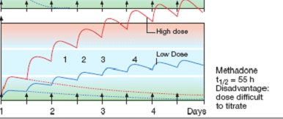
METHADONE
Synthetic, μ- Weaker Agonist, t½ 55 h.
Used to treat opioid withdrawal.
Firm occupancy of opioid receptors by methadone  desire for other opioid intake, because it is producing an  effect that stop withdrawal manifestations. With time addicts improve   craving
In non addicts, it causes tolerance & dependence but not as severe as that of morphine

Slide 16
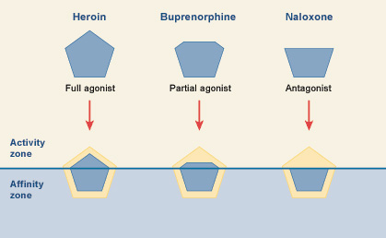
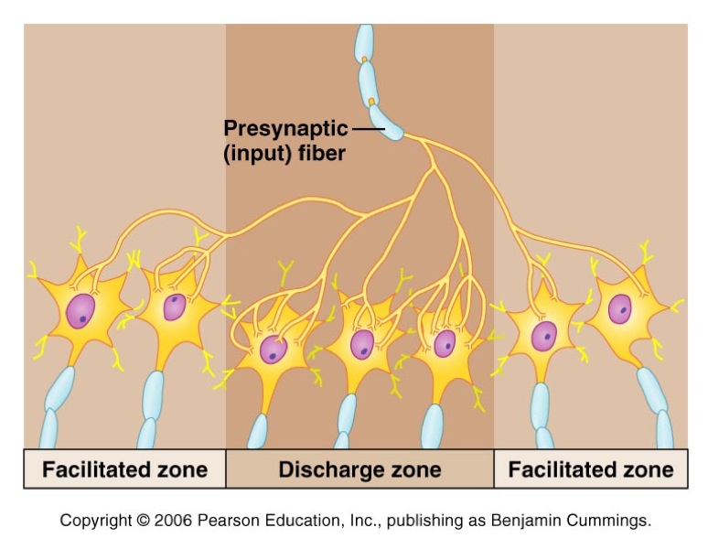
Antagonizing Acute Opioid Toxicity
Morphine
Nalorphine
Naloxone

Slide 17
Antagonizing Acute Opioid Toxicity
Naloxone
Pure opioid antagonist.
Used to treat respiratory depression caused by opioid overdose & to reverse the effect of analgesia on the respiration of the new born baby
Effect lasts only for 2-4 hours.
Precipitates withdrawal syndrome in addicts
Naltrexone
Very similar to naloxone but with longer duration of action [t½=10h]

Slide 18

GOOD LUCK

