Slide 1
Drugs Used For Affective Disorders
By
Prof. Abdulqader Alhaider

Slide 2
Definition of Affected Disorders
Either Depression or mania
Incidence: Depression is a chronic and recurrent illness that can affect at least 20% of the population at some period in their lifetime. An estimated 35-40 million Americans living today will suffer from major Depressive Illness during their lives.

Slide 3
For each person directly suffering, three or four times that number of their relatives, employees, associates, and friends will also be adversely affected.
Cost: 15-35 billions $/years in USA only.

Slide 4
Symptoms of Depression
The symptoms of Depressive Illness are highly recognizable, both to those affected and to those closest to them, once they are told what to look for.
Here is a checklist of symptoms of Depressive illness:
Loss of energy and interest.
Diminished ability to enjoy oneself.
Decreased -- or increased -- sleeping or appetite.
Difficulty in concentrating; indecisiveness; slowed or fuzzy thinking.
Exaggerated feelings of sadness, hopelessness, or anxiety.
Feelings of worthlessness.
Recurring thoughts about death and suicide.
If most of these symptoms last for two weeks or more, you probably have Depressive Illness. Sometimes depression alternates with "mania" and is called Manic-Depressive Illness (Bipolar).

Slide 5
Symptoms of Mania
causes mood swings creating periods with the following symptoms:
A high energy level with decreased need for sleep.
Unwarranted or exaggerated belief in one's own ability.
Extreme irritability.
Rapid, unpredictable emotional change.
Impulsive, thoughtless activity, with a high risk of damaging consequences (i.e., stock speculations, sudden love affairs, etc.).

Slide 6
Figure 1:Biochemical Theory of Affective Disorders.
Affective Disorders Serotonin
NE NE
Mania Depression
Rx Drugs that decrease NE Drugs that increase NE
What is the evidence to support this theory ?
Amphetamine Ass with mania while Clonidine and methyldopa produce depression.

Slide 7
What are the features of drugs that should be used for Rx of Depression?
Simply either increase NE or 5-HT or both.

Slide 8
Classification of Antidepressants Based on Site of Action (see Fig 29-2)
A ) Drugs that Block the RE-uptake of NE and 5- HT ( e.g.:Most tricyclics) (old Antidepressants)
B) Drugs that Selectively Block Re-Uptake of 5- HT (SSRIs) (Fluoxetine; Paroxetine; Sertraline; Citalopram)
C) Drugs that Block Presynaptic α₂- adrenoceptors (e.g.: Mirtazapine, Mianserin).
D) Drugs that Inhibit MonoAminoOxidase (MAOIs, Phenelzine, Tranylcypraine, Moclobemide) (old Antidepressants)

Slide 10
Classification of Antidepressants Based on Site of Action (see Fig 29-2)
A ) Drugs that Block the RE-uptake of NE and 5- HT ( e.g.:Most tricyclics) (old Antidepressants)
B) Drugs that Selectively Block Re-Uptake of 5- HT (SSRIs) (Fluoxetine; Paroxetine; Sertraline; Citalopram)
C) Drugs that Block Presynaptic α₂- adrenoceptors (e.g.: Mirtazapine, Mianserin).
D) Drugs that Inhibit MonoAminoOxidase (MAOIs, Phenelzine, Tranylcypraine, Moclobemide) (old Antidepressants)

Slide 11
Antidepressants Available in the Market (Worldwide)¹
1) Tricyclics and Tetracyclics (TCA)
Imipramine Doxepin Desipramine Amoxepine Trimipramine
Maprotiline Clomipramine Amitriptyline Nortriptyline Protriptyline
2) Monoamine Oxidase Inhibitors (MAOIs)
Tranylcypramine Phenelzine Moclobemide
3) Serotonin Selective Reuptake Inhibitors (SSRIs)
Fluoxetine Fluvoxamine
Sertraline Paroxetine Citalopram
4) Dual Serotonin and Norepinephrine Reuptake Inhibitor (SNRI)
Venlafaxine Duloxetine
5) Serotonin-2 Antogonist and Reuptake Inhibitors (SARIs)
Nefazodone Trazodone
6) Norepinephrine and Dopamine Reuptake Inhibitor (NDRI)
Bupropion
7) Noradrenergic and Specific Serotonergic Antidepressant (NaSSAs)
Mirtazapine
8) Noradrenalin Specific Reuptake Inhibitor (NRI)
Reboxetine
9) Serotonin Reuptake Enhancer
Tianeptine

Slide 12
Mechanism of Action of Antidepressants
1) Inhibition of reuptake of NE and or 5-HT ?? or increases the release of NE or 5-HT. ???
2) Desensitization (down-regulation) of β- adrenoceptors (decrease c-AMP). (Very important and related to clinical response).
Why does it take three weeks to see a significant effects of Antidepressants?
How do SSRIs desensitize β-adrenoceptors?
Hint: Remember Raphe nuclei!!

Slide 13
Fluoxetine
Fluvoxamine
Citalopram Sertraline
Paroxetine
Selective Serotonin Reuptake Inhibitors SSRIs
Venalafaxine
Serotonin Norepinephrine Reuptake Inhibitors (SNRIs)
Reboxetine
Norepinephrine Reuptake Inhibitors (NRIs)
α₂ – adrenoceptors antagonists
Mirtazapine
Bupropion
Norepinephrine Dopamine Reuptake Inhibitors (NDRIs)
Serotonin Antagonists & Reuptake Inhibitors (SARIs)
Trazodone
Nefazodone

Slide 14
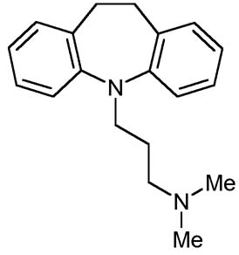
A. Old Antidepressants
1. Tricyclic Antidepressants (TCAs)
e.g.: Imipramine; Amitriptyline ; Desipramine; Doxepin (see Table 1).
Discovered in the late 1950s.

Slide 15
Pharmacological Actions of TCAs:
Blockade of Monoamine uptake (see Table 1)
Which one of them selectively blocks NE?
Side effects of TCA (see table 2 )
Note: They are drugs with broad spectrum of pharmacological effects at many receptors (e.g. Histamine ; ACH therefore, they are also associated with many side effects) (see Table 2).
Sedation Why?
Cardiovascular effects (Tachycardia and hypotension) How?
Anticholinergic effects (dry mouth, constipation, urinary retention)
Weight gain.
Seizure
Hypomania (How?)

Slide 16
Table 1: Effects of tricyclic antidepressants on Reuptake and 5-HT
 | Noradrenaline reuptake | 5-HT reuptake | Tricyclic antidepressants
 | + - + + + + + | + + ++ - - ++ + | Tricyclic antidepressants Amitriptyline Clomipramine Desipramine Dothiepin Doxepin Imipramine
Which one of the tricyclics is more selective on inhibiting reuptake of NE?
Which one of the tricyclics is more selective on inhibiting reuptake of 5-HT?

Slide 17
Table 2: Side Effects of Tricyclic antidepressants
Relative Side effects Reuptake inhibition
5-HT | NE | Anti-Cholinnergic | Hypotension | Cardio-toxicity | Sedation
+++ + + /- + + +++ + + + + | ++ +++ _ +++ + + + + +++ ++++ + | +++ ++ ++ ++ ++ ++ +++ + ++ ++ ++ | +++ + ++ + ++ ++ +++ + 0/+ + ++ | +++ + +++ +++ +++ ++ +++ + ++ +++ +++ | +++ ++ ++ + +++ +++ ++ + + - +++ | Amitriptyline Amoxapine Clomipramine Desipramine Dothiepin Doxepin Imipramine Lofepramine Nortriptyline Protriptyline Trimipramine

Slide 18
Pharmacokinetics:
Lipophilic with High protein binding; basic in nature,
metabolized in liver.
Nowadays, this group of antidepressants became less
popular than it was, due to the unwanted effects.
Treatment of overdose of Tricyclic Antidepressants
Why hemodialysis is not effective for Rx of TCA toxicity?.
NaCO3; Diazepam for seizure; Gastric levage plus charcoal

Slide 19
2. Monoamine Oxidase Inhibitors:
History: The anti TB Iproniazide exhibited mood elevating properties and latter found to inhibit MOA.
Clinical Uses: Only used for refractory cases and in atypical depression where phobia and anxiety are prominent symptoms.

Slide 20
Classifications of MAOIs
Either:
Hydralazine Derivatives (Phenelzine (Nardil®)
Non –hydralazine DER.(Tranylcypramine (Parnate®)
Or as irreversible non –selective (Phelzine and Tranylcypramine) vs reversible selective ( Meclobemide)
Side Effects:↑ appetite (Phenelzine like) ↓ appetite (Tranylcypramine; hepatotoxicity; SLE like;
Drug and Food interactions (very important).

Slide 21
Hypretensinve crisis can occur if MAOIs taken together with:
Food Containing Tyramine such as: Aged cheese, Aged or cured meats (e.g., air-dried sausage); Any potentially spoiled meat, poultry, or fish pickles and wines.
Sympathomimetic drugs like (Tricyclics; pseudoephedrine.
Serotonergic crisis can occur if MAOIs taken together with SSRIs

Slide 23
Hypotensin | Anticholinergic effects | Sedation | Drug
+ + + - | ++ ++ + - | + + - - | Isocarboxazid Phenelzine Tranylcypromine | Non-selective irreversible
 |  |  | Moclobemide | Selective reversible

Slide 24
B. New Antidepressants 1) Selective Serotonin Reuptake Inhibitors (SSRI)
e.g. Fluoxetine; Fluvoxamine; Paroxetine; Sertraline; Citalopram and Escitalopram (see table 3).
Pharmacological Activities:
MOA : Selective uptake of 5-HT in the presynaptic cleft.
Why they are better choice as compared to TCA?

Slide 25
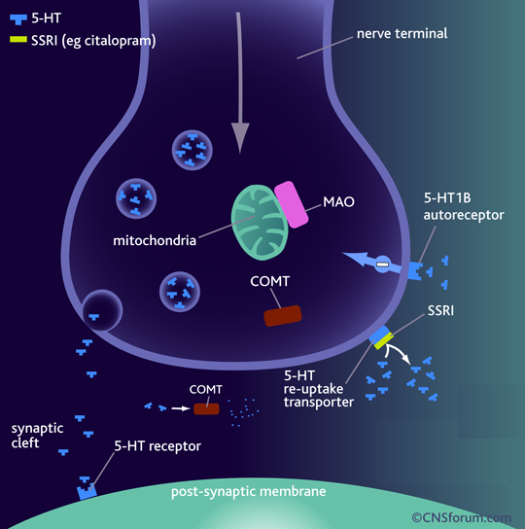
Fluoxetine
Fluvoxamine
Citalopram
Escitalopram Sertraline
Paroxetine
Binds to SERT ➔  5-HT levels in synapse
No effect on NET
No block to mAch, H, or α₁ Adrenoceptor ➔ so no antimuscarinic nor sedative effects Exept Paroxetine
They are nearly of comparable efficacy but of preferential response in each individual

Slide 26
Pharmacokinetics
t_{1/2} :
Too long (3-11 days): Fluoxetine (Prozac)
 Moderate length (~24hr): Sertraline, Paroxetine, Citalopram.
Metabolism: P450 then conjugation
They are enzyme inhibitors
 Weak inhibitors < Sertraline, Citalopram  interaction
 Strong inhibitors > Fluoxetine, Paroxetine  metabolism of TCA, neuroleptic, some antiarrhythmic, β-blockers.
.

Slide 27
Table 3: Effect of SSRIs on Reuptake and 5-HT2
5-HT2 antagonists | Noradrenaline reuptake | 5-HT reuptake
- - - - - | - - - - - | + + + + + | Selective serotonin reuptake inhibitors Citalopram Fluoxetine Fluvxamine Paroxetine Sertraline
What is the clinical significant of the antagonistic effect on 5-HT2 receptors?

Slide 28
Side Effects of SSRI (see Table 4)
Almost have no cardiovascular manifestations as compared to TCA.
Nausea and vomiting and decrease appetite How? 5-HT3
Insomnia and anxiety (with Fluoxetine ; Citalopram; but not with Paroxetine. So What?
Impotence and sexual dysfunction (in male and female) via stim of 5-HT2 receptors .
Is the inhibition of the 5-HT reuptake always harmful?
Do not use in epilepcy
Decrease weight. How?

Slide 29
Table 4: Side effects of SSRIs
Drug Cardiotoxicty Nausea Anticholinergic Sedation effects
Citalopram ? ++ _ _ Fluoxetine - ++ _ _ Fluvoxamine _ +++ _ + Paroxetine _ ++ + + Sertraline _ ++ _ _

Slide 30
Side effects of SSRIs cont’d
Drug interactions due to their significant inhibitory action at CYP450 (Except Citalopram.)
Which one of SSRIs does produce active metabolite? Fluoxetine
Which one has the longest t_{1/2} ?

Slide 31
Fluoxetine differs from others members of this class in :
1- It has a longer t_{1/2} (50hrs).
2- Available  as sustained release preparations once weekly.
3- Metabolite norfluoxetine = potent as parent drug t_{1/2} 10 days.

Slide 32
2. α₂ – adrenoceptors antagonists
e.g. Mirtazepine (Romeron ®); Mianserin
acts by increasing the release of 5-HT and NE
Via………
Differ from SSIRs in
As it blocks 5-HT3 receptors, Mirtazepine increases appetite (good for patients taking cancer chemotherapy) NO N/V.
As it blocks 5-HT2 receptors it produce no Sexual dysfunction.

Slide 33
Mirtazapine has a sedative effect thus good for agitated depressed patients.
May produce constipation and rarely leads to agranulocytosis as with mianserin.

Slide 34
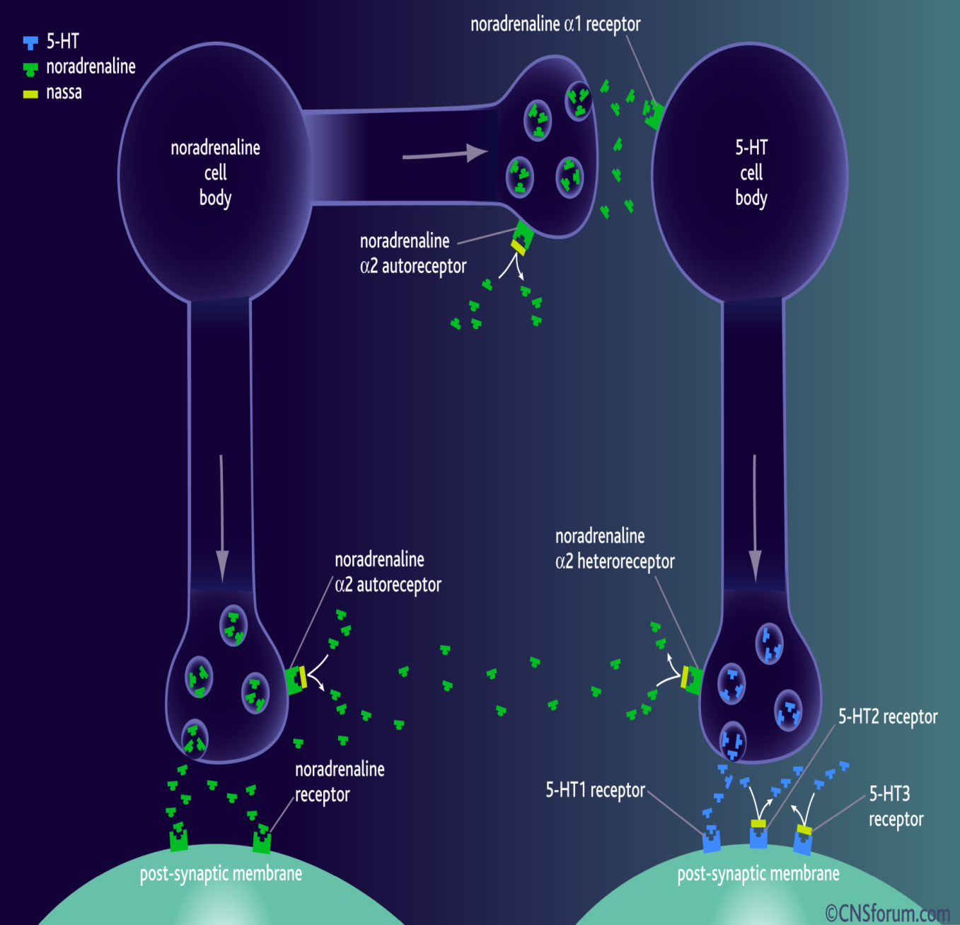
2. α₂ – adrenoceptors antagonists
Mirtazapine
Blocks presynaptic α₂ adrenoceptors + 5HT₃ > 5HT₂ receptors
Preferred in cancer patients because:
1. Improves appetite
2- nausea & vomiting ( 5-HT₃ blocking)
3-  body weight
4- Sedation (potent antihistaminic)
5- Less sexual dysfunction (5-HT₂ blocking)
6- Has no anti-muscarinic effect .
Side effects; Drowsiness, appetite, and weight gain.

Slide 35
Table 6: Side effects of atypical antidepressants
Anticholinergic effects | Hypotension | Sedation | Toxicity | Drug
+ + - - + | - - + +++ - | ++ ++ + +++ ++ | - - - + + | Mianserin Mirtazepine Nefazodone Trazodone Venlafaxine

Slide 36
3. Serotonin Antagonists & Reuptake Inhibitors (SARIs)
1) Trazodone: Selective blocker of 5-HT uptake but has significant α- blocking effect (hypotension and sedation); Blocks 5-HT2 receptors (Priapism)

Slide 37
2) Nefazodone: Structurally related to trazodone but has less sedative effect and does not block α- adrenoceptors , however; it likes most SSRI inhibit P450 3A4 isoenzyme.

Slide 38
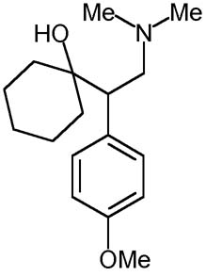
4. Serotonin and Noradrenaline Reuptake Inhibitors (SNRIs)
Venlavaxine (Effexor^{R}): Acts by blocking 5-HT and NE uptake but it has side effects profile similar to SSRI. However, it may produce seizure and constipation. Why?
Differs from TCADs in structure and having low affinity for muscarinic cholinergic, histamine H1 and adrenergic receptors.
Desvenlafaxine
PristiqR (metabolite of Venlavaxine)

Slide 39
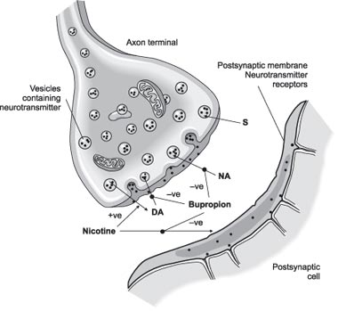
5. Norepinephrine Dopamine Reuptake Inhibitors (NDRIs)
Bupropion
Is unique in possessing significant potency as NE and DA reuptake inhibitor, with no direct action on 5HT. Acts as a nAch antagonist
Therapeutic uses:
1- Treatment of major depression and bipolar depression.
2- Can be used for smoking cessation.
As it reduces the severity of nicotine craving & withdrawal symptoms
Advantages: No sexual dysfunction given in young
No weight gain [ No 5HT effect ]
No orthostatic hypotension.
Side effects: Seizures; it  threshold of neuronal firing

Slide 40
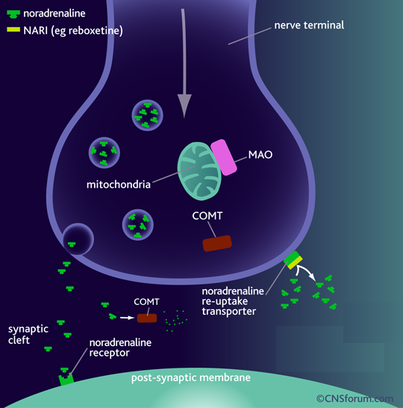
6. Norepinephrine Reuptake Inhibitors [ NRIs ]
Reboxetine
Block only NET
No affinity for 5HT, DA, ADR, H, mAch receptors
So, has positive effects on the concentration and motivation in particular.
Safe to combine with SSRIs
Minimal side effects only related to activation of ADR system as tremor, tachycardia, and urinary hesitancy

Slide 41
Clinical uses of Antidepressant Drugs.
A. Endogenous Depression ( SSRIs (first Choice) New generation and Tricyclics can be used
B. Panic Disorders ( Imipramine or SSRIs)
C. Obsessive Compulsive Disorders (SSRIs and Clomipramine)
& Chronic pain (Amitriptyline)
D. Anorexia nervosa and Bulemia (SSRIs)
E. Schizo-Afective Disorders (Amoxapine or SSRI + Haloperidol)
Premature ejaculation (SSRI)

Slide 42
Clinical Uses of Antidepressants (Continue…)
Anxiety disorders (Amitriptyline)
Migraine and Anxiety & IBS(Amitriptyline)
Nocturnal Enuresis in children e.g. Imipramine
Neuropathic Pain (Dual NE and 5-HT reuptake Blocker)

Slide 43
Thank you
Any Questions
0505281200

