Slide 1
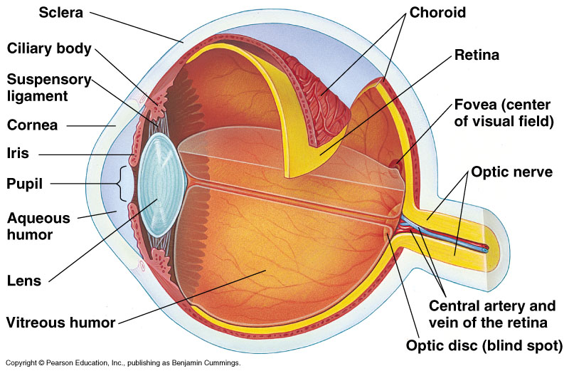
LECTURE 1
PHYSIOLOGY OF THE EYE
& REFRACTION
DR SYED SHAHID HABIB
MBBS DSDM PGDCR FCPS
Professor
Dept. of Physiology
College of Medicine & KKUH

Slide 2
OBJECTIVES
At the end of this lecture you should be able to describe:
Different components of the eye and function of each and understand the eye protection media
Refraction of light as it passes through the eye to the retina, identifying the refractive media of the eye
Principles of optics and errors of refraction
Visual acuity, glaucoma and binocular vision

Slide 3
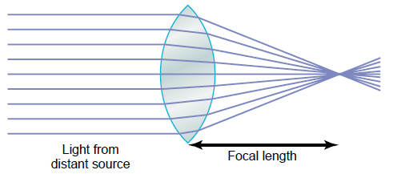
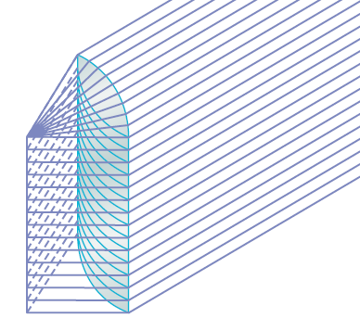
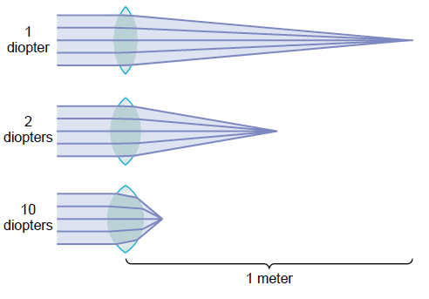
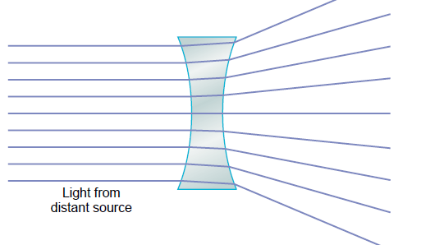
Physical Principles of Optics

Slide 4
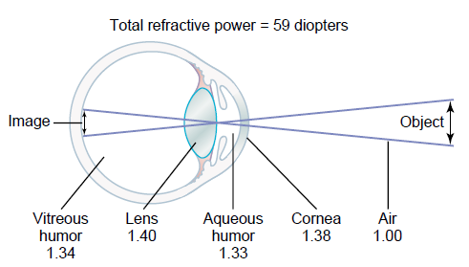
Formation of an Image on the Retina

Slide 5
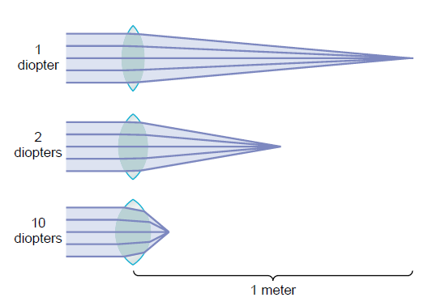
Refractive power of lens is measured in Dioptre (D)
Equals the reciprocal of the focal distance in meters.
Example: 10 diopters = 1/10 meters = 10 cm
Dioptre (s) = 1 / Focal length (m)
Diopteric power of the eye:
Cornea …………40-45 D (max refraction)
Lens …………… 15-20 D
Accomodation …. +12 D
? If Principal focal distance of a lens is 50cm,how much is RF?

Slide 6
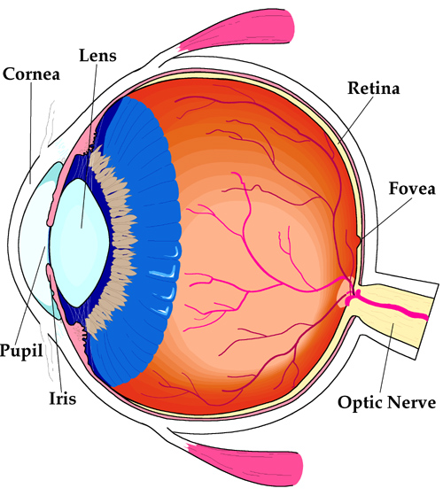
Human Eye – Cross section
Refracting Media
3 Coats (Sclera, Choroid and Retina)
Post2/3Retina, Ant1/6Cornea
70% of all sensory receptors in body are in the eye.
Requires the most learning.
Easily fooled sense (optical illusions)
Lens--retina distance =15mm

Slide 7
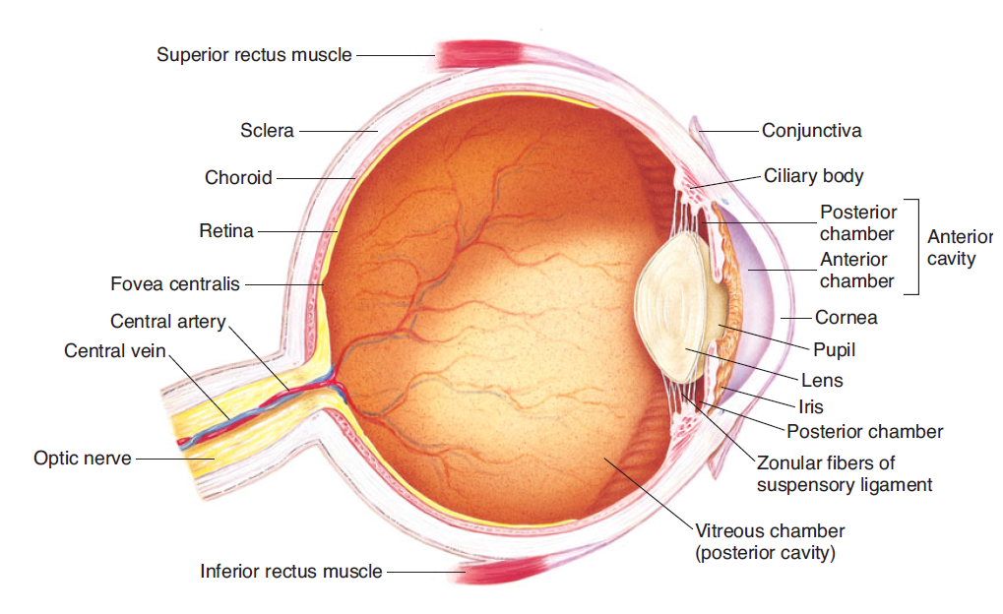
What is glaucoma ? (intraocular pressure more than 20mm Hg)
Why it causes damage of optic nerve?

Slide 8
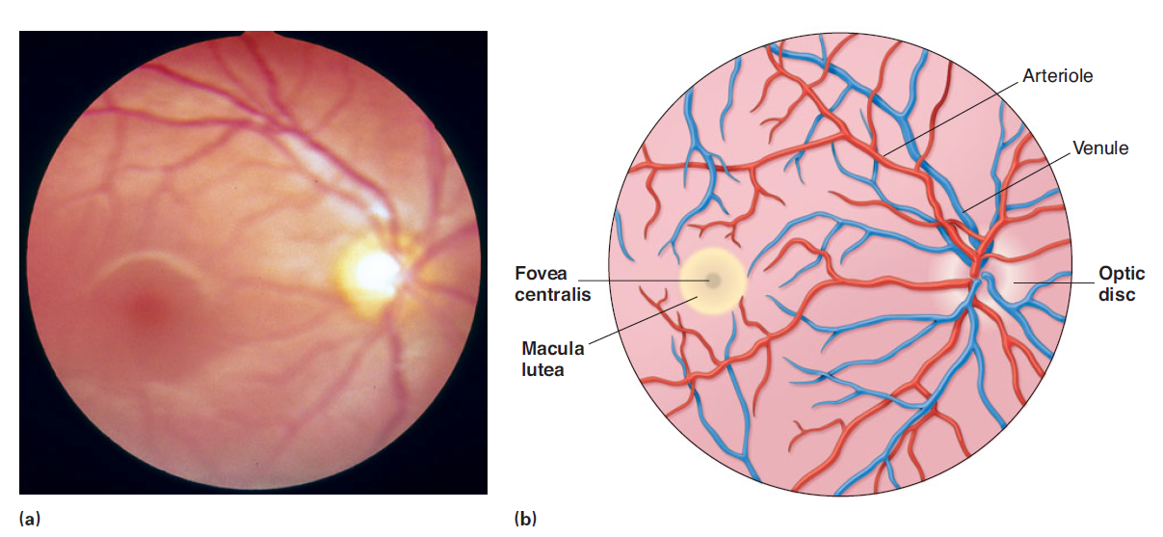
Retina:
PHOTORECEPTORS: Rods & Cones
OPTIC DISC: ( blind spot-WHY? -2 - 3mm medial & above post pole of eye - optic nerve leave & retinal blood vessles enter & no photoreceptors)
FOVEA CENTRALIS: Depression in Macula lutea - yellow pigmented spot at post pole of eye. Have cones only

Slide 9
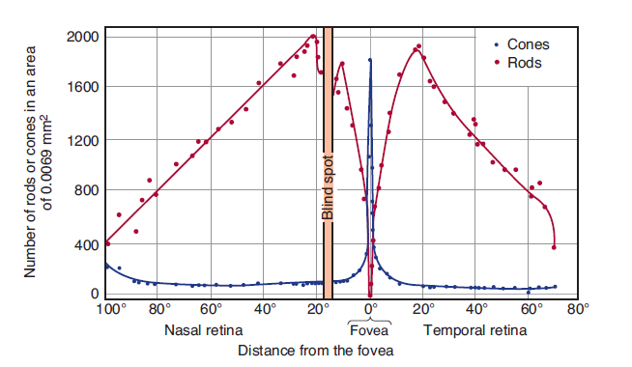
Retina Rods and Cones

Slide 10
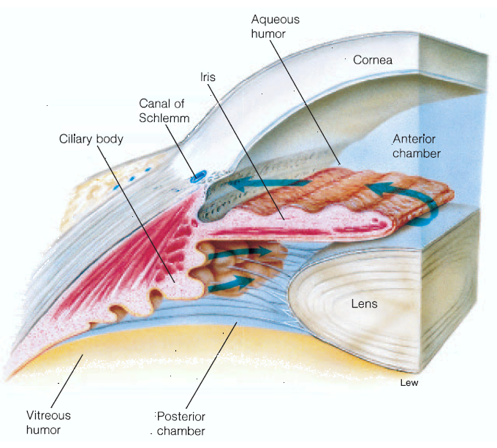
The aqueous humor➔ nourishes the cornea and iris ➔ it is produced in the ciliary body ➔ drained into canal of Schlemm in anterior chamber angle .

Slide 11
External protection of the eye
1- bony orbit
2- lids blinking keep cornea moist
3 -conjuctiva
4-tears have antibacterial & lubricating effect

Slide 12
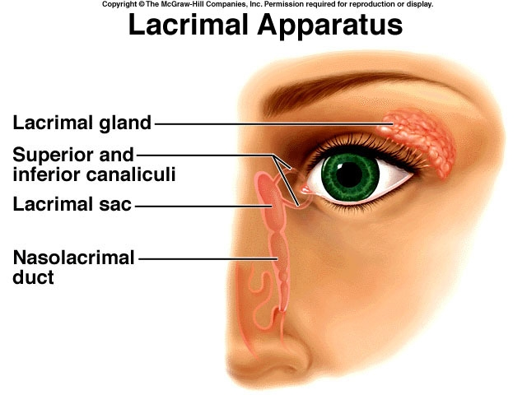
Tears
Protection
Wetness
Cleaning

Slide 13
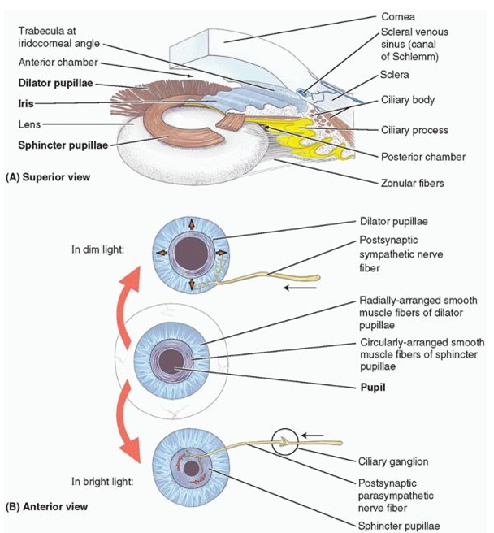
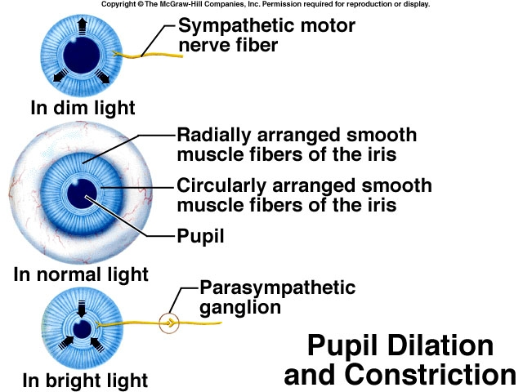

Slide 14
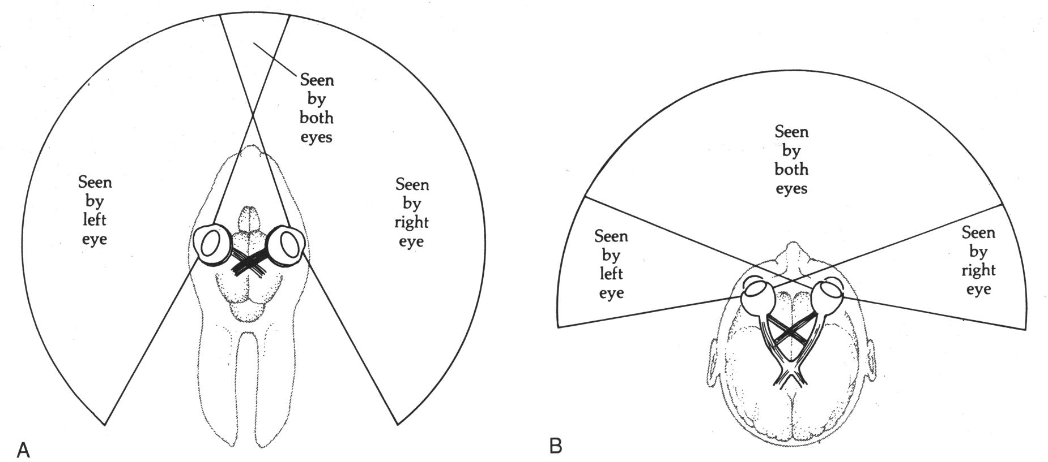
Visual Fields
Rabbit
Human

Slide 15
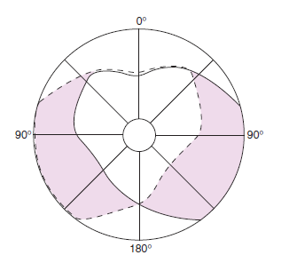
BINOCULAR VISION
1- Large visual field
2- cancel the effect of blind spot
3- stereoscopic vision
4- one eye lesion does not affect vision
The common area (heart-shaped clear zone) is viewed with binocular vision

Slide 16
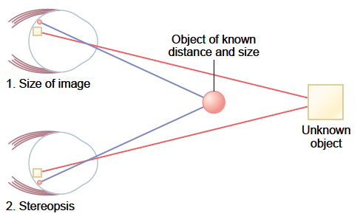
“Depth Perception” Ability to determine Distance of an Object from the Eye
Sizes of images of known objects on retina
Phenomenon of moving parallax
Phenomenon of Stereopsis

Slide 17
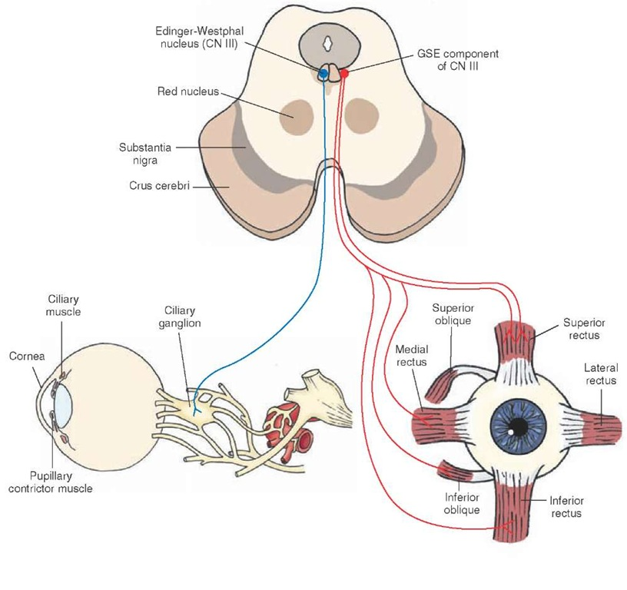
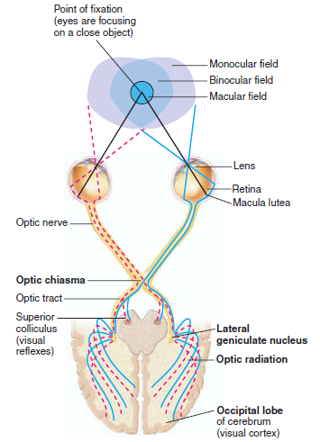
LECTURE 2
VISION, ACCOMMODATION & THE LIGHT PATHWAYS AND EFFECT OF LESIONS
DR SYED SHAHID HABIB
MBBS DSDM PGDCR FCPS
Professor
Dept. of Physiology
College of Medicine & KKUH

Slide 18
OBJECTIVES
At the end of this lecture you should be able to describe:
Describe visual acuity
Contrast photopic and scotopic vision
To know visual pathway and field of vision
Describe the process of accommodation reflex and its pathway, contrasting the refraction of light by the lens in near vision and in far vision
Identify and describe pupillary light reflex and its pathway and -relate these to clinical situations as argyl Robertson pupil
Identify the lateral geniculate body and visual cortex

Slide 19
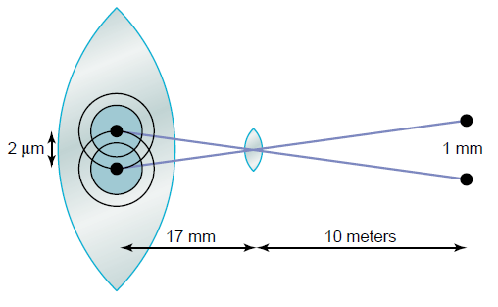
Visual Acuity
The degree to which the details and contours of objects are perceived, and it is usually defined in terms of the shortest distance by which two lines can be separated and still be perceived as two lines.
Visual threshold / is minimal amount of light that elicit sensation of light

Slide 20
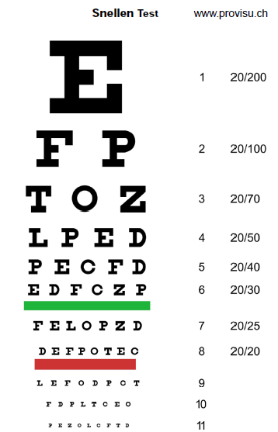
Visual Acuity (Cont.)
Clinically, visual acuity is often determined by the use of the familiar Snellen’s letter charts viewed at a distance of 20 ft (6 m)
The numerator of the fraction is 20, the distance at which the subject reads the chart
Normal visual acuity is 20/20;
Subject with 20/15 visual acuity has better than normal vision
What is meant by 15/20 visual Acuity?

Slide 21
DUPLICITY THEORY OF VISION
(2 kinds of vision)
1-PHOTOPIC VISION (bright light vision) -served by cones -high visual acuity = colors & details - low sensitivity to light = needs high visual threshold to be stimulated
2-SCOTOPIC VISION (night vision, dimlight vision) - served by rodes - low visual acuity = no colors or details - great sensitivity to light =low visual threshold

Slide 22
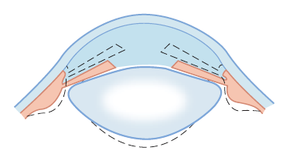
Accomodation
Accomodatopn is an active process for modification of the refractive power of the eye to view a nearby object by increasing the curvature of lens.
Mechanism: Ciliary muscles contract ➔ relaxes the lens ligaments ➔ mainly increase curvature of anterior surface of lens
Test: Sanson Purkinje Image

Slide 23
THE ACCOMODATION REFLEX
Retina ➔optic nerve ➔ optic chiasma optic tract ➔ lateral geniculate body ➔ visual cortex ➔EWN ➔ Occuluomotor nucleus (parasympathetic) ➔ ciliary ganglion ➔ ciliary muscle & constrictor pupillary muscle
The light reflex: Retina➔optic tract ➔ PRETECTAL NUCLEUS ➔ occulomotor nucleus (EWN) ➔ occulomotor nerve ➔ ciliary ganglion ➔ constrictor pupillary muscle

Slide 24
The near response
Three Part Response
Accomodation
Pupillary Constriction
Convergence of Visual Axes

Slide 25
PUPILLARY LIGHT REFLEXES
When light is directed into one eye, the pupil constricts (direct light response).
The pupil of the other eye also constricts (consensual light response).
The light reflex: Retina➔optic tract ➔ Pretectal Nucleus ➔ occulomotor nucleus (EWN) ➔ occulomotor nerve occulomotor ➔ ciliary ganglion ➔ constrictor pupillary muscle
Note: Blindness with preservation of the pupillary light reflex is usually due to bilateral lesions caudal to the optic tract.

Slide 26
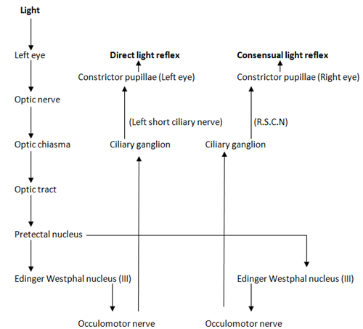

Slide 27
Near point and amplitude of Accomodation
Amplitude of Accomodation | Near point (cm) | Age (yrs)
11.0 | 9.0 | 10
10.0 | 10.0 | 20
8.0 | 12.5 | 30
5.5 | 18 | 40
1.2 | 83 | 60
1.0 | 100 | 70

Slide 28
Argyll Robertson pupils in Neurosyphilis
Pupils constrict in response:
to accomodation reflex
but not
to the light reflex
In syphilis tabes dorsalis destroys pretectal nucleus

Slide 29
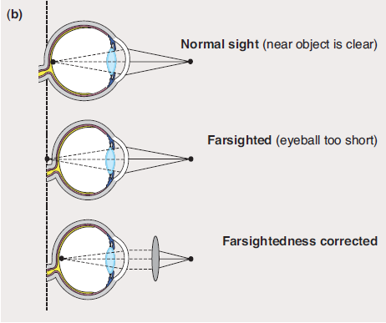

Slide 30
Errors of Refraction
Hyperopia (Farsightedness): the eyeball is shorter than normal and the parallel rays of light are brought to a focus behind the retina. [Headache & Blurred Vision]
Myopia (Nearsightedness) the anteroposterior diameter of the eyeball is too long and the parallel rays of light are brought to a focus in front the retina.
Astigmatism: the curvature of the cornea is not uniform. When the curvature in one meridian is different from that in others, light rays in that meridian are refracted to a different focus (part of the retinal image is blurred)
Presbyopia: loss of accommodation with age

Slide 31
NEAR POINT
Nearest point to eye at which an object can be brought into focus on retina by ACCOMODATION
10 years-----9 cm
At 60 years-----80-100 cm.
Presbyopia : With increase in age (45-50) loss of accommodation is usually sufficient to make reading and close work difficult .
Loss of lens elasticity
Near point is receded
Corrected by convex lenses

Slide 32
COMMON DEFECTS OF THE IMAGE-FORMING MECHANISM
Strabismus (misalignment of the eyes) ➔ turning inward ( esotropia ), outward ( exotropia )
Suppression scotoma (Visual images chronically fall on noncorresponding points in the two retinas in young children & one is eventually suppressed It is a cortical phenomenon)
Amblyopia (suppression with subsequent permanent loss of visual acuity children)

Slide 33
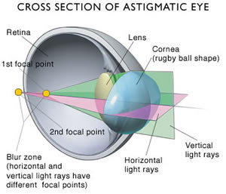
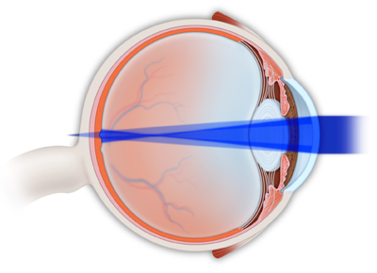
Astigmatism

Slide 34
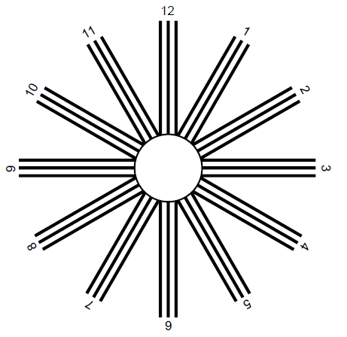

Slide 35
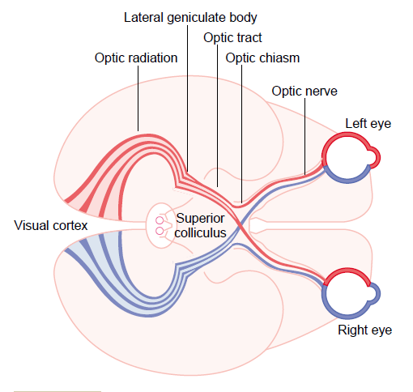
NEURAL PATHWAYS ➔VISUAL PATHWAY
Cones & rods ➔ bipolar cells ➔ ganglion cells ➔ optic nerve (axons of ganglion cells) ➔ optic chiasma ➔ optic tract ➔ lateral geniculate body in thalamus ➔ axons of cells form geniculocalcarine tract ➔ optic radiation ➔ Visual cortex in occipital cortex (Broadmann Area17)
Cortical Areas Activated: inferior temporal cortex, the posteroinferior parietal cortex, portions of the frontal lobe, and the amygdala
Subcortical Areas Activated: superior colliculus, pulvinar, caudate nucleus, putamen, and claustrum

Slide 36
NEURAL PATHWAYS ➔VISUAL PATHWAY
Cortical Areas Activated: Inferior temporal cortex, the posteroinferior parietal cortex, portions of the frontal lobe, and the amygdala
Subcortical Areas Activated: superior colliculus, pulvinar, caudate nucleus, putamen, and claustrum
1- Some ganglion cells axons pass to pretectal region of midbrain for pupillary reflexes & eye movement
2- Some axons of ganglion cells from optic chiasma pass directly to hypothalamus for circadian rhythm (light-dark cycle)
3-Some axons pass to superior colliculus in midbrain for accomodation and eye movements

Slide 37
Note: From Ganglion Cells
70% to 80%
of the axons from the retina pass to the LGB ➔
This geniculostriate system➔ perception of the visual details➔ What is it?
20% to 30%
of the fibers from the retina, ➔ superior colliculus of the midbrain (optic tectum).
Axons from the superior colliculus activate motor pathways for eye and body movements. ➔
Where is it?

Slide 38
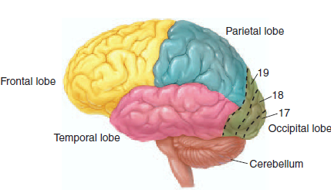
Visual Areas of the Human Cortex

Slide 39
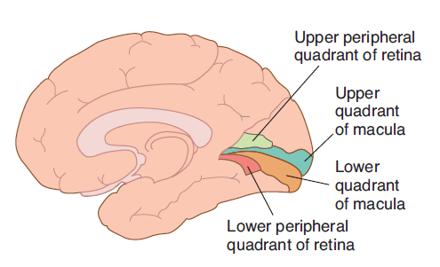
VISUAL CORTEX
Visual cortex has 6 layers
1-Primary visual cortex(braodmann area 17 (also V1): percieve sensation of vision (movement + shapes+ stereoscopic vision + brightness) & has clusters of cells called blobs for color detection
2-Association visual cortex(area 18&19): for interpretation of visual information
FEATURE DETECTORS
Simple cells detect bars of light, lines and edges
Complex cells detect linear movements of a stimulus
Note: Macular sparing in cortical Lesions Why?

Slide 40
The Magnocellular pathway from layers 1 and 2, carries signals for detection of movement, depth, and flicker. The Parvocellular pathway from layers 3–6, carries signals for color vision, texture, shape, and fine detail. LGB interlaminar cells project to Visual Cortex Cells called BLOBS
LATERAL GENICULATE BODY
(Relay Station with
Spatial Representation)
P ganglion cells (parvo, P cells)
M ganglion cells
(M Cells)

