Slide 1
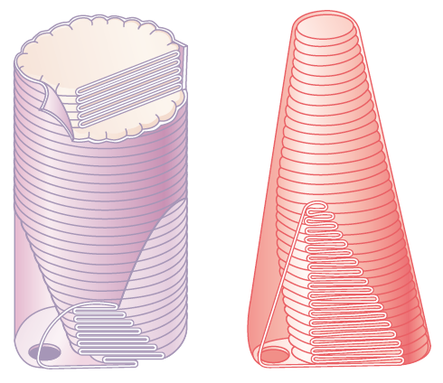
LECTURE 3
PHOTO TRANSDUCTION IN LIGHT AND DARK
DR SYED SHAHID HABIB
MBBS DSDM PGDCR FCPS
Professor
Dept. of Physiology
College of Medicine & KKUH

Slide 2
OBJECTIVES
At the end of this lecture you should be able to:
Explain functional properties of rods and cones in scotopic and photopic vision
Know the convergence and its value
Describe phototransduction process for rods and cones in light and dark and the ionic basis of these responses
Enumarate Synaptic mediators at retina
Describe Rhodopsin regeneration
Define nyctalopia, dark and light adaptation

Slide 3
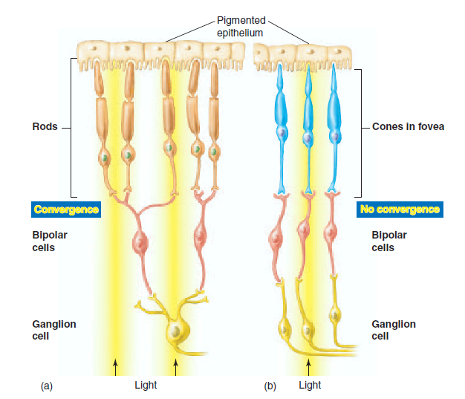
Low convergenc in cones:
cones synapse with →one bipolar cell →one ganglion cell
It increases visual acuity & decreases sensitivity to light
High convergence of rods: 300:1-
It decreases visual acuity & increases sensitivity to light
Notes:
several rodes about 300 synapse with one bipolar cell& one ganglion cell
-high convergence/// decreases visual acuity acuity = integrated information from large area of retina
- but increases sensitivity to light i.e so low light threshold stimlate the rods)
3- 120 million rode& 6 million cone &1.2 million optic nerve fibers , (126 million recepton on 1.2 million nerve fiber )so convergence is 105 receptor : 1 fiber.

Slide 4
Receptors of vision (Rods&cones)
Outer segment (modified cilia) has disks full of photosensitive pigment (rhodopsin) react with light to initiate action potential
-In cones is conical , small and contain 3 types of rhodopsin
- in rods it is big, rode like and contain one type of rhodopsin
-There are Na channels in the outer segment
Inner segment full of mitochondria ( source of energy for Na-K pump), it is thick in cones
There is Na-K pump in inner segment

Slide 5
Comparison of Rods and Cones
Rods
Abundant in the periphery of the retina
About 120 million
Contain Scotopsin
Best for low light conditions
See black/white and shades of gray
Cones
Abundant in fovea
About 6 million
Contain Photopsin (3Types)
Best for bright light conditions
See all colors

Slide 6
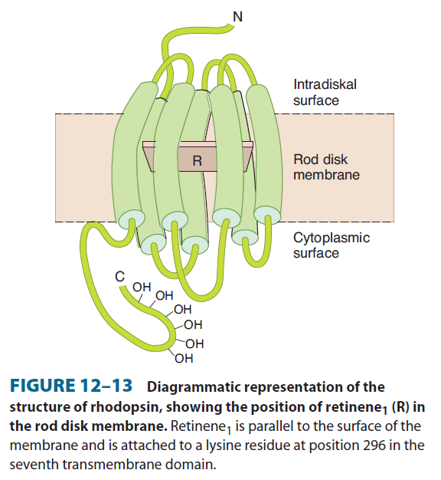
Photochemistry of Vision
1-In Rods: it is rhodopsin:
[Scotopsin protein (opsin) + retinal (retinene 1 = Vit A)]
Called visual purple (Rhodopsin of the rods most strongly absorbs green-blue light and, therefore, appears reddish-purple
2- In cones there are 3 types of Photopsins (I,II & III) :
[Photopsin protein (opsin) + retinal (retinene 1 = Vit A)]
- It is stored in disks of rods at outer segment - It forms (90% of its protein ) -In dark rhodopsin is in 11-cisretinal form (INACTIVE) It is light sensitive form which increase sensitivity of rods to light

Slide 7
RHODOPSIN
NYCTALOPIA (night blindness)
Deficiency of Vitamine A (main source of retinal of rhodopsin) cause ↓ rods pigments
Also causes xerophthamia (Dry Eyes)
Notes:
Diagrammatic representation of the structure
of rhodopsin, showing the position of retinal in the rod disk
membrane . Retinal (R) is located in parallel to the surface of the
membrane and is attached to a lysine residue at position 296 in the
7th transmembrane domain.

Slide 8
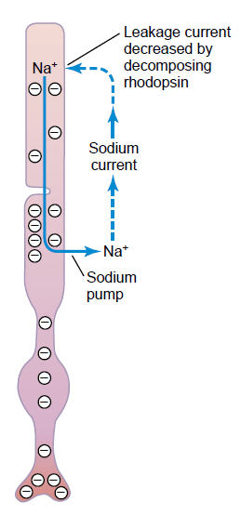
Sodium Current in Rods In Dark
2. Cancels Negativity
(-40 mv)
Creates Negativity
(-70 to -80 mv
Sodium Current is flowing in Dark
Notes:
Th e amount of rhodopsin in the receptors
therefore varies inversely with the incident light level.

Slide 9
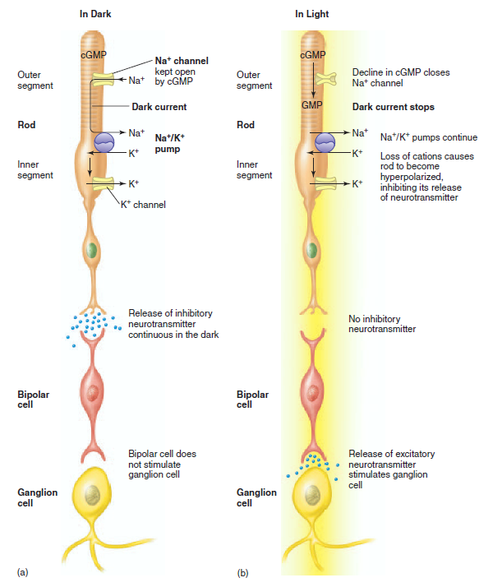
PHOTOTRANSDUCTION
In dark
Na⁺ current leads to
Depolarization flow to synaptic endings to steadily release glutamate
Response in bipolar cells( depolarization)
Stimulate ganglion cells
AP in optic nerve
Vision in dark called Dark vision (Scotopic Vision)
Steady State Release of Glutamate
Release of Glutamate ⬇ ⬇ ⬇
Notes:
In the dark (a), a
continuous dark current causes the rod to
release inhibitory neurotransmitter. In the
light (b), the conversion of cyclic GMP
(cGMP) to GMP causes Na+ channels in
the outer segment of the rod to close
(see text for details). This prevents the
dark current, thereby hyperpolarizing the
rod. When the rod is hyperpolarized, it no
longer secretes inhibitory neurotransmitter.
This allows the bipolar cell to become
activated, releasing excitatory
neurotransmitter to the ganglion cell,
which can then generate action potentials
in its axon (part of the optic nerve).

Slide 10
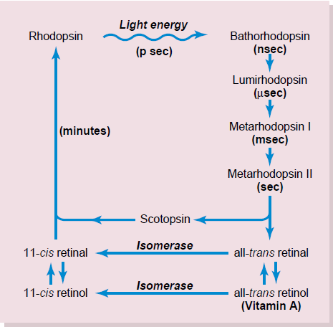
RhodopsinRetinal Visual Cycle
Notes:
The amount of rhodopsin in the receptors therefore varies inversely with the incident light level.Rhodopsin-retinal visual cycle in the rod, showing decomposition of rhodopsin during exposure to light and subsequent slow reformation of rhodopsin by the chemical processes

Slide 11
Photochemistry of Color Vision by the Cones
Photopsins Retinal Visual Cycle
The cones are about 30 to 300 times less sensitive than rods
Photopsins
Notes:
Rhodopsin-retinal visual cycle in the rod, showing decomposition
of rhodopsin during exposure to light and subsequent slow reformation
of rhodopsin by the chemical processes

Slide 12
SEQUENCE OF EVENTS IN PHOTOTRANSDUCTION OF RODS AND CONES

Slide 13
SEQUENCE OF EVENTS IN RODS AND CONES ACTIVATED BY LIGHT
1. The Photon transforms 11-cis retinal of rhodopsin to metarhodopsin II, [active form of rhodopsin in 11-trans retinal form]
2. The activated rhodopsin ➔ activates transducin [G Protein]
3. Activated transducin ➔activates phosphodiesterase.
4. Activated phosphodiesterase ➔ converts cGMP to 5-GMP ➔ Decrease in cGMP ➔closes Na Channels
5. Leads to Hyperpolarization ➔ ↓ Glutamate
6. Rhodopsin kinase ➔inactivates metarhodopsin II

Slide 14
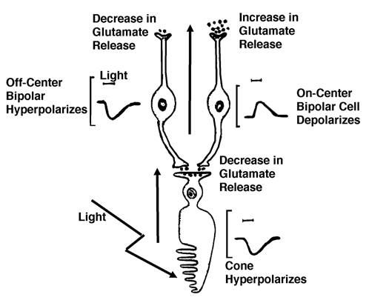
Glutamate binds to specific receptor sites on the bipolar cells, associated with specific types of ion channels.
Depending on the kinds of ion channels present, the bipolar cell may become depolarized (On Center) or it may become
Hyperpolarized (Off Center)

Slide 15
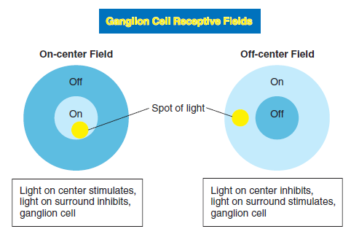
Note: This may be due to lateral inhibition by Horizontal cells to sharpen the edges of a stimulus and improve discrimination

Slide 16
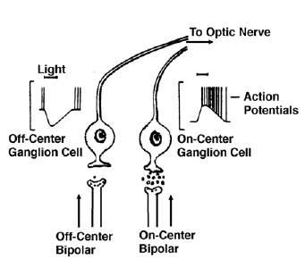
Rodes &cones potentials are graded, local potential (generator potential) propagated as AP in ganglion cells.
Only Ganglion cell action potential (All or none AP) are transmitted to optic nerve.

Slide 17
Notes:
Light striking the photoreceptors causes Na+ channels to close. Light causes the photoisomerization of 11-cis to all-trans-retinene
and its dissociation from opsin. This releases α subunits of G-proteins, which activate phosphodiesterase. This activated enzyme converts cyclic GMP
(cGMP) to GMP. Since the cGMP is needed to keep the Na+ channels of the plasma membrane open, conversion of cGMP to GMP causes these channels
to close. This stops the dark current produced by Na+ entry in the dark, leading to hyperpolarization of the photoreceptor.

Slide 18
Notes:
Light striking the photoreceptors causes Na+ channels to close. Light causes the photoisomerization of 11-cis to all-trans-retinene
and its dissociation from opsin. This releases α subunits of G-proteins, which activate phosphodiesterase. This activated enzyme converts cyclic GMP
(cGMP) to GMP. Since the cGMP is needed to keep the Na+ channels of the plasma membrane open, conversion of cGMP to GMP causes these channels
to close. This stops the dark current produced by Na+ entry in the dark, leading to hyperpolarization of the photoreceptor.

Slide 19
DARK ADAPTATION
If a person moves from brightly lighted surroundings to a dim lighted area the retinas slowly become more sensitive to light as the individual becomes “accustomed to the dark” [20 min] for dark vision (only gross features but no details or colors
Rapid (5 minutes) due to adaptation of cones in fovea (sensitivity of cones to light increases)
Less rapid (20 min) due to adaptation of rodes in the peripheral retina (sensitivity of rodes to light increases)
More light sensitive pigments
↓ In Visual threshold
↑ In Visual sensitivity
Na channels remain open
Na current continues

Slide 20
LIGHT ADAPTATION
If a person moves from dim to enlightened area light seems intensely and even uncomfortably bright until the eyes adapt to the increased illumination and the visual threshold rises in 5 minutes.
Less light sensitive pigments
↑ In Visual threshold
↓ In Visual sensitivity
Na channels remain close
Na current decreases
Why radiologists & aircraft pilots wear red goggles in bright light?
Red light mainly stimulates the cones & rods to some extent, so red goggles for rods act as dimlight, so with it rods are adapted to darkness & form large amounts of rhodopsin while the person is in bright light & when person enters a dark place he can see well & do not have to wait for 20 minutes for dark adaptation.

