Slide 1
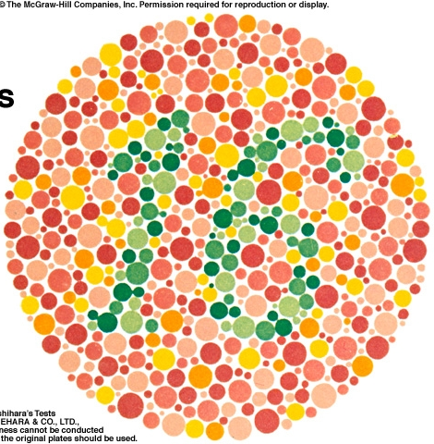
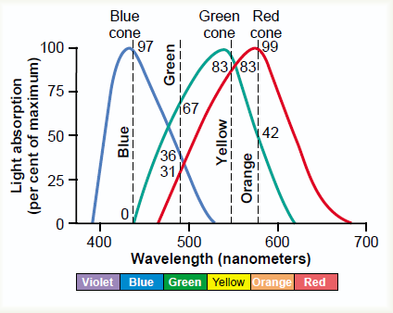
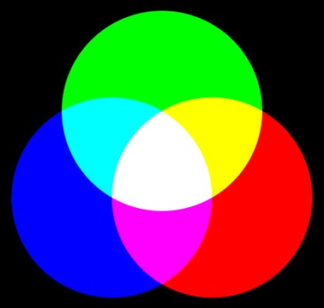
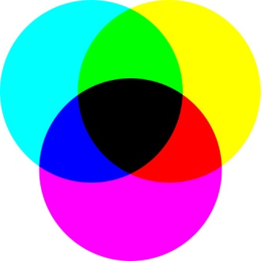
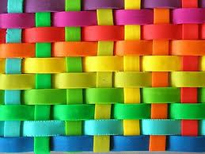
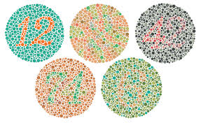
PHYSIOLOGY OF COLOR VISION
LECTURE 4

Slide 2
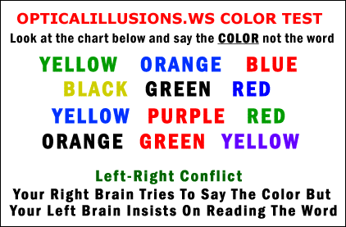

Slide 3
Color Vision Concepts
Colors have three attributes hue, intensity, and saturation (degree of freedom from dilution with white).
For any color there is a complementary color that, when properly mixed with it, produces a sensation of white
Black is the sensation produced by the absence of light, but it is probably a positive sensation because the blind eye does not “see black;” rather, it “sees nothing.”

Slide 4
Color Vision 3 primary colors
Tricolor Mechanism of Color Detection: When red, green, and blue monochromatic lights are appropriately mixed in different combinations
Each cone system respond to its color at a different threshold than needed to sense other colors (red cones respond to red or yellow color at a lower threshold than to green color)
Perception of white is due to equal stimulation of blue & red & green cones. There is no wave length corresponds to white, white is a combination of all wave lengths

Slide 5
COLOR VISION THEORY (YOUNG–HELMHOLTZ THEORY)
There are 3 kinds of cone photopigments & are sensitive to one of the 3 primary colors
Blue cone system: Conatins S pigment (blue sensation pigment) which respond to short wave length ( 440nm senses the blue color)
Green cone system: Contains M pigment (green sensation pigment) which respond to middle wave length ( 535nm senses the green color & less to yellow) & absorb light at the green portion.
Red cone system: Contains L pigment ( red sensation pigment) which respond to large wave length at or > 535 nm so senses the red & yellow color & absorb light at the red portion.

Slide 6
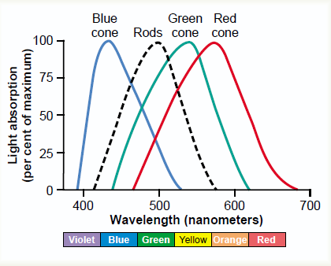
Light absorption by the pigment of the rods and by the pigments of three color-receptive cones of human retina.

Slide 7
Perception of colors
Depends on wave length, amount of light absorbed, threshold of stimulus & frequency of impulses from cones
perception of orange is due to stimulation of 99% of red cones & 42% of green cones & 0% of blue cones( so ratio is 99:42: 0)
perception of yellow is due to stimulation of50% of red cones & 50% of green cones & 0% of blue cones( so ratio is 50:50: 0)
perception of blue is due to stimulation of 0% of red cones & 0% of green cones & 97% of blue cones( so ratio is 0:0: 97 )

Slide 8
NEURAL MECHANISMS OF COLOR VISION
Color is mediated by ganglion cells that subtract or add input from one type of cone to input from another type
3 TYPES OF NEURAL PATHWAYS PROJECT TO BLOBS IN V1 and layer 4:
red– green pathway that signals differences between L and M-cone Responses
blue–yellow pathway that signals differences between S-cone and the sum of L- and M-cone responses
luminance pathway that signals the sum of L- and M-cone

Slide 9
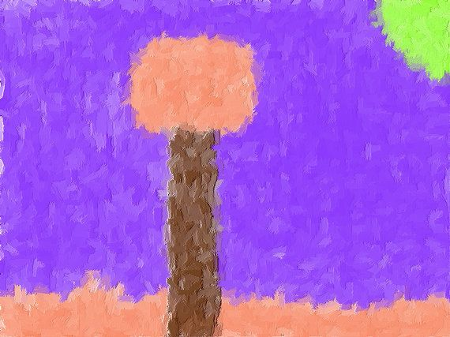
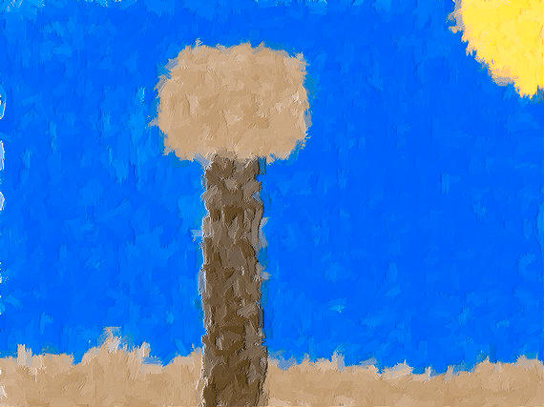

Slide 10
COLOR BLINDNESS
Gene for rhodopsin is on chromosome 3
Gene for blue sensitive S cone pigment is on chromosome 7
Gene for red & green sensitive cone pigment is on X chromosome.
when a single group of color receptive cones is absent ( due to absence of there gene) the person can not see or distinguish some colors from others

Slide 11
COLOR BLINDNESS
Red-green blindness:-
Green & red cones see different colors between wave length 525-675 nm & distinguish them.
If either of these cones are absent, the person can not distinguish 4 colors ( red –green-yellow-orange) & he can not distinguish red from green (primary colors)
It is x-linked disease (the gene is on x chromosome). Females from color blind fathers are carriers and transmit the disease to ½ of their sons.

Slide 13
Ishihara charts

Slide 14
Chromatic theories of color vision
Trichromats:-have 3 cone pigments( normal or have slight weakness in detecting red or green or blue color
Dichromats:-have only 2 cone pigments systems only so he is completely blind to red or green or blue ( so they may have protanopia, deuteranopia,or tritanopia) they get color by mixing only 2 of the primary colors.
Monochromats:-have only one cone system or loss of all so see only blackor grey or have no color perception.

Slide 15
NOPIA (BLINDNESS) NOMALY (WEAKNESS)
1-Protanopia (red-blindness): no red cones system so person has vision in shorter spectrum wave lengths. weakness ➔protanomaly
2-Deutranopia (green -blindness):-no green cones system-so person see only long & short wave length) . weakness ➔ deutranomaly.
3-Tritanopia (blue -blindness) : no blue cones system. weakness ➔ tritanomaly.

