Slide 1
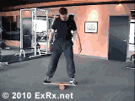
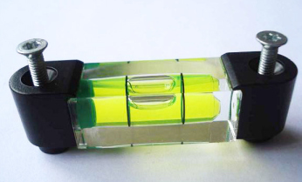
THE SPECIAL SENSES
VESTIBULAR FUNCTION
DR SYED SHAHID HABIB
MBBS DSDM PGDCR FCPS
Professor
Dept. of Physiology
College of Medicine & KKUH

Slide 2


OBJECTIVES
At the end of this lecture you should be able to describe:
Functional anatomy of Vestibular apparatus
Dynamic and static equilibrium
Role of utricle and saccule in linear acceleration
Role of semicircular canals in angular motions
Vestibular Reflexes

Slide 3
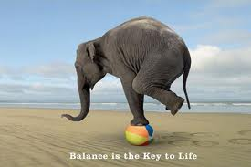
To balance the centre of gravity
must be above the support point.
Centre of gravity

Slide 4
Balance & Equilibrium
Balance is the ability to maintain the equilibrium of the body
Foot position affects standing balance
Equilibrium is the state of a body or physical system at rest or in un accelerated motion in which the resultant of all forces acting on it is zero and the sum of all torques about any axis is zero.
There are 2 types of Equilibrium
        Static -
        Dynamic –

Slide 5
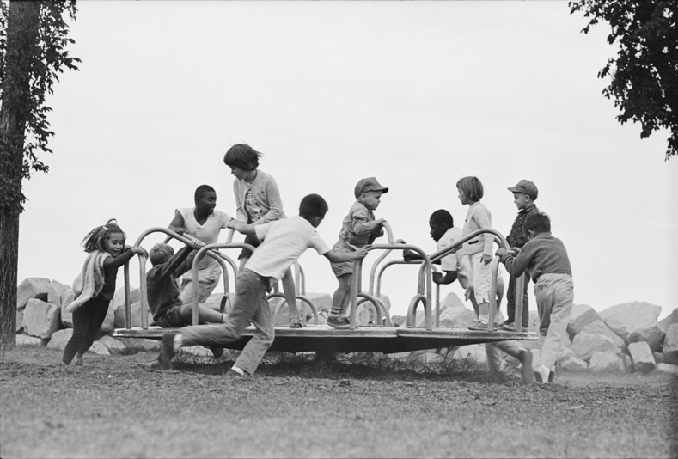
Static Equilibrium
keep the body in a desired position
Static equilibrium –The equilibrium is maintained in a FIXED POSITION, usually while stood on one foot or maintenance of body posture relative to gravity while the body is still.

Slide 6
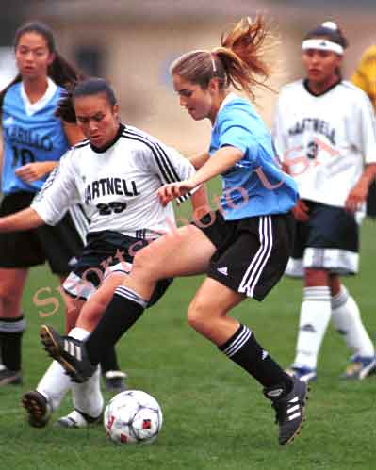
Dynamic Equilibrium
to move the body in a controlled way
Dynamic equilibrium The equilibrium must be maintained while performing a task which involves MOVEMENT e.g. Walking the beam. – maintenance of the body posture (mainly the head) in response to sudden movements. Tracking a moving object.

Slide 7
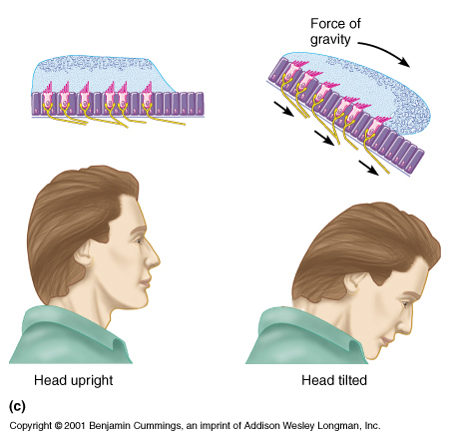
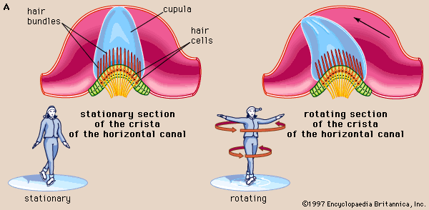
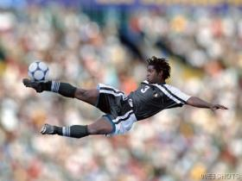
Acceleration
Linear & Angular (Rotational)

Slide 8
The Vestibular Apparatus
Components
Three SCCs
  Anterior
  Posterior
  Lateral
Vestibule (Utricle and Saccule)
Vestibular nerve and nuclei

Slide 9
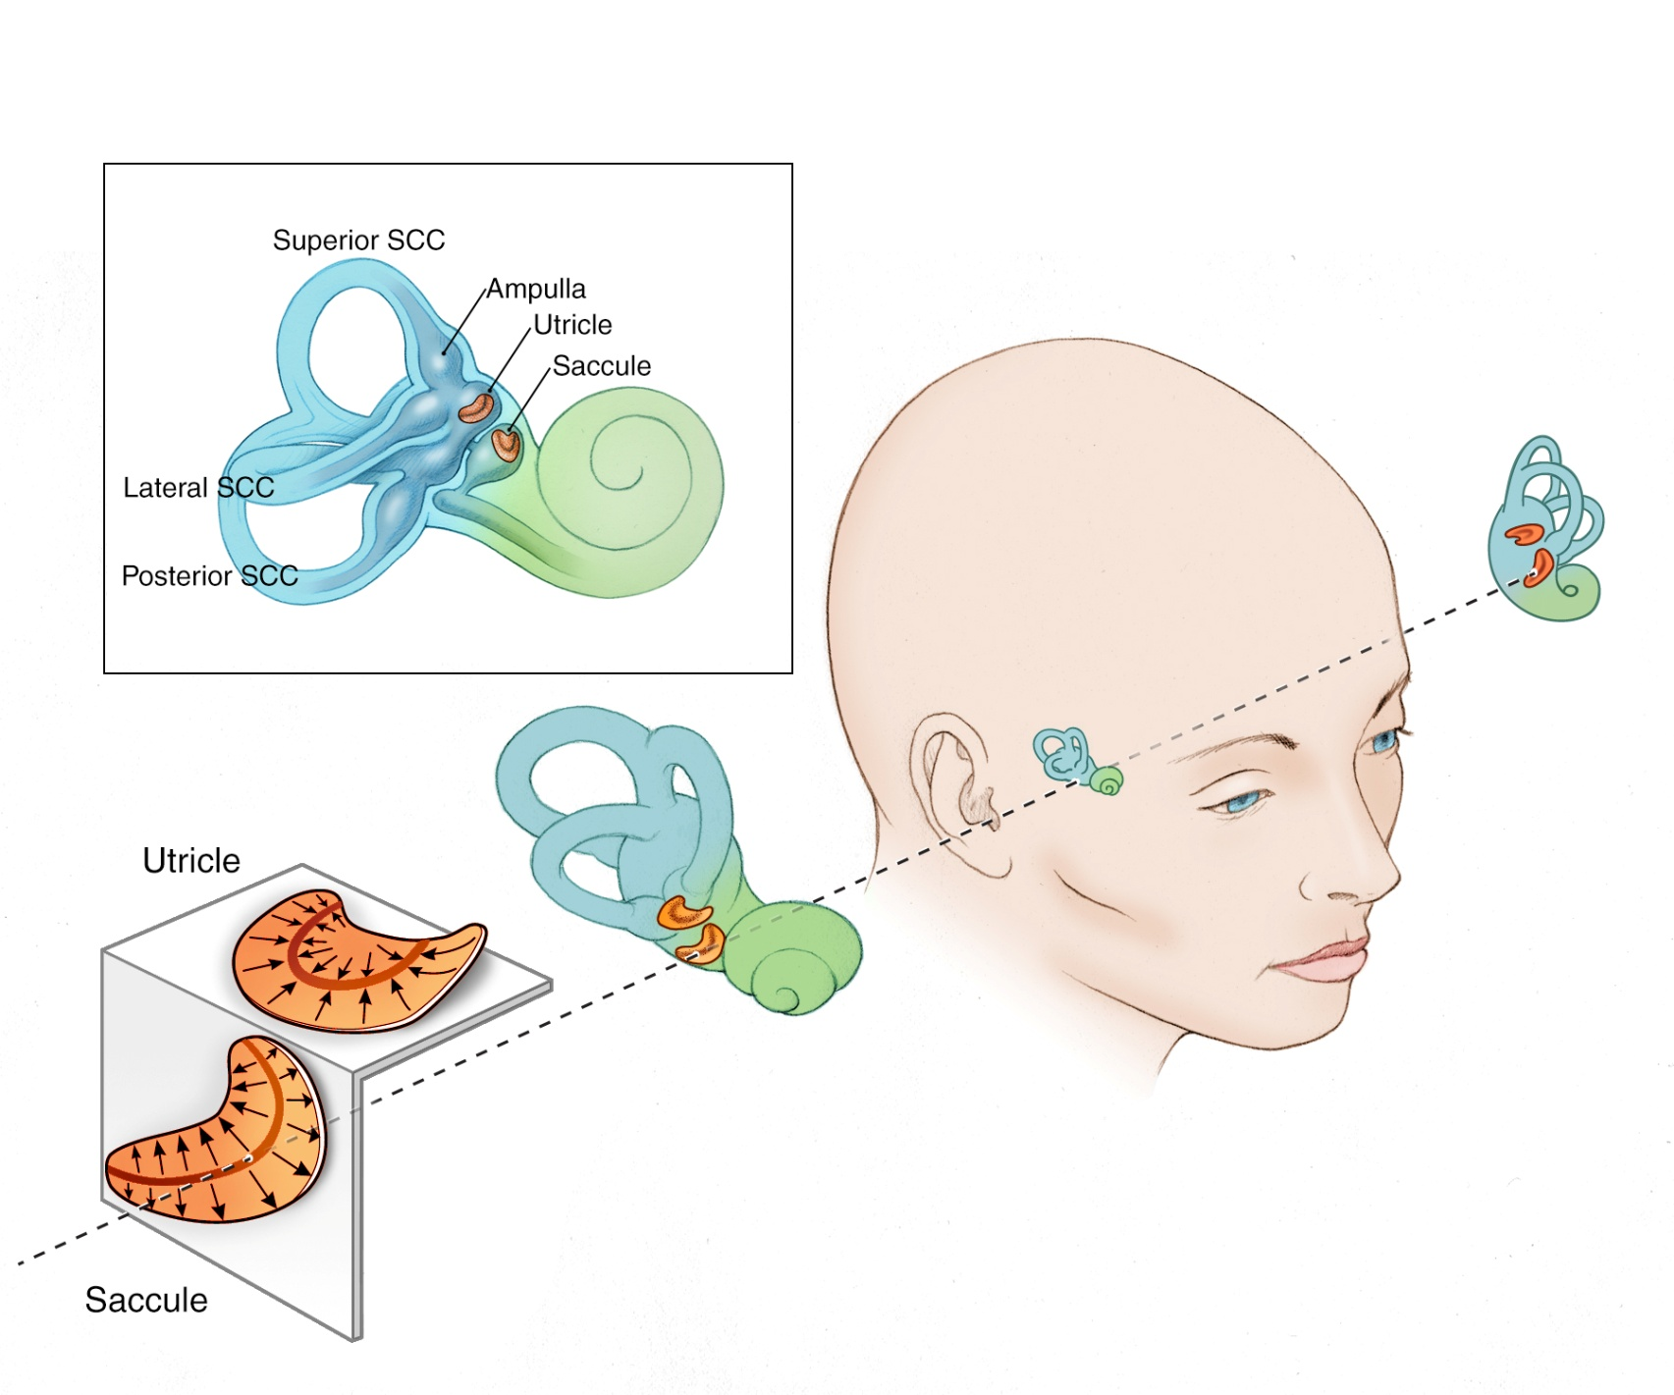
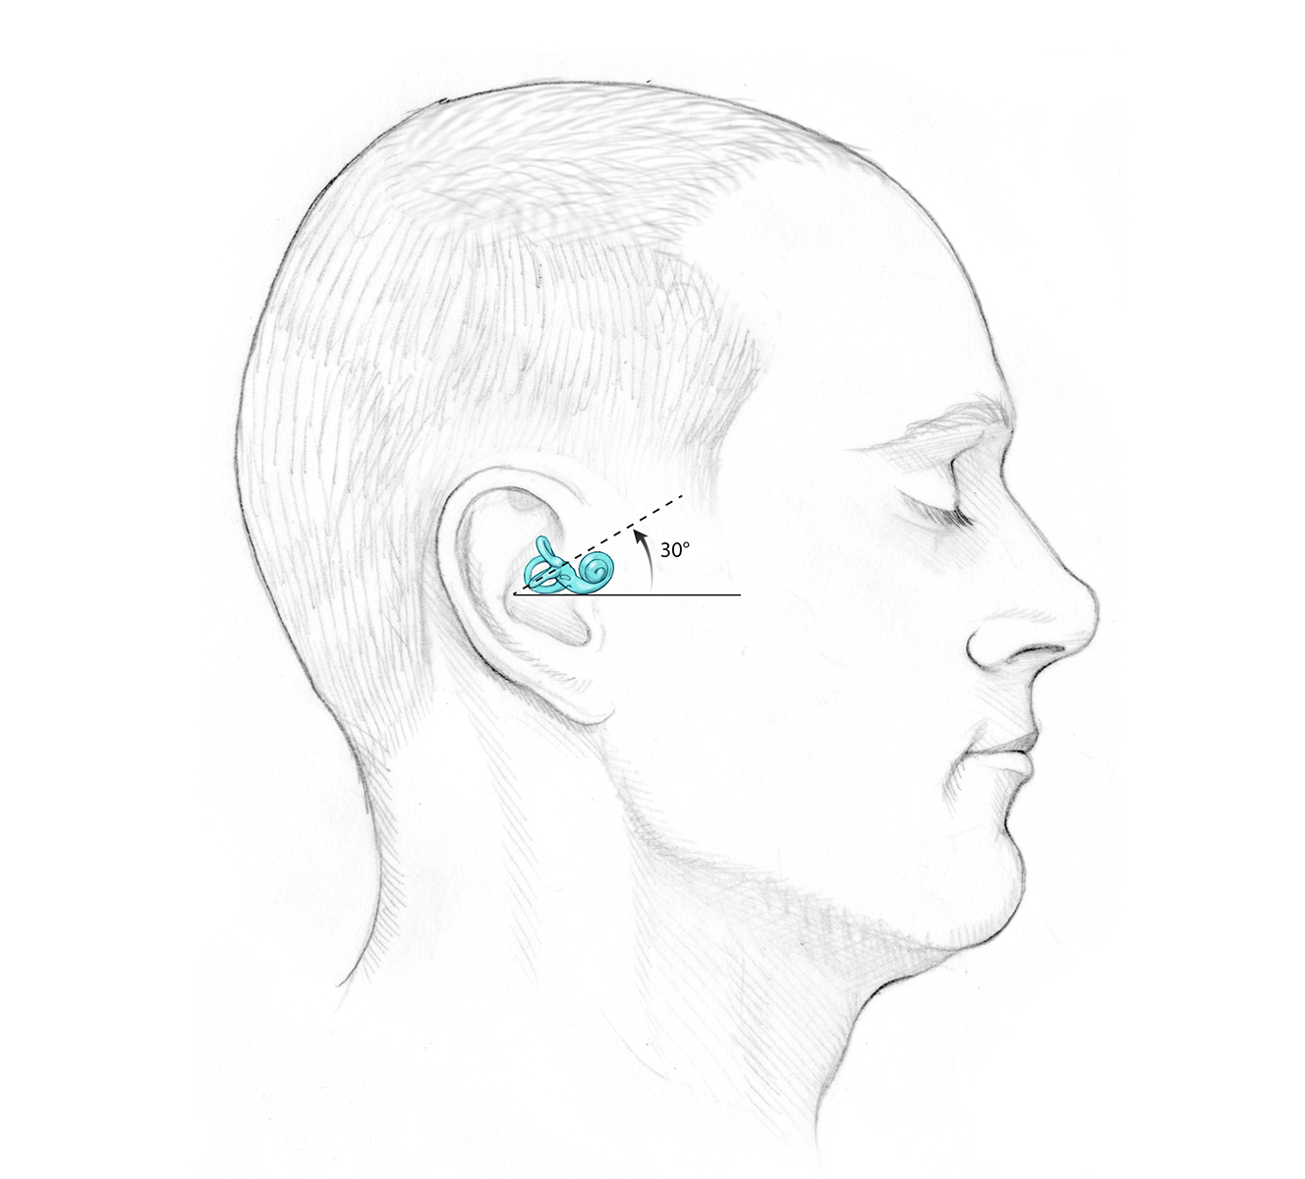
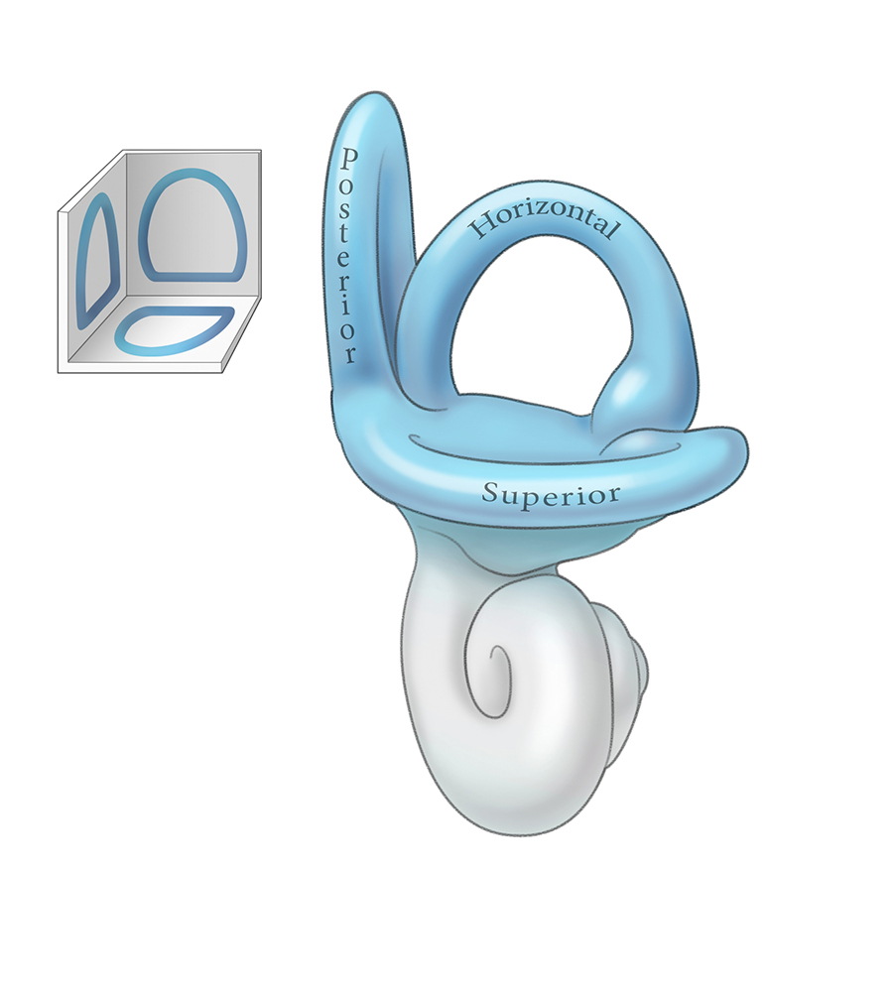
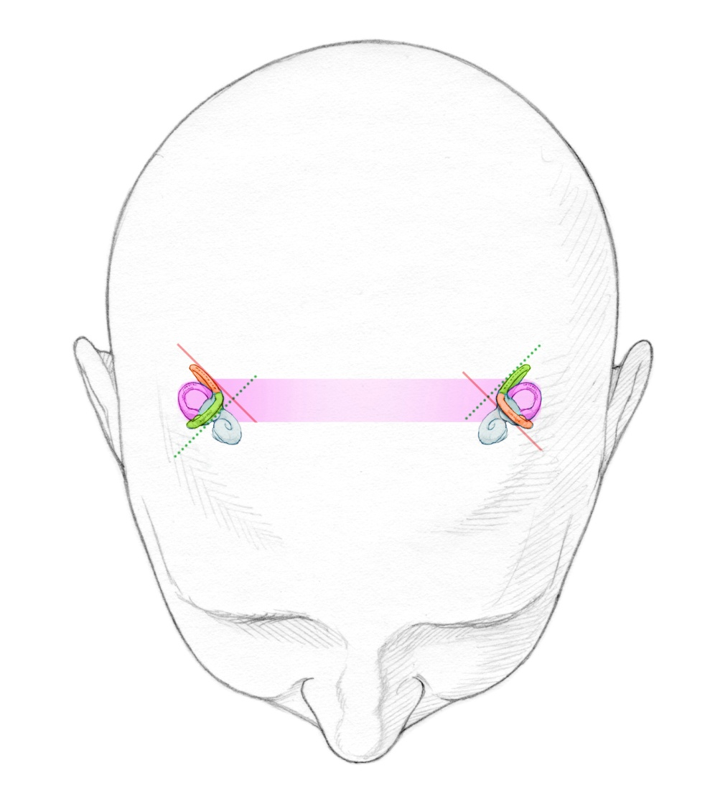

Slide 10
Equilibrium
Semi-circular canals
(Ant,Post,Lat)
Crista ampullaris
Hair cells in each crista are oriented in the same direction
Rotational motion
Vestibule
(saccule and utricle)
Maculae
Hair cells in each macula are oriented in all direction
Otoliths (calcium carbonate crystals)
Static equilibrium

Slide 11
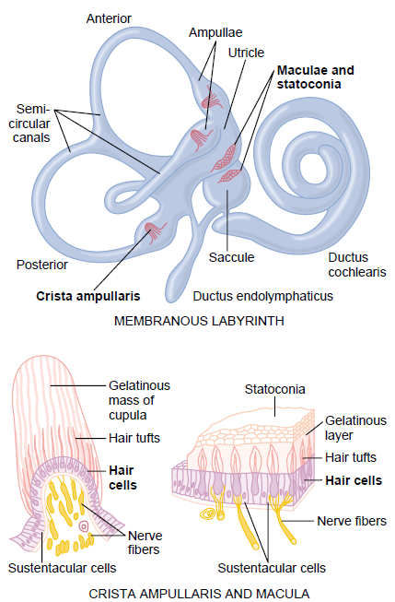
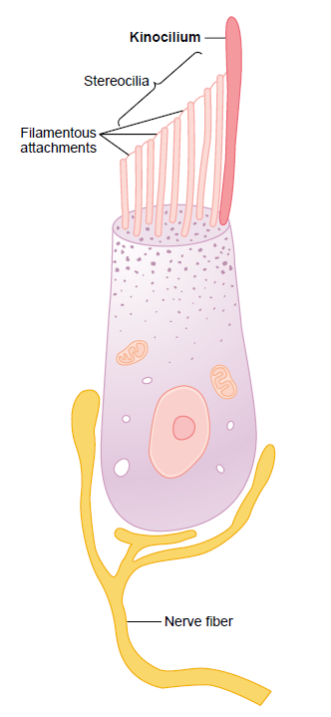
  One (large) kinocilium
  30 to150 (small) stereocilia
  Cilia connected by fine filaments (tip links)

Slide 12
In macula: hair cells are oriented in different direction and tilt Of Head In Any Direction is Signaled

Slide 13
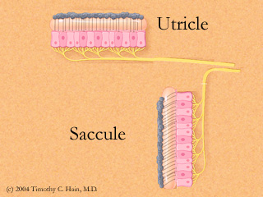
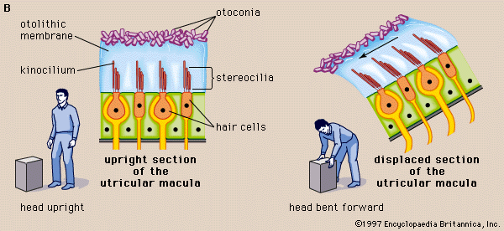
The two maculae, the utricle and saccule, are oriented in the horizontal and vertical planes and tell us how we are aligned relative to gravity.

Slide 14
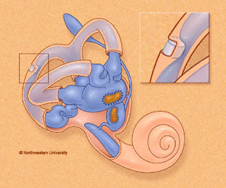
Hair cells in Utricle & Saccule
In upright position: (Head vertical)
In utricle:
  Macula in horizontal plane
  Hairs pointing upwards
  Hair cells signal head movements in any direction
In saccule:
  Macula in vertical plane
  Hairs pointing laterally
  Hair cells operate when one is lying down
  inform the brain of orientation
  of head in space

Slide 15
Function of utricle and saccule
Detection of static tilt
    Upright vertical position:
    Impulses from both utricle maculae
    balance each other
    Body tilts to one side:
    Two maculae send signals informing brain of
    new position of head in space
    Sensation of imbalance
    (Response???)

Slide 16
Function of utricle and saccule
2. Detection of linear acceleration:
Sudden acceleration >>>
Falling backwards >>>
Otoliths falls back on hairs >>>
sensation of mal-equilibrium >>
Correction by leaning forward
*Saccular maculae detect vertical acceleration
*Both utricle and saccule horizontal acceleration

Slide 17
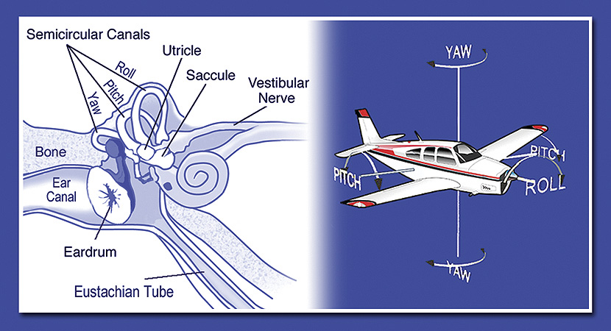
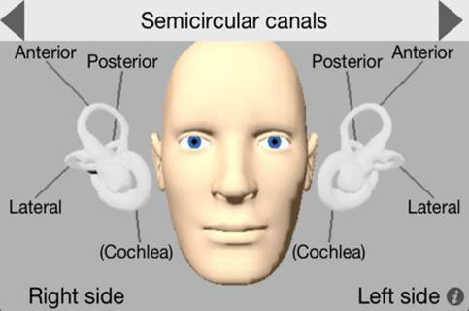
Three Semicircular Canals

Slide 18
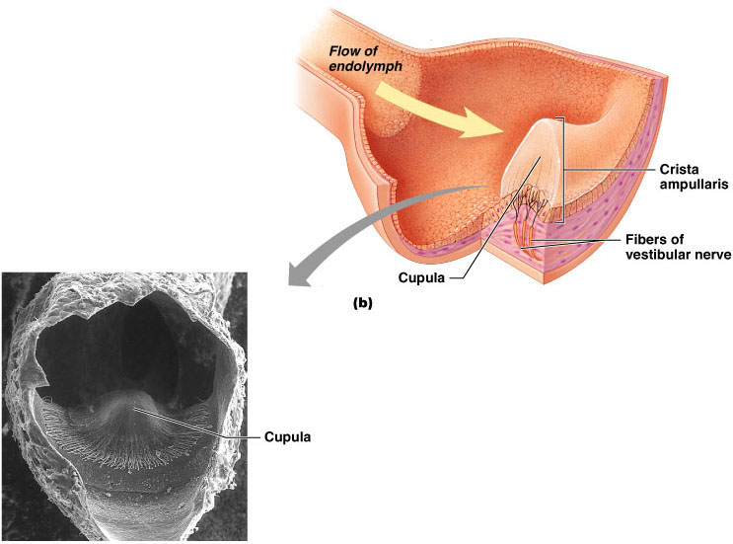
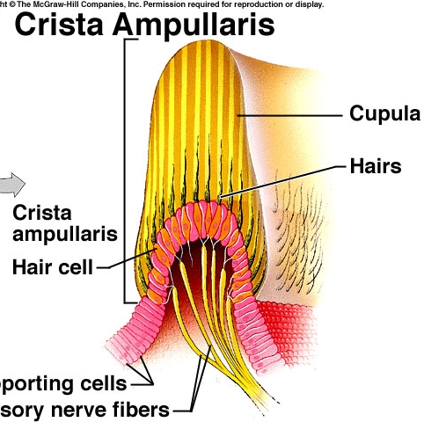
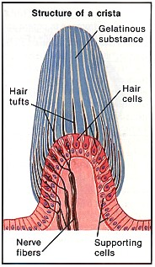
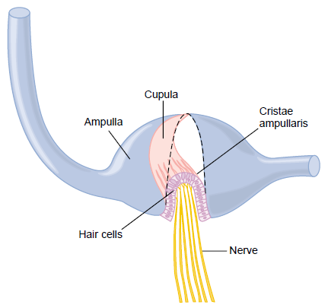
Three Semicircular Canals
Horizontal (lateral)
Vertical:
  Anterior
  Posterior
SENSORY ORGAN: CRISTA AMPULLARIS
    Contain Endolymph
    Each canal has a dilated end = Ampulla
    The ampulla houses the sensory hair cells (oriented in same direction) which are covered by a gelatinous material (Cupula)

Slide 19
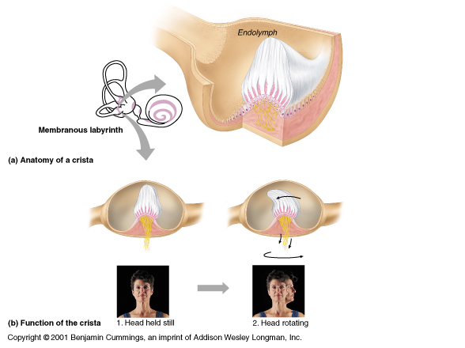
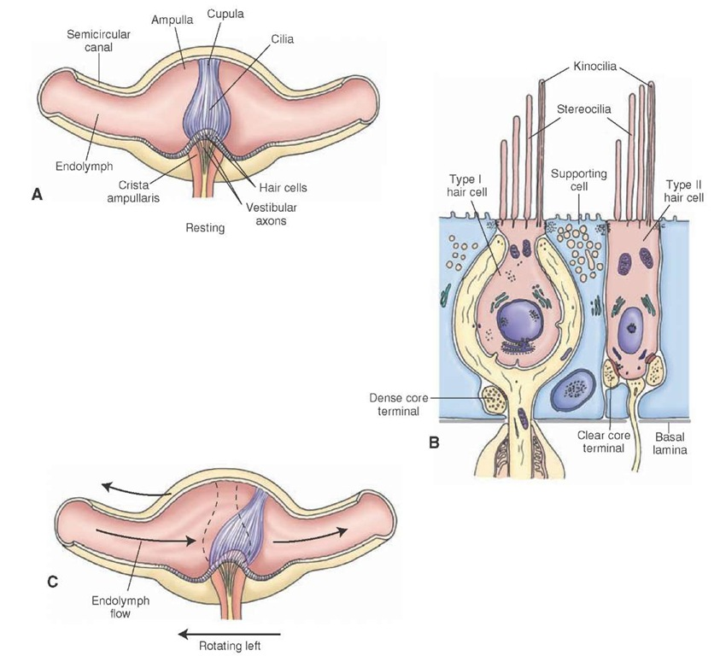
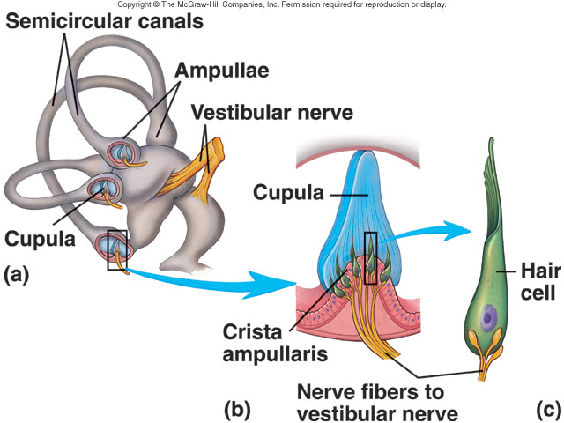

Slide 20
Plane of rotation determines the canal to be stimulated:
Rotation of head on vertical axis→Horizontal
Lateral movement of head (AP axis) (approximate head to shoulder) → posterior
Anterolateral or posterolateral head movement (Oblique axis) → Superior

Slide 21
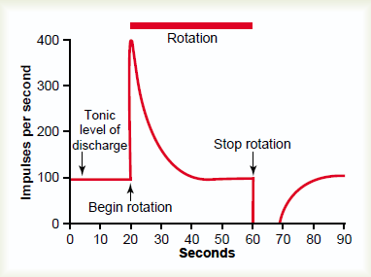
Angular (rotational) acceleration
Movement of endolymph in SCC ➔ Bending of hairs (Opposite on two sides) ➔ Opposite discharge from two sides ➔ Sensation of rotation in CNS ➔ As rotation continues endolymph will soon rotate in the same direction (& speed)
as the SCC ➔
Cupula being elastic returns to resting position ➔
Discharge from both sides returns to resting level
No sensation of rotation so long eyes are closed

Slide 22
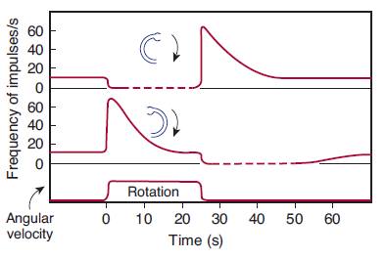
Rotational Acceleration, Steady Rotation & Deceleration
Rotation of canal from L to R
Endolymph moves R to L
Bends cupula (hair cells)
LT
RT
↑ discharge from R canal
↓ discharge from L canal

Slide 23
VESTIBULAR FUNCTION
SCCs detect ANGULAR ACCELERATION:
  The beginning of rotation
  End of rotation
  Changes in rate of rotation (eg; Joy Riding)
Predictive function of SCC in the maintenance of equilibrium:
i.e. Predict ahead of time that mal-equilibrium is going to occur ➔ Send impulses to CNS for corrective measures before the start of the fall

Slide 24
VESTIBULAR PATHWAY
Neural connections:
Cerebellum
Motor nuclei of CNs 3,4 & 6
Reticular formation (Spinal cord)**
Spinal cord (Vestibulo-spinal tract)**
** Impulses maintain equilibrium i.e. facilitate or inhibit the stretch reflex (regulate muscle tone)

Slide 25
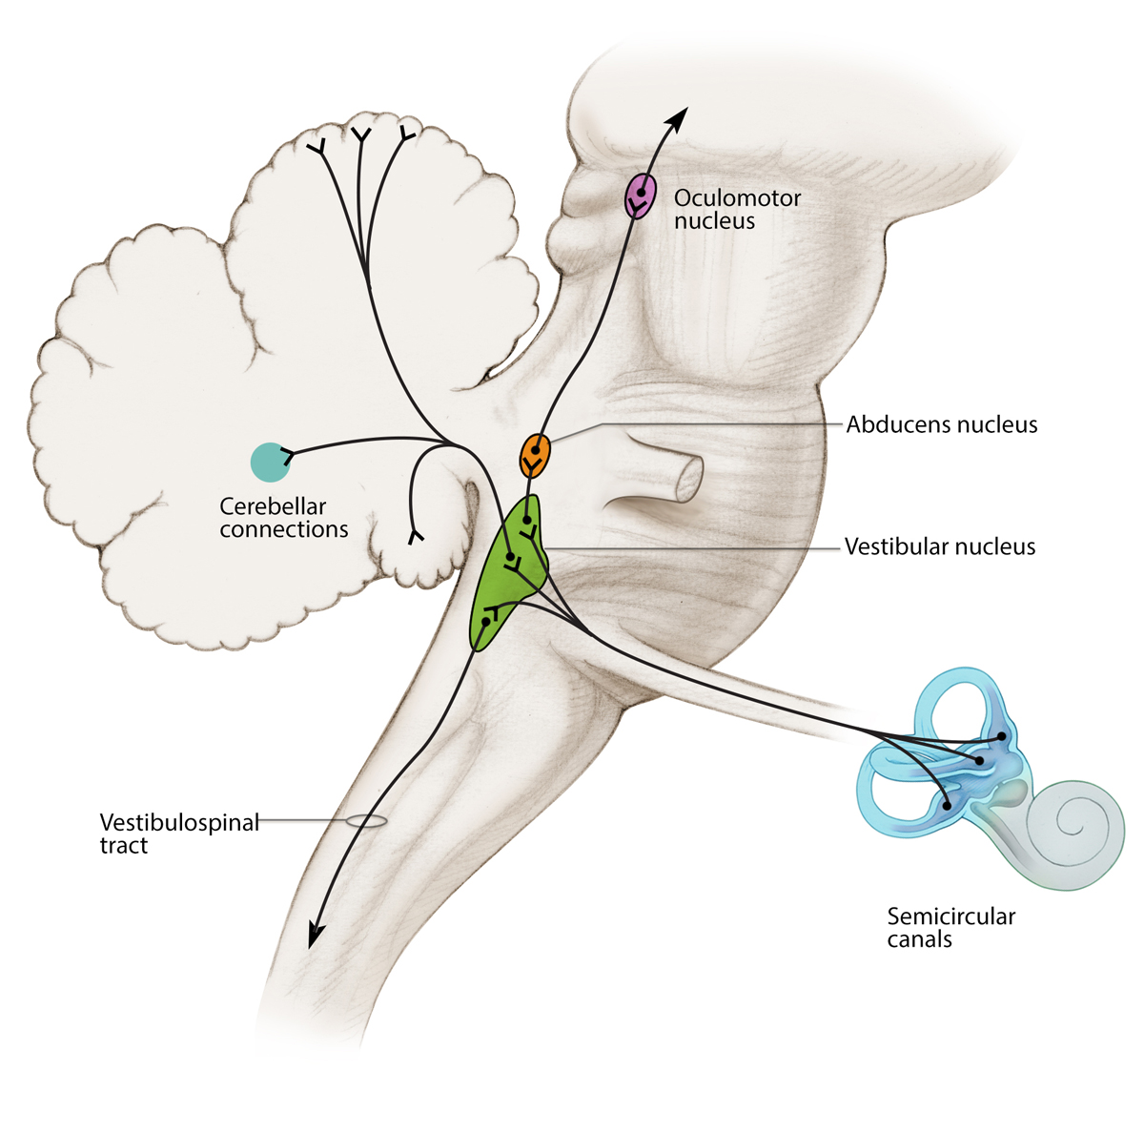

Slide 26
Testing Vestibular system
Calorie test
The semicircular canals are stimulated by instilling warm (40°C) or cold (30°C) water into the external auditory meatus.
The temperature difference sets up convection currents in the endolymph, with consequent motion of the cupula.
In healthy subjects, warm water causes nystagmus that bears toward the stimulus, whereas cold water induces nystagmus that bears toward the opposite ear.
Mnemonic COWS (Cold water nystagmus is Opposite sides, W arm water nystagmus is Same side).
In the case of a unilateral lesion in the vestibular pathway, nystagmus is reduced or absent on the side of the lesion.
2. Rotation tests
To avoid nystagmus, vertigo, and nausea when irrigating the ear canals in the treatment of ear infections, it is important to be sure that the fl uid used is at body temperature.

Slide 27
Abnormalities
(Motion Sickness)
Clinical signs:
Vertigo: feeling of rotation when body is not
Nystagmus
Clinical signs:
Nausea
Vomiting
Bradycardia
Hypotension
Sweating
Mechanism: autonomic stimulation
Vertigo: feeling of rotation when body is not moving

