Slide 1
PHYSIOLOGY OF THE PROPRIOCEPTORS IN BALANCE & ITS PATHWAYS
DR SYED SHAHID HABIB
MBBS DSDM PGDCR FCPS
Professor
Dept. of Physiology
College of Medicine & KKUH

Slide 2

OBJECTIVES
At the end of this lecture you should be able to:
Identify the major sensory pathways
Describe the components, processes and functions of the sensory pathways
Appreciate the dorsal column system in conscious proprioception
Describe the pathway of spinocerebellar tract in subconscious proprioception from muscles, tendons and joints
Differentiate between sensory and motor ataxia

Slide 3
PROPRIOCEPTION
Latin proprius, meaning "one's own", "individual" and perception, is the sense of the relative position of neighbouring parts of the body and strength of effort being employed in movement.
exteroception, by which one perceives the outside world
interoception, by which one perceives pain, hunger, etc., and the movement of internal organs.
MECHANORECEPTORS: which detect mechanical compression or stretching of the receptor or of tissues adjacent to the receptor

Slide 4
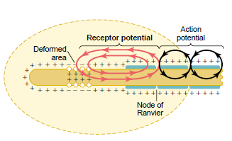
Receptor Potential of the Pacinian Corpuscle
For joint position and vibration sensation
(Also Ruffini’s Endings)
The receptor potential produced by compression induces a local circuit of current flow that spreads along nerve fiber.
The frequency of repetitive action potentials transmitted from sensory receptors increases approximately in proportion to the increase in receptor potential

Slide 5
Types of proprioception
1- conscious proprioception reach the level of cerebral cortex sensory area via dorsal column tract.
2- Subconscious proprioception reach the level of cerebellum via spinocerebellar tracts
Where is the location of these tracts?

Slide 6
Three Types of Proprioceptors
Muscle spindles – measure the changing length of a muscle
  Imbedded in the perimysium between muscle fascicles
Golgi tendon organs – located near the muscle-tendon junction
  Monitor tension within tendons
Joint kinesthetic receptors
  Sensory nerve endings within the joint capsules

Slide 7
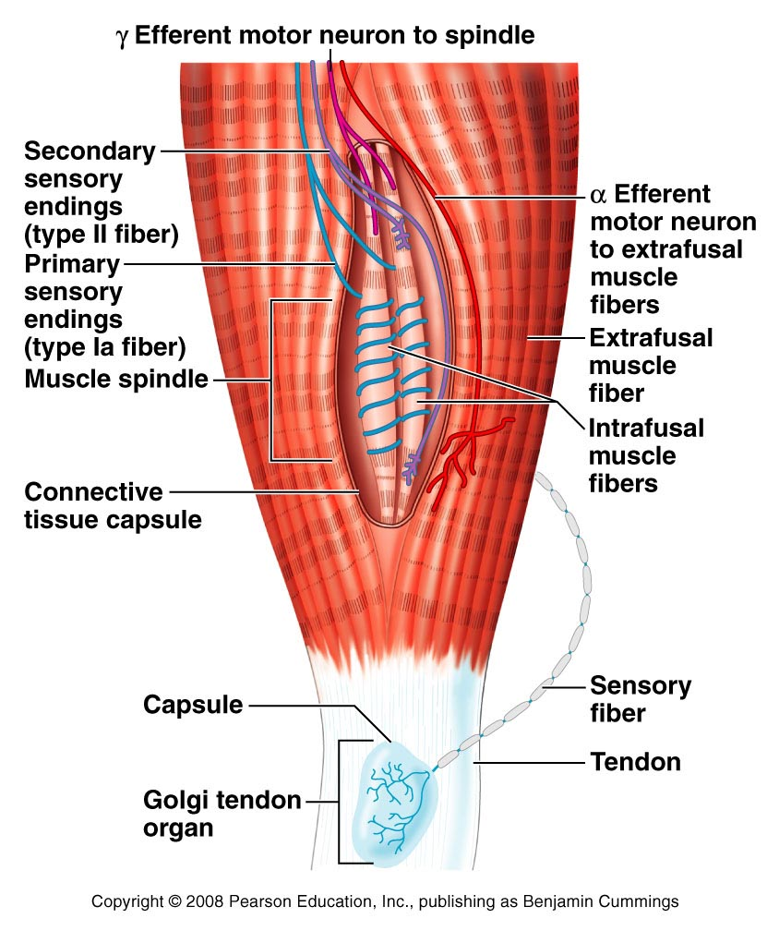
Structure of Proprioceptors

Slide 8
NERVE FIBERS CLASSIFICATION
Type A
  Alpha
  Beta
  Gamma
  Delta
Type C

Slide 9
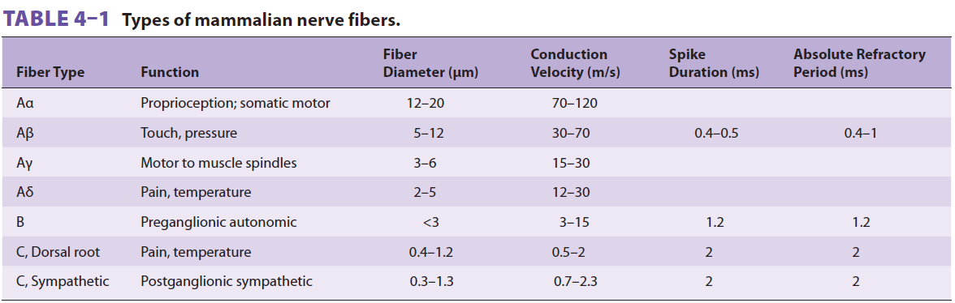

Slide 10
SENSORY TRACTS
DORSAL COLUMN SYSTEM
ANTEROLATERAL SYSTEM
Each system carries different types of sensations which are known as MODALITIES like pain, temperature, fine touch, crude touch, vibration, proprioception etc

Slide 11
1. Dorsal column pathway- carries signal of fine touch, pressure, vibration , stereognsis and proprioception,
2. Spinothalamic pathway- carries signals of pain, temperature, deep pressure, and course touch.
3,4- Posterior and anterior spinocerebellar pathways- carry subsconcious proprioception. Dorsal gray horn- to lateral column- to medulla oblongata- to pons – to cerebellum.

Slide 12
DORSAL COLUMN
MEDIAL LEMNISCAL SYSTEM
Touch sensations requiring a high degree of localization of the stimulus
Touch sensations requiring transmission of fine gradations of intensity
Phasic sensations like vibratory sensations
Sensations that signal movement against skin
Joints Position sensations (Proprioception)
Pressure sensations requiring fine degrees of judgment of intensity
Strereognosis

Slide 13
ANTEROLATERAL SYSTEM
Ventral & lateral spinothalamic tracts
Pain
Thermal sensations, (warmth & cold)
Crude touch and pressure sensations capable only of crude localizing ability on the surface of the body
Tickle and itch sensations
Sexual sensations

Slide 14
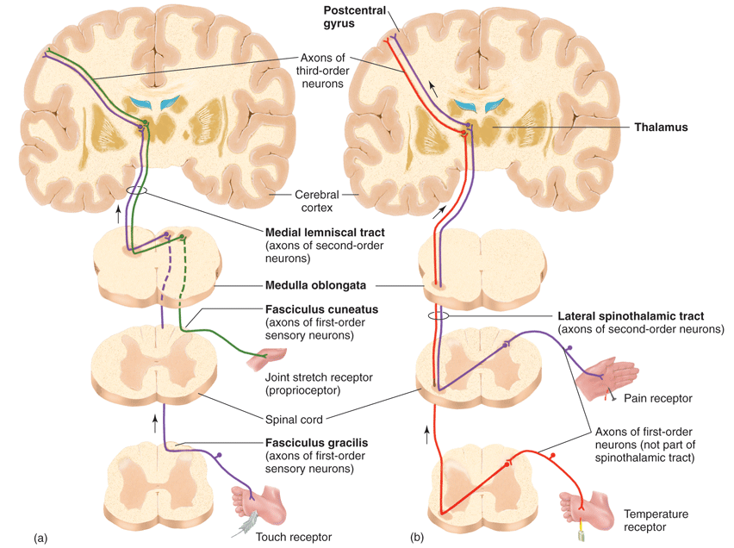
ANTEROLATERAL
SYSTEM
DORSAL
COLUMN
SYSTEM

Slide 15
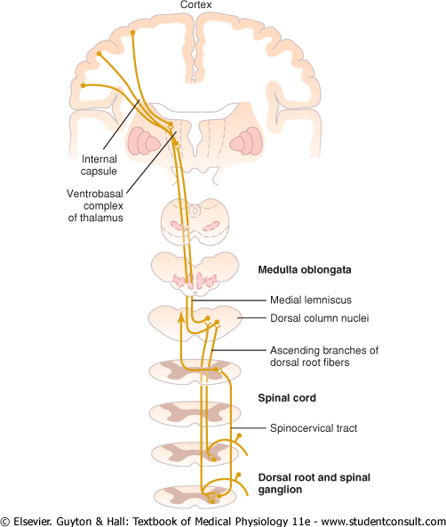
PROPRIOCEPTION FROM HEAD
In this pathway through the brain stem, each medial lemniscus is joined by additional fibers from the sensory nuclei of the trigeminal nerve; these fibers subserve the same sensory functions for the head that the dorsal column fibers subserve for the body.

Slide 16
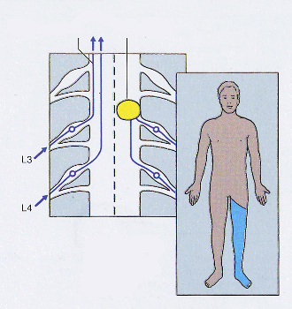
Dorsal column damage
Left
spinal cord injury
dorsal column
pathway
Loss of sense of:
touch
proprioception
vibration
in left leg

Slide 17
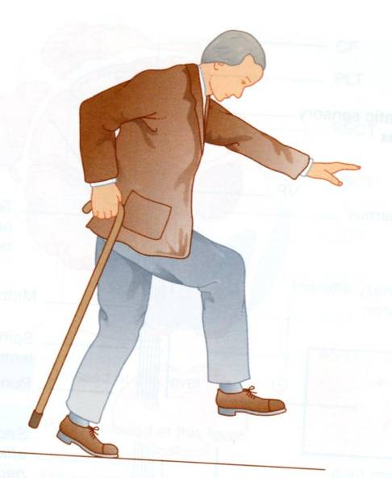
Dorsal column damage
Sensory ataxia
Patient staggers; cannot perceive position or movement of legs
Visual clues help movement
Positive Romberg test
The test depends on the integrity of proprioception from the joints of the legs.

Slide 18
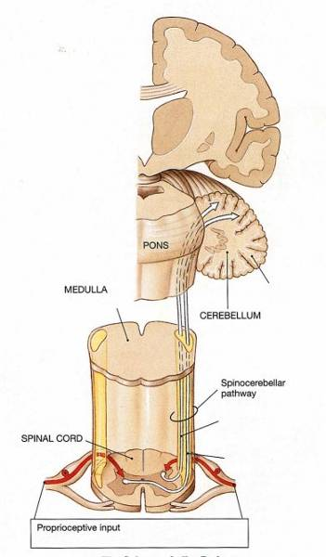
Spinocerebellar pathway
Carries subconscious proprioception signals
Receptors in muscles & joints
1st neuron: enters spinal cord through dorsal root
2nd neuron: ascends to cerebellum
No 3rd neuron to cortex

Slide 19
Spinocerebellar tract damage
Cerebellar ataxia
  Clumsy movements
  Incoordination of the limbs (intention tremor)
  Wide-based, reeling gait (ataxia)
  Alcoholic intoxication produces similar effects!

Slide 20
Ataxia and Gait Disturbances
Pathophysiology
  Result from any condition that affects the central and peripheral nervous systems
  Ataxia: Types
    Motor ataxia
    Sensory ataxia

Slide 21
Ataxia and Gait Disturbances
Motor Ataxia
  Caused by cerebellar disorders
    Intact sensory receptors and afferent pathways
    Integration of proprioception is faulty
    Midline cerebellar lesions cause truncal ataxia
    Lateral cerebellar lesions cause limb ataxia
    Thalamic infarcts may cause contralateral ataxia with sensory loss

Slide 22
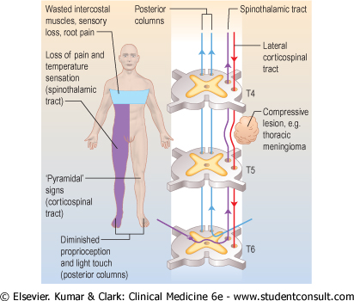


Slide 23
Brown Sequard syndrome
HEMISECTION OF SPINAL CORD
Ipsilateral Loss:
Fine touch, Vibration, Proprioception (Dorsal Column)
Leg Ataxia (Dorsal Spinocerebellar)
Spastic Paresis below lesion (Lat Corticospinal)
Flaccid Paralysis (Vent horn destruction)
Dermatomal Anesthesia (Dorsal Horn destruction)
Contralateral Loss:
Loss of pain and temp (lat Spinothalamic)
Loss of crude touch and Pressure (Vent Spinothalamic)
Minor Contralat Muscle Weakness (Vent Corticospinal)
Leg Ataxia (Vent Spinocerebellar)

