Slide 1
Postural Reflexes
Dr Taha Sadig Ahmed

Slide 2
Objectives
At the end of this lecture the student should :
1. be able to define human posture .
2. explain/define the concepts of “ center of gravity ’’ and “ support base, base of support “.
3. Explain what are postural reflexes and their overall function .
4. Know the centers of integration of postural reflexes .
Explain the structure and function of the vestibular apparatus ( utricle, saccule & semicircular canals ) in maintenance of balance
Describe decorticate rigidity and decerbrate rigidity and explain the mechanisms underlying them .

Slide 3
Definitions
Human posture → is the way in which your body is positioned when you are sitting or standing
Postural Reflexes→ Are automatic body movements related to body positioning alone (basic postural reflexes), and ones related to vestibular input (labyrinthine or vestibular spinal reflexes).
When we stand or move, our body tends to automatically assume particular postures based on the combination of these responses.
Center of Gravity مركز الثقل→ The center of gravity is the average location of the weight of an object.
Base of support , support base → he base of support refers to the area beneath a person that includes every point of contact person makes with the supporting surface.
These points of contact may be body parts e.g. feet or hands, or they may include things like crutches or the chair a person is sitting in.

Slide 4
Postural Control Centers :
Cerebral cortex
Optical Righting reflex
Placing Reaction
Hopping Reaction
Midbrain : the Midbrain Righting Reflexes →
(a) Labyrinthine
(b) Neck
(c) Body on Head
(d) Body on Body
Medulla
(1) Tonic Labyrinthine Reflex
(2) Tonic Neck Reflex
Spinal Cord
Positive and Negative Supporting Reaction
Stretch Reflex

Slide 5
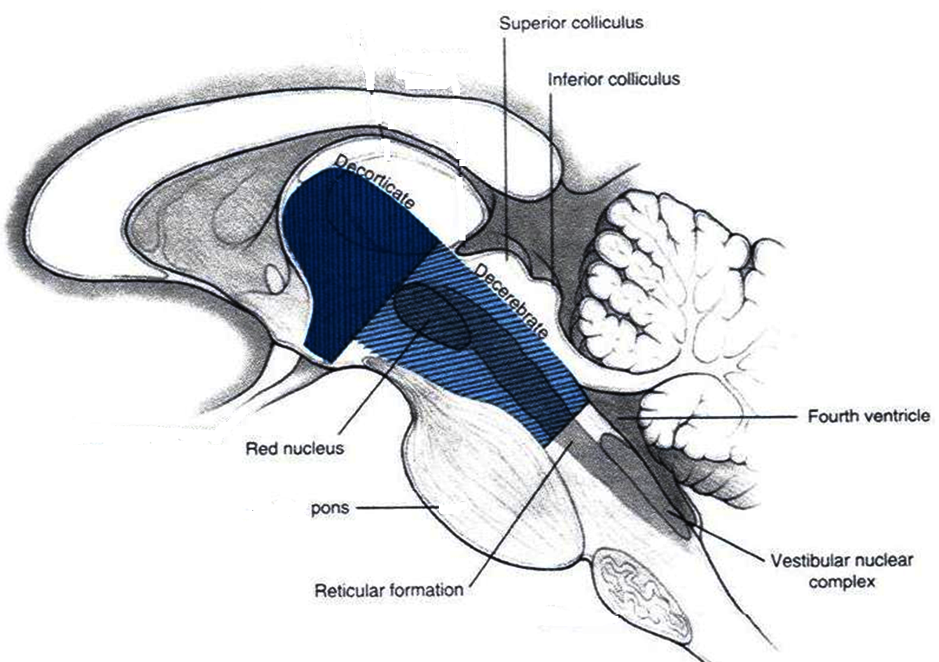
Levels of Lesions
Decorticate
Animal Decerebrate
Spinal Animal

Slide 6
Reflexes Integrated at the level of Cerebral Cortex ( Cortical Reflexes ) Examples : (1) Optical righting Reflex, (2) Placing Reaction , (3) Hopping Reaction

Slide 7
Optical righting reflex :
Visual stimuli that enable an
animal to maintain the correct
position of the head in space,
by bringing about movements
of the muscles of the neck
and limbs.
visual clues –> righting of
the head

Slide 8
Placing reflex : when the infant is held erect and the dorsum of the foot is drawn along the under edge of a table top → flexion followed by extension of the leg
Appears by 4 days in the newborn
Stepping Reflex
When feet touch the ground , the infant appears to take some steps
Stepping reflex disappears before walking :

Slide 9
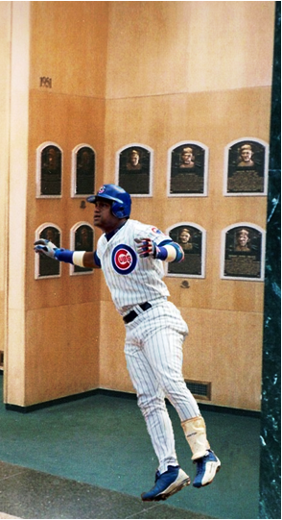
Hopping reaction
lateral displacement while standing
cause animal to hop to maintain balance

Slide 10
Vestibulospinal Reflexes , VSR)

Slide 11
Vestibular Apparatrus and Balance

Slide 12
Otollithic Organs →
The utricle,, along with the saccule is one of the two otolith (agglutinated crystals crystals around a nucleus) organs located in the inner ear.
The utricle and the saccule are parts of the balancing apparatus (membranous labyrinth) located within the vestibule of the bony labyrinth (small oval chamber).
These use small stones and a viscous fluid to stimulate hair cells to detect motion and orientation.
The utricle detects linear accelerations and head tilts in the horizontal plane.

Slide 13
The Utricle responds to movements of the head in the horizontal plane, such as sideways head tilts and rapid lateral displacements,
whereas the Saccule responds to movements in the vertical plane →
(1) up-down , and
(2) forward-backward movements in the sagittal plane
Note that the saccular and utricular maculae on one side of the head are mirror images of those on the other side. Thus, a tilt of the head to one side has opposite effects on corresponding hair cells of the two utricular maculae.

Slide 14
Lower decerebration removes everything above the Medulla →Bulbospinal Animal
results in a n animal with Functional Medulla &Spinal Cord "Bulbospinal" animal: Result →
(1) reflexes that are integrated in the Cortex & Midbrain are abolished, whereas
(2) Reflexes that are which are integrated within the Mdedulla & Spinal Cord and medulla are intact/functional,
There is accentuationj ( increase) in the tonic labyrinthine reflexes, ( absence of inhibitory descending impulses , similar to UMNL) ( whose receptors are Otolithic Organs ) and integration in the Vestibular Nuclei in the Medulla , which is still intact.

Slide 15
the otolithic organs mediates input about the gravitational force exerted on the body and the labyrinthine reflex acts on the extensor muscles in order to resist this gravitational force and maintain upright posture .
In a Decerebrate animal , in which the influences of
(1) the cortical areas , inhibitory, ;
and/or
(2) midbrain centers have been "cut off" /removed from the neural axis,
this reflex ( Labyrinthine Reflex , mediated by Vestibular Nuclei in the Medulla, which are excitatory to muscle tone ) is hyperactive and the animal will maximally extend all four limbs ( like pillars ) .
This phenomenon is known as Decerebrate Rigidity .

Slide 16
The Vestibulospinal Reflex , VSR ( Receptor in Vestibular Apparatus ) , example → The Labyrinthinre Righting Reflex :
1. When the head is tilted (rolled) to one side, both the canals and otoliths are stimulated.
2. The vestibular nerve and vestibular nucleus are activated.
3. Impulses are transmitted via the lateral and medial vestibulospinal tracts to the spinal cord.
4. Extensor activity is induced on the side to which the head is inclined, and flexor activity is induced on the opposite side.

Slide 17
Decerebrate Rigidity
Site of lesion → between the superior and inferior colliculi of the midbrain , lesion below Red Nucleus , resulting in
extensive extensor posture of all extremeties → Rigidity of all 4 limbs
All limbs extended arms extended by the sides & rotated internally (outward)
(hallmark → elbows extended)
Head may be arched to the back
It is due to →
(1) increased general excitability of the motor neuron pool → especiallly Gamma efferent discharge ( due to facilitatory effects of the un inhibited Vestibulospinal Tract ) .

Slide 18
In a decerebrate animal :
head arched back
arms extended by the sides & rotated internally (outward)
extended elbows*
legs extended & rotated internally
rigid with clenched teeth
damage to (level below red nucleus)
brain stem
midbrain
cerebellum
Reflexes that are lost/absent
Righting Reflexes ( optical)
Reflexes that are retained /still present ( i.e., reflexes the do not depend primarily cerebrum on cerebrum :
(1) Tonic Labyrinthine reflexes
(2) Tonic Neck Reflexes

Slide 19
Decorticate Rigidity

Slide 20
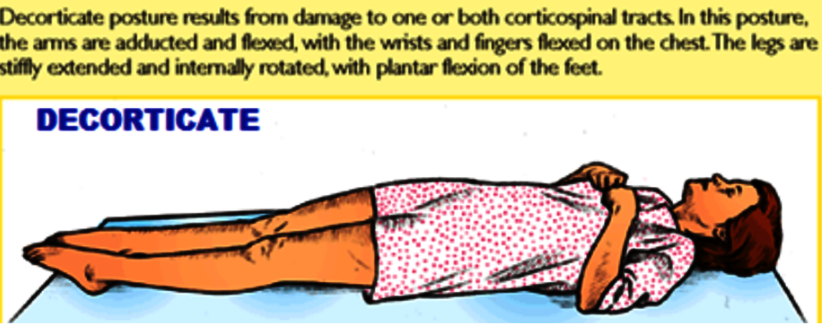
In humans , where true decerebrate rigidty is rare , since the damage to the brain centers involved in it are lethal.
However decorticate rigidity can be caused by bleeding in the internal capsule which causes UMNL (damage to upper motor neurons) .
Symptoms & Signs :
Flexion in the upper limbs and extension in the lower limbs.
Arms flexed & bent inwards towards chest
Feet turned inward
Seen in corticospinal animal : damage above Red Nucleus
( in cerebral hemispheres , internal capsule or thalamus ).

Slide 21
In a decorticate animal :
Reflexes that are lost/absent
(1) Placing Reaction , Hopping Reaction
(2) Visual righting reflex
Reflexes that are retained /still present ( i.e., reflexes the do not depend primarily on cerebral cortex :
(1) Tonic Labyrinthine reflexes
(2) Tonic Neck Reflexes
(3) Other Righting Reflexes

Slide 22
Bulbospinal Animal ( Animal with intact Medulla + intact Spinal Cord

Slide 23
Medulla Reflexes
Tonic neck reflex (primitive reflex found in newborn)
head up causes
hind limbs to flex
fore limbs to extend
head down
fore limbs flex
hind limbs extend
head turn to one side
limbs on the side where head is turned to extend/straighten
opposite side is bent/flexed

Slide 24
Spinal Animal

Slide 25
Spinal Cord Reflexes
Stretch reflex a muscle contraction in response to stretching within the muscle
When muscle lengthens, the spindle is stretched and the activity increases.
This increases alpha motorneuron activity.
Therefore the muscle contracts and the length decreases as a result.

Slide 26
Thank You

