Slide 1
Upper Motor Neuron Lesion (UMNL) Lower Motor Neuron Lesion ( LMNL)
Dr Taha Sadig Ahmed
د. طه صادق أحمد
بكالوريوس الطب و الجراحة – جامعة الخرطوم
دكتوراه في فسيولوجيا الجهاز العصبي – بريطانيا
عضوية الجمعية الأمريكية لتخطيط المخ و الأعصاب – الولايات المتحدة
إستشاري تخطيط المخ و الأعصاب
بمستشفي الملك خالد ومستشفي الملك عبد العزيز الجامعي
أستاذ مشارك بقسم وظائف الأعضاء بكلية الطب

Slide 2
Control of Complex Patterns of movement (coordinated muscle activity ) → consists of
(1) Primary motor cortex ( Brodmann Area 4)
(2) Premotor Cortex ( PMC),
(3) Supplementary motor area (SMA), MII
(4) BG ( basal ganglia), &
(5) Thalamus, and

Slide 3
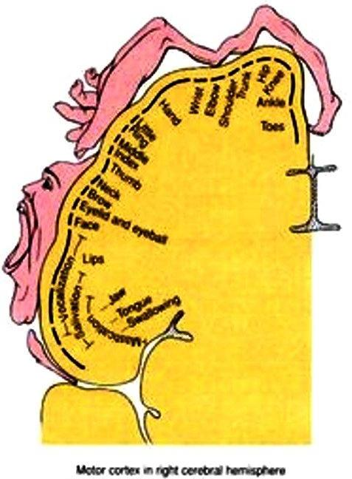
Pyramidal (Corticospinal ) Tract ( Upper Motor Neuron)
(1) The primary motor area ( M1 )
occupies the precentral gyrus & contains large , highly excitable Betz cells.
MI of one side controls skeletal muscles of the opposite ( contralateral ) side of the body
The cortex contains a map of the body parts (surface ) .
This called cortical map or cortical representation of body parts .
The body is represented upside-down so that the head down and legs up
Representation of a body part is not directly proportional to its actual size , but is proportional to the degree of complexity of movement executed buy that part ( e.g. … ) .
Representation of a body part is not directly proportional to its actual size , but is proportional to the degree of complexity of movement executed buy that part ( e.g. hand area is bigger than trunk area )

Slide 4
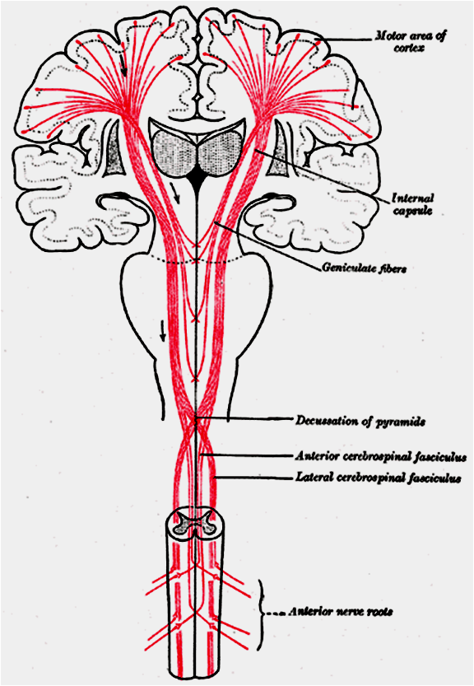
Cerebral Dominance : The Dominant Hemisphere
One hemisphere giving out the pyramidal ttract usually has more influence than the other hemisphere and is called the “ Dominant Hemisphere “ .
About 90 % of people are right-handed,
and consequently their Dominant Hemisphere s on the left side ( their left cerebral hemisphere ) .
The remaining 10 % of people have their right cerebral hemisphere as the Dominant
Hemisphere , and therefore they are left-handed .

Slide 5
(2) The Supplementary Motor Area ( M2 )
is a small area located on the lateral side of the brain in front of area 4 and above the pre­motor area .
This area projects mainly to M1 and is concerned with planning and programming motor sequence of movements .
(3) Premotor Area ( M3)
lies in front of the primary motor area & below supplementary motor area.
Stimulation of the premotor area produces complex coordinated movements, such as setting the body in a certain posture to perform a specific task.
(4) Parietal lobe :
The Parietal lobe contributes about 40% of the fibers that
run in the pyramidal tracts
Notes:
الهيمنة الدماغية cerebral dominance

Slide 6
Primary motor area ( M1, Brodmann area 4 )
In precentral gyrus &
Contains large , highly excitable Betz cells ( Pyramidal cells) .
Controls movement of contralateral skeletal muscles
Cortical Motor Areas
2.Supplementary Motor Area (M2)
Located on the lateral side
in front of area 4 and above
the pre­motor area
This area projects mainly to M1 and is concerned with planning and programming
M2(SMA)
PPC
S1
3.Premotor Area ( M3, Brodmann area 6 )
lies in front of the primary motor area & below supplementary motor area.
Stimulation of the premotor area produces complex coordinated movements, such as setting the body in a certain posture to perform a specific task.
Central sulcus
Lateral sulcus
4. The Parietal lobe contributes about 40% of the fibers that run in the pyramidal tracts

Slide 7
Descending ( Motor ) Tracts
Two major groups :
Pyramidal (Corticospinal) tracts
Extrapyramidal tracts

Slide 8
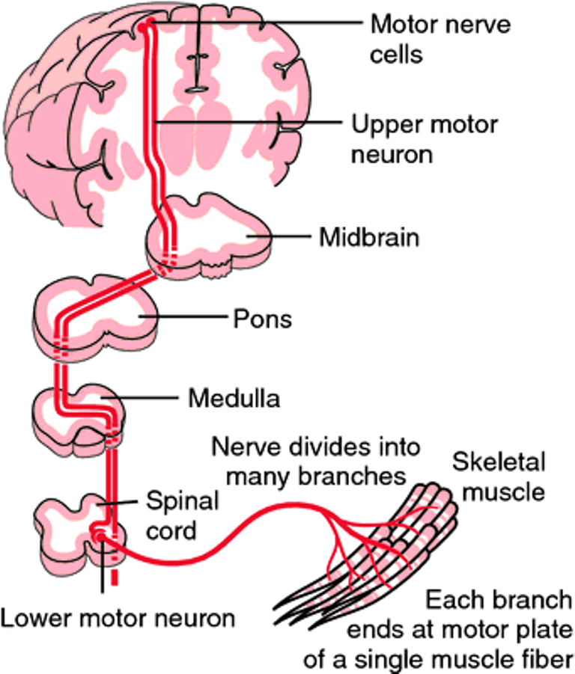
For performance of voluntary movements two levels of neurons are essential:
Upper motor neurons (UMN) These are the cortical & brainstem neurons which send motor signals through the pyramidal and extrapyramidal tracts to the cranial and spinal motor nuclei.

Slide 9
.
Lower motor neurons: (LMN , also called Final Common Pathway , & consists of →
(1) anterior horn cells ( AHCs) of spinal cord , or
(2) the motor nuclei of the cranial nerves .

Slide 10
Cerebral Dominance : The Dominant Hemisphere
The One hemisphere (1) giving out the pyramidal tract usually has more influence than the other hemisphere and is called the “ Dominant Hemisphere “ .
It also contains “ Broca’s Speech area ” which is essential for production of speech .
About 90 % of people are right-handed because in them the dominant hemisphere is the left one .
The remaining 10 % of people have their right cerebral hemisphere as the Dominant Hemisphere , and therefore they use more their left hand i.e.they are left-handed .أ
And their speech center (area) is in the right hemisphere

Slide 11
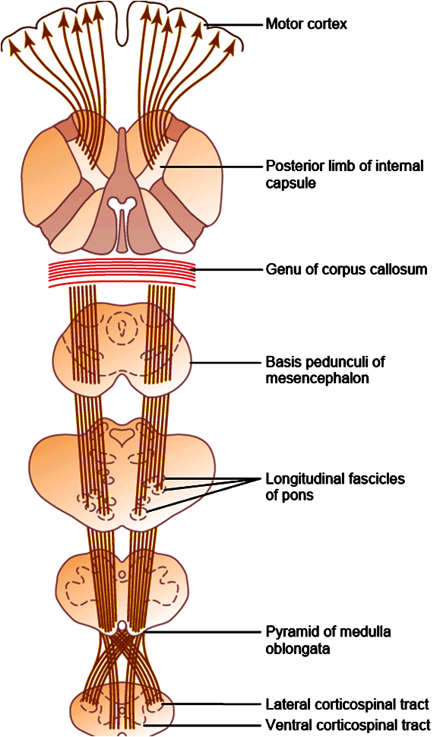
Pyramidal ( Corticospinal ) Tract
Controls primarily distal muscle, which control execution of fine , skilled movements of the contralateral hand eg. Writing , Painting , Picking up of a small object etc.
Effect of lesion → : loss of distal , skilled motor function in opposite side.
Fibers of Upper Motor Neron of Corticospina tract originates from :
30% of its fibers from the Primary Motor Cortex,
30% from the Premotor & Supplementary Motor Areas,
40% from the somatosensory areas posterior to the central sulcus
It contains Large myelinated fibers originate from giant pyramidal (Betz) cells
The majority ( 80 %) of the pyramidal fibers then cross in the lower medulla to the opposite side and descend as the lateral corticospinal tract .ة .

Slide 12
Pyramidal ( Corticospinal ) Tract
Anterior (or ventral , or uncrossed ) corticospinal tract is formed by uncrossed pyramidal fibers, which are primarily concerned with the control of fine movements that require dexterity مهارة .

Slide 13
Causes of UMNL & LMNL
Upper Motor Neuron Lesion,UMNL
Can be due to
(1) Cerebral haemorrhage , thrombosis or embolism
(2) Spinal cord transection or hemisection
(Brown- Sequard syndrome )
Lower Motor Neuron Lesion,LMNL
Can result from
(1) Anterior horn cell lesions ( e.g. , poliomyelitis, motor neuron disease )
(2) Spinal root lesions or peripheral nerve lesion
( e.g. nerve injury by trauma or compressive lesion)

Slide 14
Principal Features of UMNL & LMNL
UMNL:
(1) No marked or significant muscle wasting . However minor wasting may occur due to disuse ( disuse atrophy)
(3) Spasticity ( hypertonia ) , called
” clasp-knife spasticity “
(4) Clonus ( rhythmic oscillation on tendon stretch ) present
(5) Brisk ( exaggerated) tendon jerks
(6) Extensor plantar reflex , either a complete Babinski sign
( dorsiflexion of the big toe and
fanning out of the other toes ) , or
just an upgoing toe .
(7) Absent abdominal reflexes
(8) No fasciculations
(9) No fibrillation potential in EMG
LMNL:
(1) Marked muscle wasting
(atrophy)
(3) Hypotonia (flaccidity, hence the
name ” flaccid paralysis “)
(4) No clonus
(5) Diminished or absent tendon reflexes
(6) Absent plantar reflex ( normally it is flexor ) .
(7) Absent abdominal reflexes
(8) Fasciculations may be seen .
(9) Fibrillation potentials may be detected by EMG .

