Slide 1
SPASTICITY AND
INCREASED MUSCLE TONE
Prof. Syed Shahid Habib
MBBS DSDM FCPS
Professor
Dept. of Physiology
King Saud University
Note: Pure corticospinal tract lesion cause hypotonia instead of spasticity The reason is that pure pyramidal tract lesion is very very rare, and spasticity is due to loss of inhibitory control of extrapyramidal tracts.

Slide 2
OBJECTIVES
At the end of this lecture you should be able to
Define spasticity ,rigidity and dystonia
Describe the neurophysiology of spasticity
Describe the features of upper and lower motor neuron lesions
Describe the causes of spaticity
Enumarate the effects of spasticity
List the treatments to reduce spasticity

Slide 3
MUSCLE TONE ➔⬇⬆
The resistance of a muscle to stretch is often referred to as its tone or tonus.
If the motor nerve to a muscle is severed,
the muscle offers very little resistance and is said to be flaccid.
A hypertonic (spastic) muscle is one in which the resistance to stretch is high because of hyperactive stretch reflexes

Slide 4
COMAPRISON BETWEEN UPPER & LOWER MOTOR NEURON LESIONS
UMN LESION
Paralysis affect movements
Wasting not pronounced.
Spasticity Muscles hypertonic (Clasp Knife).
Tendon reflexes increased.
Superficial reflexes diminished
Babinski’s sign +ve,
LMN LESION
Individual muscle or group of muscles are affected.
Wasting pronounced.
Flaccidity. Muscles hypotonic.
Tendon reflexes diminished or absent.
Superficial reflexes often unaltered.

Slide 5
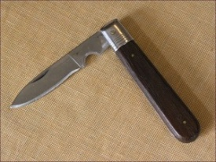
What is Spasticity?
“Spasticity is a motor disorder characterized by a velocity-dependant increase in tonic stretch reflexes with exaggerated tendon jerk, resulting from hyperexcitability of the stretch reflex” James Lance (1980)
In UMN lesions Spasticity is of Clasp Knife Type
Rigidity is increased neural activity throughout the range of muscle movement and is not velocity dependent. Rigidity is present in both agonist and antagonist muscles. It is often associated with basal ganglia disease such as Parkinson’s disease

Slide 6
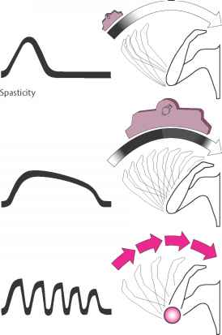
Rigidity in Parkinsonism
Lead-pipe rigidity . Passive movement of an extremity meets with a constant dead feeling resistance like a lead pipe throughout the range of movement.
Cog-wheel rigidity In cogwheel rigidity one feels that resistance varies rhythmically when applying a passive movement. It is because of an underlying resting tremor associated with rigidity.
Sometimes a series of “catches”
takes place during passive motion like a cogwheel

Slide 7
CAUSES OF SPASTICITY
A-(UMNS) syndrome include : • (1) Cerebral palsy • (2) Stroke • (3) Spinal cord injury • (4) Multiple Sclerosis • (5) Acqiured brain injury ( trauma , etc ) B-Parkinsonism C- Decerebrate & decorticate rigidity
Patients complain of pain, stiffness & inability to relax
Prolonged stiffness leads to bone & joint deformities with disability and contractures & its consequences

Slide 8
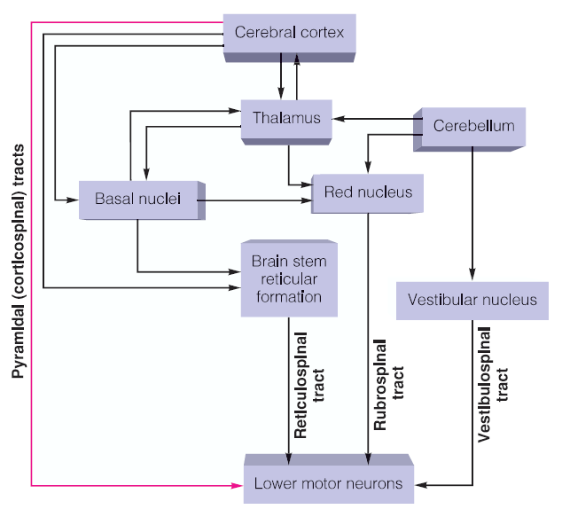

Slide 9
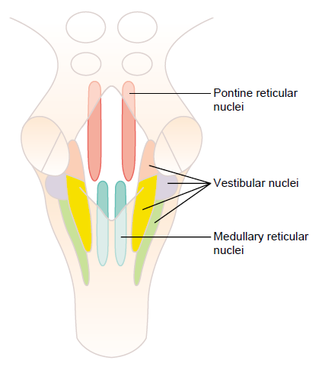
Support of Body Against Gravity is the role of the Reticular and Vestibular Nuclei
Pontine Reticular System. Transmit excitatory signals downward into the cord through the pontine reticulospinal tract in the anterior column of the cord
Medullary Reticular System. Transmit inhibitory signals to the same antigravity anterior motor neurons by way of a different tract, the medullary reticulospinal tract, located in the lateral column of cord
Decerebrate rigidity results from blockage of normally strong input to the medullary reticular nuclei from the cerebral cortex, the red nuclei, and the basal ganglia.
Medullary reticular inhibitor system becomes nonfunctional
Pontine excitatory system becomes overactive

Slide 10
Decerebrate Rigidity
Upper Pontine damage
Decorticate Rigidity
Upper midbrain damage

Slide 11
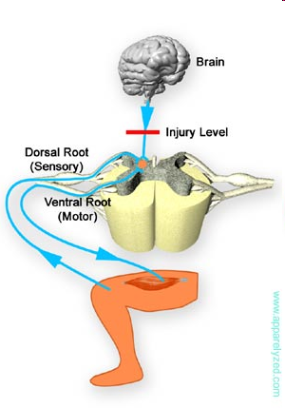
Mechanism of Spasticity
When Central Nervous System Lesion occurs
Hypotoncity
Alpha Lower motor neuron
Days to weeks later
Denervation hypersensitivity
Alpha lower motor neurons lower threshold
An increase in the number of Ach receptors
Pure corticospinal tract lesion cause hypotonia instead of spasticity The reason is that pure pyramidal tract lesion is very very rare, and spasticity is due to loss of inhibitory control of extrapyramidal tract.

Slide 12
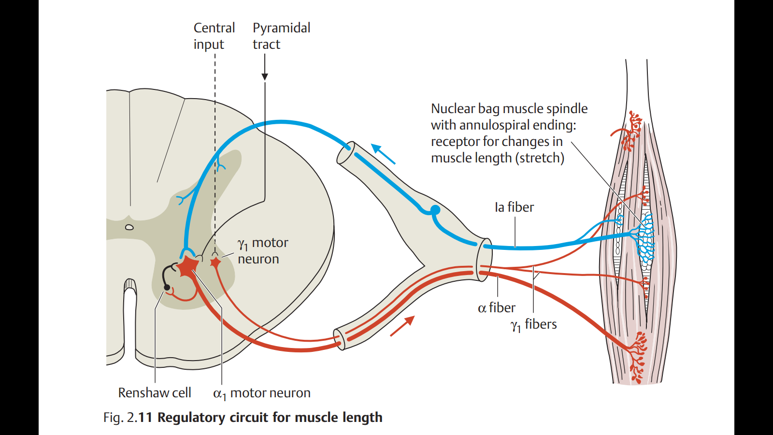
Increased Gamma efferent discharge is the main cause of increased muscle tone.

Slide 13
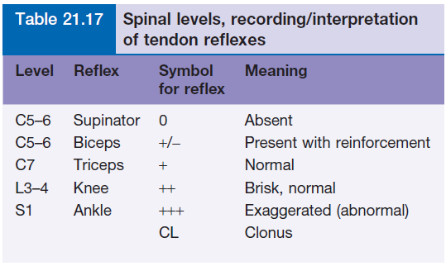

Slide 14
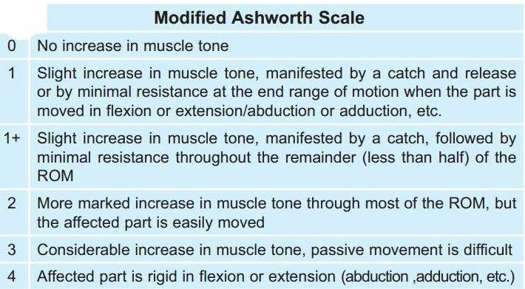
Ashworth Scale
Physical therapist need clarity to realize how spasticity can have affects on a patients ability to move
A valid & reliable measure scale for spasticity

Slide 15
Spasticity vs Dystonia
Increased muscle tone
Resistance to passive muscle stretch at a joint
Velocity and joint-angle dependent
Has to be palpated – ie you need to lay on hands
Other features: clonus, increased reflexes, upgoing plantars
Sustained and repititive muscle contractions & abnormal postures
Visible Involuntary movements
Suggests active rather than passive movements
Not usually velocity-dependent
Dependent on mental state: alertness, emotion

Slide 16
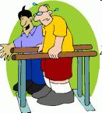
Interventions/Treatments
Effective Treatments for reducing Spasticity
PT Intervention
Electrical and Functional Electrical Stimulation
Casting
Mental Imagery
Pharmacological Interventions
Surgery

Slide 17
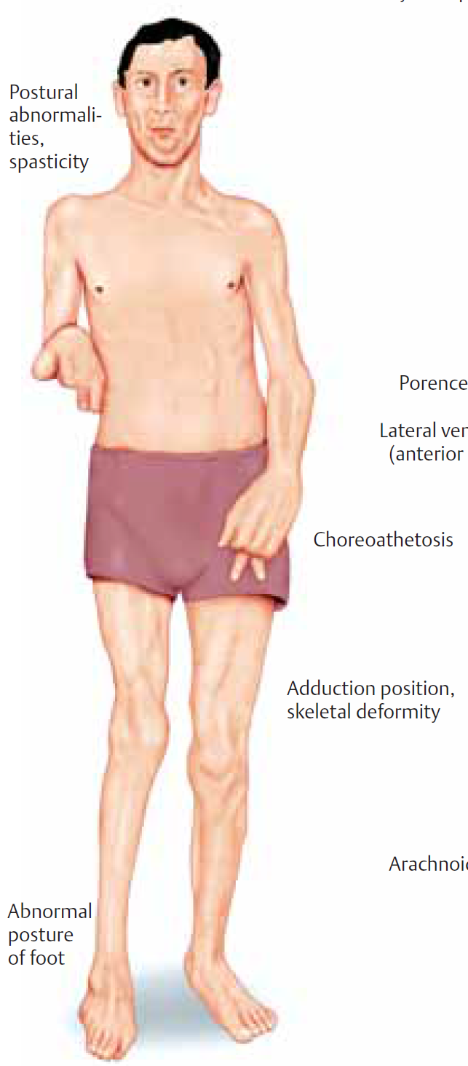
CEREBRAL PALSY (CP)
CP includes disorders apparent at birth or in childhood due to intra-uterine or neonatal brain damage mainly motor control centers; deficits are non-progressive
hypoxia in utero and/or during parturition
neonatal cerebral haemorrhage and/or infarction
trauma, neonatal or during parturition
prolonged seizures – status epilepticus
Hypoglycaemia
kernicterus

Slide 18
MULTIPLE SCLEROSIS
Auto-immune demyelinating disease , in which the body's own immune system attacks the myelin sheath of nerves mainly of brain, spinal cord & optic nerve
Demyelination affects saltatory conduction and cause muscle weakness& wasting.
Onset usually in young adults (F>M)
When it causes demyelination of descendindg motor tracts in the brainstem & spinal cord , the patient develops spasticity and other signs of UMN lesions .
The disease frequently remits and relapses
Treated by steroids

Slide 19
STROKE
Haemorrhagic stroke & Ischaemic stroke
Results in paralysis in the opposite half of the body • A lesion in Corona Radiata on one side can cause Monoplegia in a contralateral limb (UL or LL). • A lesion in the Internal Capsule on one side may cause Hemiplegia or Hemiparesis on the contralateral side • Presents with features of upper motor neuron syndrome UMNL .

Slide 20
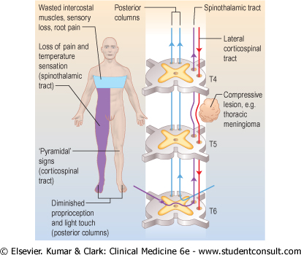
Brown Sequard syndrome
HEMISECTION OF SPINAL CORD
Ipsilateral Loss:
Fine touch, Vibration, Proprioception (Dorsal Column)
Leg Ataxia (Dorsal Spinocerebellar)
Spastic Paresis below lesion (Lat Corticospinal)
Flaccid Paralysis (Vent horn destruction)
Dermatomal Anesthesia (Dorsal Horn destruction)
Contralateral Loss:
Loss of pain and temp (lat Spinothalamic)
Loss of crude touch and Pressure (Vent Spinothalamic)
Minor Contralat Muscle Weakness (Vent Corticospinal)
Leg Ataxia (Vent Spinocerebellar)

Slide 22
Complete transection of spinal cord
in lower cervical region ➔quadriplegia
down in the thoracic region ➔ paraplegia (both lower limbs)
3 Stages :- A/ Spinal shock ( 2-6 weeks ) B/ Recovery of reflex activity C/ Paraplegia in extension
A/ Spinal shock: Immediately following transection there is loss of all sensations (anaesthesia), reflexes, tone (flacciduty) and voluntary movement below the level of the lesion , due to interruption of all sensory and motor tracts.
Bladder urinary retention with overflow) and Loss of vasomotor tone occurs causes a fall in blood pressure;
Voluntary movements and sensations are permanently lost

Slide 23
C/ Stage of extensor paraplegia The lower limbs become spastically extended. -Extensor reflexes become exaggerated, as shown by tendon jerks and by the appearance of clonus. -The positive supportive reaction returns and the patient can stand on his feet with appropriate support. The flexor withdrawal reflex and crossed extensor reflex returns
B/ Stage of return of reflex activity due to increase in degree of excitability of the spinal cord neurons
Gradual rise of arterial blood pressure
Exaggerated tendon reflexes, spasticity, viceral reflexes return (micturition, defecation & erection reflexes)
Mass reflex A minor painful stimulus to the skin of the lower limbs causes withdrawal and evoke autonomic reflexes (bladder and rectum emptying, sweating , blood pressure rise)

