Slide 1







PHYSIOLOGY OF BASAL GANGLIA AND REGULATORY MECHANISMS
Dr Syed Shahid Habib
MBBS DSDM FCPS
Professor
Dept. of Physiology
King Saud University

Slide 2


OBJECTIVES
  At the end of this lecture the students should be able to:-
Enumarate different nuclei of basal ganglia
Know different pathways (loops) and neurotransmitters involved in basal ganglia functions
Explain functions of Caudate & Putamen circuits of basal ganglia
Integration of direct and Indirect Pathways
Diagnose basal ganglia disorders

Slide 3
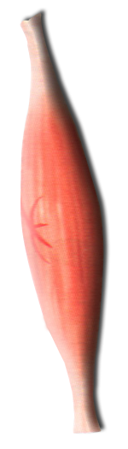
CEREBRAL CORTEX
Cerebral Cortex
Cerebral Cortex
BASAL GANGLIA
Corticospinal tracts
THALAMIUS
Corticobulbar tracts
BRAIN STEM
CEREBELLUM
Bulbospinal tracts
SENSORY INPUT
SPINAL CORD
FINAL COMMON PATH

Slide 4
3 Connections to remember
Main input to the basal ganglia
Main output from the basal ganglia
Connections between parts of basal ganglia
Basal
Nuclei
Caudate
Nucleus
Corpus
Striatum
Lentiform
Putamen
Globus Pallidus
Subthalamic Nucleus
Substantia Nigra

Slide 5

BASIC CIRCUITS OF BASAL GANGLIA
Motor loop (putamen circuit) concerned with execution of learned movement subconciosly.
Cognitive loop (Caudate circuit) concerned with cognitive control of sequences of motor pattern. Basically it is concerned with motor intentions.
(Note: cognition means thinking process using sensory input with information already stored in memory.)
Limbic loop involved in giving motor expression to emotions like, smiling, aggressive or submissive posture.
Occulomotor loop concerned with voluntary eye movement [ saccadic movement]

Slide 6
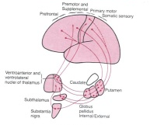
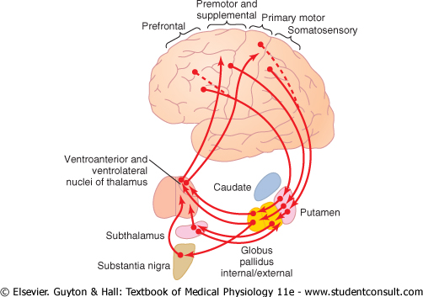
The Putamen Circuit
Prim Motor Cortex
Premotor
Suppl Motor Areas
Premotor
Suppl Motor
Somatosensory Cortex

Slide 7
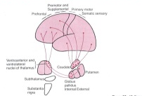
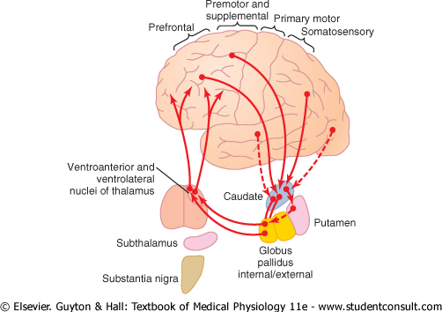
The Caudate Circuit
Prefrontal
Premotor
Suppl Motor
Association
Areas

Slide 8
Metabolic characteristics of BG
High Oxygen consumption .
High Copper content in Wilson’s disease (Copper intoxication):
Autosomal Recessive
Copper binding protein Ceruloplasmin is low
Lenticular degeneration occurs

Slide 9
BASAL GANGLIA
FUNCTIONS
Control of movements
Planning and programming of movements
Cognition

Slide 10


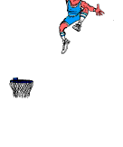
The Putamen Circuit
Executes Learned Patterns of Motor Activity
Basal ganglia function in association with the corticospinal system to control complex patterns of motor activity.
Examples are:
  writing of letters of the alphabet.
  cutting paper with scissors,
  hammering nails,
  shooting a basketball through a hoop,
  passing a football,
  throwing a baseball,
  the movements of shoveling dirt,
  most aspects of vocalization,
  controlled movements of the eyes
  virtually any other of our skilled movements, most of them performed subconsciously.

Slide 11
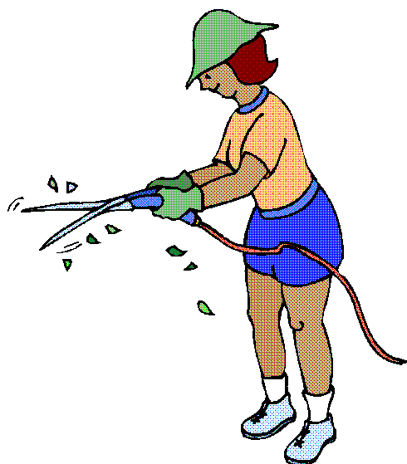
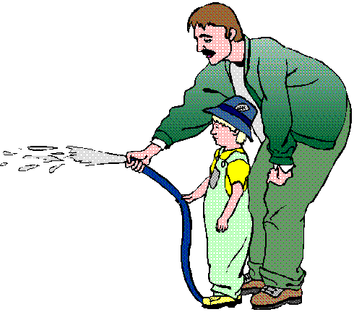


Slide 12
The Caudate Circuit
Cognitive Control of Sequences of Motor Patterns
Cognition means the thinking processes of the brain, using both sensory input to the brain plus information already stored in memory. Thoughts are generated in the mind by a process called cognitive control of motor activity.
Example:A person seeing a lion approach and then responding instantaneously and automatically by (1) turning away from the lion, (2) beginning to run, and (3) even attempting to climb a tree.
Thus, cognitive control of motor activity determines subconsciously, and within seconds, which patterns of movement will be used together to achieve a complex goal

Slide 13


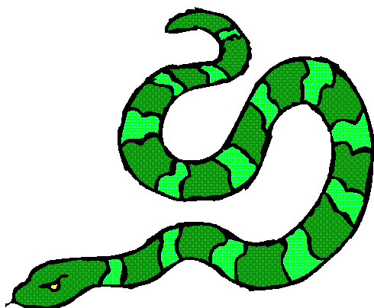

Slide 14
The Caudate Circuit
Change the Timing and to Scale the Intensity of Movements
Two important capabilities of the brain in controlling movement are
  (1) to determine how rapidly the movement is to be performed and
  (2) to control how large the movement will be.
For instance, a person may write the letter "a" slowly or rapidly. Also, he or she may write a small "a" on a piece of paper or a large "a" on a chalkboard. Regardless of the choice, the proportional characteristics of the letter remain nearly the same

Slide 15
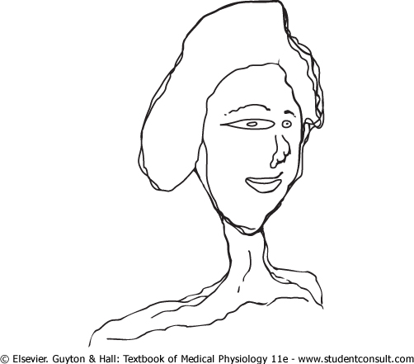



Slide 16
Basal Ganglial Pathways
Direct and Indirect

Slide 17
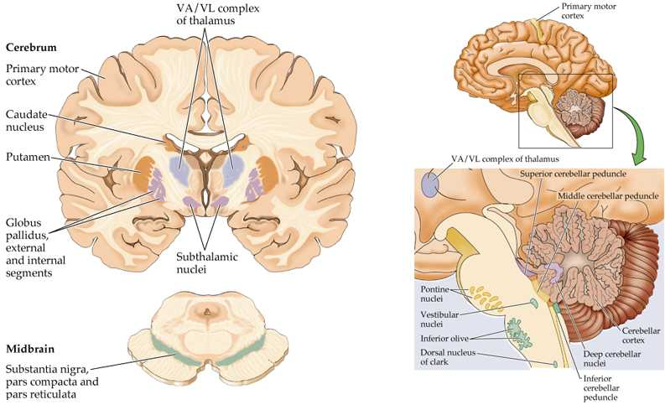
Both Direct & Indirect Basal Ganglial Pathway
↓ MOTOR ACTIVITY
↑ MOTOR ACTIVITY
Direct
Indirect
GPe
Striatum
GPi
Thalamus
SThN
SNPC

Slide 18
Direct Basal Ganglial Pathway
Stimulation leads to ↑ Motor Activity
↑ MOTOR ACTIVITY
GLU
+
GLU
+
GPe
↓GABA
-
+
DA1+
GPi
St
-
Thalamus
↑ GABA
-
Thalamocortical Neurons
are disinhibited
DA2 -
SThN
SNPC

Slide 19
↓ MOTOR ACTIVITY
Indirect Basal Ganglial Pathway
Stimulation leads to ↓ Motor Activity
GLU
+
+
GLU
GPe
↑GABA
-
St
GPi
↑ GABA
-
Thalamus
-
Subthalamic Neurons
are disinhibited
GLU
+
DA2 -
+
DA1+
-
↓GABA
SThN
SNPC

Slide 20
Both Direct & Indirect Basal Ganglial Pathway
↓ MOTOR ACTIVITY
↑ MOTOR ACTIVITY
+
+
GLU
GLU
GLU
+
-
GABA
GPe
↑GABA
-
+
GLU
GPi
St
GABA
-
Thalamus
-
-
GABA
GLU
+
DA1 +
DA2 -
-
GABA
SThN
SNPC

Slide 21






Movement Disorders
Hyperkinetic
  Hemiballismus
  Huntington’s Disease
  Athetosis
Hypokinetic
  Parkinson’s Disease
  Drug Induced (Neuroleptics, MPTP)

Slide 22
Movement Disorder | Features | Lesion
Chorea | Multiole quick, random movements, usually most prominent in the appendicular muscles | Atrophy of the striatum. Huntington Chorea
Athetosis | Slow writhing movements,which are usually more severe in the appendicular muscles | Diffuse hypermyelination of corpus striatum and thalamus
Hemiballismus | Wild flinging movements of half of the body | Hemorrhagic destruction of contralateral subthalamic n. Hypertensive patients
Parkinsonism | Pill rolling tremor of the fingers at rest, lead pipe rigidity and akinesia | Degenration of Substantia Nigra

Slide 23

Parkinson’s Disease
Described by James Parkinson
Degeneration of dopaminergic nigrostriatal neurons (60-80 %).
Phenthiazines (tranquilizers drugs) .
Methyl-Phenyl-Tetrahydro-Pyridine (MPTP). The oxidant MPP+ is toxic to SN.
Five cardinal features
  Tremor
  Rigidity
  Akinesia & Bradykinesia
  Postural Changes
  Speech Changes

Slide 24
Both Direct & Indirect Basal Ganglial Pathway
↓ MOTOR
↑ MOTOR
+
+
GLU
+
-
GABA
GPe
GABA
-
+
GLU
GPi
P
GABA
-
Thalamus
-
-
GABA
GLU
+
DA1 +
DA2 -
-
GABA
SThN
SNPC

