Slide 1
PAIN MODULATION
numerical value
adjectives
DR SYED SHAHID HABIB
MBBS DSDM FCPS
Professor
Dept. of Physiology
College of Medicine & KKUH

Slide 2
OBJECTIVES
At the end of this lecture you should be able to describe:
Nociceptors, Referred Pain, radiating pain
“Gating” of Pain
Pain Suppression (“Analgesia”) System in the Brain and Spinal Cord
Transcutaneous Electrical Nerve
Stimulation (TENS)
Transcranial Direct Current Stimulation (tDCS)

Slide 3
Nociceptive & Neuropathic Pain
Nociceptive pain is detected by specialized transducers connected to A-delta and C-fibers (stimuli from somatic and visceral structures)
Neuropathic pain damage to nerves (trigeminal neuralgia, postherpetic pain, diabetic neuropathy)
4 Basic Processes
Transduction—nociceptors free nerve endings
Transmission
Perception of Pain-At cortical Level
Modulation of Pain, Changing or inhibiting pain impulses in the descending tract (brain→ spinal cord) [norepinephrine and serotonin]

Slide 4
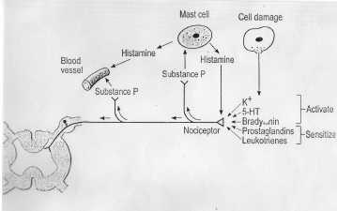
Chemical agents that produce pain
Nociceptors are activated by: Bradykinin, serotonin, Histamine, K⁺ ion, Acids, acetyl choline, & proteolytic enzymes.
Nociceptors are sensitized by: Prostaglandins & substance P

Slide 5
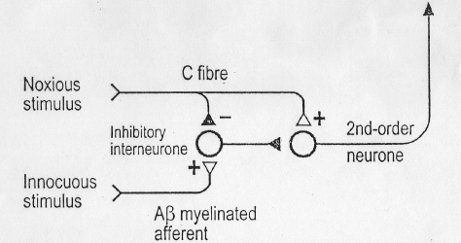
A MODAL OF “GATING” OF PAIN
Implies a non-painful stimulus can block the transmission of a noxious stimulus.
Is based on the premise that the gate, located in the dorsal horn of the spinal cord, modulates the afferent nerve impulses.
A-Delta fibres (sharp pain)
C fibres (dull pain)
A-Beta fibres that carry messages of light touch

Slide 6
Conditions that open or close the gate
Conditions that open the gate
Conditions that close the gate
Physical conditions
Extent of the injury
Medication
Inappropriate activity level
Counterstimulation, eg massage
Emotional Conditions
Anxiety or worry
Positive emotions
Tension
Relaxation
Depression
Rest
Mental conditions
Focusing on the pain
Intense concentration or distraction
Boredom
Involvement and interest in life activities

Slide 7
REFERRED PAIN
Pain that is not felt in the diseased structure itself, but at another place in the body far away from the site of origin.
Visceral and deep somatic pain are often referred, but superficial pain is not.
Mechanism of referred pain
  Dermatomal rule
  Convergence of peripheral & visceral pain on the same second order neuron that project to brain

Slide 8
REFERRED PAIN
Convergence
Branches of visceral pain fibers synapse in the spinal cord on the same second-order
Neurons that receive pain signals from the
skin

Slide 9
REFERRED PAIN
Localization of Visceral Pain
“Visceral” and the “Parietal” Pain
Transmission Pathways
When pain is both localized and spreading it is called radiating pain

Slide 10
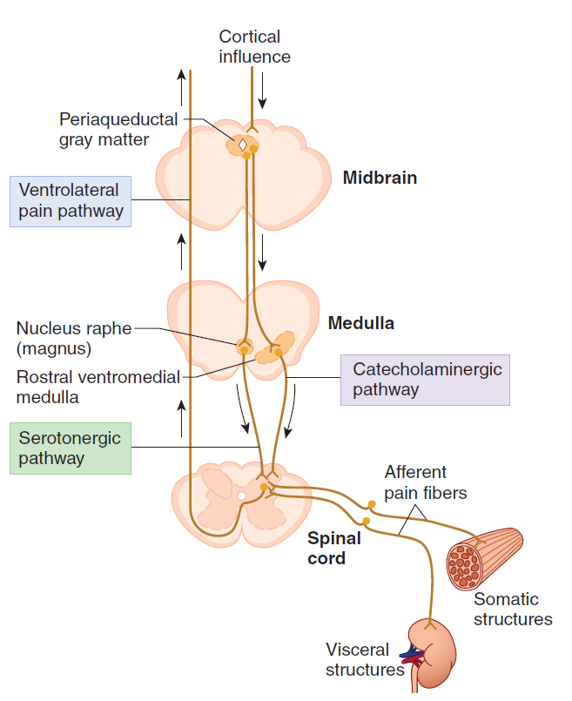
Pain Suppression
(“Analgesia”)
System
in the Brain
and Spinal Cord
Ascending Pain
Pathway
Descending
Analgesic
Pathway

Slide 11
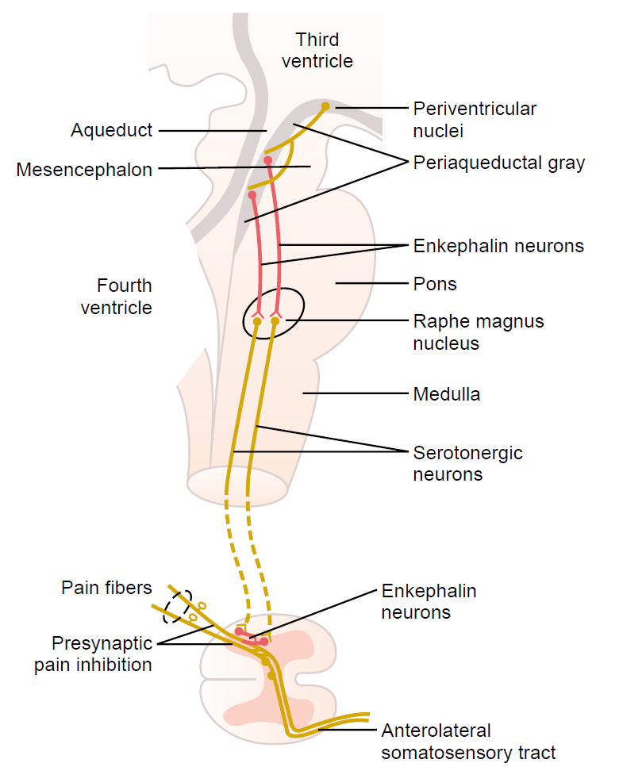
(1) Enkephalin Neurons from periaqueductal gray and periventricular areas of the mesencephalon and upper pons send signals to
(2) Raphe magnus nucleus, in the lower pons and upper medulla From these nuclei, second-order N go down the dorsolateral columns in the spinal cord & secrete Serotonin which act on local neurons to secrete Enkephalin
(3) a pain inhibitory complex in the dorsal
Pain Suppression (“Analgesia”) System
in the Brain and Spinal Cord
At this point, the analgesia signals can block the pain before it is relayed to the brain.

Slide 12
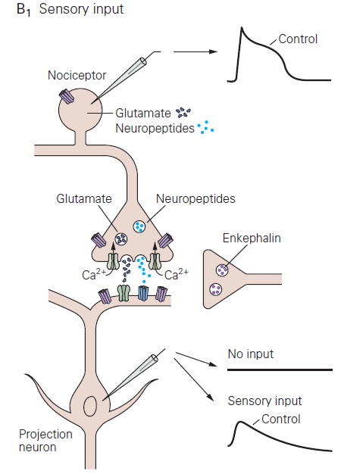
Activation of the presynaptic OR leads to a decrease in Ca⁺⁺ influx, resulting in a decrease in release of glutamate and substance P.
Activation of the postsynaptic OR hyperpolarizes the dorsal horn interneuron by causing an increase in K⁺ conductance.
⬇ duration of the EPSP in the dorsal horn neuron.
Activation of OR on dorsal root ganglia cell bodies also contributes to reduced transmission from nociceptive afferents.
Opioid Receptor (OR)

Slide 13
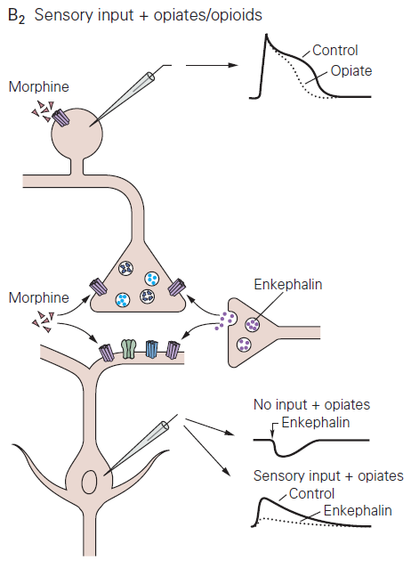

Slide 14
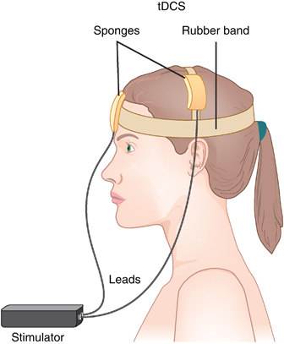
TRANSCRANIAL DIRECT CURRENT STIMULATION (TDCS)
It is a non-invasive procedure in which a device sends a small Direct Current (DC) across electrodes in the areas of interest on the scalp to modulate brain function.
This current flow can increases or decreases the neuronal excitability in the specific area being stimulated, based on which type of stimulation.
When the current passes from the anode to the cathode, it may increase the activity of the brain at the anode site and decrease the activity of the brain near the cathode site.

Slide 15
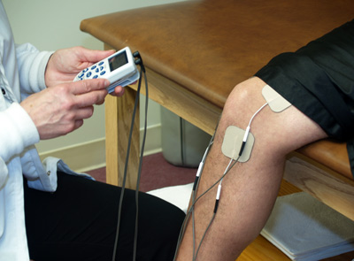
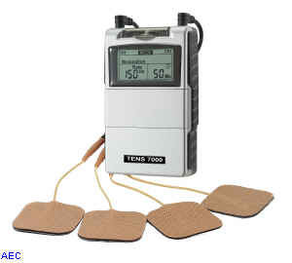
TRANSCUTANEOUS ELECTRICAL NERVE
STIMULATION (TENS)
The gate-control mechanism of pain modulation and serves as the rationale behind the use of transcutaneous electrical nerve stimulation (TENS) for pain relief.
TENS uses electrodes to activate Aα and Aβ fibers in the vicinity of the injury.

Slide 16

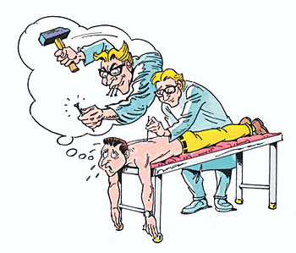
Inhibition of Pain Transmission by Tactile
Sensory Signals
Stimulation of large type Aβ sensory fibers from peripheral tactile receptors depress transmission of pain signals from the same body area by lateral inhibition in the spinal cord
The simultaneous physical and psychogenic excitation of the central analgesia system is the basis of pain relief by ACUPUNCTURE.

Slide 17
CHARACTERSITICS OF VISCERAL PAIN
Poorly localized
Associated with nausea and autonomic disturbance
Often referred
Cutting, crushing are not painful when applied to viscera
Pain is caused by distension, ischemia and inflammation
Pain - Aδ and fibers
Travel with autonomic afferent
Spinal cord
(Dorsal Horn)
Lat. spinothalamic tract
Thalamus
Somatosensory Cortex

Slide 18
PAIN SCALES
Visual Analog Scale
Locate area of pain on a picture
McGill pain questionnaire
  Evaluate sensory, evaluative, & affective components of pain
    20 subcategories, 78 words
numerical value
adjectives

Slide 19
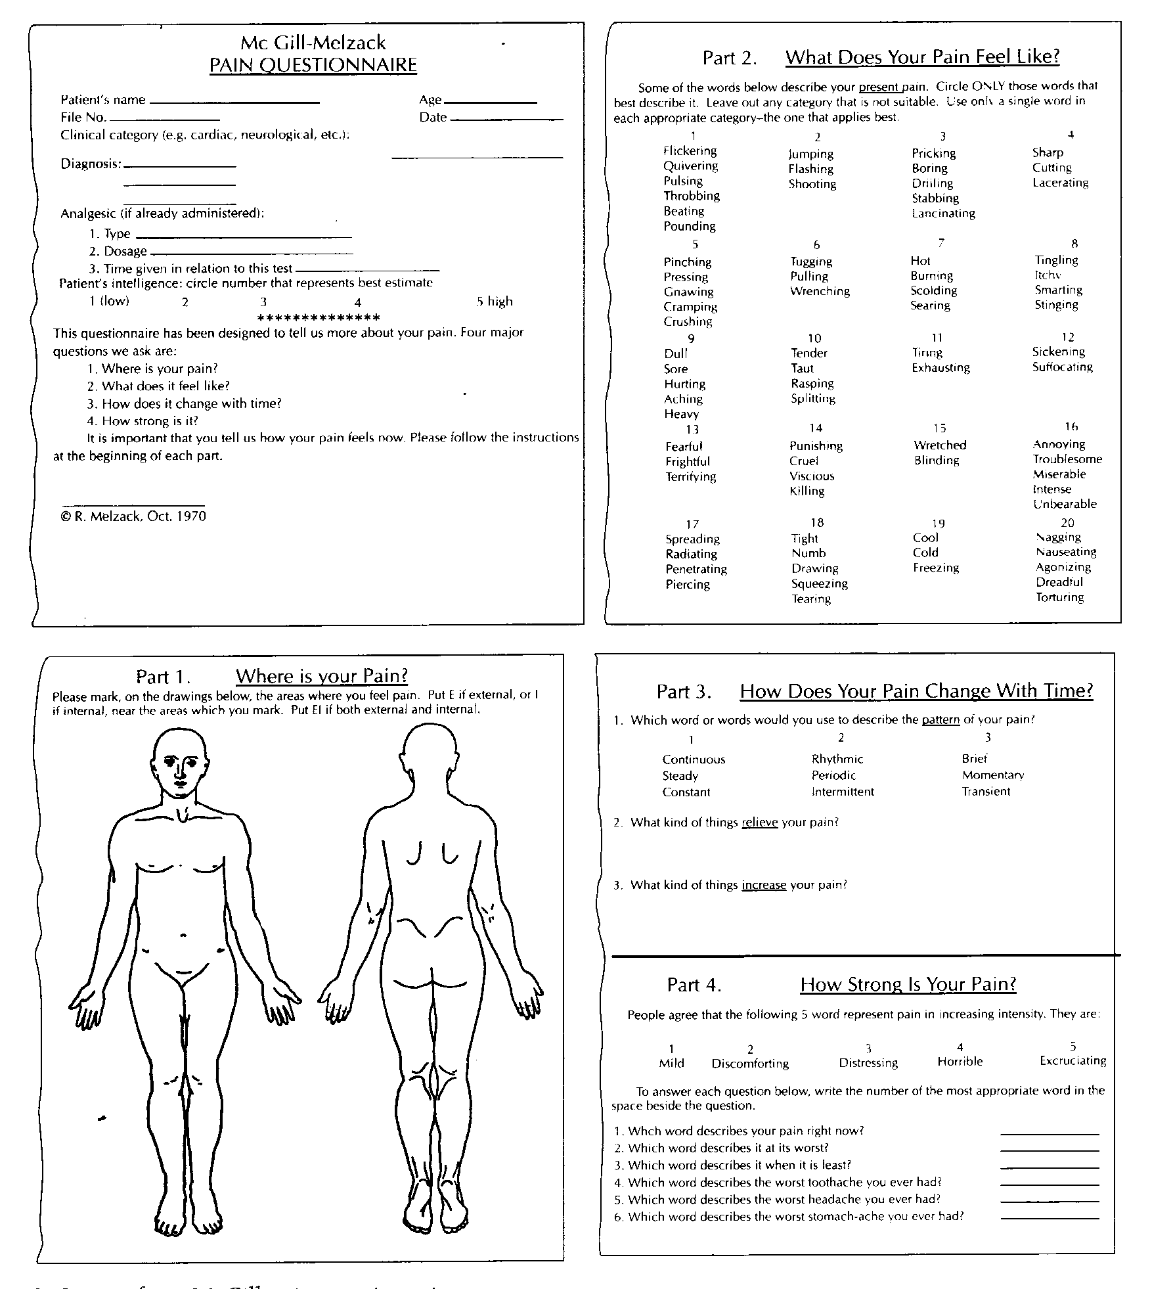

Slide 20
Placebo Effect
Placebo stems from the Latin word for “I shall please”
  Used to describe pain reduction obtained from a mechanism other than those related to the physiological effects of the tx.
  Linked to psychological mechanisms
All Treatments ™ have some degree of placebo effect
  Most studies involving TM involving the use of a sham TM (ultrasound set at the intensity of 0) and an actual treatment have shown ↓ levels of pain in each group.

Slide 21
Congenital Analgesia
A well-known case of congenital insensitivity to pain is a girl referred to as ‘Miss C' who was a student at McGill university in Montreal in the 1950s.
She was normal in every way, except that she could not feel pain. When she was a child she had bitten off the tip of her tongue and had suffered third-degree burns by kneeling on a radiator.
she did not feel any pain when she was given strong electric shocks or when exposed to very hot and very cold water. When these stimuli were presented to her she showed no change in heart rate, blood pressure or respiration.
She died at the age of 29 as a result of her condition, because she damaged her knees, hips and spine.

Slide 22
Fibromyalgia: Pain Without Injury
The occurrence of body-wide pain in the absence of tissue damage, as in fibromyalgia, interferes with all aspects of a person's life and undermines their credibility.
The problem is that normal activities can be exhausting, sleep is disturbed, the ability to concentrate is impaired, gastrointestinal function is often abnormal, persistent headaches are common, and the unrelenting pain that no one can see is often detrimental to their personal and professional lives--as it creates a "credibility gap."

Slide 23
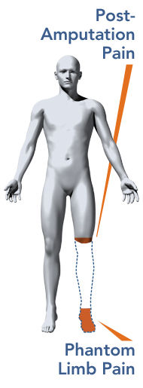
Phantom limb pain
Phantom limbs give impression of pressure and pain
Even if phantom limb is experienced as spatially detached from the body, it is still felt to belong to the patient.
Paraplegic people experience phantom limbs. They can even experience continually cycling legs.
It is the emotional and motivational systems that cause the phantom limb experience.
Our brain can reorganize if sensory input is cut off at the ventral posterior thalamic nucleus even after that part is amputated

Slide 24
This acquired tolerance is different
from addiction
Opiate Tolerance
receptor desensitization
compensatory adaptations in neuronal circuit
learning mechanisms
Physical Dependence
compensatory adaptations in neuronal circuit
Drug Withdrawal
removal of opiate unmasks compensatory adaptations
Drug Addiction Psychological addiction is extremely rare during treatment of pain
This acquired tolerance is different from addiction, which refers to a psychological craving.
Psychological addiction rarely occurs when morphine is used to treat chronic pain, provided the patient does not have a history of drug abuse.

Slide 25
TERMS FREQUENTLY USED
Hyperalgesia: Excessive Pain
Allodynia: Pain caused by any other sensation e.g. touch will cause pain.
Muscular Pain: Less blood flow in the muscles (ischemia).
Stress analgesia: Mild degree of pain is not felt if the other part of the body has excessive pain.
Causalgia: burning pain Both develop after wound or disease has ended. Triggered by a simple stimulus e.g. breeze or vibration.
Neuralgia - sharp pain along a nerve pathway.
Thalamic Syndrome: Obstruction of the thalmogeniculate branch of the posterior cerebral artery Affects posterior thalamic nuclei Patient suffers from prolonged severe pain

