Slide 1
AGING AND CHANGES IN THE BRAIN

Slide 2
Objectives
Definition of Aging
Theories and terms Used
Body Changes in Aging
Brain Changes in Aging
Memory Changes in Aging
Carotid Hypersensitivity

Slide 3
AGING
Aging is the progressive, universal decline first in functional reserve and then in function that occurs in organisms over time
Aging is not a disease; however, the risk of developing disease is increased, often dramatically, as a function of age.
Notes:
3

Slide 4
Aging is characterized by
Changes in appearance (gradual reduction in height and weight loss due to loss of muscle & bone mass)
A lower metabolic rate
Longer reaction times
Declines in certain memory functions
Declines in sexual activity and in women menopause
A functional decline in audition, olfaction, and vision
Declines in kidney, pulmonary, and immune functions, declines in exercise performance, and multiple endocrine changes
(Craik and Salthouse, 1992; Hayflick, 1994, pp. 137-186; Spence, 1995

Slide 5
THE TERM AGEING
UNIVERSAL AGEING: age changes that all people share)
PROBABILISTIC AGEING: age changes that may happen to some (eg type two diabetes).
CHRONOLOGICAL AGEING: referring to how old a person is
SOCIAL AGEING:society's expectations of how people should act as they grow older
BIOLOGICAL AGEING: an organism's physical state as it ages
Notes:
5

Slide 6
Some Theories of Aging
Hypothesis | How It May Work
Genetic | Aging is a genetic program activated in post-reproductive life when an individual's evolutionary mission is accomplished
Oxidative stress | Accumulation of oxidative damage to DNA, proteins, and lipids interferes with normal function and produces a decrease in stress responses
Mitochondrial dysfunction | A common deletion in mitochondrial DNA with age compromises function and alters cell metabolic processes and adaptability to environmental change

Slide 7
Some Theories of Aging
Hypothesis | How It May Work
Hormonal changes | The decline and loss of circadian rhythm in secretion of some hormones produces a functional hormone deficiency state
Telomere shortening | Aging is related to a decline in the ability of cells to replicate
Defective host defenses | The failure of the immune system to respond to infectious agents and the overactivity of natural immunity create vulnerability to Inf..
Accumulation of senescent cells | Renewing tissues become dysfunctional through loss of ability to renew

Slide 8
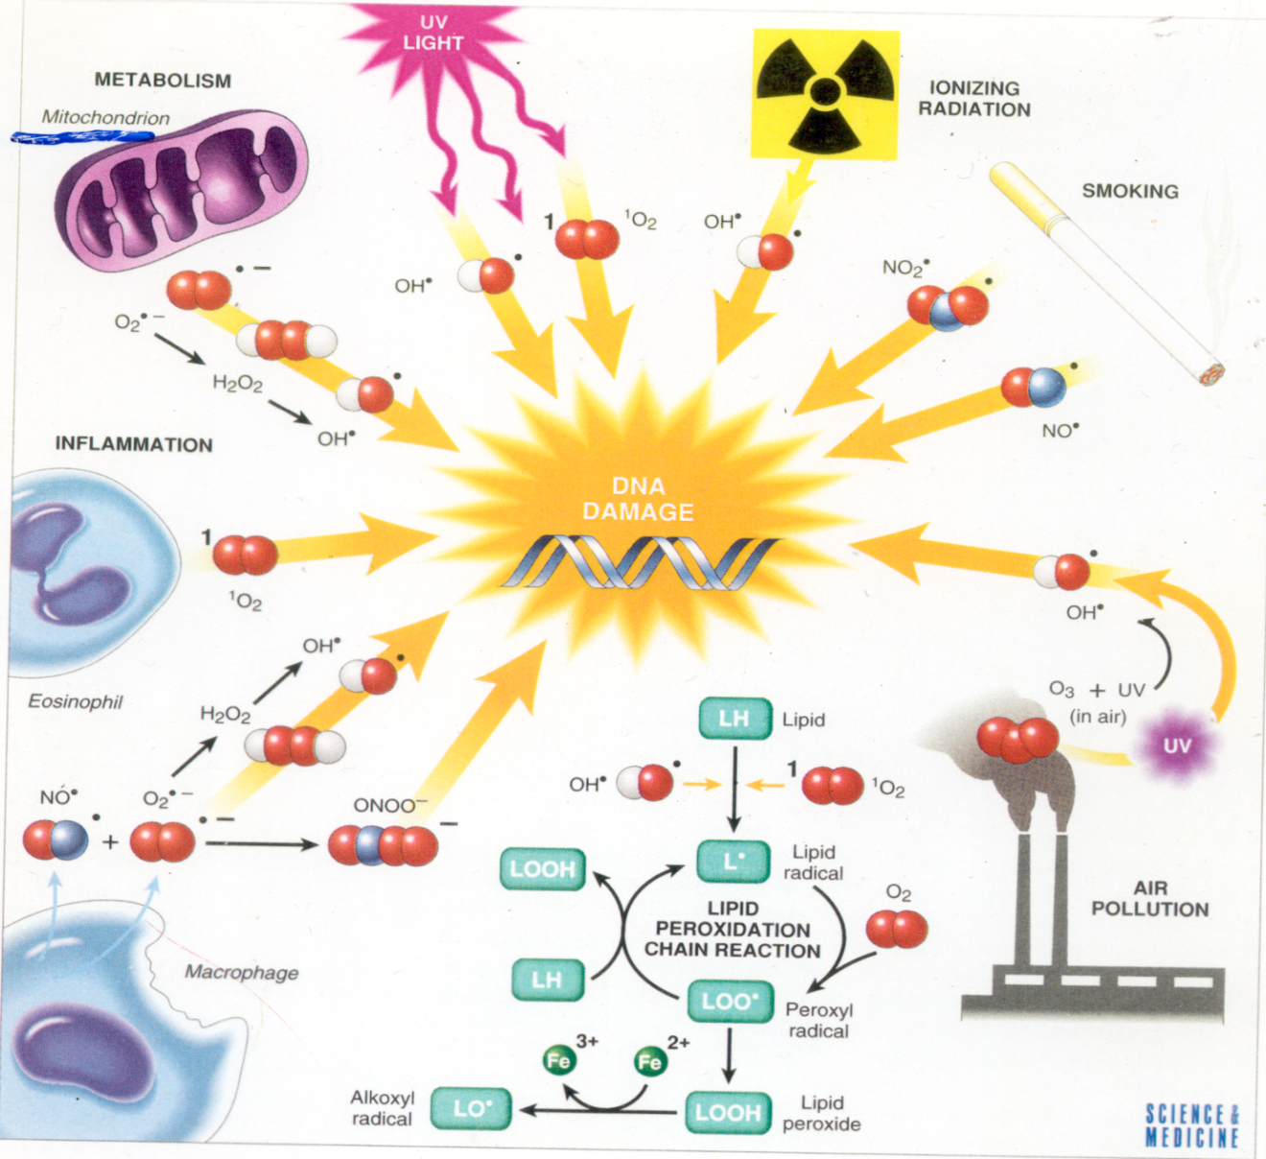
OXYGEN - free radicals (FR) and reactive oxygen species (ROS)
Cell metabolism
environment
Infection
lifestyle
DNA damage
diet
pollution

Slide 9
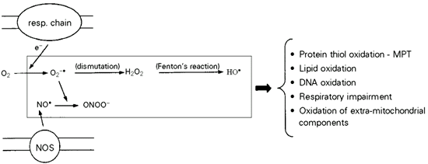
Mitochondria produce ROS:
Molecules damaged
The respiratory chain (resp. chain) produces superoxide radicals (O₂^{-·}), which generate hydrogen peroxide (H₂O₂) and hydroxyl radicals (HO·). Mitochondrial nitric oxide synthase (NOS) produces nitric oxide (NO·), which combines with O₂^{-·} to generate peroxinitrite (ONOO⁻). All these ROS may cause mitochondrial and cellular damage if present in excess. MPT, Mitochondrial permeability transition.
Kowaltowski 2002

Slide 10
Leading Causes of Death Age 65+ “Medical Diagnoses”
Heart Disease 32%
Cancer 22%
Stroke 8%
Chronic respiratory 6%
Flu/Pneumonia 3%
Diabetes 3%
Alzheimer’s 3%
State of Aging and Health CDC/NCHS Health US, 2002

Slide 11
Brief Geriatric Assessment Instruments
Domain | Instrument | Comments
Cognition
Dementia | MMSE | Widely studied and accepted
 | Timed time and change test | Sensitive and quick
Delirium | CAM | Sensitive and easy to apply
Affective disorders | GDS 5-question form | Rapid screen
Visual impairment | Snellen chart | Universally used
Hearing impairment | Whispered voice | No special equipment needed
 | Pure tone audiometry | Can be performed by trained office staff
Dental health | DENTAL^{c}
Nutritional status | Weight loss of >4.5 kg (>10 lb) in 6 months or weight <45 kg (<100 lb)
Gait and balance | "Timed Get Up and Go" test | Requires no special equipment

Slide 12
Aging nervous system
Structure | Regional function
Basal ganglia | Becomes bright in appearance due to iron accumulation (movements affected)
Subarachnoid space | Increase in size due to brain shrinkage
Hippocampus | Reduction in size due to cell loss in the structure. Par of limbic system Involved in learning & memory
Ventricles | Increase in size due brain shrinkage.
White Matter | Reduction in size due to neuronal atrophy in the deep brain. Involves in information transmission.

Slide 13
Aging nervous system
Changes
Consequences
Drug toxicities
delirium
Altered mood
Decreased IQ scores
“Benign senile forgetfulness”
Increased postural
instability
Altered gait
Falls, accidents
Decreased brain weight
Cerebral blood flow
memory
Alteration in CNS neurotransmitters
Decreased vibratory sense

Slide 14
Neurological System
Neuronal loss is normal in the aging brain but the ability to learn remains generally unchanged
There is loss of dendritic arborization
Recall memory is affected more than cognitive function in normal aging
Cerebral atrophy shows up on CTs and MRI scans
Lowered seizure threshold
Reduced Sympathetic nervous system activity
Reduced Neurotransmitter levels
Changes in sleep patterns
Abnormalities in EEG tracings
Increased risk of stroke

Slide 15
Nervous System
Aging leads to increased cerebral amyloid
Average amount of brain protein is reduced with a marked loss in multiple enzymes (carbonic anhydrase and the dehydrogenases) but with a relative increase in abnormal proteins such as amyloid in tangles and plaques.
Loss of RNA (messenger and transcription) but not DNA
Loss of lipids, and lipid turnover rate, and a decrease in catabolism and synthesis.

Slide 16
Carotid sinus hypersensitivity
Carotid sinus syncope occurs when there is an exaggerated vagal response to carotid sinus stimulation,
Provoked by wearing a tight collar, looking upwards or turning the head
Carotid sinus syndrome occurs in the elderly and mainly results in bradycardia.
Most common etiologies of atrioventricular block
Do not massage both carotids simultaneously.

Slide 17
Pressure on the carotid sinus,
produced by the
tight collar or carotid massage
can
cause
marked
bradycardia
vasodilatation
Fainting
or syncope

Slide 18
Sensorineural Hearing Loss
Damage to the hair cells of the organ of Corti may be caused by intense noise, viral infections, ototoxic drugs (e.g., salicylates, quinine and its synthetic analogues, aminoglycoside antibiotics, loop diuretics such as furosemide and ethacrynic acid, and cancer chemotherapeutic agents such as cisplatin), fractures of the temporal bone, meningitis, cochlear otosclerosis (see above), Ménière's disease, and aging
Notes:
18

Slide 19
Vision
Loss of ability to see items that are close up begins in the 40’s (Presbyopia)
Size of pupil grows smaller with age: focusing becomes less accurate
Lens of eye yellows making it more difficult to see red and green colors
Sensitivity to glare increases
Night vision not as acute

Slide 20
Disorders of the Sense of Taste
Disorders of the sense of taste are caused by
transport loss
sensory loss
neural loss
Sensory gustatory losses are caused by inflammatory and degenerative diseases in the oral cavity; a vast number of drugs, particularly those that interfere with cell turnover such as antithyroid and antineoplastic agents; radiation therapy to the oral cavity and pharynx; viral infections; endocrine disorders; neoplasms; and aging

Slide 21
Pain and Sense of Touch
With age, skin is not as sensitive as in youth
Contributing factors include:
1. Loss of elasticity
2. Loss of pigment
3. Reduced fat layer
Safety Implications:
1. Lessened ability to recognize dangerous levels of heat
2. Lessened ability of body to maintain temperature
3. Tendency to develop bruises, skin tears more easily

Slide 22
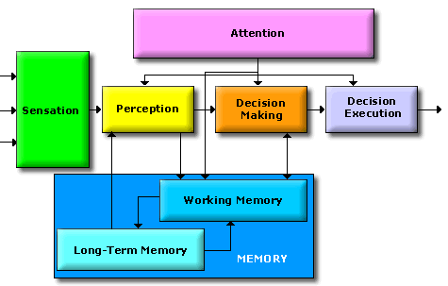
CONGITIVE CHANGES IN AGING: MENTAL PROCESSING
Decline in attentional ability
Working memory
There is decline in mental processing via reduction of attentional ability and decline in ability in forming working memory (mainly includes short term memory)
There is decline in explicit memory that involves hippocampus (surroudings & Skills)

Slide 23
Geriatric Syndromes
Dementia and Delirium
Falls
Urinary Incontinence
Pressure Ulcers
Functional Decline

Slide 24
Dementia and Delirium
Dementia is a syndrome of progressive decline in which multiple intellectual abilities deteriorate, causing both cognitive and functional impairment.
Delirium is an acute state of confusion
Delirium may be the only manifestation of a life-threatening illness in the older adult.

Slide 25
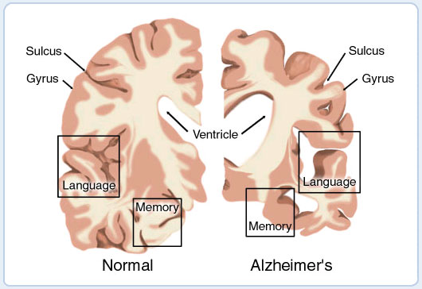
Alzheimer’s Disease
Alzheimer’s disease is defined as premature aging of the brain, usually beginning in mid-adult life and progressing rapidly to extreme loss of mental powers similar to that seen in very, very old age.

Slide 26
Alzheimer’s Disease (Features)
(1) an amnesic type of memory impairment
(2) deterioration of language
(3) visuospatial deficits.
Motor and sensory abnormalities, gait disturbances, and seizures are uncommon until the late phases of the disease.

Slide 27
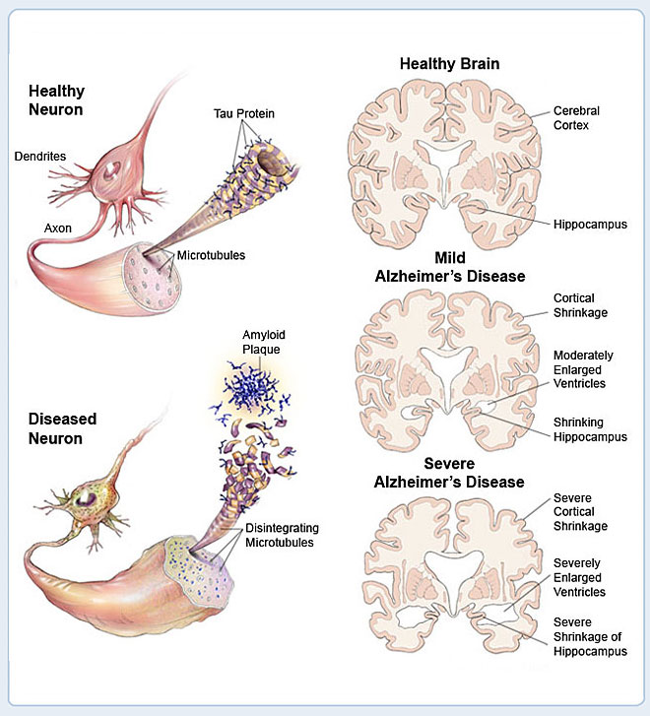

Slide 28
Amyloid Plaques
It is hallmark of Alzheimer's disease
There is accumulation of amyloid plaques between nerve cells (neurons) in the brain.
Amyloid is a general term for protein fragments that the body produces normally. Beta amyloid is a protein fragment snipped from an amyloid precursor protein (APP).
In a healthy brain, these protein fragments are broken down and eliminated. In Alzheimer's disease, the fragments accumulate to form hard, insoluble plaques.

Slide 29
Neurofibrillary Tangles
These are insoluble twisted fibers found inside the brain's cells.
Consist primarily of a protein called tau, which forms part of a structure called a microtubule. The microtubule helps transport nutrients and other important substances from one part of the nerve cell to another.
In Alzheimer's disease, however, the tau protein is abnormal and the microtubule structures collapse.

Slide 30
Sexual Dysfunction
Erectile dysfunction (ED) is not considered a normal part of the aging process. Nonetheless, it is associated with certain physiologic and psychological changes related to age.
In the Massachusetts Male Aging Study (MMAS), a community-based survey of men between the ages of 40 and 70, 52% of responders reported some degree of ED. Complete ED occurred in 10% of respondents, moderate ED occurred in 25%, and minimal ED in 17%
Notes:
30

