Slide 1
Dr. Sajjad Hussain
Assistant Professor
Consultant Neuroradiologist
Radiology Department
KKUH / KSU

Slide 2
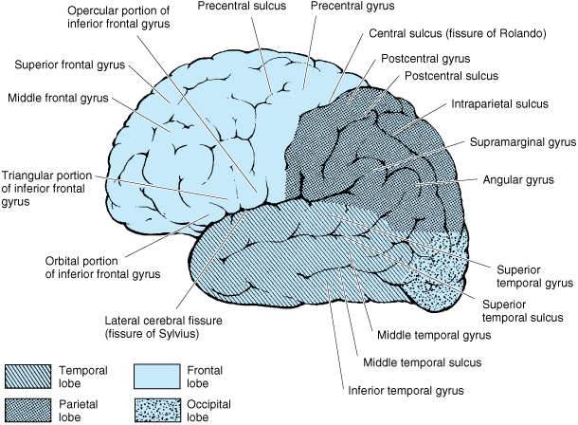
Notes:
Lateral view of L hem

Slide 3
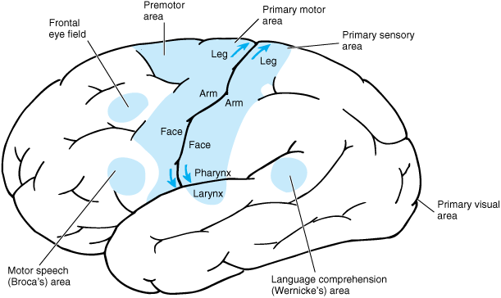
Notes:
Left lateral view showing the functions of the local areas

Slide 4
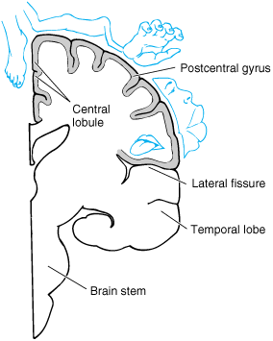
Notes:
Sensory homunculus drawn overlying a coronal section through the postcentral gyrus. The location of the cortical representation of various body parts is shown.

Slide 5
CT SCAN..
Contrast enhanced CT -- After IV injection of contrast medium
Abnormality becomes visible or more prominent
Contrast enhancement is due to breakdown of blood brain barrier allowing contrast to enter the lesion particularly in neoplasm, infection, inflammation and subacute stage of ischemia
Also it is helpful in demonstrating blood vessels
ACA
MCA
Basilar artery
Straight sinus
Superior sagittal sinus

Slide 6
CT SCAN..
Computerized reconstructions can be made from axial sections to provide images in coronal or sagittal planes
Sagittal reconstruction
Coronal reconstruction

Slide 7
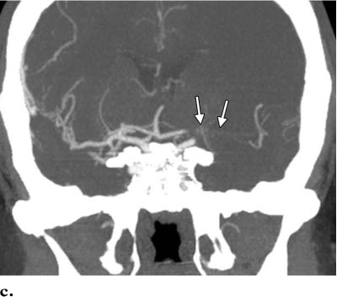
CT SCAN..
CT Angiography
Helpful in diagnosis of vascular abnormalities e.g. stenosis, occlusion, aneurysm or vascular malformation
Occlusion of left middle cerebral artery

Slide 8
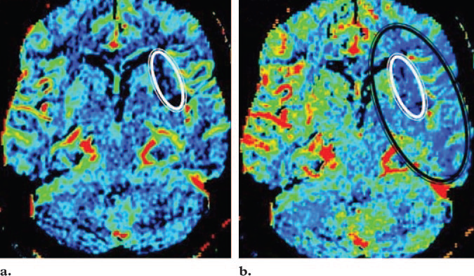
CT SCAN..
CT PERFUSION

Slide 9
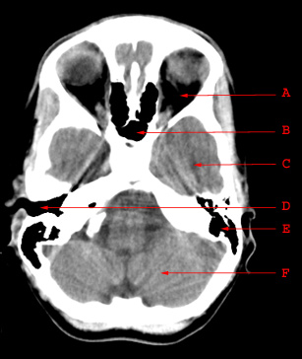
CT SCAN..
A. Orbit
B. Sphenoid Sinus
C. Temporal Lobe
D.Externa Auditory Canal
E. Mastoid Air Cells
F. Cerebellar Hemisphere

Slide 10
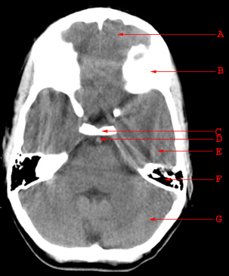
CT SCAN..
A. Frontal Lobe
B. Frontal Bone (Superior Surface of Orbital Part)
C. Dorsum Sellae
D. Basilar Artery
E. Temporal Lobe
F. Mastoid Air Cells
G. Cerebellar Hemisphere

Slide 11
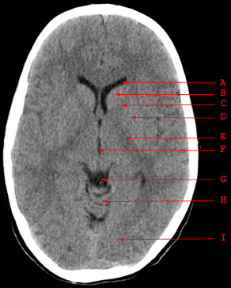
CT SCAN..
A. Anterior Horn of Lateral Ventricle
B. Head of Caudate Nucleus
C. Anterior Limb of Internal Capsule
D. Putamen and Globus Pallidus
E. Posterior Limb of Internal Capsule
F. Third Ventricle
G. Quadrigeminal Plate Cistern
H. Cerebellar Vermis
I. Occipital Lobe

Slide 12
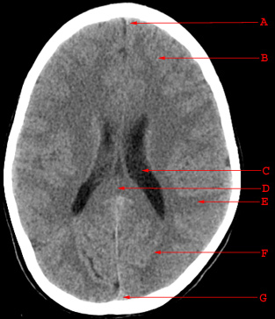
CT SCAN..
A. Falx Cerebri
B. Frontal Lobe
C. Body of Lateral Ventricle
D. Splenium of Corpus Callosum
E. Parietal Lobe
F. Occipital Lobe
G. Superior Sagittal Sinus

Slide 13
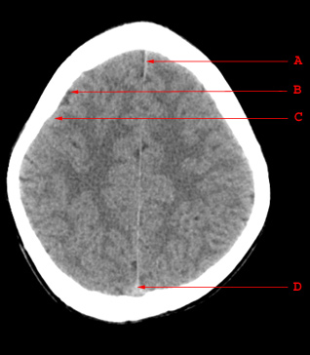
CT SCAN..
A. Falx Cerebri
B. Sulcus
C. Gyrus
D. Superior Sagittal Sinus

Slide 14
MRI..
No ionizing radiation
No Patient preparation
fasting for general anesthesia.
Contrast medium: Gadolinium
Indications:
strokes
tumors
infection
Vascular disorders
white matter disease
some cases of trauma

Slide 15
MRI..
Contraindications
Cardiac pacemaker
Intraocular ferrous foreign body
Pregnancy (1st trimester)
Claustrophobia
Nothing magnetic can be allowed inside the MRI room

Slide 16
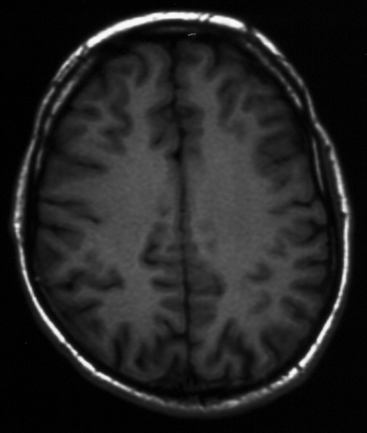
MRI..
T1 weighted
T2 weighted
FLAIR

Slide 17
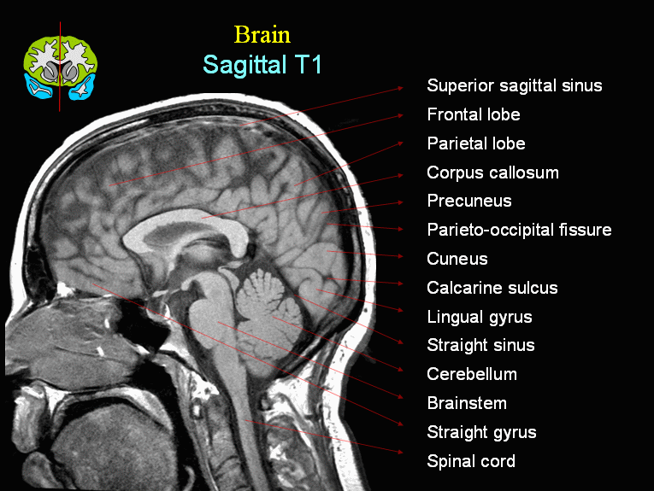

Slide 18
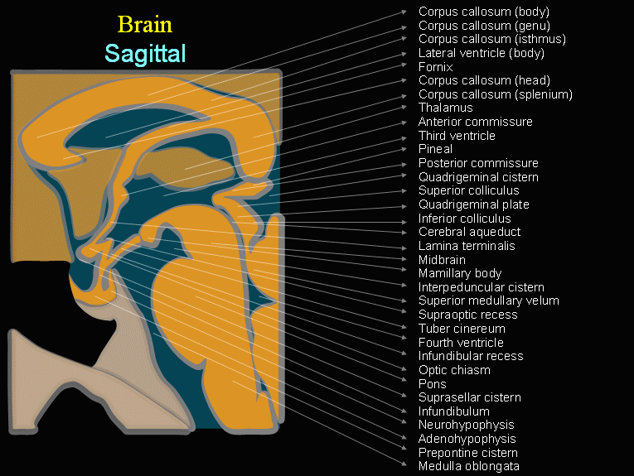

Slide 19
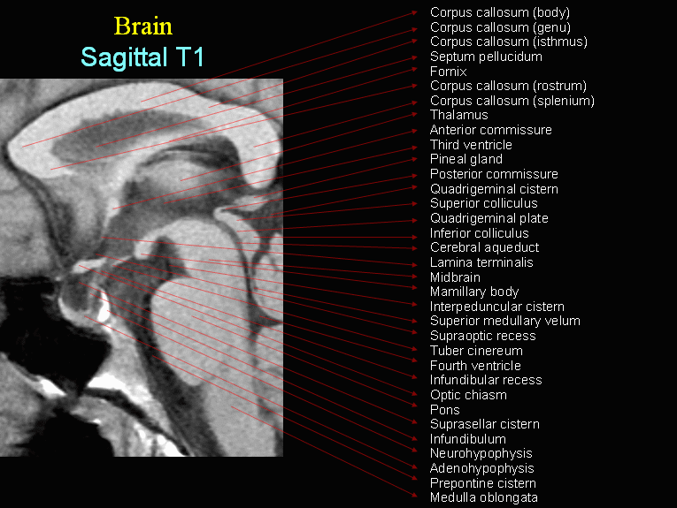

Slide 20
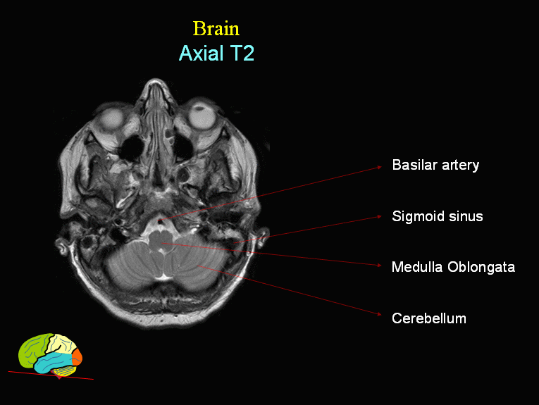

Slide 21
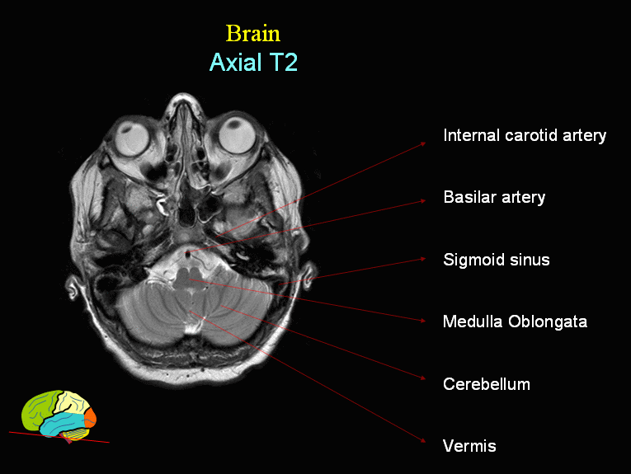

Slide 22
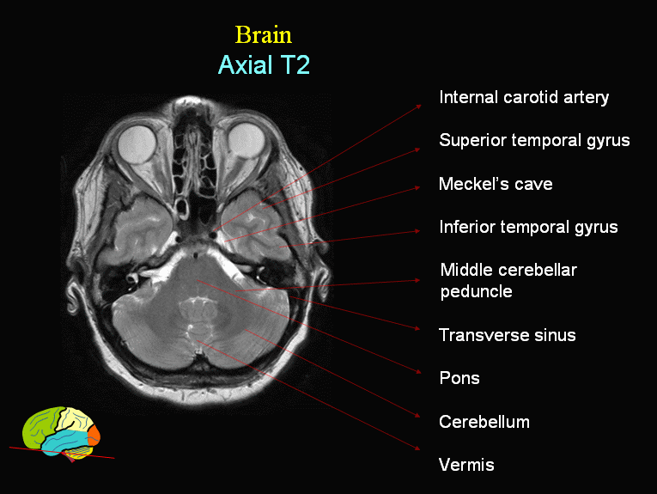

Slide 23
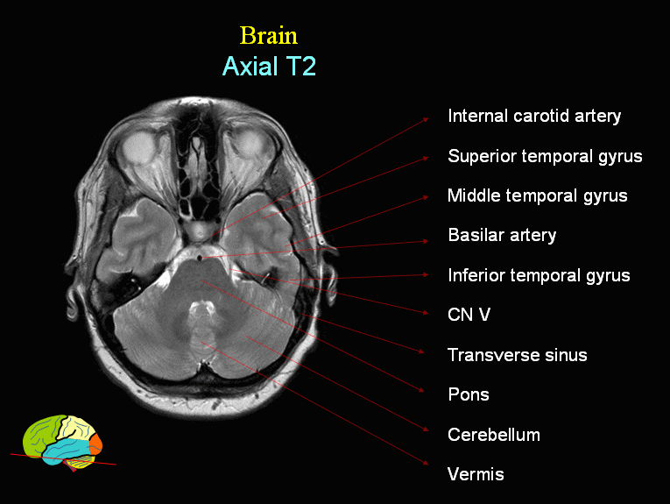

Slide 24
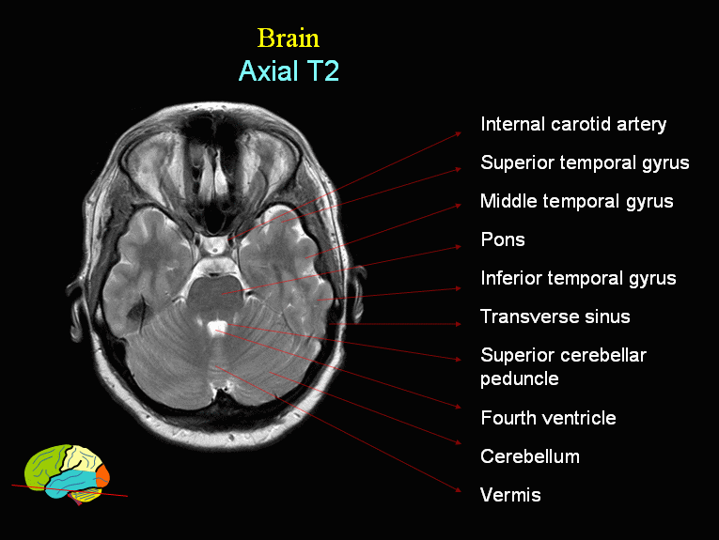

Slide 25
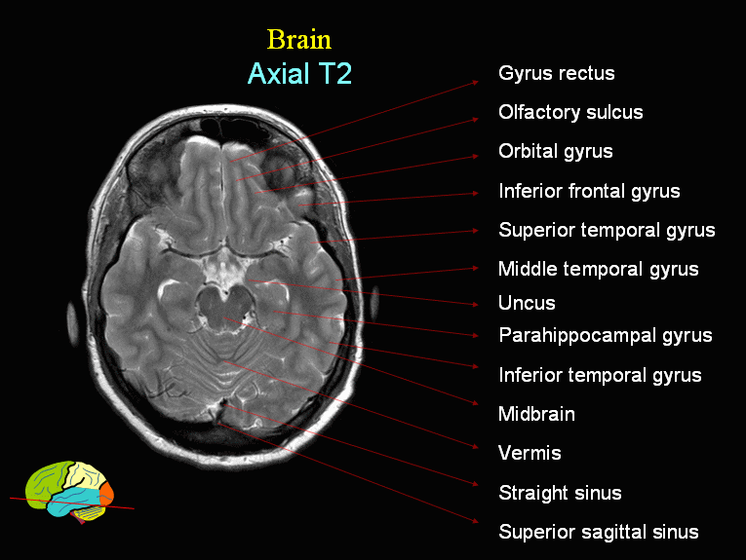

Slide 26
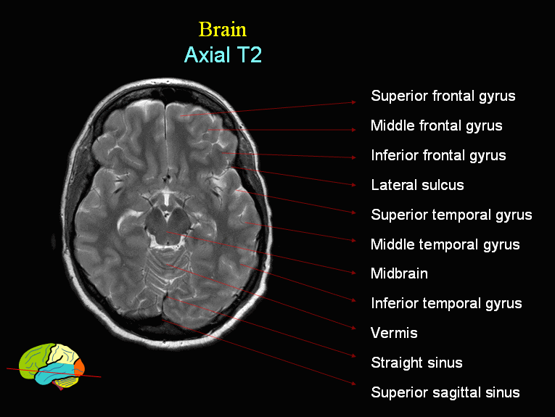

Slide 27
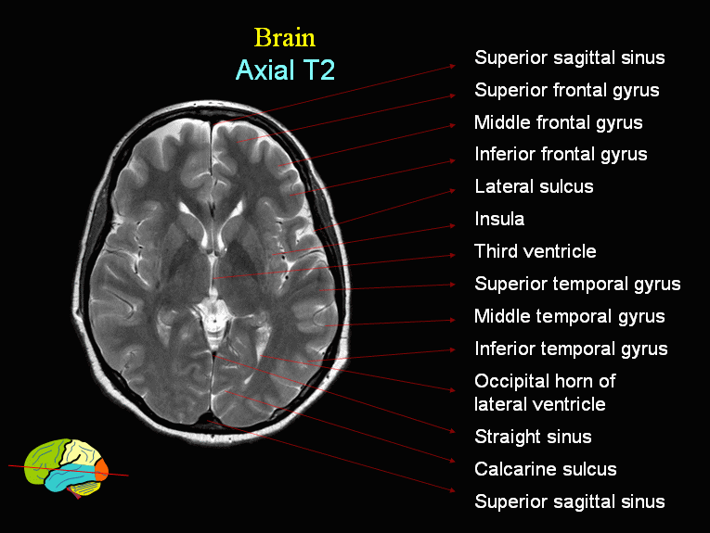

Slide 28
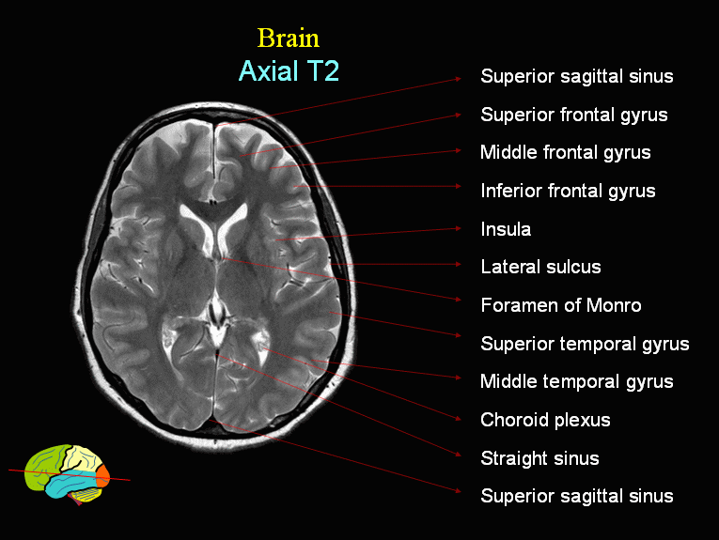

Slide 29
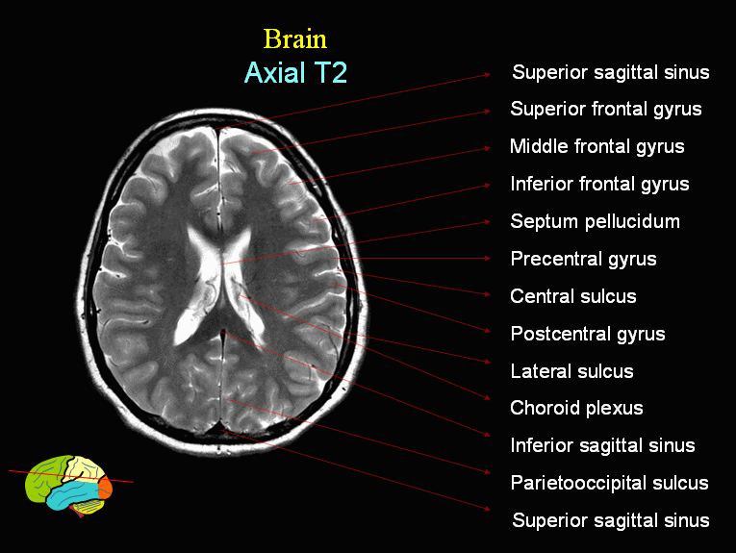

Slide 30
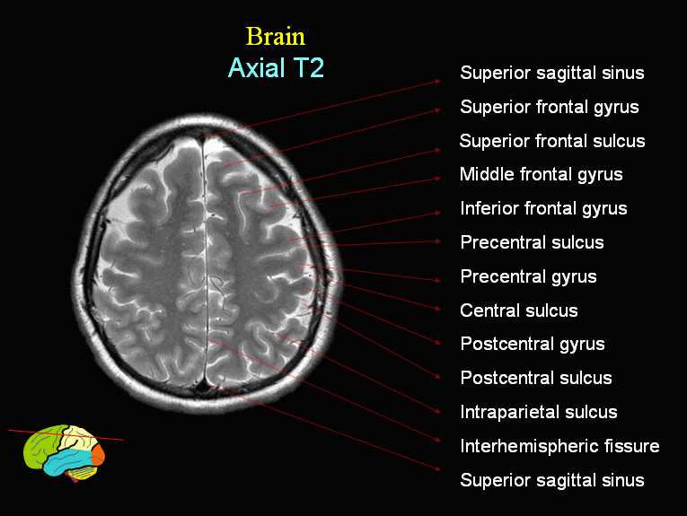

Slide 31
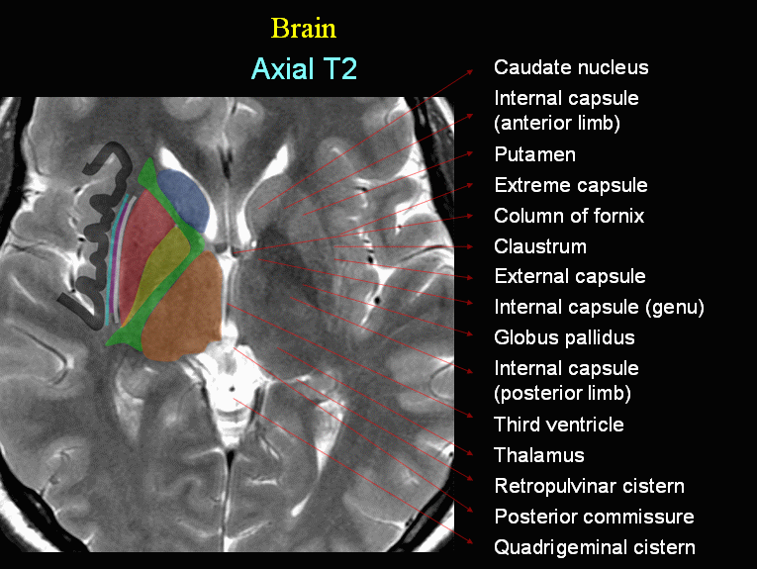

Slide 32
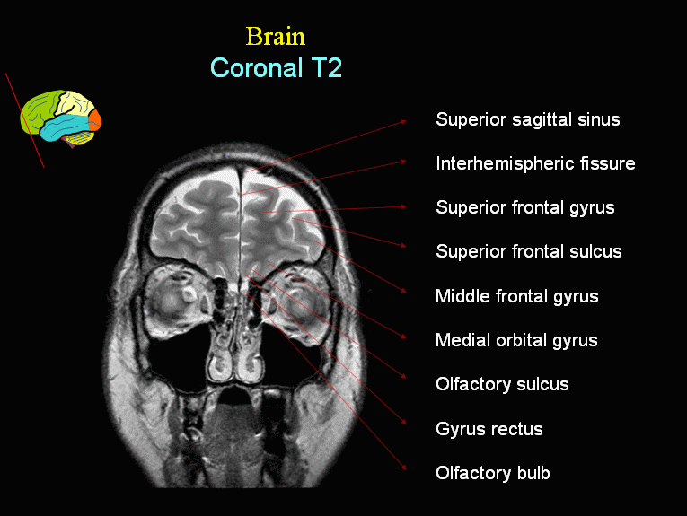

Slide 33
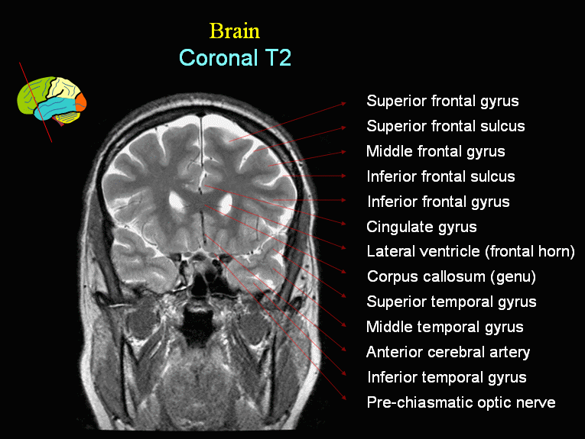

Slide 34
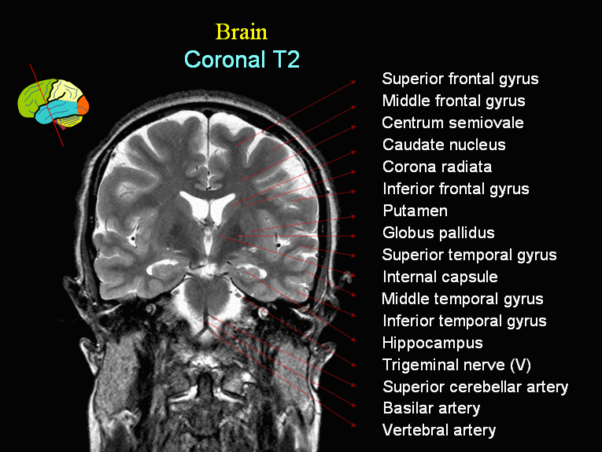

Slide 35
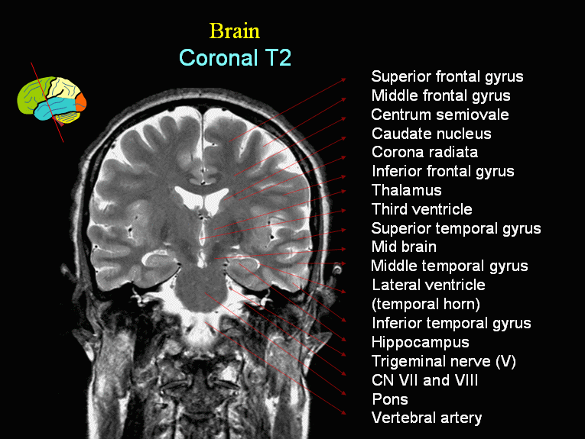

Slide 36
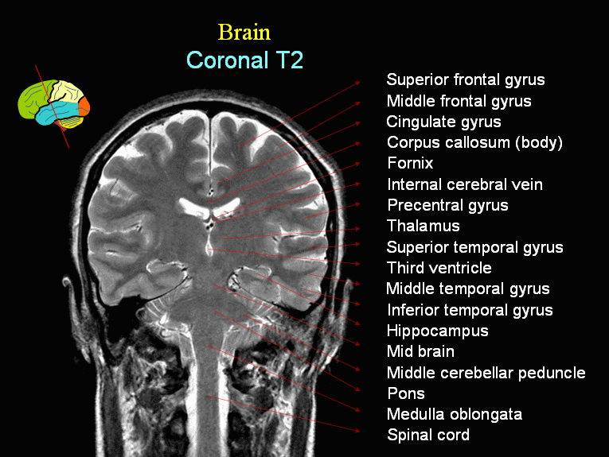

Slide 37
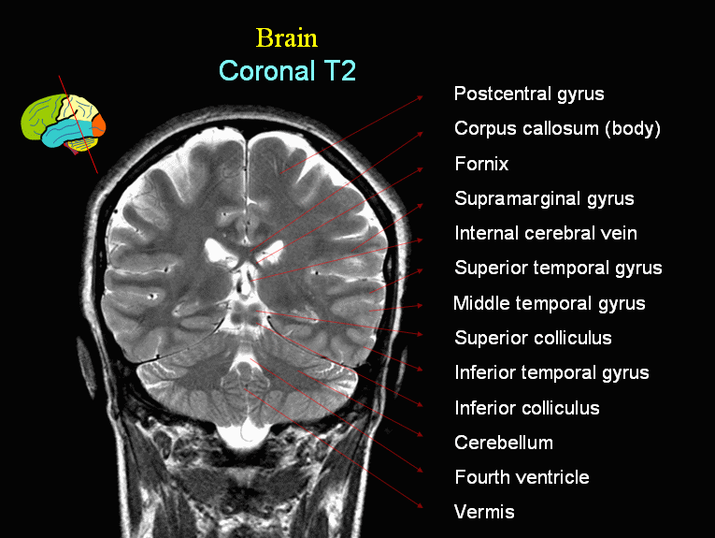

Slide 38
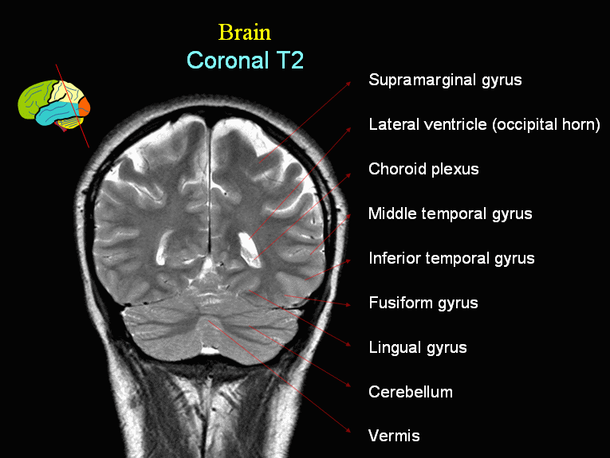

Slide 39
MR Angiography..
Can be done with or without intravenous injection of contrast material
Assesses intra and extra cranial arteries for any abnormalities such as stenosis, occlusion or vascular malformation.

Slide 40
MR Venography..
Can be done with or without intravenous injection of contrast material
Assess venous sinuses and major cortical veins
Can confirm or exclude venous thrombosis

Slide 41
Middle Cerebral Artery
Notes:
MCA is the largest branch which supplies the frontal, temporal and parietal lobes
MCA has three branches (put three fingers spaced apart beside inner aspect of ear to show location of MCA)
MCA is the most commonly affected vessel in embolic stroke (plaque or clot from a distant source = embolic)

Slide 42
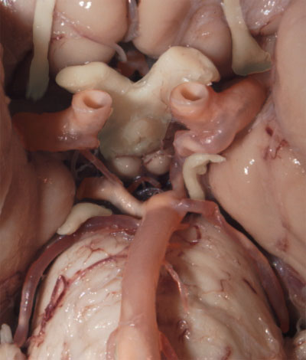
Circle of Willis
Notes:
The Circle of Willis join the anterior and posterior circulation – the carotid and vertebral-basilar circulations
Important route of secondary or collateral circulation in the event of loss of circulation
The Circle of Willis is the most common location for congenital aneurysm

Slide 43
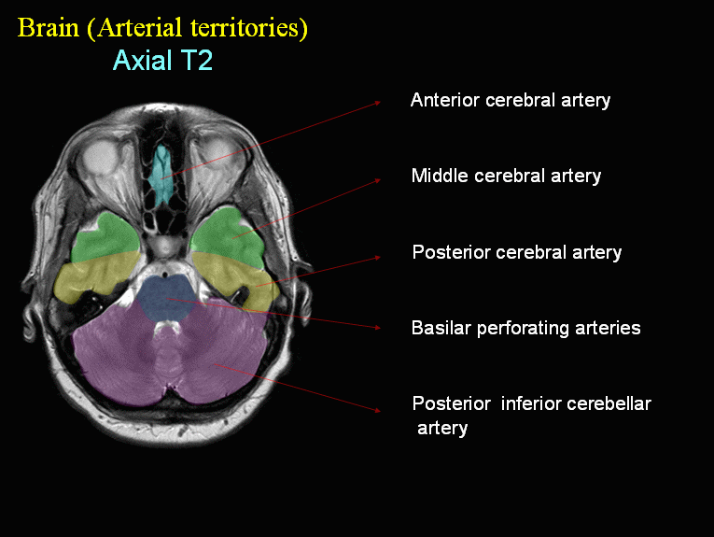

Slide 44
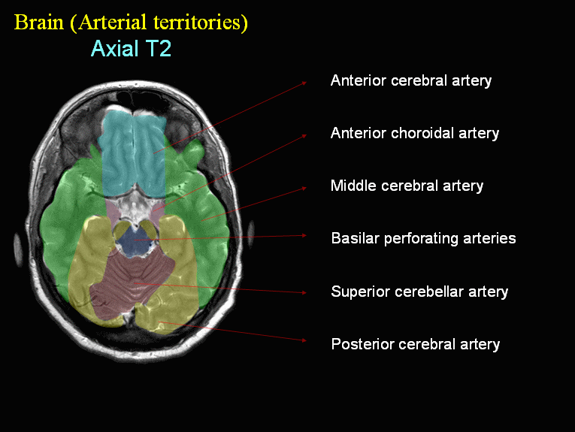

Slide 46
CEREBRAL ANGIOGRAM..
Gold standard technique for assessment of intra and extra cranial vessels
It can demonstrate different vascular diseases (stenosis, occlusion, vascular malformation and blood supply of brain tumors
It is an invasive technique – needs femoral artery puncture and cannulation.
Recently its main is for treatment of acute occlusions, vascular malformations, aneurysms, or pre operative embolization of vascular supply of tumors.

Slide 47
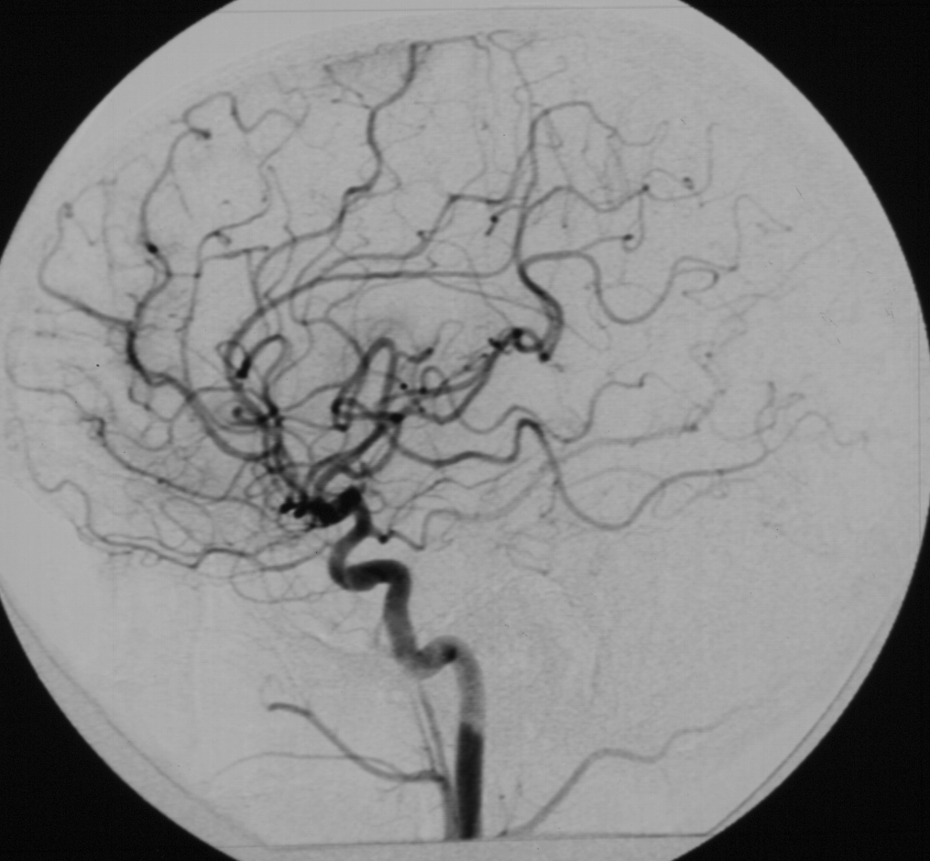
Lateral view AP view
CEREBRAL ANGIOGRAM..
ARTERIAL PHASE
ACA MCA
middle cerebral artery
Anterior cerebral artery
Internal carotid artery
Cavern.
Pterous
cervical
ICA
CAVERNOUS
PTEROUS
CERVICAL
CERVICAL

Slide 48
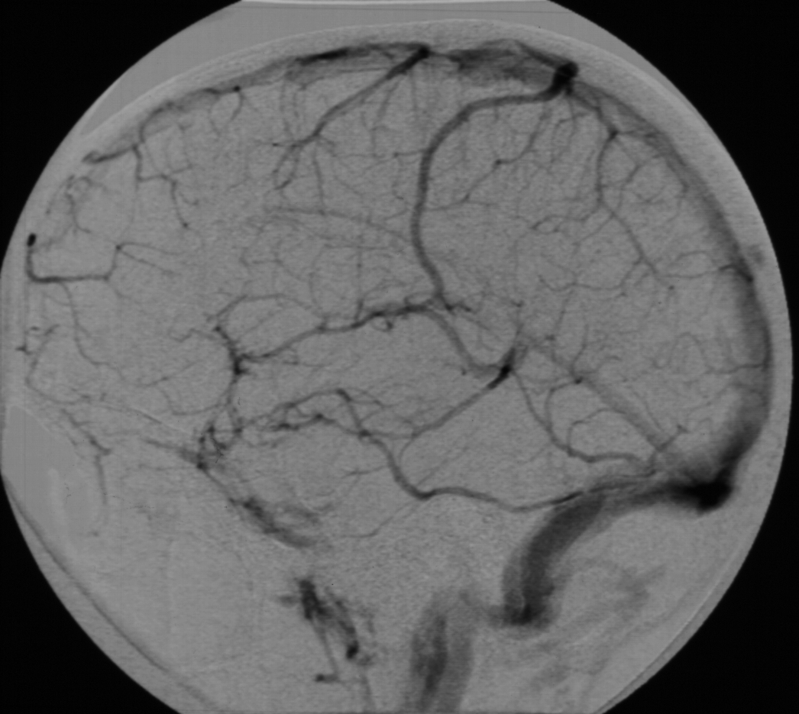
CEREBRAL ANGIOGRAM..
VENOUS PHASE
SSS
Straight sinus
Transverse sinus
Sigmoid sinus
IJV

Slide 49
CAROTID DOPPLER..

Slide 50
ULTRASOUND NEONATAL BRAIN..
Simple and easy way to scan the head of neonates and young babies with no discomfort to the baby
Not using ionizing radiation
Scanning is best done through an open fontanellae.
Readily carried out even on sick babies in ICU.
Particularly useful in detecting
Hydrocephalus
Intracerebral hemorrhage
Congenital abnormality of the brain

Slide 51
ULTRASOUND NEONATAL BRAIN..
CORONAL
SAGITTAL

Slide 52
Thank you

