Slide 1
Introduction to Degenerative Brain Diseases

Slide 2
Objectives
Explain the basic pathological concepts of neurodegenerative disease, using Alzheimer’s and Parkinson disease as a classical example.
- Know the definition of “dementia” syndrome.
- List the possible causes of dementia.
- Explain the basic pathological concepts of a neurodegenerative disease, using Alzheimer’s disease as a classical example.

Slide 3
- Understand the major clinico-pathological features of Alzheimer’s disease.
- Hypothesize the possible etiologies of Alzheimer’s disease.
- List the causes of Parkinsonism.
- Understand the major clinical and pathological feature of Parkinson disease.
- Hypothesize the possible etiologies of Parkinson disease.

Slide 4
Degenerative Brain Disease
The term “Degenerative”:
reflecting an underlying cellular degeneration of neurons in the brain
Cause symptoms that depend on the pattern of involvement of the brain

Slide 5
Degenerative brain disease is an umbrella term for the progressive loss of structure or function of neurons, including death of neurons. Classical examples on this group of diseases are Alzheimer’s disease and Parkinson’s disease.

Slide 6
Causes and Pathology of Dementia

Slide 7
Dementia
Dementia:
The development of memory impairment and other cognitive deficits with preservation of a normal level of consciousness
One of the most important public health issues in the industrialized world
There are many causes of dementia
Regardless of etiology, dementia is not part of normal aging and always represents a pathologic process

Slide 8
Major Causes of Dementia with Examples
Primary Neurodegenerative Disorders
Alzheimer disease
Parkinson disease
Huntington disease
Infections
Prion-associated disorders (e.g. Creutzfeldt-Jakob disease)
HIV encephalopathy (AIDS dementia complex)
Progressive multifocal leukoencephalopathy
Notes:
Huntington disease (HD) is an inherited autosomal dominant disease characterized clinically by progressive movement disorders and dementia, with degeneration of the striatum (caudate and putamen). The movement disorder consists of jerky, hyperkinetic, sometimes dystonic movements (chorea)

Slide 9
Vascular and Traumatic Diseases:
Multi-infarct dementia
Global hypoxic-ischemic brain injury
Chronic subdural hematomas
Metabolic and Nutritional Diseases:
Thiamine deficiency (Wernicke-Korsakoff syndrome)
Miscellaneous:
Brain tumors
Neuronal storage diseases
Toxic injury (e.g. mercury)

Slide 10
So remember !
While Alzheimer's disease is considered as "degenerative"-that is, reflecting an underlying cellular degeneration of neurons in the brain- not all forms of dementia are degenerative
Notes:
Remember it is loss of neurons

Slide 11
Alzheimer Disease
The most common cause of dementia in the elderly
The disease usually becomes clinically apparent as insidious impairment of higher intellectual function, with alterations in mood and behavior
Later, severe cortical dysfunction:
Progressive disorientation
Memory loss
Aphasia
Over the next 5 to 10 years, the patient becomes profoundly disabled, mute, and immobile

Slide 12
Death usually occurs from intercurrent pneumonia or other infections
When considered by age groups, the incidence of Alzheimer disease:
3% for individuals 65 to 74 years old
19% for 75 to 84 years
47% for 85 years or more
This increasing incidence with age has given rise to major medical, social, and economic problems in countries with a growing number of elderly

Slide 13
Although pathologic examination of brain tissue remains necessary for the definitive diagnosis of Alzheimer disease, the combination of clinical assessment and modern radiologic methods allows accurate diagnosis in 80% to 90% of cases
Most cases are sproadic
At least 5% to 10% are familial
In general, patients rarely become symptomatic before 50 years of age, but early onset can be seen with some of the heritable forms
Evidence from familial forms of the disease indicates that the accumulation of a peptide (β amyloid, or Aβ) in the brain initiates a chain of events that result in the morphologic changes of Alzheimer disease and dementia

Slide 14
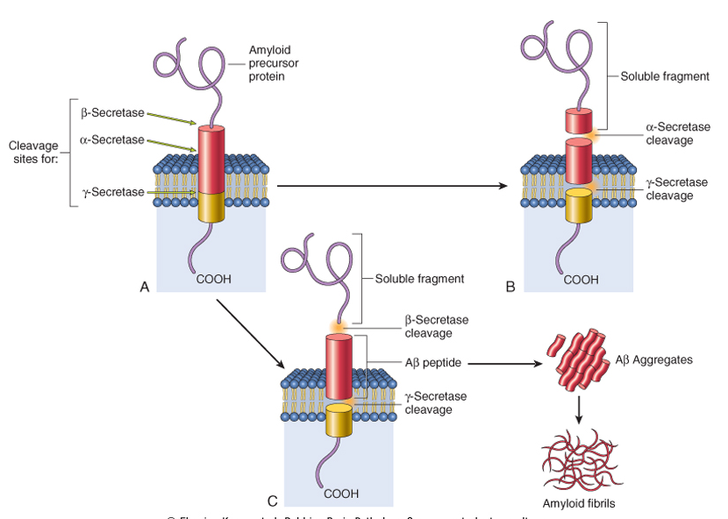

Slide 15
Aβ his peptide is derived from a larger membrane protein known as amyloid precursor protein (APP), which is processed in either of two ways
It can be cleaved by two enzymes, α-secretase and γ-secretase, in a process that prevents formation of Aβ
It can be cut by β-site APP-cleaving enzyme and γ-secretase to generate Aβ
Generation and accumulation of Aβ occur slowly with advancing age

Slide 16
Mutations in APP or in components of γ-secretase (presenilin-1 or presenilin-2) lead to early onset familial Alzheimer disease by increasing the rate at which Aβ accumulates
Alzheimer disease occurs in almost all patients with trisomy 21 (Down syndrome)-where the gene encoding APP is located-who survive beyond 45 years (due to APP gene dosage effects)

Slide 17
The search for genes associated with typical, sporadic Alzheimer disease is beginning to identify genetic associations that may provide new clues about the pathogenesis of the disease:
An allele of apolipoprotein, called ε4 (ApoE4), is associated with as many as 30% of cases, and is thought to both increase the risk and lower the age of onset of the disease
ApoE4 may contribute to the deposition of Aβ, but how it does so is not known
Notes:
To be considered
Amyloid precursor protein APP

Slide 18
Another gene, called SORL1, has recently been found to also be associated with late-onset Alzheimer disease
Deficiency of the SORL1 protein may alter the intracellular trafficking of APP, shuttling it to a compartment where the Aβ peptide is generated by enzymatic cleavage, the net result being increased generation of this pathogenic peptide

Slide 19
Accumulation of Aβ has several effects on neurons and neuronal function:
Small aggregates of Aβ can alter neurotransmission, and the aggregates can be toxic to neurons and synaptic endings
Larger deposits, in the form of plaques, also lead to neuronal death, elicit a local inflammatory response that can result in further cell injury, and may cause altered region-to-region communication through mechanical effects on axons and dendrites

Slide 20
The presence of Aβ also leads neurons to hyperphosphorylate the microtubule binding protein “tau”
With this increased level of phosphorylation, tau redistributes within the neuron from the axon into dendrites and cell body and aggregates into tangles
This process also results in neuronal dysfunction and cell death
The anatomic distribution of these changes, which occur roughly in parallel, are responsible for the clinical signs and symptoms; they appear to develop well in advance of clinical presentation

Slide 21
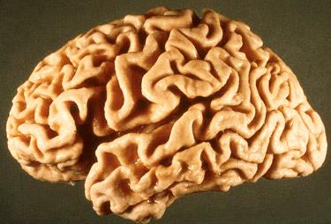

Slide 22
Notes:
A: NEURITIC PLAQUE AND TANGLES
B: AMYLOID
C: TAU

Slide 23
Macroscopic:
a variable degree of cortical atrophy with widening of the cerebral sulci that is most pronounced in the frontal, temporal, and parietal lobes
With significant atrophy, there is compensatory ventricular enlargement (hydrocephalus ex vacuo)

Slide 24
Microscopic:
plaques (a type of extracellular lesion)
neurofibrillary tangles (a type of intracellular lesion)
Because these may also be present to a lesser extent in the brains of elderly nondemented individuals, the current criteria for a diagnosis of Alzheimer disease are based on a combination of clinical and pathologic features

Slide 25
There is a fairly constant pattern of progression of involvement of brain regions pathologic changes:
earliest in the entorhinal cortex → then spread through the hippocampal formation and isocortex → then extend into the neocortex
Silver staining methods or immunohistochemistry are extremely helpful in assessing the true burden of these changes in a brain
→ What is immunohistochemistry?
Notes:
Enthorhianl cortex where memory processing begins, connected with hippocampus, for preporcessing of input signals

Slide 26
Neuritic plaques:
Focal, spherical collections of dilated, tortuous, silver-staining neuritic processes (dystrophic neurites), often around a central amyloid core
Plaques can be found in the hippocampus and amygdala as well as in the neocortex, although there is usually relative sparing of primary motor and sensory cortices until late in the course of the disease
The amyloid core contains Aβ
Aβ deposits can also be found that lack any surrounding neuritic reaction, termed diffuse plaques

Slide 27
Neurofibrillary tangles:
Bundles of paired helical filaments visible as basophilic fibrillary structures in the cytoplasm of the neurons that displace or encircle the nucleus
Tangles can remain after neurons die, then becoming a form of extracellular pathology
They are commonly found in cortical neurons, especially in the entorhinal cortex, as well as in other sites such as pyramidal cells of the hippocampus, the amygdala and the basal forebrain
A major component of paired helical filaments is abnormally hyperphosphorylated forms of the protein tau
Tangles are not specific to Alzheimer disease, being found in other degenerative diseases as well.

Slide 28
Pathogenesis and Pathology of Parkinsonism

Slide 29
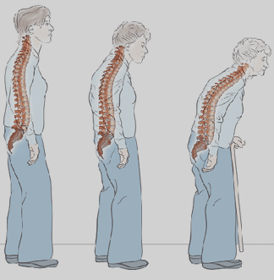
Parkinsonism
A clinical syndrome characterized by:
diminished facial expression (masked facies)
stooped posture
slowness of voluntary movement
festinating gait (progressively shortened, accelerated steps)
rigidity
"pill-rolling" tremor

Slide 30
Motor disturbance that is seen in a number of conditions that share damage to dopaminergic neurons of the substantia nigra or their projection to the striatum

Slide 31
Parkinsonism can be induced by:
drugs that affect these neurons, particularly dopamine antagonists and toxins
post-encephalitic parkinsonism (associated with the influenza pandemic)
Idiopathic Parkinson disease (the most common neurodegenerative disease associated with parkinsonism)
other neurodegenerative diseases
rare: head trauma, stroke

Slide 32
Parkinson’s Disease
Diagnosis:
progressive parkinsonism
absence of a toxic or other known underlying etiology
clinical response to l-dihydroxyphenylalanine (l-DOPA) treatment
6-8 decades
more than 2% in North America develop disease
men more than women
22/100,000 = crude prevalence rate in Saudi population
caused by loss of dopaminergic neurons

Slide 33
While most Parkinson disease is sporadic, there are both autosomal dominant and recessive forms of the disease
Genetic analysis has identified specific causal mutations, For example α-synuclein mutations cause autosomal dominant Parkinson disease as can gene duplications and triplications
Even in cases of Parkinson disease not caused by mutations in this gene, the diagnostic feature of the disease-the Lewy body-is an inclusion containing α-synuclein
This is a widely expressed neuronal protein that is involved in synaptic transmission and other cellular processes

Slide 34
How the alterations in sequence or protein levels result in disease is unclear
The presence of α-synuclein in the Lewy bodies has suggested that defective degradation of the protein in the proteasome might play a role
This is supported by the identification of two other genetic loci for Parkinson disease:
which involve genes encoding parkin (an E3 ubiquitin ligase)
UCHL-1 (an enzyme involved in recovery of ubiquitin from proteins targeted to the proteasome)

Slide 36
Macroscopic:
pallor of the substantia nigra and locus ceruleus
Microscopic:
loss of the pigmented, neurons in these regions
associated with gliosis
Lewy bodies may be found in some of the remaining neurons

Slide 37
Lewy Bodies
Single or multiple, intracytoplasmic, eosinophilic, round to elongated inclusions that often have a dense core surrounded by a pale halo
Ultrastructurally, Lewy bodies are composed of fine filaments, densely packed in the core but loose at the rim
These filaments are composed of α-synuclein, along with other proteins

Slide 38
Clinical Features:
L-DOPA therapy is often extremely effective in symptomatic treatment, but it does not significantly alter the progressive nature of the disease
Over time, L-DOPA becomes less effective at providing the patient with symptomatic relief and begins to cause fluctuations in motor function on its own

Slide 39
Usually progresses over 10 to 15 years
Eventual severe motor slowing to the point of near immobility
Death is usually the result of intercurrent infection or trauma from frequent falls caused by postural instability
About 10% to 15% of individuals with Parkinson disease develop dementia, with the incidence increasing with advancing age
Characteristic features of this disorder include a fluctuating course and hallucinations
While many affected individuals also have pathologic evidence of Alzheimer disease, the dementia in other Parkinson disease patients is attributed to widely disseminated Lewy bodies in the cerebral cortex

Slide 40
Parkinson disease has been targeted for many novel therapeutic approaches, including transplantation, gene therapy, and stem cell injection
Currently used neurosurgical approaches to Parkinson disease include the placement of lesions in the extrapyramidal system to compensate for the loss of nigrostriatal function or placement of stimulating electrodes - deep brain stimulation

