Slide 1
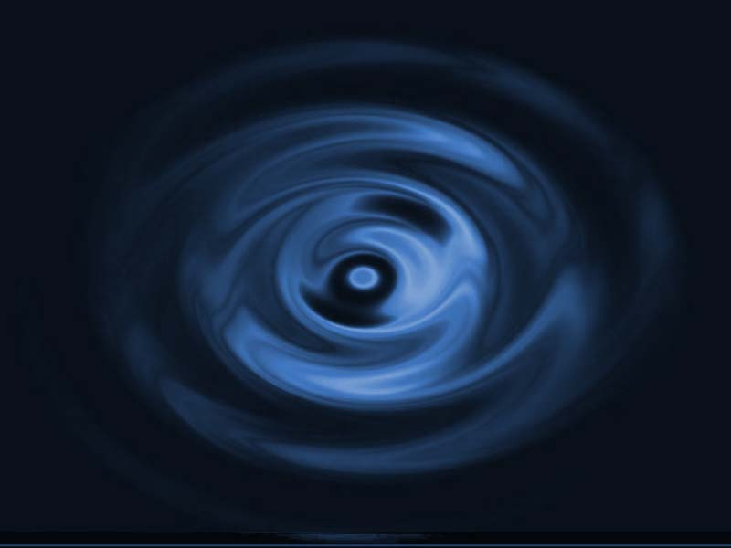
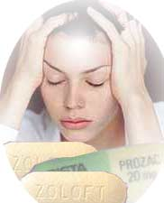
An intense feeling of
sadness hopelessness despair + inability to experience ordinary power to cope with regular life events
E
R
D
P
S
O
S
E
I
N

Slide 2

D E PRESSION
An AFFECTIVE DISORDER
Disturbance in MOOD rather than of thought or behavior
Yet it affects the way one feels about himself … (emotional changes), the way he person eats, sleeps,… (biological changes), the way one thinks about things….(though changes)
& the way he reacts….(behavioral changes)
CLASSIFICATION OF DEPRESSION
Unipolar Depression
Bipolar Depression
Unipolar Depression
Mood swings are always in the same direction
> common (75%) > in elder /associated with stressful life effects
+ symptoms of anxiety and agitation (reactive depression)
The patients are usually inert

Slide 3
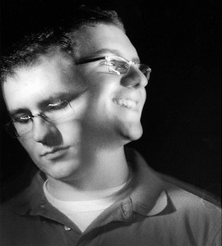

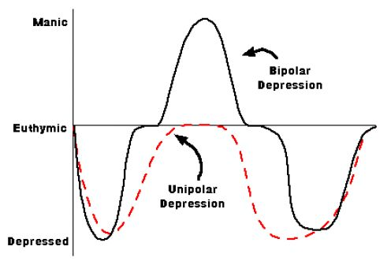
Bipolar Depression
Depression alternates & oscillates with mania
< common (25%), develops early in life, runs in families,
hereditary nature (endogenous depression) i.e related to genes
Episodes can sometimes be provoked by stressful
experiences or physical illness

Slide 4
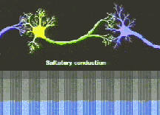
PATHOPHYSIOLOGY OF DEPRESSION
Too little monoaminergic activity
TRANSMITTERS
Alteration in receptor density
RECEPTORS
Abnormal 2nd messenger cascade  gene expression
SIGNAL TRANSDUCTION
NEUROTROPHIC REGULATION
brain-derived neurotrophic factor  hippocampal atrophy &  neurogenesis.
SYNAPTIC TRANSMISSION

Slide 5
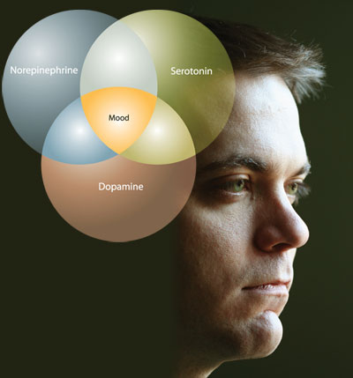
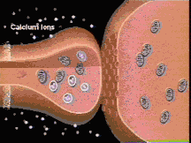
PATHOPHYSIOLOGY OF DEPRESSION
SYNAPTIC TRANSMISSION
Neurotransmitter Imbalances & Dysregulation
 creates a state of deficiency in monoamines ???
5-HT
NE
Not distinguished clearly
DA

Slide 6
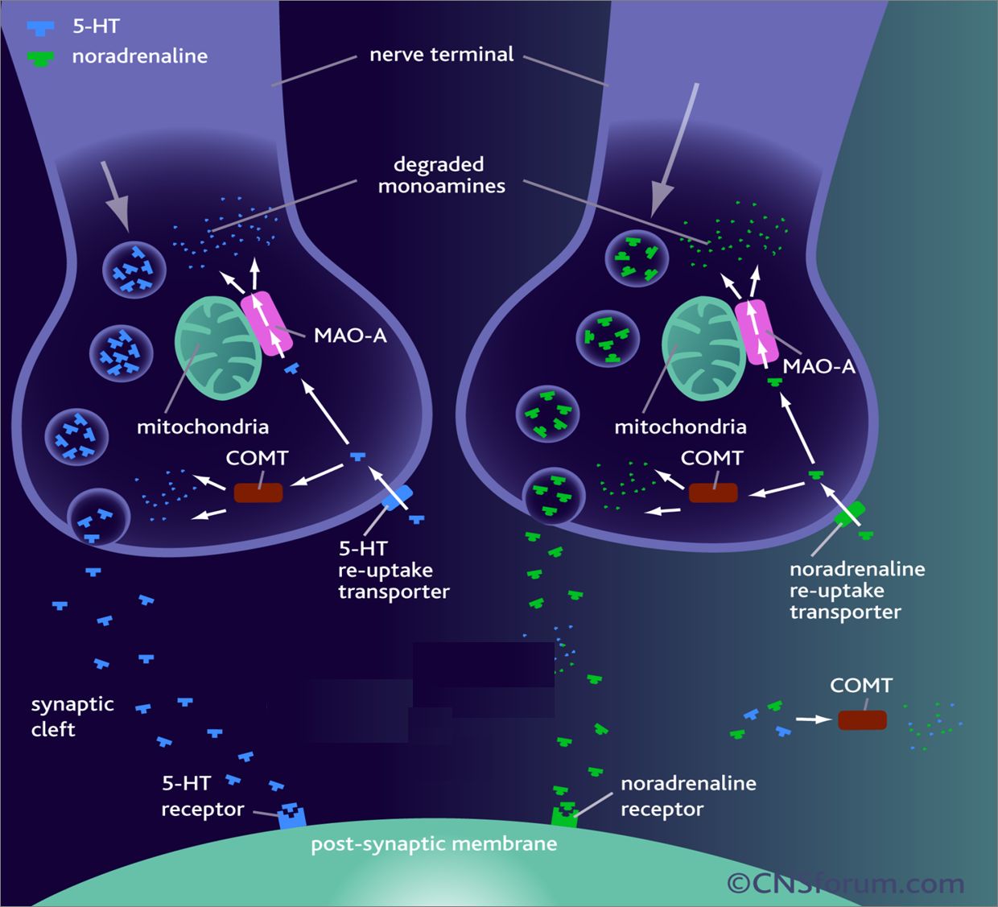
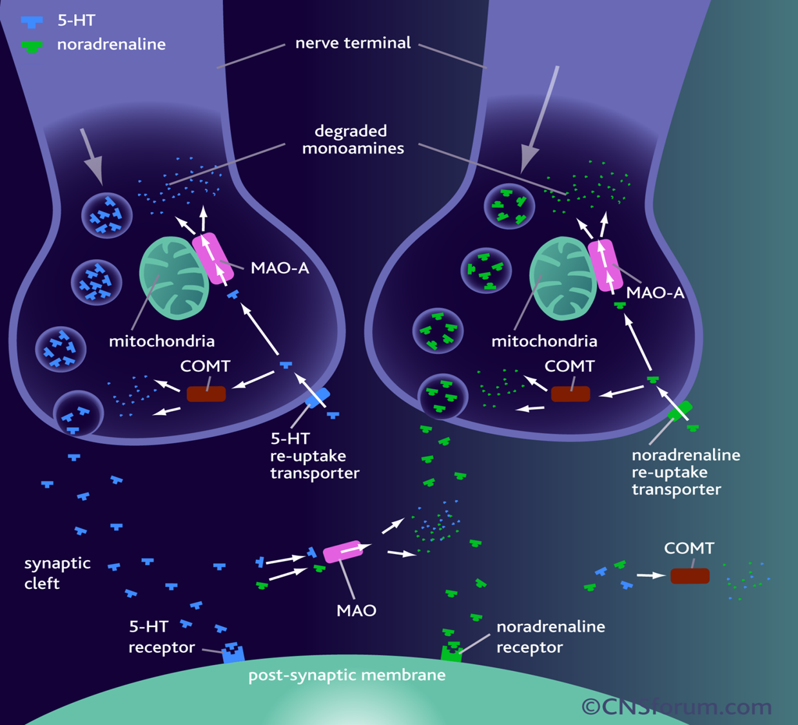
5HT
NE
SERT
NET

Slide 7
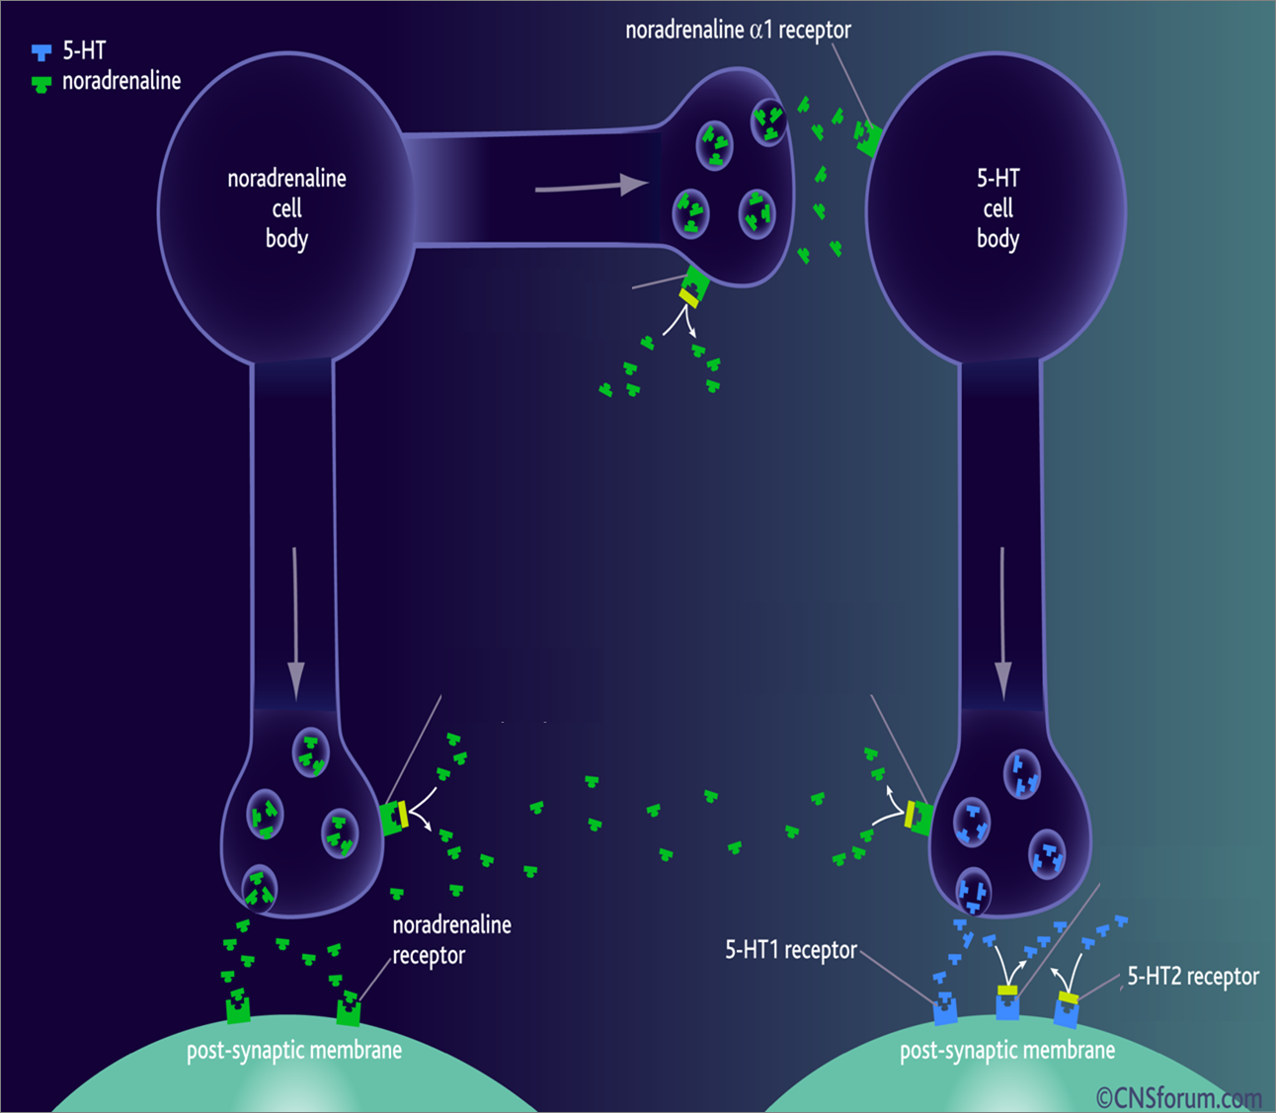
NE _{a2}
5HT_{1A}
NE _{a2}
NE _{a2}
5HT_{1D}
α₁
β
They mediate 5HT actions

Slide 8
Both manic & depressive phases of the disorder are characterized by low central 5HT function; meaning that 5HT cannot exert its normal modulatory effects on control of monamines and other neurotransmitters, specially NE
DA
New View
DA
If 5HT fall, is not properly modulating NE and NE also falls to abnormally low levels, the patient becomes DEPRESSED
In reverse, is not properly modulating NE, so that it becomes abnormally high, the patient becomes MANIC.

Slide 9
ANTIDEPRESSANTS
?
Restore the ability of 5HT to modulate NA, thus restoring the critical balance between transmitters that controls emotional behavior.
?

Slide 10
ANTIDEPRESSANTS
The concept of action of all drugs relay on extracellular biogenic amines in the brain indirectly by blocking their catabolism or directly by preventing their uptake + altering receptor firing.
All drugs take weeks to manifest their clinical effect [to control depressive manifestations], even though their pharmacological actions starts immediately indicating that secondary adaptive changes must occur before the benefit is gained
The delay presentstime needed for inhibitory somatodendritic autoregulatory 5HT_{1A} receptors or axonal autoregulatory 5HT_{1D} to be sensitized [down regulated] to permit more synthesis & release of transmitter at synaptic cleft with enhanced signaling at postsynaptic serotonergic & adrenergic > (β) neurones → therapeutic effect.

Slide 11
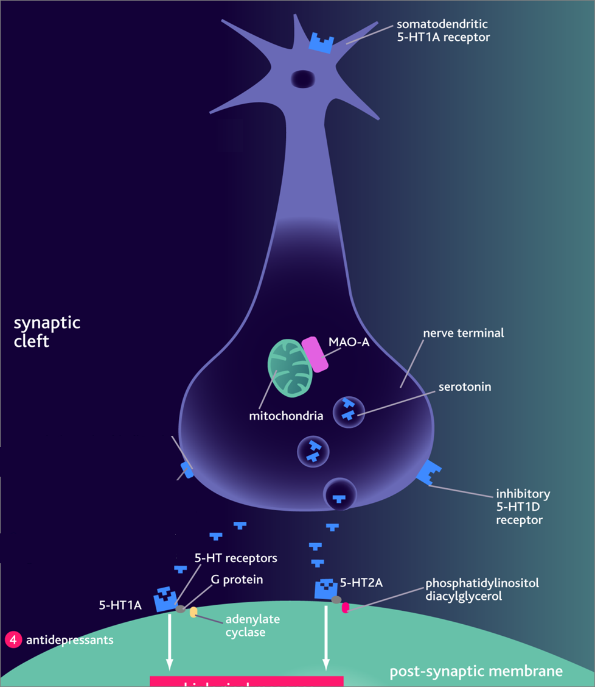
Treatment should continue
6 months at full therapeutic
doses before withdrawal.
Withdrawal of drugs must
be very gradual otherwise
withdrawal symptoms
Agitation
Worsening of the disease
Withdrawal manifestation
They mediate therapeutic effects

Slide 12
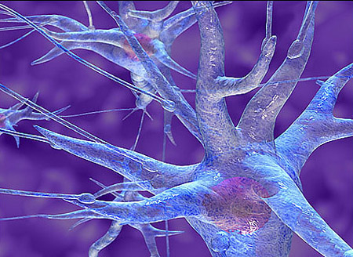
MONOAMINE
OXIDASE
INHIBITORS

Slide 13
MAO is a mitochondrial enzyme found in nearly all tissues
Two forms of monoamine oxidase exist:
  MAO-A responsible for NE, 5-HT catabolism. It also metabolizes tyramine of ingested food
  MAO-B is more selective for dopamine metabolism
MONOAMINE OXIDASE INHIBITORS
Non Selective Inhibitors (MAO-A & MAO-B)
Irreversible ➔Phenelzine, long acting [persists 2w after stop]
Reversible ➔ Tranylcypromine, [persists 7 days after stop]
Selective Reversible Inhibitors
➔ Moclobemide, (MAO-A)
➔ Selegiline, (MAO-B)
Seldom used now because;
➔ADR, Food & Drug Interactions
➔ Low antidepressant efficacy
= Low benefit/risk ratio;
All are well absorbed, metabolized & excreted in urine

Slide 14
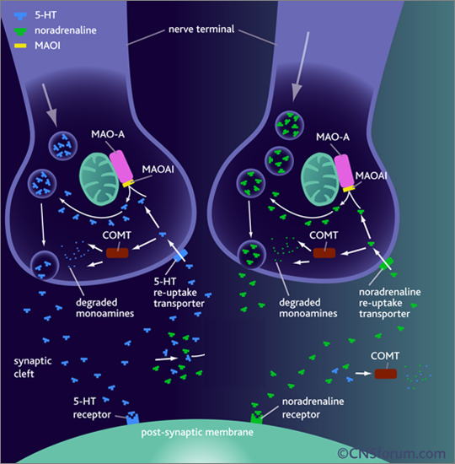
MAOIs ➔⬇ activity of MAO ➔ preventing monamine break down ➔⬆ availability indirectly
Possess both α Adrenoceptor & mAch blocking effects
Indications
MAOIs ➔ now only reserved in atypical depression and depression resistant to other therapy
In treatment of social anxiety (agrophobia)

Slide 15
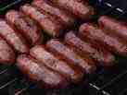

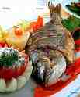

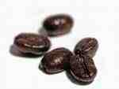
ADRs
1. Antimuscarinic effects.
2- Postural hypotension.
3- Sexual dysfunction mainly with phenelzine.
4- Sedation , sleep disturbance.
5- Weight gain
6- Hepatotoxicity ( phenelzine)
Food interactions
Many foods containing tyramine are normally degraded in the gut by MAO-A
MAOIs inhibit this process  tyramine is absorbed taken up into adrenergic neurons  converted into -a false transmitter  replaces NE in the vesicles & massively released
➔ results in hypertensive crisis.
Distribution of 5-HT2 receptors
So avoid foods rich in
Tyramine ; Aged cheese, liver, sausages, fish , some meat & yeast extracts.
Levodopa ; Broad beans, FAVA beans.

Slide 16
Drug interactions
1. If with (indirect acting sympathmimetic, flue medications, local anesthetics & TCA) ➔ severe hypertension ➔ hypertensive crisis
2- If with SSRI ➔ fatal serotonin syndrome [hyperthermia, muscle rigidity, cardiovascular collapse ] ➔ so keep 6 weeks space between their use
3- If with pethidine ➔ inhibition of metabolism
➔ ↑ its levels ➔leads to hyperpyrexia, irritability, hypotension and coma.
Distribution of 5-HT2 receptors

Slide 17
TRICYCLIC ANTIDEPRESSANTS

Slide 18
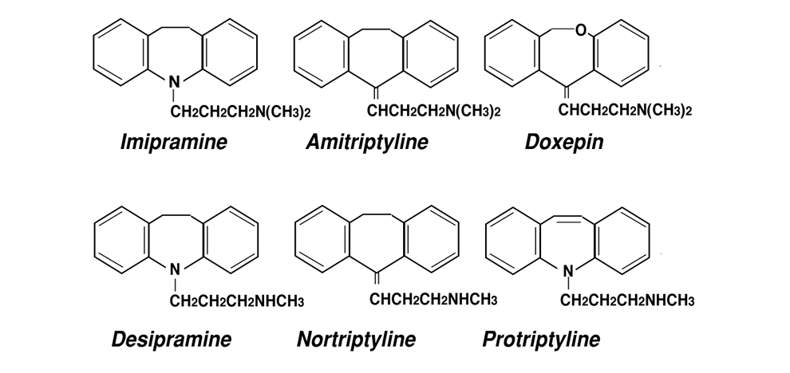
1st Generation Tricyclic Antidepressants
 have three-ring nucleus structure
Tertiary amines
Block 5HT& NE reuptake
More side effects
Imipramine (Tofranil)
Amitriptyline (Elavil)
Secondary amines
More selective to NE
Less side effects
Desipramine (Norpramin)
Nortriptyline (Pamelor)
+ Block ADR (α₁), Histamine (H₁) & Ach (M₁)receptors.

Slide 19
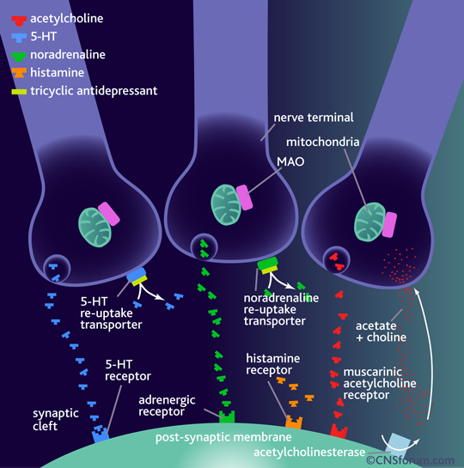
+ block adrenergic (α₁), histamine (H₁) & muscarinic (M₁)receptors.

Slide 20
Given once daily
Most are incompletely absorbed
Undergoe first-pass metabolism.
Highly bound to plasma proteins.
Some of them give active metabolites
  Imipramine  Desipramine
  Amitriptyline Nortriptyline
Pharmacokinetics
Clinical Indications
Used for long duration without loss of effectiveness [preferable to MAOIs]
  Elevate mood
  Improve mental alertness.
  Increase physical activity
1- Treatment of depression;
- With lithium in depressed phase of bipolar depression
- In resistant depression if other therapy fail
- With antipsychotics in depressed psychotic patients.

Slide 21
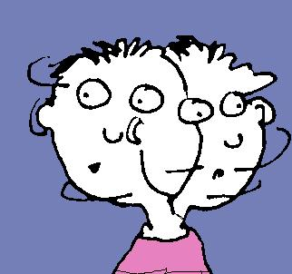
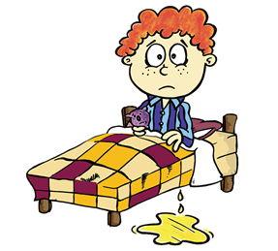
2-Other psychiatric disorders;
Obsessive-compulsive disorders (OCD)
(OCD;  DA & NE in the brain's prefrontal cortex.)
Generalized anxiety disorders
Panic disorders
Anorexia nervosa
3-Other disorders;
Control bed-wetting in children; Imipramine  contraction of
internal sphincter of bladder . Better desmopressin
Gradually withdrawn / Treatment period do not exceed 3 months.
Neuropathic pain; better Tertiary amines > → modulate endorphins
given at doses < that prescribed for depression.
Prophylaxis of migraine

Slide 22

ADRs
Anti-cholinergic: Dry mouth, blurred vision, constipation & urine
retention, aggravation of glaucoma
Anti-histaminic: Sedation, confusion. Stop sedatives 1-2 w before use
Anti-adrenergic (>α)  C.V.S ; Postural hypotension, arrhythmias
conduction defects ( prolonged Q-T interval - heart block )
Weight gain, sexual dysfunction & impotence
Lower seizure threshold
Aggravation of psychosis
EARLY IN USE  During 1st month  aggravate suicidal thoughts specially in young aged. Can happen less upon change of dose.
DURING USE  narrow therapeutic index  toxicity can develop
Excitement, delirium , convulsions, respiratory depression , coma, atropine like- effects, cardiac arrhythmias, sudden death. DIALYSIS
STOPAGE OF USE  Withdrawal Symptoms; characterized by cholinergic rebound, flu-like symptoms.

Slide 23
Interactions
Being strongly bound to plasma proteins  toxicity enhanced
by aspirin, phenylbutazone, ….etc
Being metabolized by hepatic microsomal enzymes  toxicity
enhanced by enzyme inhibitors.
With MAOIs, SSRIs or any sympathomimetic drugs  cause
hypertensive crisis
Additive to sedatives or other CNS depressants  respiration
Additive to antipsychotics & anti parkinsonisms  anti-
cholinergic effects.
Glaucoma
Heart disease
Liver disease
Seizure disorder
Thyroid disease
Prostate hypertrophy
Pheochromocytoma
Chronic bronchitis
Contraindications

Slide 24
ANTIDEPRESSANTS
New Antidepressants
To be Continued

