Slide 1
Schizophrenia Spectrum and Other Psychotic Disorders
Fatima Alhaidar
Professor,
Child & Adolescent Psychiatrist
College of Medicine, KSU
1436/2013

Slide 2
Schizophrenia Spectrum and Other Psychotic Disorders
Schizophrenia
Brief Psychotic Disorder
Schizophreniform Disorder
Delusional Disorder
Schizoaffective Disorder
Schizotypal (Personality) Disorder
Substance/Medication-Induced Psychotic Disorder
Psychotic Disorder Due to Another Medical Condition

Slide 3
Schizophrenia
- It is not a single disease but a group of disorders with heterogeneous etiologies.
- Found in all societies and countries with equal prevalence & incidence worldwide.
- A life prevalence of 0.6 – 1.9 %
- Annual incidence of 0.5 – 5.0 per 10,000
- Peak age of onset are 10-25 years for ♂ & 25-35 years for ♀

Slide 4
Clinical Features
No clinical sign or symptom is pathognomonic for schizophrenia Patient's history & mental status examination are essential for diagnosis.
Picture of schizophrenia includes positive and negative symptoms:
* Positive symptoms like: delusions, hallucinations, disorganized speech & disorganized behavior
* Negative symptoms like: affective flattening or blunting, poverty of speech, poor grooming, lack of motivation, and social withdrawal.
Social / Occupation dysfunction
Duration of at least 6 months
Premorbid history includes schizoid or schizotypal personalities, few friends & exclusion of social activities.
Prodromal features include obsessive compulsive behaviors
-

Slide 5
Mental status examination
* Appearance & behavior ( variable presentations)
* Mood, feelings & affect ( reduced emotional responsiveness, inappropriate emotion)
* Perceptual disturbances ( hallucinations, illusions )
* Thought: Thought content ( delusions)
Form of thought ( looseness of association)
Thought process ( thought blocking, poverty of
thought content, poor abstraction, perseveration )
* Impulsiveness, violence, suicide & homicide
* Cognitive functioning
* Poor insight and judgment

Slide 6
Cognitive deficits in schizophrenia

Slide 7
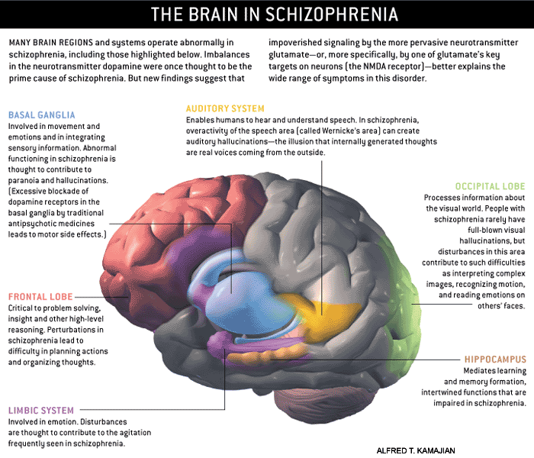
Notes:
http://www.schizophrenia.com/schizpictures.html

Slide 8
Etiology
Exact etiology is unknown.
1- Stress-Diathesis Model;
Integrates biological, psychosocial and environmental factors in the etiology of schizophrenia.
Symptoms of schizophrenia develop when a person has a specific vulnerability that is acted on by a stressful influence.
Predisposing factors → precipitating factors

Slide 9
Etiology cont.
2- Neurobiology
Certain areas of the brain are involved in the pathophysiology of schizophrenia: the limbic system, the frontal cortex, cerebellum, and the basal ganglia.
A. Dopamine Hypothesis;
Too much dopaminergic activity ( whether it is ↑ release of dopamine, ↑ dopamine receptors, hypersensitivity of dopamine receptors to dopamine, or combinations is not known ).
B. Other Neurotransmitters;
Serotonin, Norepinephrine, GABA, Glutamate & Neuropeptides

Slide 10
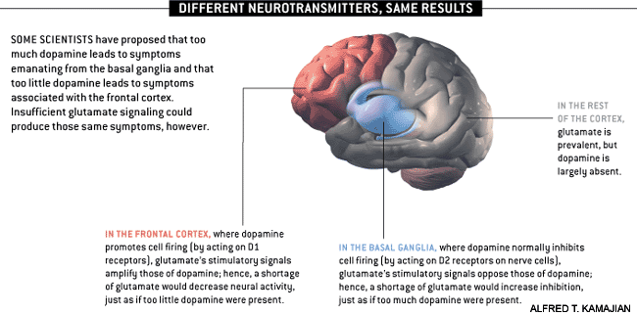
Notes:
http://www.schizophrenia.com/schizpictures.html

Slide 11
Etiology cont.
C- Neuropathology;
Neuropathological and neurochemical abnormalities have been reported in the brain particularly in the limbic system, basal ganglia and cerebellum. Either in structures or connections as shown in previous slide

Slide 12
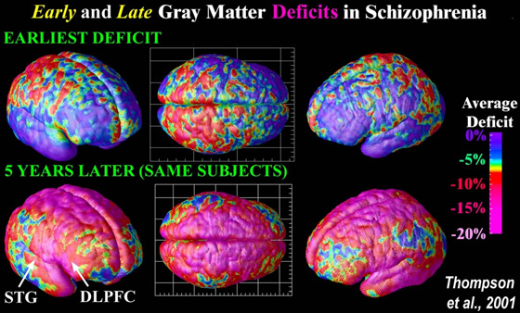
Notes:
Image Source: UCLA Laboratory of Neuro Imaging, UCLA, Derived from high-resolution magnetic resonance images (MRI scans), the above images were created after repeatedly scanning 12 schizophrenia subjects over five years, and comparing them with matched 12 healthy controls, scanned at the same ages and intervals. Severe loss of gray matter is indicated by red and pink colors, while stable regions are in blue. STG denotes the superior temporal gyrus, and DLPFC denotes the dorsolateral prefrontal cortex. Note: This study was of Childhood onset schizophrenia (defined as schizophrenia diagnosed in children under the age of 13 or so) which occurs in approximately 1 of every 40,000 people and is frequently a significantly more aggressive form of schizophrenia (than regular schizophrenia that typically begins when people are aged 15 to 25 (slightly later for women) - and impacts approximatley 1 of every 100 people).

Slide 13
Etiology cont.
D- Psychoneuroimmunology;
↓ T-cell interlukeukin-2 lymphocytes, abnormal cellular and humoral reactivity to neurons and presence of anti-brain antibodies.
These changes are due to neurotoxic virus ? or endogenous autoimmune disorder ?
E- Psychoneuroendocrinology;
Abnormal dexamethasone-suppression test
↓ LH/FSH
A blunted release of prolactin and growth hormone on stimulation.

Slide 14
Etiology cont.
3- Genetic Factors
- A wide range of genetic studies strongly suggest a genetic component to the inheritance of schizophrenia that outweights the environmental influence.
-These include: family studies, twin studies and chromosomal studies.

Slide 15
Notes:
http://www.schizophrenia.com/prevention.htm
Before going into the specific risk reduction strategies its important to know the initial risks that a person may face of getting schizophrenia. In the general population, for someone who has no family history of mental illness, the average risk is estimated at approximately 1% (and therefore a 99% probability that the person will not get schizophrenia). If someone who is genetically related to a person in the extended family that does have schizophrenia, then the risk is higher - and the chart below provides a rough estimate of that risk. If, for example, you have an aunt or uncle who developed schizophrenia, then your risk (on average) is estimated at approximately 3% (and therefore there is a 97% probability you won't get schizophrenia). Even for the situation where one parent has schizophrenia the risk is estimated at 13% for a child, which means there is an 87% probability that the person will not develop schizophrenia. If a family has a history of more than one person developing schizophrenia then the risk goes up. People who have a strong history of mental illness in their family may want to consider genetic counseling in addition to the schizophrenia prevention tactics identified below

Slide 16
Etiology cont.
4- Psychosocial Factors;
- In family dynamics studies, no well-controlled evidence indicates specific family pattern plays a causative role in the development of schizophrenia.
- High Expressed Emotion family : increase risk of relapse.

Slide 17
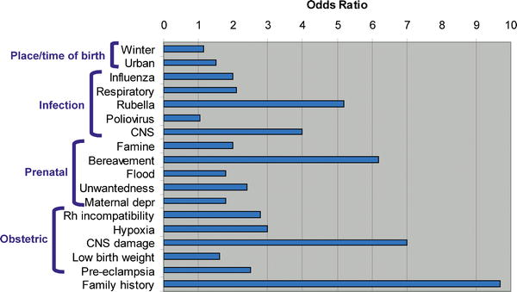
Risk Factors
PLOS Medicine
Notes:
Its also important to keep in mind as you read about the risk factors, that most of these risk factors are associated with approximately a doubling of risk (also called the "Odds Ratio") - which might sound high, but that means that overall for someone with no family history of schizophrenia, that the risk goes from about 1% to 2% (with risk of not getting schizophrenia declining from 99% to 98%). Therefore, for the average person with no family history of schizophrenia or mental illness most of these risk factors may not make a significant difference in terms of total risk of schizophrenia which remains low. At the same time good healthcare, nutrition and a positive emotional environment for women during pregnancy are always important factors for the health of a baby and always recommended by doctors. Research also suggests that nurturing, sensitive child care is also important for the healthy emotional development of children
Image: Some of the Schizophrenia Environmental Risk Factors - Source; PLOS Medicine (Note: different studies suggest different risk factors - so you will see some variance in the risk number that we quote below for some environmental factors).
The factors listed below matter most significantly for people who have a history of schizophrenia or other mental illness in their family which suggests that a person may have some of the genes that are associated with schizophrenia risk. At this time little is known about exactly how the environmental exposures identified below increase risk in those with some sort of genetic vulnerability - so don't get too worried if you have in the past experienced a given environmental factor, as its impossible to know for sure how that environmental factor might impact you or your child. Focus on the environmental factors that you still have some influence over.
The take home message is that if you have a family history of mental illness it would probably be beneficial to take some reasonable steps to reduce or avoid exposure to the risk factors -- especially those factors involved in pregnancy, prenatal care and early child care. For teens interested in lowering their risk of schizophrenia, the avoidance of street drugs, maintenance of healthy friendships, and early treatment for any depression, sadness and anxiety is likely to be valuable. At the same time, all of the actions below are likely to help the mental health of any child or person - so the more steps you can take, the better your (or your child's) mental health is likely to be.

Slide 18
Course
Acute exacerbation with increased residual impairment
Full recovery: very rare
Longitudinal course: downhill

Slide 19
Differential Diagnosis
Nonpsychiatric disorders:
Substance-induced disorders
Epilepsy ( TLE)
CNS diseases
Trauma
Others
Psychiatric disorders:
Schizophreniform disorder
Brief psychotic disorder
Delusional disorder
Affective disorders
Schizoaffective disorder
Personality disorders ( schizoid, schizotypal & borderline personality)
Malingering & Factitious disorders

Slide 20
Treatment
1. Biological therapies
2. Hospitalization
3. Psychosocial therapies

Slide 21
Biological therapies
- Antipsychotic medications are the mainstay of the treatment of schizophrenia.
Generally, they are remarkably safe.
Two major classes:
Dopamine receptor antagonists ( haloperidol, chlorpromazine )
Serotonin-dopamine receptor antagonists ( Risperidone, clozapine, olanzapine ).
- Other drugs:
Anticonvulsants
Lithium
Benzodiazepines
Depot forms of antipsychotics eg. Risperidone Consta is indicated for poorly compliant patients
- Electroconvulsive therapy (ECT) for catatonic or poorly responding patients to medications

Slide 22
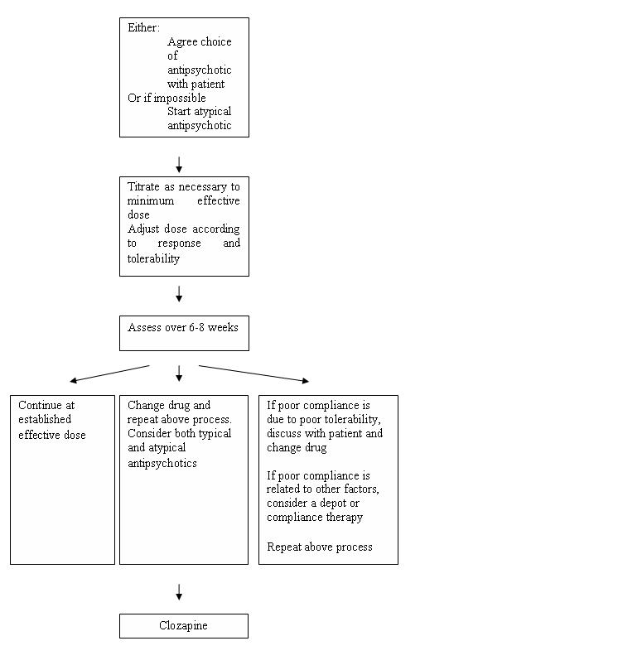
Pharmacological Treatment Algorithm Adapted from the Maudsley prescribing Guidelines (Taylor et al, 2005)

Slide 23
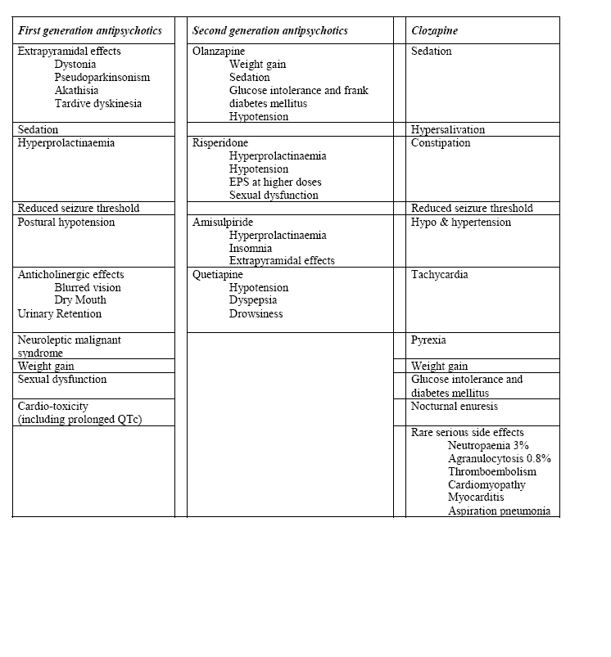
Common side effects of antipsychotic medication (Taylor et al, 2005)

Slide 24
Hospitalization
Indications:
Diagnostic purpose
Patient & other's safety
Initiating or stabilizing medications
Establishing an effective association between patient & community supportive systems

Slide 25
Psychosocial therapies
Social skills training
Family oriented therapies
Group therapy
Individual psychotherapy
Assertive community treatment
Vocational therapy
Notes:
Psychosocial treatments with demonstrated efficacy includefamily interventions,
supported employment,
assertive community treatment,
social skills training, and
cognitive behaviorally oriented psychotherapy

Slide 26
Prognosis
Good P.F | Poor P.F
Late age of onset Acute onset PPT factor Presence of mood component Good response to TTT Good supportive system | Young age of onset Insidious onset Lack of P.T. Multiple relapses Low IQ Pre-morbid personality Negative symptom Positive family history

