Slide 1
Biochemical Aspects of Digestion of Proteins & Carbohydrates
Dr. Reem Sallam, MD, PhD

Slide 2
OBJECTIVES
By the end of this lecture, the student should be able to:
Understand the overall process of dietary protein and carbohydrates digestion, the organs involved, the enzymes required, and the end products.
Implement the basic science knowledge of the process of protein & carbohydrates digestion to understand the clinical manifestations of diseases that involve defective protein or carbohydrates digestion &/or absorption

Slide 3
Biochemical Aspects of Digestion of Dietary Proteins

Slide 4
Protein Digestion
Dietary proteins constitute 70-100 g/day
Proteins are generally too large to be absorbed by the intestine.
They must, therefore, be hydrolyzed to their constituent amino acids, which can be absorbed

Slide 5
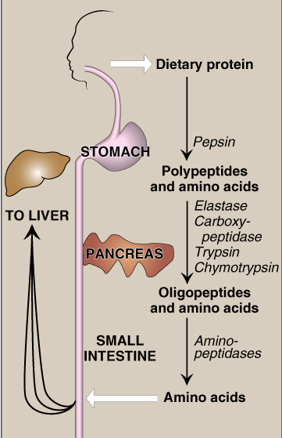
The source of proteolytic enzymes responsible for degrading dietary proteins
The stomach
The pancreas
The small intestine
1
& Rennin
2
3

Slide 6
1- Digestion of Proteins by Gastric Secretion
The gastric juice contains 3 components important for protein digestion:
Hydrochloric acid
Pepsin
Rennin (in neonates and infants)
Protein digestion by stomach Polypeptides

Slide 7
2- Digestion of Proteins by Pancreatic enzymes
The digestion in small intestine is hormonally controlled.
Two small peptide hormones are released from cells of the upper part of small intestine:
Cholecystokinin (CCK)
Secretin

Slide 8
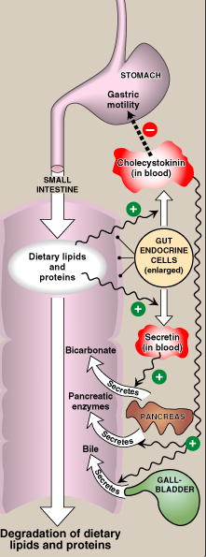
Hormonal control of digestion in small intestine:
Cholecystokinin (CCK):
Secretion of pancreatic enzymes
Bile secretion
Slow release of gastric contents
Secretin:
Release of watery solution
rich in bicarbonate by pancreas

Slide 9
The gut hormones:
The gut hormone | Stimulus for secretion | Effects
1- Cholecystokinin (CCK) | The presence of partially digested proteins (& lipids) in the upper small intestine | Stimulates the release of pancreatic digestive enzymes Stimulates the contraction of the gall bladder & release of bile Decreases gastric motility → slower release of gastric contents into the small intestine

Slide 10
The gut hormones: continued…
The gut hormone | Stimulus for secretion | Effects
2- Secretin | Low pH of the chyme entering the intestine | Stimulates the pancreas to release a watery solution rich in bicarbonate to neutralize the pH of the intestinal contents (to reach the optimum pH for digestive activity by pancreatic enzymes)

Slide 11
Pancreatic enzymes for Digestion of Proteins
The pancreatic secretion contains a group of pancreatic proteases
Each of these enzymes has different specificity for the cleavage sites
These proteases are synthesized and secreted as inactive zymogens

Slide 12
Activation of Pancreatic enzymes
Enteropeptidase activates trypsinogen:
It converts trypsinogen (inactive) into trypsin (active)
Trypsin then activates all the other pancreatic zymogens (including itself)
Enteropeptidase is an enzyme synthesized by, and present on the luminal surface of intestinal mucosal cells (the brush border membrane)

Slide 13
Pancreatic enzymes, continued…
Activating enzyme | Active enzyme | Zymogen
1- Enteropeptidase 2- Trypsin (autocatalysis) | Trypsin (endopeptidase) | Trypsinogen
Trypsin | Chymotrypsin (endopeptidase) | Chymotrypsinogen
Trypsin | Elastase (endopeptidase) | Proelastase
Trypsin | Carboxypeptidases (exopeptidases) | Procarboxypeptid-ases

Slide 14
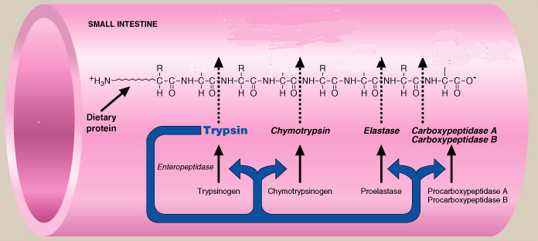
Activation of Pancreatic enzymes CONT’D

Slide 15
3- Digestion of proteins in small intestine
Oligopeptides that result from the action of pancreatic proteases are cleaved into free amino acids and smaller peptides (di- & tri-peptides) by
intestinal aminopeptidase
(an exopeptidase on the luminal surface of the intestine)

Slide 16
Absorption of digested proteins
Intestinal lumen
Amino Acids
Di- & tripeptides
Amino Acids
Di- & tripeptides
Enterocyte
peptidases
Amino Acids
Amino acids
Amino Acids in portal vein to the liver

Slide 17
Abnormalities in protein digestion
Pancreatic insufficiency, e.g., chronic pancreatitis, cystic fibrosis, surgical removal of the pancreas → incomplete digestion & absorption of lipids & proteins → abnormal appearance of lipids (steatorrhea) & undigested proteins in the feces

Slide 18
Celiac Disease (Celiac sprue)
It is a disease of malabsorption resulting from immune-mediated damage to the small intestine in response to ingestion of gluten
Gluten is a protein found in wheat, rye, and barley

Slide 19
Biochemical Aspects of Digestion of Dietary Carbohydrates

Slide 20
Carbohydrates Digestion
Carbohydrates digestion is rapid:
Generally completed by the time the gastric contents reach the junction of the duodenum & jejunum.
Sites for digestion of dietary carbohydrates:
The mouth
The intestinal lumen

Slide 21
Dietary carbohydrates
Mainly:
Polysaccharides:
Starch from plant origin
Glycogen from animal origin
Cellulose from plant origin
Oligosaccharides
Disaccharides:
Sucrose
Lactose
Maltose
Monosaccharides: Little amounts
Contain α (1→4) & α (1→6) bonds
Contains β (1→4) bonds

Slide 22
Enzymes for Digestion of Dietary Carbohydrates
α-amylase (Both salivary & pancreatic):
Substrate: Polysaccharides
Disaccharidases (Intestinal):
Substrate: Disaccharides
Isomaltase & α(1,6) glucosidase (Intestinal):
Substrate: Branch points of oligo- and di-saccharides

Slide 23
Effect of α-Amylase on Glycogen
Hydrolysis of:
α(1,4) glycosidic bonds
Products:
Mixture of short oligosaccharides (both branched & unbranched)
Disaccharides: Maltose and isomaltose

Slide 24
Enzymes for Digestion of Dietary Carbohydrates CONT’D
No dietary carbohydrate digestion occurs in the stomach (the high acidity of the stomach inactivates the salivary α–amylase).
Pancreatic α–amylase continues the process of starch & glycogen digestion in the small intestine
(Secreted by pancreas and worked in small intestine)

Slide 25
Serum level of α-Amylases
Normal level in serum:
25 -125 U/L
The clinical significance of rising circulating levels of α-amylase activity:
Diagnosis of acute pancreatitis (damage of pancreatic cells → release & activation of the intracellular enzymes into the blood)
Its level starts to rise within few hours
Reaches a peak within 12- 72 hours
Then returns to normal within few days

Slide 26
Final digestion of carbohydrates by intestinal enzymes in the small intestine
Enzymes:
Secreted by & remain associated with the luminal side of the brush border membranes of the intestinal mucosal cells
Location of their action:
the mucosal lining of the jejunum
They include:
Disaccharidases
α(1,6) Glucosidase (for branched oligosaccharides)

Slide 27
Intestinal disaccharidases
Enzyme | Substrate | Product
Isomaltase | isomaltose | 2 Glucose
Maltase | maltose | 2 Glucose
Sucrase | sucrose | Glucose & fructose
Lactase (β-galactosidase) | lactose | Glucose & galactose

Slide 28
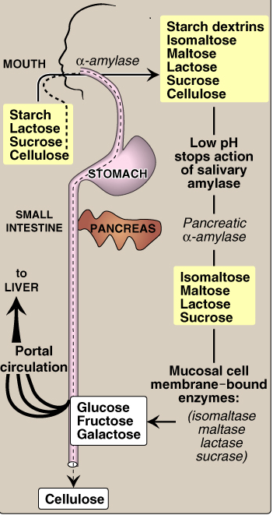
Digestion of Carbohydrates
Dietary cellulose cannot be digested due to the absence of enzyme that can cleave β (1-4) bonds. It passes through the GIT largely intact. Despite that, it has several beneficial effects.

Slide 29
Absorption of Monosaccharides by Intestinal Mucosal Cells
Location:
Duodenum & upper jejunum
Insulin is not required for the uptake of glucose by intestinal cells
Different monosaccharides have different mechanisms of absorption
Facilitated diffusion (GLUT-mediated)
Active transport (Energy-dependent): Co-transport with Na⁺

Slide 30
Absorption of digested carbohydrates
Intestinal lumen
Glucose & Galactose
Fructose
Na⁺-dependent Active transport
GLUT-5
Glucose & Galactose
Fructose
Enterocyte
GLUT-2
Monosaccharides in portal vein to the liver

Slide 31
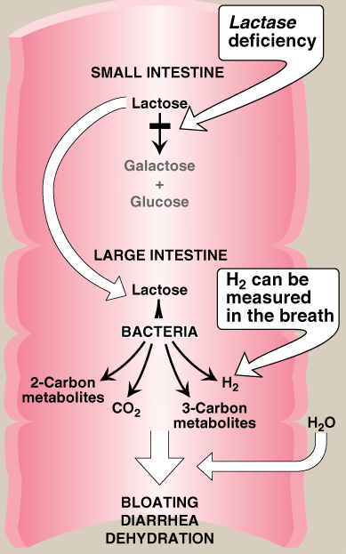
Abnormal digestion of disaccharides (e.g. of lactose)
Lactose intolerance
(Lactase deficiency)
Lactase (β-galactosidase) deficiency → Undigested carbohydrate in large intestine → osmotic diarrhea.
Bacterial fermentation of the undigested compounds in the large intestine → CO₂, H₂ gas → abdominal cramps, diarrhea & distension (flatulence)

Slide 32
Take home message Digestion of dietary proteins
Proteolytic enzymes responsible for digestion of dietary proteins are produced by the stomach, the pancreas & the small intestine.
The digestion of proteins in the stomach is the result of the action of HCl, pepsin & rennin
Pancreatic proteases are, like pepsin, synthesized and secreted as inactive zymogens

Slide 33
Take home message Digestion of dietary proteins
The intestinal digestion of proteins occurs in the small intestine’s lumen, on the luminal surface of the small intestine, and is completed intracellularly to produce free amino acids
In pancreatic insufficiency, the digestion and absorption of fat & protein is incomplete → steatorrhea & appearance of undigested proteins in the feces

Slide 34
Take home message Digestion of dietary carbohydrates
Salivary α-amylase acts on dietary glycogen & starch in the mouth
Pancreatic α-amylase continues the process of polysaccharide digestion in small intestine
The final digestive processes of carbohydrates into monosaccharides occur at the mucosal lining of the small intestine by disaccharidases & α(1,6) glucosidase
Dietary cellulose cannot be digested due to the absence of enzyme that can cleave β (1-4) bonds, so it passes through the GIT largely intact. Despite that, it has several beneficial effects.

Slide 35
Take home message Digestion of dietary carbohydrates
Absorption of the monosaccharides requires specific transporters (GLUTs)
Lactose intolerance is due to deficiency of lactase enzyme and causes abdominal cramps, diarrhea & flatulence

Slide 36
THANK YOU

