Slide 1
بسم الله الرحمن الرحيم

Slide 2
Urea Cycle
By
Rana Hasanato, MD
Medical Biochemistry Unit, Path. Dept.
College of Medicine, King Saud University

Slide 3
Objectives:
Identify the major form for the disposal of amino groups derived from amino acids
Understand the importance of conversion of ammonia into urea by the liver
Understand the reactions of urea cycle
Identify the causes and manifestations of hyperammonemia, both hereditary and acquired

Slide 4
Background:
Unlike glucose and fatty acids, amino acids are not stored by the body.
Amino acids in excess of biosynthetic needs are degraded.
Degradation of amino acids involves:
Removal of α-amino group Ammonia (NH₃)
Remaining carbon skeleton Energy metabolism

Slide 5
Background: Removal of α-amino group
Amino groups of amino acids are funneled to glutamate by transamination reactions with α-ketoglutarate
Oxidative deamination of glutamate will release NH₃ and re-generate α-ketoglutarate
Glutamate is unique. It is the only amino acid that undergoes rapid oxidative deamination

Slide 6
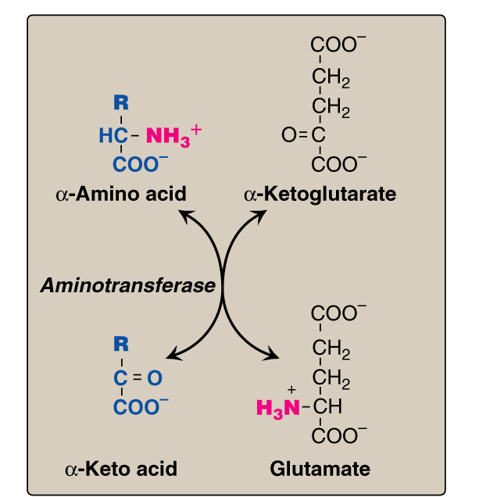
Background: Transamination

Slide 7
Background: Transamination by ALT

Slide 8
Background: Oxidative Deamination
Glutamate
Glutamate
Dehydrogenase NH₃
α-ketoglutarate

Slide 9
Transport of NH₃ from peripheral tissues into the liver
Ammonia is produced by all tissues and the main disposal is via formation of urea in liver
Blood level of NH₃ must be kept very low, otherwise, hyperammonemia and CNS toxicity will occur (NH₃ is toxic to CNS)
To solve this problem, NH₃ is transported from peripheral tissues to liver via formation of:
Glutamine (most tissues)
Alanine (muscle)

Slide 10
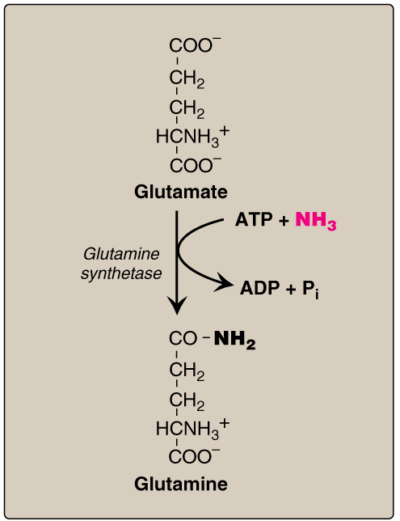
Transport of NH₃ from peripheral tissues into the liver
Cont’D
From most peripheral tissues:
NH₃ is transported Into
the liver through forming
glutamine by glutamine synthetase

Slide 11
Transport of NH₃ from peripheral tissues into the liver
Cont’D
From the muscle:
First, NH₃ will be transferred
into α-ketoglutarate to form
glutamate
Then, glutamate will give its
amino group to pyruvate
to form alanine by ALT
Therefore, NH₃ is transported
from muscle into the liver
through forming alanine

Slide 12
Fate of glutamine and alanine in the liver
In the Liver:
1. Glutamine is converted into
glutamate by glutaminase.
2. Alanine will give its amino group
to α-ketoglutarate to form glutamate by
ALT.
1
3
3. Glutamate is converted into
α-ketoglutarate and releasing NH₃
by glutamate dehydrogenase.
2
NH₃ is transported by glutamine and alanine into liver where both
will release NH₃ inside the liver to start urea cycle

Slide 13
Summary Transport of NH₃ from peripheral tissues (in the form of glutamine and alanine) into the liver and the release of NH₃ back in the liver to start the urea cycle

Slide 14
Urea Cycle
Urea is the major form for disposal of NH₃
Urea cycle occurs in the liver
One nitrogen of urea is from NH₃ and the other nitrogen from aspartate
Urea is transported in the blood to the kidneys for excretion in urine

Slide 15
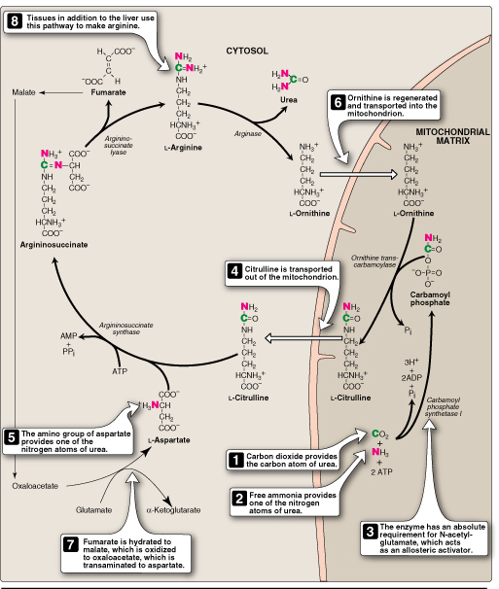
Urea Cycle
CONT’D
The five enzymes of urea cycle:
Carbamoyl phosphate synthetase I
Ornithine transcarbamoylase (OCT)
Argininosuccinate synthase
Argininosuccinate lyase
Arginase

Slide 16
Fate of Urea
Urea Kidneys and excreted in urine
Intestine NH₃ + CO₂
Blood
Urease
Lost in feces
Reabsorbed
into blood
The action of intestinal urease to form NH₃
is clinically significant in renal failure:
Renal failure Blood urea Urea to intestine NH₃ blood level
Urease
(Acquired hyperammonemia)

Slide 17
Sources of Ammonia
Sources:
Amino acids
Glutamine
Bacterial urease in intestine
Amines e.g., catecholamines
Purines & pyrimidines

Slide 18
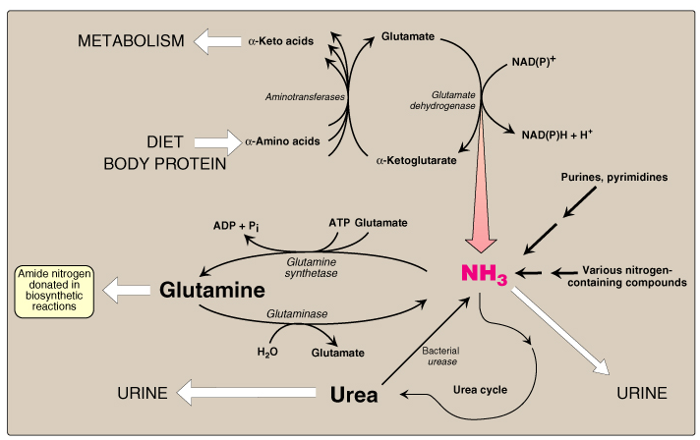
Sources and Fates of Ammonia
Normal blood level of ammonia: 5 – 50 µmol/L

Slide 19
Hyperammonemia
Acquired hyperammonemia:
1. Liver diseases: Acute: Viral hepatitis or hepatotoxic Chronic: Cirrhosis by hepatitis or alcoholism
2. Renal failure
Inherited hyperammonemia:
Genetic deficiencies of any of the 5 enzymes of urea cycle

Slide 20
Inherited Hyperammonemia
Ornithine transcarbamoylase deficency: X-linked recessive Most common of congenital hyperammonemia Marked decrease of citrulline and arginine
Others: Autosomal recessive

Slide 21
Clinical Presentation of Hyperammonemia
Lethargy and somnolence
Tremors
Vomiting and cerebral edema
Convulsions
Coma and death

Slide 22
Thank You

