Slide 1
BLOOD TRANSFUSION

Slide 2
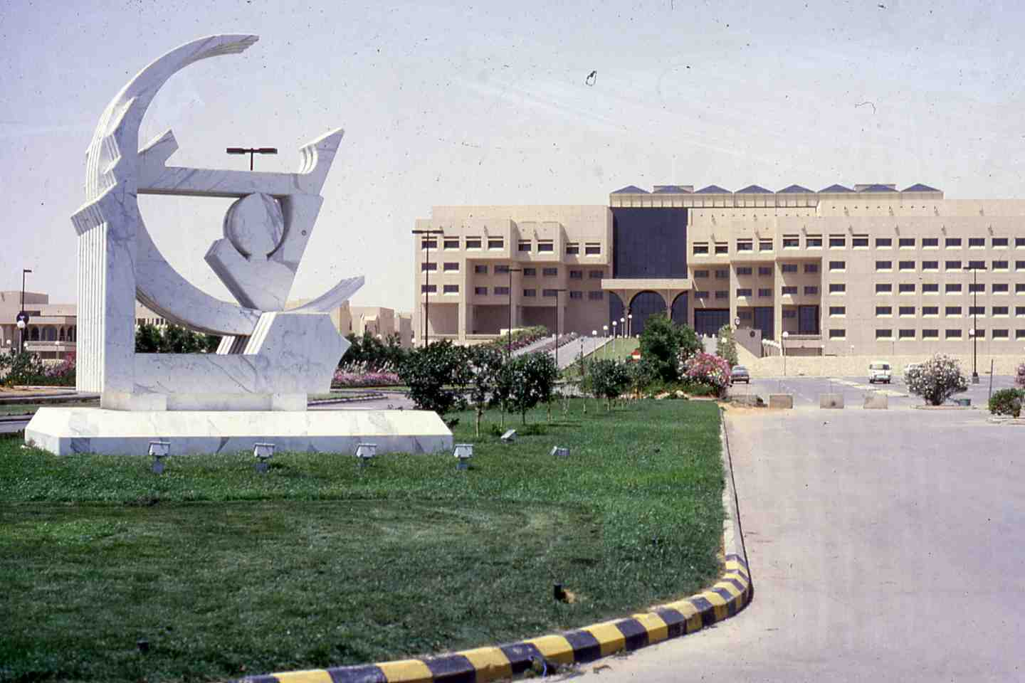

Slide 3
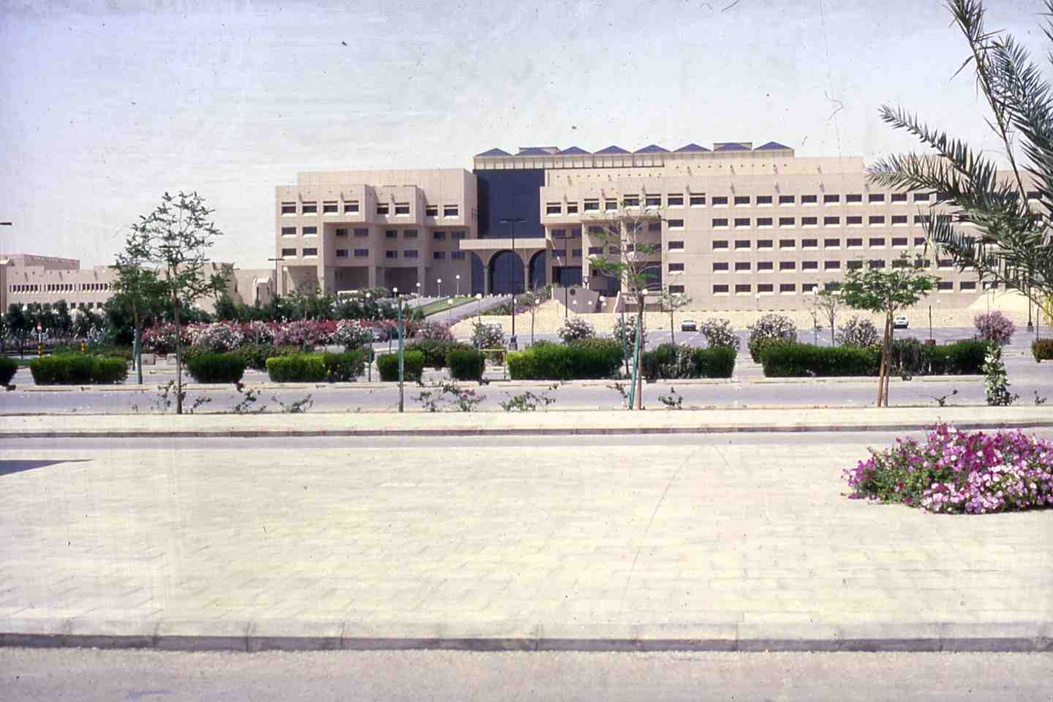

Slide 4
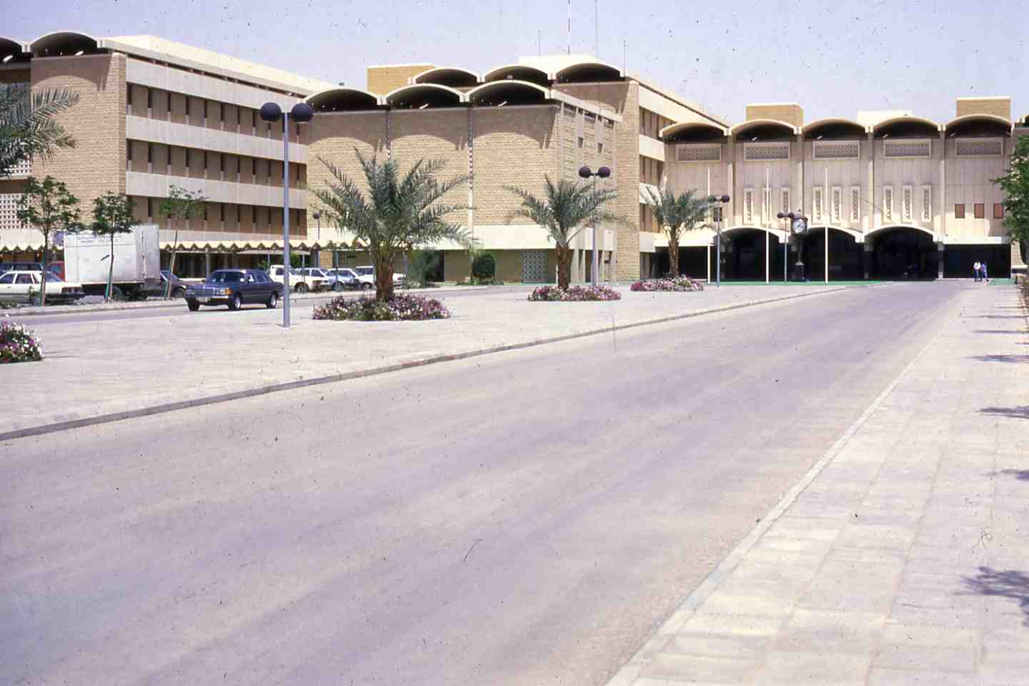

Slide 5
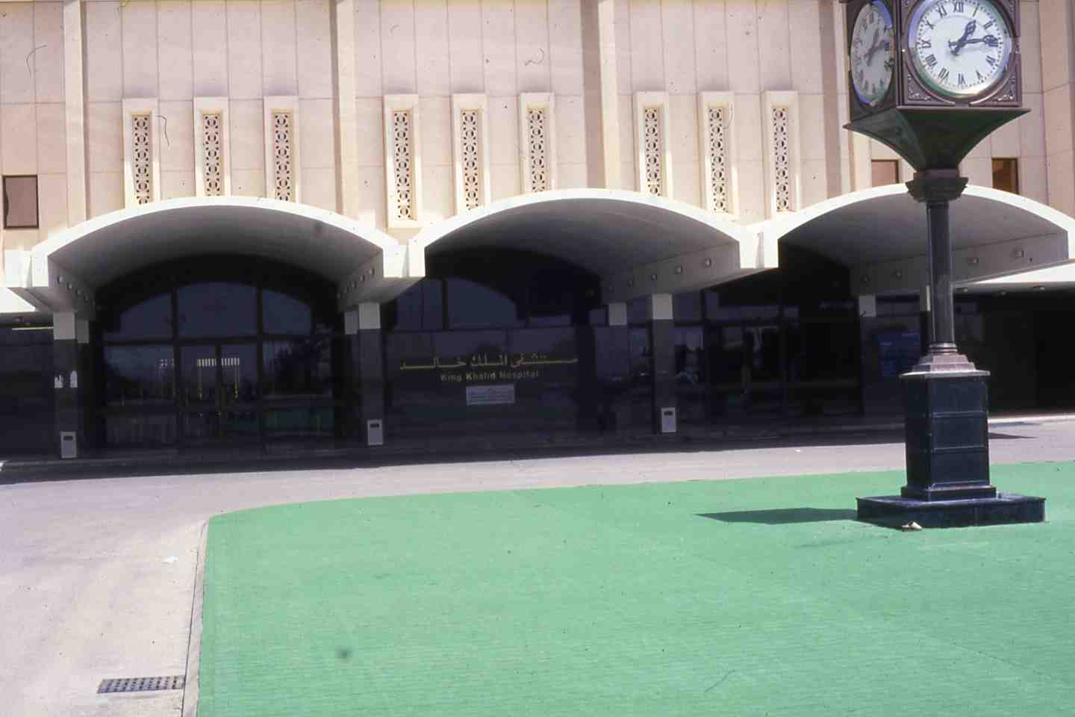

Slide 6
BLOOD DONORS
1. Voluntary donors
- Outdoor donors and recruitment campaigns.
Hospital staff.
2. Involuntary donors
Relatives of patients admitted to hospital for elective surgery and normal deliveries.
Relative of patients who receive emergency blood transfusion (replacement donations).
Persons applying for driving licenses.

Slide 7
Autologous donations
Patients for elective surgery can donate 4 units in one month before surgery (one unit/week).
Acute normovolaemic haemodilution, 2-3 units of blood can be obtained from the patient immediately before surgery (Target haematocrit 25-30%).
Salvage of the blood lost during surgery with special blood salvage devices.
Combination of the above methods.
4. Directed blood donations from close relative of patients on their requests.

Slide 8
AUTOLOGUS BLOOD TRANSFUSION
Predeposited:
Blood is collected in the weeks prior elective surgery
Haemodilution:
Blood is collected immediately before surgery to be reinfused at the end of the operation
Salvage:
Heavy blood loss during operation is collected to be reinfused

Slide 9
What are the criteria for blood donation?
1. To be eligible to donate blood, a person must be in good health and generally must be at least 16 years of age.
2. Minimum weight requirements may vary among facilities, but generally, donors must weigh at least 110 pounds (50kg).
3. Most blood banks have no upper age limit.
4. All donors must pass the physical and health history examinations given prior to donation.

Slide 10
What are the criteria for blood donation? (Continue)
5. Volunteer donors provide nearly all blood used for transfusion in KSA.
6. The donor's body replenishes the fluid lost from donation in 24 hours. It may take up to two months to replace the lost red blood cells.
7. Whole blood can be donated once every eight weeks (56 days).
8. Two units of red blood cells can be donated at one time, using a process known as red cell apheresis. This type of donation can be made every 16 weeks.

Slide 11
4. Who should not donate blood?
Anyone who has ever used intravenous drugs (illegal IV drugs).
Men who have had sexual contact with other men since 1977.
Anyone who has ever received clotting factor concentrates.
Anyone with a positive test for HIV (AIDS virus)
Men and women who have engaged in sex for money or drugs since 1977.
Anyone who has had hepatitis since his or her eleventh birthday.

Slide 12
Who should not donate blood? (Continued)
Anyone who has ever used intravenous drugs (illegal IV drugs).
Men who have had sexual contact with other men since 1977.
Anyone who has ever received clotting factor concentrates.
Anyone with a positive test for HIV (AIDS virus)
Men and women who have engaged in sex for money or drugs since 1977.
Anyone who has had hepatitis since his or her eleventh birthday.

Slide 13
Donors temporary deferral
Active disease under treatment:
Cold, flu, T.B., Syphilis, infections, curable disease of heart, lungs, kidneys, liver, GIT, treatment with antibiotics.
For Three Years:
Immigrant coming from malarial endemic area, one who had diagnosis of malaria.
For One Year:
Hepatitis B vaccine.
Rabies vaccine.
History of close contact with viral hepatitis patient.
Tattoo patient.
Contact with a prostitute or other persons with high risk for AIDS.

Slide 14
Donors Temporary Deferral (continued)
For Two Months:
Recent blood donation.
For Six weeks:
Following delivery.
For One Month:
Rubella vaccination (German measles).

Slide 15
Where is blood donated?
There are many places where blood donations can be made.
Blood mobiles (mobile blood drives on specially constructed buses) travel to high schools, colleges, factories, military camps and community organizations.
2. People can also donate at community blood centers and hospital-based donor centers.
3. Many people donate at blood drives at their places of work.

Slide 16
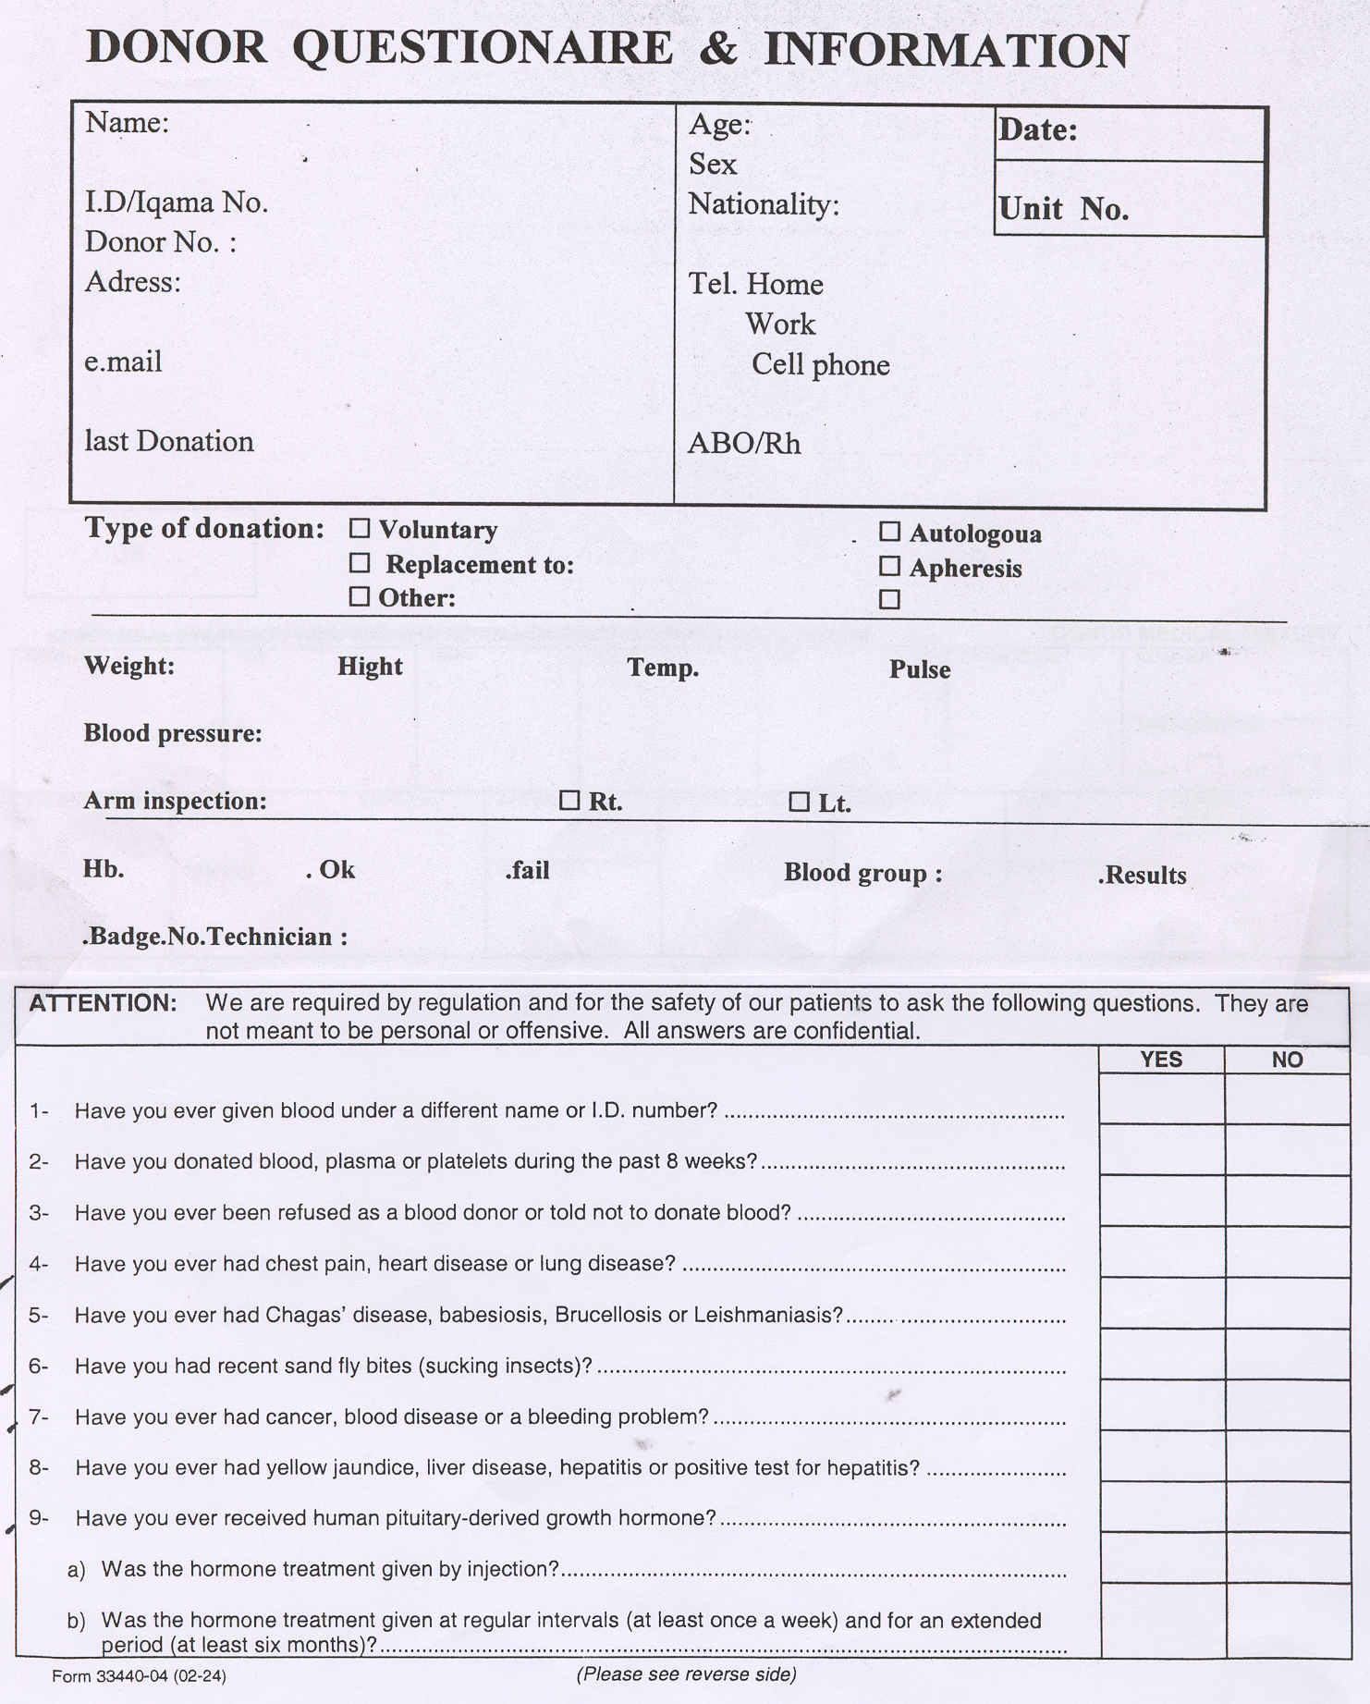

Slide 17
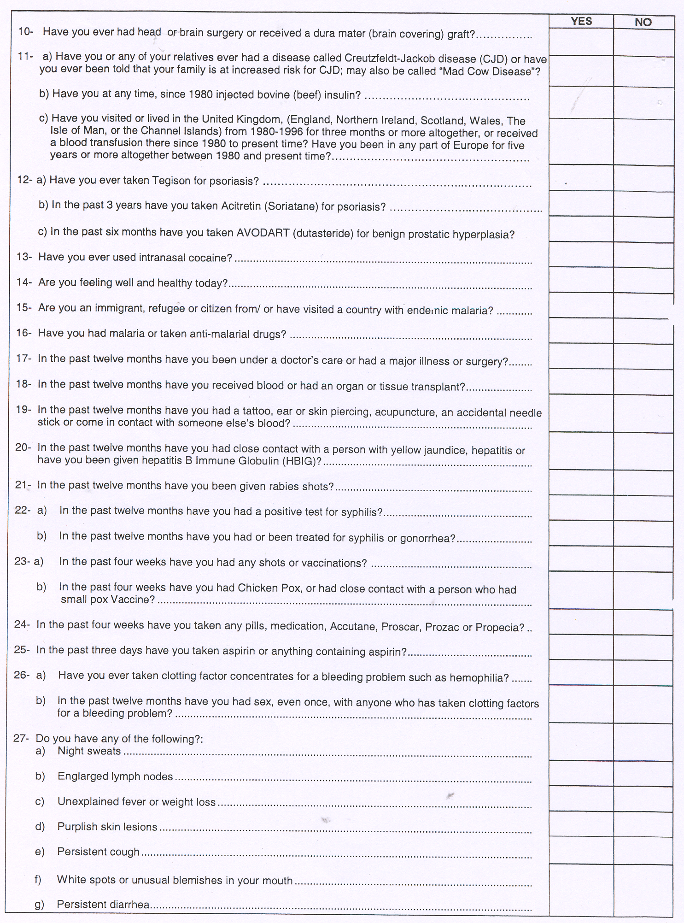

Slide 18
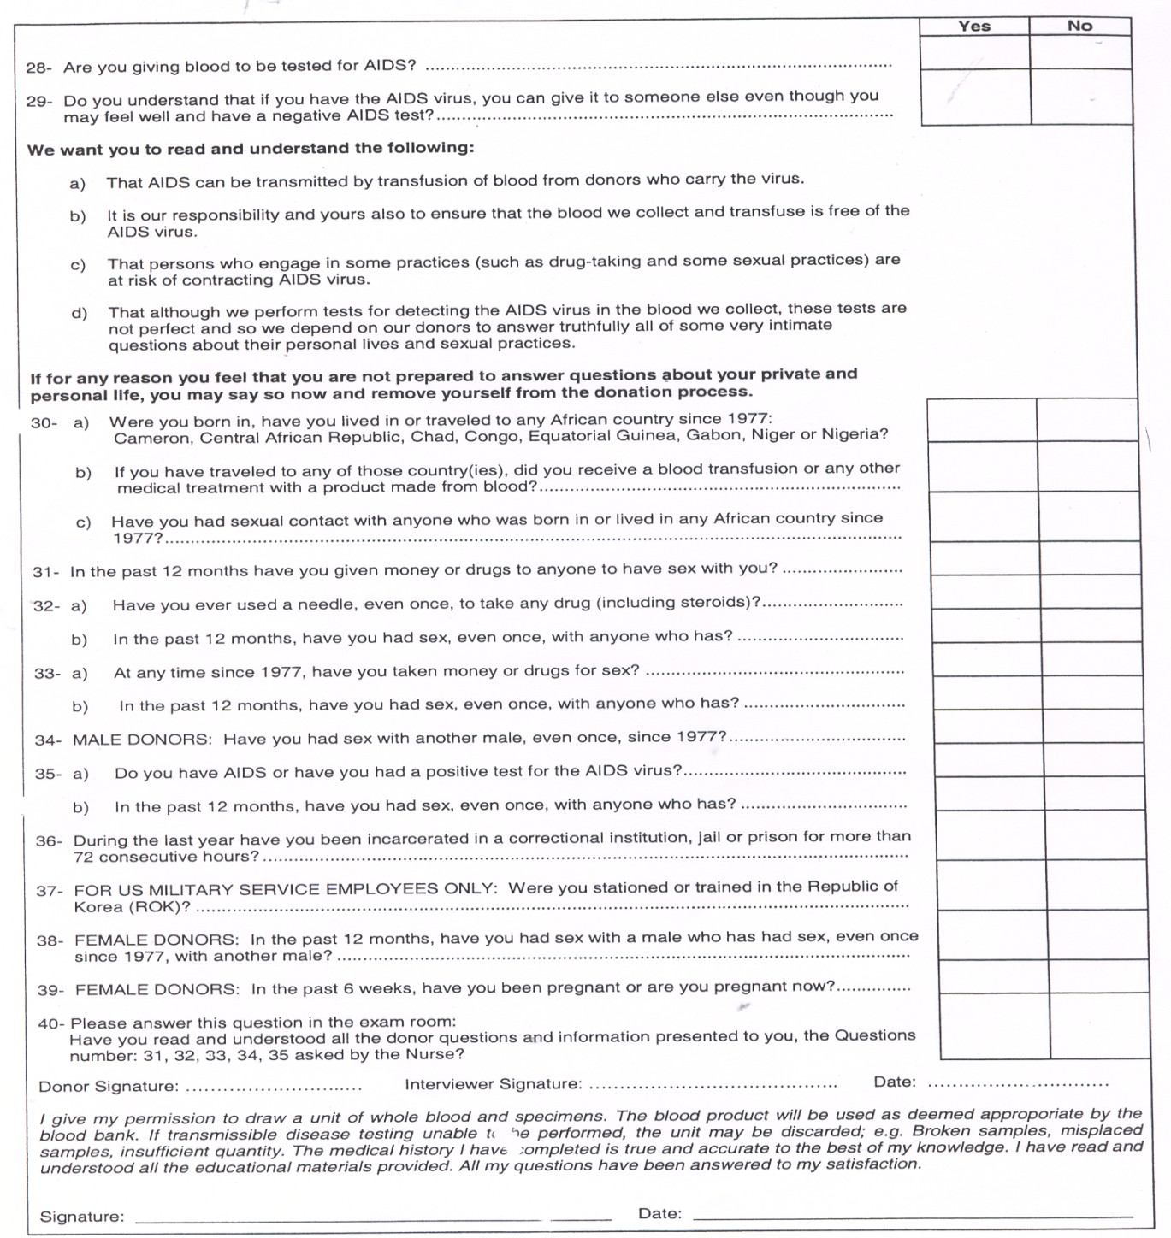

Slide 19
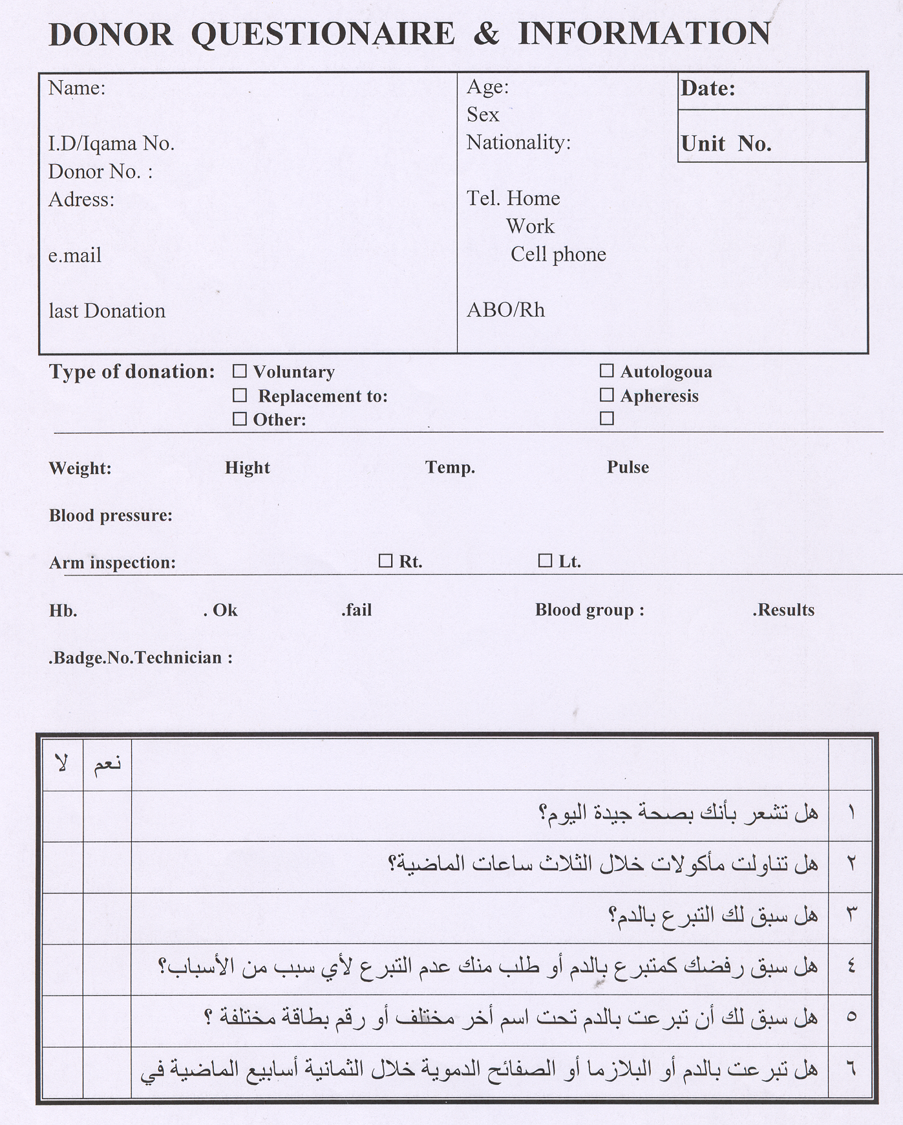

Slide 20
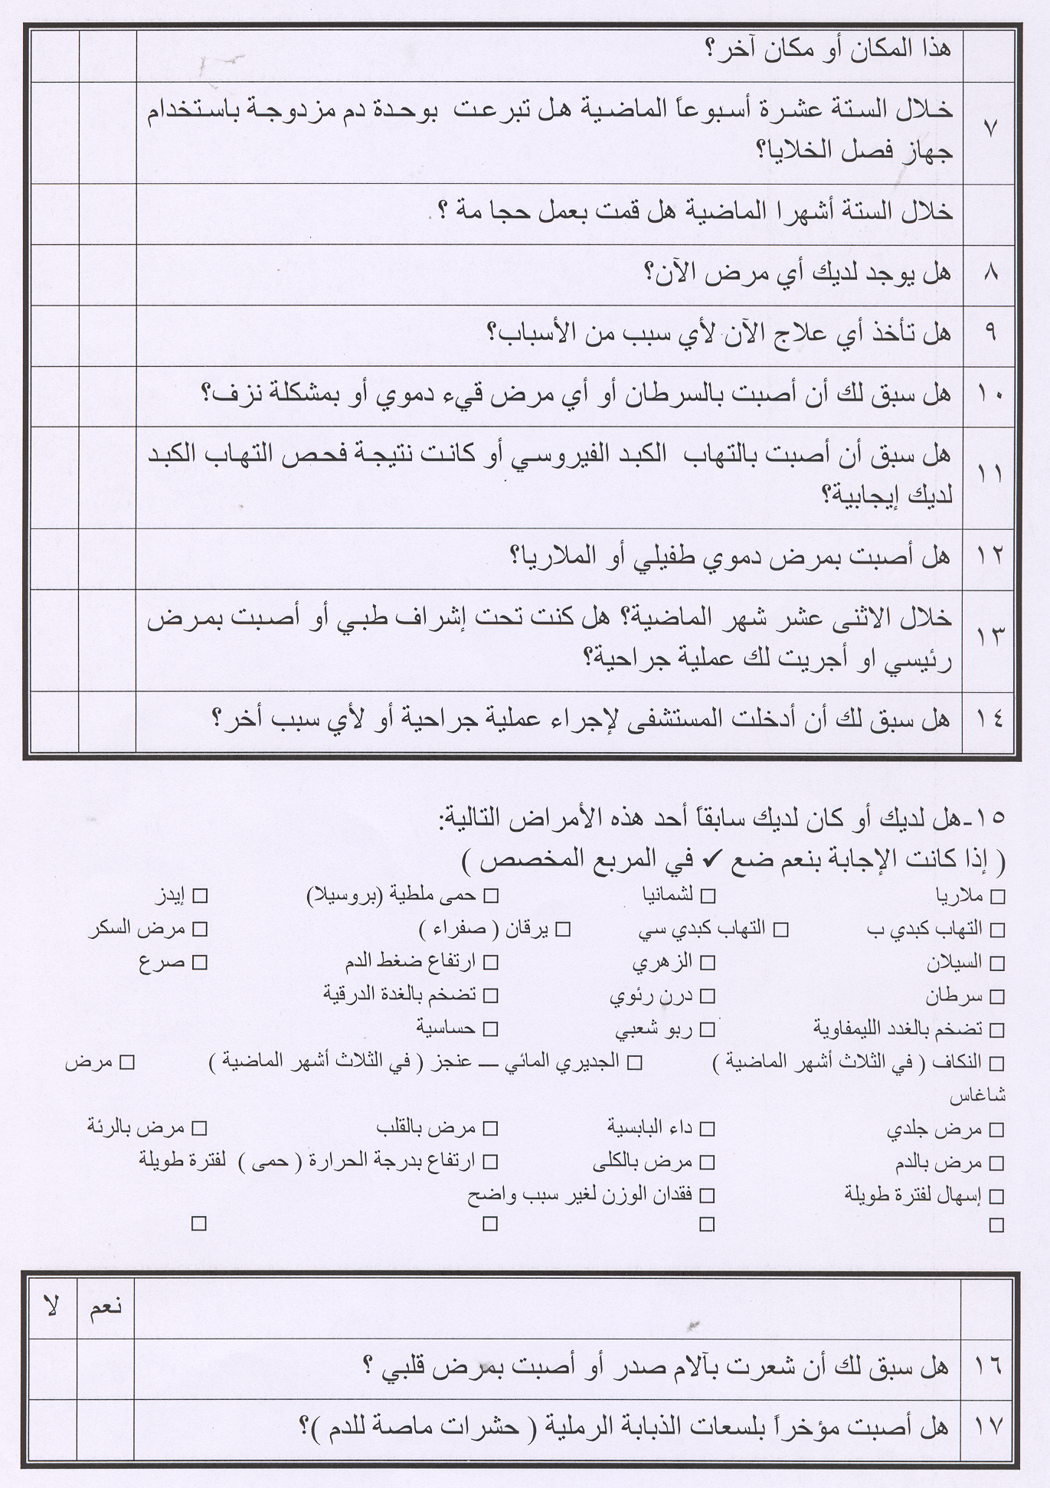

Slide 21
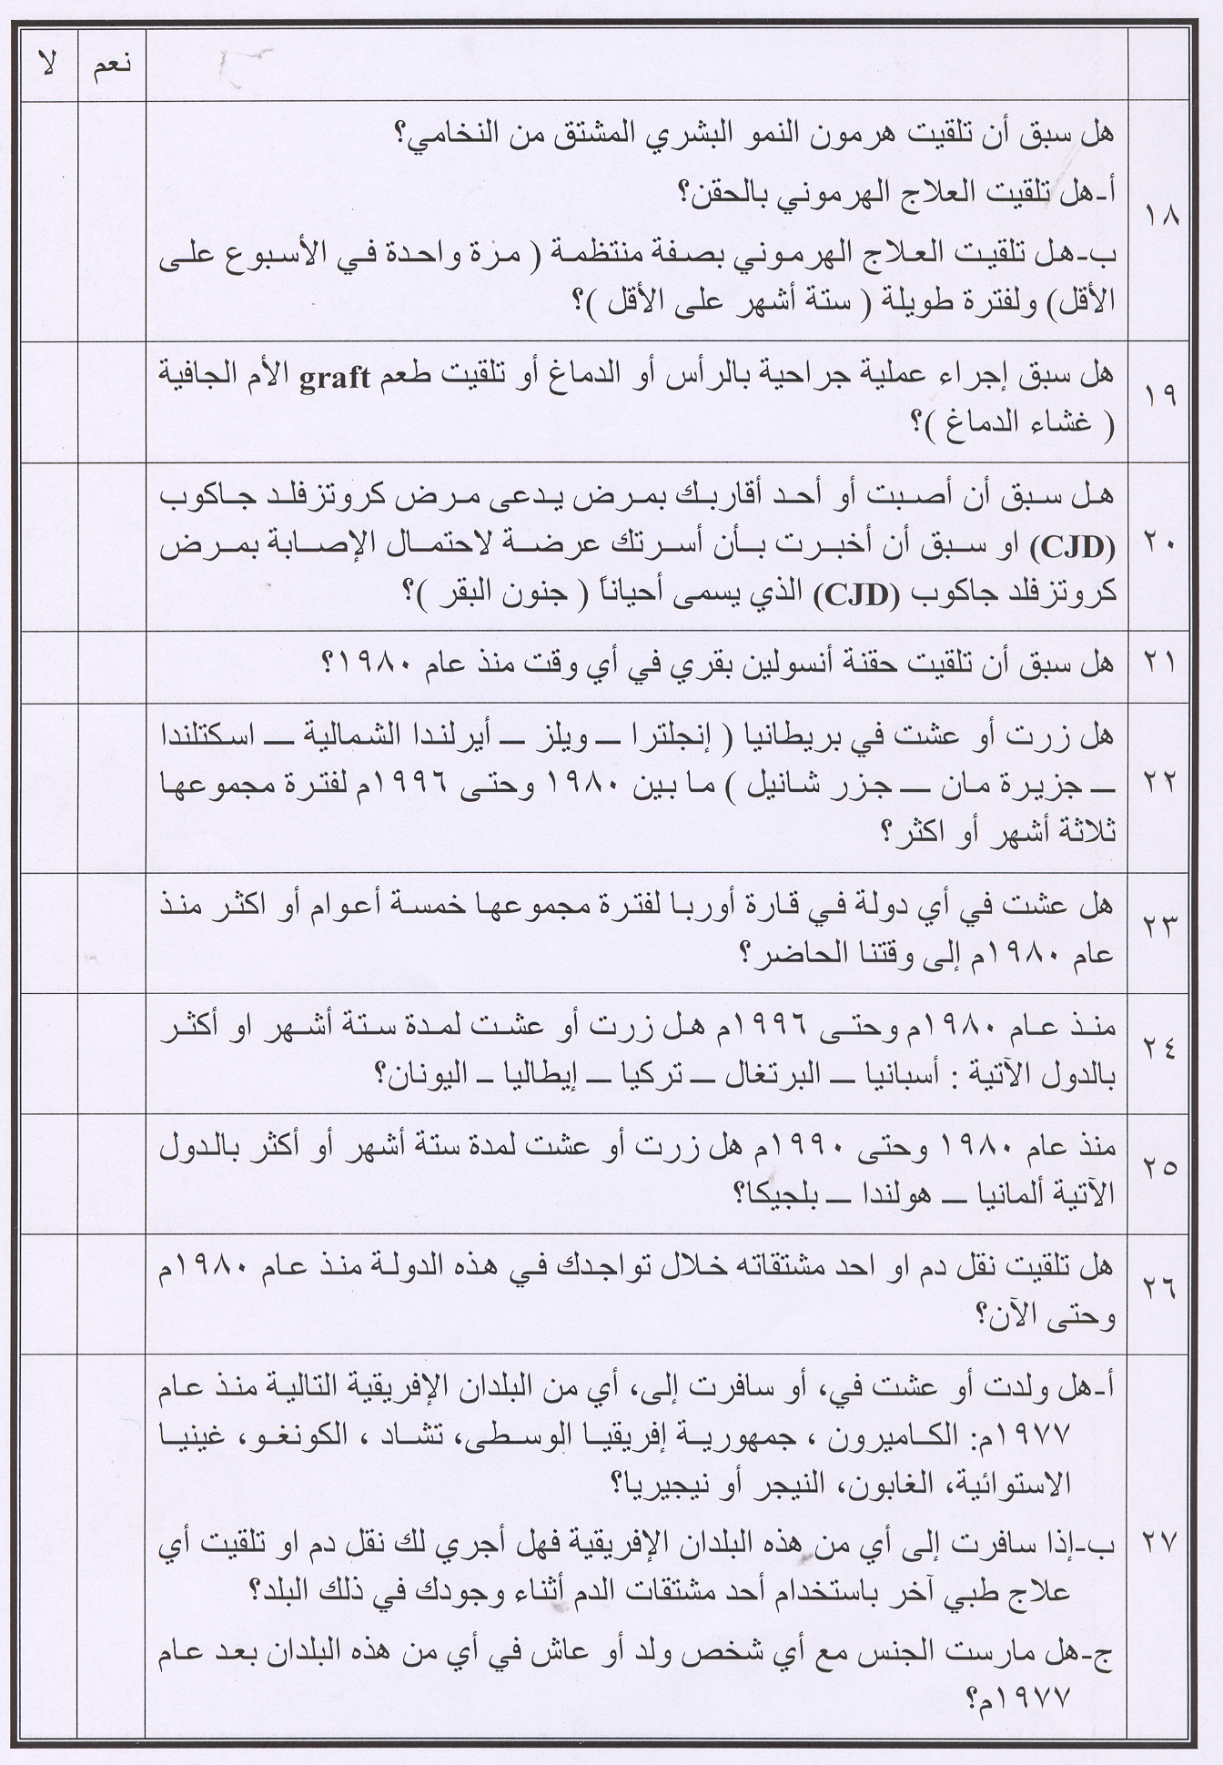

Slide 22
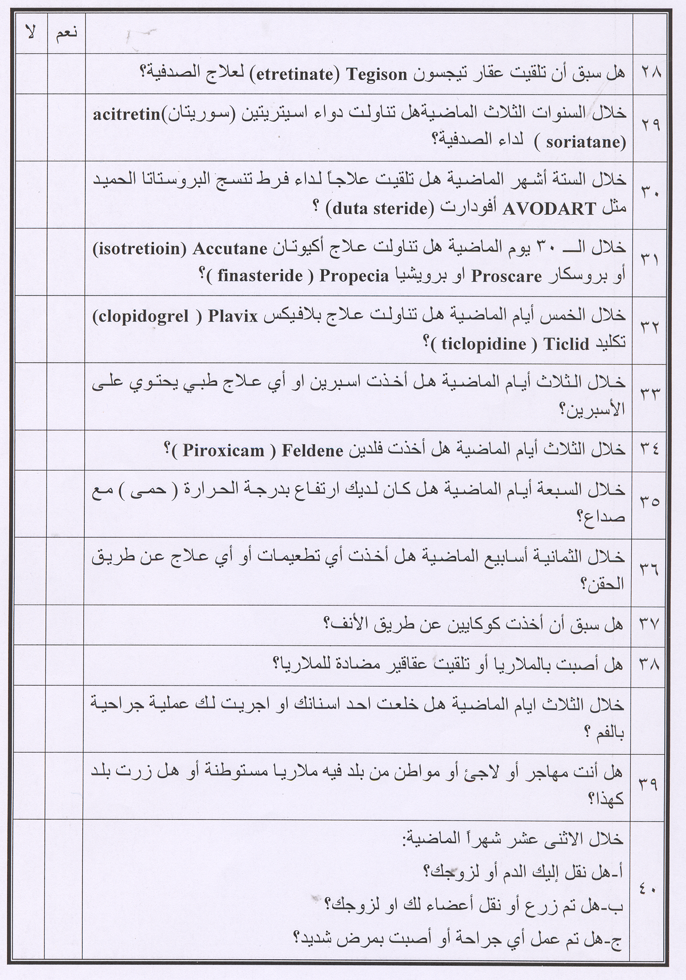

Slide 23
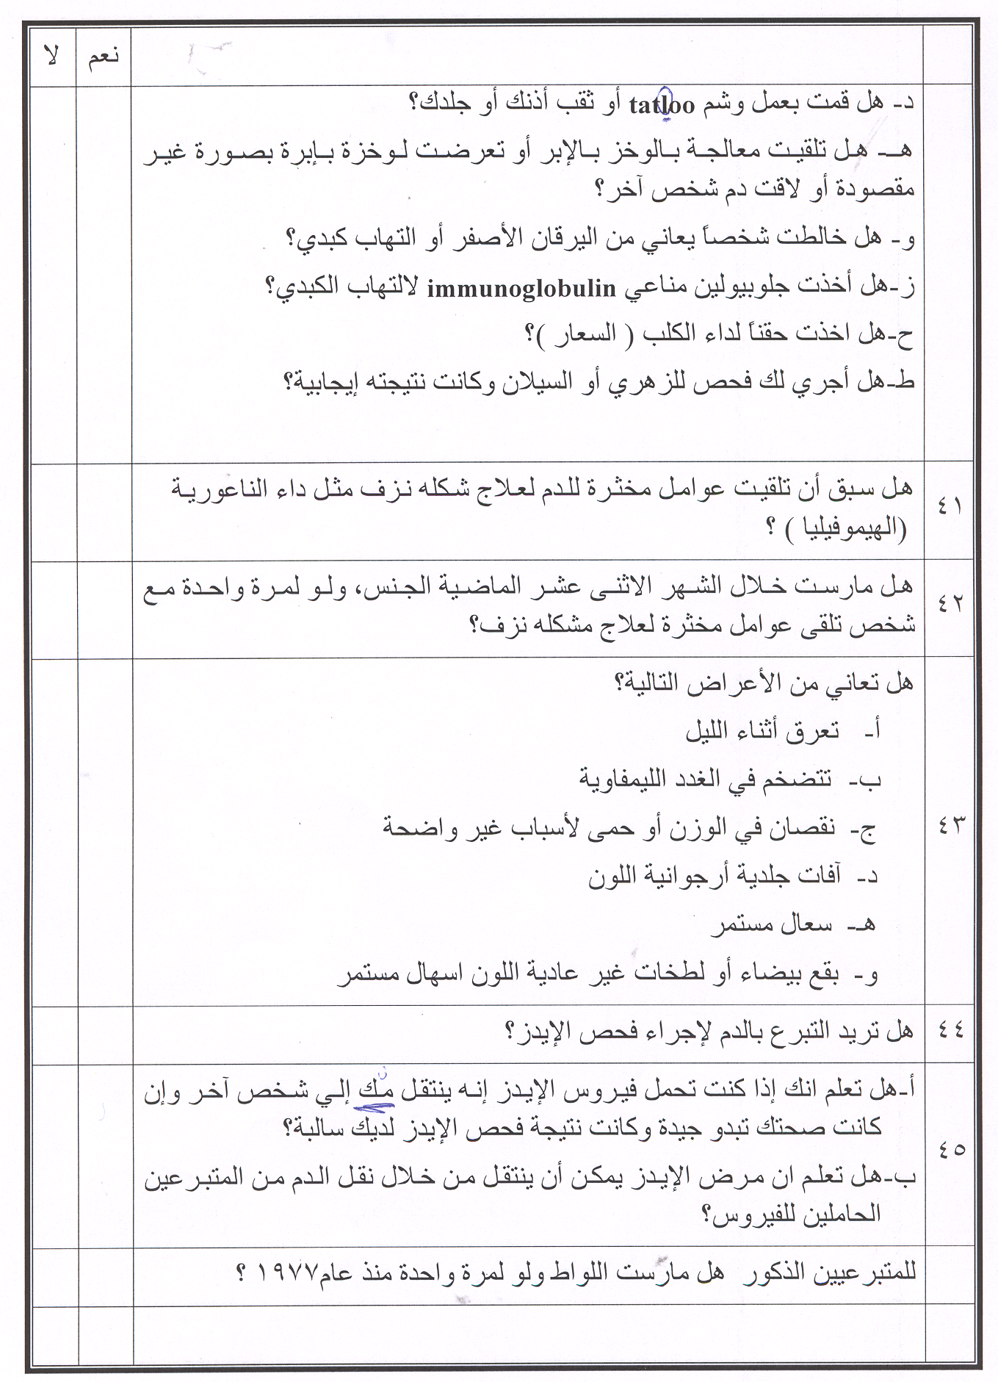

Slide 25
Those who may be deferred include:
* Anyone who has ever used intravenous drugs (illegal IV drugs).
* Men who have had sexual contact with other men since 1977.
* Anyone who has ever received clotting factor concentrates.
* Anyone with a positive test for HIV (AIDS virus)
* Men and women who have engaged in sex for money or drugs
since 1977.
* Anyone who has had hepatitis since his or her eleventh birthday.
* Anyone who has had babesiosis or Chagas disease.

Slide 26
8. Those who may be deferred include:
* Anyone who has taken Tegison for psoriasis.
* Anyone who has risk factors for Crueutzfeldt-Jakob disease (CJD)
or who has an immediate family member with CJD.
* Anyone who has risk factors for vCJD.
* Anyone who spent three months or more in the United Kingdom from
1980 through 1996. (This is applied in USA)
* Anyone who has spent five years in Europe form 1980 to the present.
(This is applied in USA).

Slide 27
Medication deferral list
If the donor now taking or if he has EVER taken any of these medications:
□ Proscar© (finasteride) - usually given for prostate gland enlargement.
□ Avodart© (dutasteride) - usually given for prostate enlargement.
□ Propecia© (finasteride) - usually given for baldness.
□ Accutane© (Amnesteem, Claravis, Sotret, isotretinoin) - usually given for severe acne.
□ Soriatane© (acitretin) - usually given for severe psoriasis.
□ Tegison© (etretinate) - usually given for severe psoriasis.

Slide 28
Medication deferral list (Continued)
If the donor now taking or if he has EVER taken any of these
medications:
□ Growth Hormone from Human Pituitary Glands - used usually for children with delayed or impaired growth.
□ Insulin from Cows (Bovine, or Beef, Insulin) - used to treat diabetes.
□ Hepatitis B Immune Globulin - given following an exposure to hepatitis B.
NOTE: This is different from the hepatitis B vaccine which is a series of 3 injections given over a 6 month period to prevent future infection from exposures to hepatitis B.
□ Unlicensed Vaccine - usually associated with a research protocol.

Slide 29
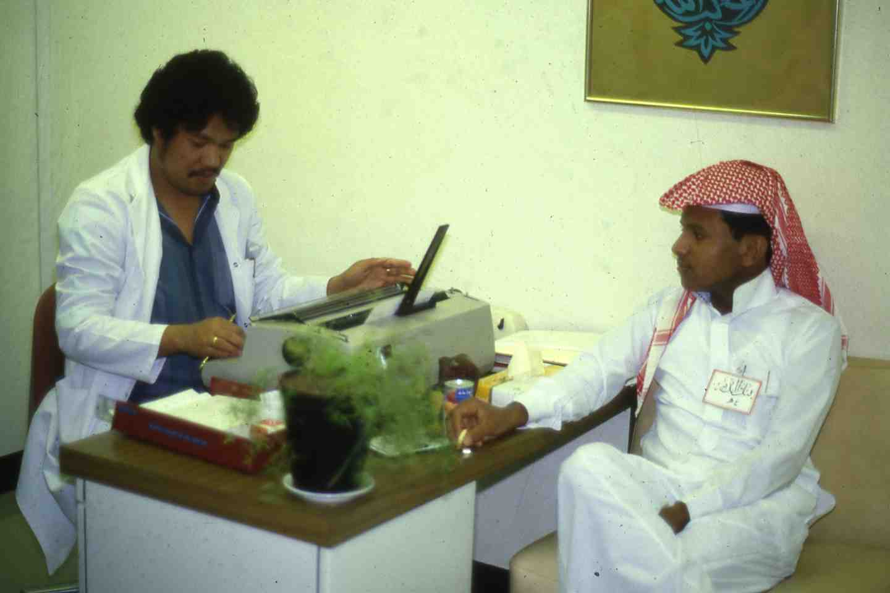

Slide 30
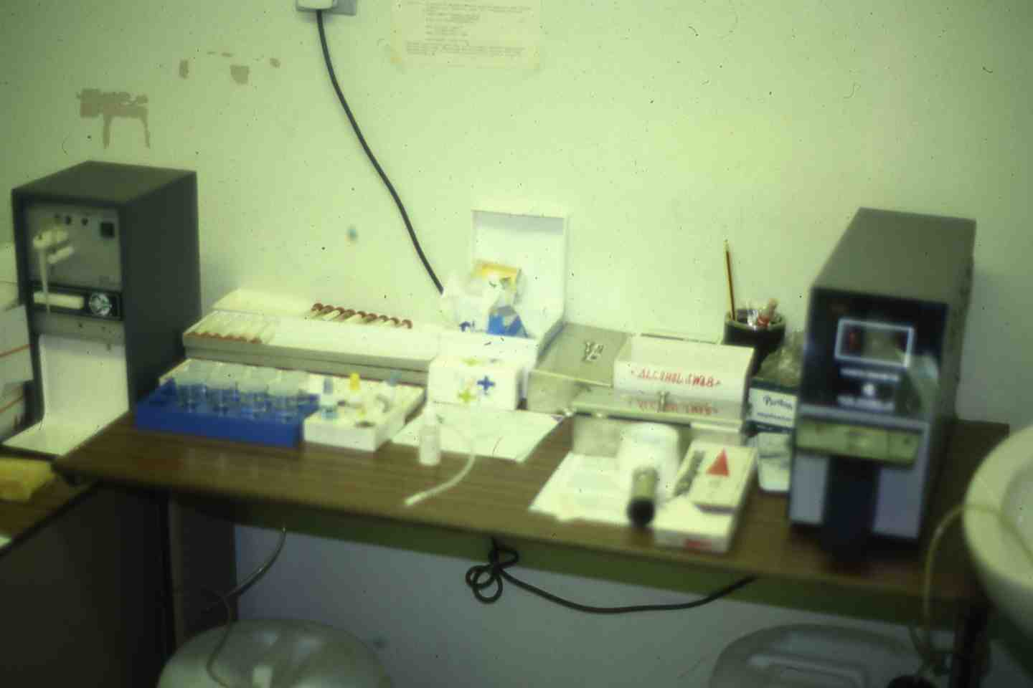

Slide 31
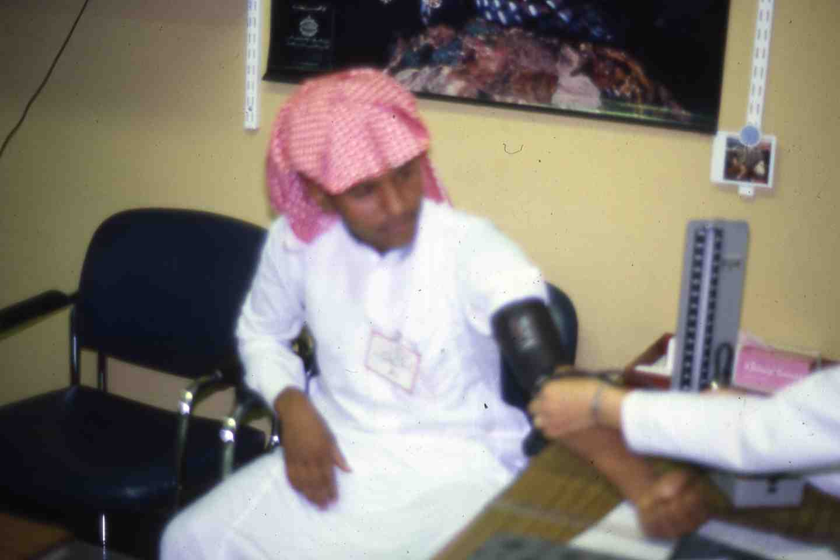

Slide 32
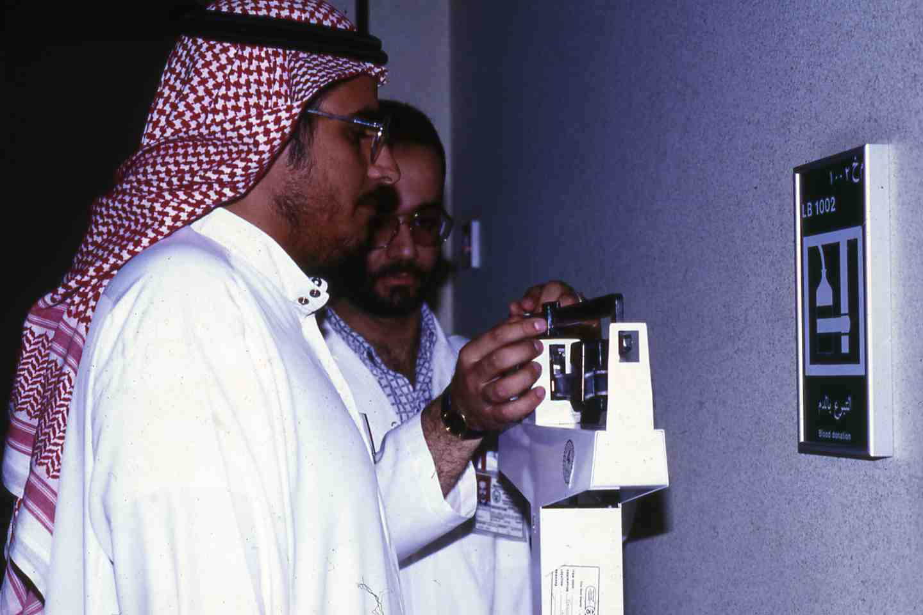

Slide 33
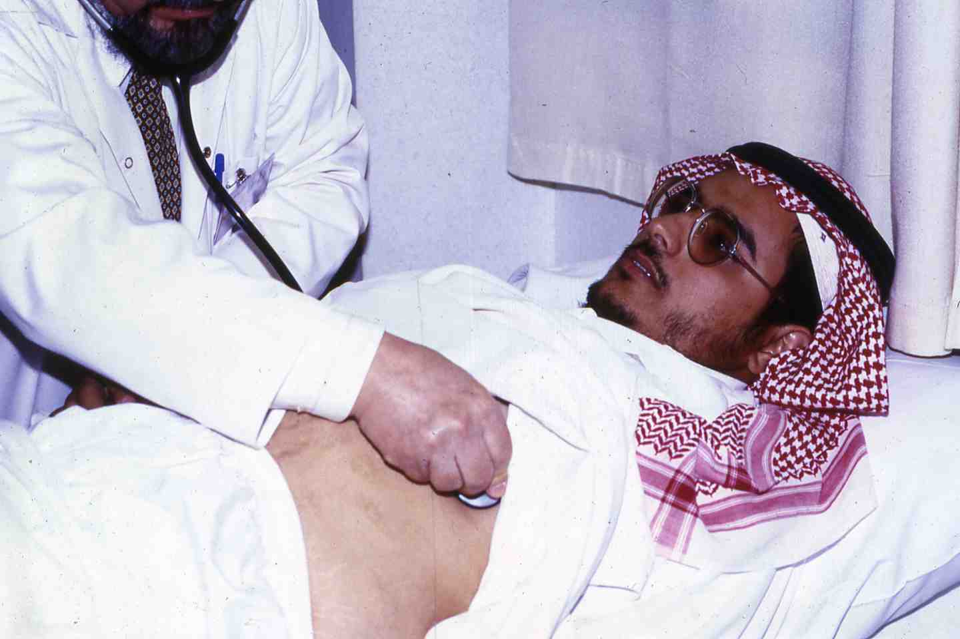

Slide 34
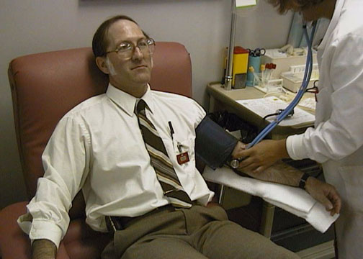
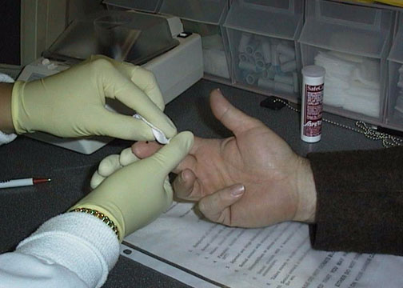
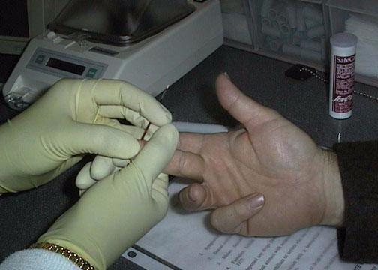
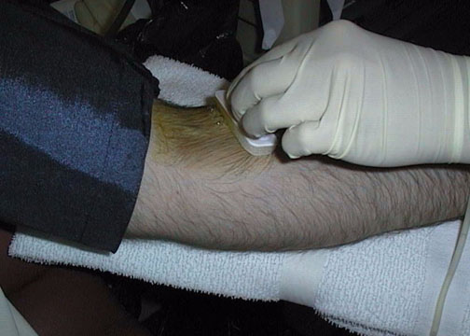
Blood Donation
1
2
3
4

Slide 35
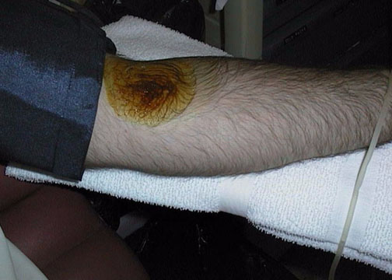
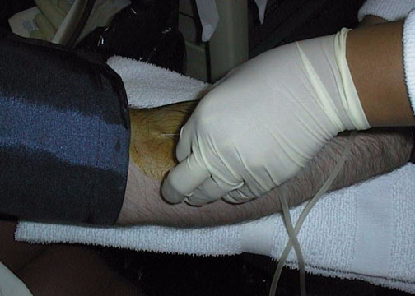
5
6
7
8

Slide 36
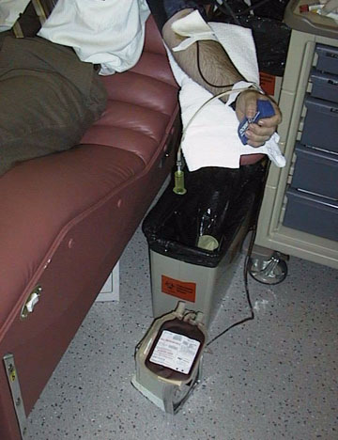
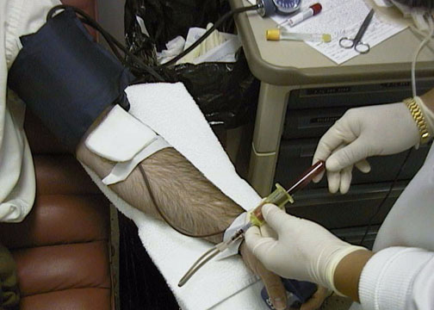
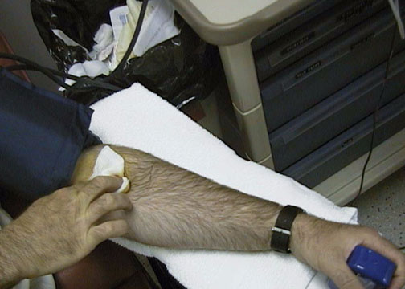
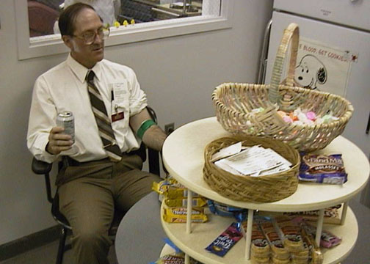
9
10
11
12

Slide 38
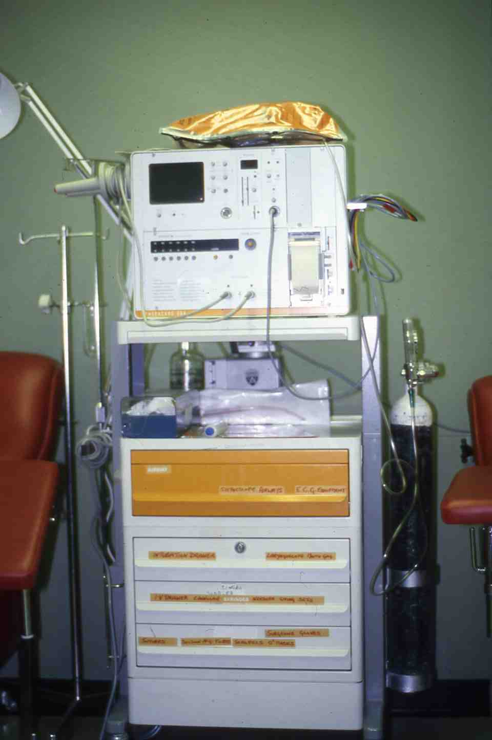

Slide 39
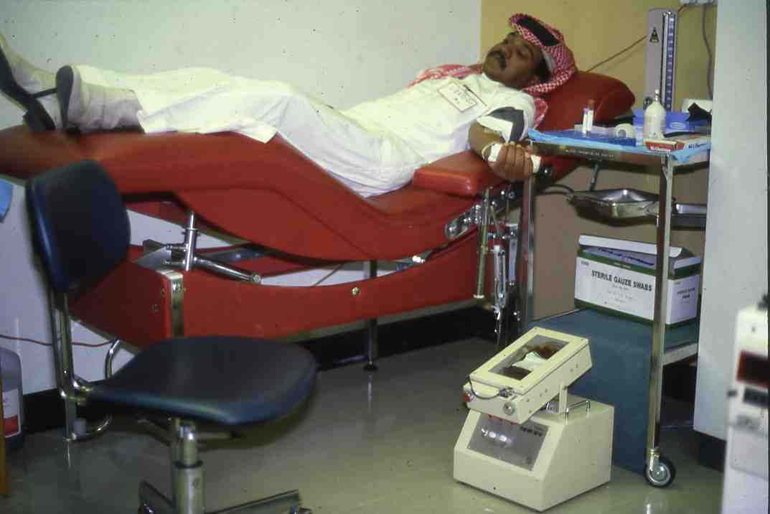

Slide 40
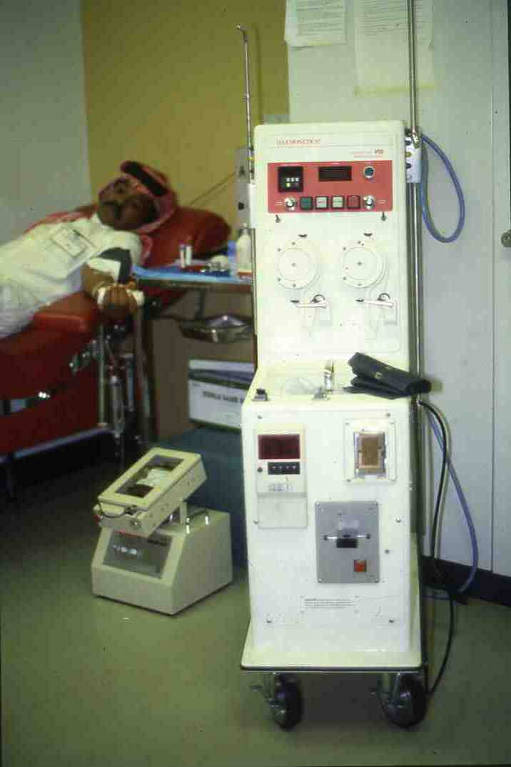

Slide 41
ACD - A (NIH - A) SOLUTION
Trisodium Citrate (Dihydrate) 2.2 g
Citric Acid (Monohydrate) 0.8 g
Dextrose 2.5 g
Water to 100 ml
67.5 ml of this solution (pH 5.0 – 5.1) are mixed with 450 ml of Blood
Store Red Blood Cells 21 days at 1 – 6 ⁰ C

Slide 42
CITRATE – PHOSPHATE – DEXTROSE (CPD)
Trisodium Citrate (Dihydrate) 26.3 g
Citric Acid (Monohydrate) 3.27 g
Sodium Dihydrogen Phosphate (Monohydrate) 2.22 g
Dextrose 25.5 g
Water to 1000 ml
63 ml of this solution (pH 5.0 – 5.1) are mixed with 450 ml of Blood
Store Red Blood Cells for 28 days at 1 – 6 ⁰ C
Store Platelets for 3days at 20 – 24 ⁰ C

Slide 43
Anticoagulant Citrate Phosphate Dextrose (CPDA-1) Red Blood Cells
63ml Anticoagulant Citrate Phosphate Dextrose Adenine Solution USP for collection of 450ml of blood
Each 63ml contains:
188 mg Citric Acid (anhydrous) USP
1.66 g Sodium Citrate (anhydrate) USP
140 mg Monobasic Sodium Phosphate (monohydrate) USP
2.01 g Dextrose (monohydrate) USP
17.3 mg Adenine USP
Store Red Blood Cells 35 days at 1 – 6 ⁰ C
Store Platelets 5 days at 20 – 24 ⁰ C

Slide 44
Optisol ^{R} AS – 5 Red Cell Preservative Solution
100 ml containing:
877 mg Sodium Chloride USP
900 mg Dextrose (monohydrate) USP
525 mg Mannitol USP
30 mg Adenine USP
Contains 15.0 mEq Sodium
Caution: Add Optisol ^{R} Solution to Red Blood Cells within
72 hours after Blood Collection
Store Red Blood Cells 42 days at 1 – 6 ⁰ C

Slide 45
Anticoagulant Citrate Phosphate Dextrose (CPDA-2) Plus Optisol ^{R} for RBCs
63ml Anticoagulant Citrate Phosphate Dextrose Solution USP for collection of 450ml of blood
Each 63ml contains:
188 mg Citric Acid (anhydrous) USP
1.66 g Sodium Citrate (anhydrate) USP
140 mg Monobasic Sodium Phosphate (monohydrate) USP
1.61 g Dextrose (monohydrate) USP
15 mEq Sodium Added
Store Red Blood Cells 42 days at 1 – 6 ⁰ C
Store Platelets 5 days at 20 – 24 ⁰ C

Slide 46
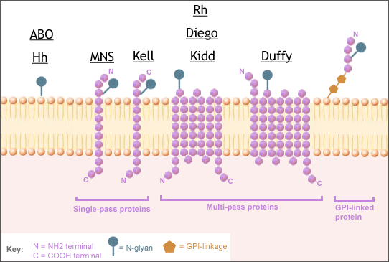
Blood Groups

Slide 47
Significance of Certain Blood Group Antibodies
 |  |  | Clinical Significance
Blood Group System | Antibody | Relative Frequency in Antibody Screening | HTR | HDN
ABO | Anti-A Anti-B | All group B and O All group A and O | Yes Yes | Yes Yes
Rhesus | Anti-D Anti-c Anti-E Anti-C Anti-e | Common Common Common Common Common | Yes Yes Yes Yes Yes | Yes Yes Yes Yes Yes
Kell | Anti-K Anti-k | Common Rare | Yes Yes | Yes Yes
Kidd | Anti-Jkª Anti-Jk^{b} | Common Rare | Yes Yes | Yes Yes
Duffy | Anti-Fyª Anti-Fyª | Common Rare | Yes Yes | Yes Yes
MN | Anti-M Anti-N | Common Rare | Occasional Rare | Occasional Rare
SsU | Anti-S Anti-s | Uncommon Rare | Yes Yes | Yes Yes
Lewis | Anti-Leª Anti-Le^{b} | Common Uncommon | Yes No | No No
P | Anti-P1 | Uncommon | Rare | No
Li | Anti-l | Uncommon | No | No
HRT = hemolytic transfusion reaction, HDN = hemolytic disease of the newborn.

Slide 48
What are the most common blood types?
Distribution may be different for special racial and ethnic
groups?
O Rh-positive --- 38 percent.
O Rh-negative --- 7 percent.
A Rh-positive --- 34 percent
A Rh-negative --- 6 percent
B Rh-positive --- 9 percent
B Rh-negative ---2 percent
AB Rh-positive --- 3 percent
AB Rh-negative --- 1 percent

Slide 49
Antibody specificities related to the mechanism of immune haemolytic destruction.
Blood group system | Intravascular haemolysis | Extra vascular haemolysis
ABO,H | A,B,H
RH |  | All
Kell | K | K, k, Kpª, Kp^{b}, Jsª, Js^{b}
Kidd | Jkª | Jkª, JK^{b}, Jk³
Duffy |  | Fyª, Fy^{b}
MNS |  | M,S,s,U
Lutheran |  | LU^{b}
Lewis | Leª
Cartwright |  | Ytª
Colton |  | Coª, Co^{b}
Dombrock |  | Doª, Do^{b}

Slide 50
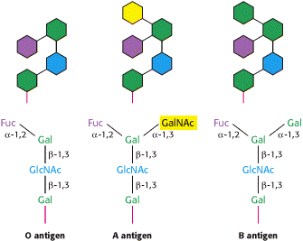

Slide 51
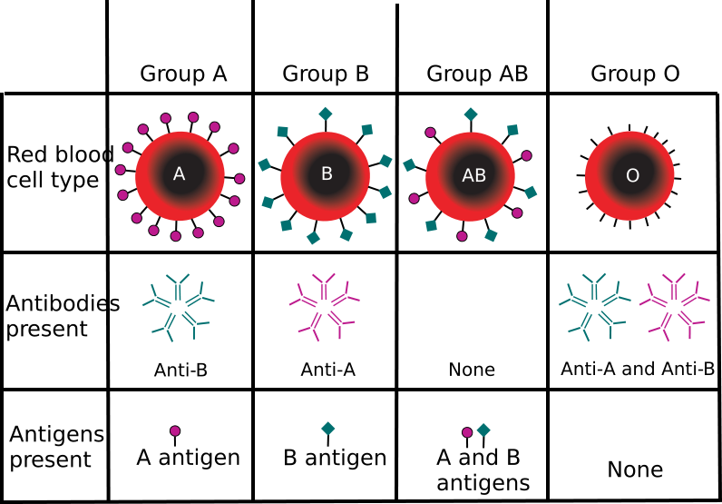
ABO Blood Group

Slide 52
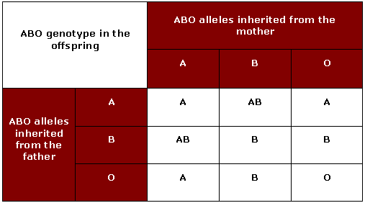
ABO Blood Groups Inheritance

Slide 53
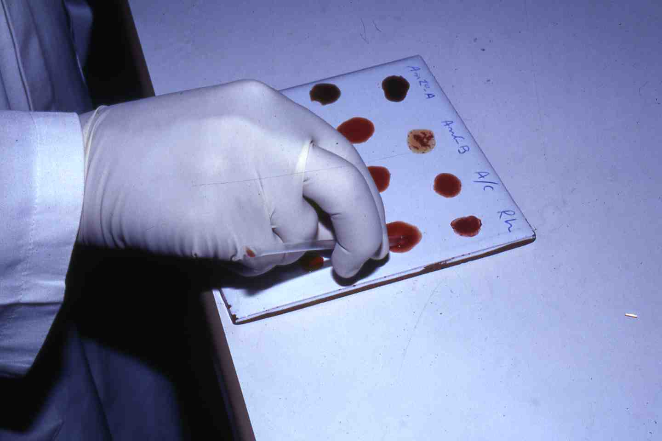

Slide 54
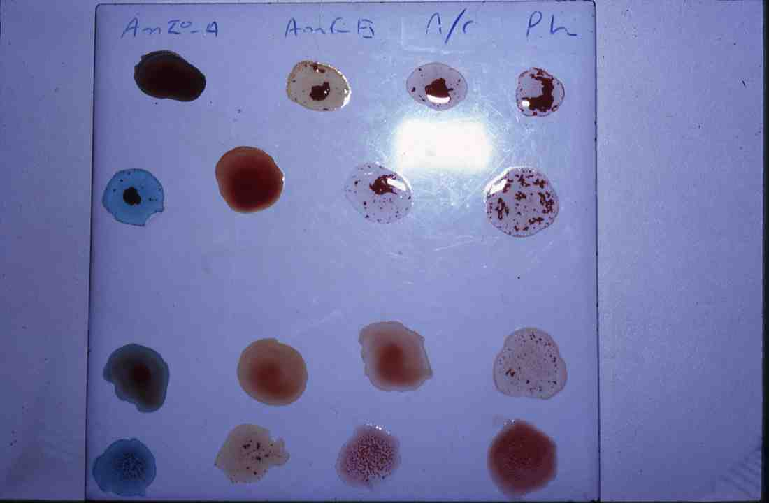

Slide 55
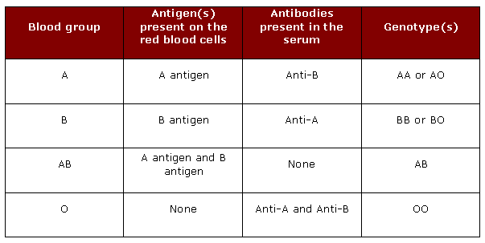
ABO Blood Groups

Slide 56
ABO blood group system
Blood group | Subgroup | Antigens on red cells | Antibodies in plasma
A | A₁ A₂ | A + A₁ A | Anti-B (Anti- A₁)*
B | - | B | Anti-A, Anti- A₁
AB | A₁B A₂B | A + A₁ + B A + B | None (Anti- A₁)*
O | - | (H)† | Anti-A Anti- A₁ Anti-B Anti-A,B†
* Anti- A₁ found in 1-2% of A₂ subjects and 25-30% of A₂B subjects. * The amount of H antigen is influenced by the ABO group; O cells contain most H and A₁B cells least. Anit-H may be found in occasional A₁ and A₁B subject (see text). * Crossreactivity with both A and B cells.

Slide 57
BLOOD TRANSFUSION Blood Compatibility Testing (Crossmatch)
The “Front Type" determines which antigens ("flags") in the ABO blood group system are on the patient's Red Blood Cells as follows:
A antigen only Type A
B antigen only Type B
A and B antigens Type AB
Neither A or B Type O

Slide 58
BLOOD TRANSFUSION Blood Compatibility Testing (Crossmatch)
The “Back Type" identifies the isohaemagglutinin (Naturally Occurring Antibody) in the patient's serum and should correspond to the antigens found on the Red Blood Cells as follows:
Anti-B Type A
Anti-A Type B
Anti-A and anti-B Type O
Neither anti-A or anti-B Type AB
In addition, RBCs are Rh typed and identified as "D“ positive or negative

Slide 61
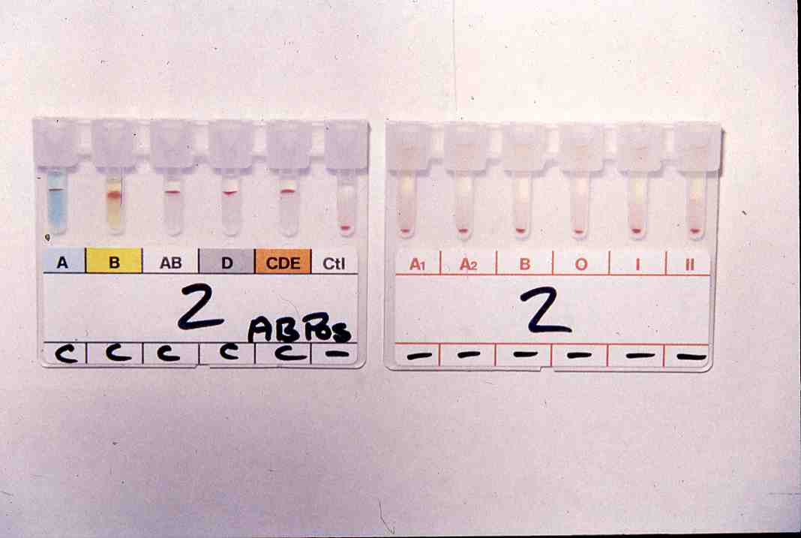

Slide 62
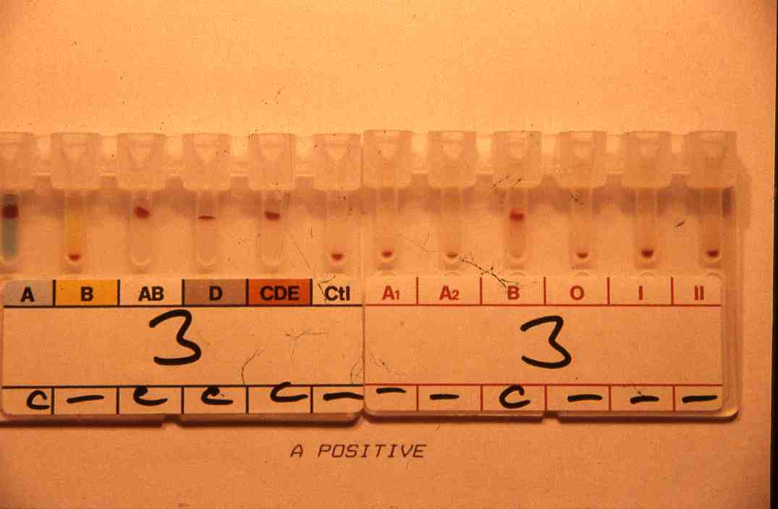

Slide 63
The Rh haplotypes in order of frequency (Fisher nomenclature) in caucasians and the corresponding short notations
Fisher | Short notations | Approximate frequency (%)
CDe | R¹ | 41
Cde | r | 39
cDE | R² | 14
cD3 | R^{O} | 3
C^{w}De | R^{1w} | 1
cdE | r” | 1
Cde | r’ | 1
CDE | R^{z} | Rare
CdE | R^{y} | Rare

Slide 64
The specific tests performed on donated blood are listed below.
Hepatitis B surface antigen (HBsAg).
Hepatitis B core antibody (anti-HBc)
Hepatitis C virus antibody (anti-HCV).
HIV-1 and HIV-2 antibody (anti-HIV-1 and anti-HIV-2).
HTLV-1 and HTLV-II antibody (anti-HTLV-I and anti-HTLV-II).
Serologic test for syphilis, VDRL, RPR, TPHA.
Nucleic acid amplification testing (NAT) for HIV-1 and HCV.
NAT for WNV.
G6PD test.
Sickle cell test.

Slide 65
Signs and Symptoms of Blood Loss
Volume Lost
mL | % of Total Blood Volume | Clinical Signs
500 | 10 | None; occasionally vasovagal syncope in blood donors.
1000 | 20 | At rest there may be no clinical evidence of volume loss; a slight postural drop in BP may be seen; tachycardia with exercise.
1500 | 30 | Resting supine blood pressure and pulse may be normal; neck veins flat when supine; postural hypotension
2000 | 40 | Central venous pressure, cardiac output, systolic blood pressure below normal even when supine and at rest; air hunger, cold clammy skin; tachycardia.
2500 | 50 | Signs of shock, tachycardia, hypotension, oliguria, drowsiness, or coma.

Slide 66
COMPATIBLITY TESTING BLOOD TRANSFUSION Laboratory Tests
To be Completed Before Blood or Blood Products
can be Transfused:
* Determination of the blood type with a crossmatch ( between
patients serum and donor red cells).
* Antibody screening on patients sera. (indirect comb’s test)
* Directs comb’s test on (donors red cells and patients red cells)
* Screening for antibodies that may produce adverse effects if
transfused.
* Screening for possible infectious agents that could be transmitted
with transfusion.

Slide 67
BLOOD TRANSFUSION Mandatory Tests on All Units of Blood
ABO group and Rh type
Screening for blood-group antibodies
Serologic test for syphilis
Serologic tests for human retroviruses including:
HIV-1 antibody
HIV-2 antibody
HIV p24 antigen
HTLV I antibodies
Serologic tests for hepatitis including:
Hepatitis B core antibody (HBcAb)
Hepatitis B surface antigen (HBsAg)
Hepatitis C antibody

Slide 68
BLOOD TRANSFUSION Type And Cross match
It determines compatibility between patient
serum and donor red blood cells.
A full crossmatch procedure takes about 45
minutes to complete and cannot be shortened.
Units are refrigerated until used.
A unit of blood MUST be properly labeled and the
label MUST be checked before use.

Slide 69
BLOOD TRANSFUSION Type And Crossmatch (continue)
Every unit cross matched is removed from the general
inventory and reserved for the patient for 72 hours.
Units which are crossmatched unnecessarily will
deplete Blood Bank inventories and can result in
blood shortages.
Blood shortages can result in cancellation of elective
surgical procedures.
Blood will ordinarily not be released for transfusion
until compatibility testing is completed.

Slide 70
BLOOD TRANSFUSION Type And Crossmatch (continue)
However, under emergency conditions,
blood products may be released without a
crosshatch if the patient is in danger of
dying if transfusion is delayed.
In such cases, if the patient's blood type is
not known, then group O Rh negative
(O Neg) blood can be released without
compatibility testing.
In cases in which the patient's blood type is
reliably known, then type-specific blood or
RBCs of the same ABO and Rh group may be
released.

Slide 71
BLOOD COMPONENTS
PREPARATION

Slide 72
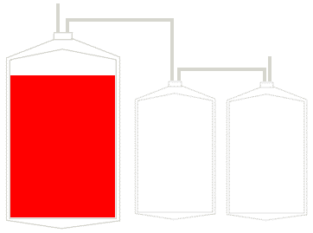
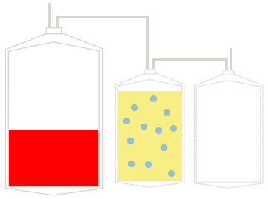
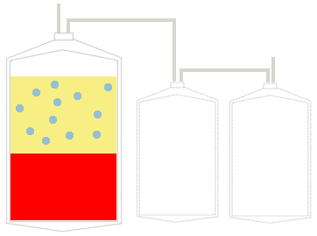
BLOOD COMPONENTS PREPARATION

Slide 73
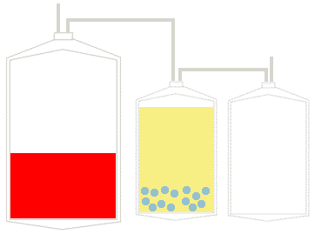
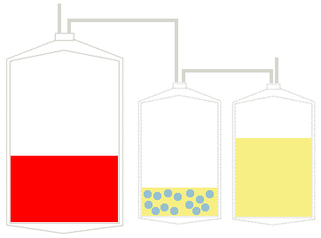
BLOOD COMPONENTS PREPARATION (Cont…)

Slide 75
What types of tests are performed on donated blood?
After blood is drawn, it is tested for ABO group (blood type) and RH type (positive or negative), as well as for any unexpected red blood cell antibodies that may cause problems for the recipient. Screening tests performed are listed below:
* Hepatitis B surface antigen (HbsAg).
* Hepatitis B core antibody (anti-HBc).
* Hepatitis C virus antibody (anti-HCV)

Slide 76
9. What types of tests are performed on donated blood? (continue)
* HIV-1 and HIV-2 antibody (anti-HIV-1 and anti-HIV-2)
* HIV p24 antigen
* HTLV-I and HTLV-II antibody (anti-HTLV-I and anti-HTLV-II)
* Serologic test for syphilis (VDR, RPR, TPHA).
* Nucleic Acid amplification Testing (NAT)
* Tests for malaria
* Sickle cell test
* G6PD test.

Slide 77
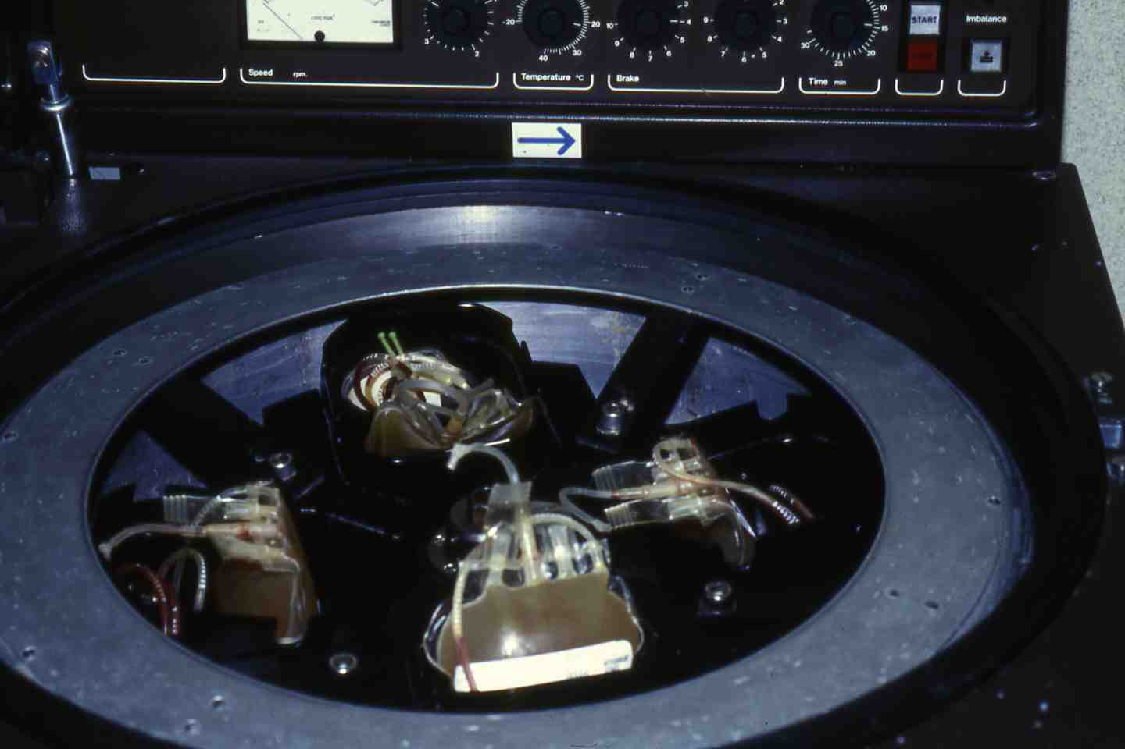

Slide 78
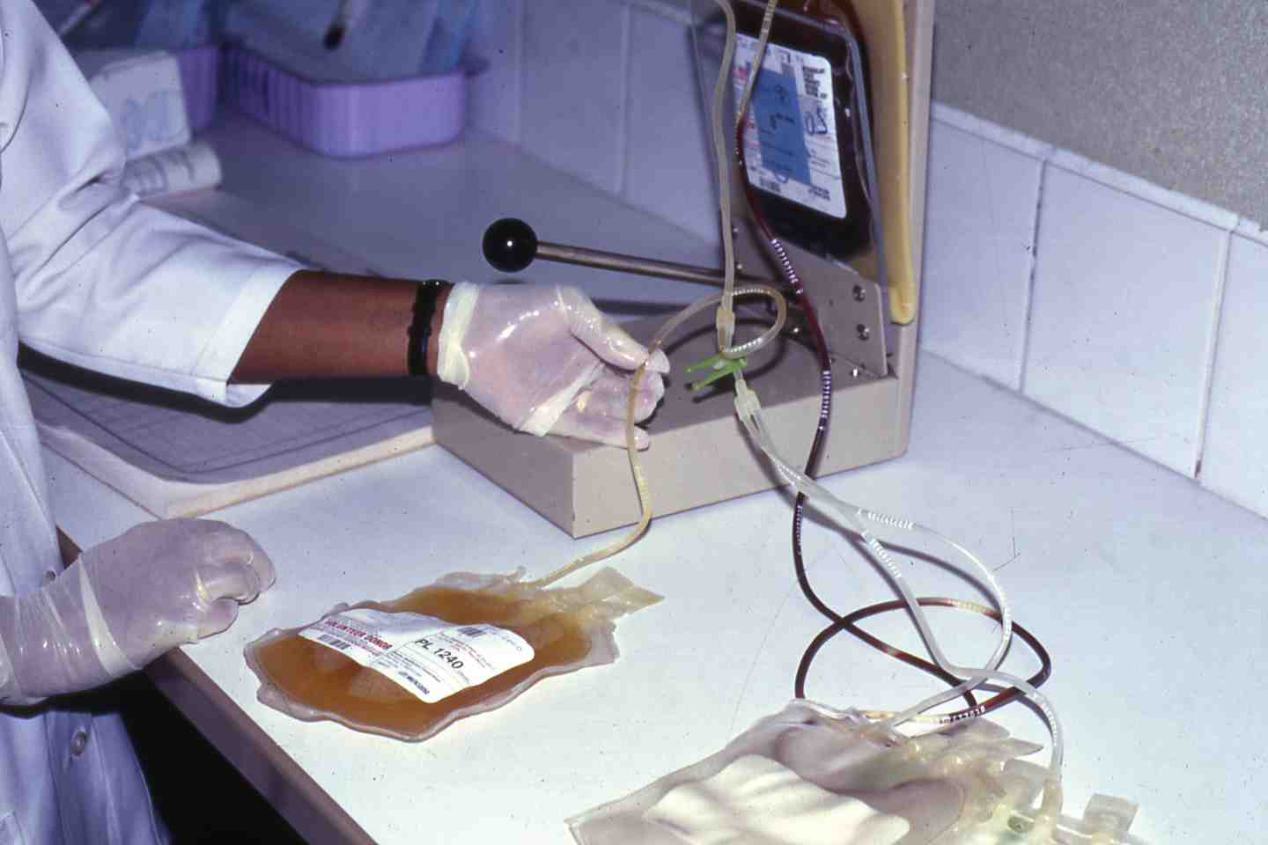

Slide 79
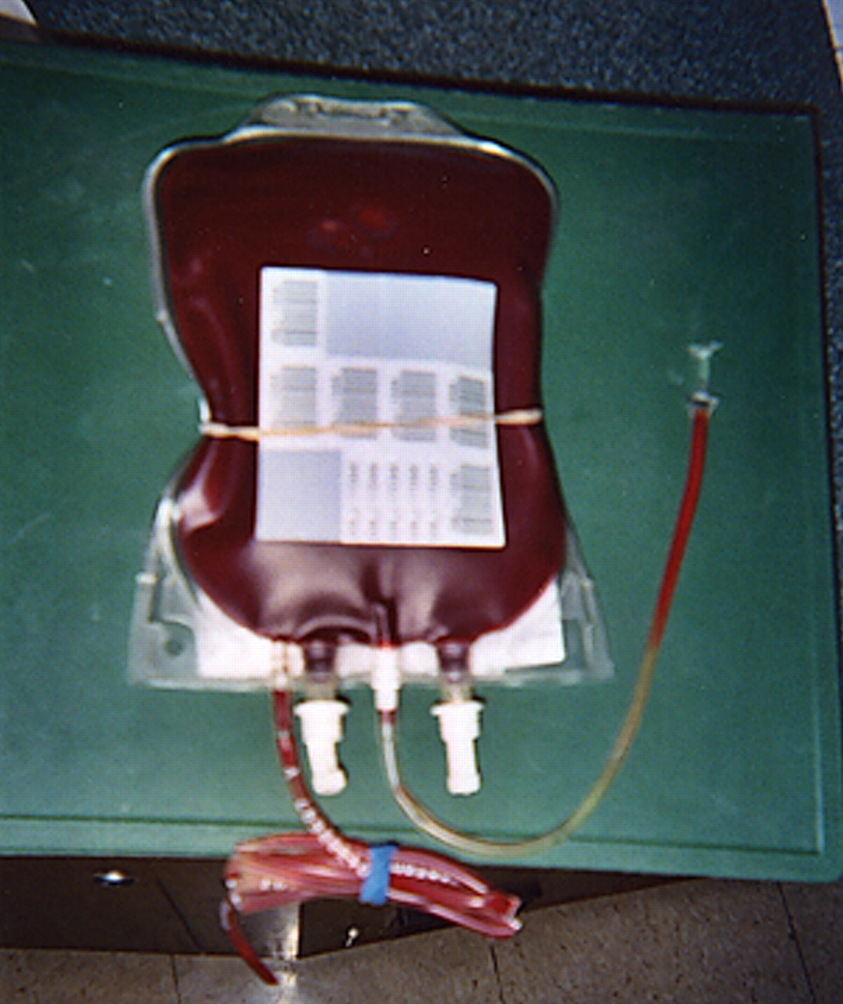
Packed red cells may contain enough leukocytes and platelets to result in alloimmunization
Copyright ©2005 American Society of Hematology. Copyright restrictions may apply.

Slide 80
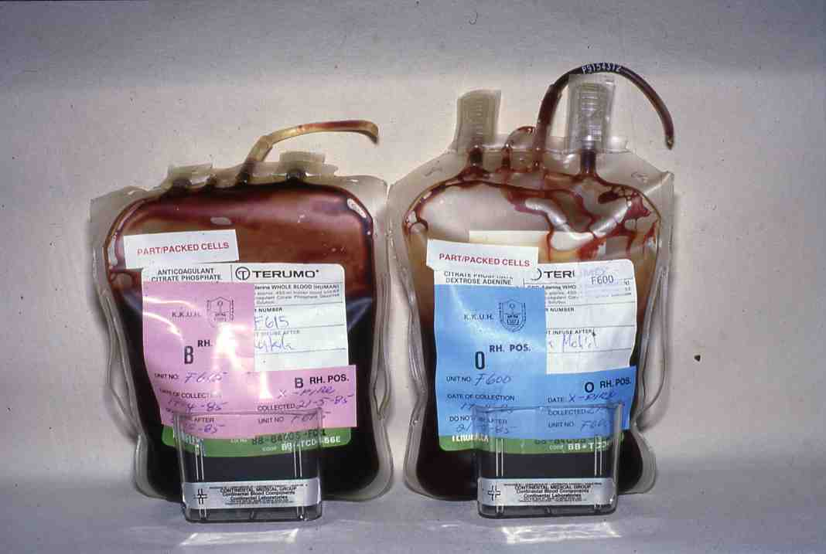

Slide 81
How is blood stored and used?
Each unit of whole blood normally is separated into several components.
Red blood cells may be stored under refrigeration for a maximum of
42 days, or they may be frozen for up to 10 years. Red cells carry
oxygen and are used to treat anaemia.
Platelets are important in the control of bleeding and are generally used in
patients with leukaemia and other forms of cancer. Platelets are stored
at room temperature and may be kept for a maximum of five days.
Fresh frozen plasma, used to control bleeding due to low levels
of some clotting factors, is kept in a frozen state for usually up to
one year.

Slide 82
How is blood stored and used? (Continued)
Cryoprecipitated AHF, which contains only a few specific clotting
factors, is made from fresh frozen plasma and may be stored frozen
for up to one year. Granulocytes are sometimes used to fight
infections, although their efficacy is not well established. They must
be transfused within 24 hours of donation.
Other products manufactured from blood include albumin,
Immune globulin, specific immune globulins, and clotting
factor concentrates.
Commercial manufactures commonly produce these blood
products.

Slide 83
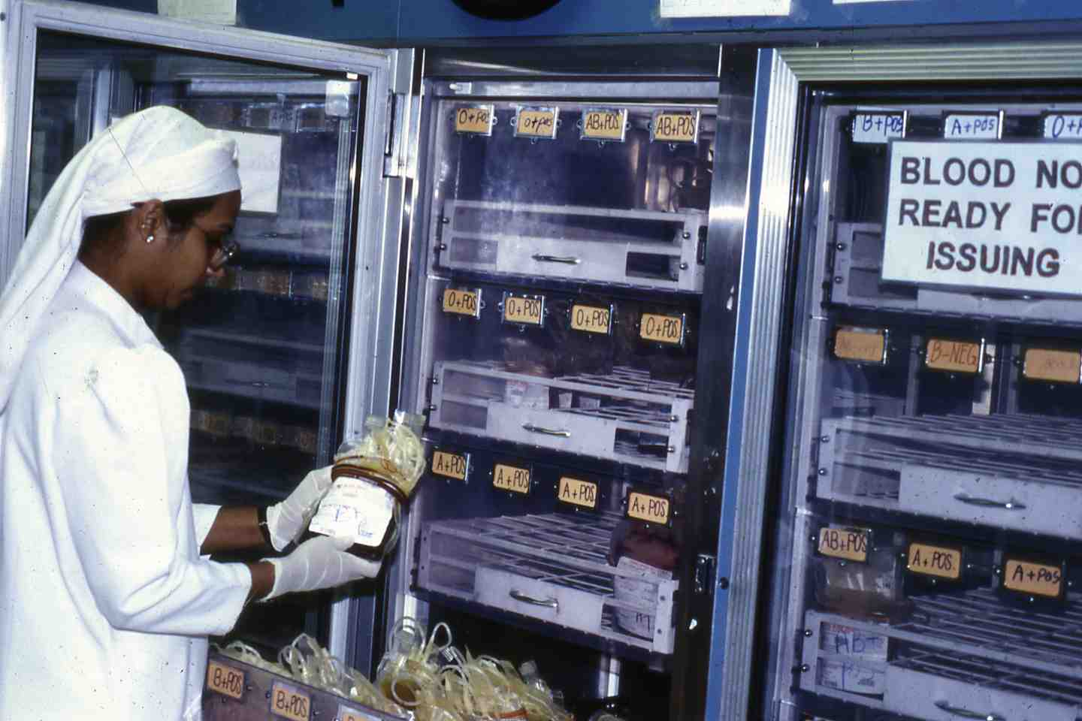

Slide 84
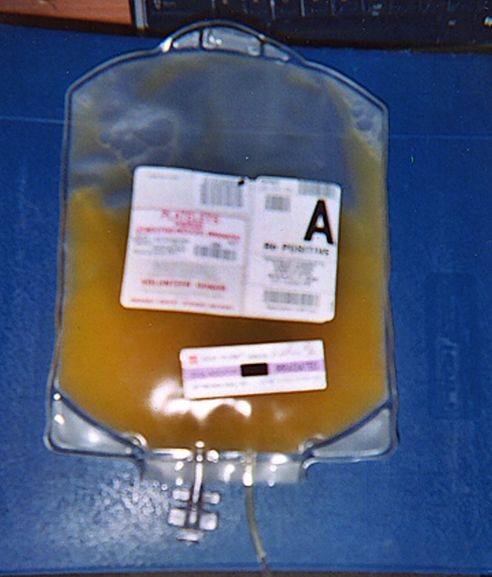
Platelet blood components may be stored for 5 days at room temperature without loss of function or viability
Copyright ©2005 American Society of Hematology. Copyright restrictions may apply.

Slide 88
Summary of blood component values
Component | Indication for use | Component rise (In patient with 5000 ml blood volume) | Approximate volume | Contents | Amount of active substance per transfused unit
Whole blood | Decreased red cell mass and blood volume | 1-2% hematocrit | 450 ml | Red cells, plasma, white blood cells, platelets and fragments, stable coagulation factors | 230ml red cells 60 g hemoglobin 300 ml plasma
Red cells | Decreased red cell mass | 2-3% hematocrit | 230-250 ml | Red cells, some plasma, white blood cells and platelets or their degradation products | 200 ml red cells
Leukocyte poor blood | Decreased red cell mass, febrile reactions from leukoagglutinis | 2-3% hematocrit | 200-250 ml | Red cells, some plasma, white blood cells | 185 ml red cells
Frozen red cells | Decreased red cell mass, febrile or anaphylactic reactions, rare blood | 2-3% hematocrit | 200 ml | Red cells; no plasma, minimal white blood cells and platelets | 169-190 ml red cells

Slide 89
Summary of blood component values
Component | Indication for use | Component rise (In patient with 5000 ml blood volume) | Approximate volume | Contents | Amount of active substance per transfused unit
Platelets | Bleeding caused by thrombocytopenia | 5000 platelets/µl 1-2% factor VIII 2% stable factors | 50-70 ml | Platelets, few white blood cells, some plasma, stable coagulation factors (100%) , labile coagulation factors (100% on day 1, 60-70% on day 3) | 5.5X10¹⁰ or more platelets 1-2 ml red blood cells 40 units factor VIII
Fresh frozen plasma | Various coagulation diisorders | 8% factor VIII 8% stable factors | 220-250 ml | All coagulatin factors | 175-250 units coagulation factors 400 mg fibrinogen
Cryo- precipitate | Hemophilia A von Willebrand’s disese, fibrinogen deficiency | 2-3% factor VIII rise from each bag | 10-25 ml | Von Willebrand’s factor, coagulation factors | 250 mg fibrinogen 80-100 units Factors VIII

Slide 91
Complications of Blood Transfusion
Immediate Transfusion Reactions
Hemolytic Reactions
Allergic Reactions
Febrile Reactions
Transfusion related acute lung injury (TRALI)
Bacterial Contamination
Circulatory Overload
Citrate toxicity
Air embolism
Alloimmunization:
RBCs
Platelets

Slide 92
Complications of Blood Transfusion
Delayed Transfusion Reactions
Graft Versus Host Disease (GVHD)
Transfusion-associated graft versus host disease (TAGVHD)
Post-transfusion purpura
Haemosiderosis
H.D.N.

Slide 93
BLOOD TRANSFUSION
Delayed Transfusion Reactions (Cont…)
Transmitted Diseases
Hepatitis B
Hepatitis C
Human Immunodeficiency Virus (HIV)
Human T-lymphocytotrophic Virus (HTLV-1)
Cytomegalovirus (CMV)
Kaposi’s sarcoma and human herpes virus-8 (KS & HHV-8)
Malaria
Leishmaniasis
Others:
Babesiosis.
Lyme disease.
Chagas' disease
Creutzfeldt-Jakob Disease (CJD)
Toxoplasmosis

Slide 94
Investigation of a Haemolytic Transfusion Reaction
Evidence of Haemolysis
Examine patient’s plasma and urine for haemoglobin and its derivaties.
Blood film may show spherocytosis
Evidence of incompatibility
Clerical checks. An identification error will indicate the type incompatibility.
If no evidence of clerical error, proceed as follows:
Repeat ABO and Rh D groups of patient and donor unit and screen for antibodies.
Use patient’s pre-and post-transfusion samples
Repeat compatibility tests, using patient’s pre-and post –
transfusion serum
Direct antiglobulin test on post-transfusion red cells may indicate antibody and/or complement
Evidence of bacterial infection of donor blood
Gram stain and culture donor blood.

Slide 95
6. What is apheresis?
Apheresis, an increasingly common procedure, is the process
of removing a specific component of the blood, such as
platelets, and returning the remaining components, such as
red blood cells and plasma, to the donor. This process allows
more of one particular part of the blood to be collected than
could be separated from a unit of whole blood. Apheresis is
also performed to collect red blood cells, plasma (liquid part
of the blood), and granulocytes (white blood cells).

Slide 96
6. What is apheresis? (continued)
The apheresis donation procedure takes longer than
that for whole blood donation. A whole blood donation
takes about 10 to 20 minutes to collect the blood, while
an apheresis donation may take about one to two hours.

Slide 97
If an acute transfusion reaction occurs:
* Stop blood component transfusion immediately.
* Verify the correct unit was given to the correct patient.
* Maintain IV access and ensure adequate urine output with an appropriate crystalloid
or colloid solution.
* Maintain blood pressure, pulse.
* Maintain adequate ventilation.
* Notify attending physician and blood bank.
* Obtain blood/urine for transfusion reaction workup.
* Send blood bag and administration set to blood transfusion service immediately.
Blood bank performs workup of suspected transfusion reaction as follows:
A. Check paper work to ensure correct blood component was transfused to the right patient.
B. Evaluate plasma for hemoglobinemia.
C. Perform direct antiglobulin test.
D. Repeat other serologic testing as needed (ABO, Rh).

Slide 98
If intravascular hemolytic reaction is confirmed.
1. Monitor renal status (BUN, creatinine).
2. Initiate a diuresis.
3. Analyze urine for hemoglobinuria.
4. Monitor coagulation status (prothrombin time, partial thromboplastin time, fibrinogen, platelet count).
5. Monitor for signs of haemolysis (lactate dehydrogenase, bilirubin, haptoglobin, plasma hemoglobin).
6.. Repeat compatibility testing (crossmatch).
7. If sepsis is suspected, culture unit and patient, and treat as appropriate.

Slide 99
THANK YOU
Notes:
99

