Slide 1
ANAEMIA
DR.FATMA AL-QAHTANI

Slide 2
Hemoglobin structure
β
α
Globin chain
O2
O2
Fe⁺⁺
Fe⁺⁺
Haem
α
β
Iron atom
Fe⁺⁺
Prophyrin ring
Fe⁺⁺
O2
O2
Dr. Aljabry

Slide 3
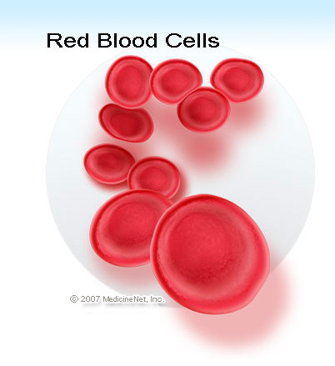
Hemoglobin
Hemoglobin is the protein molecule in RBC that carries O2 from the lungs to the body's tissues and returns carbon CO2 from the tissues back to the lungs.
Hemoglobin maintains the shape of RBC also.

Slide 4
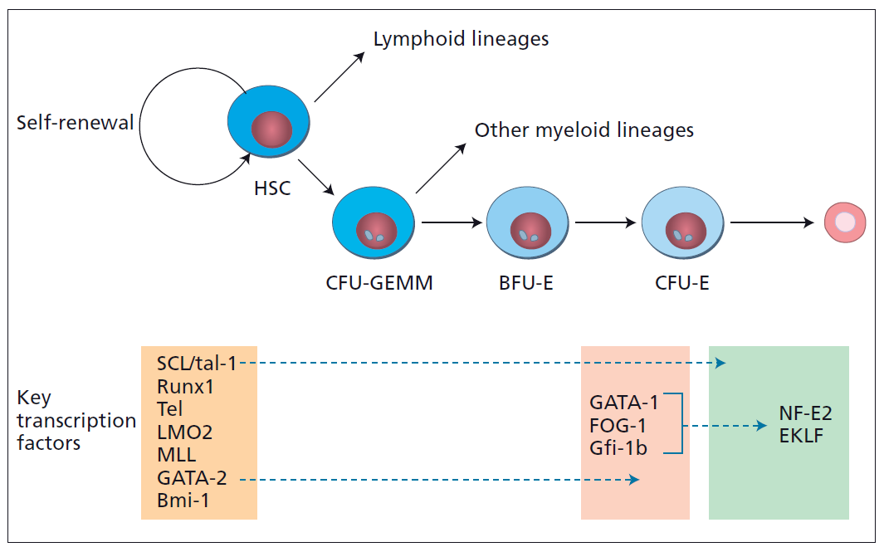
Hematopoiesis
Hematopoietic stem cell:
1- Self renewal
2- Cell differentiation
Myeloid SC
Erythroid Precursors
Erythropoietin
GATA1
Transcriptional
Factor

Slide 5
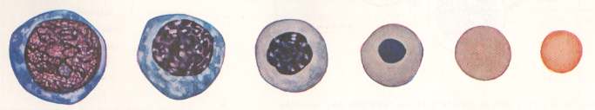
Erythropoiesis
The “Bone Marrow” is the major site with the need of:
Folic acid – Iron “Ferrous” – Vit B12 – Erythropoietin -Amino acids
minerals - other regulatory factors
Erythroblast
Basophilic
Normoblast
Intermediate
Normoblast
Late
Normoblast
Reticulocyte
Erythrocyte
+
++
+++
++
+
-
Synthesis of Hemoglobin
5
Notes:
5

Slide 6
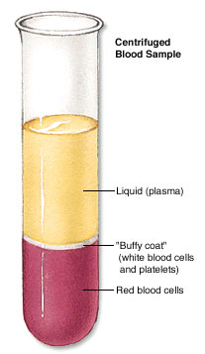
Normal Ranges
HCT
Female | Male | Indices
11.5-15.5 | 13.5-17.5 | Hemoglobin(g/dL)
36-48 | 40-52 | Hematocrit (PCV) (%)
3.9-5.6 | 4.5-6.5 | Red Cell Count (×10¹²)
80-95 |  | Mean Cell Volume (MCV) (fL)
30-35 |  | Mean Cell Hemoglobin (MCH) (pg)
Hb
MCV
MCH
Microcytic
Hypochromic
Normocytic
Macrocytic
Normochromic

Slide 7
ANEMIA
An (without) -aemia (blood)
Reduction of Hb concentration below the normal range for the age and gender
Leading to decreased O2 carrying capacity of blood and thus O2 availability to tissues (hypoxia)

Slide 8
Clinical Features
Presence or absence of clinical feature depends on:
1-Speed of onset :
Rapidly progressive anemia causes more symptoms than slow onset anemia due to lack of compensatory mechanisms:
(cardiovascular system, BM &O2 dissociation curve
2-Severity:
Mild anemia :no symptoms usually
Symptoms appear if Hb less than 9g/dL
3- Age:
Elderly tolerate anemia less than young patients

Slide 9
Clinical Features
Weakness
Headache
Pallor
Lethargy
Dizziness
Palpitation (tachycardia)
Angina
Cardiac failure
Related to anemia
Related to compensatory mechanism

Slide 10
Classification of Anemia

Slide 11
Hemoglobin
DNA
RBC count
Prophyrin
DNA synthesis
Blood loss
Iron
Hemolysis
Globin chain
RBC production
Acute bleeding
Thalassemia
Megaloblastic anemia:
-B12 def.
-Folate def.
MDS
Autoimmune
Enzymopathy
Membranopathy
Mechanical
Sickle cell anemia
BM failure:
-Chemotherapy
-Aplastic anemia
-Malignancy
Anemia of chronic disease
Iron def. anemia
Sidroblastic anemia
Hypochromic microcytic anemia
Macrocytic anemia
Normocytic normochromic anemia

Slide 12
Iron Deficiency Anemia
Iron is among the abundant minerals on earth (6%).
Iron deficiency is the most common disorder( 24%).
Limited absorption ability :
1-Only 5-10% of taken iron will be absorbed
2- Inorganic iron can not be absorbed easily.
Excess loss due to hemorrhage
!

Slide 13
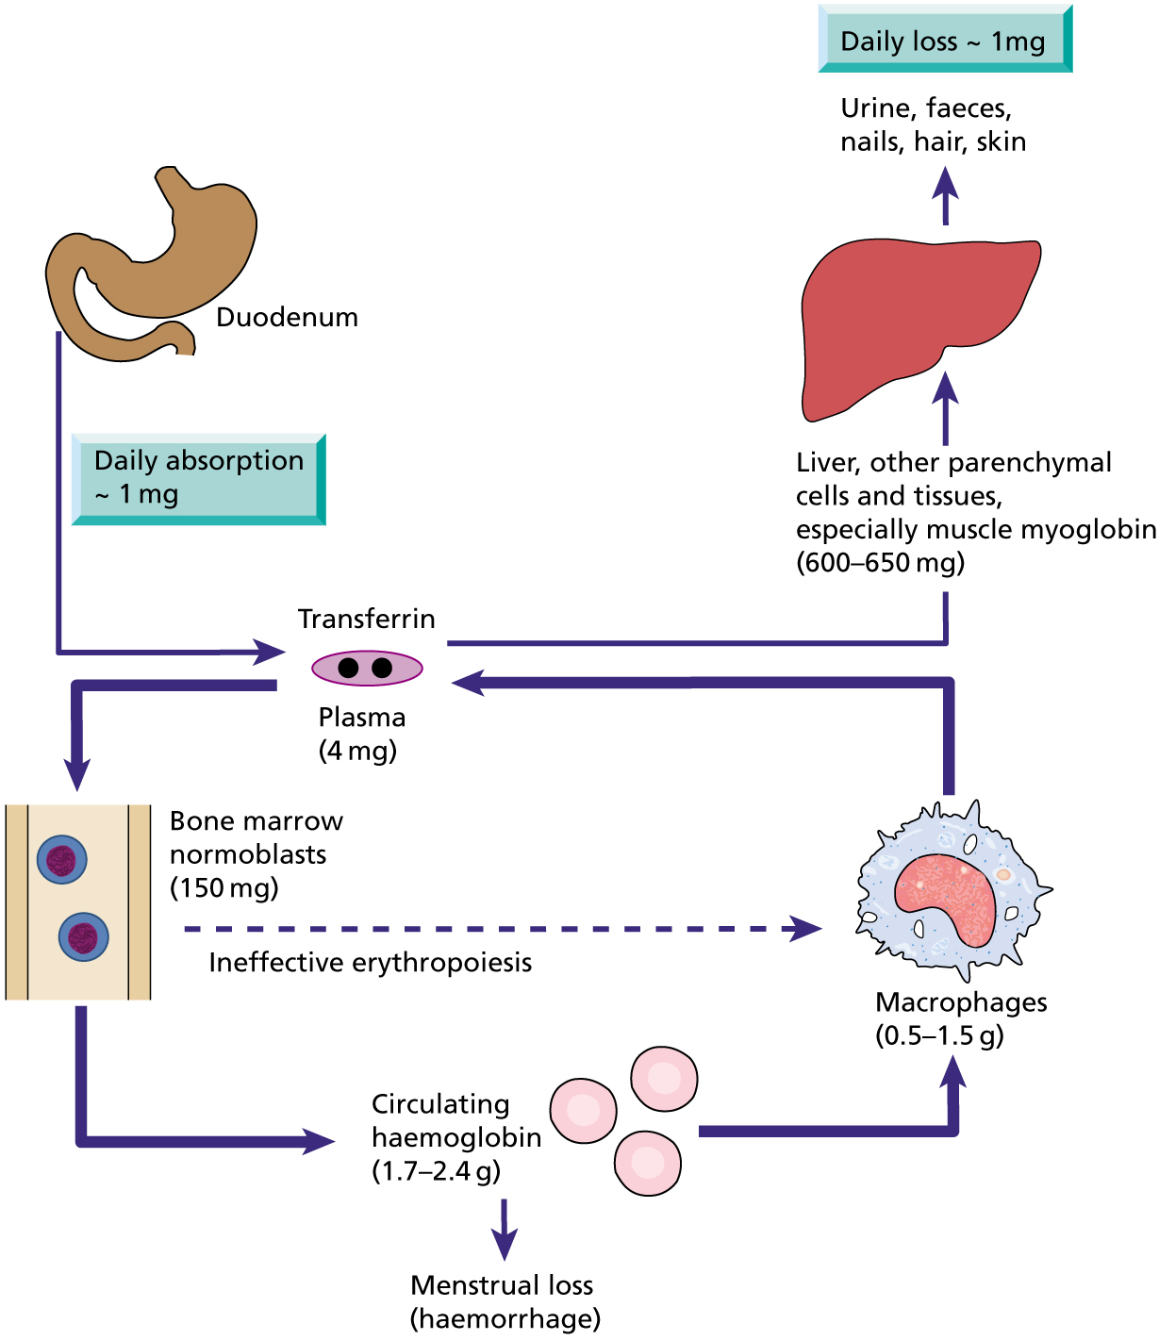
Iron cycle and storage
Storage forms:
Ferritin
Haemosiderin

Slide 14
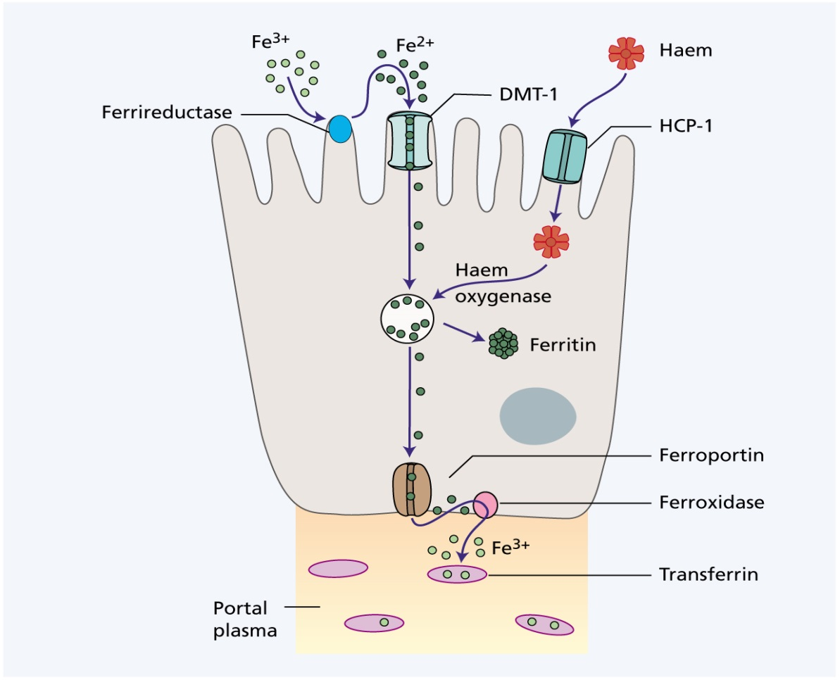

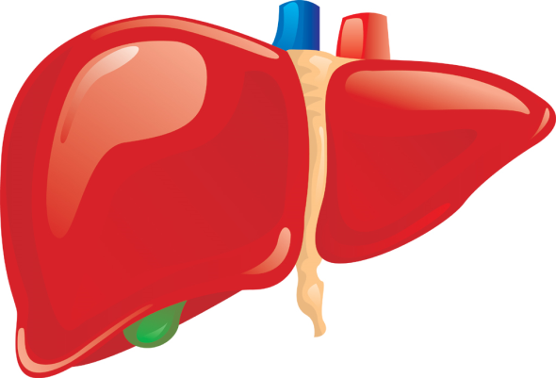


IL6
Tfr2
Hypoxia
+ve
Hepcidin
- ve
Iron for erythropoeisis
BM macrophage

Slide 15
Iron Absorption
Factor reducing absorption | Factors favoring absorption
Inorganic iron | Haem iron
Ferric iron Fe+++ | Ferrous Iron (Fe++)
Alkalines | Acid
Iron overload | Iron def
Tea | Pregnancy
Increased hepcidin | Hemochromatosis
Precipitating agent(phenol) | Solubilizing agent (Sugar)

Slide 16
Iron Absorption
1-Body Iron status:
Increased demands
(iron def.,pregnancy..)
Low iron stores
high absorption
Iron overload
Full iron stores
Low absorption
2- Content and form of dietary iron
More Iron
More absorption
Heam Iron
Ferrous Iron
3- Balance between dietary enhancers&Inhibitory factors:
Enhancers
Inhibitors
Meat (haem iron)
Fruit (Vitamin C)
Sugar (Solubilizing agent )
Dairy foods (calcium)
High fiber foods (phytate)
Coffee &tea (polyphenoles)

Slide 17
Causes of IDA
1-Chronic blood loss:
GIT Bleeding: peptic ulcer, esophageal varices , hookworm cancer
Uterine bleeding
Hematuria
2- Increased demands:
Immaturity
Growth
Pregnancy
EPO therapy
3-Malabsorption:
Enteropathy
Gastrectomy
4-Poor diet: Rare as the only cause (rule out other causes)

Slide 18
Development of IDA
4 Patent | 3 Latent | 2 Pre-latent | 1 Normal
Low | Low | Low | Normal | Stores
Low | Low | Normal | Normal | MCV/MCH
Low | Normal | Normal | Normal | Hemoglobin
Signs of anemia

Slide 19
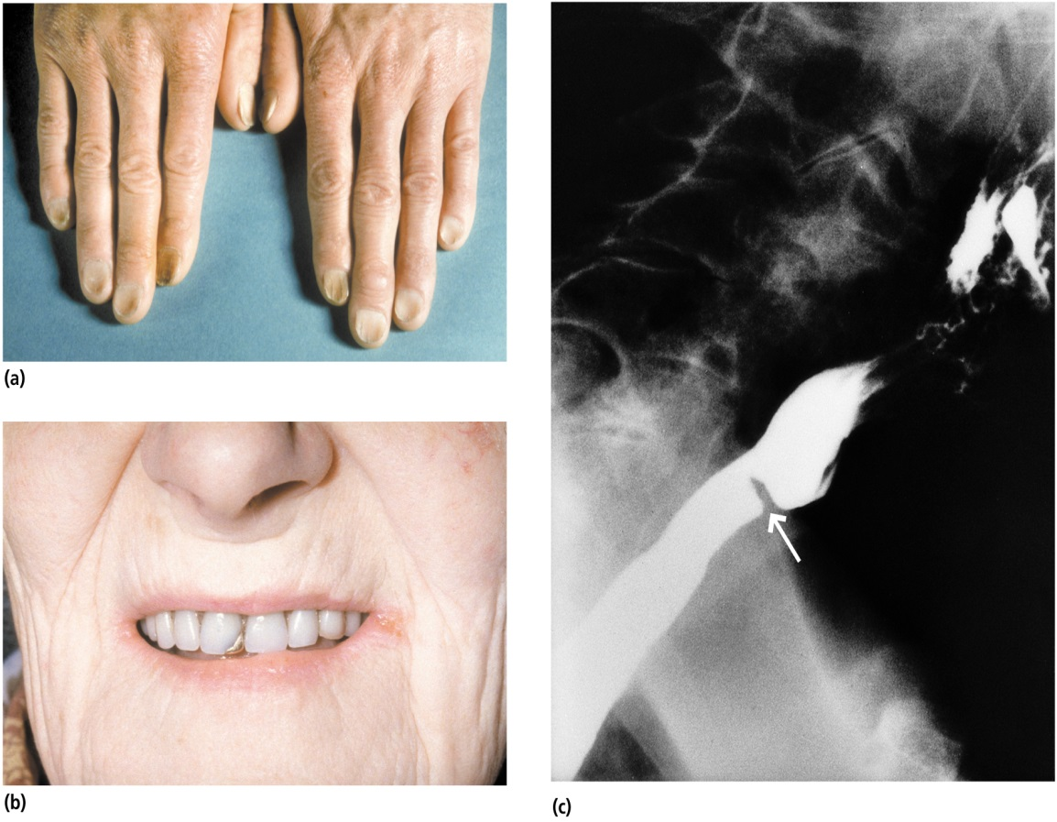
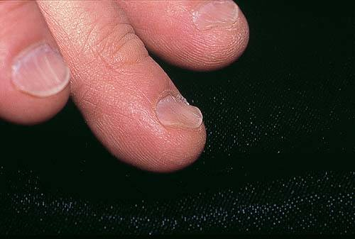
Signs and symptoms of IDA
a
b
c
Beside symptoms and signs of anaemia +/- bleeding patients present with:
(a): Koilonychia (spoon-shaped nails)
(b): Angular stomatitis and/or glossitis
(c): Dysphagia due to pharyngeal web (Plummer-Vinson syndrome)

Slide 20
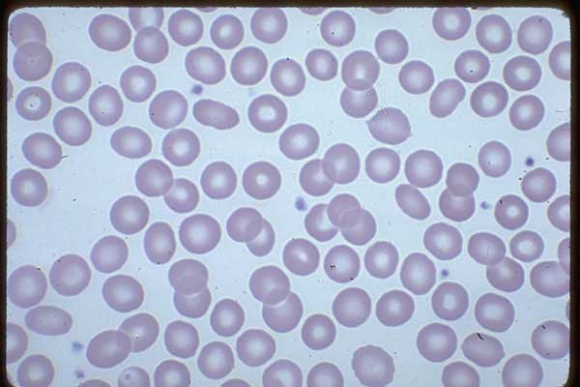
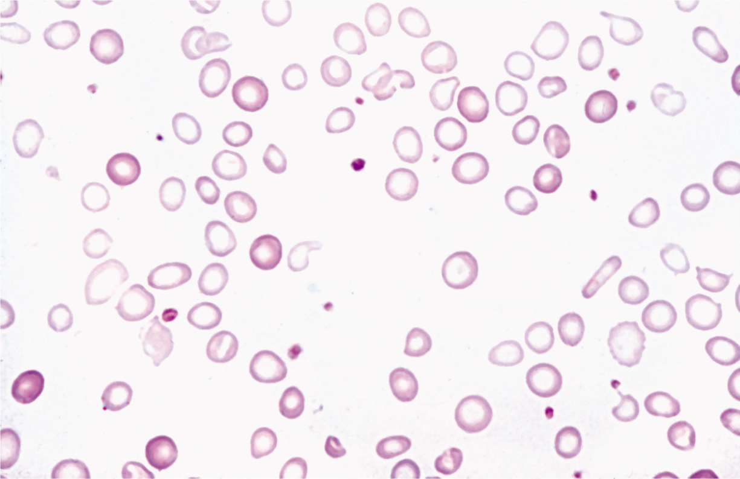
Investigation
normal
Microcytic hypochromic anemia with:
Anisocytosis( variation in size)
Pokiliocytosis (variation in shape)

Slide 21
Iron Studies
Normal
IDA
TIBC*
high TIBC
Serum Iron
Serum ferritin
Transferrin saturation
Low serum iron
Low serum ferritin
Low transferrin saturation
TIBC : total iron binding capacity of transferrin

Slide 22
Iron Studies
Thalassemia
Normal
IDA
Low TIBC*
high TIBC
High Serum Iron
High Serum ferritin
High Transferrin saturation
Low serum iron
Low serum ferritin
Low transferrin saturation

Slide 23
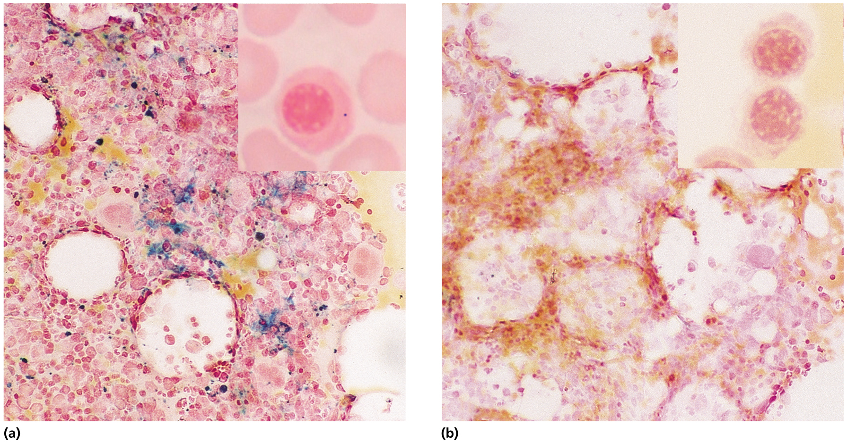
Investigation
BM Iron stain (Perl’s stain): The gold standard but invasive procedure
Normal
IDA: reduced or absent iron stores
(hemosiderin)

Slide 24
Treatment of IDA
Treat the underlying cause
Iron replacement therapy:
Oral :( Ferrous Sulphate OD for 6 months)
Intravenous:( Ferric sucrose OD for 6 months)
Hb should rise 2g/dL every 3 weeks

Slide 25
PREVENTION OF IDA
Dietary modification
Meat is better source than vegetables.
Food fortification (with ferrous sulphate)
GIT disturbances ,staining of teeth & metallic taste.
Iron supplementation:
For high risk groups.

Slide 26
Anemia of chronic disease
  Normochromic normocytic (usually) anemia caused by decreased release of iron from iron stores due to raised serum Hepcidin .
  Associated with
  - Chronic infection including HIV, malaria
  - Chronic inflammations
  -Tissue necrosis
  -Malignancy

Slide 27

Tuberculosis
SLE
Carcinoma
Lymphoma
IL-6
IL-1
TNF
+ve
Hepcidin
- ve
no Iron for erythropoeisis
BM macrophage

Slide 28
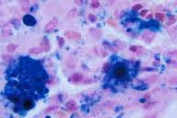
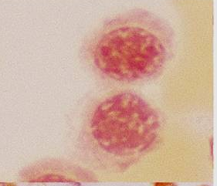
Work-up and treatment
Normocytic normochromic or mildly microcytic anaemia
Low serum iron and TIBC
Normal or high serum ferritin ( acute phase reactant)
High haemosiderin in macrophages but low in normoblasts
Management:
Treat the underlying cause
Iron replacement +/- EPO

