Slide 1
Salmonella & shigella
GIT BLOCK
Dr. Ali Somily & Prof .Hanan Habib
Department of Pathology& Laboratory Medicine
KSU

Slide 2
Objectives
1-Develop an algorithm using biochemical to
identify and classify Salmonella and Shigella
2- Describe the antigenic structures and virulence factors of Salmonella and Shigella
3- Compare the pathogenesis of various species of Salmonella and Shigella
4-Describe the clinical features and risk factors for the infection with the two organisms
5- Describe the general concepts for the management of gastroenteritis caused by both organisms.

Slide 3
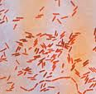
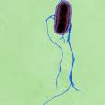
SALMONELLA

Slide 4
INTRODUCTION
Gram negative facultative anaerobic bacilli
Non lactose fermenting colonies

Slide 5
CLASSIFICATION -Has two species s.enterica (six subspecies I, II, III, IV, V, VI) s.borgori (rare) -Cold blooded animal, birds, rodents, turtles, snake and fish
Has two species S.enterica (six subspecies I, II, III, IV, V, VI) S.bongori (rare)
Cold blooded animal, birds, rodents, turtles, snake and fish

Slide 6
VIRULENCE FACTORS
Fimbriae - adherence
Enterotoxin

Slide 7
Antigenic structures
O. Somatic antigen
H. Flagellar antigen
K. Capsular antigen

Slide 8
V_{I} in Salmonella serotype typhi (virulence) vs phagocytosis
O Antigen (Heat – stable) is lipopolysaccharide in the outer membrane
H antigen (Heat labile)

Slide 9
CLINICAL FEATURES
Acute gastroenteritis
Typhoid fever
Nontyphoidal bacteremia
Carrier state following Salmonella infection

Slide 10
Source
Water, food and milk contaminated with human or animal excreta
Salmonella typhi and S. paratyphi , the source is human

Slide 11
GASTROENTERITIS
Food poisoning through contaminated food
S. enterica subsp. enterica
Source :poultry, milk, egg & egg products and handling pets
Infective dose: 10⁶ bacteria
IP: 8 – 36 hrs.
fever, chills, watery diarrhea and abdominal pain. Self limiting.
In sickle cell ,hemolytic disorder and ulcerative colitis, elderly or very young patients; the infection may be very severe.
Patients at high risk for dissemination ; antimicrobial therapy is indicated.

Slide 12
ENTERIC FEVER
Prolonged fever
Bacteremia
Involvement of the reticulo endothelial system (liver, spleen, intestines and mesentery)
Dissemination to multiple organs
Ingestion of contaminated food by infected or carrier individual
Caused by Salmonella serotype typhi or S. paratyphi A, B and C (less severe)
Common in tropical ,subtropical countries, traveler (sewage, poor sanitation)
IP : 9 – 14 days.

Slide 13
First week fever, malaise, anorexia, myalgia and a continuous dull frontal headache then,
Patient develops constipation
Mesenteric lymph node → blood stream liver, spleen and bone marrow
Engulfment of Salmonella by mononuclear phagocytes (multiply intercellularly)
Released into the blood stream again that can lead to high fever ( positive blood culture)

Slide 14
2nd and 3rd week
Sustained fever, prolonged bacteremia
Invade gallbladder and payer's patches
Rose spots 2nd week of fever
Billiary tract →GIT
Organism isolated from stool in large number

Slide 15
ANTIBIOTIC& management
Ceftriaxone
Ciprofloxacin
Trimelhoprim – Sulfamethoxazole
Ampicillin
Azithromycin or Ceftriaxone from patients from India and SE Asia due to resistance of strains. Ciprofloxacin from patients from other areas.
Salmonella gastroenteritis uncomplicated cases require fluid and electrolyte replacement only.

Slide 16
COMPLICATION
Necrotizing cholecystitis
Bowel hemorrhage and perforation
Pneumonia and thrombophlebitis
Meningitis, osteomyelitis, endocarditis and abscesses.

Slide 17
SHIGELLA

Slide 18
CLINICAL INFECTION
S.sonnei most predominant in USA ( fever, watery diarrhea)
S.flexneri 2nd most common
Young adult ( man who have sex with man)
S. dysenteriae and S. boydii are most commonly isolates in developing countries
S. dysenteriae type 1 associated with morbidity and mortality.
Human is the only reservoir

Slide 19
Cause bacillary dysentery ( blood, mucus and pus in the stool)
Non lactose fermenting bacteria

Slide 20
ANTIGENIC STRUCTURE
Has 4 species and 4 major O antigen groups
All have O antigens ,some serotype has K antigen
Shigella are non motile, lack H antigen

Slide 21
Person to person through fecal –oral route
Flies, fingers
Food and water
Young children in daycare, people in crowded area and anal oral sex in developed countries
Low infective dose < 200 bacilli
Penetrate epithelial cells leads to local inflammation, shedding of intestinal lining and ulcer formation

Slide 22
SYMPTOMS
High fever, chill, abdominal cramp and pain accompanied by tenesmus , bloody stool with mucus & WBC
IP : 24 - 48 hrs
Can lead to rectal prolapsed in children
Complication ileus, obstruction dilatation and toxic mega colon
Bacteremia in 4 % of severely ill patient
Seizures, HUS

Slide 23
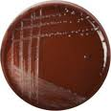
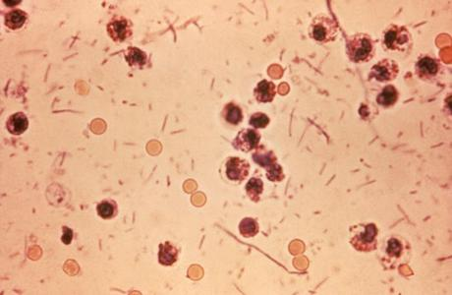
DYSENTRY STOOL & SHIGELLA CULTURE

Slide 24
TREATMENT
Antibiotic is used to reduce duration of illness
IV Ceftriaxon and including :
Ampicillin , oral TMP-SMX or
Ciprofloxacin or Doxycycline.

