Slide 1
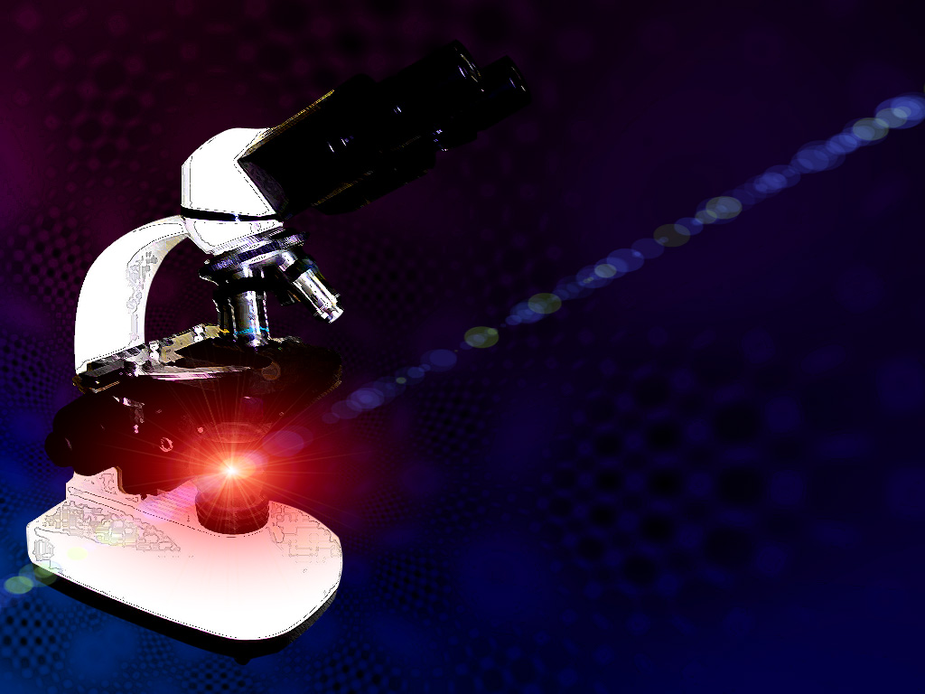
PRACTICAL ON BLOOD PARASITES

Slide 2

Common methods for parasitological diagnosis of malaria
The two methods common in use :
1: Light microscopy
2: Rapid diagnostic tests (RDTs).

Slide 3
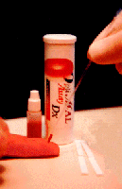
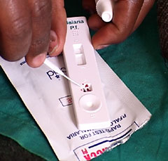
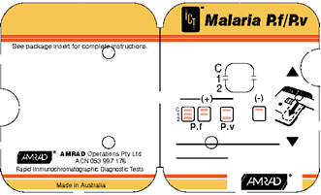
Laboratory diagnosis of malaria
Rapid diagnostic tests detect malaria antigens

Slide 4
RDT procedure

Slide 5
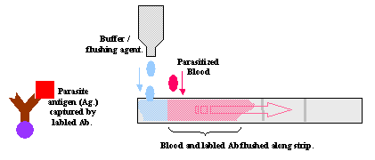
RDT procedure

Slide 6
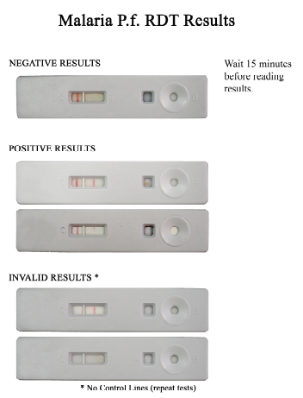

Slide 7
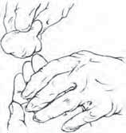
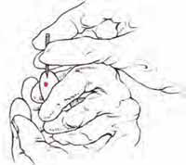
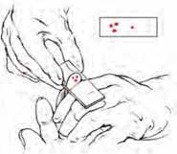
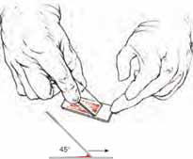
Laboratory diagnosis of malaria
Light microscopy:1: Preparing blood film

Slide 8
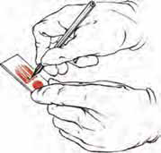
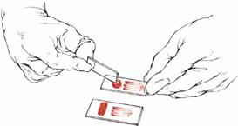
Laboratory diagnosis of malaria
Light microscopy:1: Preparing blood film

Slide 9

Laboratory diagnosis of malaria
Light microscopy: Thick and thin films

Slide 10
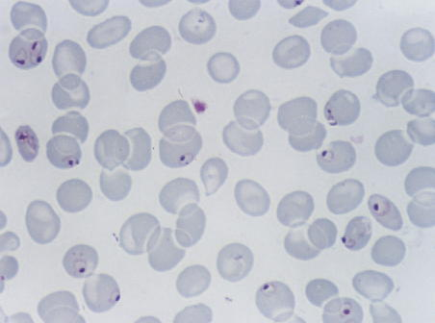
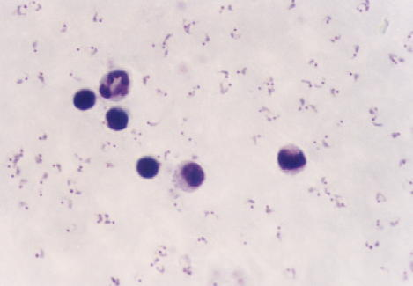
Laboratory diagnosis of malaria
Plasmodium falciparum (trophozoite stage in thin smear)
Plasmodium falciparum (trophozoite stage in thick smear)
CCMOVBD

Slide 11
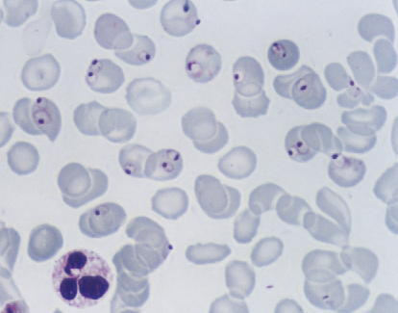
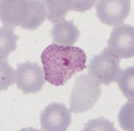
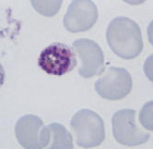
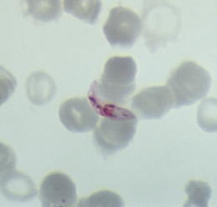
The Malaria Parasite
Trophozoites
Three developmental
stages seen in blood
films:
CCMOVBD
CCMOVBD
Trophozoite
Schizont
Gametocyte
2. Schizont
3. Gametocyte
CCMOVBD
CCMOVBD

Slide 12
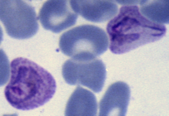
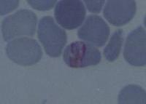
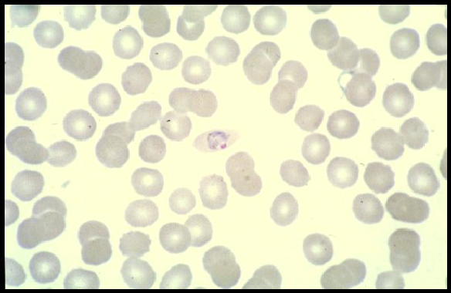
Plasmodium vivax
CCMOVBD
Species of malaria is identified by its chracteristic microscopic appearance:
Plasmodium malariae
Plasmodium ovale
CCMOVBD
Malaria Tutorials, Wellcome Trust

Slide 13
Plasmodium falciparum (trophozoite stage in thin smear)
CCMOVBD

Slide 14
Plasmodium falciparum (trophozoite stage in thick smear)
CCMOVBD

Slide 15
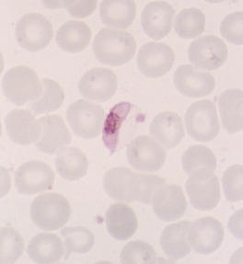
Plasmodium falciparum
(characteristic banana-shaped or crescent –shaped gametocyte stage in thin smear)
CCMOVBD

Slide 16
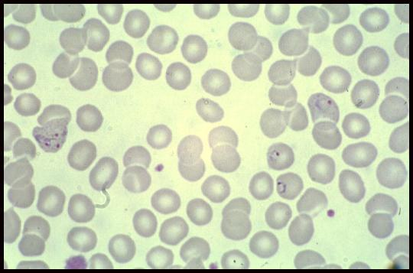
A 25 year-old male from India, who came 3 months ago was admitted in KKUH with a history of severe anaemia and intermittent high grade fever for the last two months not responding to antibiotics.
WHAT IS THE DIAGNOSIS?
Diagnosis: malaria or Plasmodium vivax

Slide 17
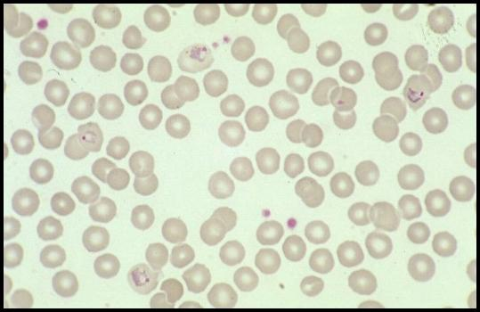
A businessman who makes frequent trips to Thailand , presents with intermittent fever .
WHAT IS THE DIAGNOSIS? Blood film with Gimsa stain showed
Diagnosis: malaria or Plasmodium vivax which cause replace due to reactivation of liver hypnozoites.

Slide 18
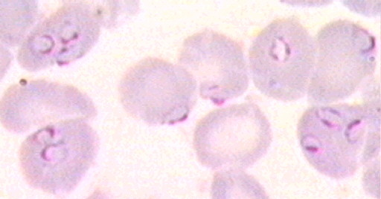
A student in KSU who returned three weeks from vacation in Africa , he developed intermittent fever last week and lost consciousness a short time ago.
WHAT IS THE DIAGNOSIS?
Diagnosis: malaria or Plasmodium falciparum the most one causing complication e.g :cerebral malaria.

Slide 19
Definition
Severe malaria is defined as symptomatic malaria in a patient with P. falciparum with one or more of the following complications:
  Cerebral malaria (unrousable coma not attributable to other causes).
  Generalized convulsions (> 2 episodes within 24 hours)
  Severe normocytic anaemia (Ht<15% or Hb < 5 g/dl)
  Hypoglycemia (blood glucose < 2.2 mmol/l or 40 mg/dl )
  Metabolic acidosis with respiratory distress (arterial pH < 7.35 or bicarbonate < 15 mmol/l)
  Fluid and electrolyte disturbances
  Acute renal failure (urine <400 ml/24 h in adults; 12 ml/kg/24 h in children)
  Acute pulmonary edema and adult respiratory distress syndrome
  Abnormal bleeding
  Jaundice
  Haemoglobinuria
  Circulatory collapse, shock, septicaema (algid malaria)
  Hyperparasitaemia (>10% in non-immune; >20% in semi-immune)

Slide 20
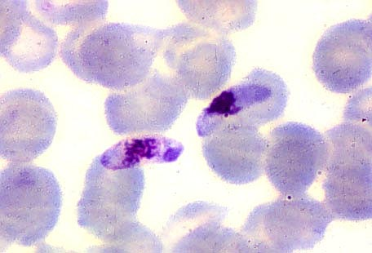
The patient was then treated with schizontocidal antimalarial drugs, a follow-up blood film is shown .
ARE THERE ANY PARASITES? WHAT STAGE ?
Plasmodium flaciparum , gametocyte stage

Slide 21
Leishmania Parasites and Diseases
Disease | SPECIES
Cutaneous leishmaniasis | Leishmania tropica* Leishmania major* Leishmania aethiopica Leishmania mexicana
Mucocutaneous leishmaniasis | Leishmania braziliensis
Visceral leishmaniasis | Leishmania donovani* Leishmania infantum* Leishmania chagasi
* Endemic in Saudi Arabia

Slide 22
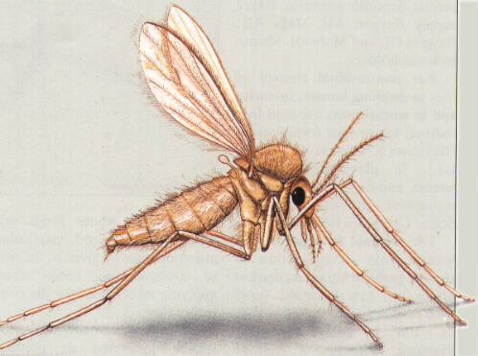
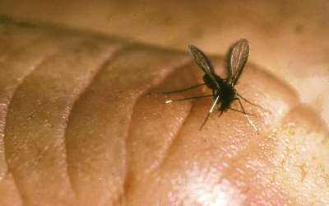
Sand fly

Slide 23
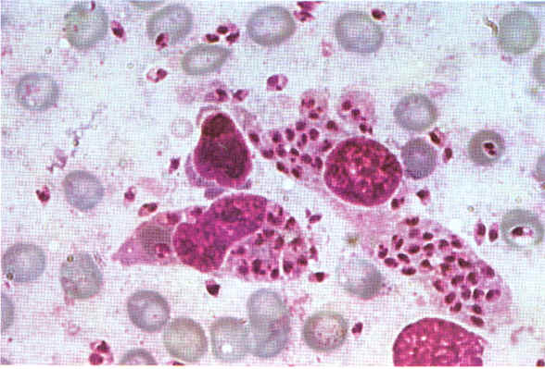
A 7 year old child presented with anemia , hepatospenomegaly and fever .Not responding to antimalarials and antibiotics . Bone marrow smear is shown
ARE THERE ANY PARASITES? WHAT STAGE ?
Leishmania , amastigote stage (Lishmania donovani)

Slide 24
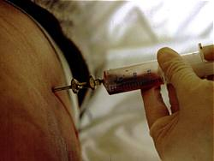
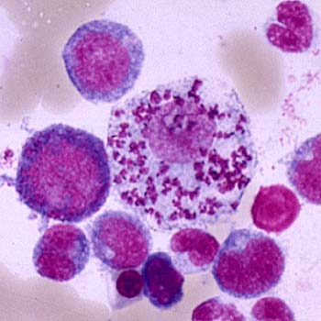
Bone marrow aspiration
Bone marrow stain with Gimsa stain to look for amastigotes of Leishmania donovani

Slide 25
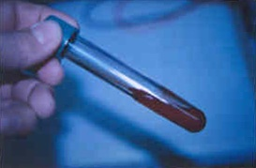
NNN media to see promastigotes

Slide 26
(2) Immunological Diagnosis:
Specific serologic tests: Direct Agglutination Test (DAT), ELISA, IFAT
Skin test (leishmanin test) for survey of populations and follow-up after treatment.

Slide 27
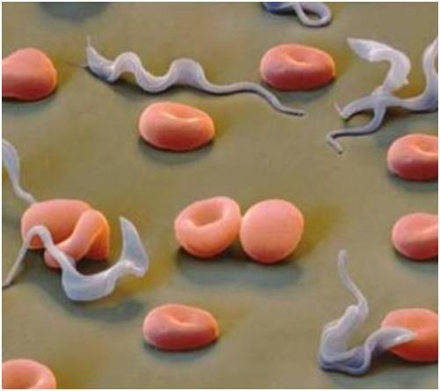
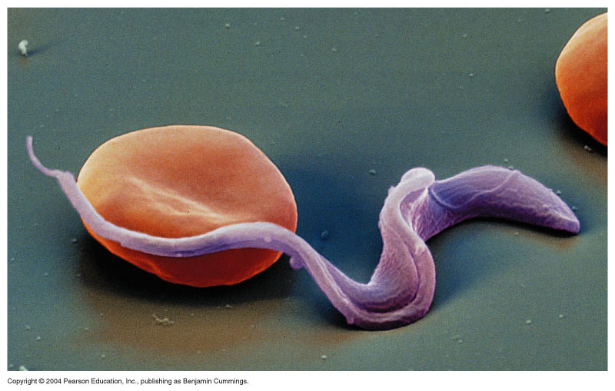
Trypanosomiases

Slide 28
1-African sleeping sickness
Trypanosoma brucei rhodesiense: East Africa, wild and domestic animal reservoirs
Trypanosoma brucei gambiense: West and Central Africa, mainly human infection
2-Chaga’s disease in central and south America
Trypanosma cruzi cause Chaga’s disease.

Slide 29
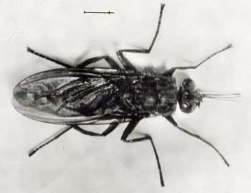
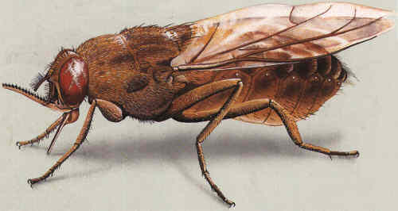
Tsetse fly is the vector of african sleeping sikness

Slide 30
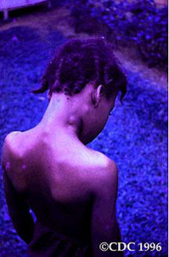
Winterbottom’s stage

Slide 31
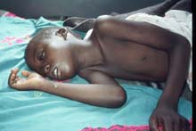
3rd stage CNS: CNS involvement in typical case there is daytime sleeping, psychological changes ,tremors ,convulsions and finally coma.

Slide 32
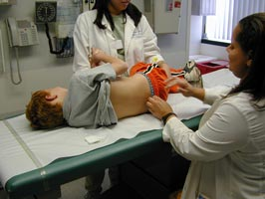
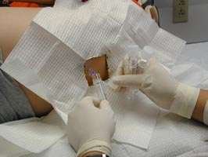
CSF lumbar puncture TRYPOMASTIGOTES

Slide 33
Trypanosomiases Trypomastigotes

Slide 34
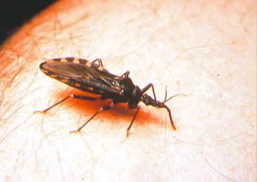
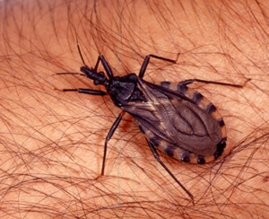
Reduviid (Triatomine) bug the vector of american trypanosomiasis chaga’s disease

Slide 35
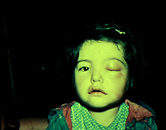
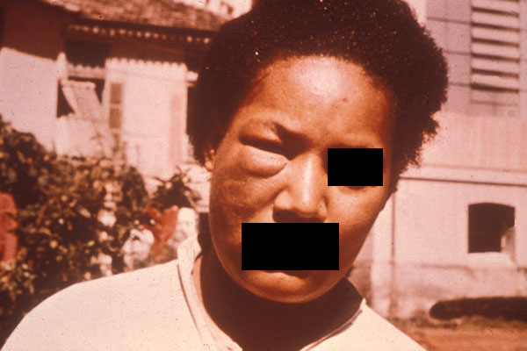
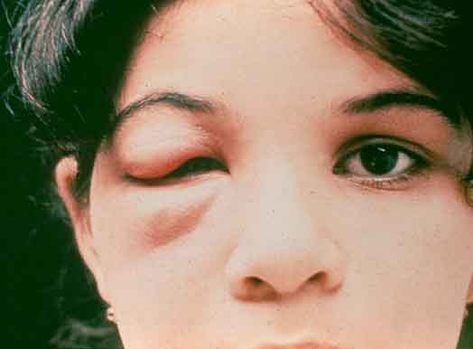
Ocular lesion (Romana’ sign)

Slide 36
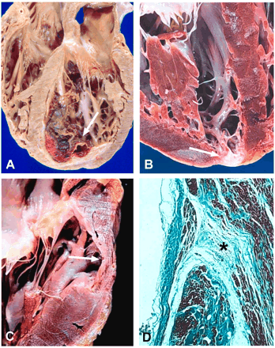
Heart damage due to American trypanosomiasis

Slide 37
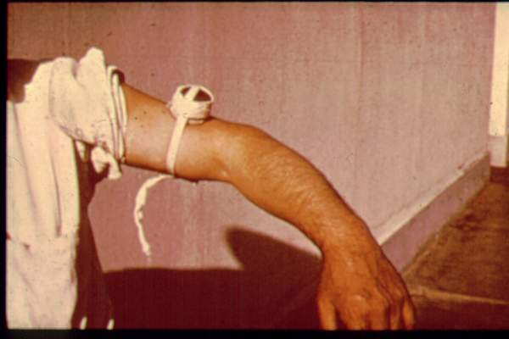
Diagnosis
Blood film
Serology: IFAT
Xenodiagnosis: feeding bugs on a suspected cases.

Slide 38
Trypanosomiases Trypomastigotes

Slide 39


Slide 40
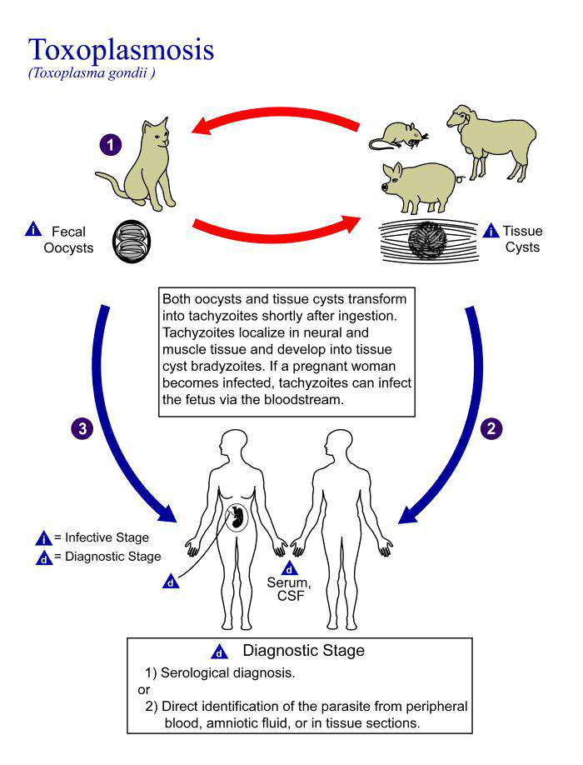

Slide 41
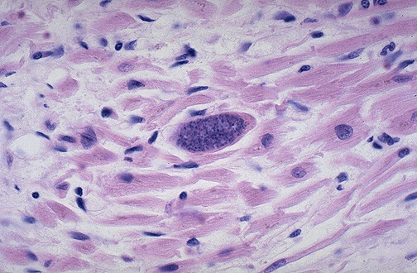
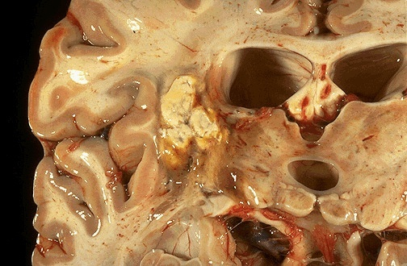

Slide 42



Toxoplasma gondii,
ACUTE PHASE
CHRONIC PHASE
Immunity +
Tachyzoites: rapidly dividing forms
Immunity -
Bradyzoites: slowly dividing forms
ACTIVATION

Slide 43


Slide 44


Slide 45


LYMPHATIC FILARIASIS Wuchereria bancrofti

Slide 46

FILARIAL WORMS: (Adult worms + microfilariae)
1 Wuchereria bancrofti,:
Lymphatic filariasis (adults in lymphatics,
microfilariae in blood)
2 Loa loa:
Adults in subcutaneous and subconjunctival tissues, causing Calabar swellings. Microfilariae in blood
3 Onchocerca volvulus:
Adults in subcutaneous swellings Microfilariae : mainly in skin, eyes causing River blindness

Slide 47

Onchocerciasis

