Slide 1
PATHOLOGY AND PATHOGENESIS OF CHOLECYSTITIS
Dr Hala Kfoury

Slide 2
Pathology and pathogegenesis of cholecystitis
Recognize the predisposing factors of cholecystitis.
Describe the different types of cholecystitis.
Understand the pathogenesis of acute and chronic cholecystitis

Slide 3
Disorders of the Gallbladder CHOLELITHIASIS (GALLSTONES)
Majority of gallstones (>80%) are "silent," and most individuals remain free of biliary pain or stone complications for decades.
There are two main types of gallstones. About 80% are cholesterol stones, containing more than 50% of crystalline cholesterol monohydrate. The remainder are composed predominantly of bilirubin calcium salts and are designated pigment stones.

Slide 4
Prevalence and Risk Factors. The major risk factors for cholesterol stone are .

Slide 5
Cholesterol Stones
Demography: Northern Europe, North and South America, Native Americans, Mexican Americans
Advancing age
Female sex hormones
Female gender
Oral contraceptives
Pregnancy
Obesity
Rapid weight reduction
Gallbladder stasis
Inborn disorders of bile acid metabolism
Hyperlipidemia syndromes
Pigment Stones
Demography: Asian more than Western, rural more than urban
Chronic hemolytic syndromes
Biliary infection
Gastrointestinal disorders: ileal disease (e.g., Crohn disease), ileal resection or bypass, cystic fibrosis with pancreatic insufficiency

Slide 6
Pathogenesis of Cholesterol Stones
Cholesterol is rendered soluble in bile by aggregation with water-soluble bile salts and water-insoluble lecithins, both of which act as detergents.
When cholesterol concentrations exceed the solubilizing capacity of bile (supersaturation), cholesterol can no longer remain dispersed and nucleates into solid cholesterol monohydrate crystals.
Cholesterol gallstone formation involves four simultaneous defects:

Slide 7
Pathogenesis of Cholesterol Stones
Supersaturation of bile with cholesterol is the result of hepatocellular hypersecretion of cholesterol.
Gallbladder hypomotility ensues. It promotes nucleation typically arround a calcium salt crystal nidus.
Cholesterol nucleation in bile is accelerated.

Slide 8
Pathogenesis of Cholesterol Stones
4) Mucus hypersecretion in the gallbladder traps the crystals, permitting their aggregation into stones.
prolonged fasting, pregnancy, rapid weight loss, total parenteral nutrition, and spinal cord injury also promote stone formation.

Slide 9
Pathogenesis of Pigment Stones
Pathogenesis of pigment stones is based on the presence in the biliary tract of unconjugated bilirubin (which is poorly soluble in water) and precipitation of calcium bilirubin salts.
Thus, infection of the biliary tract, as with Escherichia coli or Ascaris lumbricoides or by the liver fluke Opisthorchis sinensis, increases the likelihood of pigment stone formation.
Chronic hemolytic conditions also promote formation of unconjugated bilirubin in the biliary tree.

Slide 10
Morphology
Cholesterol stones arise exclusively in the gallbladder and are composed of cholesterol ranging from 100% pure (which is rare) down to around 50%.
pale yellow, round to ovoid to faceted, and have a finely granular, hard external surface.
Stones composed largely of cholesterol are radiolucent; only 10% to 20% of cholesterol stones are radio-opaque.

Slide 11
Morphology
Pigment gallstones are black and brown.
"Black" pigment stones are found in sterile gallbladder.
"Brown" pigment stones are found in infected intrahepatic or extrahepatic bile ducts.
Both are soft and usually multiple.
Brown stone are greasy.
Because of calcium carbonates and phosphates, approximately 50% to 75% of black stones are radio-opaque.

Slide 12
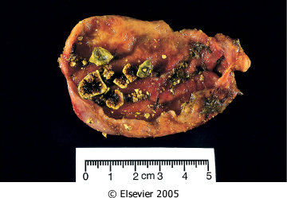
Downloaded from: Robbins & Cotran Pathologic Basis of Disease (on 9 March 2006 02:58 PM)
© 2005 Elsevier

Slide 13
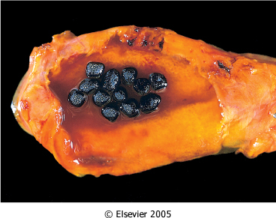
Downloaded from: Robbins & Cotran Pathologic Basis of Disease (on 9 March 2006 02:58 PM)
© 2005 Elsevier

Slide 14
Cholesterolosis
An incidental finding, is cholesterolosis. Cholesterol hypersecretion by the liver promotes excessive accumulation of cholesterol esters within the lamina propria of the gallbladder. The mucosal surface is studded with minute yellow flecks, producing the "strawberry gallbladder

Slide 15
Clinical Features of gall stones
70% to 80% of patients remain asymptomatic throughout their lives.
Symptoms: spasmodic or "colicky" fighrt upper quadrant pain, which tends to be excruciating . It is usually due to obstruction of bile ducts by passing stones.
More severe complications include empyema, perforation, fistulae, inflammation of the biliary tree (cholangitis), and obstructive cholestasis or pancreatitis with ensuing problems. The larger the calculi, the less likely they are to enter the cystic or common ducts to produce obstruction; it is the very small stones, or "gravel," that are the more dangerous. Occasionally, a large stone may erode directly into an adjacent loop of small bowel, generating intestinal obstruction ("gallstone ileus"). Most notable is the increased risk for carcinoma of the gallbladder.

Slide 16
CHOLECYSTITIS
Inflammation of the gallbladder may be acute, chronic, or acute superimposed on chronic. It almost always occurs in association with gallstones.

Slide 17
Acute Cholecystitis
Acute calculous cholecystitis is an acute inflammation of the gallbladder, precipitated 90% of the time by obstruction of the neck or cystic duct.
It is the primary complication of gallstones and the most common reason for emergency cholecystectomy.
Acute acalculous cholecystitis occurs in the absence of gallstones, generally in severely ill patient. Most cases of occur in the following circumstances: (1) the postoperative state after major, nonbiliary surgery; (2) severe trauma (motor vehicle accidents, war injuries); (3) severe burns; (4) multisystem organ failure; (5) sepsis; (6) prolonged intravenous hyperalimentation; and (7) the postpartum state.

Slide 18
Acute Cholecystitis :Pathogenesis.
Acute calculous cholecystitis results from chemical irritation and inflammation of the obstructed gallbladder. These events occur in the absence of bacterial infection; only later in the course may bacterial contamination develop.

Slide 19
Acute Cholecystitis :Morphology.
In acute cholecystitis, the gallbladder is usually enlarged and tense, and bright red to green-black . The serosal covering is frequently layered by fibrin and, in severe cases, by exudate.
There are no morphologic differences between acute acalculous and calculous cholecystitis, except for the absence of macroscopic stones in the former. In the latter instance, an obstructing stone is usually present in the neck of the gallbladder or the cystic duct.

Slide 20
Acute Cholecystitis :Morphology.
The gallbladder lumen is filled with a cloudy or turbid bile that may contain fibrin and frank pus, as well as hemorrhage. When the contained exudate is virtually pure pus, the condition is referred to as empyema of the gallbladder.
In mild cases, the gallbladder wall is thickened, edematous, and hyperemic.
In more severe cases, it is transformed into a green-black necrotic organ, termed gangrenous cholecystitis, with small-to-large perforations.

Slide 21
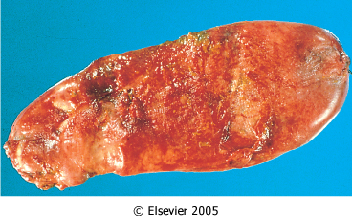
Downloaded from: Robbins & Cotran Pathologic Basis of Disease (on 9 March 2006 02:58 PM)
© 2005 Elsevier

Slide 22
Acute Cholecystitis :Clinical Features
Progressive right upper quadrant or epigastric pain, frequently associated with mild fever, anorexia, tachycardia, sweating, and nausea and vomiting. The upper abdomen is tender. Most patients are free of jaundice
Acute calculous cholecystitis may appear with remarkable suddenness and constitute an acute surgical emergency or may present with mild symptoms that resolve without medical intervention.

Slide 23
Acute Cholecystitis :Clinical Features
Clinical symptoms of acute acalculous cholecystitis tend to be more insidious, since symptoms are obscured by the underlying conditions precipitating the attacks. A higher proportion of patients have no symptoms referable to the gallbladder. The incidence of gangrene and perforation is much higher than in calculous cholecystitis.

Slide 24
Chronic cholecystitis
Chronic cholecystitis may be a sequel to repeated bouts of mild to severe acute cholecystitis, but in many instances, it develops in the apparent absence of antecedent attacks.
It is associated with cholelithiasis in over 90% of cases.

Slide 25
Chronic cholecystitis
The symptoms of calculous chronic cholecystitis are similar to those of the acute form and range from biliary colic to indolent right upper quadrant pain and epigastric distress.
Patients often have intolerance to fatty food, belching and postprandial epigastric distress, sometimes include nausea and vomiting.

Slide 26
Morphology
The morphologic changes in chronic cholecystitis are extremely variable and sometimes minimal. Gall bladder may be contracted (fibrosis), normal in size or enlarged (from obstruction). The wall is variably thickened. Stones are frequent.

Slide 27
Morphology
On histology, the degree of inflammation is variable. Outpouchings of the mucosal epithelium through the wall (Rokitansky-Aschoff sinuses) may be quite prominent.
Rarely, extensive dystrophic calcification within the gallbladder wall may yield a porcelain gallbladder, notable for a markedly increased incidence of associated cancer.
Xanthogranulomatous cholecystitis is also a rare condition in which the gallbladder is shrunken, nodular, fibrosed and chronically inflamed with abundant lipid filled macrophages.
Finally, an atrophic, chronically obstructed gallbladder may contain only clear secretions, a condition known as hydrops of the gallbladder.

Slide 28
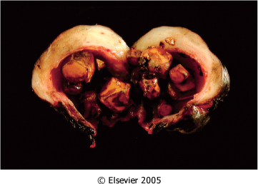
Downloaded from: Robbins & Cotran Pathologic Basis of Disease (on 9 March 2006 02:58 PM)
© 2005 Elsevier

Slide 29
Complications: acute and chronic cholecystitis
Bacterial superinfection with cholangitis or sepsis
GB perforation & local abscess formation
GB rupture with diffuse peritonitis
Biliary enteric (cholecystenteric) fistula with drainage of bile into adjacent organs, and potentially gallstone-induced intestinal obstruction (ileus)
Aggravation of pre-existing medical illness, with cardiac, pulmonary, renal, or liver decompensation

Slide 30
Cholecystitis
Take home message
Question: Causes of cholecystitis?

