Slide 1
Gastrointestinal Block
Pathology lecture
2014
Diarrhea
Dr. Maha Arafah
Dr. Ahmed Al Humaidi

Slide 2
DIARREAHA
Objectives
Define diarrhea
Describe the pathogenesis of different types of diarrhea
3. List the causes of chronic diarrhea

Slide 3
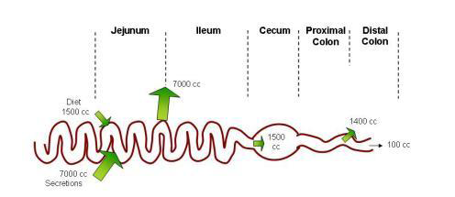
Physiology of Fluid and small intestine

Slide 4
DIARREAHA
DEFINITION
World Health Organization
3 or more loose or liquid stools per day
Abnormally high fluid content of stool
  200-300 gm/day

Slide 5
Why important?
The loss of fluids through diarrhea can cause dehydration and electrolyte imbalances
Easy to treat but if untreated, may lead to death especially in children

Slide 6
Why important?
More than 70 % of almost 11 million child deaths every year are attributable to 6 causes:
Diarrhea
Malaria
neonatal infection
Pneumonia
preterm delivery
lack of oxygen at birth.
UNICEF

Slide 7
CLASSIFICATION
Acute …………….if 2 weeks,
Persistent ……. if 2 to 4 weeks,
Chronic ………..if 4 weeks in duration.

Slide 8
Pathophysiology
Categories of diarrhea
Secretory
Osmotic
Exudative (inflammatory )
Motility-related

Slide 9
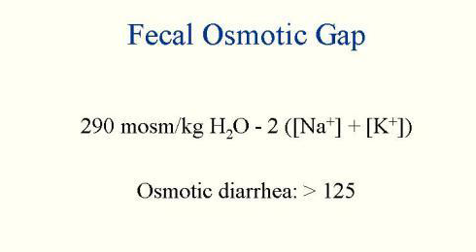
Fecal osmolarity
As stool leaves the colon, fecal osmolality is equal to the serum osmolality i.e. 290 mosm/kg.
Under normal circumstances, the major osmoles are Na⁺, K⁺, Cl–, and HCO₃–
Stool osmotic gap =
Stool osmolality - 2 x (stool Na + stool K)
Normal fecal fluid values:
Osmolality: ~290 mOsm/kg
Na+: ~30 mmol/L
K+: ~75 mmol/L

Slide 10
Osmotic
Excess amount of poorly absorbed substances that exert osmotic effect………water is drawn into the bowels……diarrhea
Stool output is usually not massive
Fasting improve the condition
Stool osmotic gap is high, > 125 mOsm/kg (loss of hypotonic fluid)
Can be the result of
Malabsorption in which the nutrients are left in the lumen to pull in water e.g. lactose intolerance
osmotic laxatives.
Hexitols (poorly absorbed): sorbitol, mannitol, xylitol).

Slide 11
Secretory
There is an increase in the active secretion of water
High stool output
Lack of response to fasting
Stool osmotic gap < 100 mOsm/kg
The most common cause of this type of diarrhea is a bacterial toxin ( E. coli , cholera) that stimulates the secretion of anions.
Other causes:
  Enteropathogenic virus e.g. rotavirus and norwalk virus
      Also seen in neuroendocrine tumours ( carcinoid tumor, gastrinomas)
      Rectal villous adenoma

Slide 12
Exudative (inflammatory)
Results from the outpouring of blood protein, or mucus from an inflamed or ulcerated mucosa
Presence of blood and pus in the stool.
Persists on fasting
Occurs with inflammatory bowel diseases, and invasive infections e.g. E. coli, Clostridium difficile and Shigella

Slide 13
Exudative (inflammatory)
Some bacterial infections cause damage by invasion of the mucosa. Many cause diarrhea with blood and pus in the stool (bacterial dysentery: bloody diarrhea with mucus due to infection or IBD)
  The main organisms are:
    Campylobacter invades mucosa in the jejunum, ileum and colon, causing ulceration and acute inflammation.
    Salmonella typhi, S. paratyphi A, B, and C
    Shigella infections are mainly seen in young children.
    Enteroinvasive and enterohemorrhagic E. coli

Slide 14
Motility-related
Caused by the rapid movement of food through the intestines (hypermotility).
Irritable bowel syndrome (IBS) – a motor disorder that causes abdominal pain and altered bowel habits with diarrhea predominating

Slide 15
SUMMARY: TYPES OF DIARRHEA
SCREENING TESTS | CAUSES | CHARACTERISTICS | TYPE
Fecal smear for leukocytes: positive in most cases | Shigella spp. Campylobacter jejuni | Pathogens invade enterocytes Low-volume diarrhea | Invasive
Order stool culture & for O&P | Entamoeba histolytica | Diarrhea with blood and leukocytes (i.e., dysentery)
Stool osmotic gap < 50 mOsm/kg Fecal smear for leukocytes: negative Increased 5-HIAA: carcinoid syndrome | Laxatives: melanosis coli with use of phenanthracene laxatives Production of enterotoxins: Vibrio cholerae Enterotoxigenic E. coli Increased serotonin: carcinoid syndrome | Loss of isotonic fluid High-volume diarrhea Mechanisms:Laxatives Enterotoxins stimulate Cl⁻ channels regulated by cAMP and cGMP Serotonin increases bowel motility No inflammation in bowel mucosa | Secretory
Fecal smear for leukocytes: negative Stool osmotic gap > 100 mOsm/kg | Disaccharidase def. Giardiasis, Celiac Dis. Ingestion of poorly absorbable solutes | Osmotically active substance is drawing hypotonic salt solution out of bowel High-volume diarrhea No inflammation in bowel mucosa | Osmotic
 | Irritable bowel syndrome (IBS) – a motor disorder | Rapid movement of food through the intestines | Motility-related

Slide 16
Entamoeba histolytica

Slide 17
Acute diarrhea

Slide 18
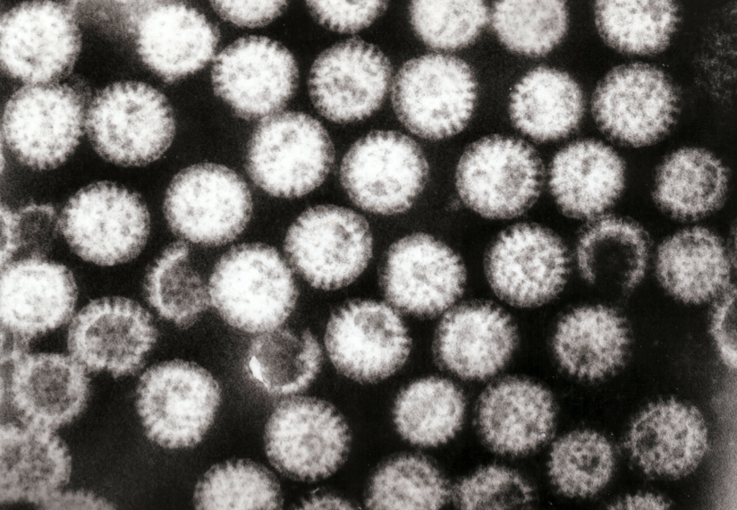
Aetiology
Acute diarrhea
Approximately 80% of acute diarrheas are due to infections (viruses, bacteria, helminths, and protozoa).
Viral gastroenteritis (viral infection of the stomach and the small intestine) is the most common cause of acute diarrhea worldwide.
Food poisoning
Drugs
Others
Rotavirus
The cause of nearly 40% of hospitalizations from diarrhea in children under 5
Rotaviruses cause 50% of infantile diarrhea
Clinically person become dehydrated with electrolyte disturbance and low bicarbonate in blood

Slide 19
Antibiotic-Associated Diarrheas
Diarrhea occurs in 20% of patients receiving broad-spectrum antibiotics; about 20% of these diarrheas are due to Clostridium difficile
Leading to pseudomembranous colitis

Slide 20
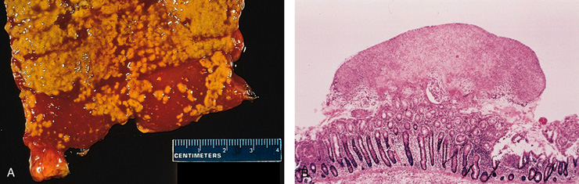
Pseudomembranous colitis
patients received broad-spectrum antibiotics
Caused by Clostridium difficile

Slide 21
Clostridium species. Gram-positive rods

Slide 22
Chronic diarrhea

Slide 23
Chronic diarrhea
Aetiology
Infection e.g. Giardia lamblia . AIDS often have chronic infections of their intestines that cause diarrhea.
Post-infectious Following acute viral, bacterial or parasitic infections
Malabsorption
Inflammatory bowel disease (IBD)
Endocrine diseases
Colon cancer
Irritable bowel syndrome

Slide 24
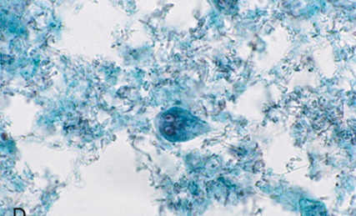
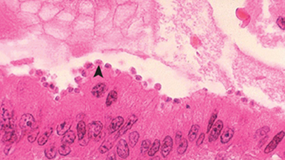
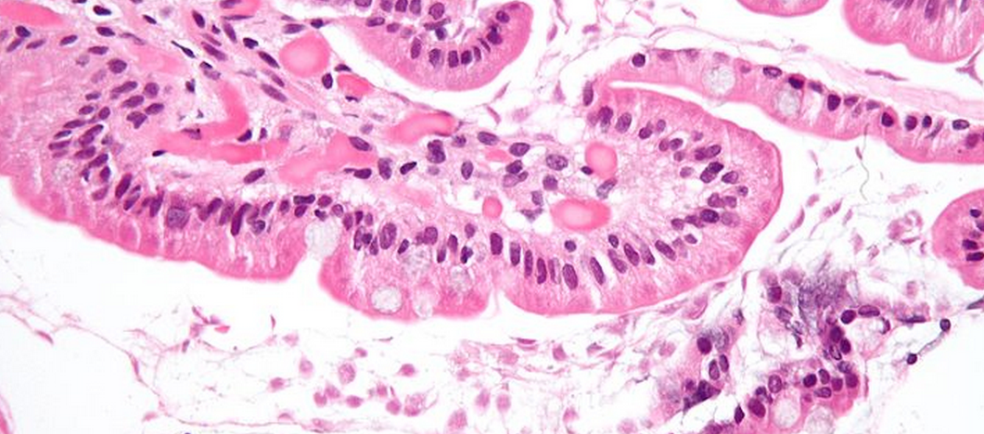
Causes of Chronic Diarrhea
Giardia lamblia
Cryptosporidiosis in AIDS
Parasitic and protozoal infections affect over half of the world's population on a chronic or recurrent basis.

Slide 25
Complications
Fluids ………………Dehydration
Electrolytes …………….. Electrolytes imbalance
Sodium bicarbonate……. Metabolic acidosis
If persistent ……Malnutrition

Slide 26
Tests useful in the evaluation of diarrhea
Acute diarrhea
Fecal leukocytes
present
not present
Inflammatory Diarrhea
Noninflammatory Diarrhea
Suggests colonic mucosa damage caused by invasion
shigellosis, salmonellosis, Campylobacter or Yersinia infection, amebiasis)
toxin (C difficile, E coli O157:H7).
Inflammatory bowel diseases
Suggests a small bowel source
Or colon but without mucosal injury

Slide 27
Chronic diarrhea
Infection
+
Stool analysis
Ova, parasites
-
Secretory or
Noninfectious
inflammatory diarrhea
-
Stool fat test
(normal <20%)
+
Malabsorption
Quantitative stool for fat
  (1) Best screening test
  (2) 72-hour collection of stool
  (3) Positive test > 7 g of fat/24 hours.
Do serum Anti-tissue transglutaminase antibodies
Anti-endomysial IgA antibodies
Antigliadin antibodies to check for celiac disease
Duodenal biopsy

Slide 28
A
B
Fasting improve the condition
inflammatory bowel diseases
High stool output
Presence of WBC in stool
Irritable bowel syndrome
bacterial toxin
Malabsorption
High fecal osmotic gap
Secretory
Osmotic
Exudative (inflammatory )
Motility-related

Slide 29
A
B
Irritable bowel syndrome
Giardia lamblia
Viral gastroenteritis
Inflammatory bowel disease
Food poisoning
Antibiotic-Associated Diarrheas
Malabsorption
Acute diarrhea
Chronic diarrhea

Slide 30
CLASSIFICATION diarrhea
Acute
Persistent
Chronic

Slide 31
What are complications of diarrhea?
What are complications of malabsorption?

Slide 32
Pathophysiology of malabsorption ?

Slide 33
Clinical presentation of malabsorption ?

Slide 34
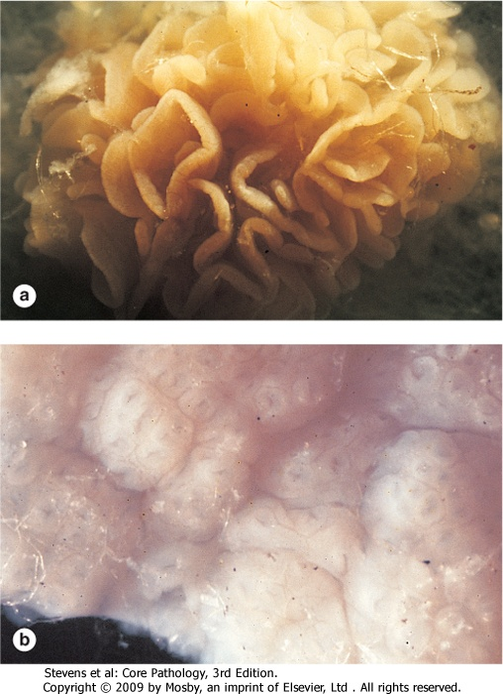
Endoscopy what is the finding?
normal

Slide 35
What is Celiac disease?

Slide 36
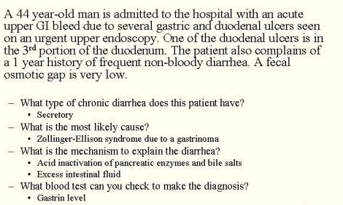
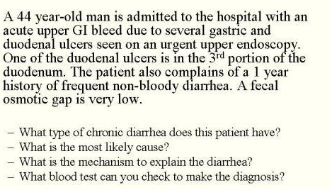

Slide 37
A 10-month-old, previously healthy male infant develops a severe, watery diarrhea 2 days after visiting the pediatrician for a routine checkup. The most likely diagnosis is
a. Rotavirus infection
b. Enterotoxigenic E. coli infection
c. Entamoeba histolytica infection
d. Lactase deficiency
e. Ulcerative colitis

Slide 38
Scenario
A 44-year-old white male presented with a seven-month history of diarrhea. The frequency of his bowel movements had increased to 5-7 per day, and his stools were yellow and floated at the top of the water in the toilet. He had occasional abdominal cramping, but no tenesmus, melena, or bleeding. His appetite was good, but he had experienced gradual weight loss. His bowel movement frequency would decrease upon fasting and would increase with food intake.
Stool tests revealed a stool output of 4128 g/d (nl 100-200 g/d) with fat excretion of 17 g/d (nl <5 g/d).
Microscopic examination for ova and parasites and cultures for bacterial pathogens and acid-fast bacilli were negative.
Blood testing showed mild anemia , hypoproteinemia (4.9 mg/dL), and hypoalbuminemia (3.4 mg/dL).

Slide 39
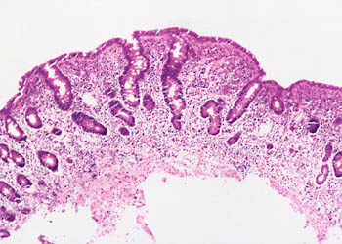
Duodenal biopsy

Slide 40
Exposure to what dietary antigen is thought to be the cause of these changes?
What food components contain this antigen?
Would these histologic changes resolve with dietary modification?
Exposure to gluten (specifically, the gliadin constituent of this protein)
Wheat, barley, flour, and possibly oats contain gluten.
yes

Slide 41
A 6-year-old boy has been brought to outpatients by his mother because he has abdominal pain after some meals. This has been getting increasingly frequent and it sounds, from his description, somewhat colicky in nature. You discover that he has always had very smelly, loose, pale bulky stools, which his parents have put down to the fact that he likes milk. On examination, he is pale, underweight, and of short stature.

Slide 42
1. What are the important differential diagnoses on presentation?
Celiac disease is the most likely diagnosis. Parasitic infection (e.g. giardiasis) and pancreatic insufficiency (e.g. due to chronic pancreatitis or cystic fibrosis) may give rise to a similar presentation, but these are not supported by the results of the investigations.

Slide 43
2. Blood tests reveal a mild macrocytic anemia. There is a low level of vitamin B12, and folate is at the lower end of normal. Autoantibody screens reveal a positive reaction to antigliadin antibodies. Do these tests help to narrow down the diagnosis?
These results are very suggestive of celiac disease due to the low levels of vitamin B¹² and the hypersensitivity reaction to α-gliadin, a component of gluten. The finding of villous atrophy would support the diagnosis, and this is achieved by endoscopic biopsy of the first part of the duodenum.

Slide 44
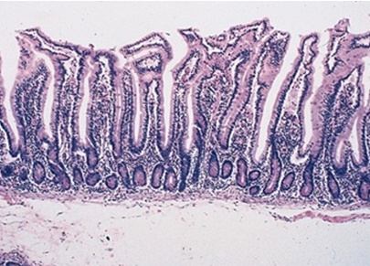
3. A duodenal biopsy shows
Normal

Slide 45
The final diagnosis is celiac disease, provided the patient’s symptoms respond to a gluten-free diet and the histological changes relapse on re-challenge. Such criteria are necessary before confining a patient to a lifelong gluten-free diet.

Slide 46
4. What treatment options are available?
Treatment is by adhering to a strict gluten-free diet.

Slide 47
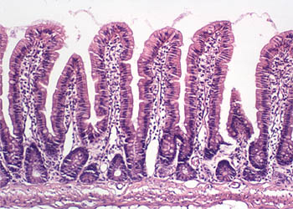

Slide 48
Lactose Intolerance
Pathophysiology
lactase
Lactose
glucose + galactose
At the brush border of enterocytes
Lactose Intolerance
Low or absent activity of the enzyme lactase

Slide 49
Lactose Intolerance causes
Inherited lactase deficiency
Congenital lactase deficiency
Childhood-onset and adult-onset lactase deficiency
extremely rare
common
Genetically programmed progressive loss of the activity of the small intestinal enzyme lactase.
Gastroenteritis: Infectious diarrhea, particularly viral gastroenteritis in younger children, may damage the intestinal mucosa enough to reduce the quantity of the lactase enzyme.
Acquired lactase deficiency
Transient
Secondary lactase deficiency due to intestinal mucosal injury by an infectious, allergic, or inflammatory process

Slide 50
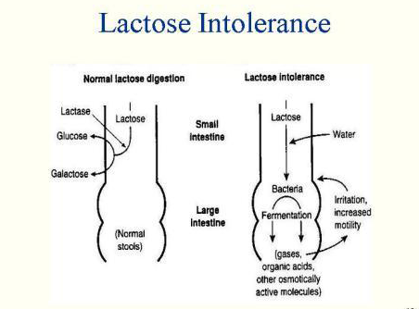

Slide 51
How to diagnose lactose intorelence ?
How to treat lactose intorelence ?
Empirical treatment with a lactose-free diet, which results in resolution of symptoms;
Hydrogen breath test
lactose-free diet

