Slide 1
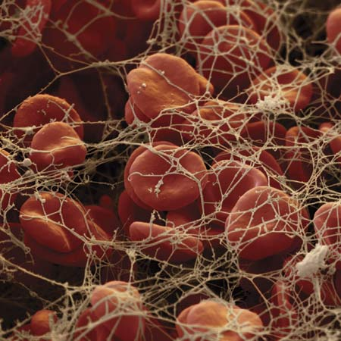
ANTICOAGULANTS

Slide 2
ANTICOAGULANTS
ILOs
Re-visit the coagulation cascade
Classify drugs acting as anticoagulants
Elaborate on their mechanism of action, correlating that with methods of monitoring
Contrast the limitations & benefits of injectable anticoagulants in clinical settings
Emphasis on the limitations of VKAs & on variables altering or modifying their response.
Apply such variability in a clinical scenario.

Slide 3
Intrinsic Pathway
Extrinsic Pathway
Clotting: slower / accessed by aPTT
Clotting: is rapid in sec. / accessed by PT
BV Injury
Tissue Injury
XII
XIIa
Tissue Factor
XI
XIa
VIIIa
IX
IXa
VIIa
VII
Ca⁺⁺
Va
AT III
X
Xa
X
> 1000 times
XIII
Heparin
Prothrombin II
Thrombin IIa
LMWH
Fibrinogen
Fibrin monomer
XIIIa
Vitamin K Antagonists
Direct Thrombin Is
Fibrin polymer
Factor Xa Is

Slide 4
ANTICOAGULANTS
>VENOUS THROMBOSIS
Parenteral Anticoagulants
Oral Anticoagulants
UF Heparin
LMWH
Direct Thrombin Is
Factor Xa Is
Vitamin K Antagonists
3000-30000
< 8000
Pentasaccharide
Coumarins;
Warfarin
> 40 times potency than
Dicumarol
> Xa
II a
X a
Indirect Is
Enoxaparin
Lovenox
Dalteparin
Bivaluridin
Lepirudin
Argatroban
R Is
IR Is
Fondaparinux
Rivaroxaban
R Is
R Is
Direct Is
Dabigatran
XIIa, XIa, IXa, Xa, IIa
II, VII, IX & X
Inactivation of Coag. Factors by Anti-thrombin III
Decrease Synthesis
Rapid / Variable
Slow / Latency / Variable
Monitor by aPTT (1.5 - 2.5 times normal [30sec])
Or CT (2-3 times normal [5-7 min)
Monitor by PT ( 2 times)
INR (2.5)
Antidote; Protamine Sulphate IV 1mg / 100 units UFH
+/ Fresh blood
Antidote; Vit. K₁ infusion +/ Fresh blood
+ Needs de novo synthesis

Slide 5
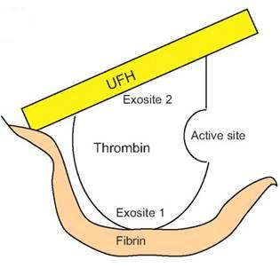
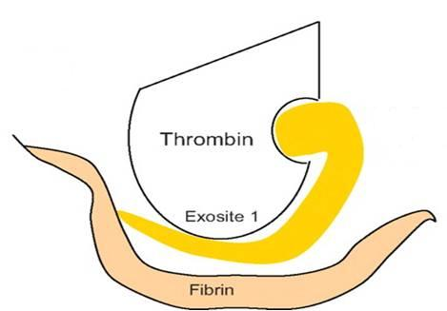
UFH
-ve IIa & Xa equally
No –ve of fibrin-bound IIa
=
Monitor by
aPTT .
1 : 1
LMWH
-ve Xa >> IIa
No –ve of fibrin-bound IIa
<
Monitor by Plasma
F Xa.
2.1 : 4.1
No effect on IIa
F Xa Is
DTIs
No effect on Xa
Indirect via AT III
Direct
–ve of fibrin-bound IIa
Rivaroxaban
Direct Antithrombins
Monitor by Plasma
F Xa.
Monitor by
aPTT .

Slide 6
ANTICOAGULANTS
UFH LIMITATIONS
No predictable anticoagulant effects; inter-patient & intra-patient variability in response to a given dosage  in hospital setting, repeated monitoring
Low bioavailability  binds to plasma proteins, endothelium & macrophages
Re-thrombosis  activates platelets & it does not neutralize fibrin-bound II a
No effect on Fibrin-bound IIa

Slide 7
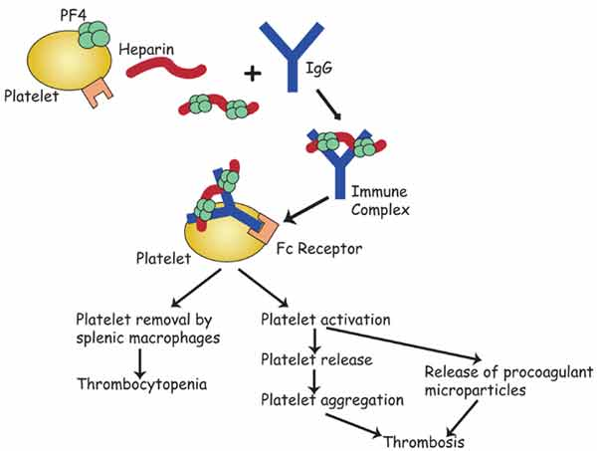
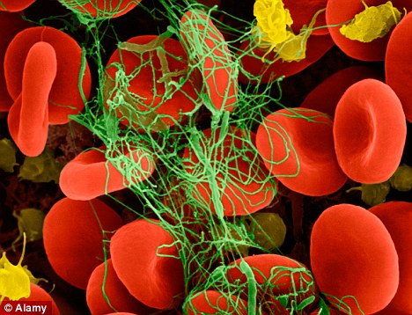
ANTICOAGULANTS
UFH LIMITATIONS
Heparin Induced Thrombocytopenia (HIT); in 4% pts. on heparin, latency 5-10 dys. after 1st exposure or 2-3 dys. after re-exposures V enous > Arterial thombosis
?
Heparin discontinuation
No packed platelets  More thrombosis
No warfarin  ppt .venous gangrene
Give  DTIs

Slide 8
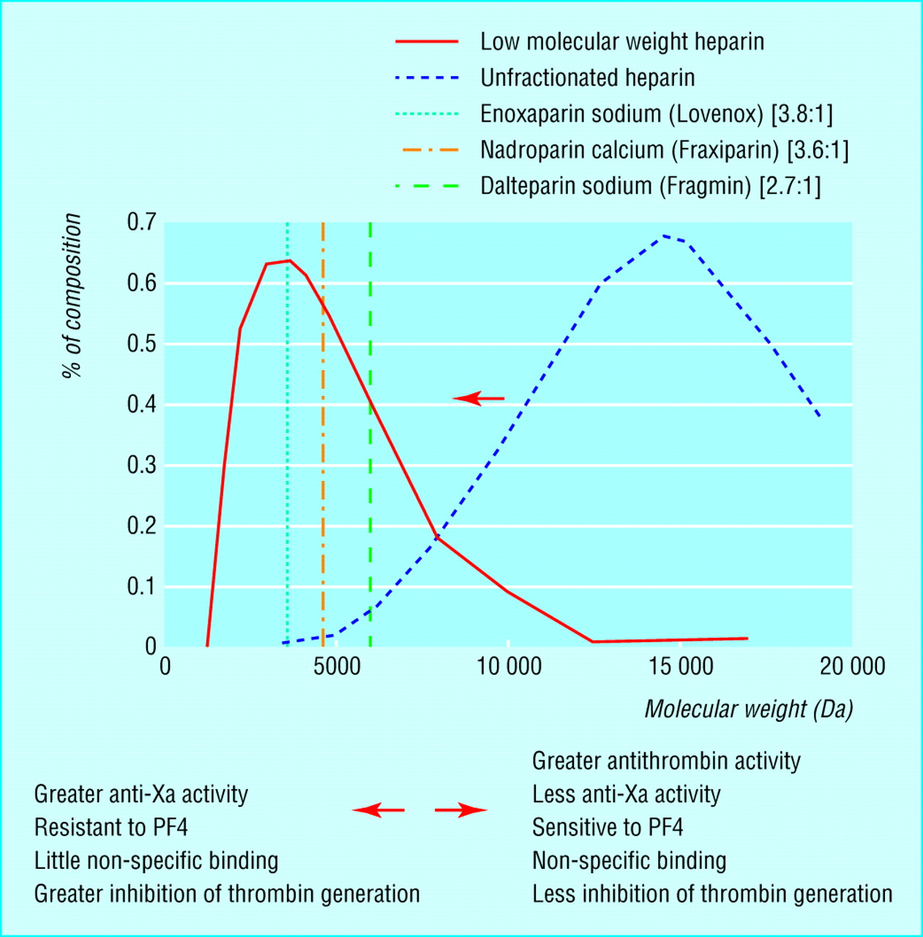
LMWH versus UFH
LMWH
UFH

Slide 9
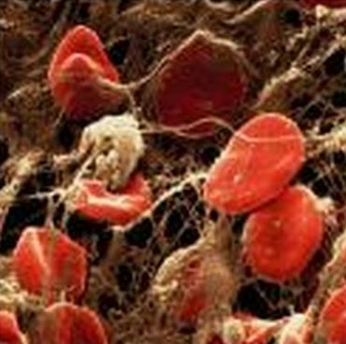
ANTICOAGULANTS
LMWH BENIFITS
 Predictability of anticoagulant response i.e. little inter-patient and intra-patient variability in response to a given dosage. So  effective anticoagulant activity can be achieved by calculating dosages based on body weight without the need for laboratory monitoring
 Bioavailability; as it hardly binds to plasma proteins, endothelium & macrophages
Incidence of thrombocytopenia; as it seldom sensitive to PF4
Incidence of bleeding tendency;  effect AT III &  platelet interactions
Much better tolerability;
given sub. cut.
◉ frequency of administration due to
longer duration of action
◉ need for regular monitoring
Outside hospital settings

Slide 10
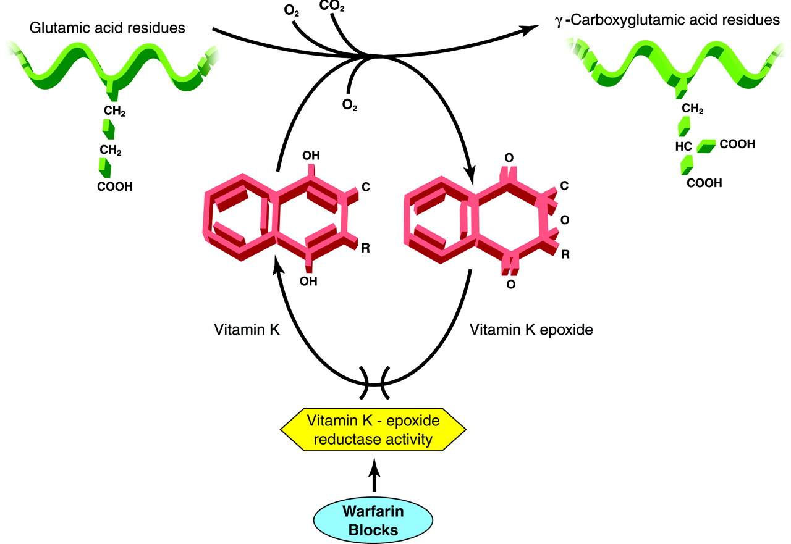
ANTICOAGULANTS
VKAs
Non-Functioning Coagulation Factors
Biologically Functioning Coagulation Factors
Carboxylase
Warfarin
Precursors of factors II, VII, IX & X require carboxylation of their glutamic a. residues to allow them to bind to phospholipid surfaces. This is provided by Vit. K as it changes from its oxidized to its reduced form. Instantaneously , the reduced Vit K has to recycle back to oxidized form by Vit K epoxide reductase. This enzyme is blocked by VKAs  losing the coagulation factors the ability to function.

Slide 11
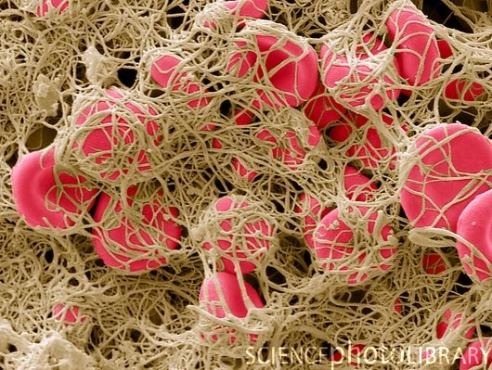
ANTICOAGULANTS
VKAs LIMITATIONS
Wide variation in drug response  a necessity for continuous monitoring (PT) & dose adjustment .
Has narrow therapeutic window; ↑ PPB, so action depends on very small fraction of free drug. So any change in its level can be hazardous.
Slow onset of action, so not in given in emergency conditions
Has latency in its action presents the time needed to launch new biologically inactive coagulation factors
Common genetic polymorphisms in CYT P450 isoforms that metabolizes warfarin  adds to its non predictable response  liability to toxicities or under use.
Numerous food- & drug-drug interactions  liability to toxicities or under use.
Contraindicated in some conditions liable to develop thrombosis i.e as in pregnancy  give heparin or LMWH instead
.

Slide 12
FACTORS ALTERING RESPONSE TO VKAs
1. Vitamin K deficiency;
a- Inadequate diet; malnutrition, dieting,….
b- Inadequate absorption; diseases of small intestine, diseases  biliary secretion
2. Impaired synthesis of clotting factors;
a. In hepatocellular disorders; ( hepatitis; viral, autoimmune, drug- induced, chronic alcoholism ... etc.)
b. In hepatic congestion; in congestive HF,…etc)
3. Increased catabolism of clotting factors;
In hypermetabolic states; as in fever, thyrotoxicosis
1. Decreased plasma protein binding;
 elimination of free drug & shortening of its t1/2. as pts with nephrotic syndrome (proteinuria)
2. Decreased catabolism of clotting factors; Hypothyroidism
3. Hereditary resistance to oral anticoagulants

Slide 13
DRUGS MODULATING RESPONSE TO VKAs
1. Inhibition of Vit. K synthesis by intestinal flora; oral antibiotics
2. Inhibition of Vit K absorption; liquid paraffin
3. Decrease in drug metabolism by microsomal enzyme inhibitors;
chloramphenicol, & cimetidine
4. Displacment of the drug from protein binding sites; phenylbutazone & salicylates
5. Co-administration of drugs that increase bleeding tendency by;
inhibiting platelet function; NSAIDs
inhibiting coagulation factors; heparin
INR
INR
1. Inhibition of drug absorption from GIT; cholystyramine, colestipol
2. Increase in synthesis of clotting factors; Vit K, oral contraceptives
3. Increase in drug metabolism by microsomal enzyme inducers;
carbamazepine, rifampicin

Slide 14
An old, peptic ulcer patient, sustained on cimetidine, has been bed ridden since a month following a major orthopedic surgery for pelvic fracture. The last week he began to complain of pain, tenderness, warmth & swelling of his left leg. He was diagnosed as deep vein thrombosis. His treating physician put him first on heparin that was replaced after three days by VKAs. Today he began to show bleeding of gums.
What is the expected explanation of his finding?
Will the treating physician 1st of all, consider giving an antidote to stop bleeding ( if so then state) or will he probably ask for lab investigation ( if so then state)?
Once lab findings are there, is the physician expected first to withdraw or to adjust the existing therapy?

Slide 15
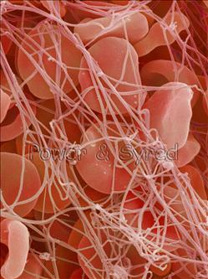
A young rheumatic artheritic patient has underwent valve replacement and is sustained on warfarin therapy for the last three years. When she married, last summer, she did not want to get pregnant, so she has taken since then, oral contraceptive pills.
Her regular lab monitoring today showed a decrease in INR this time.
What is the expected explanation of her lab result?
What will the treating physician consider doing?
Giving heparin on top
Adjusting warfarin dose
Stopping the OC
Stopping warfarin

Slide 16
A 53 years old patient had an aortic valve replacement since 5 years and he is sustained on warfarin. A week ago, he developed low grade fever, diarrhea and was diagnosed as having typhoid. He was given rehydration fluid and a course of chloramphenicol.
Today he is complaining from haematuria.
Which one of the following best explains the haematuria?
Inhibition of Vit K synthesis by chloramphenicol
Displacement of warfarin from protein binding site by rehydration
Decrease in warfarin metabolism induced by chloramphenicol
Inhibition of Vit K absorption caused by the diarrhea
Which is the right decision to do in such a case?
- Give a urinary antiseptic for fear of infection
- Stop administering the regular intake of warfarin
- Adjust the dose of warfarin after monitoring the situation.
- Stop the course of chloramphenicol intended for typhoid therapy

Slide 17
ANTICOAGULANTS
G
O
O
D
L
U
C
K

