Slide 1
Radiology of the abdomen

Slide 2
Radiological modalities
X – Ray
Flouroscopy
U/S
CT scan
MRI

Slide 3
X - Ray
It is ionizing radiation – radiation hazard.
It is useful in assessing the bones, bowel gases (obstruction) and calcification.

Slide 4
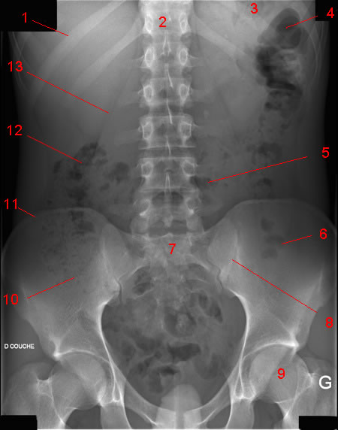
Normal AXR

Slide 5
Normal AXR
Liver
Gas in stomach
T12
Splenic flexure
11th rib
Psoas margin
Left kidney
Hepatic flexure
Transverse colon
Iliac crest
Gas in sigmoid
Sacrum
Gas in caecum
SI joint
Bladder
Femoral head

Slide 6
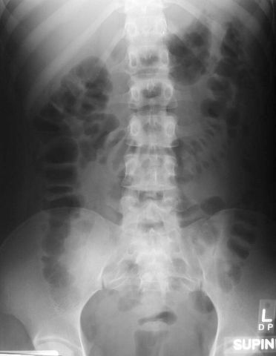
Gas pattern
What is normal?
Stomach
Almost always air in stomach
Small bowel
Usually small amount of air in
2 or 3 loops
Large bowel
Almost always air in rectum
and sigmoid
Varying amount of gas in rest of large bowel

Slide 7
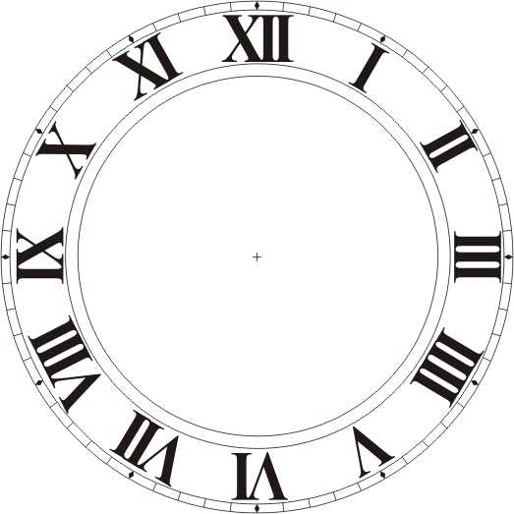
3, 6, 9 RULE
Maximum Normal Diameter of bowel
Small bowel 3cm
Large bowel 6cm
Caecum 9cm

Slide 8
Mechanical SBO
Dilated small bowel
Fighting loops (visible loops, lying transversely, with air-fluid levels at different levels)
Little gas in colon, especially rectum

Slide 9
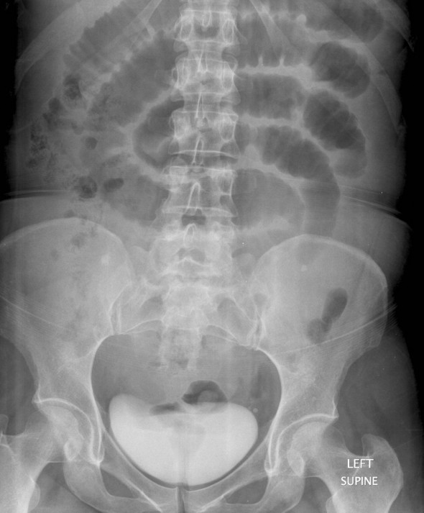
SBO Erect
SBO Supine
Air fluid levels

Slide 10
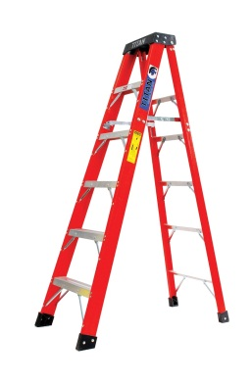
Step ladder appearance
Loops arrange themselves from left upper to right lower quadrant in distal SBO

Slide 11
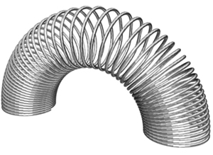
Coil spring / stack of coins sign

Slide 12
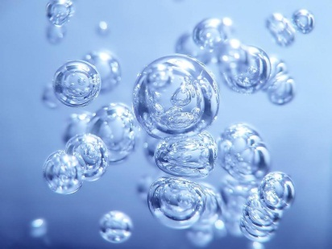
Double Bubble Sign
Duodenal Atresia

Slide 13
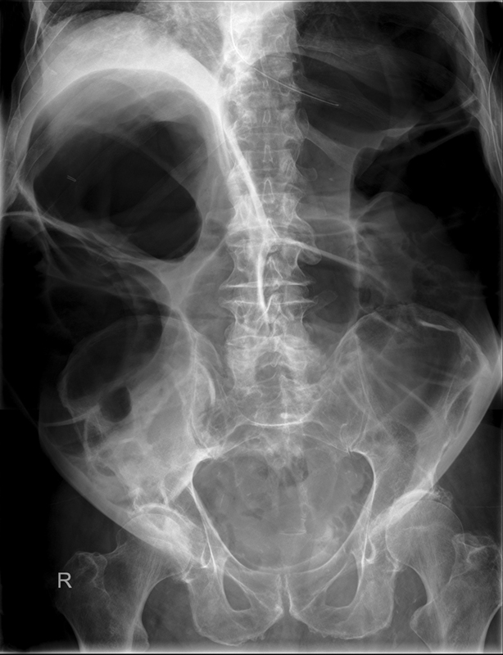
Mechanical LBO
Colon dilates from point of obstruction backwards
Little/no air fluid levels (colon reabsorbs water)
Little or no air in rectum/sigmoid

Slide 14
Causes of Mechanical LBO
TUMOUR
VOLVULUS
HERNIA
DIVERTICULITIS
INTUSSUSCEPTION

Slide 15
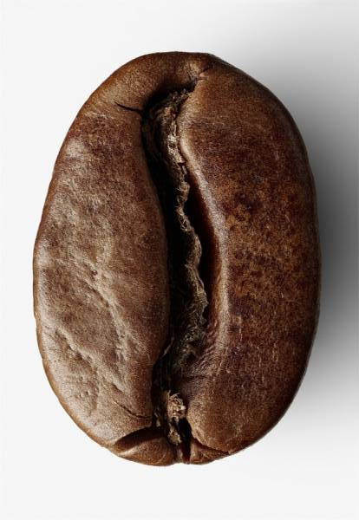
Coffee Bean Sign Sigmoid volvulus
Massively dilated sigmoid loop

Slide 16
Thumbprinting
The distance between loops of bowel is increased due to thickening of the bowel wall.
The haustral folds are very thick, leading to a sign known as 'thumbprinting.'

Slide 17
Extraluminal air
TYPES
Pneumoperitoneum/free air/intraperitoneal air
Retroperintoneal air
Air in the bowel wall (pneumatosis intestinalis)
Air in the biliary system (pneumobilia)

Slide 18
Upright film best
The patient should be positioned sitting upright for 10-20 minutes prior to acquiring the erect chest X-ray image.
This allows any free intra-abdominal gas to rise up, forming a crescent beneath the diaphragm. It is said that as little as 1ml of gas can be detected in this way.

Slide 19
Free Air Causes
Rupture of a hollow viscus
Perforated peptic ulcer
Trauma
Perforated diverticulitis (usually seals off)
Perforated carcinoma
Post-op 5-7 days normal, should get less with successive studies *NOT ruptured appendix (seals off)

Slide 20
Signs of free air
Crescent sign
Riglers sign
Football sign
Falciform ligament sign

Slide 21
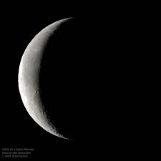
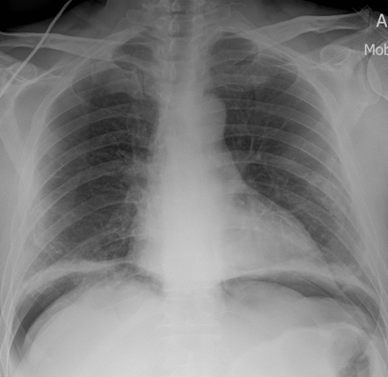
Crescent Sign II
Free air under the diaphragm
Best demonstrated on upright chest x rays or left lat decub
Easier to see under right diaphragm ? Why?

Slide 22
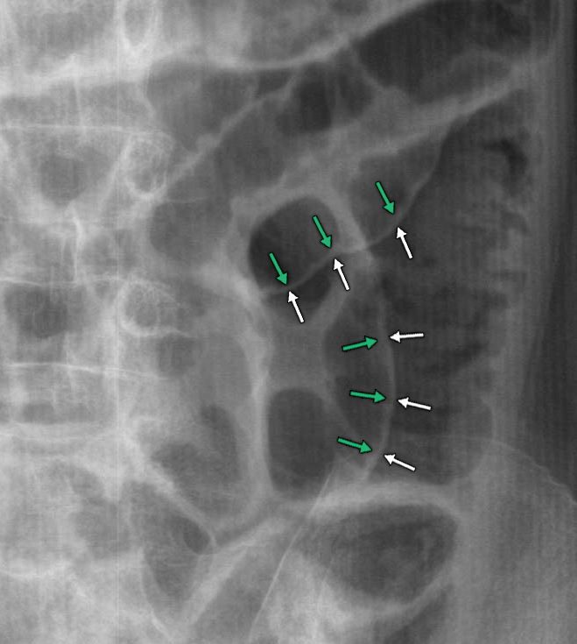
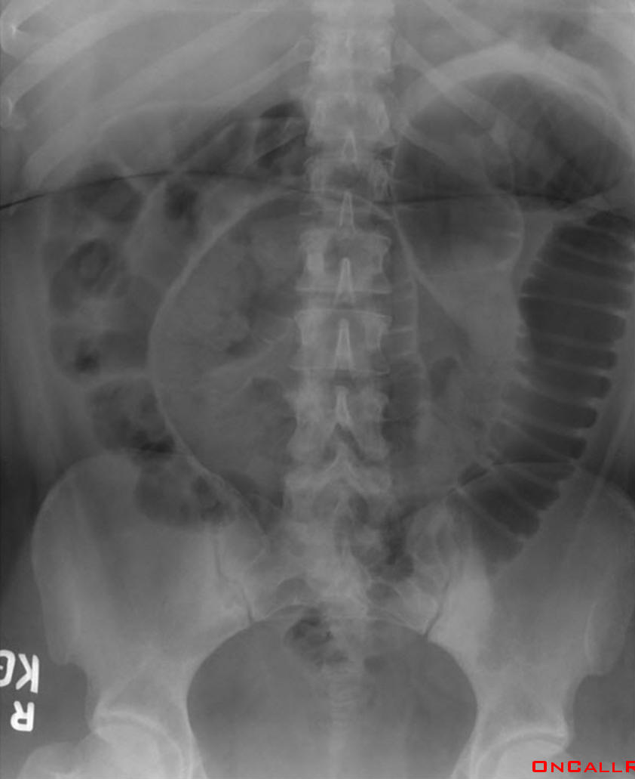
Rigler’s Sign
Bowel wall visualised on both sides due to intra and extraluminal air
Usually large amounts of free air
May be confused with overlapping loops of bowel, confirm with upright view

Slide 23
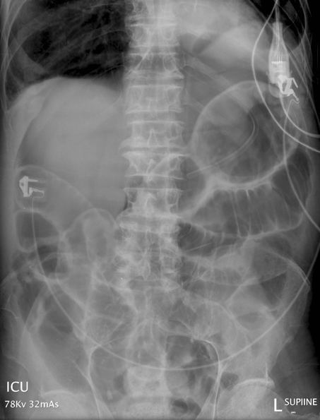
Football Sign
Seen with massive pneumoperitoneum
Most often in children with necrotising enterocolitis
In supine position air collects anterior to abdominal viscera
Paediatric
Adult

Slide 24
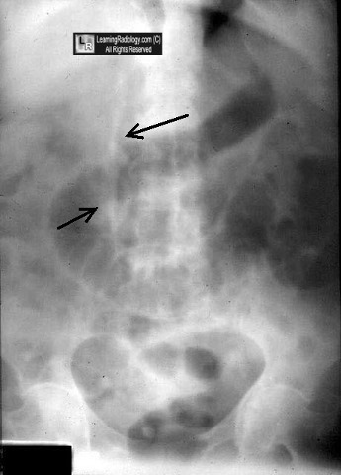
Falciform ligament sign
Normally invisible.
Supine film, free air rises over anterior surface of liver

Slide 25
Soft tissue masses
Organomegaly
Know normal landmarks
CT, US and MRI have essentially replaced conventional radiography in the assessment of organomegaly and soft tissue masses

Slide 26
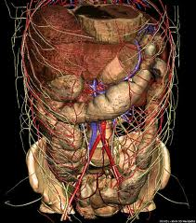
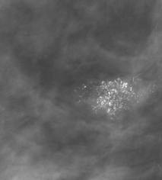
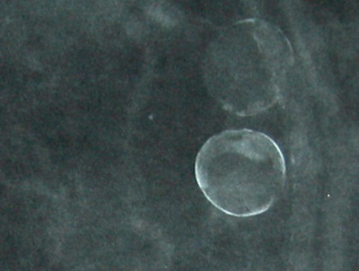
Abdominal Calcifications
Location Pattern

Slide 27
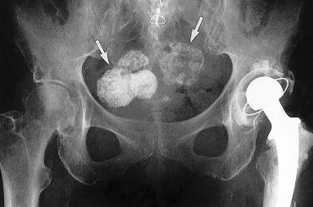
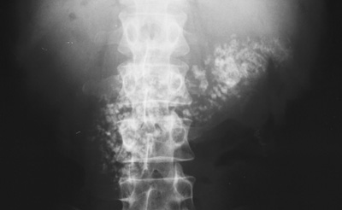
Calcified enteric lymph nodes
Calcified fibroids
Calcified pancreas
Floccular

Slide 28
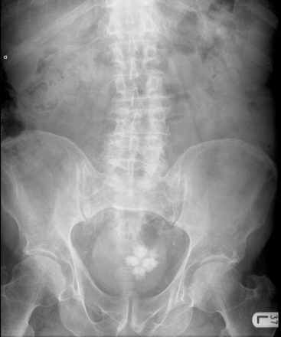
Bladder calculi
Lamellar

Slide 29
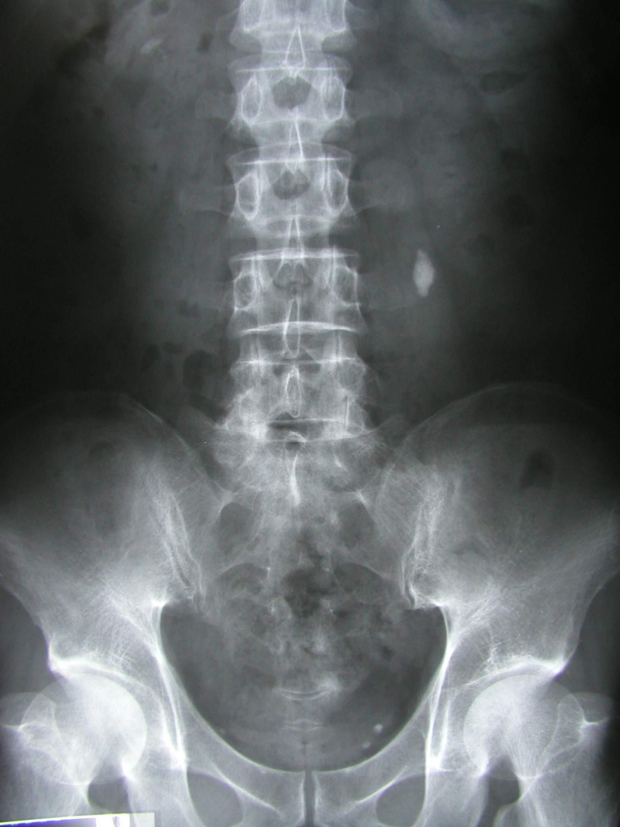
Renal calculi
Pelvicalyceal calcifications

Slide 30
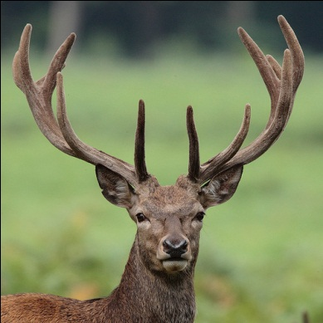
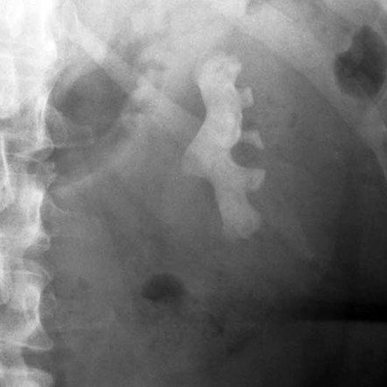
Staghorn Calcification
Renal stones are often small, but if large can fill the renal pelvis or a calyx, taking on its shape which is likened to a staghorn.
Tubular

Slide 31
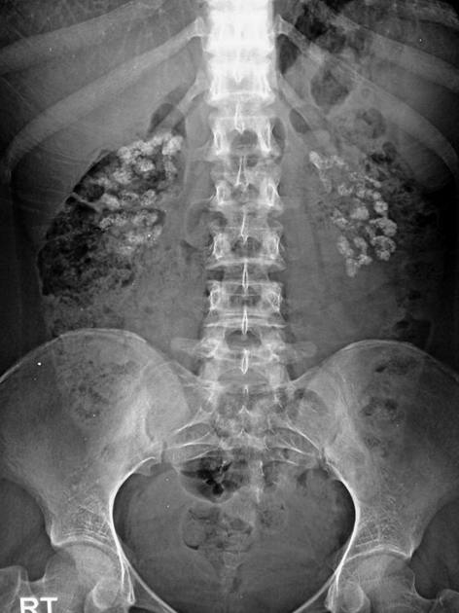
Renal calculi
Parenchymal calcification
Nephrocalcinosis
Uncommonly the renal parenchyma can become calcified.
This is known as nephrocalcinosis, a condition found in disease entities such as medullary sponge kidney or hyperparathyroidism.
Flocculent

Slide 32
Floruscopy
We are using a contrast material for better visualization of hollow organs, such as bowel loops and KUB.
It is useful to assess the mucosal pathology.
We can use either oral or rectal contrast
If we use rectal contrast; we can use either:
Single contrast barium enema.
Double contrast barium enema.

Slide 33
Small bowel contrast study (enema)

Slide 34
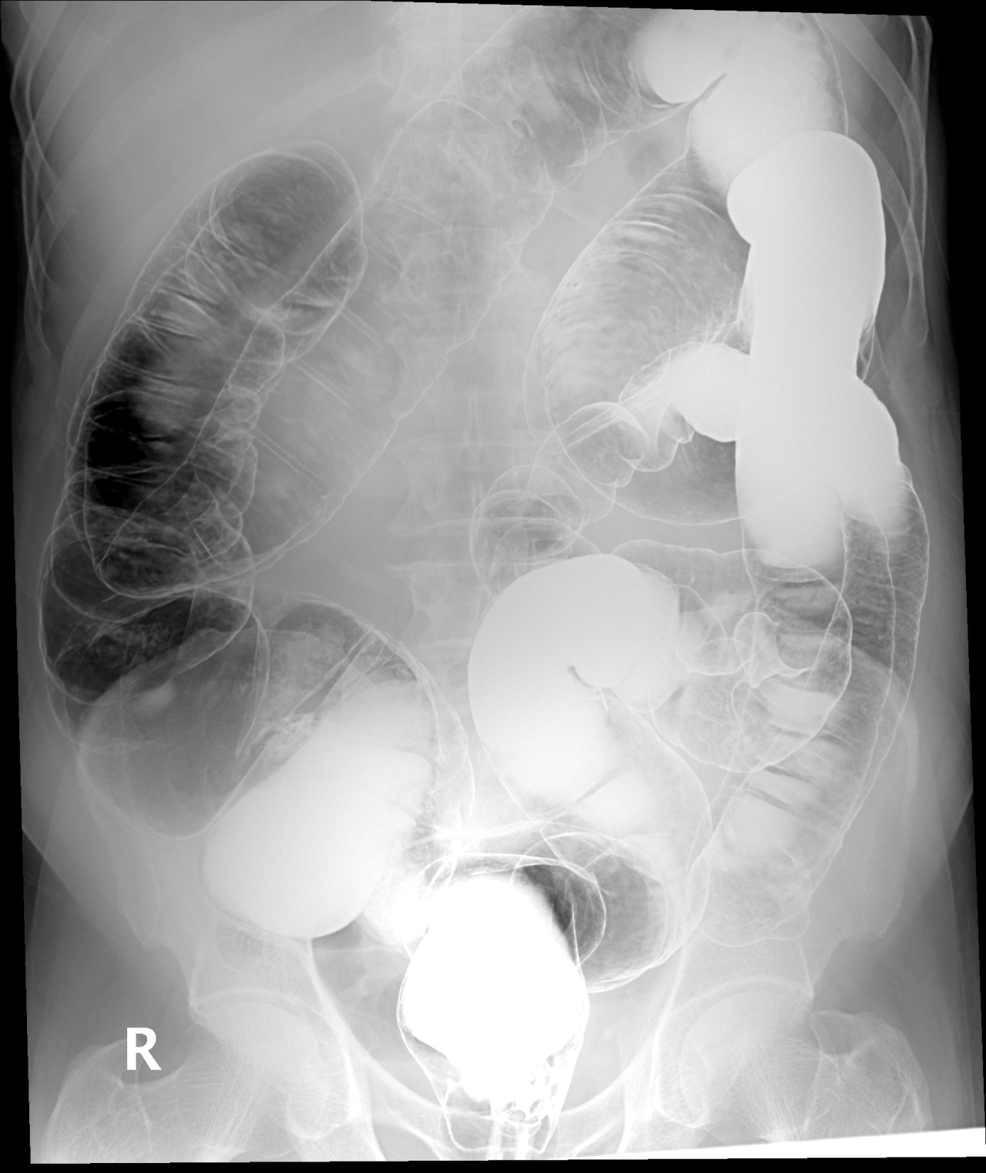
What type of this study?
Single or double?
5
4
6
3
7
2
8
1

Slide 35
4
5
6
Rectum
Sigmoid colon
Descending colon
Splenic flexure
Transverse colon
Hepatic flexure
Ascending colon
cecum
3
7
2
8
1

Slide 36
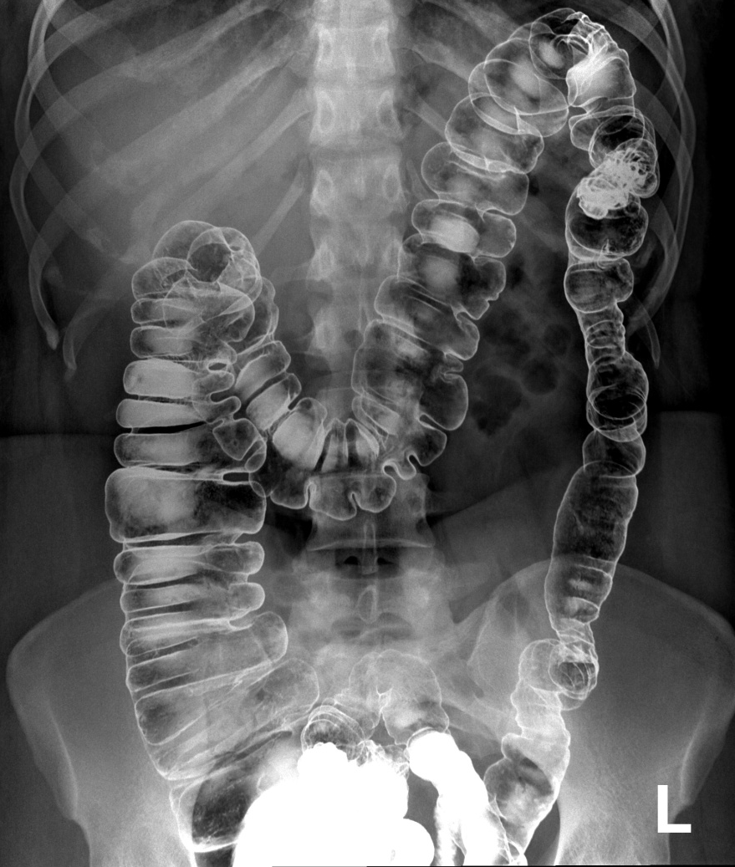

Slide 37
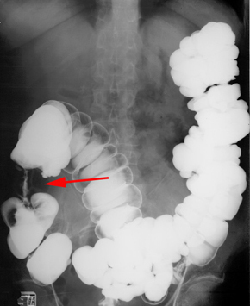
Is this study normal or abnormal? And why?

Slide 38
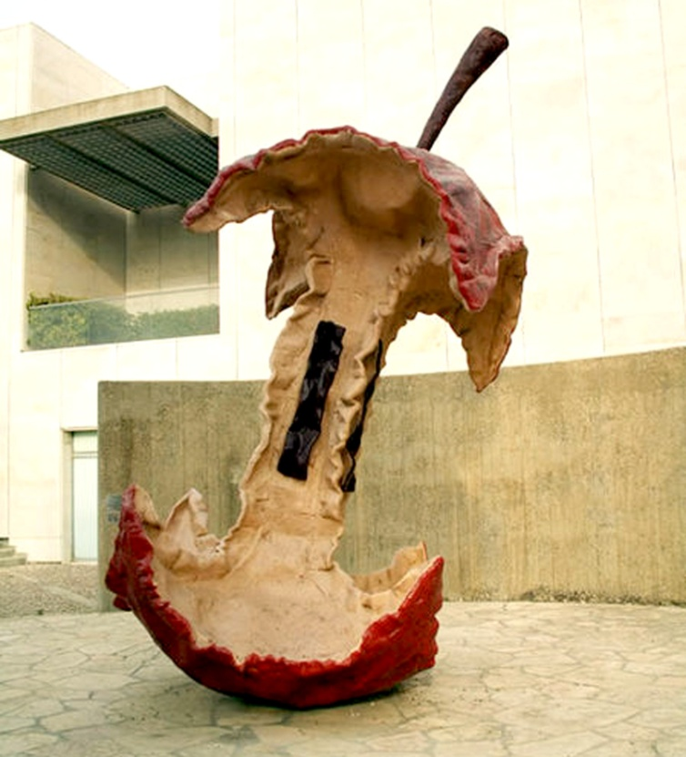
Abnormal study
Colon Cancer (apple core sign)

Slide 39
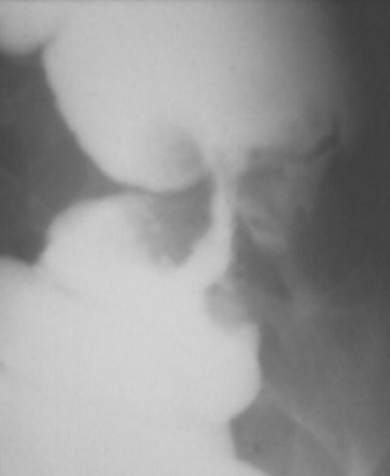
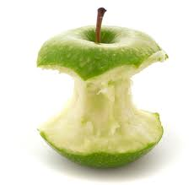
Apple core sign

Slide 40
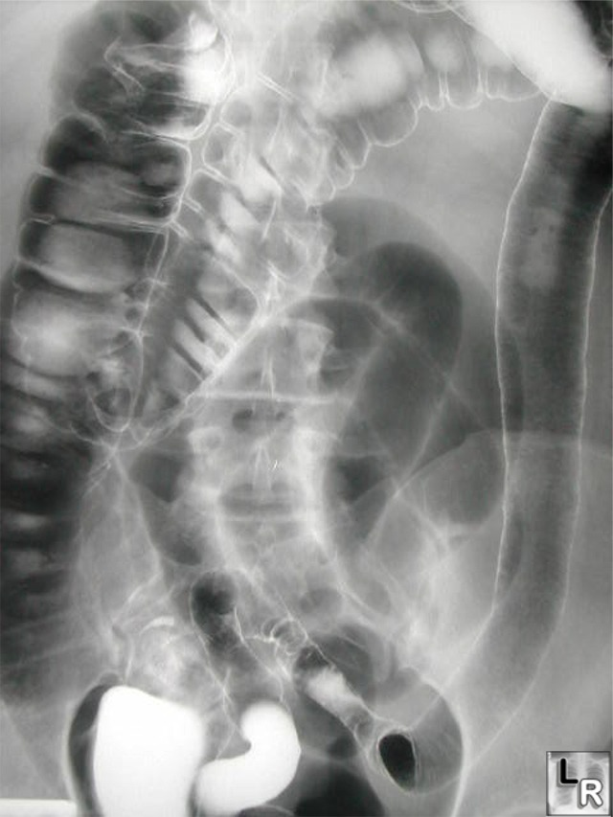
Lead pipe colon
Shortening of colon secondary to fibrosis
Loss of haustration
Ulcerative colitis

Slide 41
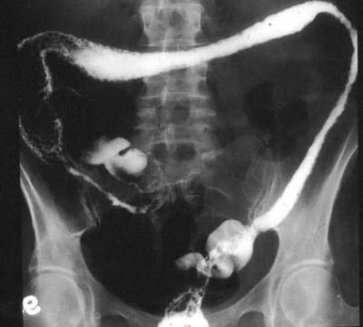
Normal
Abnormal

Slide 42
CT Scan
It is an ionizing radiation.
Corss-sectional imaging.
Better anatomical visualization.

Slide 44
5
2
1
6
4
3

Slide 45
5
2
1
6
4
3
1- Rectum 2-Sigmoid colon 3-Descending colon 4-Ascending colon 5-Transverse colon 6-Cecum

Slide 46
3
2
4
1
5
6

Slide 47
3
2
4
1
5
6
Descending colon
Splenic flexure
Hepatic flexure
Ascending colon
cecum
Sigmoid colon

