Slide 1
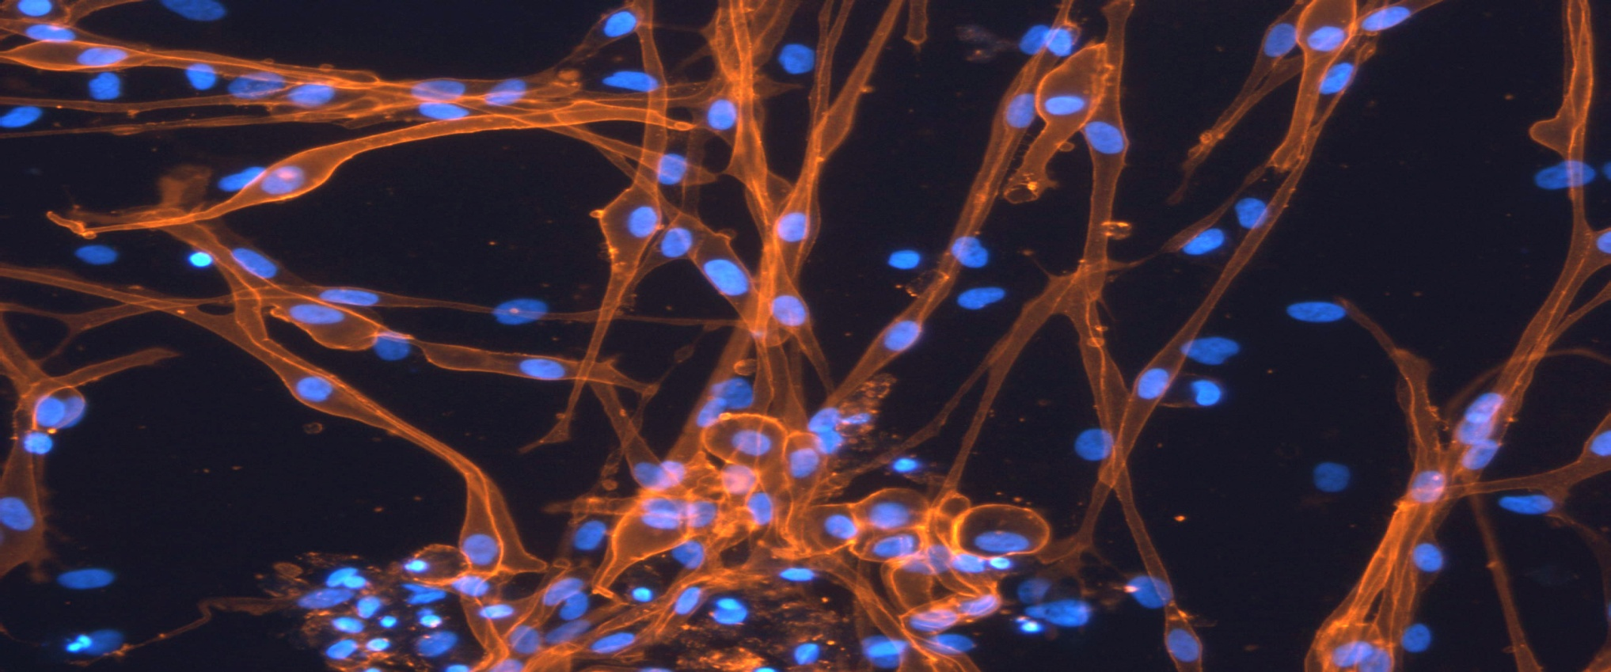
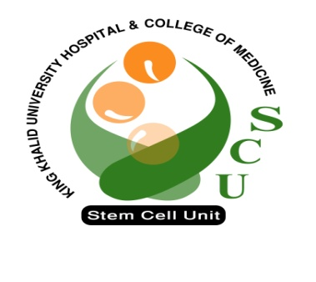
Introuduction to Stem Cell Research
BY : Dr. Amer Mahmood
Dalia Ali

Slide 2
Introducing….stem cells!
Notes:
2
This slide is designed to be interactive.
Start with a question like “What do you think of when someone mentions stem cells?” and allow the students to suggest key words.
At the click of a mouse in will come key words associated with stem cell research.

Slide 3
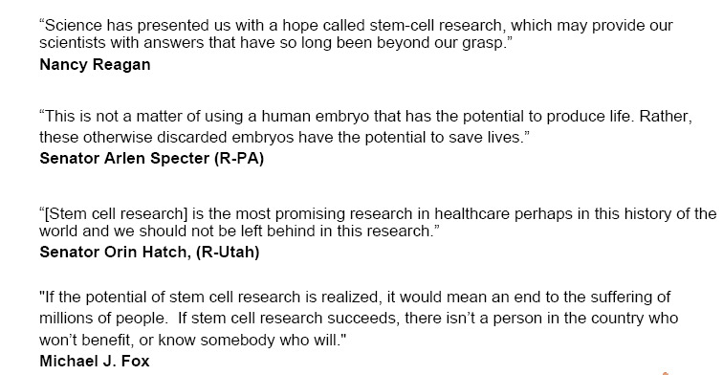
Importance of Stem Cell Research

Slide 4
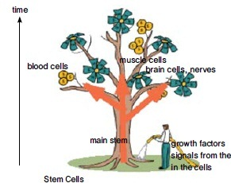
Stem Cells

Slide 5
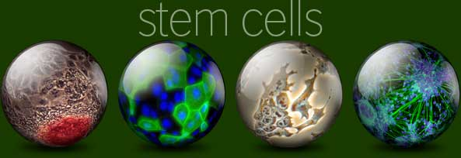
What are Stem Cells
A cell that has the ability:
to continuously divide
to give rise to new copy of itself (self-renew)
and other specialized ( differentiated ) cells/tissues.
Stem cells divide to new cell that has the potential to either remain a stem cell or become another type of cell with a more specialized function as cells of the blood, heart, bones, skin, muscles, brain etc, serving as a sort of repair system for the body.

Slide 6
The History of Stem Cells
Almost 40 years ago, the field of stem cell therapeutics was launched with the isolation of the hematopoietic stem cell (HSCs)
It took another 10 years before mesenchymal stem cells (MSCs) were identified and utilized in the repair of connective tissues in pre-clinical models
In the early 1980’s the first embryonic stem cell (ESC) was isolated from a mouse in vitro fertilized embryo
In 1998, the first human embryonic stem cell (hESC) was isolated by James A Thomson
In late 2006 the group of Takahashi and Yamanaka reported the stimulation of cells of adult and embryonic origin to pluripotent stem cells called induced pluripotent stem (iPS) cells
Notes:
Stem cells derived from an early-stage human blastocyst (an embryo fertilized in vitro and grown approximately five days in culture) have the capacity to renew indefinitely, and can theoretically provide an unlimited supply of cells. It is also possible to derive stem cells from non-embryonic tissues, including amniotic fluid, placenta, umbilical cord, brain, gut, bone marrow, and liver. These stem cells are sometimes called "adult" stem cells, and they are typically rare in the tissue of origin.

Slide 7
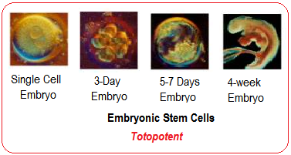
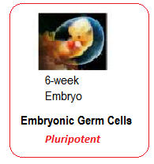
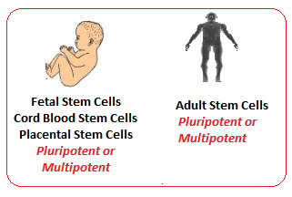
Sources and Types of Stem Cells

Slide 8
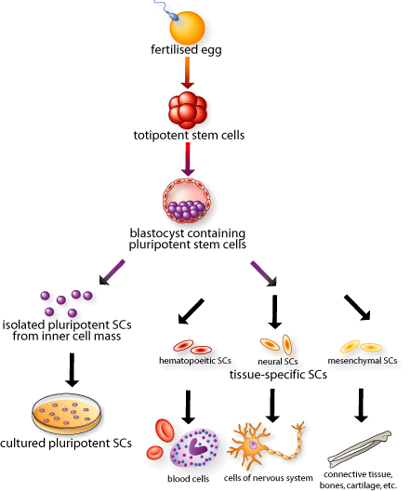
Totipotent
This cell
Can form the
Embryo and placenta
Pluripotent
This cell
Can just form the
embryo
Multi-
potent
Fully mature
Notes:
8
CLICK! This diagram will eventually show the entire range of development, from fertilized egg to mature cell types in the body.
Each cell in the 8-cell embryo, here in red, can generate every cell in the embryo as well as the placenta and extra-embryonic tissues. These cells are called CLICK! TOTIPOTENT stem cells. Why are they called totipotent? (wait for answers) Because one red cell can potentially make all necessary tissues for development. CLICK!
During In Vitro Fertilization, can parents choose whether their baby is going to be a boy or a girl? (wait) Yes, there is a widely-practiced procedure called pre-implantation genetic diagnosis, where one cell is removed from the 8-cell embryo and its DNA is examined. What might you look for when trying to identify the embryo’s sex? (wait) If there’s an X and Y chromosome it’s a boy and if there are two X’s it’s a girl. The parents can decide whether to implant it. Also parents with a genetic disease might want to see if their baby has any identifiable genetic disorders and decide whether to implant based on this information. Pre-implantation genetic diagnosis doesn’t destroy the embryo. Scientists are attempting to adapt this pre-implantation genetic diagnosis procedure and use it to create a stem cell line from one single TOTIPOTENT cell, without destroying the embryo.
The embryonic stem cells inside the blastocyst, here in purple, can generate every cell in the body except placenta and extra-embryonic tissues. These are called CLICK! PLURIPOTENT stem cells…why? (wait for answers) Because they can differentiate into all the 200+ cell types in the body, but they do not form the placenta. CLICK! Pluripotent stem cells can be isolated and grown in culture, or left to develop into more specialized cells in the body.
CLICK! Adult stem cells or tissue-specific stem cells have restricted lineages. Adult stem cells show up when the three distinct layers form in the 14-day-old embryo, and are present in the fetus, baby, child, and so forth. Adult just means they’ve gone further down their lineage pathway than the initial stem cells in the embryo. They are called CLICK! MULTIPOTENT stem cells because they will only become mature cells from the tissue in which they reside. Adult stem cells are present throughout your life and replace fully mature CLICK!, yet damaged and dying cells.
So to review (if time): TOTIPOTENT stem cells come from embryos that are less than 3 days old. These cells can make the TOTAL human being because they can form the placenta and all other tissues. PLURIPOTENT stem cells come from embryos that are 5-14 days old. Embryos and fetuses that are older than 14 days DO NOT contain pluripotent cells. These cells can form every cell type in the body but not the placenta. MULTIPOTENT stem cells are also called adult stem cells and these appear in the 14 day old embryo and beyond. At this point these stem cells will continue down certain lineages and CANNOT naturally turn back into pluripotent cells or switch lineages.

Slide 10
Generation of embryonic stem cells

Slide 11
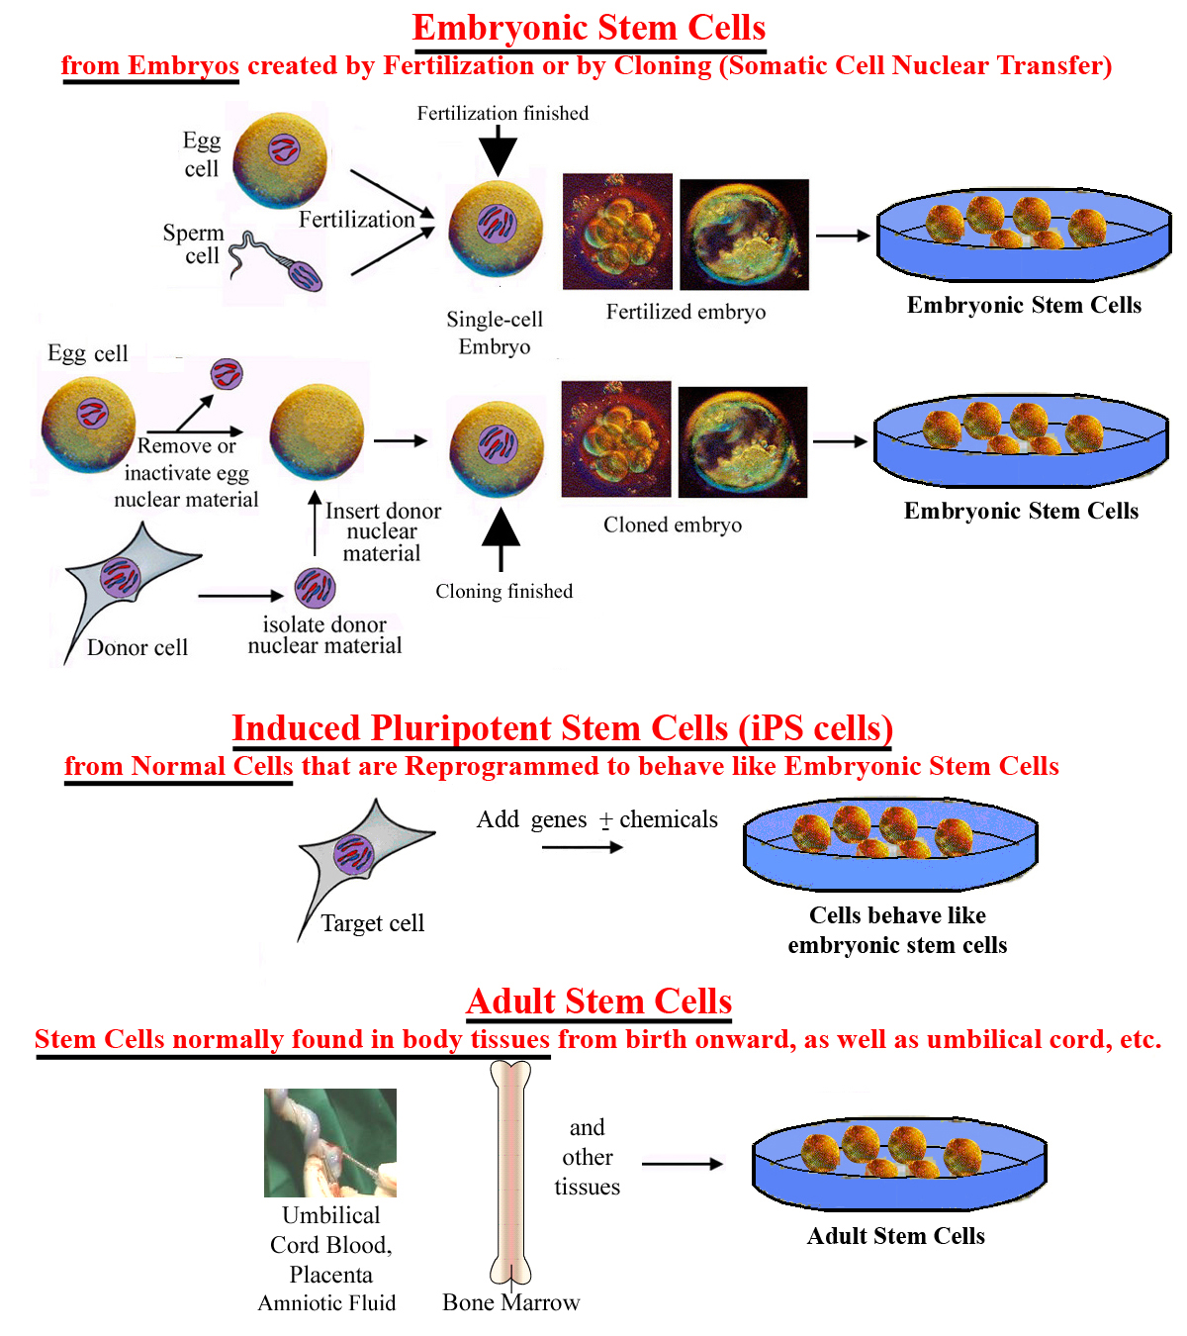

Slide 12
Challenges with Embryonic Stem Cells
Stem cells need to be differentiated to the appropriate cell types before they can be used clinically.
Recently, abnormalities in chromosome number and structure were found in three human ESC lines.
Stem cell development or proliferation must be controlled once placed into patients.
Possibility of rejection of stem cell transplants as foreign tissues is very high.
The use of mouse “feeder” cells to grow ESC could result in problems due to xenotransplantation.

Slide 13
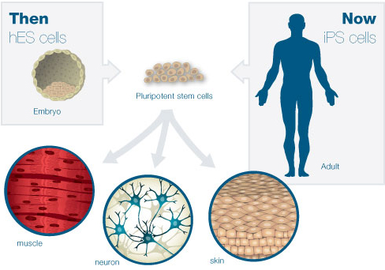

Slide 14
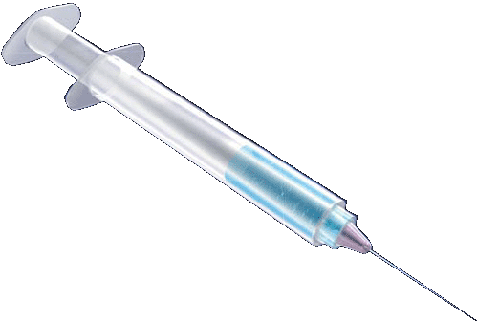
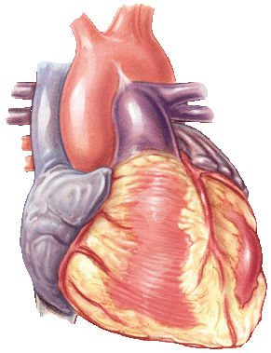
Use of Pluripotent Stem Cells
Isolate inner cell mass
(destroys embryo)
Outer cells
(forms placenta)
Inner cells
(forms fetus)
Culture cells
Day 5-6
Blastocyst
“Special sauce” (largely unknown)
Beta-cells
Heart
repaired
Neurons
Heart muscle
Notes:
The inner cell mass (the part that would form the fetus) of the embryo is isolated and disrupted to form embryonic cell lines. This process destroys the embryo. Under special culture conditions, the cells of the embryonic lines can be coaxed to form certain kinds of differentiated cell types. In theory, these differentiated cells could be used to repair or replace defective cells or tissues.

Slide 15
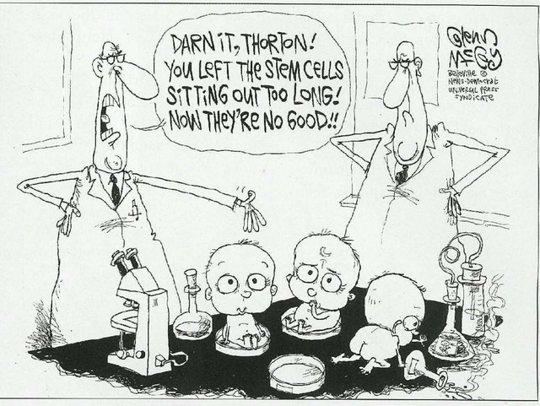

Slide 16
Notes:
The reason I am testifying before you today is that this cartoon tells the truth: it’s not possible to discuss stem cells without creating an ethical dilemma or bogging down in an ethical quagmire. I hope to show you a way out of the swamp without getting our feet too muddy.

Slide 17
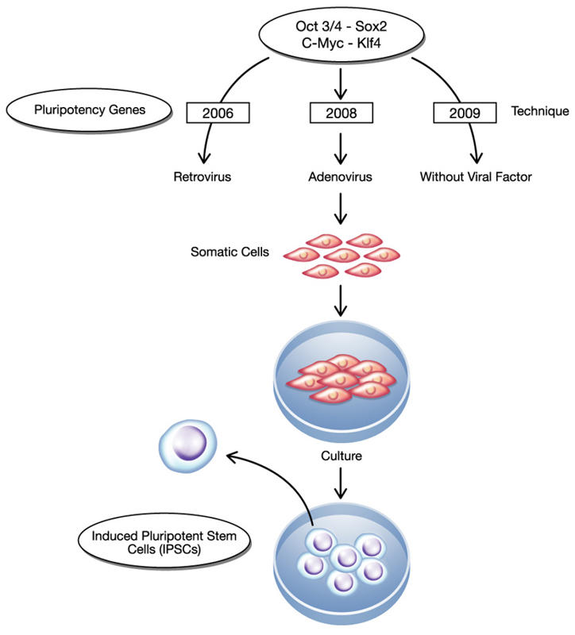
Induced Pluripotent Stem Cell (iPS) cells
The method was described by Yamanaka and Takahashi in which the skin cells of laboratory mice were genetically manipulated and returned back to their embryonic state.
iPS are somatic cells that have been reprogrammed to a pluripotent state (embryonic stem cell like state).
Several difficulties are to be overcome before iPS cells can be considered as a potential patient-specific cell therapy. It will be crucial to characterize the development potential of human iPS cell line in the future.

Slide 18
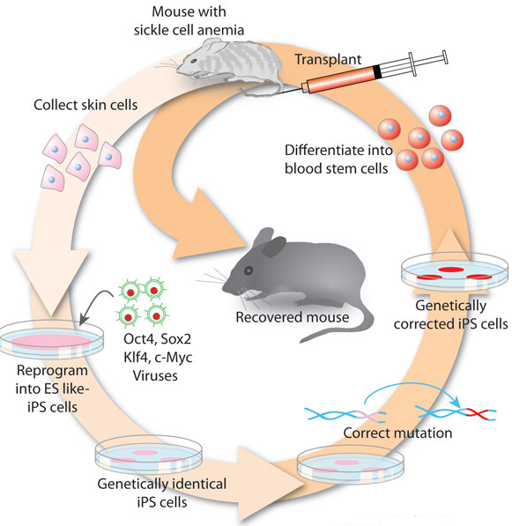
iPS
Skin cells were taken from the tail tip of a sickle-cell model mouse.
The cells were differentiated into hematopoietic cells.
The produced cells were transfused back into the sick mouse
Hanna J. et.al., 2007

Slide 19
Goal of Stem Cell Therapies
The goal of stem cell therapies is to promote cell replacement in organs that are damaged and do not have the ability for self repair

Slide 20
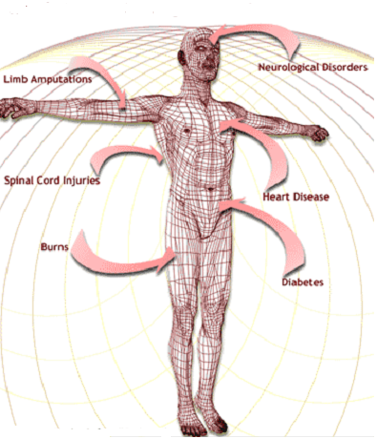
The Promise of Stem Cell Technology
Replacement of tissues/organs
Repair of defective cell types.
Study cell differentiation
Toxicity testing.
Understanding prevention and treatment of birth defects.
Study of development and gene control.
Study of drugs therapeutic potential.

Slide 21
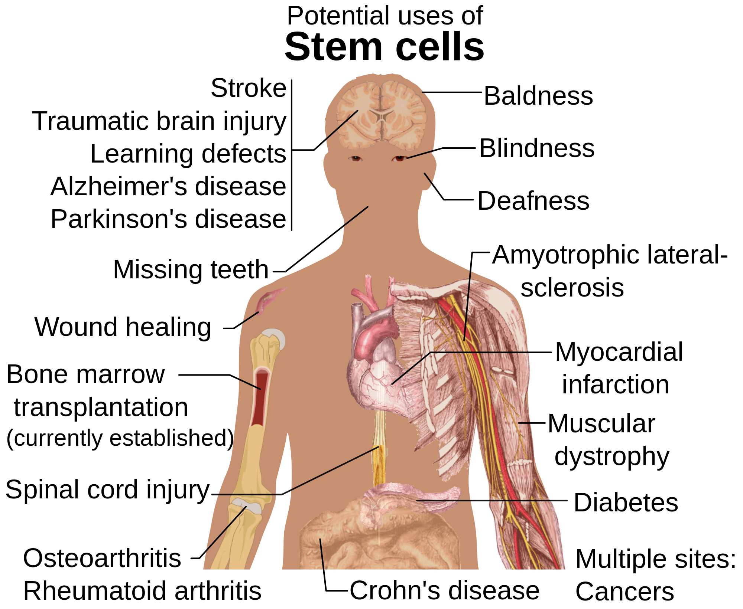

Slide 22
Obstacles of Stem Cell Research
How to find the right type of stem cells?
How to completely differentiate Stem Cells to desired cell type?
How to put the stem cells into the right place?
Will the stem cells perform the desired function in the body?
Differentiation protocols for many cell types have not been developed.

Slide 23
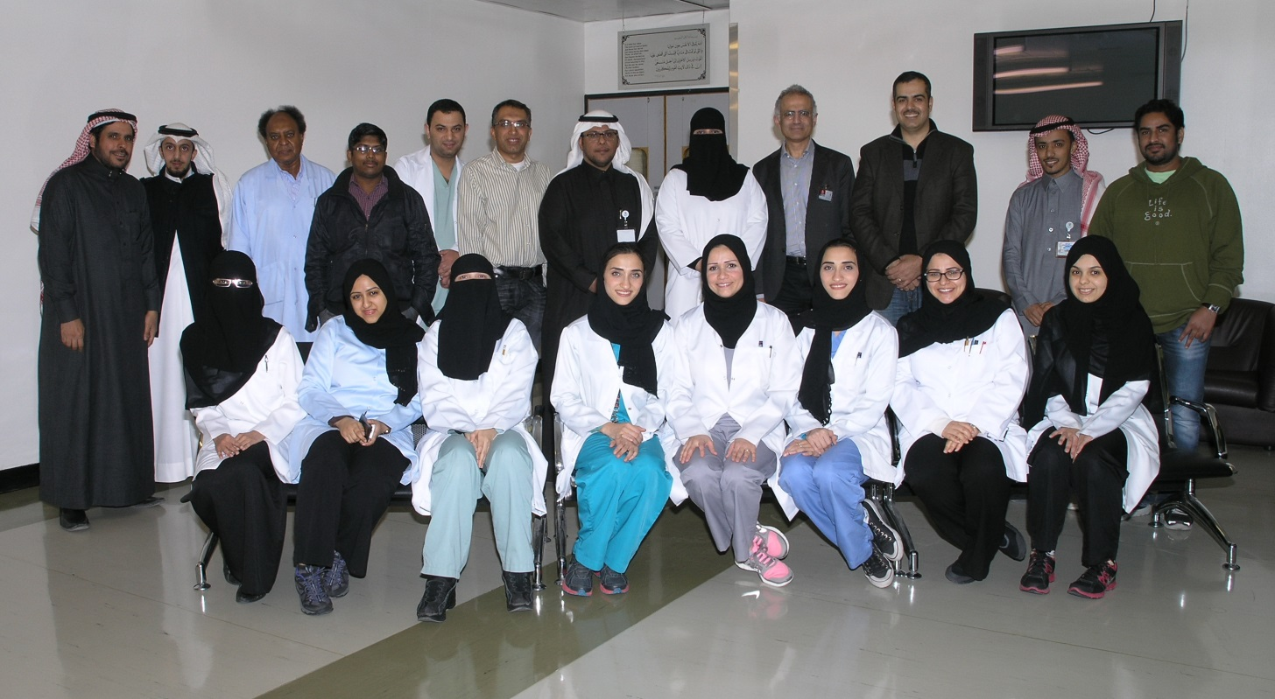
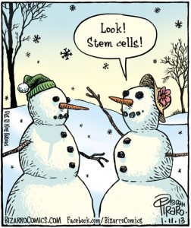
Thank You

