Slide 1
Glucose-6-Phosphate Dehydrogenase
(G6PD) Deficiency Anemia
By
Amr S. Moustafa, MD, PhD
Clinical Chemistry Unit, Pathology Dept.
College of Medicine, King Saud University

Slide 2
Objectives:
The biochemical basis of G6PD deficiency anemia
The precipitating factors for G6PD deficiency anemia
Classes of G6PD deficiency anemia (variant enzyme)
Diagnosis of G6PD deficiency anemia

Slide 3
Background
Hexose monophosphate pathway (HMP) or Pentose Phosphate Pathway (PPP):
An alternative oxidative pathway for glucose
No ATP production
Major pathway for NADPH production
Produces ribose-5-phosphate for nucleotide synthesis

Slide 4
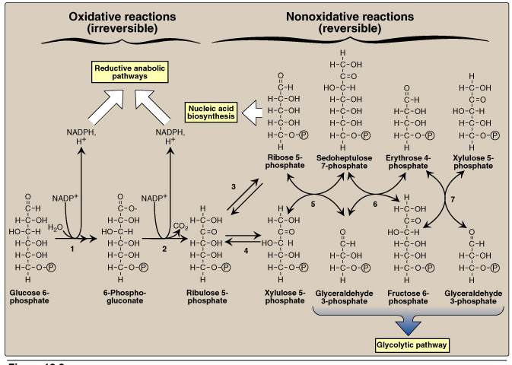
Pentose Phosphate Pathway (PPP)
Glucose-6-phosphate dehydrogenase

Slide 5
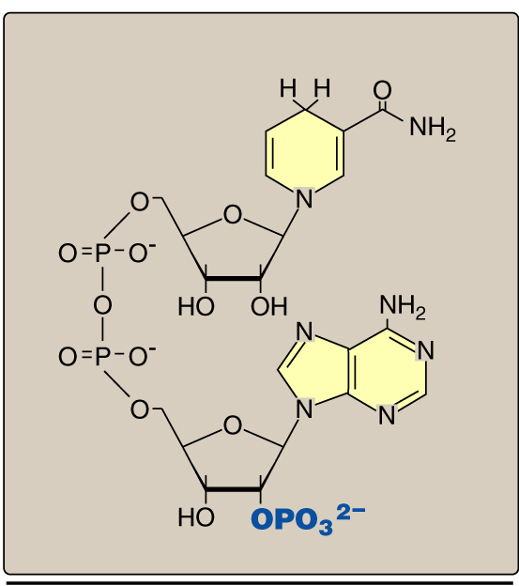
NADPH

Slide 6
Uses of NADPH
Reductive biosynthesis e.g., fatty acid biosynthesis
Antioxidant (part of glutathione system)
Oxygen-dependent phagocytosis by WBCs
Synthesis of nitric oxide (NO)

Slide 7
Reactive Oxygen Species (ROS)
Oxygen-derived Free radicals: e.g., Superoxide and hydroxyl radicals
Non-free radical: Hydrogen peroxide

Slide 8
Antioxidant Mechanisms

Slide 9
Glutathione System
Selinium

Slide 10
Oxidative Stress
Imbalance between oxidant production
and antioxidant mechanisms
Oxidative damage to:
DNA
Proteins
Lipids (unsaturated fatty acids)
Oxidative stress and diseases:
Inflammatory conditions e.g., Rheumatoid arthritis
Athersclerosis and coronary heart diseases
Obesity
Cancers
G6PD deficiency hemolytic anemia

Slide 11
G6PD Deficiency Hemolytic Anemia
Inherited X-linked recessive disease
Most common enzyme-related hemolytic anemia
Highest prevalence: Middle East, Tropical Africa
Asia and Mediterranean
~400 different mutations affect G6PD gene, but only some
Can cause clinical hemolytic anemia
G6PD deficient patients have increased resistance to
Infestation by falciparum malaria

Slide 12
Biochemical Basis of
G6PD Deficiency Hemolytic Anemia

Slide 13
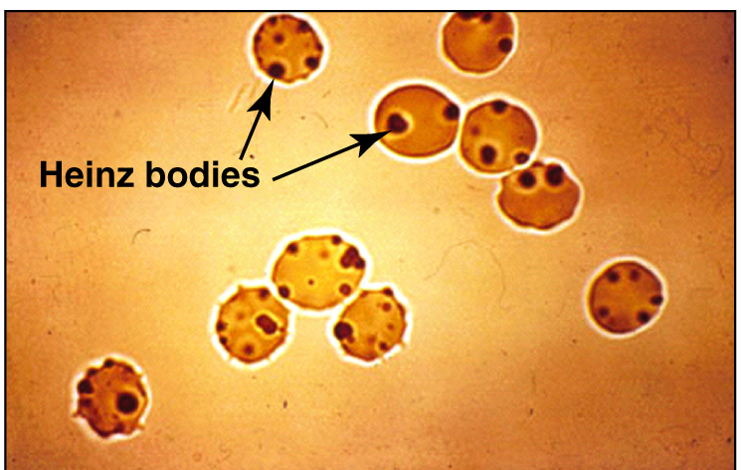
Biochemical Basis of
G6PD Deficiency Hemolytic Anemia
Oxidation of sulfhydryl groups of proteins inside RBCs
causes protein denaturation and formation of insoluble
masses (Heinz bodies) that attach to RBCs membranes

Slide 14
Biochemical Basis of
G6PD Deficiency Hemolytic Anemia
CONT’D
Although G6PD deficiency affects all cells,
it is most severe in RBCs …… Why?
Other cells have other sources for NADPH production:
e.g., Malic enzyme that converts malate into pyruvate

Slide 15
Precipitating Factors for
G6PD Deficiency Hemolytic Anemia
G6PD deficient patients will develop hemolytic attack upon:
Intake of oxidant drugs (AAA):
Antibiotics e.g., sulfa preparation
Antimalarial: e.g., Primaquine
Antipyretics
Exposure to infection
Ingestion of fava beans (favism, Mediterranean variant)
Chronic nonspherocytic anemia: Hemolytic attack in absence
of precipitating factors. Severe form due to class I mutation

Slide 16
Different Classes of
G6PD Deficiency Hemolytic Anemia
The severity of the anemia
depends on the residual
enzymatic activity
More severe disease is
associated with less
enzymatic activity

Slide 17
Variant Enzymes of
G6PD Deficiency Hemolytic Anemia
G6PD A- (class III):
Moderate, young RBCs
Contain enzymatic activity
Unstable enzyme, but
Kinetically normal
G6PD Mediterranean (II)
Enzyme with normal stability
but low activity (severe)
Affect all RBCs
(both young and old)

Slide 18
Diagnosis of
G6PD Deficiency Hemolytic Anemia
Diagnosis of hemolytic anemia
CBC and reticulocytic count
Screening:
Qualitative assessment of G6PD enzymatic activity
(UV-based test)
Confirmatory test:
Quantitative measurement of G6PD enzymatic activity
Molecular test:
Detection of G6PD gene mutation

