Slide 1
Sensitivity
Sensitivity answers the following question:
If a person has a disease, how often will the test be positive (true positive rate)? i.e.: if the test is highly sensitive and the test result is negative you can be nearly certain that the individuals don’t have disease. A Sensitive test helps rule out disease (when the result is negative). Sensitivity rule out or "Snout“
true positives
Sensitivity=
X 100
true positive + false negative

Slide 2
2 X 2 Contingency Table
Test | Disease
 | + | -
+ | True Positive (TP) | False Positive (FP)
- | False Negative (FN) | True Negative (TN)
TP
Sensitivity=
X 100
TP+ FN

Slide 3
Specificity
Specificity answers the following question:
If a person does not have the disease how often will the test be negative (true negative rate)?
i.e., if the test result for a highly specific test is positive you can be nearly certain that the individuals actually have the disease. A very specific test rules in disease with a high degree of confidence (when the result is positive).
Specificity rule in or "Spin"
true negatives
Specificity=
X 100
true negatives + false positives

Slide 4
2 X 2 Contingency Table
Test | Disease
 | + | -
+ | True Positive (TP) | False Positive (FP)
- | False Negative (FN) | True Negative (TN)
TN
Specificity=
X 100
TN+ FP

Slide 5
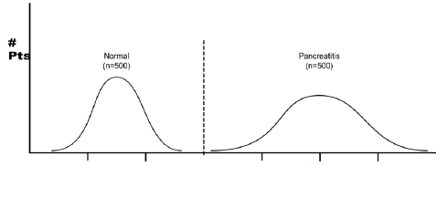
An ideal diagnostic lab test results for many subjects (normal and patients)
Normal
N = 500
Hepatitis
N= 500
A perfect test for acute hepatitis:
The test identifies ALL patients with disease and All subjects without disease 100% of the time.

Slide 6
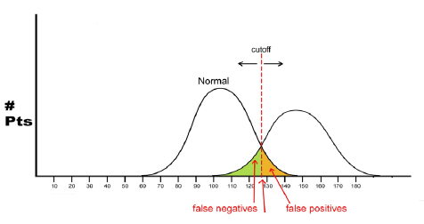
In most diagnostic lab tests, this is not the case..
Acute hepatitis
Normal
Disease
Serum bilirubin level
The lab test results in normal and disease conditions overlap.
To increase the overall accuracy of the test, the centermost point of overlapping is chosen as the cutoff value.
There are some normal subjects who will have a positive results (False positives)
There are some patients who will have negative results (False negatives)

Slide 7
Example of calculation
A Lab test to measure serum bilirubin was performed on 1000 individuals. The test gave the following results:
Number of positive results in patients with acute hepatitis: 440
Number of positive results in normal subjects: 50
Number of negative results in normal subjects: 450
Number of negative results in patients with acute hepatitis: 60
For this Serum bilirubin test, calculate the following quality measures:
The sensitivity
The specificity

Slide 8
Test | Disease
 | + | -
+ | TP | FP
- | FN | TN
Test | Disease
 | + | -
+ | 440 | 50
- | 60 | 450
Answer: draw a
2 X 2 Contingency Table
TP
440
Sensitivity= 88%
Sensitivity=
X 100
=
X 100
=
0.88 x100
TP+ FN
440+ 60
TN
450
Specificity= 90%
Specificity=
X 100
=
X 100
=
0.90x100
450+ 50
TN+ FP

