Slide 1
A 57-year-old presents with a history of a retrosternal burning sensation, particularly after large meals, and often on retiring to bed at night. Treatment with antacids has had little effect and he has been referred for endoscopy.

Slide 2
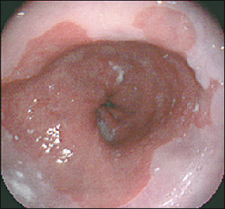
Upper gastrointestinal tract endoscopy reveals reddening of the lower esophageal mucosa
There is no evidence of a hiatus hernia. The proximal border of the reddened area is irregular, and this area is biopsied.

Slide 3
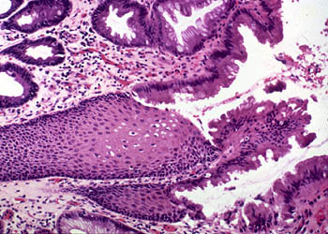
The biopsy shows intestinal-type glandular mucosa.

Slide 4
1. What is the likely cause of the symptoms?
1. The symptoms of ‘heartburn’ are suggestive of gastroesophageal reflux disease (GORD), with or without the presence of a hiatus hernia. Other important causes of retrosternal pain should not be overlooked, including cardiovascular causes, especially myocardial ischaemia, as well as other rarer causes including pneumothorax and musculoskeletal pain.

Slide 5
2. What is the final diagnosis?
2. The endoscopic and biopsy appearances confirm a Barrett’s oesophagus. This is a metaplastic process which develops as a result of persistent reflux of gastric contents into the esophagus, the normal squamous mucosa being replaced by glandular mucosa of intestinal type.

Slide 6
3. What further information do you require from the biopsy report?
3. It is important to look for dysplastic change in the biopsy which may herald the development of adenocarcinoma.

Slide 7
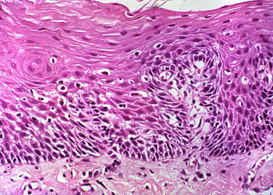
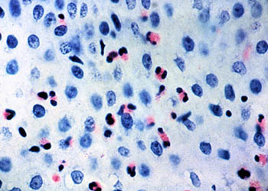
The patient is a 51-year-old white man who presented 10 years before surgery with a history of heartburn, regurgitation, and epigastric pain. Endoscopy was performed, and a large erythematous area involving the distal esophagus was noted. Biopsy specimens were taken

Slide 8
The patient was treated with antireflux drugs and given a follow-up appointment in 1 year. The patient returned 3 years later, complaining of dysphagia, heartburn, and epigastric pain. Endoscopy was performed again and revealed that the normal white squamous mucosa lining the distal esophagus was replaced by pink mucosa. Biopsy specimens were taken.

Slide 9
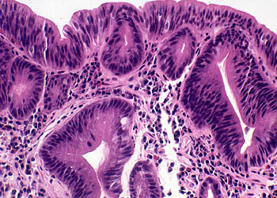
Because of the diagnosis of Barrett esophagus, the patient was enrolled in a surveillance program, and yearly endoscopic procedures were recommended. Endoscopy showed extensive Barrett esophagus 6 years before surgery, and biopsy specimens showed features of
dysplasia.

Slide 10
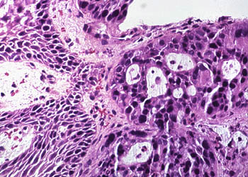
He failed to return for subsequent surveillance endoscopy. The patient was admitted with increasing dysphagia 1 month before surgery. An upper GI series (radiographs) revealed distal narrowing of the esophagus. Endoscopic examination of the esophagus revealed an ulcerating mass in the distal esophagus. A biopsy specimen was obtained.

Slide 11
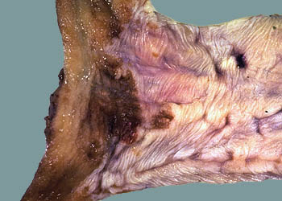
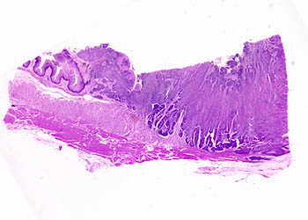
The patient was taken to surgery, where an esophagogastrectomy was performed.

Slide 12
A 52-year-old male presents with epigastric pain that improves with meals. Endoscopy demonstrates a 2 Cm ulcerated area located 3 cm distal to the pyloric junction. Which of the following is most likely to have made the strongest contribution to the development of this disease?
A. Aspirin use
B. Chronic antacid use
C. Drinking alcohol
D. Helicobacter pylori infection
E. Smoking

Slide 13
The correct answer is D. The patient has a duodenal peptic ulcer. The strongest risk factor for duodenal peptic ulcer is Helicobacter pylori infection, which is found in almost 100% of these cases (contrast to 70% Infection rate in gastric peptic ulcer).
Aspirin use (choice A) and ethanol use (choice C) are more strongly implicated in gastric ulcer disease than duodenal ulcer disease.
Chronic antacid use (choice B) is seen as a result of peptic ulcer disease, not as a cause of it.
Smoking (choice E) may also be a lesser contributing factor to the development of peptic ulcer.

Slide 14
All of the following are causes of acute peptic ulcer except
Severe burns
Helicobacter pylori infection
Major trauma
Zollinger-Ellison syndrome

Slide 15
All of the following are Defensive Factors against gastric ulcer development except
Mucus
Bicarbonate
Bile salts
Prostaglandins
Phospholipid

Slide 16
A
B
H. pylori
Phospholipid
Drugs (NSAIDs)
Mucus
bicarbonate
Blood flow
Acid
pepsin
Bile salts
cell renewal
Prostaglandins
Aggressive Factors
B. Defensive Factors

Slide 17
A 49-year-old secretary presents to medical outpatients with a 7-month history of epigastric pain. She has been treated with antacids by her GP, but this has not controlled the symptoms. In the clinic, she complains of epigastric pains which are sharp and burning and radiate her subcostal margin to the right. The pain is worse at night and is relieved by food. On examination, there is epigastric tenderness and clinical signs of anaemia.
1. What is the possible cause of this clinical presentation?
Duodenal Peptic ulceration

Slide 18
2. What are the predisposing causes?
H PYLORI INFECTION
ACID HYPERSECRETION
3. What are the major complications?
3. The major complication is perforation of a vessel with subsequent gastro-intestinal haemorrhage. This can present as either hematemesis, melena or iron deficiency anemia. Other complications include fibrosis and adhesions.

Slide 19
4. What investigations should be performed?
Endoscopy
6. What is the treatment?
Proton pump inhibitors.
H² receptor antagonists.
H. pylori eradication therapy

Slide 20
The patient is a 72-year-old white man with a history of homelessness, chronic obstructive pulmonary disease, chronic alcohol abuse, chronic dementia, and multiple episodes of upper GI bleeding.
He was admitted to the hospital with complaints of dizziness, syncope, and abdominal pain.
The abdominal examination revealed mild epigastric pain on palpation.
The rectal examinations……… black stool,
TEST | RESULT
Hemoglobin | 4.1 gm/dL
Hematocrit | 12.9%
Albumin | 2.6 gm/dL
WBC | 11,900/mm³
Ethanol | <10 mg/dL (normal: <10mg/dL)

Slide 21
The patient was admitted to the medical intensive care unit, where a nasogastric tube lavage produced coffee-ground gastric contents that tested positive for blood.
He was transfused with 6 U of packed RBCs, which increased his hematocrit to 38% (normal 40% to 52%).

Slide 22
What is your next step?

Slide 23
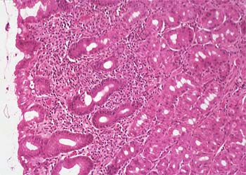
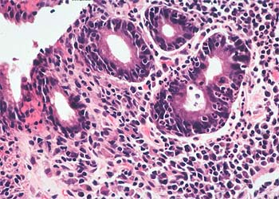
An upper GI tract endoscopy was performed, which showed a large (5 _ 5 cm) gastric ulcer in the antrum along the lesser curvature. Biopsy specimens were taken of the ulcers and surrounding mucosa.
Helicobacter pylori

Slide 24
