Slide 1
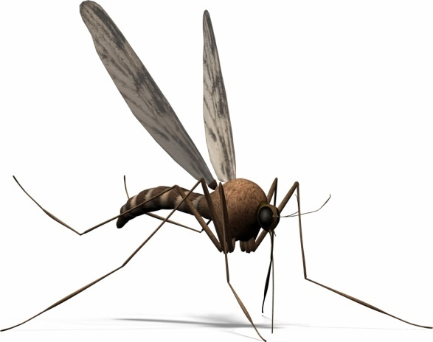
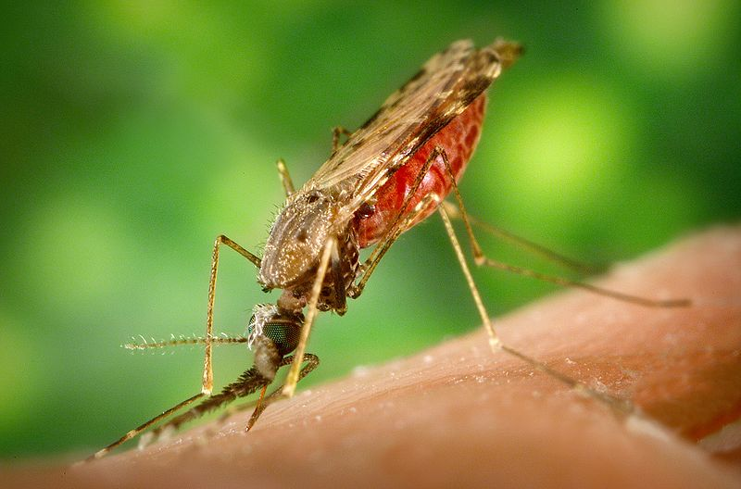
ANTIMALARIAL DRUGS

Slide 2
ANTIMALARIAL DRUGS
ILOs
By the end of this lecture you will be able to:
Classify the main antimalarial drugs depending on their target of action
Detail the pharmacokinetics & dynamics of main drugs used to treat attack or prevent relapses
Compare the mechanism and major ADRs of adjunctive drugs used in combinations
State the WHO therapeutic strategy for treatment

Slide 3
What are the Targets of Treating an infected patient?
Target of Therapy | Therapeutic Class | Drug Examples
To alleviate symptoms | Blood schizontocidal drugs | Artemisinin Chloroquine (in vivax only) Quinine (in pregnancy)
To prevent relapses | Tissue hypnotocidal (schizontocidal) drugs | Primaquine
To prevent spread | Gametocidal drugs | Primaquine
N.B. If patient has got infested by sporozoites  we want to protect against progression to Tissue Shizontocides  Primaquine

Slide 4
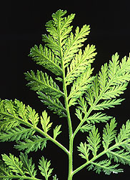
TREAT ATTACK
LACTONE ENDOPEROXIDES
ARTEMISININ
ARTEMISININ
ARTENUSATE
ARTEMETHER
Poor solubility
Soluble
Fast acting blood Schizontocide
Affect all forms including multi-drug resistant P. falciparum
Pharmacokinetics
Derivatives are rapidly absorbed orally
Rapidly biotransform in liver into artenimol active metabolite
Widely distributed
t½ artemisinin  4hrs / artesunate  45min / artemether 4-11hrs
Artemesia annua
Mechanism
They have endoperoxide bridges that are cleaved by haem iorn to yeild
carbon-centred free radicals, that will
Alkylate membranes of parasite’s food vacuole and mitochondria no energy
Irreversibly bind & inhibit sarco-endoplasmic reticulum Ca²⁺-ATPase of the parasite, thereby inhibiting its growth
Inhibiting formation of transport vesicles no food vacuoles

Slide 5
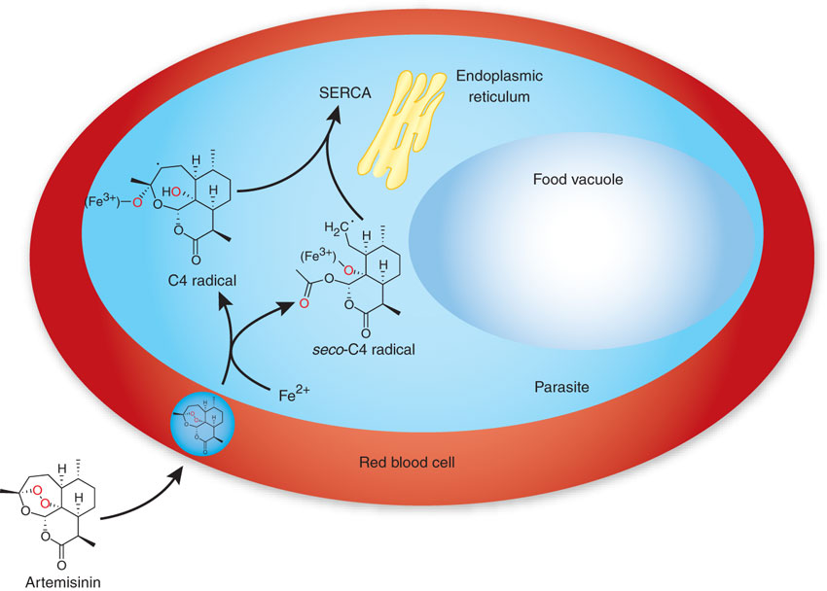
TREAT ATTACK
LACTONE ENDOPEROXIDES
ARTEMISININ
ARTEMISININ
ARTENUSATE
ARTEMETHER
ADRs
Transient heart block
↓neutrophil count
Brief episodes of fever
Neuro, hepato and bone marrow toxicity
Resistance 
was reported recently in Cambodia- Thailand border

Slide 6
TREAT ATTACK
LACTONE ENDOPEROXIDES
ARTEMISININ
ARTEMISININ
ARTENUSATE
ARTEMETHER
Preparations
Artesunate IV or IM preparations for severe complicated cases as cerebral malaria (24h) followed by complete course of ACT
Artemisin-based combination therapies (ACTs):
Artemether + lumefantrine
Artemether + amodiaquine
Artemether + mefloquine
Artemether + sulfadoxine-pyrimethamine
Artemisinin and its derivatives should not be used as monotherapy.(Recrudescence)

Slide 7
TREAT ATTACK
4-AMINOQUINOLINES
CHLOROQUINE
Chloroquine and Amodiaquine
Potent blood Schizontocide & a Gametoside
Can be active against all forms of the schizonts
(exception is chloroquine-resistant P.f. & P.v.)
Against P.v., P.o., P.f.
Pharmacokinetics
Rapidly & completely absorbed from the GIT
Has high volume of distribution(100-1000l/kg)
Concentrated into parasitized RBCs.
Released slowly from tissues
Metabolized in the liver
Excreted in the urine 70% unchanged
Initial t½ =2-3days & terminal t ½=1-2months
Chloroquine concentrates  1000-fold in food vacuole of parasite. Why ???
Its protonation & ion trapping due to  pH of vacuole
Its active uptake by a parasite transporter(s)
Its binding to a specific receptor in the food vacuole.

Slide 8
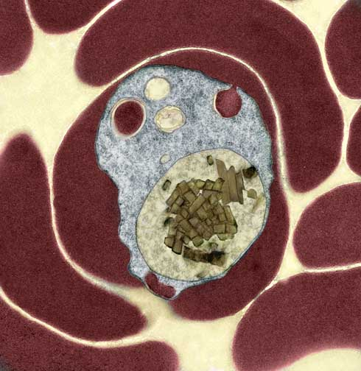
TREAT ATTACK
4-AMINOQUINOLINES
CHLOROQUINE
Mechanism
Malaria Parasite digest host cell’s Hb to obtain a.a.
Heme is released  Toxic
So parasite detoxifies it by heme polymerase  Hemozin (NonToxic) & traps it in food vacuole
RBC
Food vacuole
Malaria Parasite
(Hz)
(Heme)
(Hb)
(Hemozin)
(Heme)
(Hb)
X
Heme Polymerase
X
CHLOROQUINE
CHLOROQUINE
Peptides
concentrate inside acidic food vacuole
Lysis
N.B. It is used also in rheumatoid artheritis, SLE,….

Slide 9
TREAT ATTACK
4-AMINOQUINOLINES
CHLOROQUINE
ADRs
Short-term
1. Mild headache and visual disturbances
2. Gastro-intestinal upsets; Nausea, vomiting
3. Pruritus, urticaria.
Prolonged therapy
Retinopathy, characterized by loss of central visual acuity, macular pigmentation and retinal artery constriction. Progressive visual loss is halted by stopping the drug, but is not reversible???
N.B. Chloroquine concentrates in melanin containing tissues, e.g. the retina.
2. Lichenoid skin eruption, bleaching of hair
4. Weight loss
5. Ototoxicity (cochleovestibular paresis in fetal life)
Bolus injection→ hypotension & dysrrhythmias
N.B. Safe in pregnancy

Slide 10
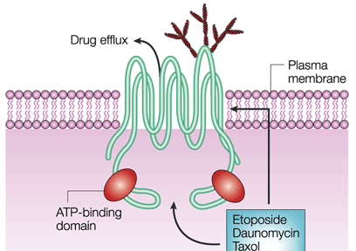
TREAT ATTACK
4-AMINOQUINOLINES
CHLOROQUINE
Resistance against the drug develops as a result of enhanced efflux of parasite vesicle →↑expression of the human multi drug resistance transporter P-glycoprotein
Chloroquine
entery
Effluxed Chloroquine
Chloroquine
Therapeutic Use:- Used to eradicate blood schizonts of. Plasmodium vivax
Plasmodium vivax resistance evolved in Indonesia, Peru and Oceania

Slide 11
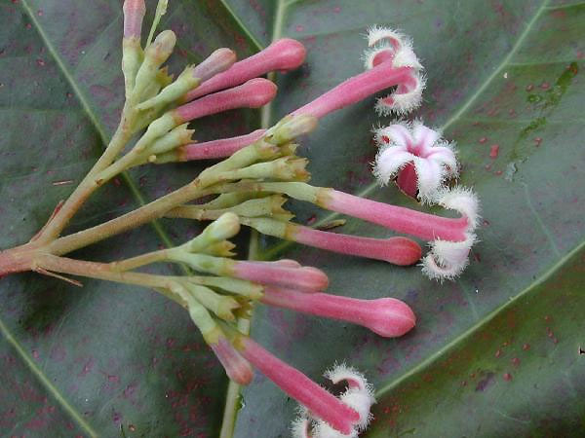
TREAT ATTACK
AMINOQUINOLINES DERIVATIVE
ARYLAMINOALCCOHOLS
Quinoline methanols; quinine, quinidine & mefloquine
QUININE
Phenanthrene methanols; halofantrine
Is a the main alkaloid in cinchona bark
Potent blood Schizontocide & weak Gametoside
Pharmacokinetics
Rapidly & completely absorbed from the GIT
Peaks after 1-3 hrs
Metabolized in the liver
5% excreted in the urine unchanged
t½ = 10 hrs but longer in sever falciparum infection
N.B. Administered: orally in a 7 day course
or by slow IV for severe P. falciparum infection
Mechanism
 As ANTIMALARIAL  Same as chloroquine
Other Actions
Quinidine – like action
Mild oxytoxic effect on pregnant uterus
Slight neuromuscular blocking action
Weak antipyretic action

Slide 12
TREAT ATTACK
AMINOQUINOLINES DERIVATIVE
Resistence  like chloroquine by efflux through p-glycoprotein MDR transporter
QUININE
ADRs
With therapeutic dose  poor compliance  bitter taste.
Higher doses 
Cinchonism  (tinnitus, deafness, headaches, nausea & visual disturbances)
Abdominal pain & diarrhea
Rashes, fever, hypersensitivity reactions
Hypotension & arrhythmias
Blood dyscarasis; anaemia, thrombocytopenic purpura &
hypoprothrombinaemia
Blackwater fever, a fatal condition in which acute haemolytic anaemia is associated with renal failure
IV  neurotoxicity  tremor of the lips and limbs, delirium, fits, stimulation followed by depression of respiration & coma
N.B. Safe in pregnancy

Slide 13
TREAT ATTACK
AMINOQUINOLINES DERIVATIVE
QUININE
Contraindications
Prolonged QT Interval
Glucose-6-Phosphate Dehydrogenase Deficiency
Myasthenia Gravis
Hypersensitivity
Optic Neuritis, auditory problems
Dose should be reduced in renal insufficiency
Interactions
Antacids: Antacids containing aluminum &/or magnesium may delay or decrease absorption of quinine.
Erythromycin (CYP3A4 inhibitor):
Cimetidine
Mefloquine.
Quinine can raise plasma levels of warfarin and digoxin.

Slide 14
PREVENT RELAPSES
8-AMINOQUINOLINES
PRIMAQUINE
Hypnozoitocides  against liver hypnozoites & gametocytocides
Radical cure of P. ovale & P. vivax
Prevent spread of all forms
Pharmacokinetics
Well absorbed orally
Rapidly metabolized to etaquine & tafenoquine  more active
t½  3-6h
Mechanism
Not well understood. It may be acting by;
Generating ROS  can damage lipids, proteins & nucleic acids
Interfering with the electron transport in the parasite  no energy
Inhibiting formation of transport vesicles no food vacuoles
Resistance;  Rare when primaquine & chloroquine  combine

Slide 15
PREVENT RELAPSES
8-AMINOQUINOLINES
PRIMAQUINE
ADRs
At regular doses  patients with G-6-PD deficiency  hemolytic anemia.
In G-6-PD deficiency  NADPH, GSH synthesis.
So RBCs become sensitive to oxidative agents  HEMOLYSIS
Primaquine
◉
Oxidizes GSH to GSSG   GSH   detoxification of toxic products
At larger doses 
Epigastric distress & abdominal cramps.
Mild anemia, cyanosis & methemoglobinemia
Severe methemoglobinemia  rarely in patients with deficiency of NADH methemoglobin reductase.
Granulocytopenia & agranulocytosis  rare

Slide 16
DRUGS USED IN COMBINATIONS
DRUG | MECHANISM | ADRs
Lumefantrine | heme polymerase [ like chloroquine ] | Palpitation, dizziness,allergic reaction, hepatotoxicity
Amodiaquine | heme polymerase [ like chloroquine ] | Nausea, vomiting, itching, stomach upset & headache.
Mefloquine | heme polymerase [ like chloroquine ] | neuropsychiatric disorders
Sulfadoxine-pyrimethamine | Sequential block of dihydropteroate synthase & dihydrofolate reductase  DNA synthesis | Allergic skin reactions, Agranulocytosis; aplastic anemia
Clindamycin | inhibits parasite apicoplast (needed for survival & successful host invasion) | Skin rash Pseudo-membranous colitis,
Doxycycline | Inhibit protein synthesis by binding to 30S subunit of ribosome | Yellowish discoloration of teeth, dental carries, bone deformity, vertigo, hypersensitivity

Slide 17
WHO TREATMENT GUIDELINES
IN VIVAX
Resistance
ACT / 3 days
followed by Primaquine for 14 days
Sensitive
Chloroquine for 3 days
followed by Primaquine for 14 days
IN FALCIPARUM
All show Resistance
Uncomplicated
ACT
Complicated
IV Artisunate for 24 hrs
Followed by; ACT
Or Artemether + [Clindamycin / doxycyline] Or Quinine + [Clindamycin / doxycyline]

Slide 18
WHO TREATMENT GUIDELINES
IN FALCIPARUM
All show Resistance
Special Risk Groups
Pregnancy; 1st trimester
Quinine + Clindamycin (7 days)
Pregnancy; 2nd & 3rd trimester
Lactating women
Infants & young children
ACT

Slide 19
L
ANTIMALARIAL DRUGS
G
U
O
C
O
K
D

