Slide 1
Antiemetics
Prof. Alhaider
1436 H
Pharmacology Department
College of Medicine

Slide 2
Learning objectives
Classify the main different classes of antiemetic drugs according to their mechanism of action.
Know the characteristic pharmacokinetics & dynamics of different classes of antiemetic drugs.
Identify the selective drugs that can be used according to the cause of vomiting.
Learn the adjuvant antiemetics.
Describe the major side effects for the different classes of antiemetics.

Slide 3
Vomiting
Is a complex series of integrated events culminating in the forceful expulsion of gastric contents through the mouth.
Such events are coordinated by the emetic (vomiting) center (VC), lying in reticular formation in medulla.
Vomiting can be a valuable, life-saving physiol-ogical response ‼‼ to rid stomach & intestine of toxins & prevent their further ingestion

Slide 4
Consequences of vomiting
Severe vomiting may result in :
Dehydration
Acid-base imbalance
Electrolyte depletion
Aspiration, pneumonia

Slide 5
Causes of Nausea and Vomiting
Nausea and vomiting may be manifestations of many conditions . However, a useful abbreviation for remembering causes of nausea and vomiting is VOMIT.
Vestibular
Obstruction or drugs like opiates)
Mind (dysmotility)
Infection (irritation of gut)
Toxins (taste and other senses)

Slide 6
Causes of Vomiting
As from previous slide nausea and vomiting may be manifestations of many conditions and may occur due to stimulation of vomiting center that respond to inputs from:
Chemoreceptor trigger zone (CTZ) stimulation
Disturbance of vestibular system
Higher cortical centers stimulation (CNS)
The periphery via sensory nerves

Slide 7
1. CTZ stimulation
CTZ is an area of medulla that communicate with vomiting center to initiate vomiting.
CTZ is physiologically outside BBB
CTZ Contains D₂ & 5 HT₃ receptors.
CTZ can be stimulated by
Drugs such as morphine, apomorphine, L-dopa, bromocryptine, digitalis, estrogen, emetine.
Chemicals
Radiation.
Uremia.

Slide 8
2. The periphery via sensory nerves
GIT irritation, myocardial infarction, renal or biliay stones.
3. Disturbance of vestibular system
4. Higher cortical centers stimulation: emotional factors, nauseating smells or sights.

Slide 9
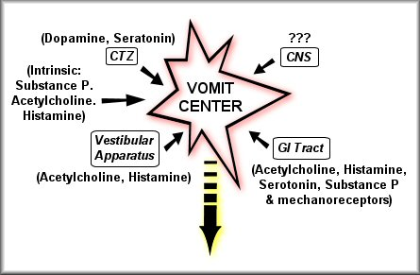
Receptors Associated with Nausea and Vomiting

Slide 10
Pathophysiology of Emesis
Cerebral cortex
Cancer chemotherapy
Opioids
Smell
Sight
Thought
Anticipatory emesis
Chemoreceptor Trigger Zone (CTZ)
Vestibular nuclei
Vomiting Centre (medulla)
Motion sickness
Muscarinic, 5 HT₃ & Histaminic H₁
Muscarinic Histaminic H₁
(Outside BBB)
Dopamine D₂
5 HT_{3,},Opioid Receptors
Chemo & radio therapy Gastroenteritis
Pharynx & GIT
5 HT₃ receptors

Slide 11
What are neurotransmitters & receptors involved in vomiting include?
Histamine (Histaminergic receptors H 1)
Serotonin (5 -HT3)
Ach (Muscarinic)
Dopamine (D2)
Substance P (Neurokinin receptors)
Opioid Receptors

Slide 12
Classification of Antiemetic Drugs:
Which group of drugs can be used as
antiemetics?
5-HT3 antagonists
D2 receptor antagonists
NK1 antagonists
H1-receptor antagonists
Muscarinic receptor antagonists
Cannabinoids
Glucocorticoids

Slide 13
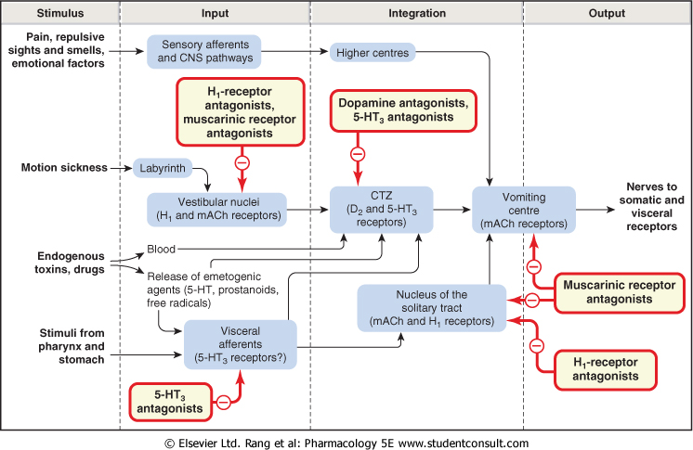

Slide 14
ANTIEMETICS
General rules on use of antiemetics
Should only be used when the cause of nausea or vomiting is known i.e cause of vomiting should be diagnosed.
Otherwise, the symptomatic relief produced could delay diagnosis of a remediable and serious cause.
Treat the cause (e.g. diabetic ketoacidosis, intestinal obstruction, intracerebral space-occupying lesion) usually cures the vomiting.
The choice of drug depends on the aetiology
Indications of antiemetics
1- Chemotherapy-induced
vomiting
2- Post-irradiation vomiting
3- Postoperative vomiting
4- Vomiting of pregnancy
5- Motion (travel) sickness

Slide 15
Antiemetics
5-HT3 antagonists
e.g. Ondansetron, Granisetron
The most Potent antiemetic, mediated through central (vomiting center, chemoreceptor trigger zone) and peripheral (intestinal and spinal) act by 5-HT3 receptor blockade
Orally or i.v., long duration of action.
Has high first pass metabolism
Very effective in nausea & vomiting due to :
Cytotoxic drugs (cisplatin)
Post-radiation and Post-operative (second line).

Slide 16
Side effects of 5-HT3 antagonists
Well tolerated
Headache, dizziness and constipation
minor ECG abnormalities (QT prolongation)

Slide 17
D2 receptor antagonists
Antagonize D2 receptors in CTZ
Drugs such as Metoclopramide Plasil^{R}, Domperidone (Motilium^{R} )
Both drugs are also prokinetic agents due to their 5 HT4 agonist activity
Domperidone- oral; Metoclopramide-oral, i.v.
Metoclopramide crosses BBB but domperidone cannot.
Effective against vomiting due to drugs, gastroenteritis, surgery, toxins, uremia, radiation
Can be used in reflux esophagitis .

Slide 18
Note: Metoclopramide also it has 5-HT3 antagonistic activity (First discovered 5-HT3 antagonist)

Slide 19
Which is a better antiemetic, metoclopramide or
domperidone ?
As CTZ is outside BBB both have antiemetic effects.
But as metoclopramide crosses BBB it has adverse effects like extrapyramidal side effects.
Side effects dyskinesia , galactorrhea, menstruation disorders, sedation (only for metoclopramide).

Slide 20
Recent caution regarding the cardiac side effects of domperidone
Cardiac arrest as a result of QT prolongation occurred with very few patients taking domperidone. Therefore:
1) Dose of domperidone should not exceed 30 mg/day
2) only used for Nausea and vomiting and should not be used as prokinetic
3) should not be given for patients with cardiac conductivity problems
4) lastly, should also not to be used for long time.

Slide 21
Other uses of Metoclopramide
Facilitate duodenal intubation & endoscopy
◉ Regurgitation & reflux oesophagitis
Diagnostic radiology of gut   time required for barium to reach caecum   No. of films required
Clears gastric contents in emergency anaesthesia
Gastroenteritis (the most common use)

Slide 22
Other D2 receptor antagonists
Neuroleptics:
Antipsychotics with potent antiemetic property due to D2 antagonism
Chlorpromazine, Droperidol
orally, parentrally, suppository
used for vomiting due to chemotherapy- induced emesis
Side effects: extrapyramidal symptoms hypotension, sedation, restlessness

Slide 23
Neurokinin1 (NK1) receptor antagonists
Aprepitant
Is a substance P antagonists that acts by blocking neurokinin 1 receptors.
Used in prevention of acute and delayed chemotherapy-induced nausea and vomiting (CINV) and for prevention of postoperative nausea and vomiting (Third line).

Slide 24
H1-receptor antagonists
Effective for motion sickness, morning sickness in pregnancy, Vestibular Disturbances and to combat opioid nausea.
Drugs as
Diphenhydramine
Cyclizine
Meclizine
Promethazine: severe morning sickness of pregnancy (if only essential).
Not in chemotherapy-induced vomiting.

Slide 25
Muscarinic receptor antagonists
Hyoscine (scopolamine)
Used as trans-dermal patches in motion sickness (applied behind the external ear).
Not in chemotherapy-induced vomiting
Cannabinoids
Nabilone, dronabinol (psychoactive drugs)
Used as adjuvant in chemotherapy induced vomiting.
Side effects: Sedation, hallucination and dysphoria.

Slide 26
Glucocorticoids
Dexamethasone and methylprednisolone
Highly effective in acute emesis alone or combined with ondansetron.
Used for vomiting by cytotoxic drugs.
Side effects:?????????????
Hyperglycemia
Hypertension
Cataract
Osteoporosis
Increased intraocular pressure
Increased susceptibility to infection
Increased appetite & obesity

Slide 27
Summary for
Therapeutic Choice of Antiemetics
Motion sickness
Hyoscine: For short Journey.
Diphenhydramine: For Long Journey.
Vomiting with pregnancy (morning sickness)
Avoid all drugs in the first trimester
Pyridoxine (B6)
Promethazine ( late pregnancy).

Slide 28
Drug- induced vomiting (CTZ)
domperidone & metoclopramide
Vomiting due to cytotoxic drugs.
Ondansetron
D2- antagonists.
Dexamethazone
Nabilone .
Post operative vomiting
Dopamine antagonists (Metoclopromide or Domperidone)
Now a day, selective 5-HT3 antagonists are commonly used

Slide 29
Thank you Questions ? aqahaider@hotmail.com
Notes:
29

