Slide 1
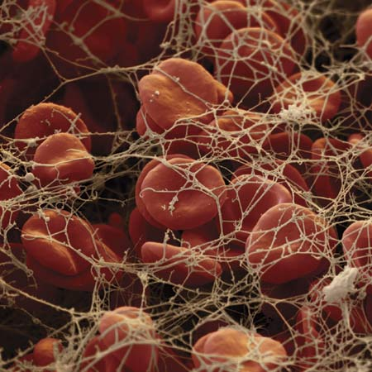
ANTICOAGULANTS

Slide 2
ANTICOAGULANTS
ILOs
Re-visit the coagulation cascade
Classify drugs acting as anticoagulants
Elaborate on their mechanism of action, correlating that with methods of monitoring
Contrast the limitations & benefits of injectable anticoagulants in clinical settings
Emphasis on the limitations of VKAs & on variables altering or modifying their response.
Apply such variability in a clinical scenario.

Slide 3
Drugs and coagulation
Anti-coagulants are molecules that prevent blood from clotting. They inhibit the chemical process of formation of the fibrin polymer.
These include heparin, low molecular weight heparin, coumarins/ warfarin.
Molecules that do not allow platelets to aggregrate and thus prevent clotting, especially in the arteries, are called anti-platelet agents e.g aspirin and ticlopidine.
Molecules that disintegrate a pre-formed clot are called fibrinolytic agents. A typical example in this category is the enzyme, streptokinase.

Slide 4
Indication of anti-coagulant
Anticoagulants are indicated
In myocardial infarction,
Deep venous thrombosis,
peripheral arterial emboli, pulmonary embolism and many other conditions.
Anticoagulants are also used in blood transfusions, and dialysis procedures.

Slide 5
Coagulation pathways and anticoagulants

Slide 6
Intrinsic Pathway
Extrinsic Pathway
Clotting: slower / assessed by aPTT
Clotting: is rapid in sec. / assessed by PT
BV Injury
Tissue Injury
XII
XIIa
Tissue Factor
XI
XIa
VIIIa
IX
IXa
VIIa
VII
Ca⁺⁺
Va
AT III
X
Xa
X
> 1000 times
XIII
Heparin
Prothrombin II
Thrombin IIa
LMWH
Fibrinogen
Fibrin monomer
XIIIa
Vitamin K Antagonists
Direct Thrombin Is
Fibrin polymer
Factor Xa Is

Slide 7
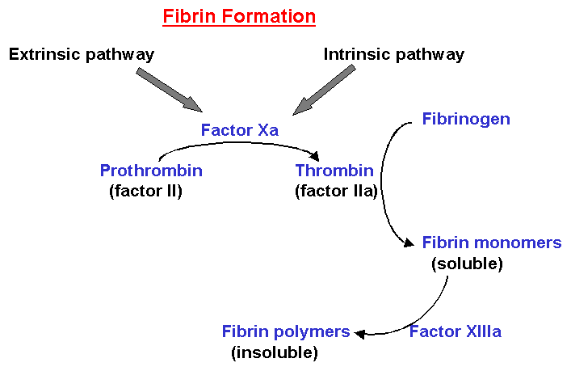
Chemical Process of Clotting

Slide 8
ANTICOAGULANTS
VENOUS THROMBOSIS
Parenteral Anticoagulants
Oral Anticoagulants
UFH
LMWH
Direct Thrombin Is
Factor Xa Is
Vitamin K Antagonists
3000-30000
< 8000
Pentasaccharide
Coumarins;
Warfarin
> 40 times potency than
Dicumarol
> Xa
II a
X a
Indirect Is
Enoxaparin
Dalteparin
Bivaluridin
Lepirudin
Argatroban
R Is
IR Is
Fondaparinux
Rivaroxaban
R Is
R Is
Direct Is
Dabigatran
XIIa, XIa, IXa, Xa, IIa
II, VII, IX & X
Inactivation Of Coagulation Factors
Decrease Synthesis
Rapid / Variable
Slow / Latency / Variable
Monitor by aPTT (1.5 - 2.5 times normal [30sec])
Or CT (2-3 times normal [5-7 min)
Monitor by PT ( 2 times)
INR (2.5)
Antidote; Protamine Sulphate IV 1mg / 100 units UFH
+/ Fresh blood
Antidote; Vit. K₁ infusion +/ Fresh blood
+ Needs de novo synthesis

Slide 9
Anti-thrombin III
Anti-thrombin III: It inactivates thrombin and other coagulation factors (IXa, Xa, XIa and XIIa) by forming complex with these factors. Heparin like molecules enhances these interactions.
Protein C and S: these are vitamin K dependent proteins that slow the coagulation cascade by inactivating factor Va and VIIIa.

Slide 10
Heparin mechanism of action
The anti-coagulant effect of heparin is mediated via anti-thrombin III.
Anti-thrombin III inactivate thrombin (essential for clot formation) and other serine proteases (clotting factors) e.g VIIa, IXa and particularly Xa.
In the absence of heparin this incativation is slow, heparin acting is a co-factor accelerate the reaction by 1000-fold.

Slide 11
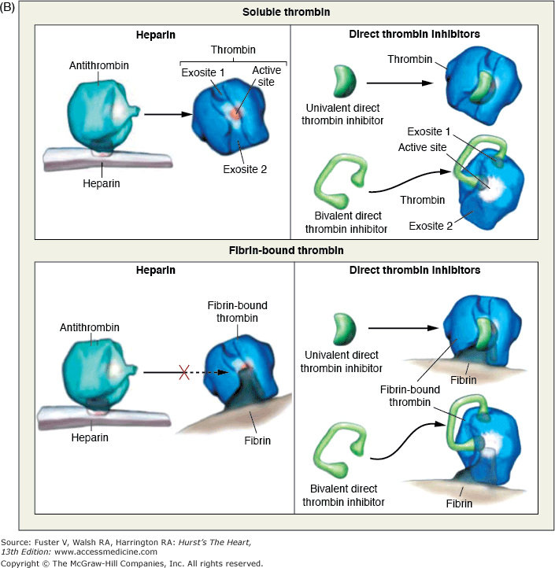

Slide 12
ANTICOAGULANTS
unfractionated heparin (UFH LIMITATIONS
No predictable anticoagulant effects; inter-patient & intra-patient variability in response to a given dosage  in hospital setting, repeated monitoring
Low bioavailability  binds to plasma proteins, endothelium & macrophages
Re-thrombosis  activates platelets as it does not neutralize fibrin-bound II a
No effect on Fibrin-bound IIa

Slide 13
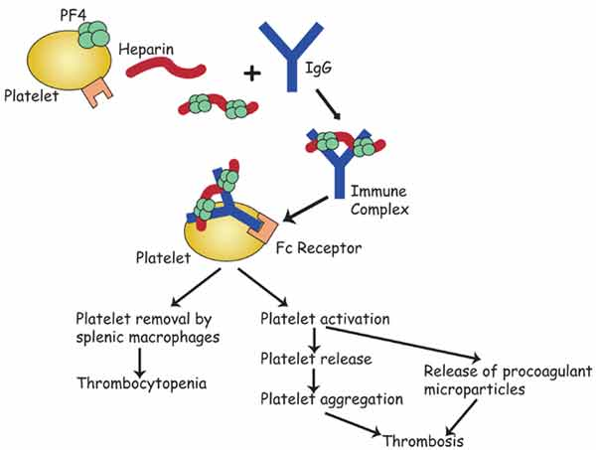
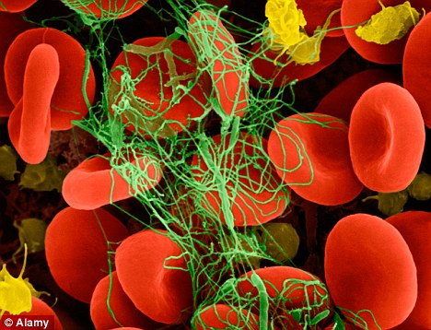
ANTICOAGULANTS
UFH LIMITATIONS
Heparin Induced Thrombocytopenia (HIT); in 4% pts. on heparin, latency 5-10 dys. after 1st exposure or 2-3 dys. after re-exposures V enous > Arterial thombosis
?
Heparin discontinuation
No packed platelets  More thrombosis
No warfarin 
Give  DTIs
PF4= platelet factor 4

Slide 14
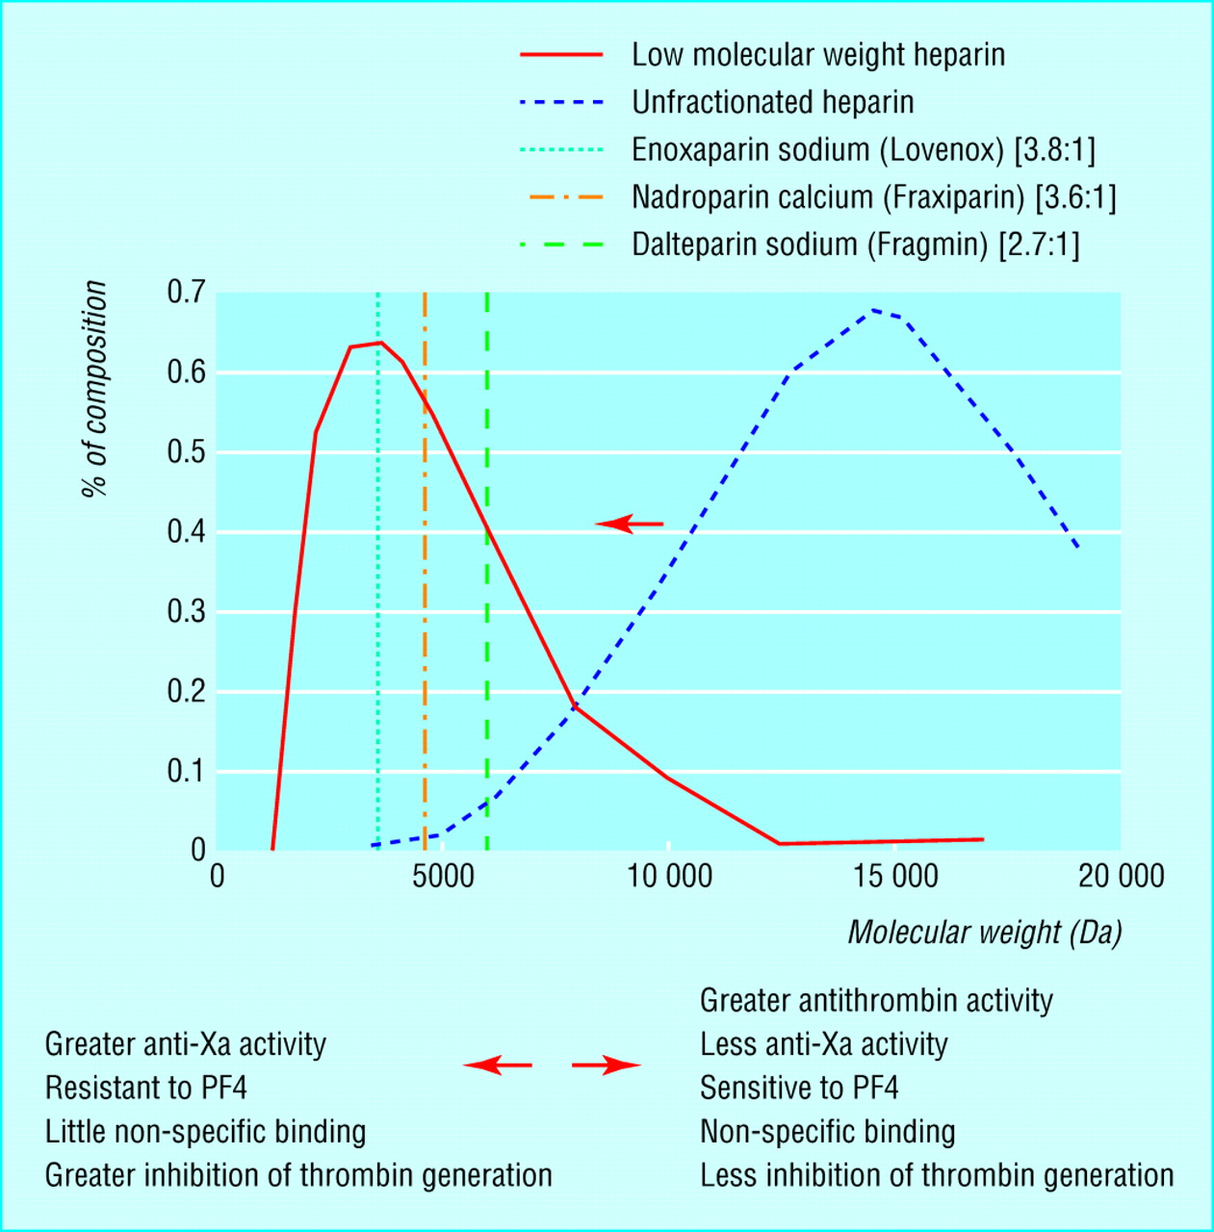
LMWH versus UFH
LMWH
UFH

Slide 15
UF heparin and LMW Heparin
The theoretical pharmacologic advantages of LMWH over UFH arise from the preferential binding ratio to factor Xa over thrombin.
LMWH (Enoxaparin , Dalteparin) have:
less plasma protein binding,
less platelet activation and lower risk of re-thrombosis and thrombocytopenia.,
Good bioavaialibility
More predictable response

Slide 16
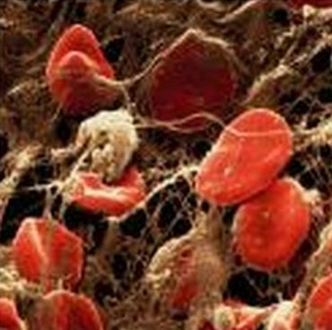
ANTICOAGULANTS
LMWH BENIFITS
 Predictability of anticoagulant response i.e. little inter-patient and intra-patient variability in response to a given dosage. without the need for laboratory monitoring
 Bioavailability; as it hardly binds to plasma proteins, endothelium & macrophages
Incidence of thrombocytopenia; as it seldom sensitive to PF4
Incidence of bleeding tendency;  effect AT III &  platelet interactions
Much better tolerability;
given sub. cut.
◉ frequency of administration due to longer duration of action
◉ need for regular monitoring
Outside hospital settings

Slide 17
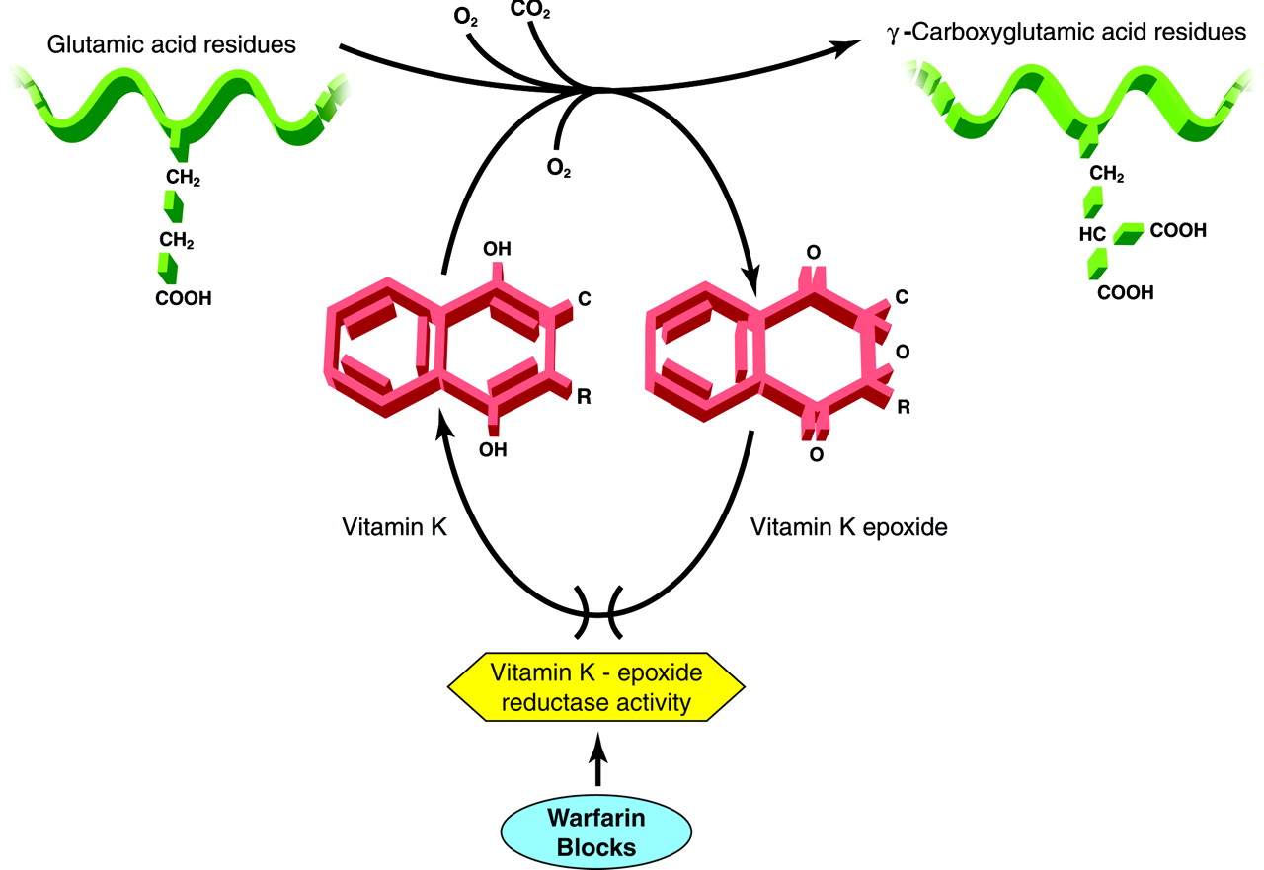
ANTICOAGULANTS
VKAs
Non-Functioning Coagulation Factors
Biologically Functioning Coagulation Factors
Carboxylase
Warfarin
Precursors of factors II, VII, IX & X require carboxylation of their glutamic a. residues to allow them to bind to phospholipid surfaces. This is provided by Vit. K as it changes from its oxidized to its reduced form. Instantaneously , the reduced Vit K has to recycle back to oxidized form by Vit K epoxide reductase. This enzyme is blocked by VKAs  losing the coagulation factors the ability to function.

Slide 18
Mechanism of Action of Warfarin
Inhibits synthesis of Vitamin K-dependent coagulation factors II, VII, IX, & X as well as anticoagulant proteins C & S
Does not have an effect on already-synthesized coagulation factors; therefore, the therapeutic effects are not seen until these factors are depleted
3-4 days until effect is seen

Slide 19
Heparin and warfarin actions

Slide 20
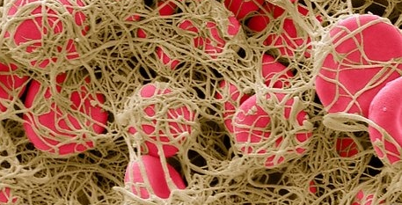
ANTICOAGULANTS
VKAs LIMITATIONS
Wide variation in drug response
Has narrow therapeutic window, So any change in that level can be hazardous.
Slow onset of action, so not in given in emergency conditions
Polymorphisms in CYT P450 isoforms that metabolizes warfarin  adds to its non predictable response  liability to toxicities or under use.
Numerous food- & drug-drug interactions  liability to toxicities or under use.
Contraindicated in pregnancy  give heparin or LMWH instead
.

Slide 21
FACTORS ALTERING RESPONSE TO VKAs
1. Vitamin K deficiency;
a- Inadequate diet; malnutrition, dieting, decreased GI absorption….
2. Impaired synthesis of clotting factors;
a. In hepatocellular disorders; ( hepatitis;infective or chronic alcoholism ... etc.)
3. Increased catabolism of clotting factors;
In hypermetabolic states; as in fever, thyrotoxicosis
1. Decreased plasma protein binding;
 elimination of free drug & shortening of its t1/2. as pts with nephrotic syndrome (proteinuria)
2. Decreased catabolism of clotting factors; Hypothyroidism
3. Hereditary resistance to oral anticoagulants

Slide 22
DRUGS MODULATING RESPONSE TO VKAs
1. Inhibition of Vit. K synthesis by intestinal flora; oral antibiotics
2. Inhibition of Vit K absorption; liquid paraffin
3. Decrease in drug metabolism by microsomal enzyme inhibitors;
chloramphenicol, & cimetidine
4. Displacment of the drug from protein binding sites; phenylbutazone & salicylates
5. Co-administration of drugs that increase bleeding tendency by;
inhibiting platelet function; NSAIDs
inhibiting coagulation factors; heparin
1. Inhibition of drug absorption from GIT; cholystyramine, colestipol
2. Increase in synthesis of clotting factors; Vit K, oral contraceptives
3. Increase in drug metabolism by microsomal enzyme inducers; Carbamazepine; barbiturates, rifampicin

Slide 23
An old, peptic ulcer patient, sustained on cimetidine, has been bed ridden since a month following a major orthopedic surgery for pelvic fracture. The last week he began to complain of pain, tenderness, warmth & swelling of his left leg. He was diagnosed as deep vein thrombosis. His treating physician put him first on heparin that was replaced after three days by VKAs. Today he began to show bleeding of gums.
What is the expected explanation of his finding?
Will the treating physician 1st of all, consider giving an antidote to stop bleeding ( if so then state) or will he probably ask for lab investigation ( if so then state)?
Once lab findings are there, is the physician expected first to withdraw or to adjust the existing therapy?

Slide 24
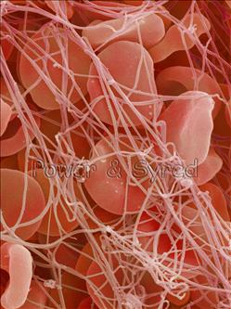
A young rheumatic artheritic patient has underwent valve replacement and is sustained on warfarin therapy for the last three years. When she married, last summer, she did not want to get pregnant, so she has taken since then, oral contraceptive pills.
Her regular lab monitoring today showed a decrease in INR this time.
What is the expected explanation of her lab result?
What will the treating physician consider doing?
Giving heparin on top
Adjusting warfarin dose
Stopping the OC
Stopping warfarin

Slide 25
A 53 years old patient had an aortic valve replacement since 5 years and he is sustained on warfarin. A week ago, he developed low grade fever, diarrhea and was diagnosed as having typhoid. He was given rehydration fluid and a course of chloramphenicol.
Today he is complaining from haematuria.
Which one of the following best explains the haematuria?
Inhibition of Vit K synthesis by chloramphenicol
Displacement of warfarin from protein binding site by rehydration
Decrease in warfarin metabolism induced by chloramphenicol
Inhibition of Vit K absorption caused by the diarrhea
Which is the right decision to do in such a case?
- Give a urinary antiseptic for fear of infection
- Stop administering the regular intake of warfarin
- Adjust the dose of warfarin after monitoring the situation.
- Stop the course of chloramphenicol intended for typhoid therapy

Slide 26
Summary of Heparin and wrafarin

Slide 29
ANTICOAGULANTS
G
O
O
D
L
U
C
K

