Slide 1
Gastrointestinal Physiology
General Principles of Gastrointestinal (Chapter 62-65)
Dec 26th 2014
Mohammed Alzoghaibi, Ph.D.
zzoghaibi@gmail.com
WhatsApp, SMS: 0506338400

Slide 2
Required Textbook
Textbook of Medical Physiology
Eleventh Edition
Guyton & Hall
Published by Elsevier Saunders
2011

Slide 3
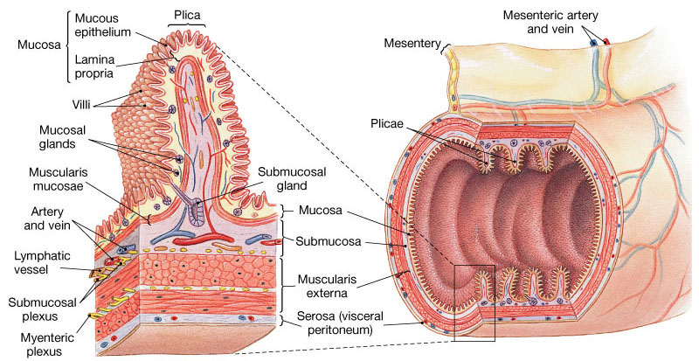
General Principles of Gastrointestinal Motility Physiologic Anatomy of the Gastrointestinal Wall
The following layers structure the GI wall from outer surface inward: (1) the serosa, (2) a longitudinal muscle layer, (3) a circular muscle layer, (4) the submucosa, and (5) the mucosa. In addition, sparse bundles of smooth muscle fibers, the mucosal muscle, lie in the deeper layers of the mucosa.

Slide 4
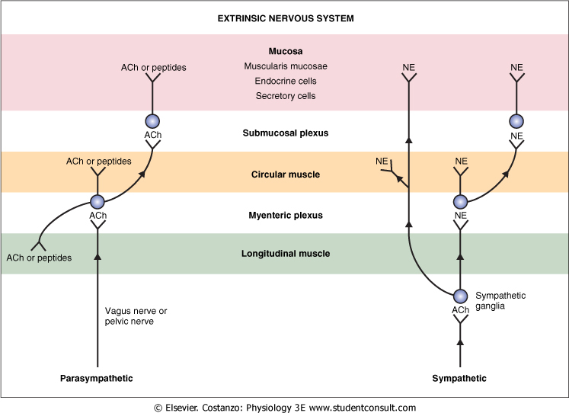

Slide 5
Hormone | Site of Secretion | Stimuli for Secretion | Actions
Gastrin | G cells of the stomach | Small peptides and amino acids Distention of the stomach Vagal stimulation (GRP) | ↑ Gastric H⁺ secretion Stimulates growth of gastric mucosa
Cholecystokinin (CCK) | I cells of the duodenum and jejunum | Small peptides and amino acids Fatty acids | ↑ Pancreatic enzyme secretion ↑ Pancreatic HCO₃⁻ secretion Stimulates contraction of the gallbladder and relaxation of the sphincter of Oddi Stimulates growth of the exocrine pancreas and gallbladder Inhibits gastric emptying
Secretin | S cells of the duodenum | H⁺ in the duodenum Fatty acids in the duodenum | ↑ Pancreatic HCO₃⁻ secretion ↑ Biliary HCO₃⁻ secretion ↓ Gastric H⁺ secretion Inhibits trophic effect of gastrin on gastric mucosa
Glucose-Dependent Insulinotropic Peptide (GIP) | K cells of the Duodenum and jejunum | Fatty acids Amino acids Oral glucose | ↑ Insulin secretion from pancreatic β cells ↓ Gastric H⁺ secretion
Motilin | M cells of the duodenum and jejunum | Fat Acid Nerve | Stimulates: Gastric motility Intestinal motility

Slide 6
Functional Types of Movements in the Gastrointestinal Tract
Two types of movements occur in the gastrointestinal tract:
propulsive movements
Organizes propulsion of material over variable distances within the GI lumen
Usual stimulus is distention. Other stimuli that can initiate peristalsis include chemical or physical irritation of the epithelial lining in the gut.
Myenteric plexus is important
Atropine (cholinergic blocker) depresses propulsis
Receiving segment---contraction (longitudinal M.)
---relaxation (circular M.)
Propulsive segment ---contraction (circular M.)
----relaxation (longitudinal M.)
Peristaltic Reflex and the "Law of the Gut." When a segment of the intestinal tract is excited by distention and thereby initiates peristalsis, the contractile ring causing the peristalsis normally begins on the orad side of the distended segment and moves toward the distended segment, pushing the intestinal contents in the anal direction for 5 to 10 centimeters before dying out.

Slide 7
Functional Types of Movements in the Gastrointestinal Tract
2) Mixing movements (segmentation)
Blend different juices with the chyme
Bring products of digestion in contact with absorptive surfaces

Slide 8
Secretory Functions of the Alimentary Tract (Secretion of Saliva)
Chapter 64; page 773-777
Mohammed Alzoghaibi, PhD
zzoghaibi@gmail.com

Slide 9
Anatomical Types of Glands
Single-cell mucous glands (goblet cells), they produce mucus.
Crypts of Lieberkühn at the mucosal pits.
Tubular glands (in the stomach and duodenum)
Salivary glands, pancreas, and liver

Slide 10
SALIVARY GLANDS
The principal glands of salivation are:
Parotid glands
Submandibular (Submaxillary) glands
Sublingual glands
Smaller glands in mucosa of tongue, palate, etc.
Daily secretion of saliva = 800-1500 mL with pH = 6-7

Slide 11
Secretion of Saliva and its Characteristics
Saliva contains two major types of secretion:
1. Aqueous fluids (a serous secretion)
Water, ions and enzymes such as ptyalin (an α-amylase)
Parotid, Submandibular and Sublingual glands
2. Mucus secretion (mucin)
Submandibular and Sublingual glands

Slide 12
Composition of Saliva
Aqueous Fluids
H₂O, K, HCO₃, Na, Cl, α-amylase, lingual lipase, IgA, kallikrein, muramidase (lyses muramic acid of Staphylococcus), lactoferrin and epithelial growth factor (EGF)
Hypotonic Solution
Ions Na, K, CI, HCO₃: (the concentrations of these ions are altered with altered flow rates), e.g., at low flow rate, the salivary secretions have:
High K and HCO₃
Low Na and CI−

Slide 13
Composition of Saliva (con’t)
Enzymes
α-amylase (from parotid glands)
cleaves α -1 ,4-glycosidic bonds
The optimal pH for this enzyme to work properly is 7
Inactivated at pH 4 but continues to work for sometime in unmixed food in Orad portion of stomach
Lingual lipase
hydrolyzes lipids
continues working in the duodenum
Kallikrein (protease, from acinar cells)
Catalyzes production of bradykinin (good vasodilator) from α-globulin
Increases local blood flow
Water (0.5 L saliva/day)

Slide 14
Composition of Saliva (con’t)
Mucus:
Lubricating and Protective Properties of Mucus:
Mucus is a thick secretion composed mainly of water, electrolytes, and glycoproteins
The mucus is an excellent lubricant and a protectant for the wall of the gut because of the following:
It has adherent qualities that make it adhere tightly to the food.
It has sufficient body that it coats the wall of the gut and prevents actual contact of most food particles with the mucosa.
It has a low resistance for slippage.
It causes fecal particles to adhere to one another.
It is strongly resistant to digestion by the GI enzymes.
The glycoproteins of mucus have amphoteric properties, (buffering small amounts of either acids or alkalies).

Slide 15
Secretory Unit (salivon)
The basic unit “salivon” consists of:
Acinus -initial secretory process
Intercalated duct -initial portion of duct
Striated duct -modification of secretory product
Myoepithelial cells
surround acinus and intercalated duct
contraction moves saliva, prevents development of back pressure

Slide 16
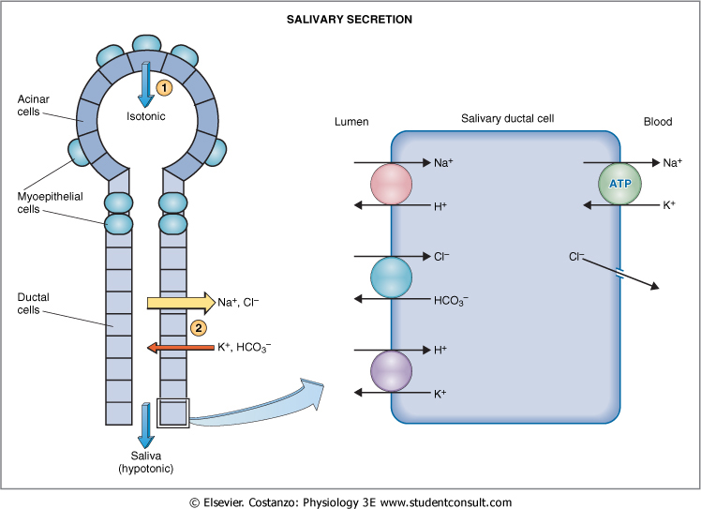

Slide 17
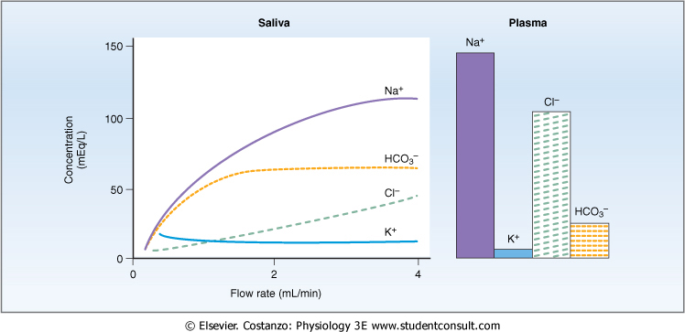
Characteristics of Saliva and Flow Rate

Slide 18
Control of Secretion
Unique aspect of control of salivary secretion
secretion rate depends entirely on neural control –autonomic nervous system (ANS)
both Parasympathetic and Sympathetic lead to increase secretion
Composition modified by Aldosterone:
increases Na, Cl reabsoption
increases K secretion

Slide 19
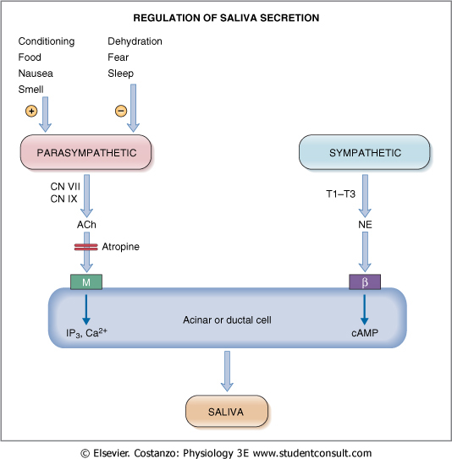

Slide 20
Swallowing (Deglutition)
Chapter 63: 763-765
Dr. Mohammed Alzoghaibi
zzoghaibi@gmail.com

Slide 21
Stages of Swallowing (Deglutition)
Swallowing is initiated voluntarily in the mouth, but thereafter is under involuntary or reflex control. The reflex portion is controlled by the swallowing center in the medulla.
Stages of Swallowing:
Oral Stage (voluntary)
Pharyngeal stage (involuntary)
Esophageal stage (involuntary)

Slide 22
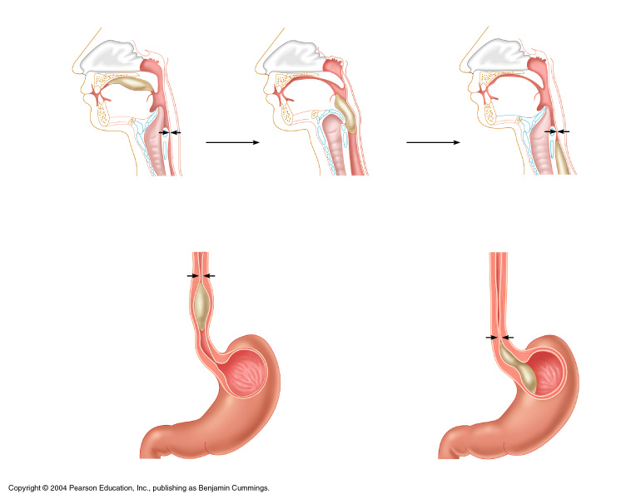
Deglutition (Swallowing)
Bolus of food
Tongue
Uvula
Pharynx
Bolus
Epiglottis
Epiglottis
Glottis
Trachea
Esophagus
Bolus
(a) Upper esophageal sphincter contracted
(b) Upper esophageal sphincter relaxed
(c) Upper esophageal sphincter contracted
Relaxed muscles
Circular muscles contract, constricting passageway and pushing bolus down
Relaxed muscles
Gastroesophageal sphincter open
Bolus of food
Longitudinal muscles contract, shortening passageway ahead of bolus
Gastroesophageal sphincter closed
Stomach
(d)
(e)

Slide 23
Function of Gastroesophageal Sphincter
● Receptive Relaxation of the Stomach. When the esophageal peristaltic waves reaches the stomach, the stomach relaxes through inhibition of myenteric neurons which prepares the stomach to receive the food that is propelled into the esophagus during swallowing.
● Function of the Lower Esophageal Sphincter (Gastroesophageal Sphincter). The esophageal sphincter is formed by the esophageal circular muscle located in an area of ~ 3 cm upward of the junction with the stomach. This sphincter remains tonically constricted (protects the esophagus from the stomach acidic juices) until the peristaltic swallowing wave passes down the esophagus and causes a “receptive relaxation” of the sphincter and the emptying of the propelled food into the stomach. Failure of the sphincter to relax will result in achalasia.
● Additional Prevention of Esophageal Reflux by Valvelike Closure of the Distal End of the Esophagus. Receptive Relaxation of the Stomach. This is another protective mechanism (safety factor) that prevents reflux of gastric secretions into the lower portion of the esophagus. This mechanism involves a short portion of the esophagus that extends slightly into the stomach and that caves the esophagus inward in response to increased intra-abdominal pressure.

Slide 24
Pancreatic Secretion
(Chapter 64; Pages 780-783; Guyton & Hall)
Mohammed Alzoghaibi, Ph.D
zzoghaibi@gmail.com

Slide 25
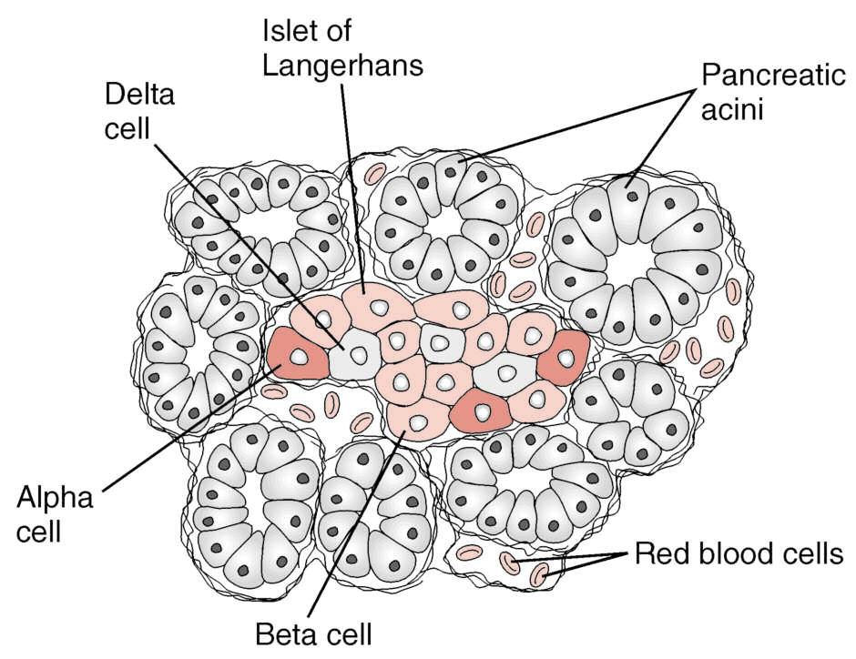
Islet of Langerhans in the pancreas.
The pancreas, in addition to its digestive functions, secretes two important hormones:
1. Insulin (Beta cells; 60%).
2. Glucagon (Alpha cells; ~25%).
that are crucial for normal regulation of glucose, lipid, and protein metabolism.
Also Somatostatin is secreted by delta cells ( form ~10% of islets’s cells).
Figure 78-1. Copyright 2011, WB Saunders Elsevier, All Rights Reserved

Slide 26
Pancreatic Secretion
The major functions of pancreatic secretion:
To neutralize the acids in the duodenal chyme to optimum range (pH= 7.0-8.0) for activity of pancreatic enzymes.
To prevent damage to duodenal mucosa by acid & pepsin
To produce enzymes involved in the digestion of dietary carbohydrate, fat, and protein

Slide 27
Pancreatic secretion (continued)
Pancreatic secretions contain many enzymes for digesting proteins, carbohydrates, and fats, and large quantities of HCO₃ ions.
The most important pancreatic enzymes for digesting proteins are:
Trypsin.
Chymotrypsin.
Carboxypolypeptidase.
Trypsin and chymotrypsin split whole and partially digested proteins into peptides of various sizes but do not cause release of individual amino acids.
Carboxypolypeptidase splits some peptides into individual amino acids, thus completing digestion of some proteins to amino acids.

Slide 28
Pancreatic Enzymes (continued)
When first synthesized in the pancreatic cells, the proteolytic digestive enzymes are in the inactive forms:
1. Trypsinogen
2. Chymotrypsinogen
3. Procarboxypolypeptidase
These enzymes become activated only after they are secreted into the intestinal tract.
1. Trypsinogen is activated by:
● Enteropeptidase (enterokinase), an enzyme secreted by the intestinal mucosa when chyme comes in contact with the mucosa.
● Trypsinogen can be autocatalytically activated by trypsin formed from previously secreted trypsinogen.
2 & 3. Chymotrypsinogen and procarboxypolypeptidase are activated by trypsin to form chymotrypsin and carboxypolypeptidase.

Slide 29
Trypsin Inhibitor
Secretion of Trypsin Inhibitor Prevents Digestion of the Pancreas Itself.
● Proteolytic enzymes of the pancreatic juice do not become activated until after they have been secreted into the intestine because the trypsin and the other enzymes would digest the pancreas itself.
● The same cells that secrete proteolytic enzymes into the acini of the pancreas secrete another substance called trypsin inhibitor, which is formed in the cytoplasm of the glandular cells, and it prevents activation of trypsin both inside the secretory cells and in the acini and ducts of the pancreas.
● Because trypsin activates the other pancreatic proteolytic enzymes, therefore trypsin inhibitor prevents activation of the other enzymes as well.

Slide 30
Pancreatic secretion (continued)
The pancreatic enzyme for digesting carbohydrates is pancreatic amylase, which hydrolyzes starches, glycogen, and most other carbohydrates (except cellulose) to form mostly disaccharides and a few trisaccharides.
The main enzymes for fat digestion are:
Pancreatic lipase
(2) Cholesterol esterase
(3) Phospholipase

Slide 31
Pancreatic secretions are rich in bicarbonate ions
The pancreas secrets about 1 L/day of HCO3 –rich fluid from the epithelial cells of the ductules and ducts.
The osmolarity of pancreatic fluid is equal to that of plasma
HCO3 concentration increases with increasing secretion rate

Slide 32
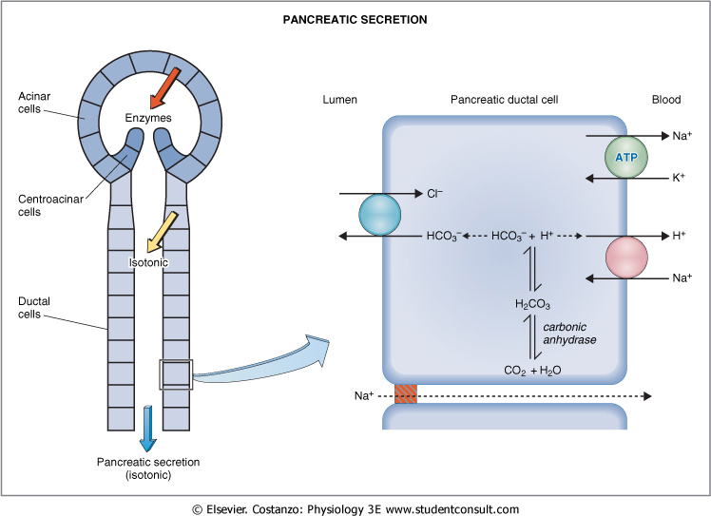
Secretion of Isosmotic Sodium Bicarbonate Solution.

Slide 33
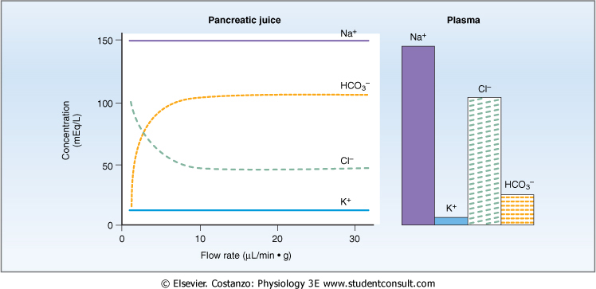
Flow Rate and pancreatic secretion

Slide 34
Pancreatic Secretion is Under Neural and Hormonal Control
Parasympathetic stimulation (through Ach on acinar cells) results in an increase in enzyme secretion-fluid and HCO3
Secretin tends to stimulate a HCO3 rich secretion by activating ductal cells.
CCK stimulates a marked increase in enzyme secretion by stimulating the acinar cells.
Pancreatic secretion normally results from the combined effects of the multiple basic stimuli, not from one alone (potentiate each other).

Slide 35
Stimuli for Pancreatic Secretion
1. Acetylcholine: released from the parasympathetic vagus nerve endings and from other cholinergic nerves in the enteric nervous system.
2. Cholecystokinin: secreted by the duodenal and upper jejunal mucosa (I cells) when food enters the small intestine.
3. Secretin: also secreted by the duodenal and jejunal mucosa (S cells) when highly acidic chyme enters the small intestine.
Acetylcholine and cholecystokinin stimulate the acinar cells of the pancreas, causing production of large quantities of pancreatic digestive enzymes but relatively small quantities of water and electrolytes to go with the enzymes.
Secretin, in contrast to the first two basic stimuli, stimulates secretion of large quantities of H₂O and NaHCO₃ solution by the pancreatic ductal epithelium.

Slide 36
Stimuli for Pancreatic Secretion (continued)
Secretin Stimulates Secretion of Copious Quantities of Bicarbonate Ions—Neutralization of Acidic Stomach Chyme.
● Secretin is present in an inactive form, prosecretin (in S cells in the mucosa of the duodenum and jejunum).
● When acid chyme with pH less than 4.5-5.0 enters the duodenum from the stomach, it causes duodenal mucosal release and activation of secretin, which is then absorbed into the blood.
● Secretin causes the pancreas to secrete large quantities of fluid containing a high concentration of HCO₃ (up to 145 mEq/L = ~5X normal) but a low concentration of Cl⁻.
HCl + NaHCO₃ → NaCl + H₂CO₃
H₂CO₃ dissociates into CO₂ and H₂O.

Slide 37
Stimuli for Pancreatic Secretion (continued)
Cholecystokinin—Its Contribution to Control of Digestive Enzyme Secretion by the Pancreas.
● The presence of food in the upper small intestine causes cholecystokinin to be released from the I cells in the mucosa of the duodenum and upper jejunum.
● Release of cholecystokinin results especially from the presence of proteoses and peptones (products of partial protein digestion) and long-chain fatty acids in the chyme.
● Cholecystokinin, like secretin, passes by way of the blood to the pancreas and causes secretion of pancreatic digestive enzymes by the acinar cells.
● This effect is similar to that caused by vagal stimulation but even more pronounced, accounting for 70-80% of the total secretion of the pancreatic digestive enzymes after a meal.

Slide 38
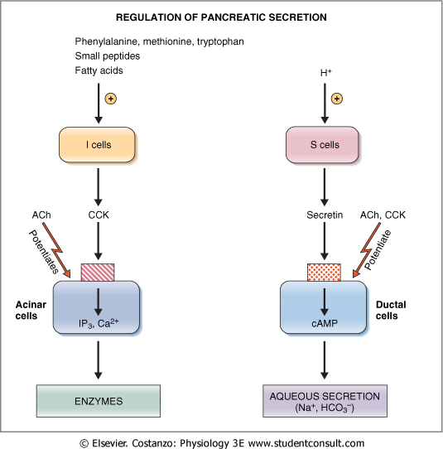
Regulation of Pancreatic Secretion

Slide 39
Multiplicative or Potentiation Effects of Different Pancreatic Secretion Stimuli
● When all different stimuli of pancreatic secretion (acetylcholine, cholecystokinin, and secretin) occur at once, then the total secretion is far greater than the sum of the secretions caused by each stimulus separately. The stimuli are said to “multiply” or “potentiate” one another.
● Usually, pancreatic secretions are the result of multiple stimuli rather than one stimulus.

Slide 40
Pancreatic secretion is phasic
Mediators | stimulus | Phase
Release of Ach | Smell, taste, chewing and swallowing | Cephalic phase
Vago-vagal reflex | Protein, gastric distention | Gastric phase
Secretin, CCK and vago-vagal reflex | Acid in chyme, fatty acids | Intestinal phase

Slide 41
Secretion of Bile by the Liver Functions of the Biliary Tree
Chapter : 64; pages: 783-786
Mohammed Alzoghaibi, Ph.D
zzoghaibi@gmail.com

Slide 42
What Are The Components of Bile?
The components of bile are:
Bile acids (bile salts)
Cholesterol
Phospholipids (Lecithin)
Bile pigments
Ions and water

Slide 43
Bile Secretion
Bile secretion is primarily regulated by a feedback mechanism, with secondary hormonal and neural controls
The major determinant of bile acid synthesis is its concentration in hepatic portal blood (feedback control)
CCK, Secretin and estrogen (hormonal control)
Parasympathetic and sympathetic nerves supply the biliary system. Parasympathetic (vagal) stimulation results in contraction of the gallbladder and relaxation of the sphincter of Oddi, as well as increased bile formation. Bilateral vagotomy results in reduced bile secretion after a meal, suggesting that the parasympathetic nervous system plays a role in mediating bile secretion. By contrast, stimulation of the sympathetic nervous system results in reduced bile secretion and relaxation of the gallbladder.

Slide 44
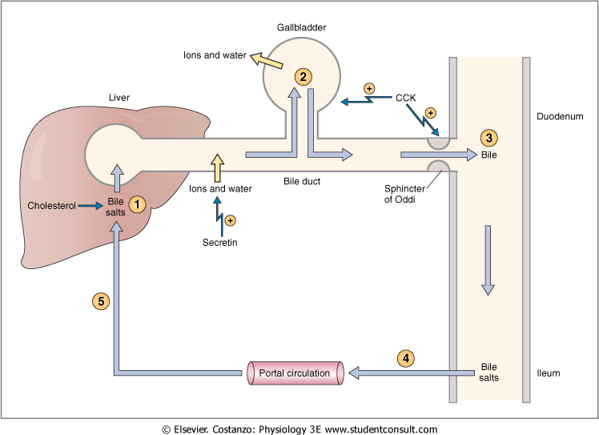
Secretion and enterohepatic circulation of bile salts

Slide 45
What is the bile acid ? What are the types of the bile acid?

Slide 46
Bile Acids Are Formed in the Liver From Cholesterol
Bile acids are formed in the liver from cholesterol. During the conversion, hydroxyl groups and a carboxyl group are added to the steroid nucleus.
Bile acids are classified as primary or secondary. The hepatocytes synthesize the primary bile acids, which include cholic acid and chenodeoxycholic acid. Bile acids are secreted as conjugates of taurine or glycine. When bile enters the GI tract, bacteria present in the lumen act on the primary bile acids and convert them to secondary bile acids by dehydroxylation. Cholic acid is converted to deoxycholic acid and chenodeoxycholic acid to lithocholic acid.

Slide 47
Bile Acids Are Formed in the Liver From Cholesterol (continued)
At a neutral pH, the bile acids are mostly ionized and are referred to as bile salts. Conjugated bile acids ionize more readily than the unconjugated bile acids and, thus, usually exist as salts of various cations (e.g., sodium glycocholate).
Bile salts are much more polar than bile acids and have greater difficulty penetrating cell membranes. Consequently, the small intestine absorbs bile salts much more poorly than bile acids. This property of bile salts is important because they play an integral role in the intestinal absorption of lipid. Therefore, it is important that the small intestine absorb bile salts only after all of the lipid has been absorbed.

Slide 48
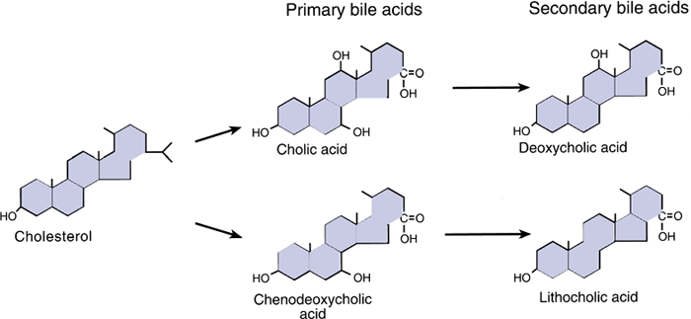
Function of Bile Salts in Fat Digestion and Absorption
Bile acids are formed from cholesterol in the liver. Bile acids are conjugated with the amino acids glycine and taurine in the liver. At neutral pH, the bile acids are mostly ionized and referred to as bile salts.

Slide 49
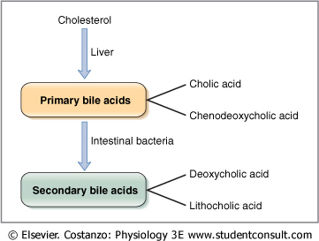
Function of Bile Salts in Fat Digestion and Absorption

Slide 50
Function of Bile Salts in Fat Digestion and Absorption
They have a detergent action (emulsifying) on the fat particles in the food which decreases the surface tension of the particles.
They help in the absorption of fatty acids, monoglycerides, cholesterol, and other lipids from the intestinal tract.

Slide 51
Enterohepatic Circulation of Bile Salts. Bile Salts Are Recycled Between the Small Intestine and the Liver
The enterohepatic circulation of bile salts is the recycling of bile salts between the small intestine and the liver. The total amount of bile acids in the body, primary or secondary, conjugated or free, at any time is defined as the total bile acid pool. In healthy people, the bile acid pool ranges from 2 to 4 g. The enterohepatic circulation of bile acids in this pool is physiologically extremely important. By cycling several times during a meal, a relatively small bile acid pool can provide the body with sufficient amounts of bile salts to promote lipid absorption. In a light eater, the bile acid pool may circulate three to five times a day; in a heavy eater, it may circulate 14 to 16 times a day. The intestine is normally extremely efficient in absorbing the bile salts by carriers located in the distal ileum. Inflammation of the ileum can lead to their malabsorption and result in the loss of large quantities of bile salts in the feces. Depending on the severity of illness, malabsorption of fat may result.

Slide 52
The Enterohepatic circulation recycles bile salts between the small intestine and the liver
Bile salts in the intestine lumen are absorbed via four pathways:
Passive diffusion
An active carrier-mediated process
De-conjugation or transforming of bile salts to bile acids (by bacteria)
Transforming the primary bile acids to secondary bile acids (by bacteria)

Slide 53
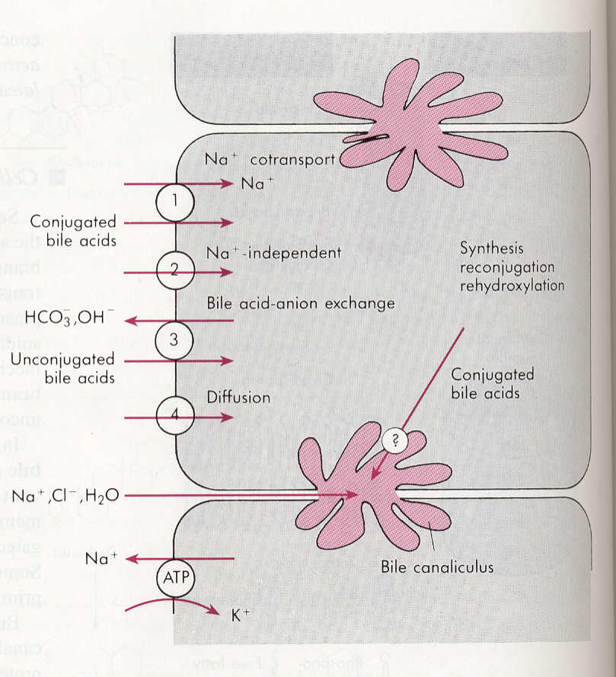
Absorption of bile acids or bile salt back into hepatocytes
Bile salts or bile acids in the portal circulation are absorbed via four pathways into hepatocytes:
An active carrier-mediated process: conjugated bile acids-Na co-transport.
Facilitated diffusion: Na-independent pathway.
Bile acid-HCO3 or Bile acid-OH exchange.
Passive diffusion (very little).

Slide 54
The End

