Slide 1
Candidiasis

Slide 2
Objectives
Students at the end of the lecture will be able to:
Acquire the basic knowledge about Candida as a pathogen
know the main infections caused by Candida species
Identify the clinical settings of such infections
Know the laboratory diagnosis, and treatment of these infections.

Slide 3
The Organism
Candida

Slide 4
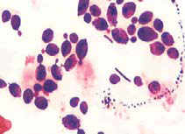
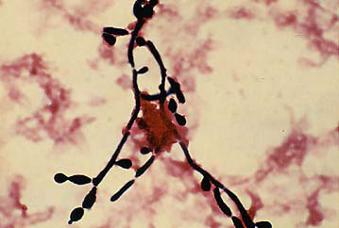
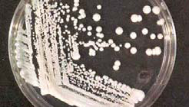
Candida
Candida is a unicellular yeast fungus.
It is imperfect reproducing by budding
Morphology
  Microscopy: Budding yeast cells, and Pseudohyphae.
Culture: Creamy colony, fast growing on Sabouraud Dextrose agar (SDA), Blood agar (48 hr)

Slide 5
Candida
There are many species of Candida (>150)
The common species are:
    Candida albicans,
    C.parapsilosis
    C.tropicalis,
    C.glabrata,
    C.krusei,

Slide 6
Candida
Human commensal
  Oral cavity
  Skin
  Gastrointestinal tract
  Genitourinary tracts

Slide 7
The disease
Candidiasis

Slide 8
Candidiasis
Definition:
  Any infection caused by any species of the yeast fungus Candida.
  The most common invasive fungal infections in immunocompromised patients
  4th most common cause of nosocomial blood stream infection
It is considered opportunistic infection

Slide 9
Candidiasis
Opportunistic Fungal Infections
Alteration in
  Immunity
  Normal physiology
  Normal flora
Damage in the barriers
Clinical – Spectrum of disease

Slide 10
Transmission of Opportunistic Fungi
  ENDOGENOUS
    Colonization precedes infection
    Antibiotic suppression of normal flora, fungal overgrowth
  EXOGENOUS ??

Slide 11
Candida - Clinical
Mucous membrane infections
  Thrush (oropharyngeal)
  Esophagitis
  Vaginitis
Cutaneous infections
  Paronychia (skin around nail bed)
  Onychomycosis (nails)
  Diaper rash
  Chronic mucotaneous candidiasis
    children with T-cell abnormality

Slide 12
Mucocutaneous infections
Oropharyngeal Candidiasis
  Oral thrush:
    White or grey Pseudomembranous patches on oral surfaces especially tongue with underlying erythema.
    Common in neonates, infants, elderly
    In immunocompromised host, e.g. AIDS.
Esophagitis
Vulvovaginitis :
  Common in pregnancy, diabetics, use of contraceptives.
  Thick discharge, itching irritation . Lesion appear as white patches on vaginal mucosa.

Slide 13
Cutaneous infections
Intertriginous candidiasis:
  Infections of skin folds eg. axilla, buttock, toe web, under breast.
  Erythematous lesion, dry or moist or whitish accompanied by itching and burning.
Nail infections:
  Onychomycosis and paronychia
Diaper rash
Chronic mucocutaneous candidiasis

Slide 14
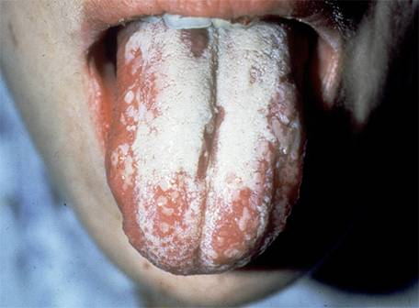
Mucosal candidiasis
Oral thrush

Slide 15
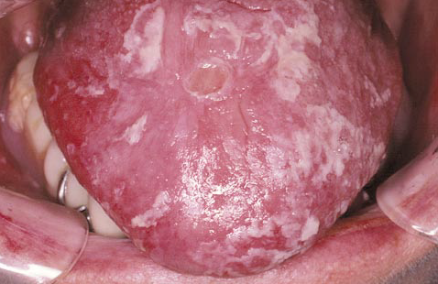
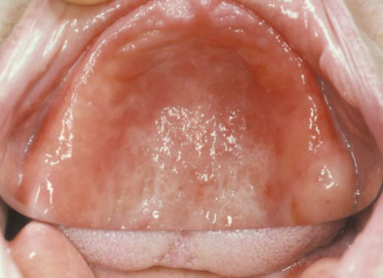
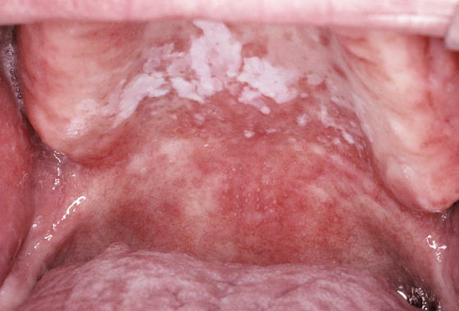
Forms of Oral candidiasis
pseudomembranous form
erythematous form
pseudomembranous-erythematous form.

Slide 16
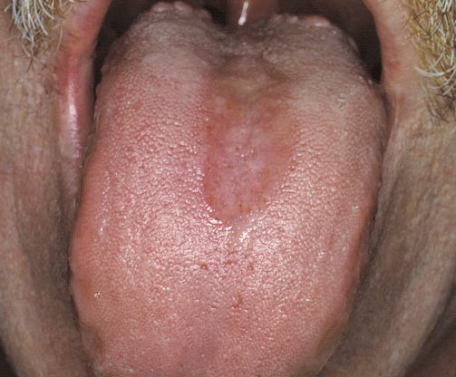
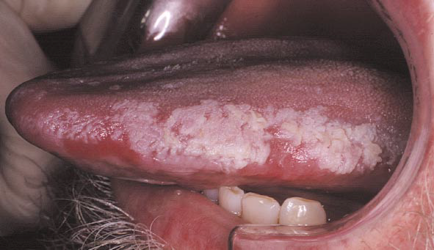
Forms of Oral candidiasis
A)
Painful, depapillation of the tongue dorsum.
B)
Painful hyperplastic Candida of the lateral tongue

Slide 17
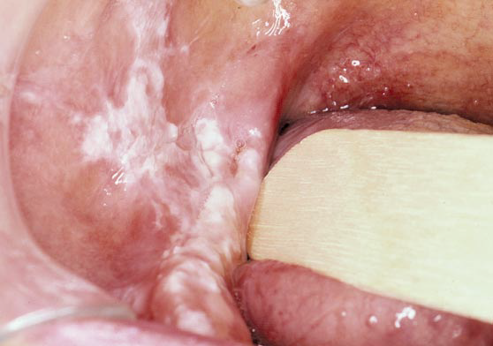
Forms of Oral candidiasis
Hyperplastic candidiasis, that was mistaken for leukoplakia

Slide 18
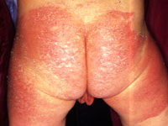
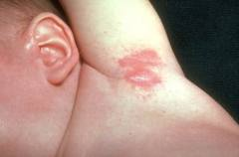
Cutaneous candidiasis

Slide 19
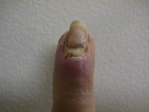
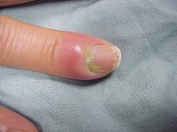
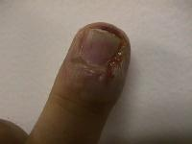

Slide 20
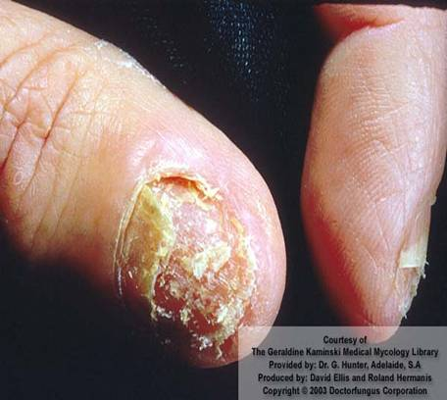
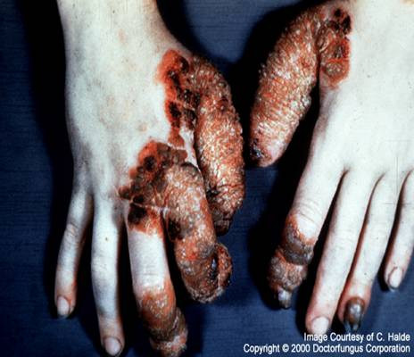
Chronic mucocutaneous candidiasis
Chronic mucocutaneous candidiasis

Slide 21
Candida - Clinical
Urinary tract infection
Candidemia
Disseminated (systemic, invasive) infection
  Endophthalmitis (eye)
  Liver and spleen
  Kidneys
  Skin
  Brain
  Lungs
  Bone

Slide 22
Pulmonary Candidiasis
Primary pneumonia is less common and could be a result of Aspiration
Secondary pneumonia commonly seen with hematogenous candisiasis
Immunocompromised patients
Isolation of Candida from sputum, BAL is not always significant
  Clinical features
  Radiology,
  Other Lab investigations

Slide 23
Candidemia
  Increased colonization (endogenous or exogenous factors)
  Damage in host barriers by catheters, trauma, surgery
  Immunosuppression
  Central venous catheters (CVC)
Disseminated candidiasis (involvement of any organ)
  Septic shock
  Meningitis
  Ocular involvement (retinitis)
Fever could be the only clinical manifestation

Slide 24
Candidemia
Candida is the fourth in causing nosocomial bloodstream infections (BSI)
Wisplinghoff H, et al. Clin Infect Dis. 2004;39:309-317.

Slide 25
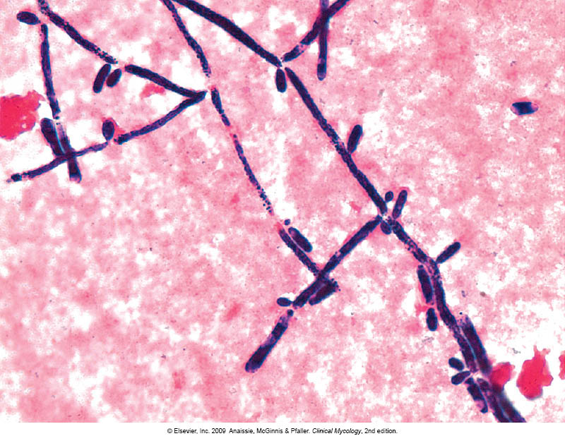
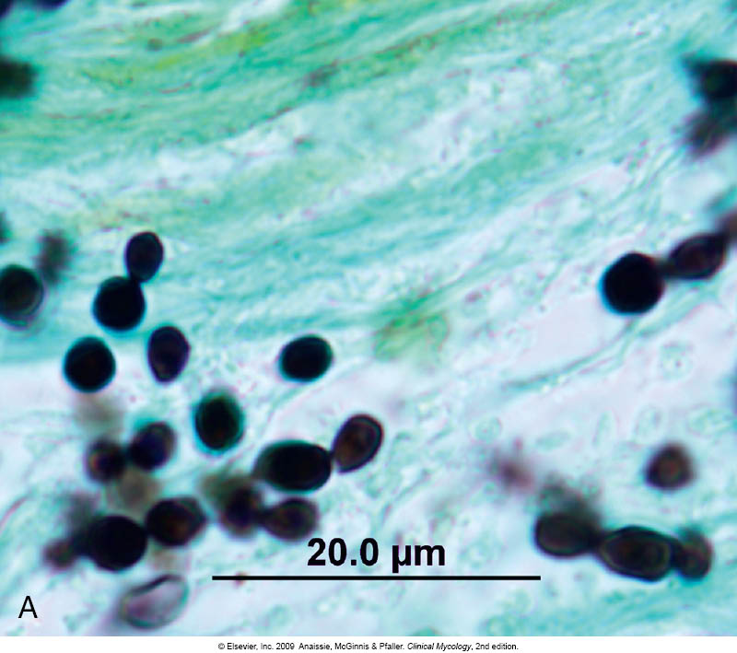
Candidiasis – Laboratory diagnosis
Specimen depend on site of infection.
Swabs, Urine, Blood, Respiratory specimens, CSF, Blood
1. Direct microscopy :
Gram stain, KOH, Giemsa, GMS, or PAS stained smears.
Budding yeast cells and pseudohyphae will be seen in stained smear or KOH.

Slide 26
Candidiasis – Laboratory diagnosis
2. Culture:
Media: SDA & Blood agar at 37ºC,
Creamy moist colonies in 24 - 48 hours.
3. Blood culture

Slide 27
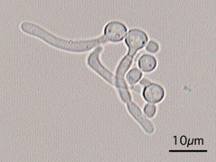
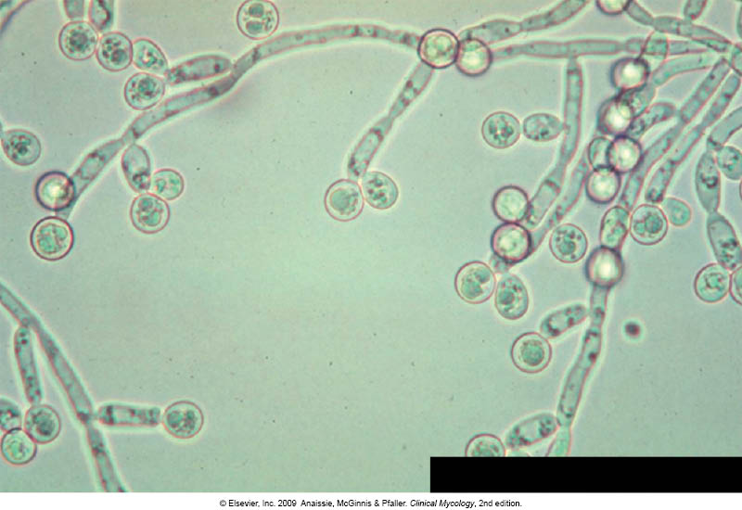
Candidiasis – Laboratory diagnosis
Laboratory identification of Yeast
Because C. albicans is the most common species to cause infection
The following tests are used to identify C. albicans:
  Germ tube test : Formation of germ tube when cultured in
  serum at 37ᵒC
  2. Chlamydospore production in corn meal Agar
  3. Resistance to 500 μg/ml Cycloheximide
If these 3 are positive this yeast is C.albicans,
If negative, then it could be any other yeast,
  Use Carbohydrate assimilations and fermentation.
    Commercial kits available for this like: API 20C, API 32C
  Culture on Chromogenic Media (CHROMagar™ Candida)
Germ tube test
Chlamydospores of C. albicans in CMA

Slide 28
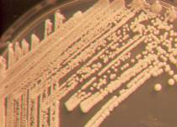
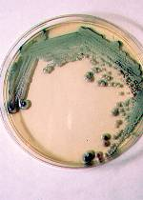
Candida species
Candida albicans
Sabouraud Agar
Morphology: Creamy white yeast,
may be dull, dry irregular and
heaped up, glabrous and tough
Chromagar
producing green pigmented colonies
on specially designed medium to
speciate certain yeasts based on
color they produce

Slide 29
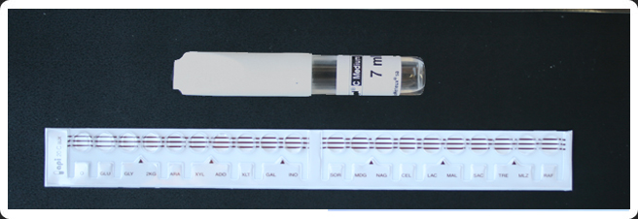
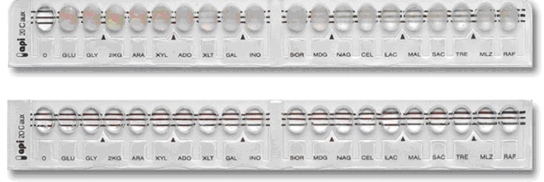
Yeast Identification
Carbohydrates assimilation test , API 20C

Slide 30
Candidiasis – Laboratory diagnosis
4. Serology:
Patient serum
  Test for Antigen , e.g. Mannan antigen using ELISA
  Test for Antibodies
5. PCR

Slide 31
Candidiasis- Treatment
Oropharyngeal:
  Topical Nystatin suspension, Clotrimazole troches ,Miconazole, Fluconazole suspension.
Vaginitis:
  Miconazole, Clotrimazole, Fluconazole
  Systemic treatment of Candidiasis
    Fluconazole
    Voriconazole
    Caspofungin
    Amphotericin
  In candidemia :
    Treat for 14 days after last negative culture and resolution of signs and symptoms
    Remove catheters, if possible

Slide 32
Candidiasis- Treatment
  Antifungal susceptibility testing in not done routinely in the microbiology lab.
  It is done in the following cases:
    For fungi isolated from sterile samples
    If the patient is not responding to treatment
    In case of recurrent infections
  Points to consider:
    C. glabrata can be less susceptible or resistant to fluconazole
    C. krusei is resistant to fluconazole

Slide 33
THANK YOU

