Slide 1
OSTEOPOROSIS

Slide 2
OSTEOPOROSIS
ILOs
By the end of this lecture you will be able to:
Revise the composition, regulation & the remodeling stages of bone turnover
Recognize the interlinks of osteoblastic & osteoclastic function
Relate changes to the development of osteoporosis
Classify drugs according to their replacement, antiresorptive or anabolic mechanism of action
Detail the pharmacology of such group of drugs& their clinical utility in combating osteoporosis

Slide 3
Bone is basically composed of 2 types of tissues
INORGANIC 65% of mass  Consists of hydroxyapatite, calcium & phosphorus salts
Formed during OSTEOGENESIS by MINERALIZATION of the organic matrix (osteoid Frame work) & is mediated by alkaline phosphatase
Organic  35% of mass  Consists of ;
• Organic matrix [OSTEOID]  produced by osteoblasts Bone Framework
• Bone cells are either; Bone Forming or Bone Resorptive
Osteoblasts
Osteocytes
A. Bone Forming Cells:
Osteogenic cells  mesenchymal in origin  are progenitor of blasts & cytes  are found on all bone surfaces
Osteoblasts  forms osteoid framework & help in its mineralization
Osteocytes  sense mechanical stress  signals to both blasts & clasts

Slide 4
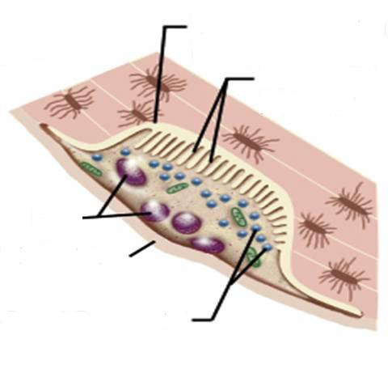
B. Bone Resorptive Cell:
Osteoclastes  myloid in origin  made by fusion of multiple progenitors of monocytes.
Reside in pits (resorption bays) that form by eaten bone surface. Secretes lysosomal enzymes (collagenase & metalloproteinase) + hydrochloric a.  dissolve bone matrix
Osteoclasts
Resorption bay
Ruffled border
Multiple nuclei
Periosteum
NORMALLY
bones continuously form & resorb
○ BONE REMODELING
Under control of systemic hormones, body mineral contents
& local autocrine-paracrine secretions (Cytokines, Growth Factors, PGs)
Lysosomes
It is meant to maintain calcium homeostasis & to renew bone in repair of microdamage & microcracks

Slide 6
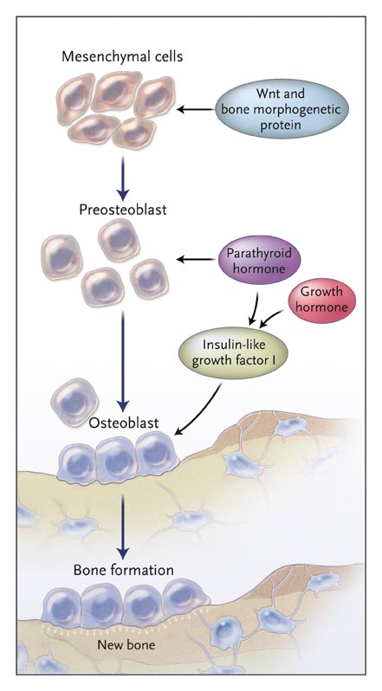
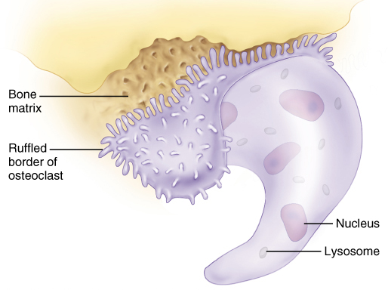
LOCAL FACTORS DRIVING THE REMODELING PROCSS
Osteoprotegerin [OPG]
RANKL
HSC
Myloid Proginator
Monocyte
Pre-Osteoclast
Mature
Osteoclast
Resorbing
Osteoclast

Slide 7
SYSTEMIC HORMONES Controlling Remodeling
1. PARATHORMONE
Maintains calcium homeostasis via
 bone formation ( intermittent) / bone resorption (continuous)
renal tubular calcium reabsorption
 renal calcitriol production
2. CALCITROL
 intestinal Ca & phosphorus absorption  bone mineralization
 bone resorption when they are deficient
3. ESTROGEN & ANDROGEN
◉ Resorption by acting on many local factors
 osteoclast apoptosis & growth factors from osteoblasts
No. & depth of resorption cavities & release of cytokines
4. CALCITONIN
Not much physiological role in man
Pharmacologically   osteoclasts & bone resorption
5. CLUCOCORTICOIDS
 apoptosis of osteoblasts & osteocytes   resorption
6. THYROID HORMONE
 Bone turn-over i.e. resorption & formation
7. Growth hormone & IGFs
 skeletal growth & endochondral bone formation.

Slide 8
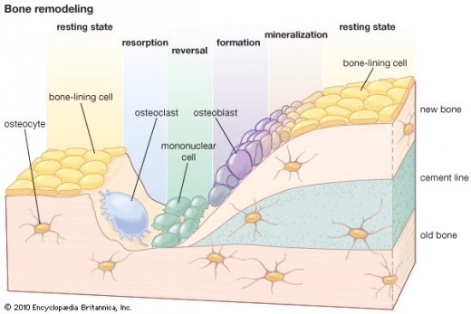
Stages of BONE REMODELING
Occurs at periosteal & endosteal surfaces
1.
2.
3.
4.
5.
2-6 weeks
~2-6 months
Non-mineralized
extracellular matrix (osteoid)
Mineralized extracellular matrix

Slide 9
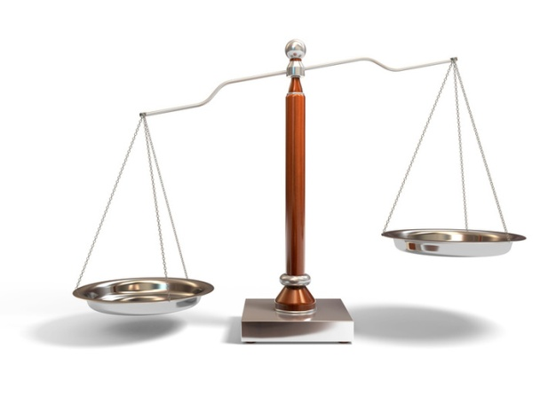
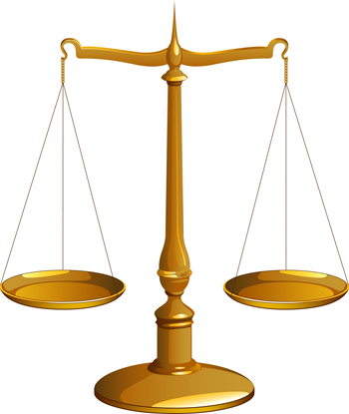
BONE REMODELING
Formation
Resorption
Formation
Resorption
OSTEOPOROSIS
A complex endocrinologic disorder of bone & mineral metabolism
(bone resorption > formation)
Low bone mass
Disruption of bone architecture
Reduced bone strength
Risk of fractures

Slide 10
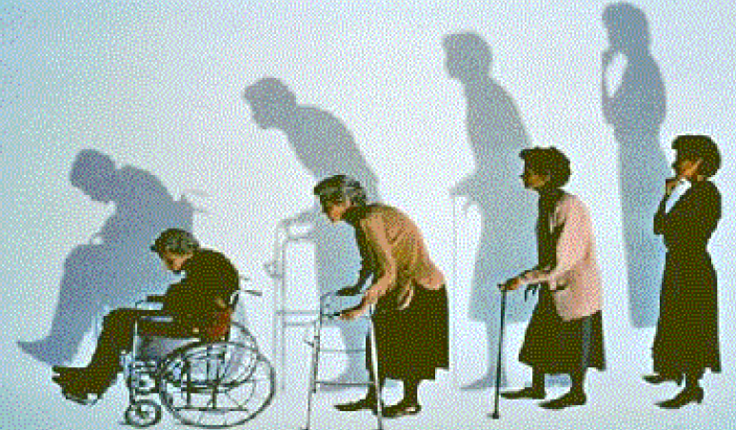
OSTEOPOROSIS
PREVENTION
TREATMENT
Potentially Modifiable | Nonmodifiable
Current cigarette smoking | Personal history of fracture
Diet low in calcium/vitamin D | 1st-degree relative has fracture
Glucocorticoids, anticonvulsants | Race (Caucasian or Asian)
Excessive alcohol intake | Elderly age
Sedentary lifestyle | Poor health
Body weight less than 127 lb | Dementia
Lack of estrogen | Hormonal disorders
Environmental risks | Neoplastic disorders
Poor eyesight | Metabolic abnormalities
History of organ transplants | Connective tissue disorders

Slide 11
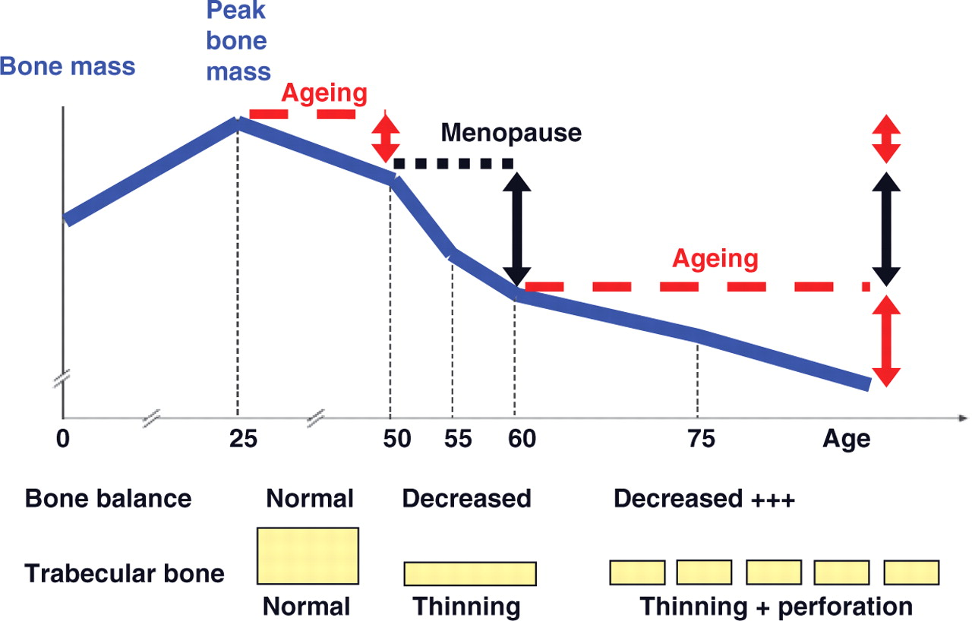

Slide 12
TREATMENT OF OSTEOPOROSIS
Replace what is missing….Ca, Vit D, Na fluoride
Reset back the balance of remodeling
Fluorapatite;
To  trabecular bone when it  in presence of normal cortical bones
ANTIRESORPTIVE AGENTS
BONE ANABOLIC AGENTS

BISPHOSPHONATES
ESTROGEN ANALOGES
ANDROGEN ANALOGES
SERMS
CALCITONIN
RANKL INHIBITORS
TERIPARATIDE




STRONTIUM

Others; Thiazide diuretics, statins

Slide 13
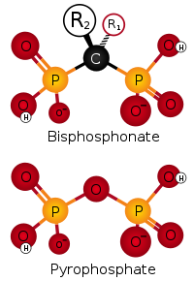
BISPHOSPHONATES
Are compounds that have two phosphonate (PO₃) groups
Non-Nitrogenous
Nitrogenous
Etidronate
Clodronate
Tildronate
Alendronate
Ibandronate
Risedronate
Zoledronate
○ 500
1000
2000
10000
10
10
Mechanism
Are structurally similar to pyrophosphate, thereby inhibiting activation of enzymes that utilize it.
They preferentially "stick" to calcium  concentrate in bones, bound to hydroxapatite.
They prevent bone resorption by inhibiting osteoclast function.
Their relative potencies for osteoclast inhibition is the most with 3rd generation “Zoledronate”
How do they inhibit osteoclasts???  It is taken up during osteoclast resorptive activity  blocks steps in cholestrol synthetic pathway within osteoclast  end up by osteoclast apoptosis

Slide 14
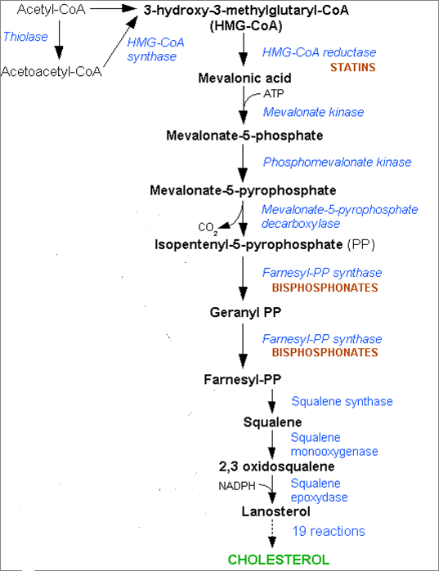
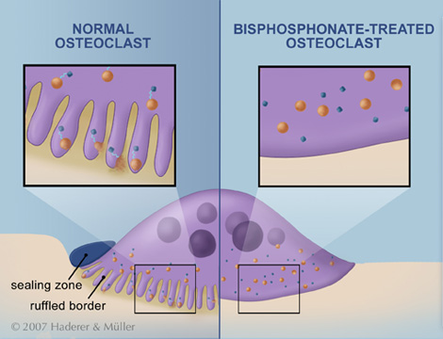
BLOCK STEPS IN CHOLESTROL SYNTHETIC PATHWAY IN OSTEOCLAST
that act as signaling molecules responsible for the osteoclastic hydrolytic & phagocytic activity.
Stop function  apoptosis
Prenylated small GP

Slide 15
BISPHOSPHONATES
Kinetics
Poorly abs (< 10%), food impair absorption more  must be given on an empty stomach. / infused IV.
t_{1/2} 1 hr.
Half of absorbed drug accumulates in bones, remainder  excreted unchanged in urine.
In bone it is retained for months, depending on bone turnover.
Indications
Osteoporosis, 2ndry to menopause, glucocorticoids, ….
Paget’s Disease
Malignancy- associated hypercalcaemia
Dosing
Once weekly, or on two consecutive days each month
Taken 1st thing am with glass of water, on empty stomach then nothing taken after for ½ hr.
Should be taken in upright position.
Separate 4 hrs before giving Ca, Mg, Al containing drugs
Newer preparations can be given as 2 hrs IV infusion (or better over a lesser time), monthly in 1st year then every 3 months after.

Slide 16
BISPHOSPHONATES
ADRs
GIT irritation; nausea, vomiting, gastritis , ulceration  to avoid give large amount of water
Gastro-esophageal reflux + ulcerations  to avoid give on empty stomach while sitting in upright
Flue like manifestations upon IV infusion
Osteo-necrosis of the jaw [ mandible > jaw ] more upon long use with IV infusion preparation usually after dental surgical procedures. It is due to activation of matrix metalloproteinase that cause lysis
Atrial fibrillation > women with alendronate & zolidronate
Contraindications
Decreased renal function
Peptic ulcer / esophageal reflux

Slide 17
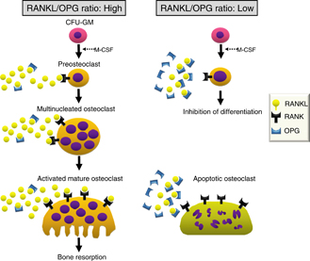
RANKL INHIBITORS
DENOSUMAB
It is a fully human MOA that mimics the activity of osteoprotegrin.
Mechanism
It binds to RANKL, expressed by osteoblasts 
-ve RANKL from interacting with RANK expressed on preosteoclasts   osteoclastogenesis ( no mature osteoclasts).
It binds also to mature osteoclast  its apoptosis
So net effect   bone resorption .
Administration
Subcutaneous every 6 month
Contraindications
In patients with hypocalcemia. Correct Ca & Vit D levels before starting denosumab

Slide 18
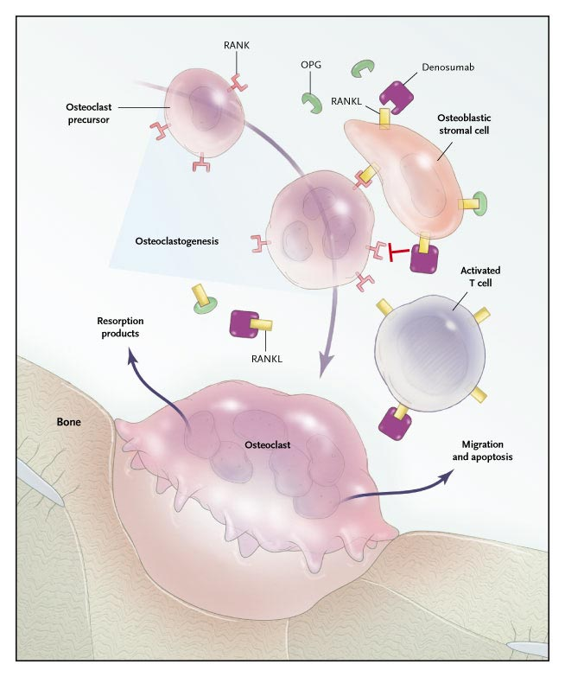
DENOSUMAB
Mechanism
ADRs
Infections;
urinary & respiratory
Eczema & skin rash
Constipation
Cataract
Joint pains

Slide 19
STRONTIUM
Sr²⁺, is a divalent cation, resembling Ca²⁺ in atomic & ionic properties.
It is orally active as distrontium
Mechanism
1st drug to possess “ dual action “ i.e has both anabolic & antiresor-ptive effects resulting in a rebalance in favor of bone formation.
On Osteoblast;
Like Ca, it is an agonist on Ca Sensing Receptor [CaSR] ; that  differentiation of pre-oteoblast to osteoblast  bone formation
It stimulate expression of OPG RANKL binding  -ve of osteo-clustogenesis  bone resorption
On Osteoclast;
Agonist on Ca Sensing Receptor [CaSP] differentiation of pre-oteoclast to osteoclast  osteoclast apoptosis  bone resorption

Slide 20
New Restriction 2013; Increased risk of myocardial infarction

Slide 21
Pharmacokinetics
STRONTIUM
Orally with a modest bioavailability 25%
Binds partially to plasma proteins and strongly to bones
t ½  60 hrs
Excreted mainly by the kidney
Indications
SEVER osteoporosis Elderly, 2ndry to menopause, glucocorticoids
Malignancy- associated hypercalcaemia
Contraindications
In severe renal disease.
In hypersensitivity to it
In increased risk of thromboembolism & MI
In phenylketonuria
Interactions
Precautions
Food specially containing milk+ its products 
Antacids 
Oral tetracycline & quinolones chelate it
2hrs spacing
ADRs
MI
GIT irritation, headache, eczema resolve in 1st 3 months

Slide 22
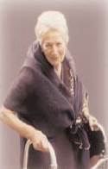
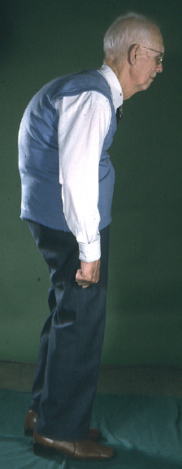
* In fertile period
if hystrectomy
* With progestins if uterus is present
ESTROGENS
HRT
At Menopause
If menopausal Symptoms present
Menopause /
Elderly
SERMs
ANDROGENS
Estrogen in females & Androgen in males
is essential for normal bone remodeling
Elderly men
 osteoclast apoptosis
◉ No. & depth of resorption cavities
 release of growth factors from osteoblasts
◉ release of inflammatory cytokines causing resorption

Slide 23
During Hot
Flashes
Post Vasomotor Symptoms
Pre fracture
Post Fracture
PTH
Risk
of Fracture
Raloxifene
Bisphosphonates
HRT
HRT
Calcitonin
AGE
HRT
Raloxifene
Bisphsphonates
PTH
50 55 60 65 70 75 80 85 90

Slide 24
SERMs
RALOXIFENE
1st selective estrogen R modulator for prevention of osteoporosis
Mechanism
Antiestrogens that exhibits partial agonistic action; acting as an agonist in bone & an antagonist in some female sex organs
 | Brain | Uterus | Vagina | Breast | Bone | CVS
Estradiol | ++ | ++ | ++ | ++ | ++ | ++
Raloxifene | — | — | — | — | + | +
Advantages
 bone density (2%) &  fracture risk (30%)
No stimulation of breast or endometrial tissue
No need for progestin in women with uterus
◉ LDL
Disadvantages
 risk of thromboembolic events
Doesn’t treat well Post-menopausal Symptoms
May  hot flushes
No effect on HDL

Slide 25
OSTEOPOROSIS
GOOD LUCK

