Slide 1
Radiological Anatomy of the Adrenal Gland
Dr. A. Alhawas

Slide 2
Main Objective:
Know the anatomy of adrenal gland in real person through medical imaging (Radiology), and correlated with gross sectional anatomy.

Slide 3
US.
CT.
MR.

Slide 4
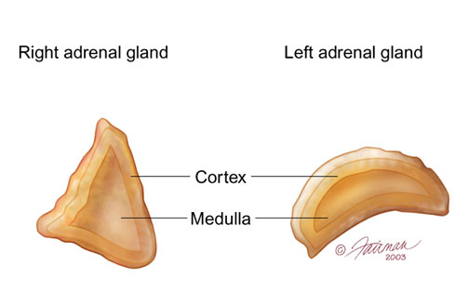

Slide 5
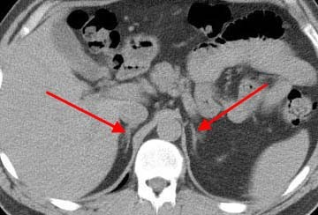

Slide 6
Right adrenal. Left adrenal

Slide 7
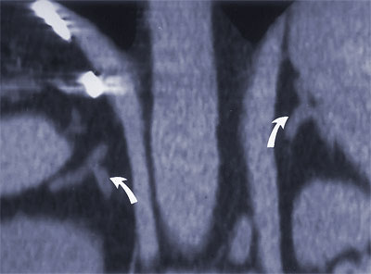

Slide 8
aorta
spleen
Right Diaphragmatic crus
Left kidney
Right kidney

Slide 9
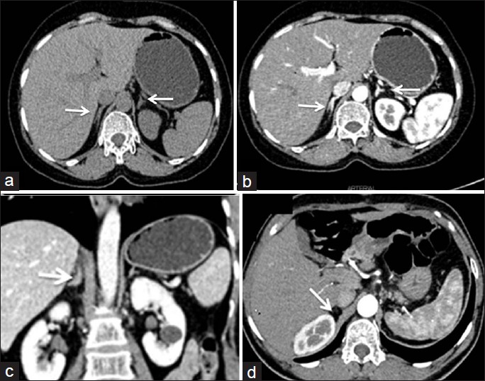

Slide 10
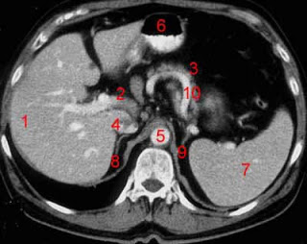

Slide 11
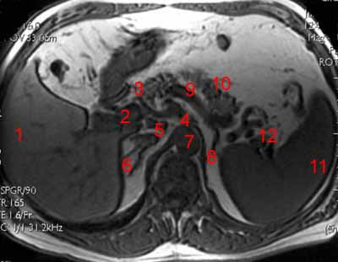

Slide 12
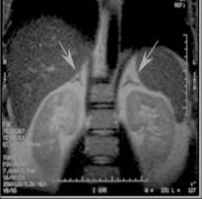

Slide 13
