Slide 1
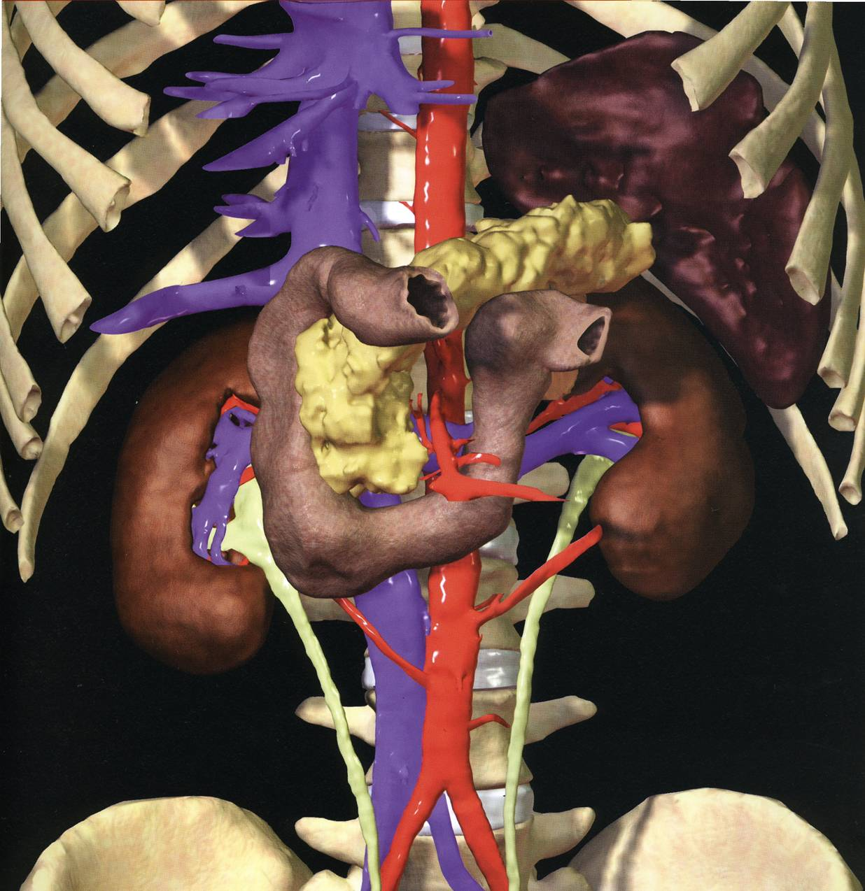
PANCREAS
Dr Saeed Vohra & Dr Jamila Elmedany

Slide 2
OBJECTIVES
By the end of this lecture the student should be able to:
Describe the anatomical view of the pancreas regarding ; location, parts relations, ducts
Know the arterial supply & venous drainage
Describe the nerve supply and lymph drainage

Slide 3
PANCREAS
A Gland with both exocrine and endocrine functions.
The exocrine portion contains enzymes capable for hydrolysis of proteins, fats & carbohydrates.
The endocrine portion is the Islets of Langerhans produce insulin & glucagon.

Slide 4
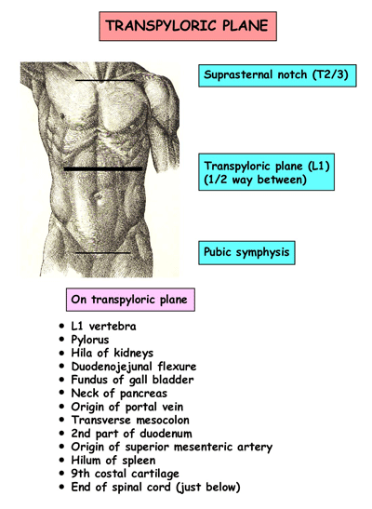
LOCATION
It lies in :
Epigastrium & Left upper quadrant
It is retro-peritoneal,
crosses the posterior abdominal wall in a transverse oblique direction at transpyloric plane pylorus & L1

Slide 5
PARTS
It is divided into:
Head,
Neck,
Body
and Tail.

Slide 6
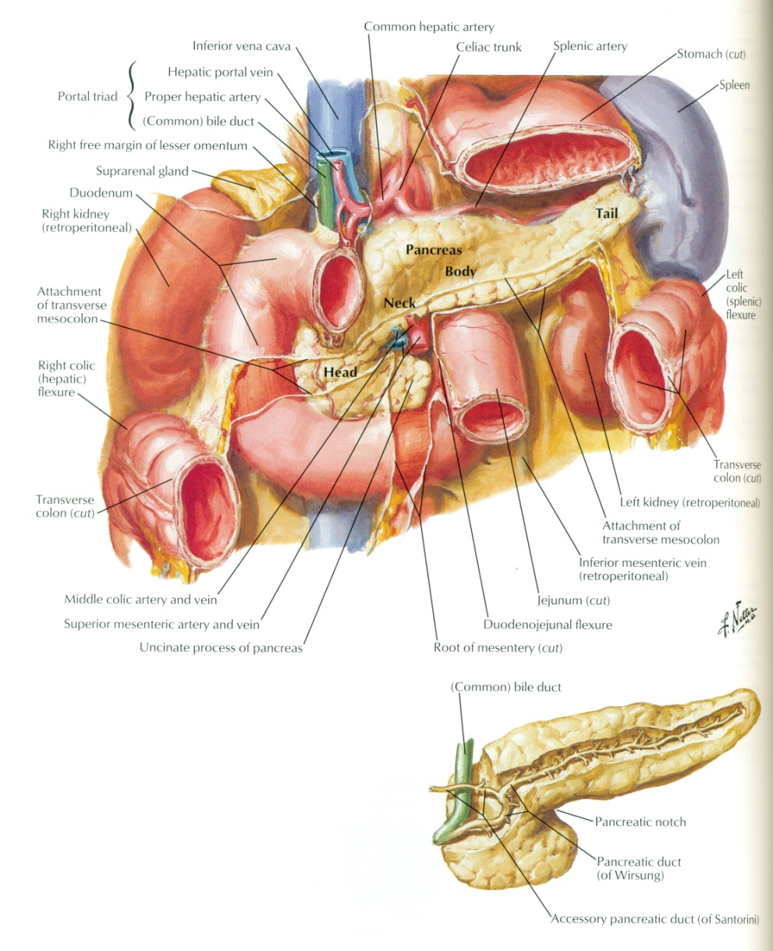
HEAD OF PANCREAS
It is disc shaped
Lies within the concavity of the duodenum
Related to the 2nd and 3rd portions of the duodenum on the right
It emerges into the neck on the left
Includes uncinate process (part to the left behind the superior mesenteric vessels)

Slide 7
NECK OF PANCREAS
The constricted portion connecting the head & body of pancreas
It lies in front of origin of superior mesenteric artery and the confluence of the portal vein
Its antero-superior surface supports the pylorus of the stomach
The superior mesenteric vessels emerge from its inferior border

Slide 8
BODY OF PANCREAS
It runs upward and to the left.
It is triangular in cross section.
The splenic vein is embedded in its post. surface

Slide 9
TAIL OF PANCREAS
A narrow, short segment
lies at the level of the 12th thoracic vertebra
Ends within the splenic hilum
Lies in the splenicorenal ligament
Anteriorly, related to splenic flexure of colon
May be injured during splenectomy

Slide 10
ANTERIOR RELATIONS
The stomach is separated from it by lesser sac
Transverse colon &
transverse mesocolon

Slide 11
POSTERIOR RELATIONS
Bile duct, portal & splenic veins, inferior vena cava, aorta & origin of superior mesenteric artery
Left psoas muscle, left adrenal gland, left renal vessels & upper 1/3rd of left kidney
Hilum of the spleen

Slide 12
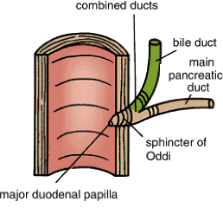
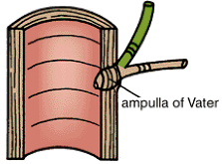
PANCREATIC DUCTS
Main duct runs the entire length of pancreas beginning from the tail
It receives many tributaries.
Joins common bile duct & together they open into a small hepatopancreatic ampulla (Ampulla of Vater) within the wall of the duodenal.
The ampulla opens into the lumen of the duodenum by means of a small Papilla, (Major Duodenal Papilla).

Slide 13
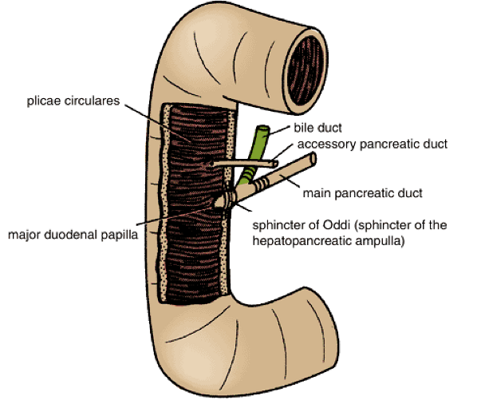
ACCESSORY PANCREATIC DUCTS
(of Santorini) drains superior portion of the head
It empties separately into 2nd portion of duodenum at (minor duodenal papilla)

Slide 14
ARTERIAL SUPPLY OF PANCREAS
It is supplied by: Celiac trunk, superior mesenteric artery & Splenic arteries
Celiac → Gastrodeudenal → Superior pancreaticoduodenal artery
SMA → Inferior pancreaticoduodenal
Splenic A supplies the Body and tail of pancreas by about 10 branches

Slide 15
VENOUS DRAINAGE OF PANCREAS
Follows arterial supply
Anterior and posterior arcades drain head and the body
Splenic vein drains the body and tail
Ultimately, into Portal Vein

Slide 16
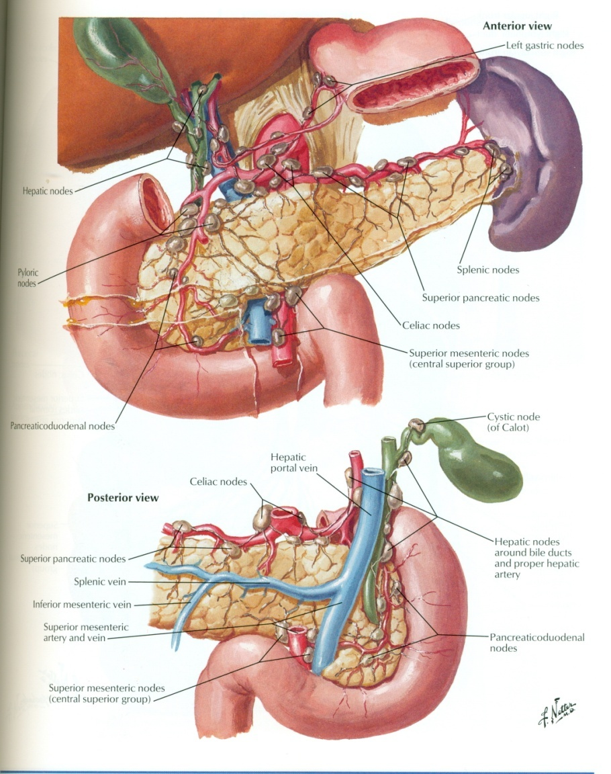
LYMPHATIC DRAINAGE
Rich network that drains into 5 nodal groups
Ultimately the efferent vessels drain into the Celiac & superior mesenteric lymph nodes.

Slide 17
INNERVATION OF PANCREAS
Sympathetic fibers from the splanchnic nerves
Parasympathetic fibers from the vagus
Parasympathetic fibers stimulate both exocrine and endocrine secretions

Slide 18
Thank you

