Slide 1
Diabetes Mellitus
Emad Raddaoui, MD, FCAP, FASC

Slide 2
Diabetes Mellitus
Learning objectives:
The student should have an understanding of the pathogenesis and major histopathological changes seen in diabetes mellitus type 1 and type 2.
The student should recognize the major complications of diabetes mellitus.

Slide 3
THE ENDOCRINE PANCREAS
1 million clusters of cells, the islets of Langerhans, which contain four major and two minor cell types.
The four main types are β, α, δ, and PP (pancreatic polypeptide) cells.
The β cell produces insulin, as will be detailed in the discussion of diabetes.
The α cell secretes glucagon .
δ cells contain somatostatin, which suppresses both insulin and glucagon release.
PP cells contain a unique pancreatic polypeptide.
The two rare cell types are D1 cells and enterochromaffin cells.
Notes:
- PP cells exerts several gastrointestinal effects, such as stimulation of secretion of gastric and intestinal enzymes and inhibition of intestinal motility.
D1 cells elaborate vasoactive intestinal polypeptide (VIP), a hormone that induces glycogenolysis and hyperglycemia; it also stimulates gastrointestinal fluid secretion and causes secretory diarrhea.
Enterochromaffin cells synthesize serotonin and are the source of pancreatic tumors that cause the carcinoid syndrome .

Slide 4
Diabetes Mellitus
Sir William Osler defined diabetes mellitus as “a syndrome due to a disturbance in carbohydrate metabolism from various causes, in which sugar appears in the urine, associated with thirst, polyuria, wasting and imperfect oxidation of fats.”

Slide 5
Diabetes Mellitus
Major health problem that affects increasing numbers of persons in the developed world.
Group of metabolic disorders sharing the common underlying feature of hyperglycemia
According to the American Diabetes Association, diabetes affects over 20 million children and adults, or 7% of the population, in the United States
Approximately 1.5 million new cases of diabetes are diagnosed each year in the United States, and
Diabetes is the leading cause of end-stage renal disease, adult-onset blindness, and non traumatic lower extremity amputations
Two major forms of diabetes mellitus are recognized, distinguished by their underlying pathophysiology.

Slide 6
Diagnosis of DM
Any one of three criteria:
1- A random glucose concentration greater than 200 mg/dL, with classical signs and symptoms .
2- A fasting glucose concentration greater than 126 mg/dL on more than one occasion.
3- An abnormal oral glucose tolerance test (OGTT), in which the glucose concentration is greater than 200 mg/dL 2 hours after a standard carbohydrate load.
Notes:
Those with fasting glucose concentrations greater than 100 mg/dL but less than 126 mg/dL, or OGTT values greater than 140 mg/dL but less than 200 mg/dL, are considered to have impaired glucose tolerance, also known as "pre-diabetes.“
Pre-diabetic individuals have a significant risk of progressing to overt diabetes over time, with as many as 5% to 10% advancing to diabetes mellitus per year. In addition, pre-diabetics are at risk for cardiovascular disease.

Slide 7
Classification of DM
1. Type 1 diabetes (β-cell destruction, usually leading to absolute insulin deficiency)
2. Type 2 diabetes (combination of insulin resistance and β-cell dysfunction)
3. Genetic defects of β-cell function:
Maturity-onset diabetes of the young (MODY), caused by mutations in:
Hepatocyte nuclear factor 4α (HNF4A), MODY1
Glucokinase (GCK), MODY2
Hepatocyte nuclear factor 1α (HNF1A), MODY3
Pancreatic and duodenal homeobox 1 (PDX1), MODY4
Hepatocyte nuclear factor HNF1β, also known as transcription factor 2 (TCF2) (HNF1B), MODY5
Neurogenic differentiation factor 1 (NEUROD1), MODY6

Slide 8
Classification of DM
4. Genetic defects in insulin action
Type A insulin resistance, Lipoatrophic diabetes, including mutations
in PPARG
5. Exocrine pancreatic defects: Chronic pancreatitis, Neoplasia, Cystic fibrosis…
7. Infections: CMV, Coxsackie B virus, Congenital rubella
8. Drugs: Glucocorticoids, Thyroid hormone, Interferon-α, β-adrenergic agonists…
9. Genetic syndromes associated with diabetes: Down’s, Kleinfelter syndrome, Turner syndrome, Prader-Willi syndrome
10. Gestational diabetes mellitus

Slide 9
Type 1 Diabetes Mellitus Type 2 Diabetes Mellitus
- Diabetes Usually before 20 - Abrupt; symptomatic (polyuria, polydipsia, dehydration); often sever with ketoacidosis Normal weight ; recent weight loss is common -Genetics <20% Monozygotic Twins 50% concordant HLA Association , ABS to islet cell AG + Histopatholog . Early—inflammation . Late—atrophy and fibrosis B-cell mass: Markedly reduced Insulin levels :Markedly reduced | Usually after 30 Gradual; usually subtle Overweight >60% 90% concordant No -Histopathology: Late-Fibrosis, amyloid Normal or slightly reduced Elevated or normal

Slide 10
Management
Type 1 :Insulin absolutely required
Type 2 : lifestyle modification; diet, exercise, oral drugs, often insulin supplement needed

Slide 11
T1DM
Type 1 diabetes mellitus (T1DM), formerly known as insulin-dependent (IDDM)or juvenile-onset diabetes, is caused by autoimmune destruction of the insulin-producing B-cells in the pancreatic islets of Langerhans, and affects less than 10% of all patients with diabetes

Slide 12
Type 2 DM
Type 2 diabetes mellitus, formerly known as non–insulin-dependent(NIDDM)or maturity-onset diabetes, is typically associated with obesity and results from a complex interrelationship between resistance to the metabolic action of insulin in its target tissues and inadequate secretion of insulin from the pancreas

Slide 13
DM, Other Forms
Gestational diabetes develops in a few percent of pregnant women, owing to the insulin resistance of pregnancy combined with a B-cell defect, but almost always abates following parturition.
Diabetes can also occur secondary to other endocrine conditions or drug therapy, especially in patients with Cushing’s syndrome or during treatment with glucocorticoids.

Slide 14
MODY
Maturity-onset diabetes of the young (MODY) :
Rare autosomal dominant form of inherited diabetes.
Associated with a variety of gene defects that affect B-cell function, including glucokinase, an important sensor for glucose metabolism within the B-cell, and several mutations in genes that control the development and function of the B-cells.
Mutations in these genes, however, do not account for the typical prevalent forms of T2DM.

Slide 15
Type 1 Diabetes Mellitus
Autoimmune destruction of the B cells in the islets of Langerhans.
The disease is characterized by:
Few if any functional B cells in the islets of Langerhans and
Extremely limited or nonexistent insulin secretion.
As a result, body fat rather than glucose is preferentially metabolized as a source of energy. In turn, oxidation of fat overproduces ketone bodies (acetoacetic acid and B-hydroxybutyric acid), which are released into the blood from the liver and lead to metabolic ketoacidosis.

Slide 16
Type 1 Diabetes Mellitus
- Hyperglycemia results from unsuppressed hepatic glucose out-put and reduced glucose disposal in skeletal muscle and adipose tissue and leads to glucosuria and dehydration from loss of body water into the urine.
- If uncorrected, the progressive acidosis and dehydration ultimately lead to coma and death

Slide 17
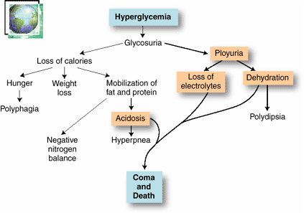

Slide 18
T1DM, EPIDEMIOLOGY
- T1DM is most common among northern Europeans and their descendants and is not seen as frequently among Asians, African-Americans, or Native Americans.
- Can develop at any age, the peak age of onset coincides with puberty.
- Some older patients may present with autoimmune B-cell destruction that has developed slowly over many years.
- An increased incidence in late fall and early winter has been documented in many geographical areas.

Slide 19
T1DM ,PATHOGENESIS
Represents interplay of genetic susceptibility , autoimmunity and environmental factors.

Slide 20
T1DM ,PATHOGENESIS
Genetic Factors:
Genome-wide association studies have identified multiple genetic susceptibility loci for type 1 diabetes, as well as for type 2 diabetes
For type 1 diabetes the most important is the HLA locus on chromosome 6p21
Ninety to 95% of Caucasians with this disease have either a HLA-DR3 or HLA-DR4 haplotype(N: 30-40%)
40% to 50% of type 1 diabetics are combined DR3/DR4 heterozygotes (Normal 5%)
Several non-HLA genes also confer susceptibility to type 1 diabetes.

Slide 21
T1DM ,PATHOGENESIS
1- GENETIC FACTORS:
- Fewer than 20% of those with T1DM have a parent or sibling with the disease.
- Monozygotic twins : 50% concordant
- The children of fathers withT1DM are three times more likely to develop the disease than are children of diabetic mothers

Slide 22
T1DM, PATHOGENESIS
2- AUTOIMMUNITY:
Patients who die shortly after the onset of the disease often exhibit an infiltrate of mononuclear cells in and around the islets of Langerhans, termed insulitis

Slide 23
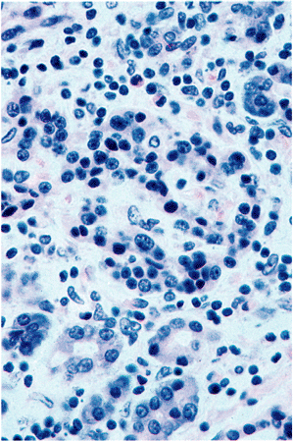
Insulitis

Slide 24
T1DM, Autoimmunity
- Cell-mediated immune mechanisms are fundamental to the pathogenesis of T1DM ,CD8+T lymphocytes pre-dominate, although some CD4+cells are also present.
- The infiltrating inflammatory cells also elaborate cytokines, for example, IL-1, IL-6, interferon-alpha, and nitric oxide, which may further contribute to B cell injury.
- An autoimmune origin for T1DM was initially suggested by the demonstration of circulating antibodies against components of the B cells (including insulin itself) in most newly diagnosed children with diabetes.

Slide 25
T1DM, Autoimmunity
- Many patients develop islet cell antibodies months or years before insulin production decreases and clinical symptoms appear.
- Detection of serum antibodies to islet cells and certain islet antigens remains a useful clinical tool for differentiating between type 1 and type 2 diabetes
- The destruction of B-cells in T1DM generally develops slowly over years .

Slide 26
T1DM , PATHOGENESIS
3- ENVIRONMENTAL FACTORS:
- Viruses and chemicals, CMV, Mumps and group B Coxsackie, Rubella viruses.
- Geographical and seasonal differences in the incidence of T1DM further suggest that environmental factors are important in its pathogenesis.

Slide 27
PATHOLOGY
- Lymphocytic infiltrate in the islets (insulitis), sometimes accompanied by a few macrophages and neutrophils
- As the disease becomes chronic, the B cells of the islets are progressively depleted of Beta cells
- Fibrosis of the islets is uncommon.
- In contrast to T2DM, deposition of amyloid in the islets of Langerhans is absent in T1DM.
- The exocrine pancreas in chronic T1DM often exhibits diffuse interlobular and interacinar fibrosis, accompanied by atrophy of the acinar cells.

Slide 29
Type 2 DM, Epidemiology
- Almost 10%of persons older than 65 years of age are affected, and 80% of patients with T2DM are overweight
- Heterogeneous disorder characterized by a combination of reduced tissue sensitivity to insulin and inadequate secretion of insulin from the pancreas.
- The disease usually develops in adults, with an increased prevalence in obese persons and in the elderly.

Slide 30
Type 2 DM, Epidemiology
- Recently, T2DM has been appearing in increasing numbers in younger adults and adolescents, owing to worsening obesity and lack of exercise in this age group.
- Hyperglycemia in T2DM is a failure of the B-cells to meet an increased demand for insulin in the body.

Slide 31
T2 DM, PATHOGENESIS
- Complex interplay between underlying resistance to the action of insulin in its metabolic target tissues and reduction in glucose-stimulated insulin secretion.
- Progression to overt diabetes in susceptible populations occurs most commonly in patients exhibiting both of these defects

Slide 32
T2 DM, Pathogenesis
1- GENETIC FACTORS:
- Multi-factorial
- Sixty percent of patients have either a parent or a sibling with the disease.
- Among monozygotic twins, both are almost always affected.
- No association with genes of the major histocompatibility complex (MHC), as seen in T1DM
- The inheritance pattern is complex and thought to be due to multiple interacting susceptibility genes.
- Constitutional factors such as obesity (which itself has strong genetic determinants),hypertension, and the amount of exercise influence the phenotypic expression of the disorder

Slide 33
T2 DM, Pathogenesis
2- GLUCOSE METABOLISM:
- In a normal person, the extracellular concentration of glucose in fed and fasting states is maintained in a tightly limited range.
- This rigid control is mediated by the opposing actions of insulin and glucagon.
- Following a carbohydrate-rich meal, absorption of glucose from the gut leads to an increase in blood glucose, which stimulates insulin secretion by the pancreatic B-cells and the consequent insulin-mediated increase in glucose uptake by skeletal muscle and adipose tissue.
- At the same time, insulin suppresses hepatic glucose production.

Slide 34
T2 DM, Pathogenesis
3- B-CELL FUNCTION:
- Persons with T2DM exhibit impaired B-cell insulin release in response to glucose stimulation
- This functional abnormality is specific for glucose, since the B-cells retain the ability to respond to other stimulants, such as amino acids.
- B-cell function may also be affected by the chronically elevated plasma levels of free fatty acids that occur in obese persons.

Slide 35
T2 DM , Pathology
- No consistent reduction in the number of B-cells
- No morphologic lesions of B- cells
- In some islets, fibrous tissue accumulates, sometimes to such a degree that they are obliterated.
- Islet amyloid is often present particularly in patients over 60 years of age.

Slide 37
Complications of Diabetes
Diabetic Microvascular Disease:
- Responsible for Many of the Complications of Diabetes, Including Renal Failure and Blindness
- Arteriolosclerosis and capillary basement membrane thickening are characteristic vascular changes in diabetes.
- The frequent occurrence of hypertension contributes to the development of the arteriolar lesions. In addition, deposition of basement membrane proteins, which may also become glycosylated, increases in diabetes.
- Aggregation of platelets in smaller blood vessels and impaired fibrinolytic mechanisms have also been suggested as playing a role in the pathogenesis of diabetic microvascular disease.

Slide 38
Complications of Diabetes
Diabetic Microvascular Disease:
- The effects of microvascular disease on tissue perfusion and wound healing are profound
- Reduce blood flow to the heart, which is already compromised by coronary atherosclerosis.
- Healing of chronic ulcers that develop from trauma and infection of the feet in diabetic patients is commonly defective

Slide 39
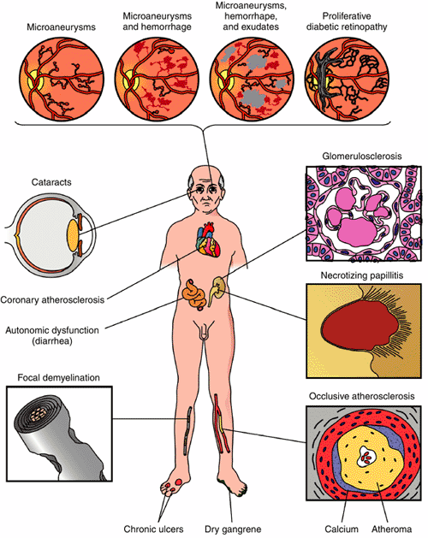

Slide 41
Diabetic Nephropathy
- 30% to 40% of T1DM ultimately develop renal failure. A somewhat smaller proportion (up to 20%) of patients with T2DM are similarly affected
- Diabetic nephropathy accounts for one third of all new cases of renal failure.
- The prevalence of diabetic nephropathy increases with the severity and duration of the hyperglycemia.
- Kidney disease due to diabetes is the most common reason for renal transplantation in adults.
- The glomeruli in the diabetic kidney exhibit a unique lesion termed Kimmelstiel-Wilson disease or nodular glomerulosclerosis

Slide 43
Diabetic Retinopathy
- The most devastating ophthalmic complication of diabetes
- The most important cause of blindness in the Unites States in persons under the age of 60 years.
- The risk is higher in T1DM than in T2DM.
- 10% of patients with T1DM of 30 years’ duration become legally blind. There are many more patients with T2DM, so these are the most numerous patients with diabetic retinopathy.

Slide 44
Diabetic Neuropathy
- Characterized by pain and abnormal sensations in the extremities.
- The most common and distressing complications of diabetes.
- Microvasculopathy involving the small blood vessels of nerves contributes to the disorder.
- Affects Sensory and Autonomic Innervations, Peripheral sensory impairment, and autonomic nerve dysfunction.

Slide 45
Diabetic Neuropathy
- Changes in the nerves are complex, and abnormalities in axons, the myelin sheath, and Schwann cells have all been found.
- Peripheral neuropathy can leads to foot ulcers.
- Plays a role in the painless destructive joint disease that occasionally occur.

Slide 46
Infections
- Bacterial and Fungal Infections Occur in Diabetic Hyperglycemia if Poorly Controlled
- Renal papillary necrosis may be a devastating complication of bladder infection.
- Mucormycosis: A dangerous infectious complication of poorly controlled diabetes is often fatal fungal infection tends to originate in the nasopharynx or paranasal sinuses and spreads rapidly to the orbit and brain.

Slide 47
Gestational diabetes
- Diabetes Occurring During Pregnancy
- May Put both Mother and Fetus at risk
- Develops in only a few percent of seemingly healthy women during pregnancy.
-It may continue after parturition in a small proportion of these patients.
- Pregnancy is a state of insulin resistance.
- These women highly susceptible to overt T2DM later in life.

