Slide 1
Calcium homeostasis and bone metabolism

Slide 2
Regulation of Calcium Metabolism
Minerals; serum concentration
Calcium (Ca²⁺) = 2.2-2.6 mM/L (total)
Phosphate (HPO₄²⁻) = 0.7-1.4mM/L
Organ systems that play an import role in Ca²⁺ metabolism
Skeleton
GI tract
Kidney
Calcitropic Hormones
Parathyroid hormone (PTH)
Calcitonin (CT)
Vitamin D (1,25 dihydroxycholecalciferol)
Parathyroid hormone related peptide (PTHrP), is markedly elevated in humoral hypercalcemia of malignancy ( sq. cell carcinoma of the lung).

Slide 3
The total serum Ca²⁺ conc. is normally about 10mg/dl. Free ionized Ca²⁺ is about 50% of the total = (5mg/dl).

Slide 4
Increase in protein con. → ↑ in total Ca²⁺ conc.
Decrease in protein con. → ↓ in total Ca²⁺ conc.
The effects on ionized Ca²⁺ conc. are insignificant.
Changes in anion con. alter the ionized Ca²⁺ con. e.g.
↑ plasma phosphate con. → ↑ in the conc. of Ca²⁺ complexd to phosphate → ↓ ionized Ca²⁺ con.
Ca²⁺ affects the Na⁺ permeability of nerve membranes.
↓ plasma Ca²⁺ → Generation of spontaneous action potentials in nerves → tetany

Slide 5
Acid-base abnormalities alter the ionized Ca²⁺ con. by changing the fraction of Ca²⁺ bound to plasma albumin.
Albumin has negatively charged sites, which can bind either H⁺ ions or Ca²⁺ ions.
Acidosis Alkalosis
Ionized [Ca²⁺ ] Ionized [Ca²⁺ ]
Hyperventilation → Respiratory alkalosis →
↓ ionized Ca²⁺ → Tetany.
H
H
H
Ca⁺⁺
Albumin
H
Albumin
Ca⁺⁺
Ca⁺⁺
Ca⁺⁺
Ca⁺⁺
Ca⁺⁺

Slide 6
Calcium Homeostasis
Parathyroid gland
Skeleton
Intestine
Ca⁺⁺
Vitamin D
Kidneys
Notes:
Bone is not metabolically inert there is a constant movement of calcium from bone and the ECF in bone remodelling

Slide 7
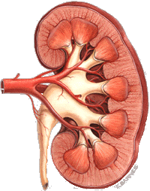
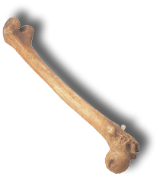
Calcium homeostasis
storage
kidney
bone
calcium deposition
Blood
Ca++
calcium resorption
1000 g Ca++ stored in bone
intake
Ca++ absorbed into blood
Ca++
lost in urine
excretion
Calcium in the diet
calcium lost in feces
small intestine
Notes:
Think of it this way:
Calcium is ingested through the gut (get more Ca++ into system)
Calcium is secreted out of the body through the urine and the feces
Calcium is stored in the bones
To understand how calcium regulation occurs at the bone, we need to understand how bones work…

Slide 8
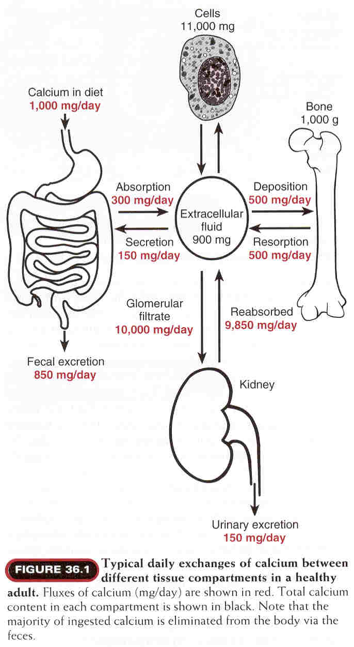

Slide 9
Bone
Inorganic (67%)
Hydroxyapatite 3 Ca₁₀(PO₄)₆(OH)₂
There is some amorphous calcium phosphate
Organic (33%) component is called osteoid
Type I collagen (28%)
Non-collagen structural proteins (5%)
Growth factors and cytokines (Trace)
Bone undergoes continuous turnover or remodeling throughout life
About 20% of bone is undergoing remodeling at any one time.

Slide 10
Calcium cycling in bone tissue
Bone formation
Osteoblasts (bone builders)
Synthesize a collagen matrix that
holds Calcium Phosphate in
crystallized form.
Once surrounded by bone,
become osteocyte.
Bone resorption
Osteoclasts (bone breakers)
Change local pH, causing Ca++ and
phosphate to dissolve from crystals
into extracellular fluids.
Notes:
Two processes: bone formation and bone resorption, going on continuously
Calcium phospate crystals called ‘hydroxyapatite’
surface of crystals can exchange Ca++ and phosphate ions with extracellular fluid
Write on board:
-osteoblasts: builds bone (takes up Ca++ into bone)
-osteoclasts: breaks down bone (removes Ca++ from bone)
Now that we understand how calcium cycling happens at the bone, we can go back to the overall picture

Slide 11
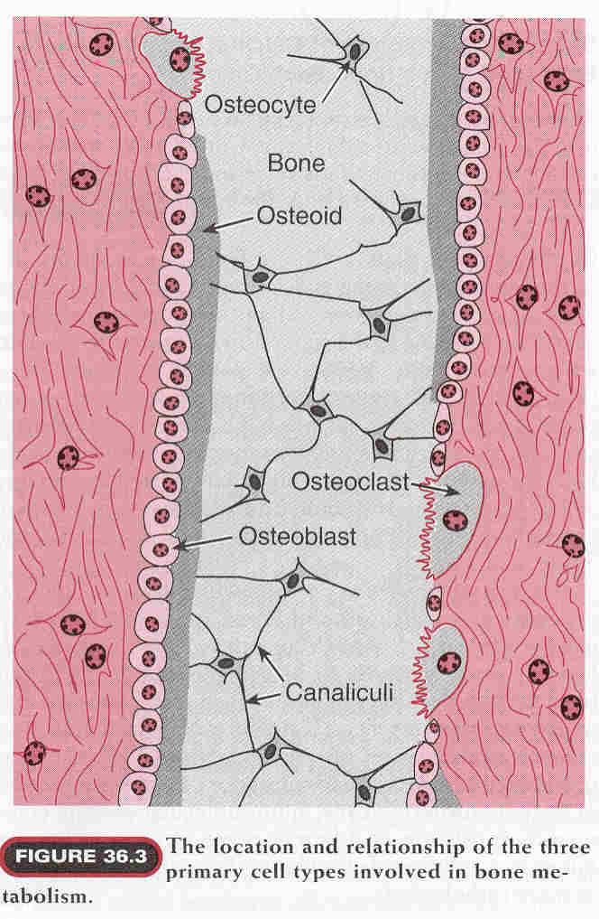

Slide 12
Functions of Calcium
Total serum calcium 2.15 - 2.6 mmol/L
Regulate neuromuscular excitability
Blood coagulation
Secretory processes
Membrane integrity
Plasma membrane transport
Enzyme reactions
Release of hormones and neurotransmitters
Bone mineralization

Slide 13
Phosphorus
Important role in cellular metabolism
Source of energy in cellular reactions
Component of phospholipids in membranes

Slide 14
Inorganic constituents of bone
constituent
%age of total body content
Present in bone
Calcium
Phosphate
Carbonate
Magnesium
Sodium
Water
99
86
80
50
35
9

Slide 15
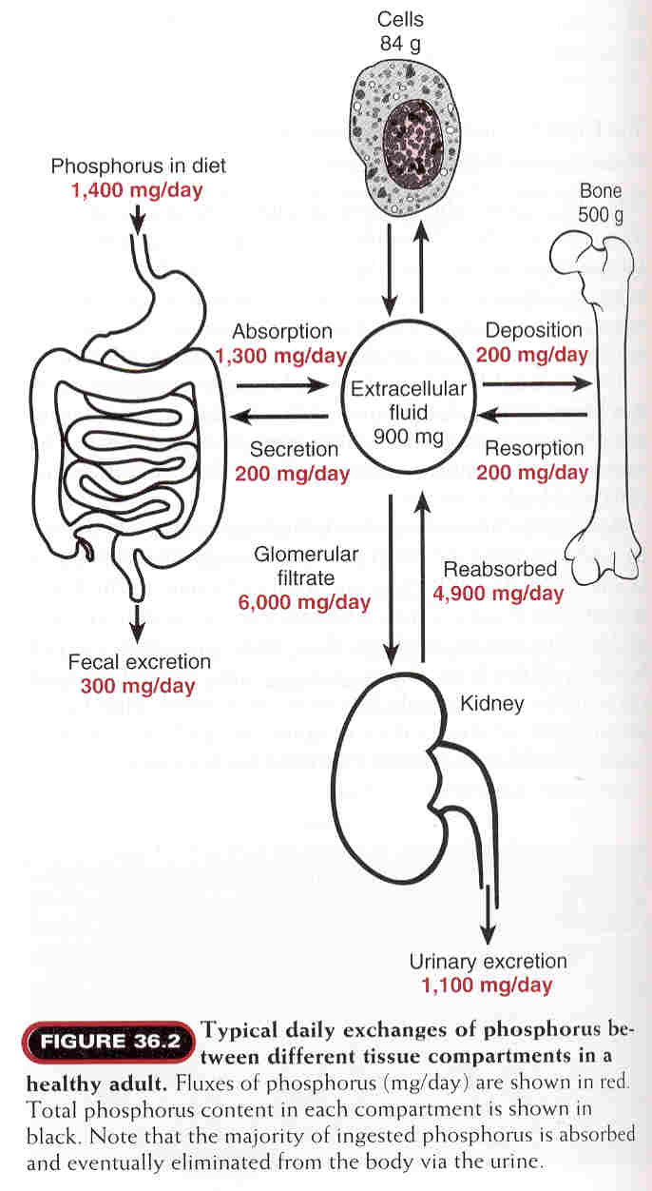

Slide 16
The Parathyroid Hormone
Secreted by the parathyroid glands.
Stimulated by hypocalcaemia.

Slide 17
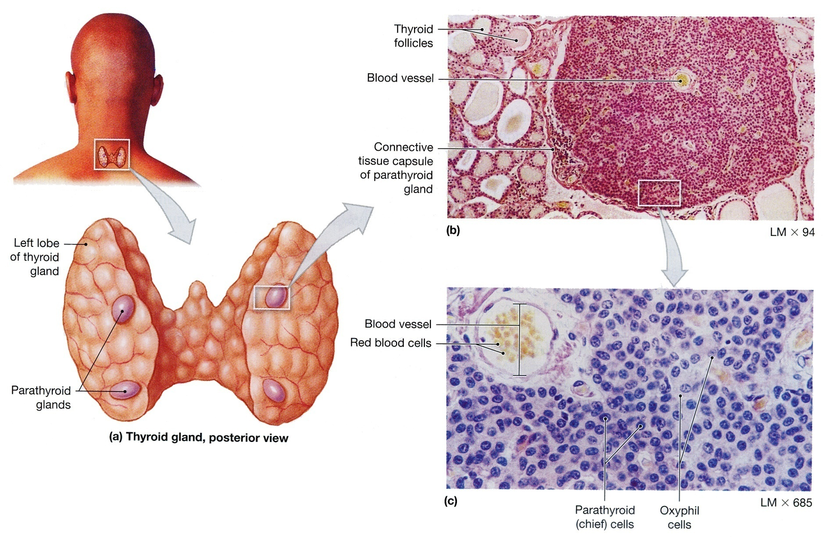
The Parathyroid Glands. (a) The location of the parathyroid glands on the posterior surfaces of the thyroid lobes. (The thyroid lobes are located anterior to the trachea). (b) Both parathyroid and thyroid tissues. (c) Parathyroid cells.

Slide 18
Actions of Parathyroid Hormone
Necessary for fine control of ionized serum Ca²⁺ levels.
It increases Ca²⁺
It decreases P_{i}
Parathyroid hormone acts directly on bone to stimulate resorption and release of Ca²⁺ into the extracellular space (slow)
Two effects in kidney
Parathyroid hormone acts directly on kidney to increase calcium reabsorption and phosphate excretion (rapid)
Stimulates transcription of 1-alpha hydroxylase enzyme for Vitamin D activation in kidney
Vitamin D increases calcium and phosphate absorption from intestine.

Slide 19
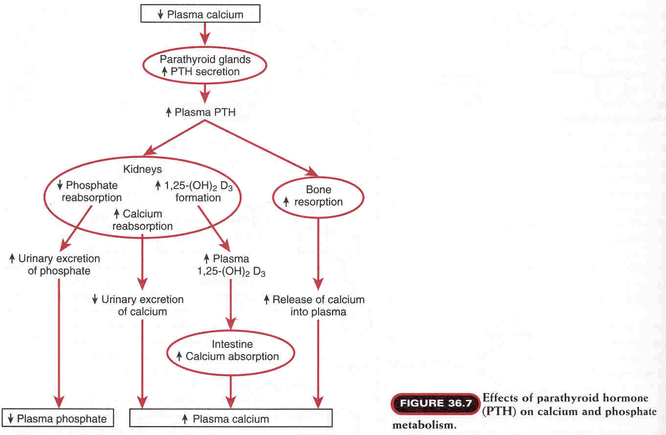

Slide 20
Calcitonin
Secreted by the parafollicular or C-cells of the
thyroid gland.
Stimulated by hypercalcaemia.
Lowers Ca²⁺ in blood
Promotes deposition of Ca²⁺ into bone (inhibits osteoclasts)
Promotes renal excretion of Ca²⁺

Slide 21
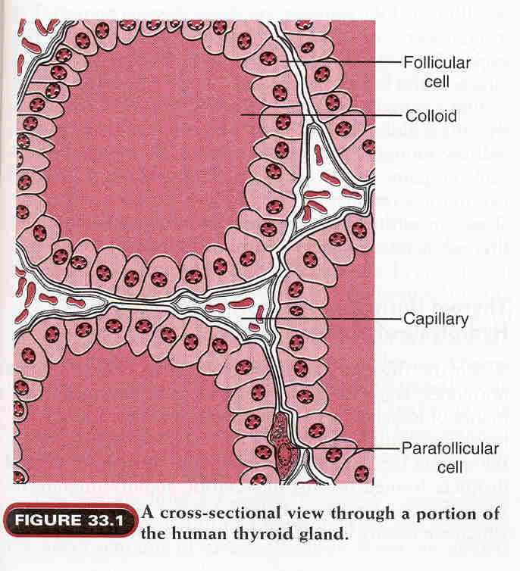

Slide 22
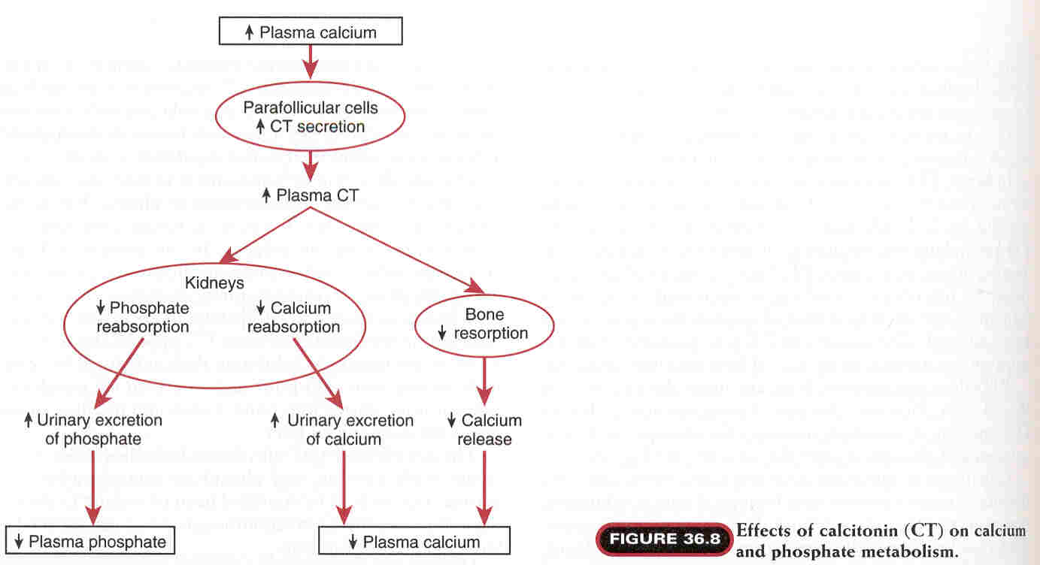

Slide 23
Vitamin D
Synthesized by the body or taken in food.
7- Dehydrocholestrol (in skin) + Ultraviolet light
→ Vit. D₃ (inactive form).
Hydroxylation of Vit. D₃ first in the Liver
→ 25, hydroxycholicalciferol (inactive form).
Second hydroxylation of Vit.D₃ in the kidneys
→ 1,25 dihydroxycholicalciferol (active form).

Slide 24
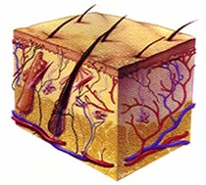
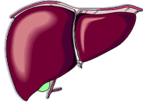
1,25 Vitamin D3
Increases Ca²⁺ uptake from the gut
Increase transcription and translation of Ca²⁺ transport proteins in
gut epithelium
Minor roll: also stimulates osteoclasts
Increase Ca++ resorption from bone
UV
Cholesterol precursor
7-dehydrocholesterol
Vitamin D3
25 Vitamin D3
1,25 Vitamin D3
Low plasma Ca²⁺ increase kidney enzymes
Notes:
1,25 Vitamin D3
-made in the liver, the skin, the liver, and the kidney
Liver: cholesterol precursor transformed to 7-dehydrocholesterol
Skin: UV transforms 7-dehydrocholesterol to Vit D3
Liver: Enzyme transforms Vit D3 to 25-OH-Vit D3
Kidney: Enzyme transforms 25-Vit D3 to 1,25 Vit D3
-lack of melanin pigment in Northen Europeans was thought to account for the lower light level: let more UV across the skin to ensure high enough levels of Vit. D3
-increases Ca++ uptake from the gut
-made from cholesterol…….acts like a steroid…..what kind of receptors? How would they act? (they increase transcription and translation of Ca++ transport proteins in the epithelial cells of the gut)
-minor roll: also acts to stimulate osteoclasts, (which would do what?) increasing Ca++ resorption from the bone
-control of secretion:
-low Ca++ levels causes increase of PTH, which increases enzymes in the kidney (more enzyme, more 1,25 Vit. D3)

Slide 25
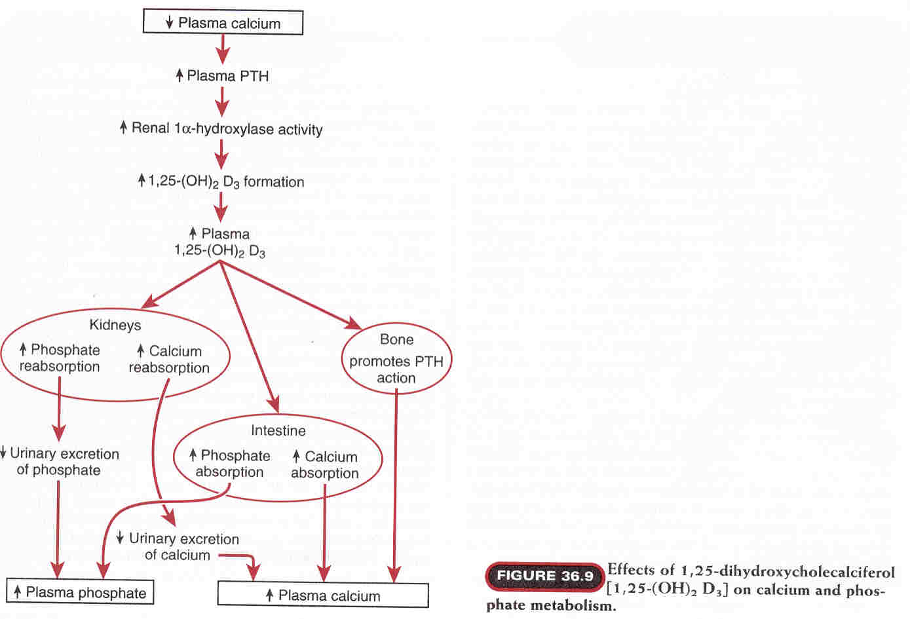

Slide 26
Other regulator of Ca²⁺ homeostasis
Estrogens:
Stimulate osteoblast activity , limits osteoclast activity, and enhance PTH secretion.
Estrogens changes the set point of PTH cells in the parathyroid so a greater reduction of Ca²⁺ is needed to increase PTH secretion so:
Estrogen decreases Ca²⁺ loss from bones.

Slide 27
Ca²⁺ homeostasis in pregnancy and lactation
The daily required dose of Ca²⁺ is greatly increased during pregnancy.
30 grams of Ca²⁺ are transferred to the fetus and lost in urine during pregnancy.
Bone turn over is increased during pregnancy → osteoporosis especially hip bone.
280 - 800 mg of Ca²⁺ is lost in breast milk per day during
lactation.
The mother compensate by:
1- ↑ intestinal absorption
2- ↓ renal excretion
3- ↑ bone resorption

Slide 28
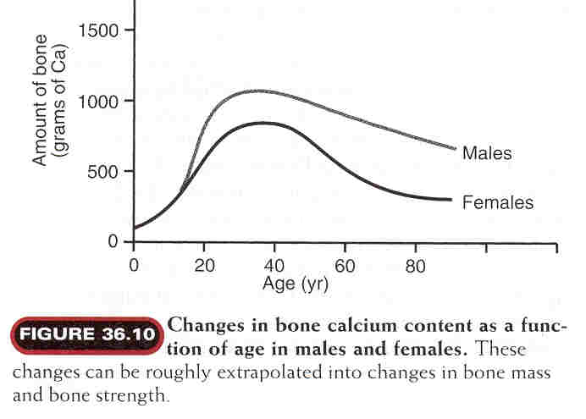

Slide 29
Hypoparathyroidism
Commonly occur accidentally after surgical removal of
the thyroid gland → Latent or overt tetany.
Characterized by hypersensitivity (Low threshold) of
nerves and muscles.
Can be demonstrated by two signs:
Chvostek’s sign:
Tapping the facial nerve as it emerge from the parotid
gland In front of the ear → Contraction of the facial
muscles.
Trousseau’s sign:
Arresting blood flow to the forearm for few minutes →
Flexion of the wrist, thumb and metacarpophalangeal
joints.

Slide 30
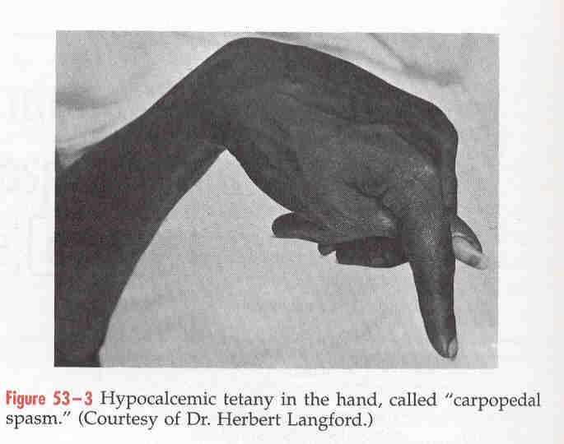

Slide 31
Hypocalcaemia
Symptoms:
Chvosteks and Trousseau’s signs
Neuromuscular excitability
Tetany
Paresthesia
Seizures

Slide 32
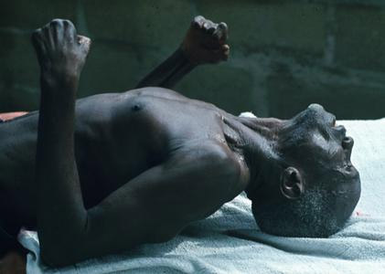
Hyperfunction
hypercalciemia
hypophosphatemia
hyperphosphaturia
osteoporosis
Accumulation of Саlcium in tissues
Hypofunction
hypocalciemia
hyperphosphatemia
hypophosphaturia
tetanus
Notes:
32

Slide 33
Causes of Hypocalcaemia
Hypoparathyroid | Nonparathyroid | PTH Resistance
Postoperative | Vitamin D deficiency | Pseudo-hypoparathyroidism
Idiopathic | Malabsorption
Post radiation | Liver disease
 | Kidney disease
 | Vitamin D resistance

Slide 34
Pseudohypoparathyroidism
Symptoms and signs
Hypocalcemia
Hyperphosphatemia
Characteristic physical appearance: short stature, round face, short thick neck, obesity, shortening of the metacarpals
Autosomal dominant
Resistance to parathyroid hormone
The patients have normal parathyroid glands, but they fail to respond to parathyroid hormone or PTH injections
Symptoms begin in children of about 8 years
Tetany and seizures
Hypoplasia of dentin or enamel and delay or absence of eruption occurs in 50% of people with the disorder
Treatment: vitamin D and calcium

Slide 35
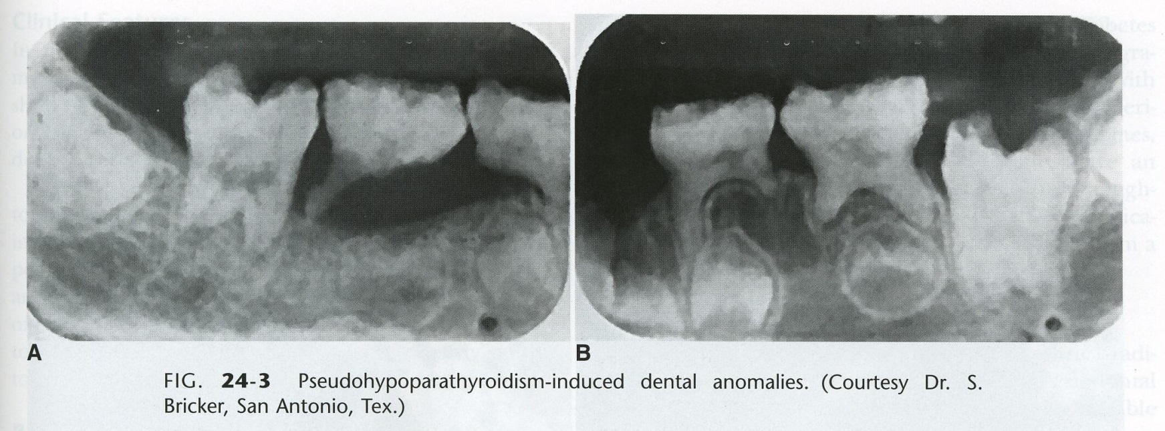
Pseudohypoparathyroidism
Short stature,
enamel hypoplasia

Slide 36
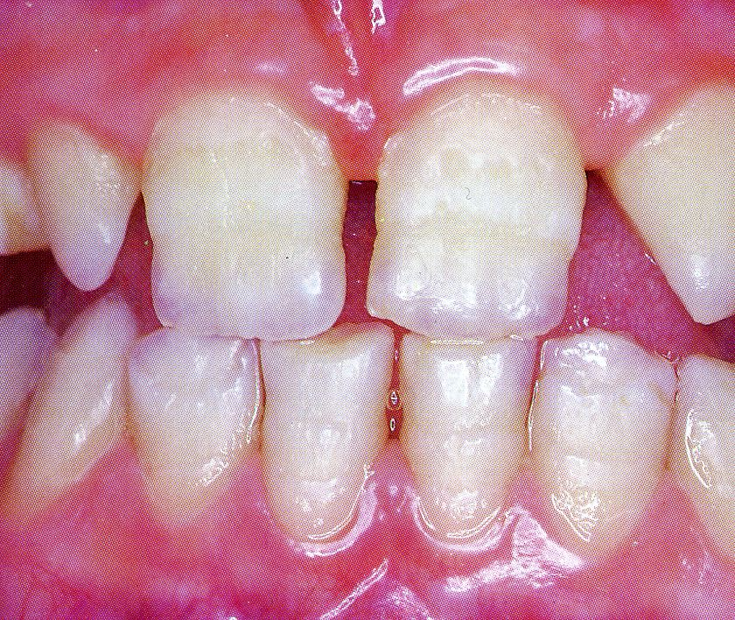
Congenital Hypoparathyroidism
Hypoplasia of the teeth, shortened roots, and retarded eruption

Slide 37
Case Study
A 27 years old man presents to his physician 3 weeks after his thyroid surgically removed for a thyroid cancer.
However, since he went home from the hospital, he noticed painful, involuntary muscular cramping.
He also felt numbness and tingling around his mouth & in his hands and feet. His parents said that he was irritable for the last 2 weeks.
He is on levothyroxine medication.
On examination
He has a well-healing thyroidectomy scar & no palpable masses in the thyroid bed.
Blood pressure cuff inflated above the systolic pressure induces involuntary muscular contracture in the ipsilateral hand after 60 seconds (Trousseau`s sign)
Tapping on the face interior to the ears cause twitching in the ipsilateral corner of the mouth (Chevostek`s sign)
Lab Investigations:
Calcium: 5.6 mg/dl (N: 8.5 – 10.2)
Albumin: 4.1 g/dl (N: 3.5 – 4.8)
PTH: < 1 pg/ml (N: N: 11 – 54)

Slide 38
DIAGNOSIS
The parathyroid glands were removed during thyroidectomy
↓
PTH undetectable
↓
Hypocalcemia
↓
Clinical Manifestations of hypocalcemia
(increased reflexes & muscular cramping)

Slide 39
Causes of Hypercalcemia
Hyperparathyroidism and Malignant neoplasms account
for majority of hypercalcemia
Neoplasms most frequently associated with hypercalcemia:
Breast cancer, lung cancer and multiple
myeloma
Most hypercalcemias in malignancy are caused by humoral hypercalcemia of malignancy (↑ PTHrP).
Single adenomas of the parathyroid gland account for 75% of primary hyperparathyroidism associated with hypercalcemia.

Slide 40
Parathyroid Hormone related Peptide (PTHrP)
Can activate the PTH receptor
Plays a physiological role in lactation, possibly as a hormone for the mobilization and/or transfer of calcium to the milk
May be important in fetal development
May play a role in the development of hypercalcemia of malignancy
Some lung cancers are associated with hypercalcemia
Other cancers can be associated with hypercalcemia

Slide 41
Clinical Manifestations of Hypercalcemia
“Stones”
“Bones”
“Abdominal moans”
“Psychic groans”
Neuromuscular
Cardiovascular
Other

Slide 42
Clinical Manifestations of Hypercalcemia
Renal “stones”
Nephrolithiasis
Nephrogenic DI: polydipsia and polyuria
Dehydration
Nephrocalcinosis

Slide 43
Clinical Manifestations of Hypercalcemia
Skeleton “bones”
Bone pain, arthralgias
Osteoporosis of cortical bone such as wrist
In primary hyperparathyroidism: Subperiosteal resorption, leading to osteitis fibrosa cystica with bone cysts and brown tumors of the long bones

Slide 44
Clinical Manifestations of Hypercalcemia
Gastrointestinal “abdominal moans”
Nausea, vomiting
Anorexia
weight loss
Constipation
Abdominal pain
Pancreatitis
Peptic ulcer disease

Slide 45
Clinical Manifestations of Hypercalcemia
“Psychic groans”
Impaired concentration and memory
Confusion, stupor, coma
Lethargy and Fatigue

Slide 46
Clinical Manifestations of Hypercalcemia
Neuromuscular
Reduced neuromuscular excitability and muscle weakness
Easy fatigability and muscle weakness more common in hyperparathyroidism than other hypercalcemic conditions
Clinical features of hyperparathyroid myopathy:
Proximal muscle weakness, wasting and mild nonspecific myopathic features on electromyogram and muscle biopsy

Slide 47
Clinical Manifestations of Hypercalcemia
Cardiovascular
Shortened QT interval on electrocardiogram
Cardiac arrhythmias
Vascular calcification

Slide 48
Clinical Manifestations of Hypercalcemia
Other
Itching
Keratitis
Conjunctivitis
Corneal calcification, band keratopathy
Carpal tunnel syndrome has occasionally been associated with hyperparathyroidism

Slide 49
Metabolic Diseases of Bones
RICKETS
Normal formation of the collagen matrix
BUT
Incomplete mineralization (poor calcification)
↓
Soft Bones
↓
CLINICALLY: Bone Deformity (Rickets)
OSTEOMALACIA
Demineralization (poor calcification) of preexisting bones
↓
CLINICALLY: More Susceptibility to Fracture

Slide 50
Vitamin D deficiency: Rickets
Inadequate intake and absence of sunlight
The most prominent clinical effect of Vitamin D deficiency in adults is osteomalacia, or the defective mineralization of bone matrix.
Vitamin D deficiency in children produces rickets leading to (bow-legged) due to weight bearing on the legs.
A deficiency of renal 1α-hydroxylase produces vitamin D-resistant rickets
Sex linked gene on the X chromosome
Teeth may be hypoplastic and eruption may be retarded

Slide 51
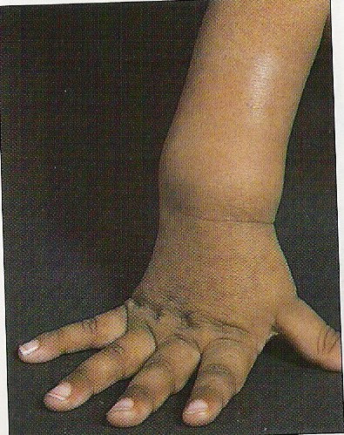
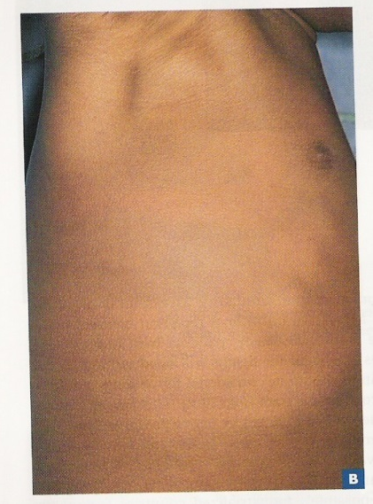
Images of Rickets
Wrist expansion: cupping and fraying of hypertrophied metaphyseal plate
Rachitic Rosary
Bone demineralization and deformity
Rotten-stump epiphysis

Slide 52
Renal Rickets Renal Osteodystrophy
In Chronic Renal Failure
Low activity of Renal 1α-hydroxylase
Decreased ability to form the
active form of vitamin D
(1, 25 DHCC will be low)
Treatment: 1,25 DHCC (Calcitriol)

Slide 53
Laboratory Investigations for the Diagnosis of Rickets & Osteomalacia
Investigations to confirm the diagnosis of rickets:
↓ Blood levels of 25-hydroxycholecalciferol (25 HCC)
↓Blood calcium, (hypocalcemia)
↑ Blood Alkaline phosphatase (ALP)
Investigations to diagnose the cause of rickets:
Kidney function tests (KFT)
Blood 1, 25 dihydroxycholecalciferol (1, 25 DHCC)
Blood PTH
Others i.e. molecular genetics (if indicated)
Notes:
53

Slide 54
Osteoporosis
Most prevalent metabolic bone disease in adults
It means reduction in bone mass.
i.e. bone matrix composition is normal, but it is reduced.
Typically silent (without symptoms) until it leads to fracture at a minimal trauma.
Most affected: vertebral compression (may be
asymptomatic) & hip fractures (requires surgery in most cases).
Post-menopausal women lose more bone mass than men (primary osteoporosis)
Notes:
54

Slide 55
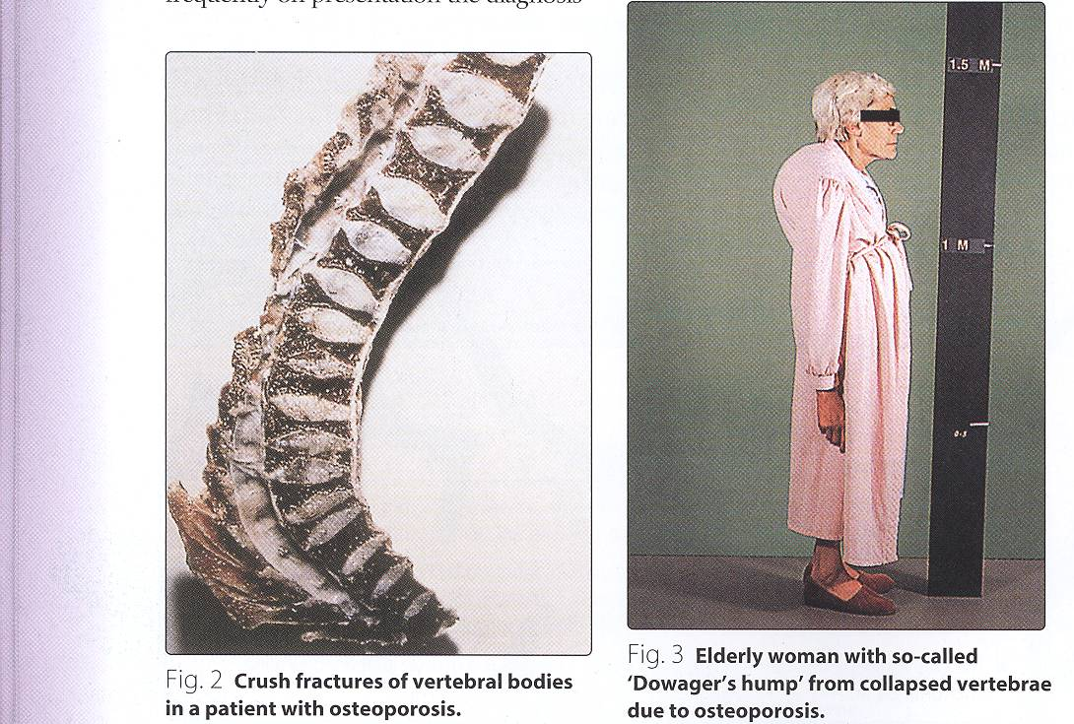
Osteoporosis
Notes:
55

Slide 56
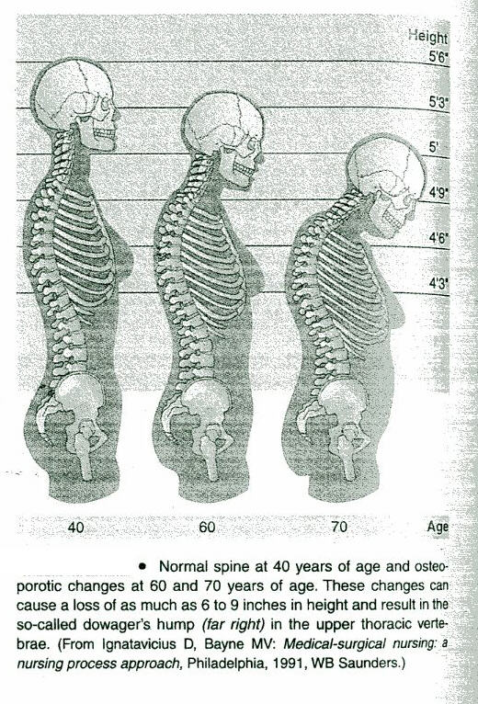
Sequelae of Osteoporosis

Slide 57
Secondary Osteoporosis Risk Factors
Risk Factors for osteoporosis:
Advanced age (esp. in females)
Certain Drugs
Family history of osteoporosis or fractures
Immobilization
Smoking
Excess alcohol intake
Cushing’s syndrome
Long term glucocorticoids therapy
Hyperparathyroidism
Hyperthyroidism
Vitamin D disorders
Certain malignancies

Slide 58
Any Questions?

