Slide 1
Pituitary Disorders
Anwar Ali Jammah
Asst. Professor & Consultant
Medicine and Endocrinology
King Saud University

Slide 2
Objectives
Basic Embryology, Anatomy and physiology
Non-functional pituitary tumours mass-effect
Prolactin secreting cell disorder: prolactinoma
Growth hormone secreting cell disorders
ACTH secreting cell disorders
TSH secreting disorders
Gonadotropin secreting cell disorder

Slide 3
Pituitary Development
Anterior pituitary is recognizable by 4- 5th wk of gestation
Full maturation by 20th wk
Notes:
Diaphragma sella is formed by a reflection of dura matter preventing CSF from entering the sella turcica by this diaphragm

Slide 4
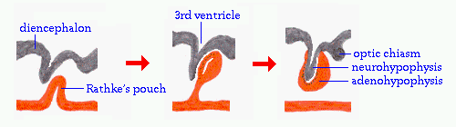
Pituitary Development
Anterior Pituitary developed from Rathke’s pouch, Ectodermal envagination of oropharynx & Migrate to join neurohypophysis
Posterior pituitary from neural cells as an outpouching from the floor of 3rd ventricle
Pituitary stalk in midline joins the pituitary gland with hypothalamus that is below 3rd ventricle

Slide 5
Pituitary Anatomy
Lies at the base of the skull as sella turcica
Roof is formed by diaphragma sellae
Floor by the roof of sphenoid sinus
Notes:
Diaphragma sella is formed by a reflection of dura matter preventing CSF from entering the sella turcica by this diaphragm

Slide 6
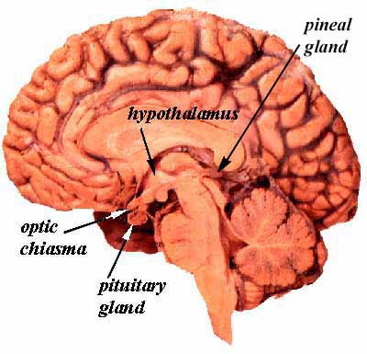

Slide 7
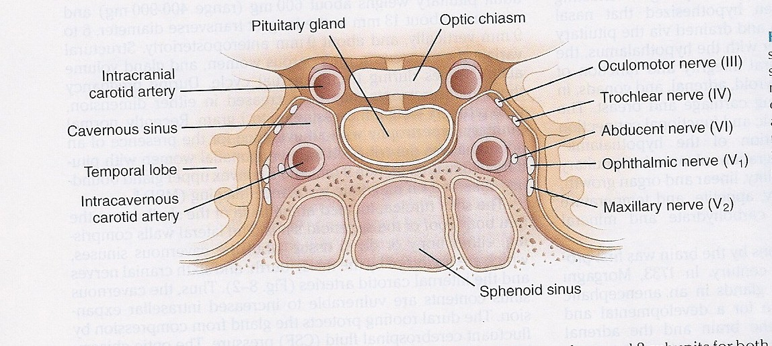
Pituitary Anatomy

Slide 8
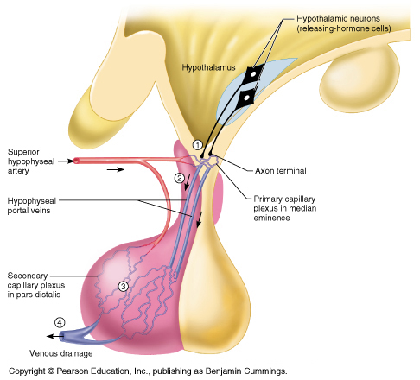

Slide 9
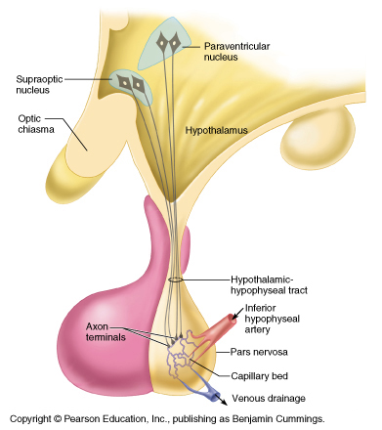

Slide 10
Pituitary Anatomy
Pituitary stalk and its blood vessels pass through the diaphragm
Lateral wall by cavernous sinus containing III, IV, VI, V1, V2 cranial nerves and internal carotid artery with sympathetic fibers. Both adjacent to temporal lobes
Pituitary gland measures 15 X 10 X 6 mm, weighs 500 mg but about 1 g in women
Notes:
Height is 5-7 mm and 10 mm lateral dimension, height is 10. superior, middle supply ant. Pituitary. Inferior supply stalk and post pituitary artery

Slide 11
Pituitary Anatomy

Slide 12
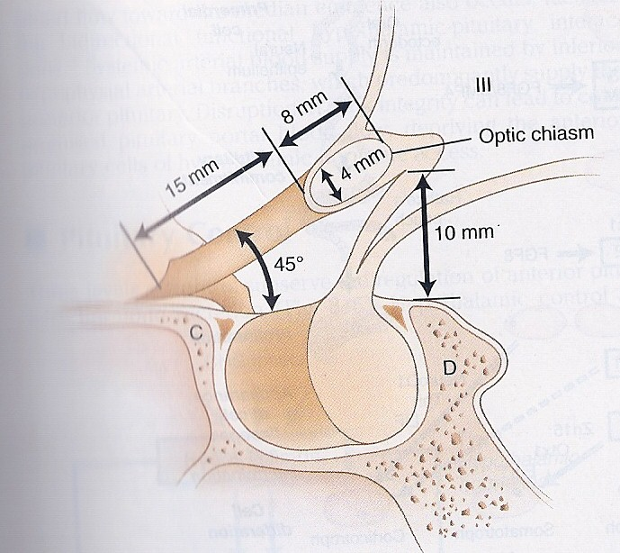
Pituitary Anatomy
Optic chiasm lies 10 mm above the gland and anterior to the stalk

Slide 13
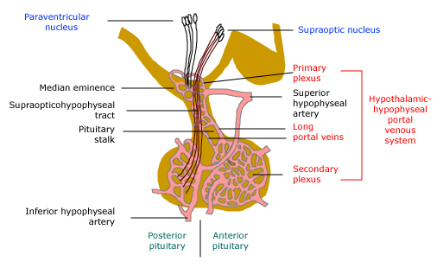
Vascular and neural connections between the hypothalamus and pituitary
Blood supply : Superior, middle, inferior hypophysial arteries ( internal carotid artery) running in median eminence from hypothalamus. Venous drainage:
To superior and inferior petrosal sinsuses to jugular vein

Slide 14
Pituitary Anatomy
Optic chiasm lies 10 mm above the gland and anterior to the stalk

Slide 15
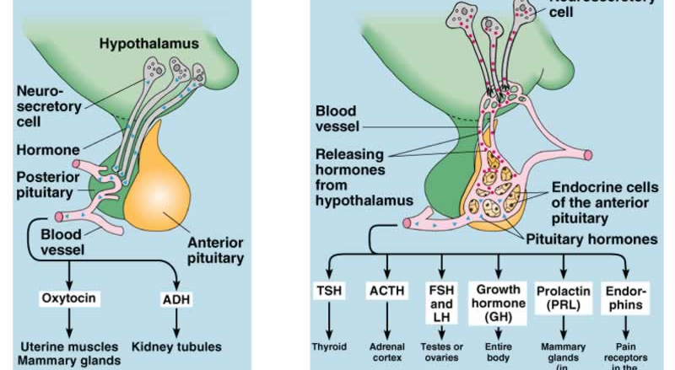
Pituitary hormones
Posterior lobe
Anterior lobe

Slide 16
Cell types of adenohypophysis
  1. Acidophils (stain with acidic dyes)
  2. Basophils (stain with basic dyes)
  3. Chromophobes (do not stain with either stain)
  Acidophils:
  Somatrophs – secrete Growth Hormone (GH)
  Mammotrophs – secrete prolactin (PRL)
  Basophils :
  Thyrotrophs – secrete Thyroid Stimulating Hormone (TSH)
  Gonadotrophs – secrete Luteinizing (LH) hormone and Follicle Stimulating Hormone (FSH).
  Chromophobes – secrete adenocorticotrophic hormone (ACTH)

Slide 17
Hypothalamic stimulatory hormones
Corticotropin-releasing hormone | Adrenocorticotropic hormone (ACTH) 20 percent of cells in anterior pituitary
 | Melanocyte-stim hormone POMC product
 | Endorphins - also products of POMC gene
Growth hormone-releasing hormone | Growth hormone (GH) represent 50% of cells in anterior pituitary
Gonadotropin-releasing hormone | Luteinizing hormone and follicle-stimulating hormone - gonadotrophs represent about 15 % of anterior pituitary cells
Thyrotropin-releasing hormone | Thyroid-stimulating hormone (TSH) thyrotropes represent about 5 percent of anterior pituitary cells
Prolactin-releasing factors (serotonin acetylcholine, opiates, &estrogens) | Prolactin - lactotrophs represent 10 to 30 percent of anterior pituitary cells

Slide 18
Summary
Releasing Hormones of Hypothalamus
CRH
TRH
GnRH
GHRH
ACTH
TSH
FSH,LH
GH
Stimulating
H- AP
Adrenal
Cortex
Thyroid
Gland
Gonads
Generalized

Slide 19
Hypothalamic inhibitory hormones
Somatostatin | Inhibits the release of growth hormone
Prolactin-inhibiting factors - includes dopamine | Major prolactin control is inhibitory

Slide 20
Sellar masses causes:
Benign tumors | Metastatic
Pituitary adenoma (most common sellar mass) | Lung
Craniopharyngioma | Breast
Meningiomas | Cysts
Pituitary hyperplasia | Rathke's cleft
Lactotroph hyperplasia (during pregnancy) | Arachnoid
Thyrotroph and gonadotroph hyperplasia | Dermoid
Somatotroph hyperplasia due to ectopic GHRH | Pituitary abscess
Malignant tumors | Lymphocytic hypophysitis
Primary | Carotid arteriovenous fistula
Germ cell tumor (ectopic pinealoma)
Sarcoma
Chordoma
Pituitary carcinoma (rare)

Slide 21
Sellar masses causes:
Neurologic symptoms (most common)
Visual impairment
Headache
Other (including diplopia, seizures, and CSF rhinorrhea)
Incidental finding
When an imaging procedure is performed because of an unrelated symptom
Hypopituitarism
Biochemical evidence (most common)
Clinical symptoms (less common, but include oligomenorrhea or amenorrhea in women, decreased libido and/or erectile dysfunction in men)

Slide 22
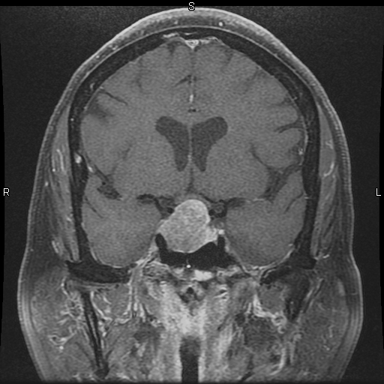

Slide 23
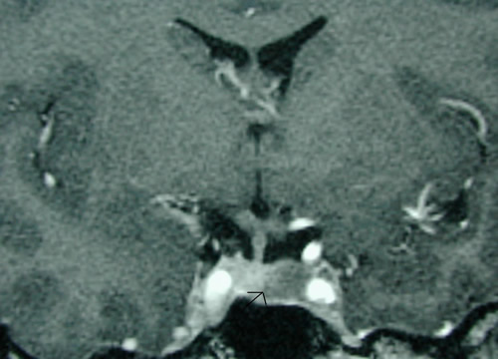
Notes:
Left side microadenoma post contract

Slide 24
Evaluation of Pituitary mass
Pituitary incidentaloma: 1.5 -31% in autopsy ( prevalence)
10 % by MRI most of them < 1 cm
Notes:
Guanine nucleatide stimulatory protein gene found in 40 % of somatotroph adenoma/ inactivation mutation in tumor supressing gene in men 1.

Slide 25
Assessment of pituitary function
Baseline: TSH, FT4, FT3, LH, FSH, Prolactin, GH, IGF-1, Testosterone, Estradiol
MRI brain
Neuropthalmic evaluation of visual field

Slide 26
Evaluation of Pituitary lesion
Functional adenoma ( hormonal-secreting)
Non-Functional adenoma

Slide 27
Primary & secondary endocrine diseases
Based on site of hormone defect (either increase or decreased secretion), Endocrine disorders are classified as:
A) Primary Disease: If defect is in the target gland from which hormone has originated
B) Secondary Disease: If defect is in the Anterior Pituitary or Hypothalamus
E.g.,
Primary hypothyroidism means decreased secretion of thyroid hormone from the Thyroid gland
Secondary hypothyroidism means deficiency of Anterior pituitary/ Hypothalamic hormone which stimulates production of thyroid hormone from the thyroid gland (defect not in the thyroid gland)

Slide 28
Evaluation of Pituitary lesion
Non-Functional pituitary lesion:
  No signs and symptoms of hormonal hypersecretion
  25 % of pituitary tumour
  Needs evaluation either micro or macroadenoma
  Average age 50 – 55 yrs old, more in male

Slide 29
Non- functional pituitary adenoma
Presentation of NFPA:
  As incidentaloma by imaging
  Symptoms of mass effects ( mechanical pressure)
  Hypopituitarism ( mechanism)
Notes:
Mass effect tumour expansion lateral compressing cavernous sinus causing cranial nerve palsy like double vision, stretching meninges causing headache, or pushing temporal lobe causing seizure, pushing optic chiasm or headache from apoplexy. Hypopituitarism from suprasellar mass pushing stalk and cutting portal blood supply and hypothalamus signal to pituitary

Slide 30
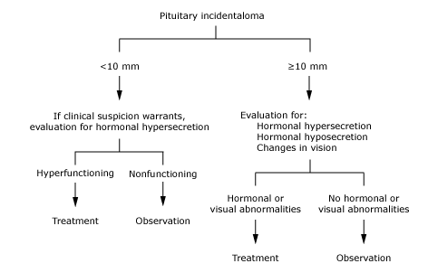
Approach to the patient with an incidental abnormality on MRI of the pituitary gland

Slide 31
Treatment of
Non- functional pituitary adenoma
Surgery
  Recurrence rate 17 % if gross removal, 40 % with residual tumour
  Predictors of recurrence: young male, cavernous sinus invasion, extent of suprasellar extention of residual tumor, duration of follow up, marker; Ki-67
Observation
Adjunctive therapy:
  Radiation therapy
  Dopamine agonist
  Somatostatin analogue
Notes:
Tumour greater than 2 cm, visual field defect, optic chiasm compression or touching by tumor with no visual field defect, headach, suprasellar/parasellar tumor extension

Slide 32
Prolactin
Prolactin (PRL) is a single chain polypeptide
Receptors resemble GH receptors
Structurally similar to GH
Increases during pregnancy & lactation
Predominant action on mammary gland
Also inhibits gonadotrophic hormone secretion

Slide 33
Physiological actions of PRL
PRL is responsible for Lactogenesis (initiation of lactation) & galactopoiesis (continuation of lactation)
Stimulates milk production in the breasts.
Stimulates breast development along with Estrogen during pregnancy
Inhibits Ovulation by decreasing secretion of LH & FSH

Slide 34
Factors affecting PRL secretion
Factors increasing PRL secretion:
Estrogen (during pregnancy stimulates lactotropes to secrete PRL)
Breast feeding (reflex increase)
TRH
Dopamine antagonists
Factors inhibiting PRL secretion:
Dopamine
Bromocryptine (Dopamine agonist)
Somatostatin
PRL (by negative feedback)

Slide 35
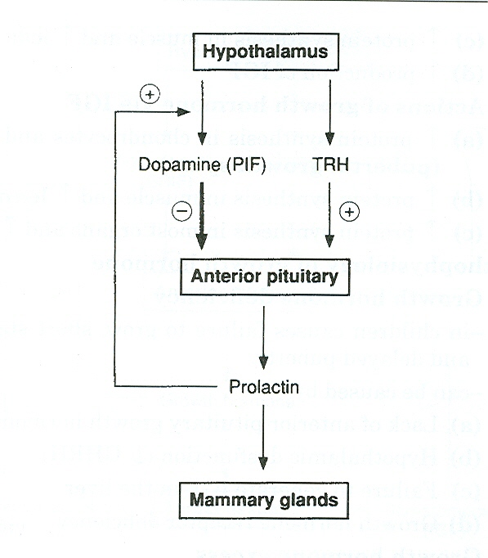

Slide 36
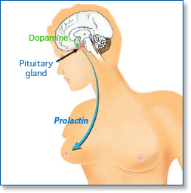
Prolactinoma

Slide 37
Prolactinoma
Premenopausal women
Menstrual dysfunction (oligomenorrhea or amenorrhea10 to 20 % )
Infertility (luteal phase abnormalities or anovulation).
Galactorrhea.
Postmenopausal women (already hypogonadal)
It must be large enough to cause headaches or impair vision,
Incidental sellar mass by MRI.
Men
Decreased libido and infertility.
Erectile dysfunction
Gynecomastia and rarly galactorrhea

Slide 38
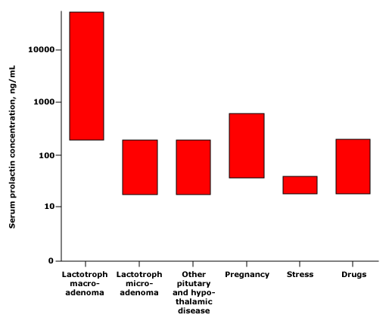
Am J Obstet Gynecol 1972; 113:14; N Engl J Med 1977; 296:589; Clin Ther 2000; 22:1085; Clin Endocrinol 1976;

Slide 39
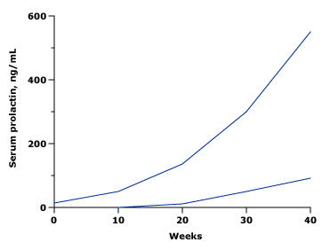
Serum prolactin concentrations increase during pregnancy
Tysonet al, Am J Obstet Gynecol 1972

Slide 40
List of drugs known to cause hyperprolactinemia and/or galactorrhea
Typical antipsychotics | Gastrointestinal drugs
Chlorpromazine, Clomipramine fluphenazine], prochlorperazine, thioridazine | Cimetidine (Tagamet)
Haloperidol (Haldol) | Metoclopramide (Reglan)
Pimozide (Orap) | Antihypertensive agents
Atypical antipsychotics | Methyldopa (Aldomet)
Risperidone (Risperdal) | Reserpine (Hydromox, Serpasil, others)
Molindone (Moban) | Verapamil (Calan, Isoptin)
Olanzapine (Zyprexa) | Opiates
Antidepressant agents* | Codeine
Clomipramine (Anafranil) | Morphine
Desipramine (Norpramin)

Slide 41
Growth hormone
Hyperfunctioning mass →→ Acromegaly
Pituitary tumor as mass effect →→ Growth hormone deficiency (Short stature)

Slide 42
ACTIONS OF GROWTH HORMONE:
Actions of GH are of 2 types.
  DIRECT CATABOLIC actions
  INDIRECT ANABOLIC actions
What are Somatomedins(IGF-1):
Polypeptides synthesized mainly in liver
Also synthesized in kidneys ,cartilage & skeletal muscles.
The Indirect actions are via the somatomedins.

Slide 43
Actions of Growth Hormone
Stimulation of growth of bones, cartilage & connective tissue; mediated mainly via Somatomedin C (IGF-1)
On Bones & cartilage (Before epiphyseal closure):
GH causes liver to secrete IGF-1, which in turn causes
  Proliferation of chondrocytes (Chondrogenesis)
  Appearance of osteoblasts
  Stimulation of DNA & RNA synthesis
  Collagen formation in cartilage
Result- Increase in thickness of epiphyseal cartilagenous end plates. Resulting in linear skeletal growth; seen maximally during puberty & causes pubertal growth spurt.

Slide 44
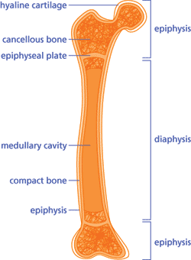
Site of action of IGF-1
Notes:
44
44

Slide 45
GH action on bones
b) After Epiphyseal closure:
No increase in bone length
Increase in bone thickness or widening through periosteal growth.
Increased protein synthesis in most organs causing hyperplasia, hypertrophy; increased tissue mass and increased organ size

Slide 46
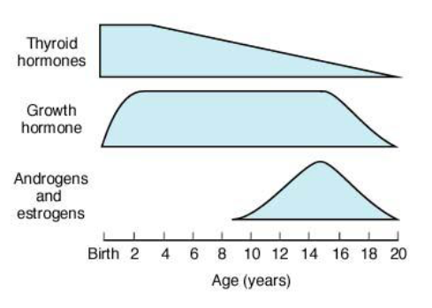
Hormonal Effects
Relative importance of hormones in human growth at various ages

Slide 47
2) Actions of GH on Metabolism
Effect of GH on Carbohydrate Metabolism:
This is a direct action of GH. Does not need IGF
GH is a Diabetogenic hormone ie; increases plasma glucose
GH causes Hyperglycemia by increasing Hepatic glucose output
Decreases peripheral utilization of glucose (Anti-Insulin Effect)

Slide 48
Metabolic actions of GH
b) Effect of GH on Protein metabolism: Indirect action which requires IGF
GH is a Protein Anabolic Hormone
It increases protein synthesis in muscle & increases lean body mass
Also increases protein synthesis in organs & increases organ size

Slide 49
Metabolic actions of GH
C) On Fat metabolism:
GH has a direct catabolic effect - mobilizes fat from adipose tissues by increasing lipolysis. (Does not require IGF for this action)
Increases plasma free fatty acids (FFA), which are further used for Gluconeogenesis
Ketogenic- Produces FFA which undergo hepatic oxidation and form ketone bodies

Slide 50
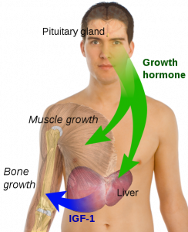
Growth hormone disorder

Slide 51
Clinical correlates of Anterior Pituitary
DWARFISM: Occurs due to GH deficiency results in Short stature/Stunted growth
Causes:
Panhypopituitarism (lack of all anterior pituitary hormones)
Decreased GHRH
Decreased IGF-1 secretion (GH receptor defect)
Hypophysectomy (Removal of pituitary gland)

Slide 52
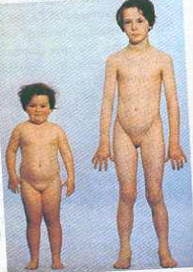
A 9- year old pituitary dwarf compared with age and sex matched control
Notes:
52
52

Slide 53
Growth Hormone excess – Before Puberty
GIGANTISM : Is seen due to overproduction of GH during adolescence, before puberty (before epiphyseal closure) – Results in excessive growth of long bones-↑↑Height (8 ft)
Clinical features:
Tall stature (up to 8 ft / 2.5 mts)
Large hands & feet
Other associated features – Bilateral Gynaecomastia (enlargement of breasts due to structural similarity of GH to Prolactin)
Coarse facial features due to increased tissue proliferation

Slide 54
GH excess after Puberty
ACROMEGALY:
Occurs due to excessive secretion of GH during adulthood (after epiphyseal closure)
Causes of Acromegaly are:
Acidophilic tumor of anterior pituitary
Hypothalamic GHRH secreting tumors
Tumor producing GHRH
Clinical features are mainly seen due to excess growth of cartilaginous & peripheral (Acral) parts
& other features due to increased metabolic actions

Slide 55
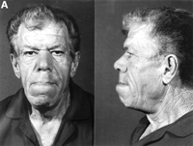
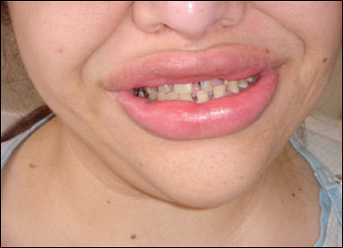
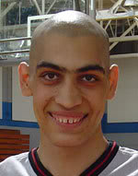
Nose is widened and thickened
Cheekbones are obvious
Forehead bulges
Lips are thick
Facial lines are marked
Overlying skin is thickened
Mandibular overgrowth
Prognathism
Maxillary widening
Teeth separation

Slide 56
Other features of Acromegaly
Hypertrophy of soft tissues
- Heart (Cardiomegaly)
- Liver (Hepatomegaly)
- Kidney (Renomegaly)
- Spleen (Splenomegaly)
- Tongue & muscles
In 4% cases- Gynaecomastia (breast enlargement in males) with/without lactation- because of structural similarity of GH to PRL
Visual field defects if pituitary tumor compresses Optic Chiasm

Slide 57
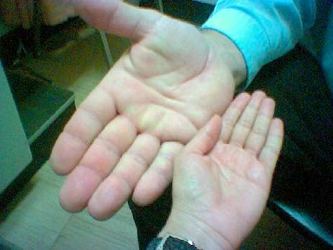
Swelling of the hands in a patient with acromegaly, which resulted in an increase in glove size and the need to remove rings.

Slide 58
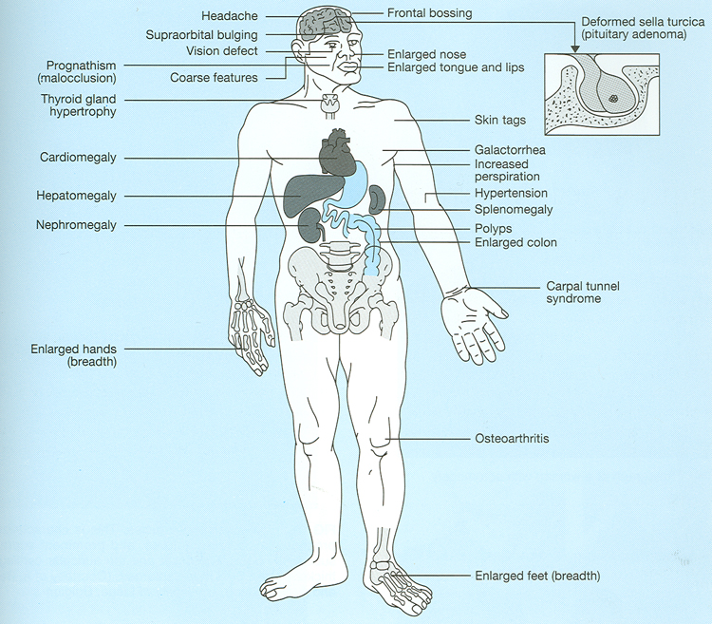

Slide 59
Acromegaly Diagnosis
GH level ( not-reliable, pulsatile)
IGF-I is the best screening test
75 g OGTT tolerance test for GH suppression is the gold standered
Other :
  Fasting and random blood sugar, HbA1c
  Lipid profile

Slide 60
Acromegaly complications
Cardiac disease is a major cause of morbidity and mortality
50 % died before age of 50
HTN in 40%
LVH in 50%
Diastolic dysfunction as an early sign of cardiomyopathy

Slide 61
Acromegaly treatment
  Medical
    Somatostatin analogue
    Pegvisomant
  Surgical resection of the tumour

Slide 62
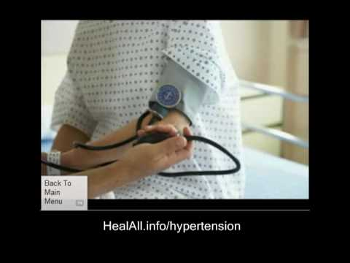
ACTH-disorders

Slide 63
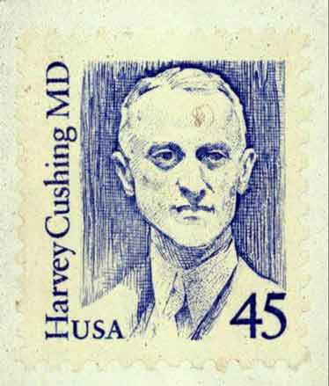
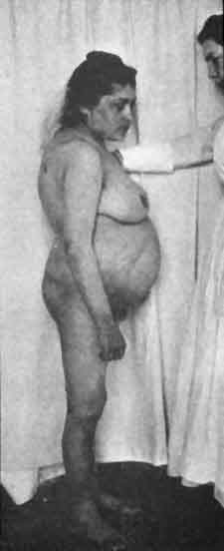
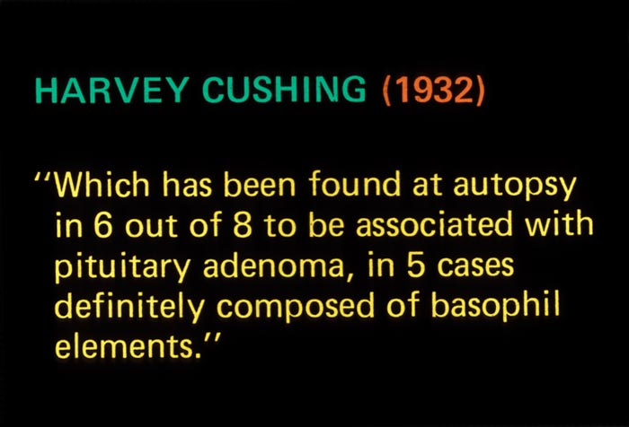

Slide 64
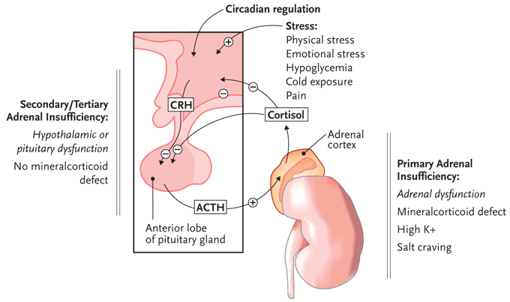
ACTH-disorders

Slide 65
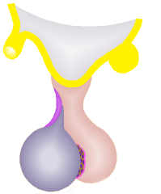

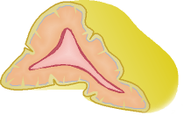
CRH
(+)
(-)
ACTH (+)
(-) Cortisol

Slide 66
CRH
ACTH-dependent Cushing’s disease
(+)
Autonomous ACTH secreting tumour
ACTH (+)
(-) Cortisol

Slide 67
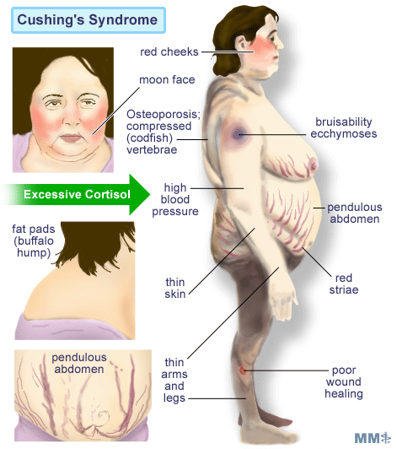

Slide 68
Diagnosis | Percent of patients
ACTH-dependent Cushing's syndrome
Cushing's disease | 68
Ectopic ACTH syndrome | 12
Ectopic CRH syndrome | <<1
ACTH-independent Cushing's syndrome
Adrenal adenoma | 10
Adrenal carcinoma | 8
Micronodular hyperplasia | 1
Macronodular hyperplasia | <<1
Pseudo-Cushing's syndrome
Major depressive disorder | 1
Alcoholism | <<1

Slide 69
HPA-axis ( excessive cortisol)
80 % HTN
Heart Failure
OSA: 33% mild, 18% severe.
Glucose intolerance in 60%, control of hyperglycemia
Osteoporosis with vertebral fracture→→ positioning of patient in OR ( 50 %), 20 % with fracture
thin skin

Slide 70
Hypoadrenalism (low ACTH and Low Cortisol)
Nausea
Vomiting
Abdominal pain
Diarrhoea
Muscle ache
Dizziness and weakness
Tiredness
Weight loss
Hypotension

Slide 71
Management of hypoadrenalism
Cortisol replacement

Slide 72
TSH-Producing adenoma
Very rare < 2.8 %
Signs of hyperthyroidism
High TSH, FT4, FT3
Treatment preop with anti-thyroid meds pre-op

Slide 73
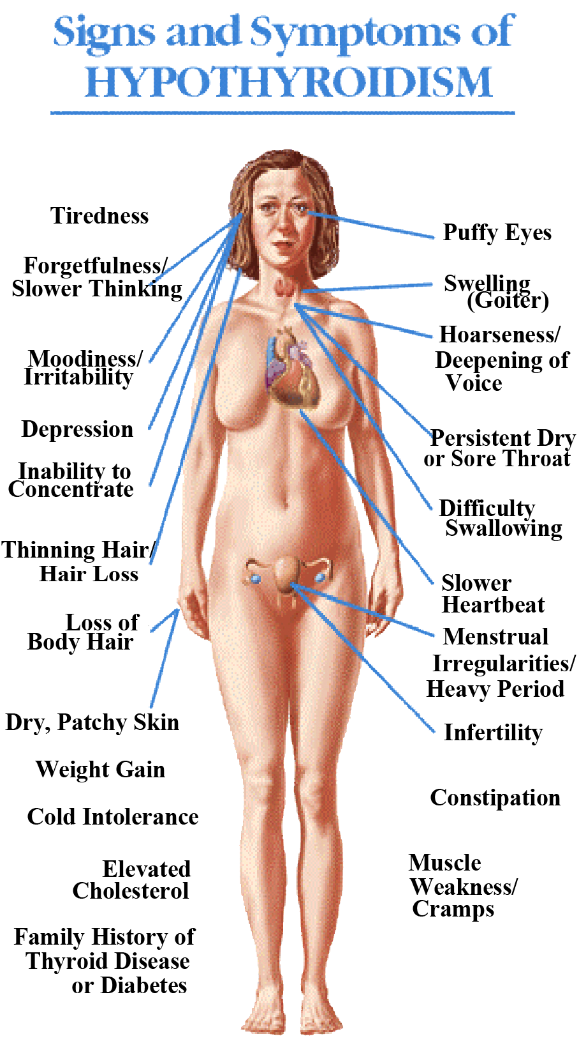
Central Hypothyroidism
Low TSH
Low free T4 and T3

Slide 74
Central Hypothyroidism
Thyroxine replacement
Surgical removal of pituitary adenoma if large

Slide 75
Gonadotroph Adenoma
High FSH, estradiol, and Low LH
High serum free alpha subunit
Surgical resection if large
Radiation therapy

Slide 76
Sheehan’s Syndrome (Panhypopituitarism)
Anterior Pituitary insufficiency commonly occurs in females with post-partum hemorrhage resulting in a clinical condition known as Sheehan’s Syndrome.
Anterior Pituitary which is highly vascular, gets enlarged during pregnancy. After childbirth, pituitary undergoes infarction & necrosis due to post partum hemorrhage – giving rise to decreased levels of all the anterior pituitary hormones resulting in Panhypopituitarism
Posterior Pituitary hormones are not affected as ADH & Oxytocin are synthesized by Hypothalamic neurons

Slide 77
Assessment of pituitary function
Baseline: TSH, FT4, FT3, LH, FSH, Prolactin, GH, IGF-I,Testosterone, Estradiol
MRI brain
Neuropthalmic evaluation of visual field
Cardiac and respiratory assessment
Anesthesiologist for airway and perioperative monitoring
Neurosurgeon
ENT for Endonasal evaluation for surgical approach
Preop hormonal replacement: all pituitary adenoma should be covered with stress dose of HC

Slide 78
POSTERIOR PITUITARY
(NEUROHYPOPHYSIS)
Notes:
78

Slide 79
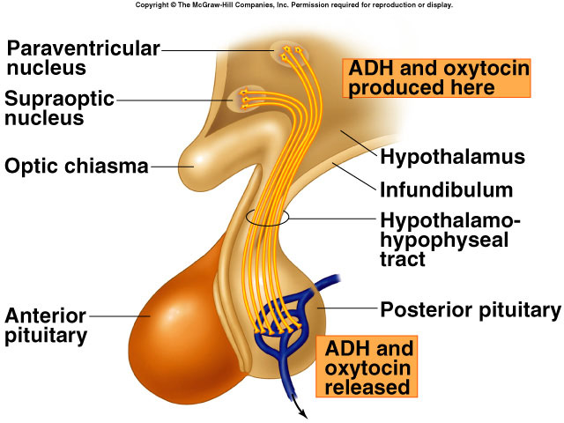
Notes:
79

Slide 80
Hormones of posterior pituitary
OXYTOCIN
VASOPRESSIN (Anti Diuretic hormone; ADH)
SITE OF SYNTHESIS – Cell bodies of magnocellular neurons in Supraoptic nucleus (SON) & Paraventricular nucleus( PVN) of hypothalamus
PVN – Predominantly Oxytocin
SON- Predominantly Vasopressin
Notes:
80

Slide 81
OXYTOCIN
Site of synthesis
Mainly PVN of Hypothalamus
1/6th SON of Hypothalamus
Actions
Milk Ejection
Contraction of Uterus
Mechanism of action
Via G proteins
Notes:
81

Slide 82
Factors affecting oxytocin secretion
Factors stimulating release:
Suckling
Emotions – Sight / sound of baby’s cry
Dilatation of cervix (Parturition)
Factors inhibiting release:
Emotions- stress, fright
Drugs-Alcohol, etc.

Slide 83
MILK EJECTION REFLEX
Stimulus: Baby suckling the nipple (skin touch receptors around nipple)
Afferent: nerves from mammary glands- via spinal cord - End on PVN (& SON)
Center: PVN in hypothalamus
Efferent: Action potentials travel down the nerve terminal to posterior Pituitary - Release of oxytocin into blood
Oxytocin stimulates myoepithelial cells of breast to contract
Effect: Ejection of milk
Increased suckling - Increased stimulation
Eg; for POSITIVE FEED BACK
Terminated when baby stops suckling
Eg; for Neuro-endocrine reflex (aff Neural, efferent endocrine)
Notes:
83

Slide 84
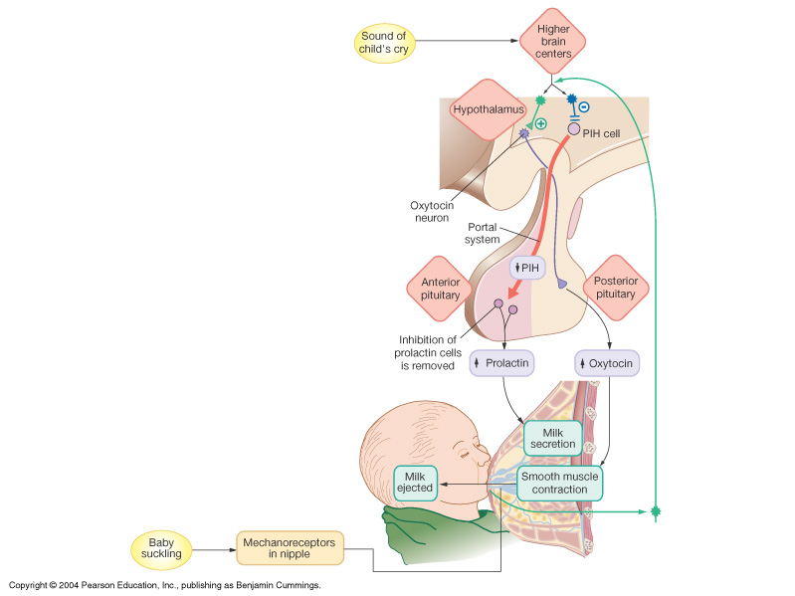
Milk ejection reflex

Slide 85
Parturition Reflex
Descent of fetus
Dilatation of cervix
Stimulation of stretch receptors
Increased activity of afferent nerve
Stimulation of PVN
Release of oxytocin into blood
Contraction of uterus
Expulsion of fetus
Positive
feedback
Notes:
85

Slide 86
VASOPRESSIN
Also called ANTIDIURETIC HORMONE
Prevents diuresis
Predominantly secreted by SON
Nonapeptide
Notes:
86

Slide 87
VASOPRESSIN - ACTIONS
Maintenance of Osmolarity & ECF volume
Acts on DCT and CD of kidney
Inserts ‘aquaporins’ (water channels) & increases permeability of the tubular cells to water
Increases water reabsorption
Notes:
87

Slide 88
VASOPRESSIN
Potent vasopressor
But not in physiological concentrations
However during hemorrhage vasopressin levels can increase – causes VASOCONSTRICTION
Notes:
88

Slide 89
Factors affecting ADH release
Factors stimulating release:
Increased plasma osmolarity
Hypovolemia (↓ECF volume)
Pain, emotion, stress, exercise
Standing
Angiotensin II
Factors inhibiting release:
Decreased plasma osmolarity
↑ ECF volume
Alcohol

Slide 90
DIABETES INSIPIDUS
Decreased ADH secretion
Characterized by polyuria (large volume of dilute urine) & polydipsia
Central DI (Neurogenic)
  ↓ synthesis/ secretion of ADH
  Inherited or Acquired
Nephrogenic DI-
  failure of receptors to respond to ADH
  Inherited or Acquired
Notes:
90

Slide 91
SIADH (Syndrome of inappropriate ADH secretion)
Excessive secretion of ADH, despite continued renal excretion of Na⁺ (serum Na⁺ <110meq/L-Hyponatraemia)
Increased blood volume & Hypoosmolality
Increased urine osmolarity
Accompanied by neurological signs-Irritability, confusion, muscular weakness, seizures
Notes:
91

