Slide 1
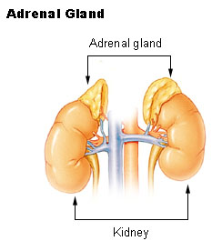
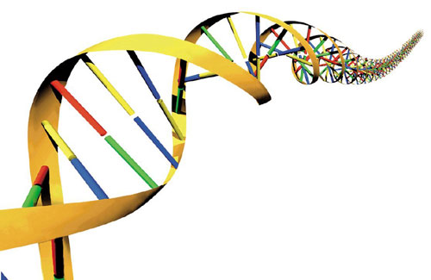
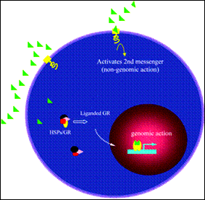
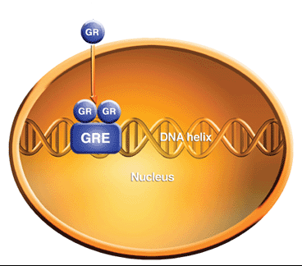
CORTICOSTEROIDS

Slide 2
CORTICOSTEROIDS
ILOs
By the end of this lecture you will be able to:
Revise synthesis, regulations & dysregulations of corticosteroids
Classify available natural vs synthetic glucocorticoids; whether systemic or topical; expanding on their properties & indications
Contrast their different ADRs & methods of prevention or treatment
Focus on therapeutic roles of mineralocorticoids &
relevant mechanism of action
Hint on drugs antagonizing corticosteroid action

Slide 3
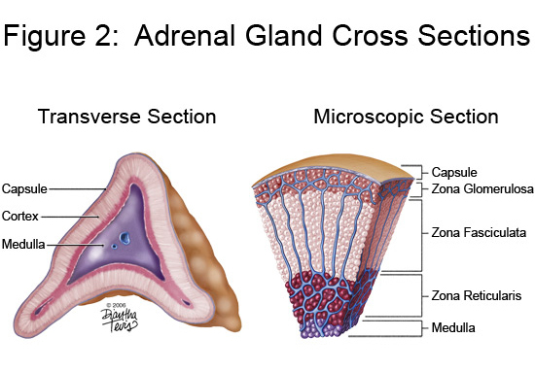
CORTICOSTEROIDS
Are a class of steroid hormones that are produced in the adrenal cortex
Glucocorticoids [GC]
Released from Zona Fasciculata 
as Cortisol , Cortisone & Corticosterone 
Regulated by ACTH + cytokines (IL-1, IL-6, TNF), neuropeptides & catecholamines (stressors)
Control carbohydrate, fat & protein metabolism. They are also anti-inflammatory & immunosuppressants
Mineralocorticoids [MC] Released from Zona Glomerulosa  as Aldosterone 
Regulated by angiotensin II, potassium, and ACTH. In addition, dopamine, atrial natriuretic peptide (ANP) and other neuropeptides
Control water & electrolyte homeostasis

Slide 4
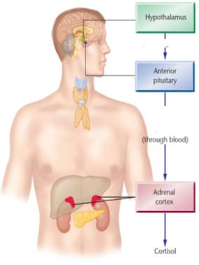
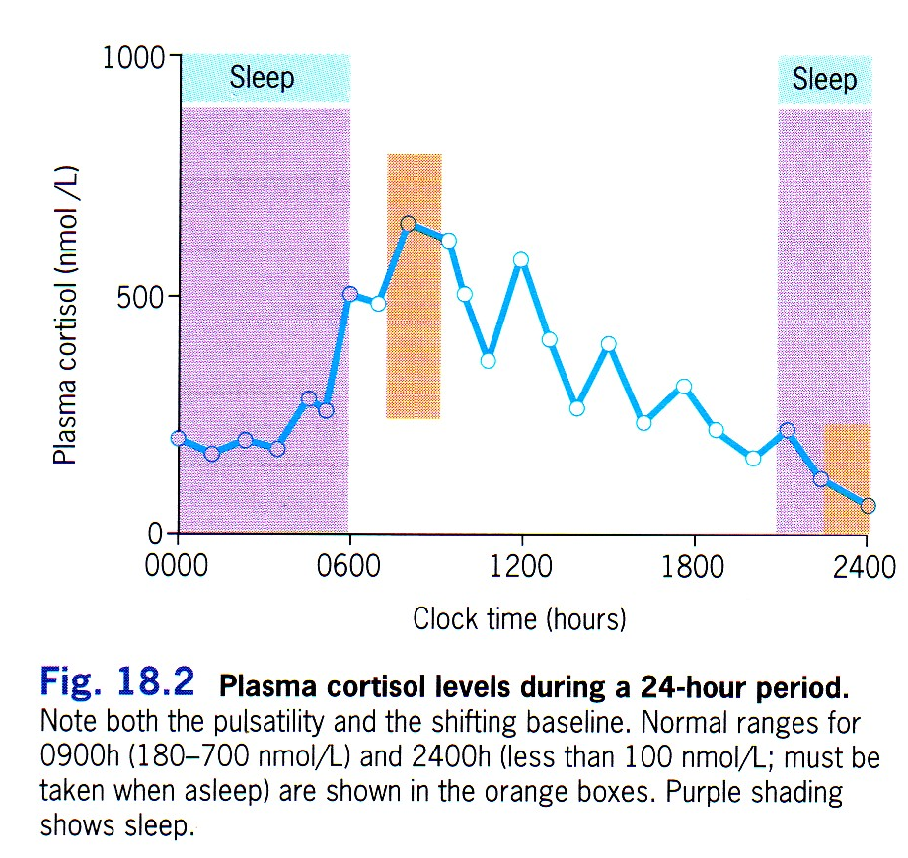
-
REGULATION
Glucocorticoids
CRH
-
ACTH
corticotropin
CORTISOL
CIRCADIAN pattern of CORTISOL
secretion

Slide 5
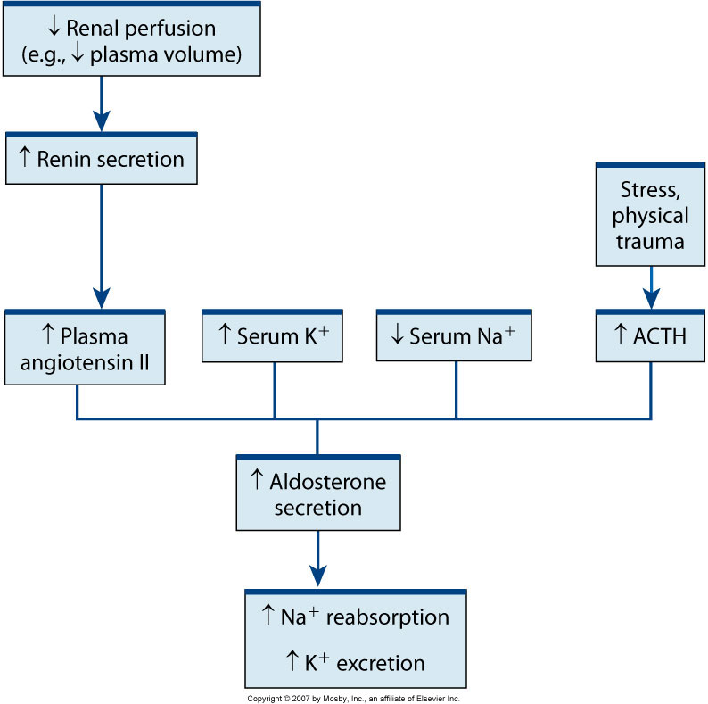
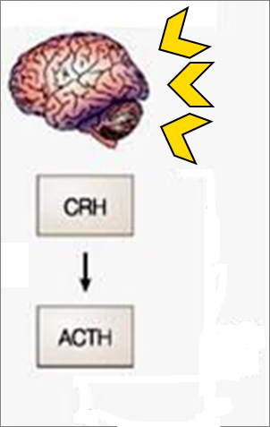
REGULATION
Mineralocorticoids
FLUID LOSS
How Fluid & Electrolyte changes converge to activate MINERALOCORTICOIDS secretion
ACTH  specifically stimulates GC & has little control over secretion of aldosterone

Slide 6
DYSREGULATION
Deficiency in corticosteroids [Addison’s disease]
Hyponatremia, hyperkalemia, hypoglycemia, progressive weakness & fatigue, low blood pressure, depression, anorexia & loss of weight, skin hyperpigmentation
  If subjected to stresses  [Addisonian Crisis ] symptoms  + fever, confusion severe vomiting, diarrhea, abdominal pain & shock
Deficiency of mineralocorticoids, seldom alone Hyponatremia, hyper kalemia, acidosis & wasting +  ECF volume, hypotension & shock .
Increased production of glucocorticoids  Cushing's syndrome
Increased production of mineralocorticoids  Conn’s syndrome
Hyperaldosteronism
Hypernatremia
Hypervolemia
Hypertension
Hypokalemia

Slide 7
PHARMACOLOGY OF EXOGENOUS GLUCOCORTICOIDS
    Cortisol, Cortisone, Hydrocortisone, Prednisone, Prednisolone, Methylprednisolone, Triamcinolone, Dexamethasone, Betamethasone, Beclomethasone, Fluticasone, Budesonide, Mometasone, …etc.
In the cytosol
MECHANISM
    GC binds to GRs
On cell membrane
Cytosolic GC R  mediates GENOMIC Action 
slow process needs  hrs-days
Expression of proteins  Anti-inflammatory Effects
Repression of proteins responsible for Pro-inflammatory Effects
Gene Transcription
mRNA Translation
New Protein Formation
e.g. Lipocortin –ve PLA₂
-ve COX-2
Prevent other transcription factors
(AP-1) from inducing Gene Trans-
cription / mRNA Translation/ new
Protein Formation
e.g.so No
proinflammatory cytokines (IL-2)&
chemokines

Slide 8
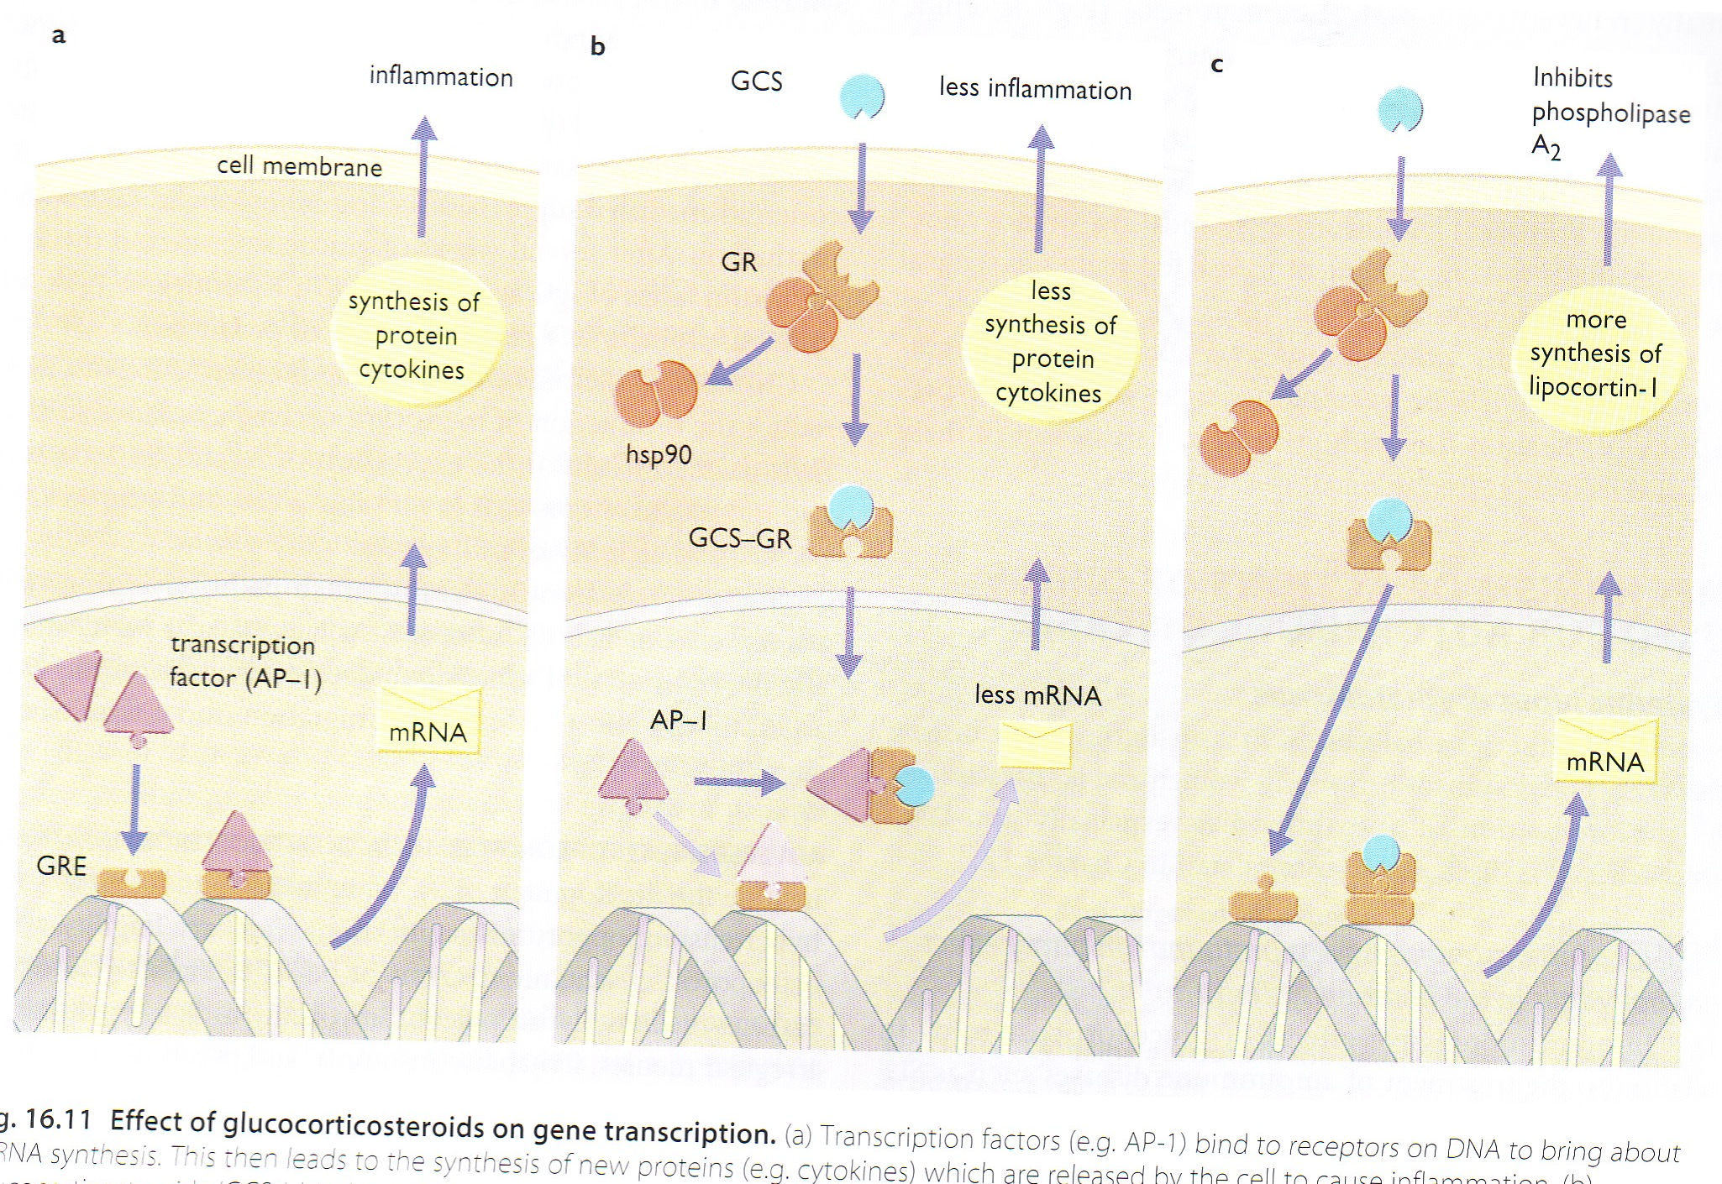
Inflammation occurs due to expression of proinflammatory mediators, cytokines & chemokines….etc.
Activated GRs prevent AP-1 from binding to RE & expressing pro-inflammatory mediators, cytokines,….etc
Activated GRs dimerize & bind to GRE allowing expression of anti-inflammatory mediators; as lipocortin, cytokines,….etc
INFLAMMATION
ANTINFLAMMATORY ACTION OF GC

Slide 9
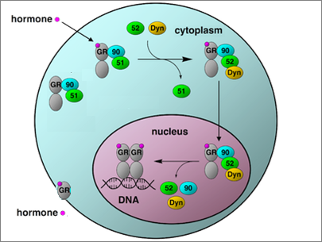
PKA
cAMP
PKC
GCRE
Ca
mRNA
Protein
2. Membranous GC R  mediates NON-GENOMIC Action
 cross talks with GP coupled receptors  alter Ca, cAMP, their downstream kinases (PKA & PKC)  rapidly exert anti-inflammatory effects & shut down proinflammatory effects  rapid process needs minutes-hrs

Slide 10
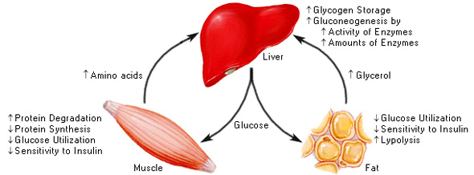

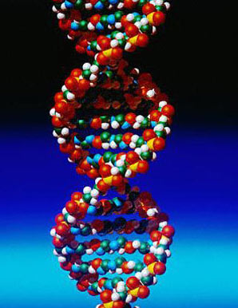
PHARMACOLOGICAL ACTIONS = PHYSIOLOGICAL ACTION
1. On METABOLISM
CHO:
glucose utilization.
gluconeogenesis →hyperglycaemia
Fats: fat deposition on shoulders, face and abdomen.
Proteins:  anabolism &  catabolism leading to:
Negative nitrogen balance with muscle wasting +  uric a. production
Osteoporosis.
Retardation of growth in children.
Skin atrophy + capillary fragility → bruising and stria.

Slide 11
Calcium metabolism:  urinary excretion &  absorption from intestine (antivitamin D action).
2. On INFLAMMATORY & IMMUNE RESPONSE
  vascular permeability; so   edema & redundancy of soft tissues
  ◉ release & synthesis of inflammatory mediators; so -ve PLA2  -ve
  AA & LTs pathways….
  antigen antibody reaction mast cell degranulation & transmitter release
  infiltration & activity of inflammatory cells (eosinophilic, lymphocytic, …etc ) by  cytokines & chemokine production
  ◉ Complement formation
3. ON HYPOTHALAMIC-PITUITARY-ADRENAL AXIS
Occurs with high doses & long periods of treatment.
Sudden withdrawal of corticosteroids
produce a state of adrenocortical insufficiency
4. Others
Euphoria or psychotic states: may occur (probably due to CNS electrolyte changes).

Slide 12

PHARMACOKINETICS
  Absorption; Most preparations are  effective orally.
  Parentral forms are also available.
  Can get absorbed systemically when given at local sites (e.g. skin, respiratory
  tract, conjunctival sac, synovial spaces etc.)
  Distribution; 90% or more of cortisol in plasma is transported by reversible
  binding to Corticosteroids Binding Globulin (CBG) & to albumin
  * Corticosteroids compete with each other on CBG;
  Glucocorticoids bind with high affinity
  Mineralocorticoids bind with low affinity
  * Only the unbound free form is active & can enter cells by diffusion
  Metabolism; are metabolized by the liver
  * Some preparations transform to active form in liver
  ◆ Cortisone  Hydrocortisone
  ◆ Prednisone  Prednisolone
  t ½ is variable [ short, intermediate & long acting ]
  Excretion; as soluble sulphates in the urine.

Slide 13
CLASSIFICATION ACCORDING TO t _{1/2} & METHOD OF ADMINISTRATION
SYSTEMIC Drugs | Anti-inflam. | Na retention | Preparations & doses
Short Acting Preparations (t1/2 < 12 h)
Cortisol | 1 | 1.0 | 5 mg tablet 100 mg/vial ( IM/IV ) EMERGENCY Topical; enema
Cortisone | 0.8 | 0.8 | 5 mg tablet / not in liver disease 25 mg/vial (IM)
Intermediate Acting Preparations (t_{1/2} = 12 -36 h)
Prednisone | 4 | 0.8 | 2.5, 5, 10, 20, 50 mg tablet
Prednisolone | 5 | 0.3 | 5, 10 mg tablet 20 mg/vial (IM, intrarticular)
Methyl- ″ | 5 | 0 | 0.5, 1.0 gm (IM / slow IV)
Triamcinolone | 5 | 0 | 4 mg Tab., 10,40 mg/ml (IM & intrarticular)
Long Acting Preparations (t1/2 > 36 h)
Dexamethasone [Fluorinated] | 25 | 0 | 0.5 mg tab. 4mg/ml inj ( IM / IV )
Betamethasone [Fluorinated] | 25 | 0 | 0.5, 1 mg tab. 4mg/ml inj (IM / IV)

Slide 14
CLASSIFICATION ACCORDING TO t _{1/2} & METHOD OF ADMINISTRATION
N.B.
Changes in basic cortisol
molecule compounds with
mineralocorticoid activity.
greater potency
duration of action
INHALANT DRUGS | Administration Forms
Beclomethasone | 50,100,200 mcg/md inhaler
Fluticasone | 25, 50 mcg/md inhaler
Budesonide | 100,200 mcg/md inhaler
TOPICAL DRUGS | Preparation | Potency
Beclomethasone | 0.025 % cream | Potent
Betamethasone | 0.025 & 0.12 % cream, ointment | Potent
Triamcinolone actonide | 0.1 % ointment | Potent
Fluocinolone actonide | 0.025% ointment | Moderate
Mometasone | 0.1 % cream, ointment | Moderate
Fluticasone | 0.05 % cream | Moderate
Hydrocortisone acetate | 2.5 % ointment | Moderate
Hydrocortisone acetate | 0.1 – 1.0% ointment | Mild
N.B. Mild-moderate topical steroids are applied on the face as creams only

Slide 15
Dosage Schedule
Time of administration of GCs specially on prolonged use follows natural circadian rhythm i.e. early morning  to minimize hypothalamo-pituitary-adrenal axis impairment. Better if administered on alternate days

Slide 16

INDICATIONS
HORMONE REPLACEMENT THERAPY
1. ADRENAL INSUFFECIENCY
ACUTE & Chronic
Addisonian Crisis
Addison’s Disease
Emergency situation
Parental Cortisol (hydrocortisone) 100 mg IV / every
6-8 hrs until patient is stable. Dose  gradually
reduced  reach maintenance dosage in 5 dys
Fluids and electrolytes should be corrected.
Treatment of precipitating factors.
Cortisol (20-30 mg/day orally) + (fludrocortisone (0.1 mg orally)
Dexamethasone could be given on prolonged use
Doses must be increased in stress to prevent development of
Addisonian crisis
Doses should follow circadian rhythm
2. CUSHING’S SYNDROME
In Diagnoses  Dexamethasone suppression test
In Treatment  Cortisol; Temporally administred AFTER surgical removal of pituitary / adrenal / corticosteroid secreting tumors

Slide 17
INDICATIONS
I. ANTI-INFLAMMATORY & IMMUNOSUPPRESSANT
Prednisolone
Dexamethasone
Betamethasone
Severe allergic reactions e.g. serum sickness,
angioneurotic edema... etc.
Diseases of allergic origin; bronchial asthma, rhinitis,
conjunctivitis, eczema & many other atopic & proliferative
skin diseases
Autoimmune disorders; rheumatoid arthritis, inflammatory
bowel disease systemic lupus erythrematosus, nephrotic
syndrome,…
Organ transplantation; kidney, cardiac, bone marrow
(rejection)
Blood dyscrasias; hemolytic anemia, thrombocytopenic
purpura, agranulocytosis ... etc.
Acute gout (resistant) to other drugs
> Anti-
inflammatory
& Immuno-
suppression

Slide 18
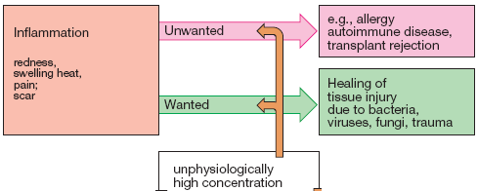
Dexamethasone
Betamethasone
INDICATIONS
II. OTHERS
Raised intracranial pressure
In neoplastic diseases
With cytotoxic drugs  as in Hodgkin's disease, acute lymphocytic
leukaemia
P^{ry} or 2^{ndry} neoplasms in the brain & postoperative to brain surgery
edema
In antiemetic regimens prevent / cure emesis of chemotherapy
Suppress excess ACTH production
If water retention is undesirable
dose &
time
related
1.  HYPOTHALAMIC PITUITARY ADRNAL AXIS
ADRs
3.
2. IATROGENIC CUSHING’s
SYNDOME

Slide 19
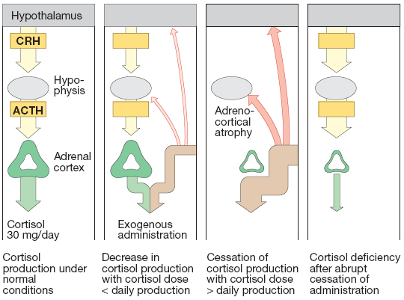
1. ADRs
SUPPRESSION OF HYPOTHALAMIC PITUITARY ADRNAL AXIS
HOW TO AVOID
  Withdraw Corticosteroids Regimens
  If < than 1 w. & not used in big doses no fear.
  If big dose you may  2.5-5 mg prednisolone  at an interval of 2-3 days
  If longer periods & high dose
  ◉ halve dose weekly until 25 mg prednisolone or equival-ent is reached
  Then  by about 1mg every 3-7 days.

Slide 20
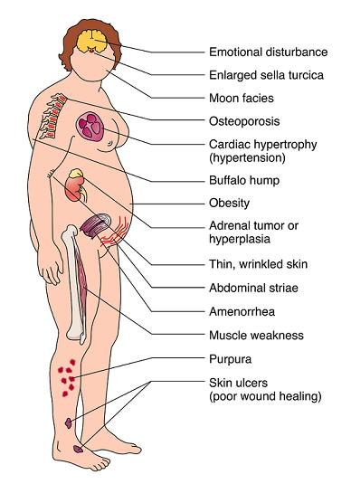
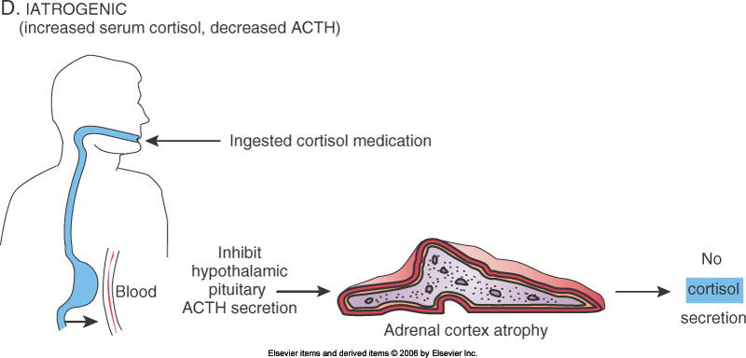
2. ADRs
IATROGENIC CUSHING’s SYNDOME
HOW TO TREAT
If possible  slow withdraw to allow body to slowly resume its normal balance of ACTH & cortisol
If not possible to stop because of underlying disease treat concurrent symptom separately
* Antidiabetic for hyperglycaemia
* Bisphosphonates for osteoporosis
* H₂ blocker or proton pump inhibitors for peptic ulcer

Slide 21
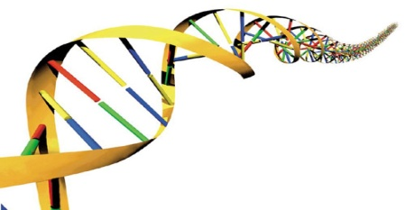
3. ADRs
  Hyperglycemia , glycosuria, diabetes mellitus > fluorinated preparations
  Growth retardation  premature closure of epiphysis short stature
  Muscle wasting -ve nitrogen balance > fluorinated preparations
  Fat redistribution & abnormal deposition
  Hypertension, oedema, Na retention
  Hypokalaemia
  Osteoporosis  -ve of osteoblasts / +ve osteoclasts &  Ca
  absorption,  Ca excretion  vertebral compression & fractures
  Avascular necrosis of head of femur ? Coagulation / apoptosis?
  Menstrual irregularities
  Psychiatric disorders; depression, euphoria,…
  Impairment of defense mechanism serious infections, flare of
  dormant T.B., activate hepatitis,  reaction to live vaccines
  Delayed wound healing
  Peptic ulcer specially if with NSAIDs
  Skin, acne, striae, hirsutism
  Ocular toxicity glaucoma & cataract

Slide 22
  Local Toxicity
  Skin infection, atrophy, bruising.
  Eye  viral infection, cataract, glaucoma.
  Inhalation  fungal infection, hoarseness
  Intraarticular  infection, necrosis
3. ADRs
CONTRAINDICATIONS
  Diabetes mellitus.
  Hypertension or heart failure
  History of mental disorders or Epilepsy.
  Osteoporosis
  Peptic ulcer
  Presence of infection or Tuberculosis 
  requires chemotherapy before administration
Precautions
  Patients receiving GCs and is subjected to stress double the dose
  In children receiving  take care of live attenuated vaccines
  In pregnant women; better avoid fluorinated GCs  teratogenicity
  Neo-born to mothers taking high dose GCs  -ve HPA axis

Slide 23
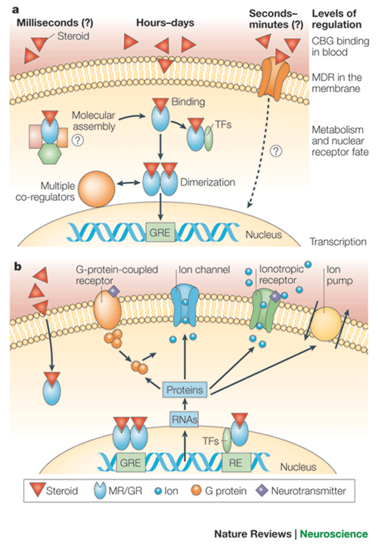
PHARMACOLOGY OF MINERALOCORTICOIDS
MECHANISM
Aldosterone, Deoxycorticosterone, Fludrocortisonee
Bind to mineralocorticoid receptors [MC R]
 in MC responsive cells i.e. distal nephron
Binds GC > MC
GC is destroyed, enzymatically in MC responsive cells  so MC will bind to its receptor alone without any competition from GC.
Cytosolic MC R  mediates GENOMIC Action  Expression of proteins
In distal & collecting tubules
Na pumps  Na retention
Na channels  Na reuptake from lumen
K simporters  excretion of K & H
N.B. Actions also on (colon, sweat & salivary glands)
2. Membranous GC R  mediates NON-GENOMIC Action
MC
Interact with GP coupled receptors & channels to mediate rapid adaptive changes to fluid depletion

Slide 24
MINERALOCORTICOIDS
EFFECTS / USES/ PREPARATIONS
Net effect is to conserve body sodium  osmotic effect  water follows  expansion of extracellular fluid
renal excretion of potassium & intracellular potassium
In excess  hypertension, atherosclerosis , fibrosis  vascular & cardiac remodeling  cerebral hemorrhage / stroke & or cardiomyopathy
SYSTEMIC Drugs | Anti-inflam. | Na retention | Preparations & doses
Aldosterone | 0.3 | 3000 | Natural / Not used clinical
Deoxycortone sterone[DOCA] | 0 | 100 | 2.5 mg sublingual, ineffective orally ? Inactive in liver
Fludrocortisone | 10 | 150 | 100mcg oral tablets / duration of 36-72hrs / Drug of Choice in Replacement Therapy

Slide 25
PHARMACOLOGY OF CORTICOSTEROID ANTAGONIST
Medications that inhibit adrenal steroid synthesis to  GC
MITOTANE
    -ve 11 β-hydroxylase
    Corticosteroid production  its peripheral metabolism & plasma & urine levels
    Used in Cushing syndrome; whether iatrogenic, or to alleviate severe symptoms till removal by surgery
    Safe in pregnancy
Medications that compete with steroids on receptors to block MC actions
SPIRONOLACTONE
    Is a competitive aldosterone antagonist 
    Is a K⁺ sparing diuretic (weak, slow onset & prolonged effect)
    Used in hypertension (alternation with others), in heart failure
    In Hyperaldosteronism (Conn’s)

Slide 26
CORTICOSTEROIDS
GOOD LUCK

