Slide 1
2nd Practical Session
FEMALE
GENITAL SYSTEM
Pathology Dept, KSU
Reproduction block

Slide 2
Normal Anatomy
and Histology
Pathology Dept, KSU
Reproduction block

Slide 3
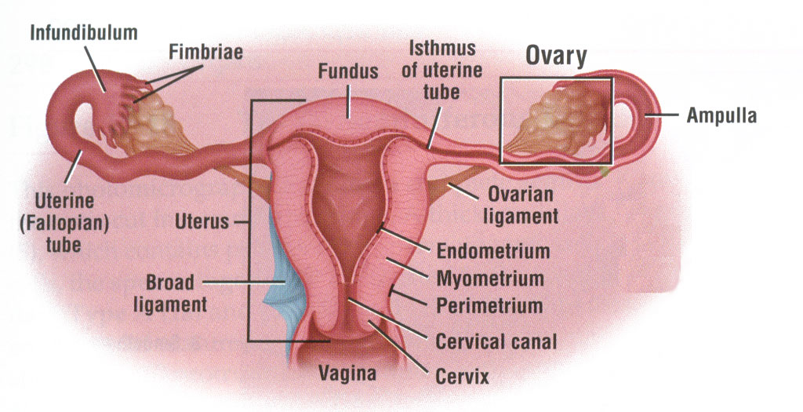
Female Reproductive System - Diagram
Pathology Dept, KSU
Reproduction block

Slide 4
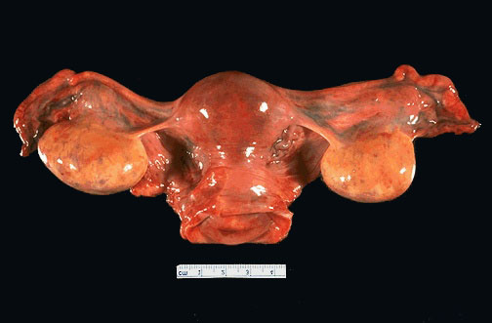
Female Reproductive System - Gross
Uterus with Cervix, Ovaries and Fallopian Tubes
Pathology Dept, KSU
Reproduction block

Slide 5
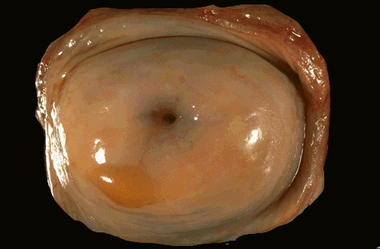
Normal Uterine Cervix - Gross
Normal cervix with a smooth, glistening mucosal surface. There is a small rim of vaginal cuff from this hysterectomy specimen. The cervical os is small and round, typical for a nulliparous woman. The os will have a fish-mouth shape after one or more pregnancies
Pathology Dept, KSU
Reproduction block

Slide 6
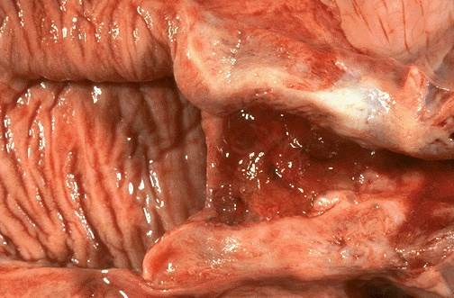
Normal Vagina & Cervix - Gross Cut section
The normal adult vaginal mucosa with a wrinkled appearance that is seen in women of reproductive years appears at the left. The cervix has been opened to reveal an endocervical canal leading to the lower uterine segment at the right that has an erythematous appearance extending to the cervical os consistent with chronic inflammation.
Pathology Dept, KSU
Reproduction block

Slide 7
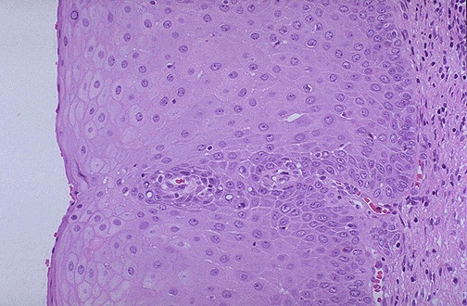
Normal Cervical Mucosa - HPF
This is normal cervical non-keratinizing squamous epithelium. The squamous cells show maturation from the basal layer to the surface
Pathology Dept, KSU
Reproduction block

Slide 8
UTERUS
GROSS and HISTOPATHOLOGY
Pathology Dept, KSU
Reproduction block

Slide 9
ENDOMETRIUM
Pathology Dept, KSU
Reproduction block

Slide 10
Uterine Leiomyomata
Pathology Dept, KSU
Reproduction block

Slide 11
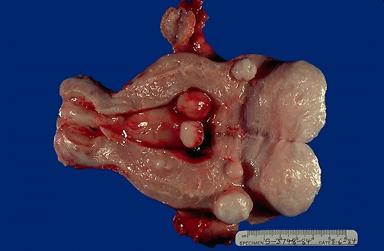
Multiple Uterine Leiomyomata - Gross
-Several submucosal, intramural and subserosal pale nodules.
Fibroids showing pale and “Whorled” cut surfaces.
Benign tumour with excellent prognosis if excised
Pathology Dept, KSU
Reproduction block

Slide 12
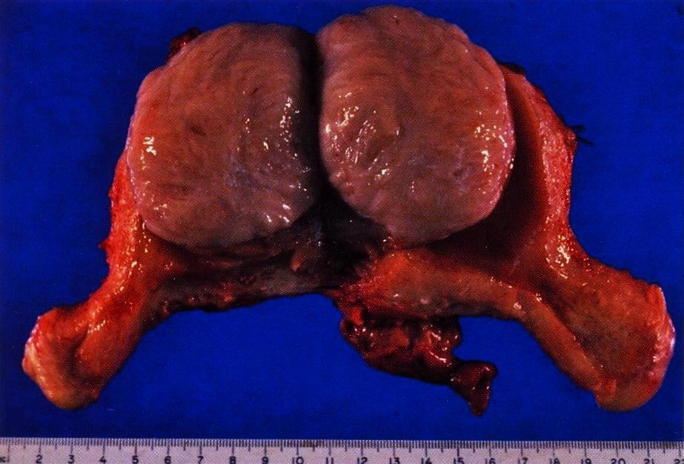
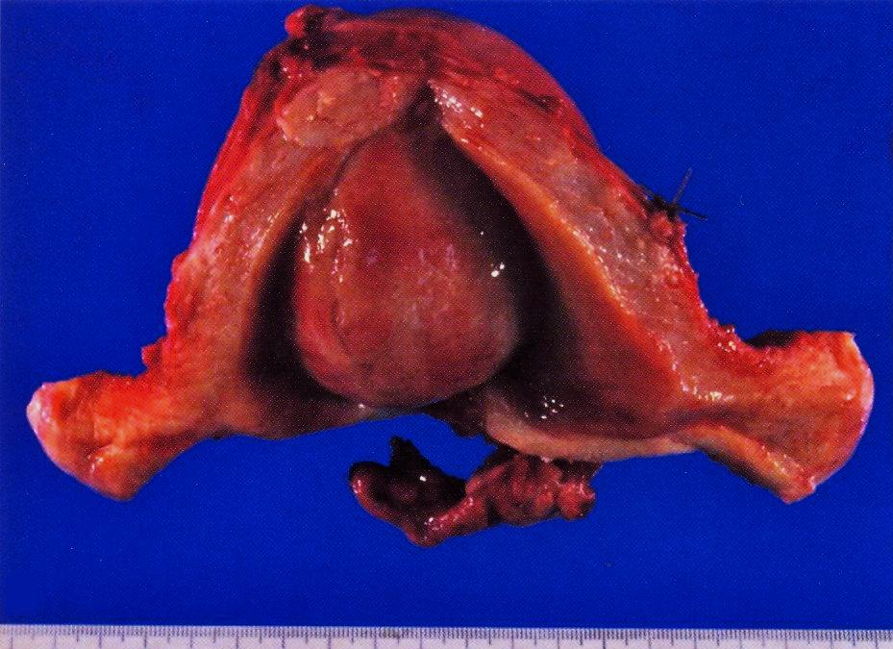
Multiple Uterine Leiomyomata - Gross
A well demarcated tumour mass in the muscle coat of
uterus without a definite capsule.
Pathology Dept, KSU
Reproduction block

Slide 13
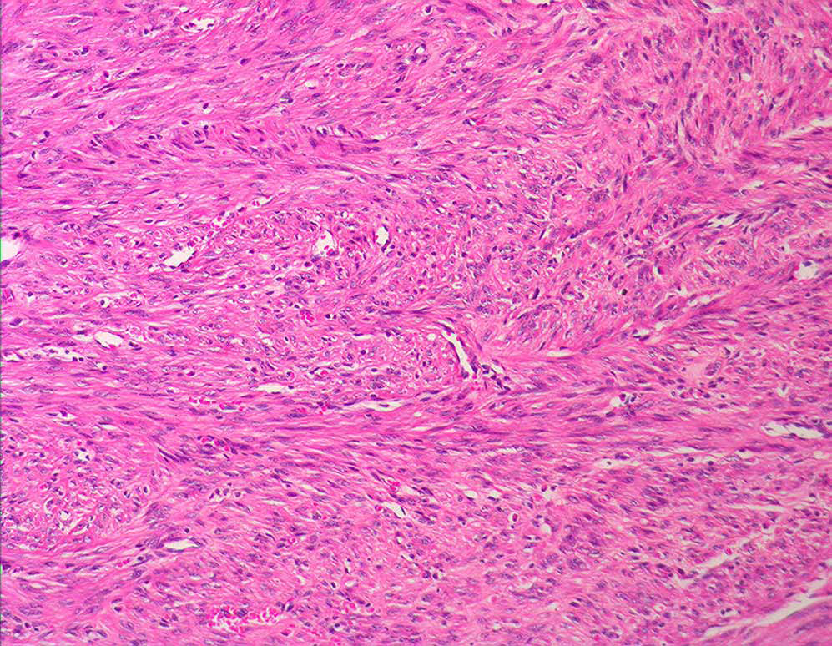
Uterine Leiomyoma – LPF
Tumour consists of interlacing bundles of smooth muscle and fibrous tissue.
The muscle cells are spindle shaped with elongated nuclei and eosinophilic cytoplasm.
Pathology Dept, KSU
Reproduction block

Slide 14
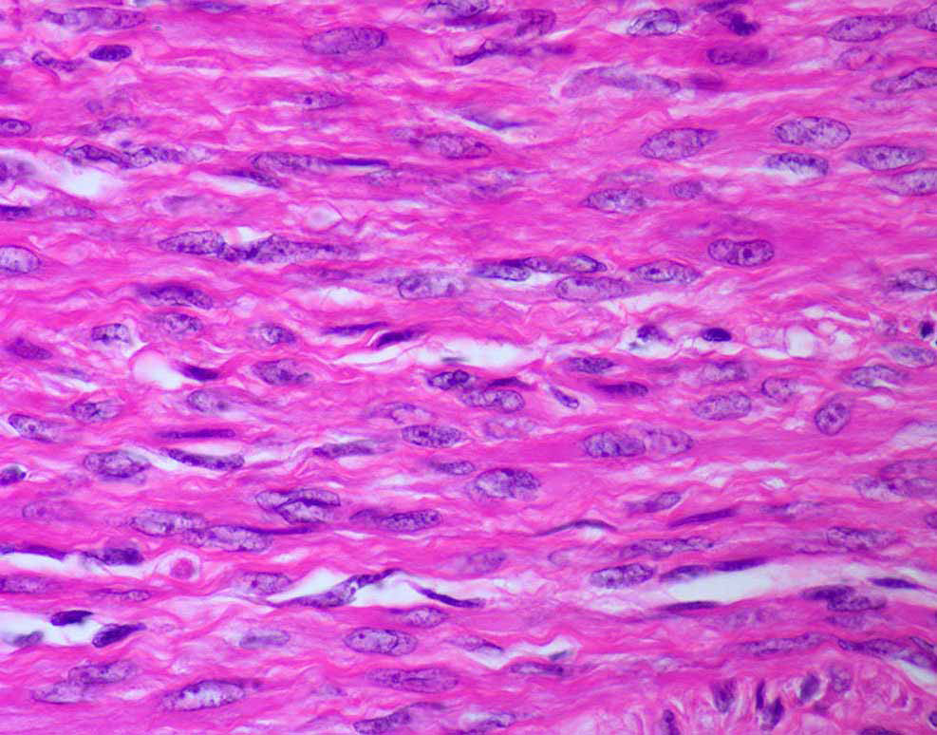
Uterine Leiomyoma – HPF
→Benign spindle cells with eosinophilic cytoplasm.
→Absence of mitoses, pleomorphism and necrosis.
→Cell of origin of this neoplasm- Smooth muscle cell.
Pathology Dept, KSU
Reproduction block

Slide 15
Endometrial Hyperplasia & Carcinoma
Pathology Dept, KSU
Reproduction block

Slide 16
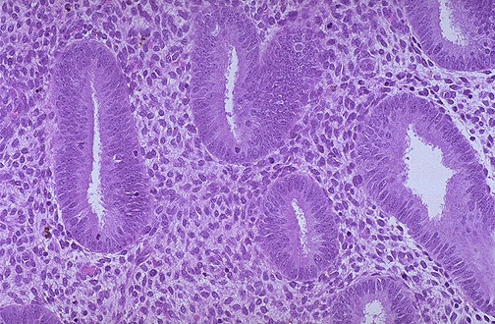
Normal Proliferative Endometrium
Normal proliferative endometrium in the menstrual cycle. The proliferative phase is the variable part of the cycle. In this phase, tubular glands with columnar cells and surrounding dense stroma are proliferating to build up the endometrium following shedding with previous menstruation.
Pathology Dept, KSU
Reproduction block

Slide 17
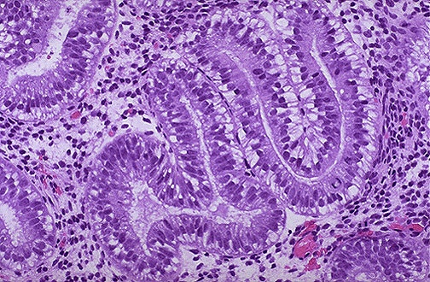
Early Secretory Endometrium
The appearance with prominent subnuclear vacuoles in cells forming the glands is consistent with post-ovulatory day 2 of luteal phase. The histologic changes following ovulation are quite constant over the 14 days to menstruation and can be utilized to date the endometrium.
Pathology Dept, KSU
Reproduction block

Slide 18
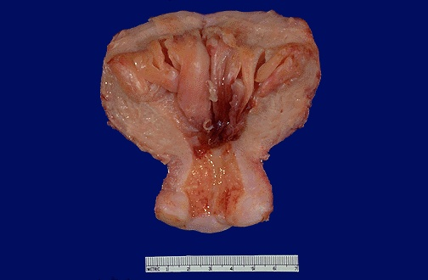
Endometrial Hyperplasia - Gross
-Thick endometrium. -Areas of haemorrhage.
Endometrial hyperplasia usually results with conditions of prolonged estrogen excess and can lead to metrorrhagia (uterine bleeding at irregular intervals), menorrhagia (excessive bleeding with menstrual periods), or menometrorrhagia.
Pathogenesis: Excessive estrogenic stimulation seen in peri and postmenopausal women because of non-ovulatory /non-cyclic menstrual cycles.
Reproduction block

Slide 19
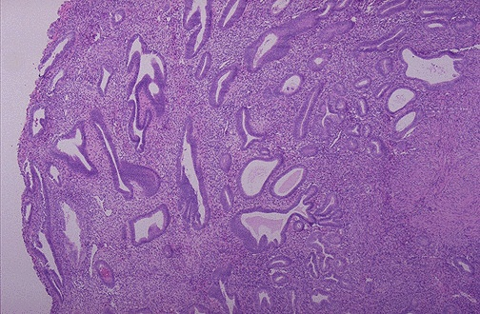
Benign Endometrial Hyperplasia - LPF
→ Irregular and cystic endometrial glands.
→ Hyperplastic lining of the glands
→ The glands are enlarged and irregular with columnar cells that have some atypia.
→ Progesterone hormone could be used to treat this condition
Pathology Dept, KSU
Reproduction block

Slide 20
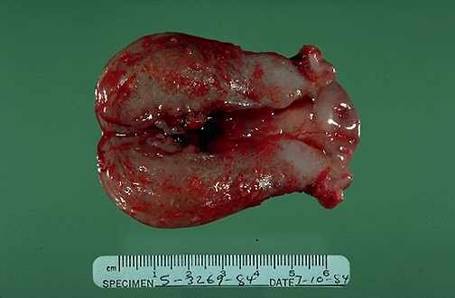
Endometrial Adenocarcinoma - Gross
This uterus is not enlarged, but there is an irregular mass in the upper fundus that proved to be endometrial adenocarcinoma on biopsy. Such carcinomas are more likely to occur in postmenopausal women.
Thus, any postmenopausal bleeding should make you suspect that this lesion may be present.
Pathology Dept, KSU
Reproduction block

Slide 21
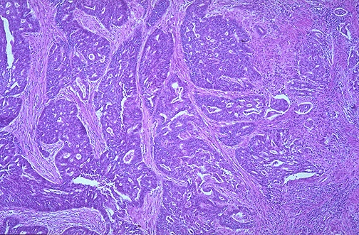
Endometrial Adenocarcinoma - LPF
This is an endometrial adenocarcinoma which can be seen invading into the smooth muscle bundles of the myometrial wall of the uterus. This neoplasm has a higher stage than a neoplasm that is just confined to the endometrium
Pathology Dept, KSU
Reproduction block

Slide 22
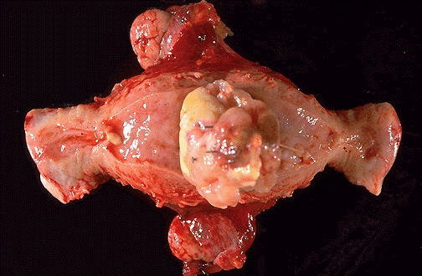
Endometrial Leiomyosarcoma - Gross
This is a leiomyosarcoma protruding from myometrium into the endometrial cavity of this uterus that has been opened laterally so that the halves of the cervix appear at right and left. Fallopian tubes and ovaries project from top and bottom.
Pathology Dept, KSU
Reproduction block

Slide 23
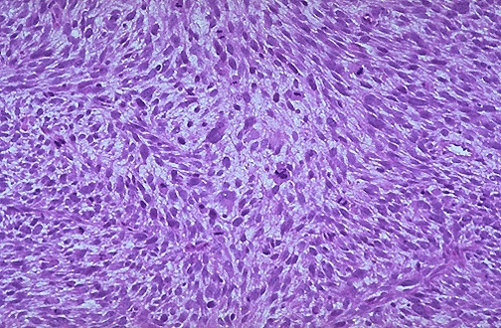
Endometrial Leiomyosarcoma - LPF
It is much more cellular and the cells have much more pleomorphism and hyperchromatism than the benign leiomyoma.
An irregular mitosis is seen in the center
Pathology Dept, KSU
Reproduction block

Slide 24
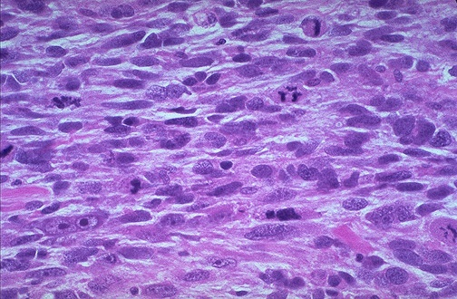
Endometrial Leiomyosarcoma - HPF
As with sarcomas in general, leiomyosarcomas have spindle cells. Several mitoses are seen here, just in this one high power field.
Pathology Dept, KSU
Reproduction block

Slide 25
ENDOMETRIOSIS
Pathology Dept, KSU
Reproduction block

Slide 26
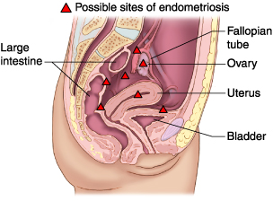
Endometriosis sites - Diagram
Endometriosis, a chronic noncancerous disorder of the female reproductive system, develops when the endometrium grows outside the uterus.
Common sites for endometriosis include ovaries, fallopian tubes, external genitalia (vulva), ligaments supporting the uterus, intestine, bladder, cervix, and vagina.
Pathology Dept, KSU
Reproduction block

Slide 27
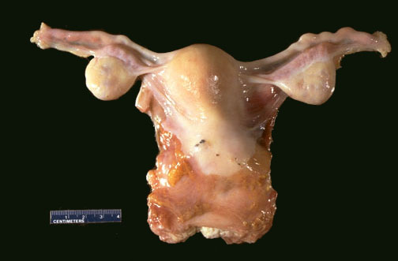
Endometriosis - Gross
Grossly, in areas of endometriosis the blood is darker and gives the small foci of endometriosis the gross appearance of "powder burns". Small foci are seen here just under the serosa.
Pathology Dept, KSU
Reproduction block

Slide 28
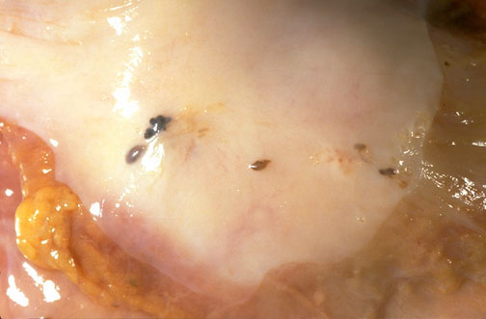
Endometriosis - Gross
Upon closer view, these five small areas of endometriosis have a reddish-brown to bluish appearance.
Pathology Dept, KSU
Reproduction block

Slide 29
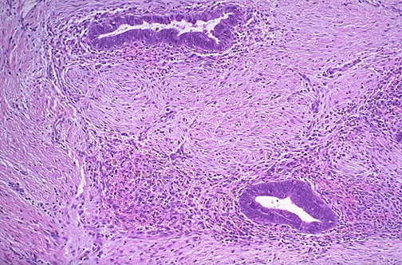
Endometriosis - HPF Microscopy
Endometrial glands along with stroma are seen at high magnification in the smooth muscle wall of the colon. Endometriosis is symptomatic during reproductive years when patients may present with dysmenorrhea, pelvic pain, and infertility
Pathology Dept, KSU
Reproduction block

Slide 30
UTERINE CERVIX
Pathology Dept, KSU
Reproduction block

Slide 31
Cervical Dysplasia & Cervical Carcinoma
Pathology Dept, KSU
Reproduction block

Slide 32
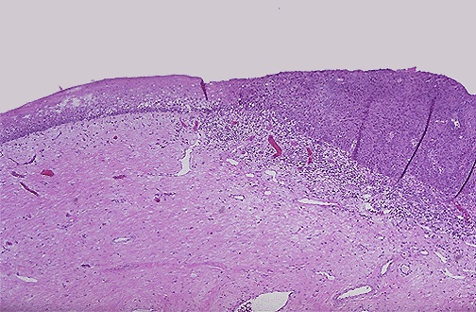
Normal and Dysplastic Cervical Squamous Epithelium
Dysplasia
Normal
The normal cervical squamous epithelium at the left transforms to dysplastic changes on the right with underlying chronic inflammation
Pathology Dept, KSU
Reproduction block

Slide 33
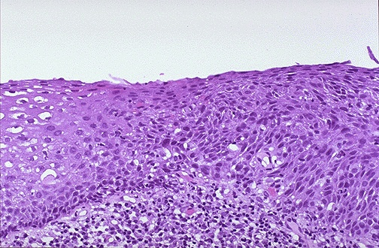
Endocervical Squamous Dysplasia
Lt
Rt
Cervical squamous dysplasia is seen at medium magnification, extending from the center to the right. The epithelium is normal at the left.
Note how the dysplastic cell nuclei at the right are larger and darker, and the dysplastic cells have a disorderly arrangement
Pathology Dept, KSU
Reproduction block

Slide 34
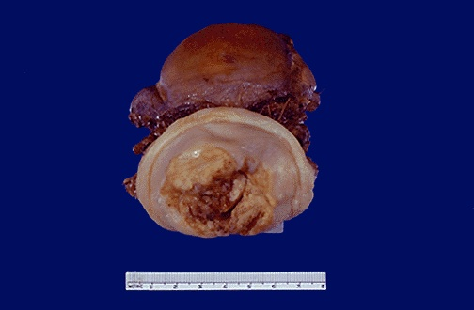
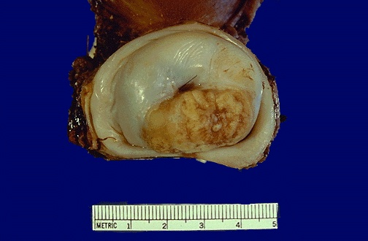
Cervical Squamous Cell Carcinoma
This is the gross appearance of a cervical squamous cell carcinoma that is still limited to the cervix (stage I).
The tumor is a fungating red to tan to yellow mass.
Pathology Dept, KSU
Reproduction block

Slide 35
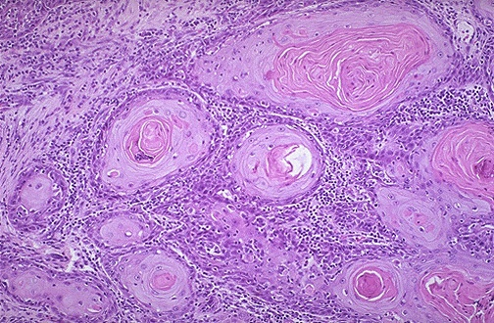
Cervical Squamous Cell Carcinoma - HPF
*
At high magnification, nests of neoplastic squamous cells are invaded through a chronically inflamed stroma.
This cancer is well- differentiated, as evidenced by keratin pearls (*) within nests of tumor cells. However, most cervical squamous carcinomas are non-keratinizing.
Pathology Dept, KSU
Reproduction block

Slide 36
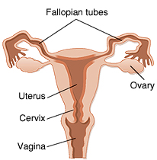
FALLOPIAN TUBES
Pathology Dept, KSU
Reproduction block

Slide 37
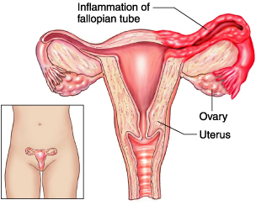
Normal vs Inflamed Fallopian Tube
Pathology Dept, KSU
Reproduction block

Slide 38
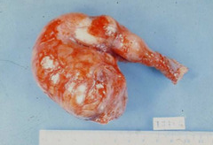
Acute Salpingitis - Gross
Acute salpingitis: Excised congested swollen fallopian tube with hemorrhagic patches
Pathology Dept, KSU
Reproduction block

Slide 39
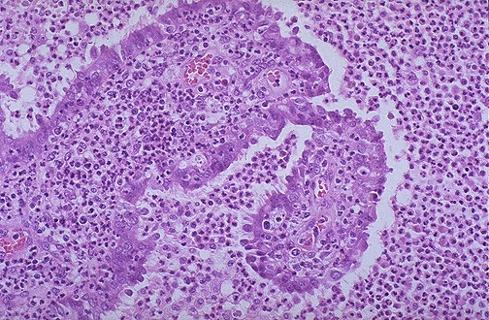
Acute Salpingitis - Microscopic
A remnant of tubal epithelium is seen here surrounded and infiltrated by numerous neutrophils. This is acute salpingitis. Neisseria gonorrheae was cultured.
Pathology Dept, KSU
Reproduction block

