Slide 1
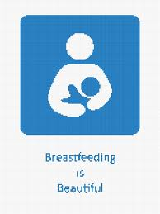
BREASTFEEDING
BY: RUBANA BAABBAD
CONSULTANT NEONATOLOGIST
Head of breastfeeding committee
MEMBER OF NATIONAL COMMITTEE OF BREASTFEEDING SUPPORT

Slide 2
contents
Introduction
Breastfeeding definitions
Breast milk contents
Advantages of breastfeeding
Preparation of the prospective mother
Establishing and maintaining the milk supply
Technique of breastfeeding
Expression of breastmilk
Contraindications

Slide 3
قال الحق تبارك وتعالى: (وَالْوَالِدَاتُ يُرْضِعْنَ أَوْلَادَهُنَّ حَوْلَيْنِ كَامِلَيْنِ لِمَنْ أَرَادَ أَنْ يُتِمَّ الرَّضَاعَةَ) [البقرة :233 ].

Slide 4
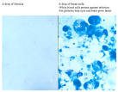
introduction
Breastfeeding is the normal feeding for infants during the first months of life which can ‘t be replicated .
It contains over 200 known component.
Breast milk bring both nutritive& non nutritive signals to the neonate .
It contain fat ,carbohydrate, proteins, menirals,vitamins,hormons, living cells, complements, enzymes,
Colostrum:
definition & contents.

Slide 5
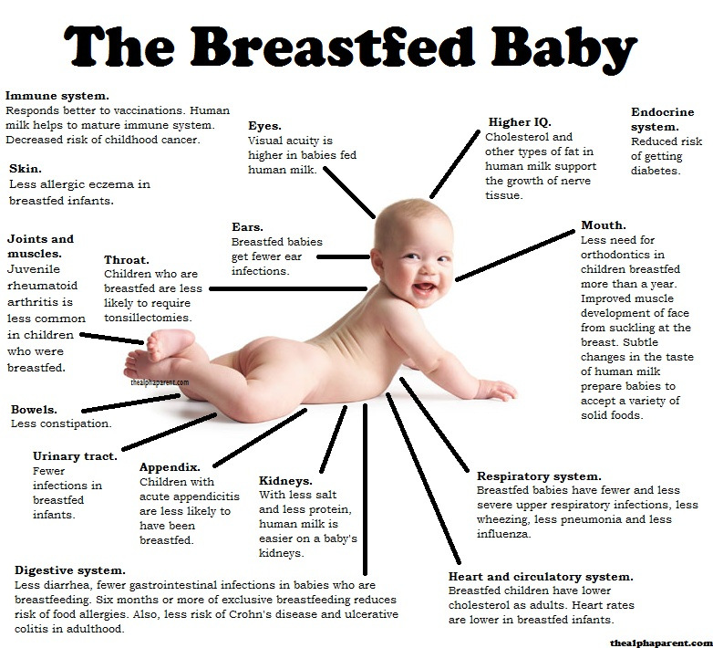

Slide 6
Benefits of breastfeeding for mothers
Helps the uterus to regress to its size before pregnancy.
Losing acummulated fat during pregnancy.
Empowernment
Decrease risk of osteoporpsis
Improve blood sugar control for diabetics
Decrease the incidence of high cholestrole ,diabetis ,breast, cervical,ovarian,uterine cancers,less chance for gallstone formation
Bonding ,decrease post partum depression

Slide 7
Benefits For Mothers
Medical: postpartum recovery
Impowerment (psychological benefits).
Improved health risks:
decrease risk of osteoporosis
Protection against ovarian censer.
reduced incidence of breast cancer.

Slide 8
Advantages of breastfeeding
Superior health outcomes in breastfed infant
Protection during breastfeeding | Protection after weaning in early childhood | Protection later in childhood
Gastrointestinal and respiratory infections | Gastrointestinal and respiratory infections | Obesity
Urinary infections | Wheezing | Types I and II diabetes
Sepsis and meningitis | Celiac disease | Leukemia/lyphomas
Atopic dermatitis | Growth faltering | Crohn disease
Food allergies | Cognition | Cognition
Wheezing | Visual acuity | Strong, secured personality
Necrotizing enterocolitis
Celiac diseas
Growth faltering
Visual acuity

Slide 9
Breastfeeding Definitions
Exclusive breast milk
Total breast milk
Predominant breast milk
Partial
No

Slide 10
Definitions of breastfeeding
Exclusive breastfeeding
The infant has received only breastmilk from his/her mother or a wet nurse, or expressed
breastmilk, and no other liquids or solids, with the exception of drops or syrups consisting of
vitamins, mineral supplements or medicines.
Predominant breastfeeding
The infant’s predominant source of nourishment has been breastmilk. However, the infant may
also have received water and water-based drinks (sweetened and flavoured water, teas,
infusions etc.); fruit juice; oral rehydration salts solution; drop and syrup forms of vitamins,
minerals and medicines;
Full breastfeeding
This definition includes both exclusive breastfeeding and predominant breastfeeding.
Partial breastfeeding
Partial breastfeeding refers to a situation where the baby is receiving some breastfeeds but is
also being given other food or food-based fluids, such as formula milk or weaning foods.
Bottle-feeding
The child has received liquid or semi-solid food from a bottle with a nipple/teat. This term
applies irrespective of the nature of the liquid or semi-liquid.
Artificial feeding
The baby who is artificially fed receives no breastmilk at all.

Slide 11
colostrum
Colostrum The often yellow and sometimes clear fluid that is released by a new mother’s breasts before her breast milk comes in. This fluid has often been referred to as “liquid gold” and it resembles blood more than it does milk as it contains protective white blood cells capable of attacking harmful bacteria. Colostrum provides a new baby high levels of antibodies from his/her mother and it also acts to “seal” the inside of the baby’s intestines thus preventing the invasion of bacteria. Colostrum is an ideal first food for baby as it is high in protein and low in sugar and fat, thus making it easy to digest.

Slide 12
Preparation of the prospective mother
Most women are physically capable of breastfeeding, provided the receive sufficient encouragement and are protected from discouraging experiences and comments while the secretion of breast milk is becoming established.
Physical Factors: leading to a good breastfeeding include: good health, having enough rest, freedom of worry, treatment of any disease, and adequate nutrition.
Retracted & inverted nipples.

Slide 13
Establishing and maintaining the milk supply
The most satisfactory stimulus to the secretion of human milk is regular and complete emptying of the breast; milk production is reduced when the secreted milk is not drained.
The breastfeeding should begin as soon after delivery as the condition of the mother and the baby permits, preferably within the first hour.

Slide 14
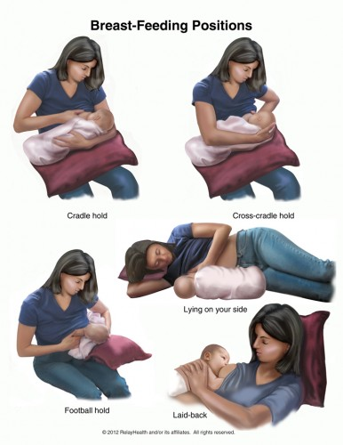
Breastfeeding position

Slide 15
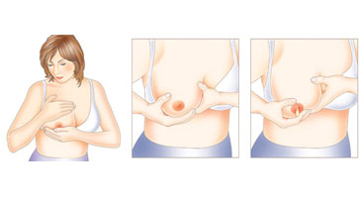
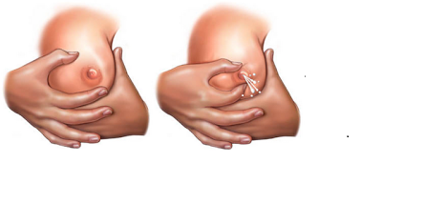
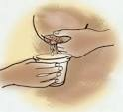
Manual expression of breast milk

Slide 16
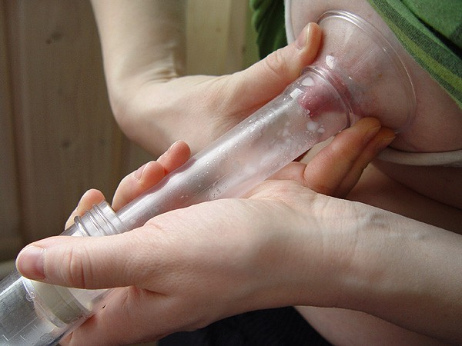
Expression of breastmilk

Slide 17
Contraindications
It is important to look at the entities that put the mother or infant at significant risk and are not remedial.
Infectious Diseases:
Life – threatening illnesses in the mother:
Medications:

Slide 18
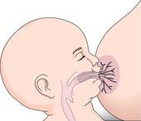
THANK YOU ALL

